Slide 1
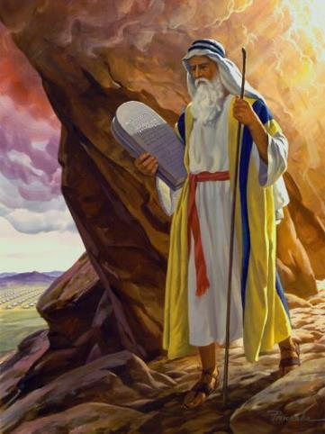
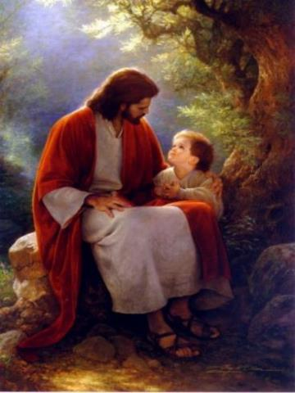
Law and Grace: An Overview Jim McGowan, Th.D. Sugar Land Bible Church 07-28-2019
…but grace and truth were realized through Jesus Christ - John 1:17
For the Law was given through Moses…
Special thanks to Dr. Vern Peterman for access to his insights and resources.

Slide 2
Session 21 Outline
Review
Purpose, Aim, and Objective
Session 20
John the Baptizer – Matthew 3
General Information
Comments and Commentary
Concluding Observations

Slide 3
OUR PURPOSE, AIM AND OBJECTIVE
Law and Grace
…is to Compare and Contrast Law and Grace so as to properly understand these two important themes and how they are related to the life of the New Testament Believer.

Slide 4
C. I. SCOFIELD, D. D.
The Grace of God, The Fundamentals Vol. 3, Chapter VII, p. 98
We have, most of us, been reared and now live under the influence of Galatianism. Protestant theology, alas, is for the most part, thoroughly Galatianized, in that neither law nor grace are given their distinct and separated places, as in the counsels of God, but are mingled together in one incoherent system.
The law is no longer, as in the Divine intent, a ministration of death (2 Cor. 3:7), of cursing (Gal. 3:10), of conviction (Rom. 3:19), because we are taught that we must try to keep it, and that by Divine help we may.
Nor, on the other hand, does grace bring us blessed deliverance from the dominion of sin, for we are kept under the law as a rule of life despite the plain declaration, “Sin shall not have dominion over you: for ye are not under the law, but under grace” (Rom. 6:14). (emphasis mine)

Slide 5
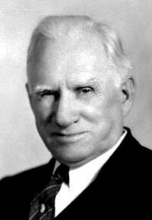
William R. Newell
Romans Verse-by-Verse (p. 274).
Grand Rapids, MI: Christian Classics Ethereal Library.
It is because Reformed theology has kept us Gentiles under the Law,—if not as a means of righteousness, then as “a rule of life,” that all the trouble has arisen. The Law is no more a rule of life than it is a means of righteousness. Walking in the Spirit has now taken the place of walking by ordinances. God has another principle under which He has put his saints: “Ye are not under law, but, under grace!” (italics mine)

Slide 6
Session 21 Outline
Review
Purpose, Aim, and Objective
Session 20
John the Baptizer – Matthew 3
General Information
Comments and Commentary
Concluding Observations

Slide 7
Law and Grace: Review Session 20
The Last of the Old Testament Books
This gospel that was written by the apostle Matthew, and we could say the gospels are the last of the Old Testament books.

Slide 8
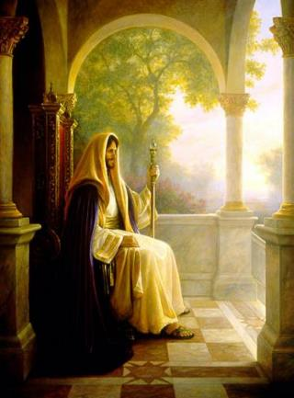
Matthew’s Purposes
Law and Grace: Review Session 20
To explain that Jesus in whom they had believed was the long-awaited Jewish Messiah.
To explain why the kingdom had been postponed despite the fact that the king had arrived.
To explain the interim program of God during the kingdom’s absence.

Slide 9
Matthew’s Message
Law and Grace: Review Session 20
Jesus is the predicted Jewish king who ushered in an interim program by building the sons of the kingdom into the church in between Israel’s past rejection and future acceptance of her king.

Slide 10
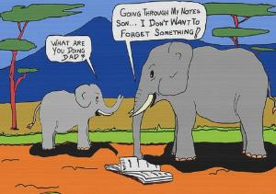
Law and Grace: Review Session 20
The Genealogy of Christ Matthew 1:1-17
Matthew begins with a genealogy made up of three lists of 14 names.
The three lists of 14 names are designed to be a memory aid.

Slide 11
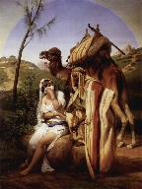
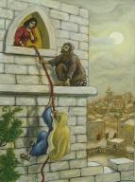
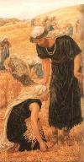
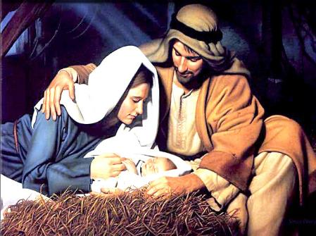
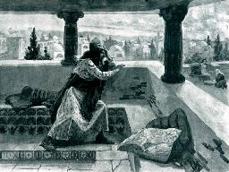
Law and Grace: Review Session 20
The Genealogy of Christ Matthew 1:1-17
Significant women are also named: Tamar, Rahab, Ruth, Bathsheba and Mary.

Slide 12
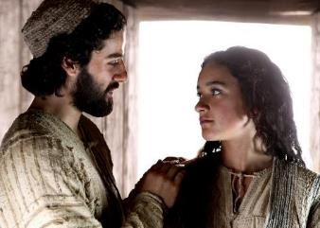
Law and Grace: Review Session 20
According to Jewish tradition Matthew 1:18-19
The betrothal and the ‘coming together’ only after marriage was all according to the Jewish law and traditions.
For Joseph to be righteous meant that he was observant of the Law of Moses and all of the traditions of Judaism.

Slide 13
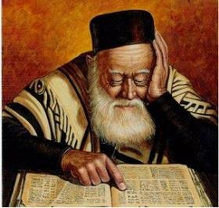
Law and Grace: Review Session 20
According to Jewish tradition Matthew 1:18-19
For Joseph to ‘send her away secretly’ meant that since she was pregnant before marriage, and he didn’t want to disgrace her, he would seek a divorce from the court of Rabbi Hillel, where they didn’t ask ‘why’ you wanted one.

Slide 14
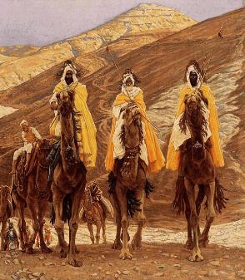
Law and Grace: Review Session 20
The Magi, Herod, & to Egypt & back Matthew 2:1-2:23
The Magi, likely received the prophecies of the Old Testament, first through Daniel (Dan. 5:11-12) and then through the other Jews living in the Babylonian and the Persian Empires.

Slide 15
Galatians 4:4–5
⁴ But when the fullness of the time came, God sent forth His Son, born of a woman, born under the Law, ⁵ so that He might redeem those who were under the Law, that we might receive the adoption as sons.

Slide 16
Law and Grace: Review Session 20
Key word in Galatians 4:5
By Roman law the adopted son had a position far better than any natural-born son: a full heir, irreversible, and the adopted son was legally severed from any prior sonship (see Ephesians 2:2; 5:6 and Colossians 3:6).

Slide 17
Law and Grace: Review Session 20
Consequences of our adoption!

Slide 18
Law and Grace: Review Session 20

Slide 19
Session 21 Outline
Review
Purpose, Aim, and Objective
Session 20
John the Baptizer – Matthew 3
General Information
Comments and Commentary
Concluding Observations

Slide 20
Matthew 3:1, 4-6
¹ Now in those days John the Baptist came, preaching in the wilderness of Judea, …⁴ Now John himself had a garment of camel’s hair and a leather belt around his waist; and his food was locusts and wild honey. ⁵ Then Jerusalem was going out to him, and all Judea and all the district around the Jordan; ⁶ and they were being baptized by him in the Jordan River, as they confessed their sins.

Slide 21
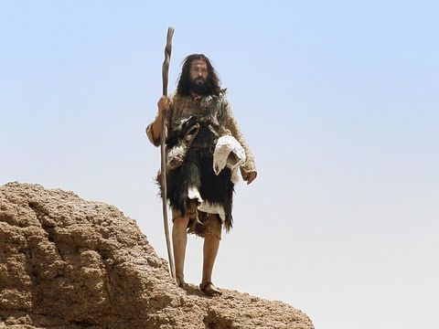
Law and Grace: Session 21
Who is John the Baptist?
Matthew 3:1, 4-6

Slide 22
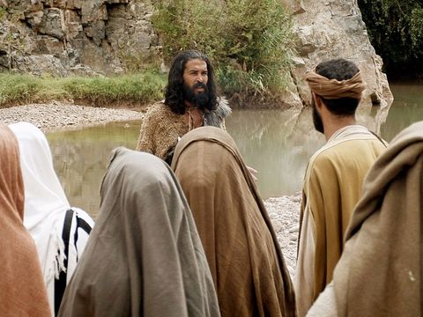
Law and Grace: Session 21
Baptist?
Matthew 3:1, 4-6

Slide 23
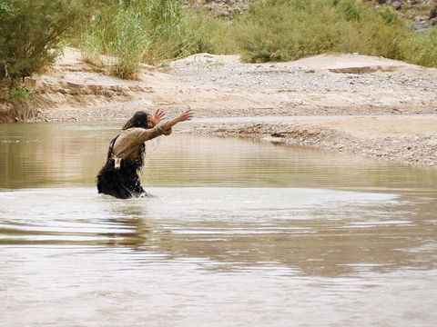
Law and Grace: Session 21
Baaaptist?
Matthew 3:1, 4-6

Slide 24
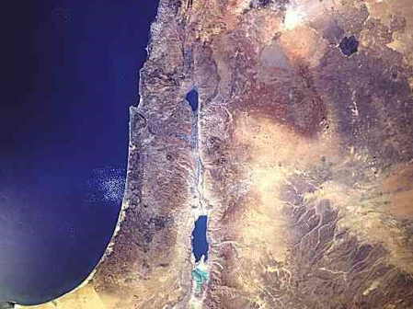
Law and Grace: Session 21
Who is John the Baptist?
Matthew 3:1, 4-6
John the Baptist, a relative of Jesus through His mother (cf. Luke 1:36), ministered along the Jordan River, north of the Dead Sea.

Slide 25
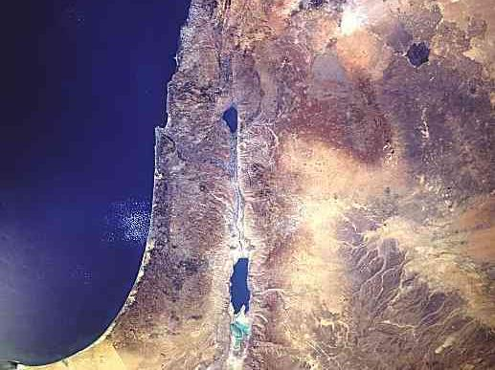
Law and Grace: Session 21
Who is John the Baptist?
Matthew 3:1, 4-6
Sea of Galilee
John the Baptist
Jordan River
Dead Sea

Slide 26
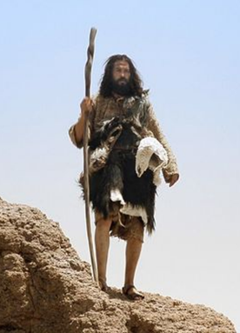
Law and Grace: Session 21
Who is John the Baptist?
Matthew 3:1, 4-6
He lived out in the wilderness.
According to Christian tradition he was born in Ein Karem, an ancient and separate village, originally located southwest of Jerusalem.
Matthew 3:1
Now in those days John the Baptist came, preaching in the wilderness of Judea,…

Slide 27
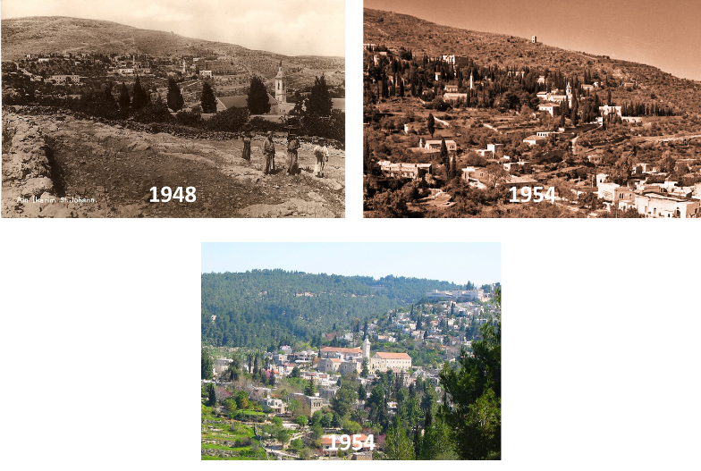
Law and Grace: Session 21
Ein Karem

Slide 28
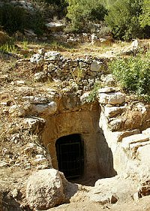
Law and Grace: Session 21
Who is John the Baptist?
Matthew 3:1, 4-6
August 16, 2004, an announcement was made regarding the discovery of a cave, believed to be identified with the ministry of John the Baptist.
https://biblearchaeology.org/research/new-testament-era (search for “John the Baptist”

Slide 29
Law and Grace: Session 21
Who is John the Baptist?
Matthew 3:1, 4-6
He wore rough and wild clothing and ate a rough and wild diet of locusts and wild honey which was allowed by the Law of Moses (cf. Lev. 11:22).
Matthew 3:4
⁴ Now John himself had a garment of camel’s hair and a leather belt around his waist; and his food was locusts and wild honey.

Slide 30
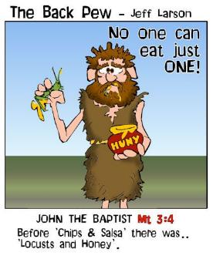
Leviticus 11:22
‘These.. you may eat: the locust in its kinds, and the devastating locust in its kinds…’

Slide 31
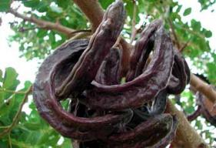
Law and Grace: Session 21
Who is John the Baptist?
Matthew 3:1, 4-6
“Some persons have assumed that the reference to grasshoppers being eaten by John the Baptist should be understood not as the insects but as carob pods, but there is neither linguistic nor cultural evidence to support such an interpretation.”
Louw, J. P., & Nida, E. A. (1996). Greek-English Lexicon of the New Testament: Based on Semantic Domains (electronic ed. of the 2nd edition., Vol. 1, p. 45). New York: United Bible Societies.

Slide 32
Law and Grace: Session 21
Who is John the Baptist?
Matthew 3:1, 4-6
John the Baptist is reminiscent of the Old Testament prophet Elijah, who is described as a hairy man with a leather girdle or belt (cf. 2 Kings 1:8; Zech. 13:4).
2 Kings 1:8
They answered him, “He was a hairy man with a leather girdle bound about his loins.” And he said, “It is Elijah the Tishbite.”
Zechariah 13:4
“Also it will come about in that day that the prophets will each be ashamed of his vision…and they will not put on a hairy robe in order to deceive;

Slide 33
Session 21 Outline
Review
Purpose, Aim, and Objective
Session 20
John the Baptizer – Matthew 3
General Information
Comments and Commentary
Concluding Observations

Slide 34
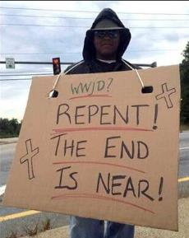
Matthew 3:1–2
¹ Now in those days John the Baptist came, preaching in the wilderness of Judea, saying, ² “Repent, for the kingdom of heaven is at hand.”

Slide 35
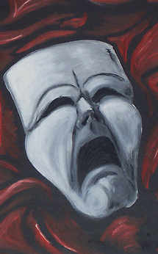
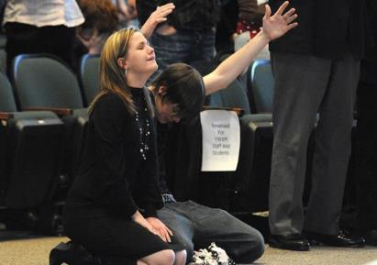
Law and Grace: Session 21
Repent! Matthew 3:2
Unfortunately, the word ‘repent’ tends to invoke a sweeping variety of images in the minds of people including:
being emotionally impacted, flowing tears, weeping and wailing, and/or…
Coming forward ‘to the altar’ at the pastor’s invitation.

Slide 36
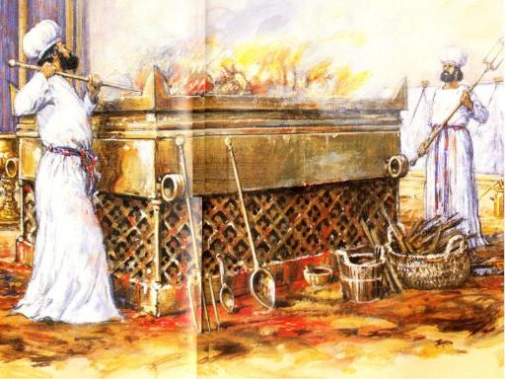
Law and Grace: Session 21
Repent! Matthew 3:2
At SLBC we don’t have one of these…
THAT’S
A JOKE,
FOLKS!

Slide 37
Law and Grace: Session 21
Repent! Matthew 3:2
Repenting means to have ‘a change of mind’ that moves us from unbelief to belief in what God says is true.

Slide 38
Law and Grace: Session 21
The Kingdom of Heaven Matthew 3:2
The terms ‘kingdom of God’, ‘kingdom of heaven’ and even just ‘kingdom’, have by some, been erroneously transferred to ‘the Church’. These same groups also mistakenly identify ‘the Church’ as those people past, present, and future, whom God has saved or will save, or ‘the spiritual domain’ of all those saved.

Slide 39
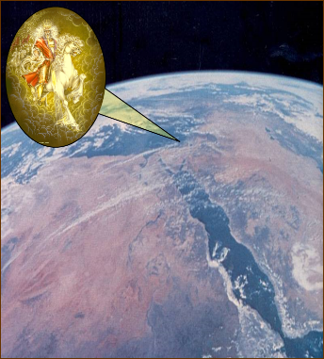
Law and Grace: Session 21
The Kingdom of Heaven Matthew 3:2
But to the Jews of New Testament times these terms meant the coming kingdom of the Messiah, the King of the Jews, reigning from Jerusalem over the people of Israel in the land of Israel, but...

Slide 40
Law and Grace: Session 21
The Kingdom (of)… Matthew 3:2
…also over the entire planet, in a long ‘golden age’.

Slide 41
Law and Grace: Session 21
The Kingdom (of)… Matthew 3:2
The Jews, John the Baptist, and Christ, all used the terms ‘kingdom of God’, kingdom of heaven’ and ‘kingdom’ as synonyms.

Slide 42
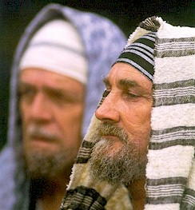
Law and Grace: Session 21
‘Heaven’ was and still is a euphemism for ‘God’
Matthew 3:2
Matthew alone used the euphemism ‘of heaven’ to replace the name of God, which was a point of habit and concern among the Jews, further indicating that Matthew is written to the Jews.

Slide 43
Law and Grace: Session 21
‘Heaven’ was and still is a euphemism for ‘God’
Matthew 3:2
We still carry on the same euphemism in our own language and culture today:
“Heaven knows…”
“Oh, heavens!”, or “My, heavens”, or “Oh my heavens!”
“For heaven’s sake”
“Oh my heavens!”
We also say “goodness” as a substitute for “God”.

Slide 44
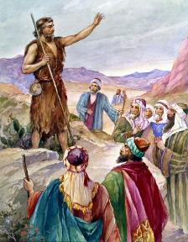
Matthew 3:3
For this is the one referred to by Isaiah the prophet when he said, “The voice of one crying in the wilderness, ‘Make ready the way of the Lord, Make His paths straight!’ ”

Slide 45
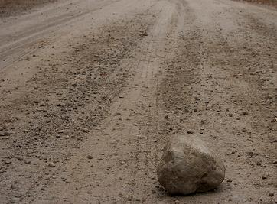
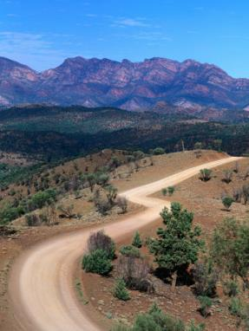
Law and Grace: Session 21
Make ready the way!
Matthew 3:3
The long-standing tradition in all of the middle east was to clear, smooth, level and straighten roads in preparation for a coming dignitary, such as a king or other royal person.

Slide 46
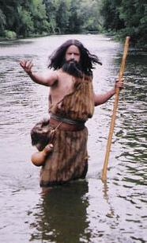
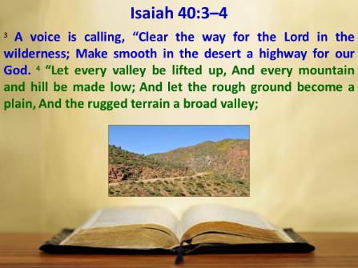
Law and Grace: Session 21
Make ready the way!
Matthew 3:3
So, that is what John the Baptist does, morally and spiritually. He clears and levels and makes straight the way both morally and spiritually for the coming of Jesus Christ, the true son of David (cf. Isa. 40:3-4).

Slide 47
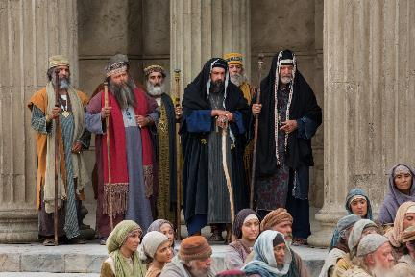
Law and Grace: Session 21
Pharisees & Sadducees
Matthew 3:7-10
The Pharisees and Sadducees were two Jewish groups that were not of the same viewpoint, but together they had a grip on the control of the practice of Judaism in Israel, at that time.

Slide 48
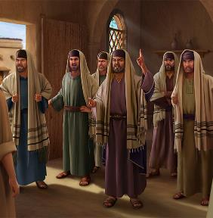
Law and Grace: Session 21
Pharisees & Sadducees
Matthew 3:7-10
The Pharisees believed in all of the Old Testament but added to and made rules around it (cf. Mattew 23:16-22).

Slide 49
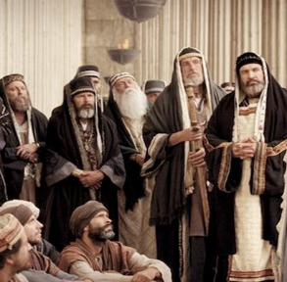
Law and Grace: Session 21
Pharisees & Sadducees
Matthew 3:7-10
The Sadducees on the other hand, claimed belief in the Pentateuch but rejected anything supernatural.

Slide 50
Law and Grace: Session 21
Pharisees & Sadducees
Matthew 3:7-10
John immediately and openly describes these two groups in strong and graphic negative terms.

Slide 51
Matthew 3:7-10
⁷ But when he saw many of the Pharisees and Sadducees coming for baptism, he said to them, “You brood of vipers, who warned you to flee from the wrath to come? ⁸ “Therefore bear fruit in keeping with repentance; ⁹ and do not suppose that you can say to yourselves, ‘We have Abraham for our father’; for I say to you that from these stones God is able to raise up children to Abraham. ¹⁰ “The axe is already laid at the root of the trees; therefore every tree that does not bear good fruit is cut down and thrown into the fire.

Slide 52
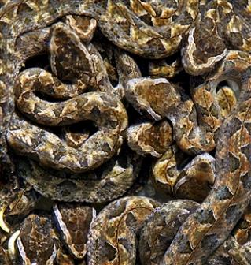
Law and Grace: Session 21
Pharisees & Sadducees
Matthew 3:7-10
John called them a ‘brood of vipers’, creatures that are poisonous, and by the Law, unclean.

Slide 53
Law and Grace: Session 21
Pharisees & Sadducees
Matthew 3:7-10
John boldly told them that they were subject to ‘the wrath to come’ and would not be exempt just because they were descended from Abraham! They needed to repent and live out that repentance.

Slide 54
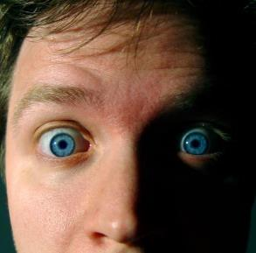
Matthew 5:20
"For I say to you that unless your righteousness surpasses that of the scribes and Pharisees, you will not enter the kingdom of heaven."

Slide 55
Law and Grace: Session 21
Pharisees & Sadducees
Matthew 3:7-10
In v. 9, John the Baptist also introduces a shocking piece of news for the Jews, that Jesus will continue later:
Entry into the coming kingdom for Jews is not to be assumed, based on their ancestry.

Slide 56
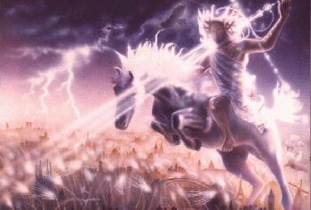
Law and Grace: Session 21
Pharisees & Sadducees
Matthew 3:7-10
John echoes what the Old Testament prophets had said, that judgment would precede the kingdom, and no Jew, be they Scribe, Pharisee, or Sadducee, would be exempt! (cf. Isa.1:27; 4:4; 5:16; 13:6-19; 42:1; Jer. 33:14-16; Dan. 7:26-27)

Slide 57
Zechariah 13:8-9a
⁸ "It will come about in all the land," declares the LORD, "That two parts in it will be cut off and perish; but the third will be left in it. ⁹ And I will bring the third part through the fire…"

Slide 58
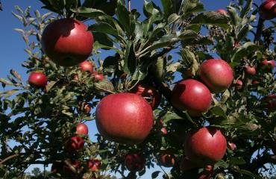
Law and Grace: Session 21
Pharisees & Sadducees
Matthew 3:7-10
Trees that are well-planted and bearing fruit were pictures of godliness in the Old Testament (cf. Psalm 1:1-3, Psalm 92:12-14).
The Law allowed that trees not bearing fruit could be cut down (cf. Deut. 20:19-20).

Slide 59
Matthew 3:11-12
¹¹ “As for me, I baptize you with water for repentance, but He who is coming after me is mightier than I, and I am not fit to remove His sandals; He will baptize you with the Holy Spirit and fire. ¹² “His winnowing fork is in His hand, and He will thoroughly clear His threshing floor; and He will gather His wheat into the barn, but He will burn up the chaff with unquenchable fire.”

Slide 60
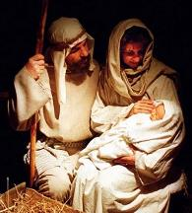
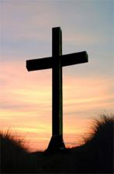
Law and Grace: Session 21
Baptized as a ‘sign of repentance’
Matthew 3:11-12
John baptized as a sign of repentance, but he also pointed to the One who was coming…both sooner and later.
In His soon coming (vv. 13-17) Jesus was coming as the Lamb of God who ‘lifts up’ our sins (cf. John 1:29, 36).

Slide 61
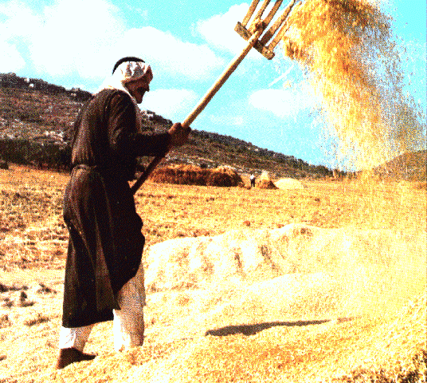
Law and Grace: Session 21
John the Baptist baptized as a ‘sign of repentance’
Matthew 3:11-12
In His later, Second Coming, Jesus will come in judgment, ‘winnowing’ in order to separate the wheat (those Jews who will be entering the kingdom) from the chaff, which will be burned up.

Slide 62
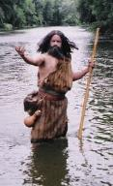
Matthew 3:11-12
¹¹ “As for me, I baptize you with water for repentance, but He who is coming after me is mightier than I, and I am not fit to remove His sandals; He will baptize you with the Holy Spirit and fire. ¹² “His winnowing fork is in His hand, and He will thoroughly clear His threshing floor; and He will gather His wheat into the barn, but He will burn up the chaff with unquenchable fire.”

Slide 63
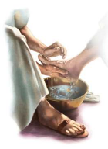
Matthew 3:11-12
¹¹ “As for me, I baptize you with water for repentance, but He who is coming after me is mightier than I, and *I am not fit to remove His sandals; He will baptize you with the Holy Spirit and fire. ¹² “His winnowing fork is in His hand, and He will thoroughly clear His threshing floor; and He will gather His wheat into the barn, but He will burn up the chaff with unquenchable fire.”
* The duty of the lowest household servant was to remove the sandals of guests and other members of the household and wash their feet.

Slide 64
Matthew 3:11-12
¹¹ “As for me, I baptize you with water for repentance, but He who is coming after me is mightier than I, and *I am not fit to remove His sandals; He will baptize you with the Holy Spirit and fire. ¹² “His winnowing fork is in His hand, and He will thoroughly clear His threshing floor; and He will gather His wheat into the barn, but He will burn up the chaff with unquenchable fire.”

Slide 65
Matthew 3:11-12
¹¹ “As for me, I baptize you with water for repentance, but He who is coming after me is mightier than I, and *I am not fit to remove His sandals; He will baptize you with the Holy Spirit and fire. ¹² “His winnowing fork is in His hand, and He will thoroughly clear His threshing floor; and He will gather His wheat into the barn, but He will burn up the chaff with unquenchable fire.”

Slide 66
Law and Grace: Session 21
John the Baptist baptized as a ‘sign of repentance’
Matthew 3:11-12
John the Baptist said he baptized as a baptism of repentance.
When the Jews came to John, they didn’t proclaim their own righteousness, but confessed their sins (vv. 5-6).

Slide 67
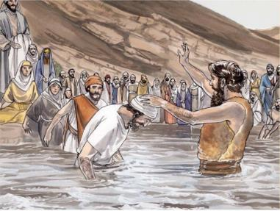
Matthew 3:5-6
“⁵ Then Jerusalem was going out to him, and all Judea and all the district around the Jordan; ⁶ and they were being baptized by him in the Jordan River, as they confessed their sins.”

Slide 68
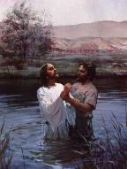
Matthew 3:13-15
¹³ Then Jesus arrived from Galilee at the Jordan coming to John, to be baptized by him. ¹⁴ But John tried to prevent Him, saying, “I have need to be baptized by You, and do You come to me?” ¹⁵ But Jesus answering said to him, “Permit it at this time; for in this way it is fitting for us to fulfill all righteousness.” Then he permitted Him.

Slide 69
Law and Grace: Session 21
Why would Jesus be baptized?
Matthew 3:13-15
Jesus didn’t need to repent or to confess His sins.
Jesus’ baptism had a three-fold effect:
It authenticated John’s ministry and message of repentance.
It presented Jesus as the spiritually, ethically, and morally, clean, Messiah, Who fulfilled God’s will.
It identified Him with sinners.

Slide 70
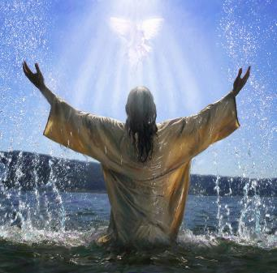
Law and Grace: Session 21
After Jesus was baptized
Matthew 3:16-17
After Jesus was baptized, we see the presence of all three persons of the Trinity: The Father, Son and Holy Spirit.
We also see the approval of God the Father toward God the Son in this event.

Slide 71
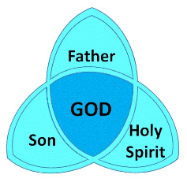
Matthew 3:16-17
¹⁶ After being baptized, Jesus came up immediately from the water; and behold, the heavens were opened, and he saw the Spirit of God descending as a dove and lighting on Him, ¹⁷ and behold, a voice out of the heavens said, “This is My beloved Son, in whom I am well-pleased.” (cf. Isaiah 42:1)

Slide 72
Session 21 Outline
Review
Purpose, Aim, and Objective
Session 20
John the Baptizer – Matthew 3
General Information
Comments and Commentary
Concluding Observations

Slide 73
John 1:29
²⁹ The next day he saw Jesus coming to him and said, “Behold, the Lamb of God who takes away the sin of the world!

Slide 74
1 Peter 2:24
and He Himself bore our sins in His body on the cross, so that we might die to sin and live to righteousness; for by His wounds you were healed. (cf. Heb. 9:29)

Slide 75
John 1:35–36
³⁵ Again the next day John was standing with two of his disciples, ³⁶ and he looked at Jesus as He walked, and said, “Behold, the Lamb of God!”

Slide 76
Matthew 3:16-17
¹⁶ After being baptized, Jesus came up immediately from the water; and behold, the heavens were opened, and he saw the Spirit of God descending as a dove and lighting on Him, ¹⁷ and behold, a voice out of the heavens said, “This is My beloved Son, in whom I am well-pleased.” (cf. Isaiah 42:1)

Slide 77
Law and Grace: Session 21
In our next session…
In our next session we will be taking at look at Matthew 4, Firsts & Beginnings in Christs ministry.

Slide 78
Law and Grace: An Overview Jim McGowan, Th.D. Sugar Land Bible Church 07-28-2019
…but grace and truth were realized through Jesus Christ - John 1:17
For the Law was given through Moses…
Special thanks to Dr. Vern Peterman for access to his insights and resources.

