Slide 1
The book of Jude
Deliverance from Apostasy

Slide 2
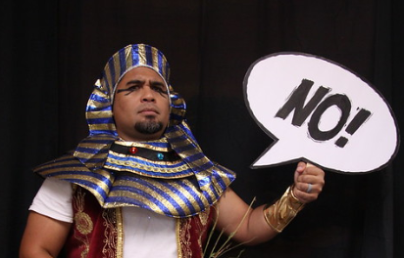

Slide 3
The Book of Jude
Who wrote the book? Jude, brother of James, half –brother of Jesus Christ.
Who was the book written to? Believers, Jews scattered in Asia Minor
When was the book written? Between 68-80 AD
Where was the book written from? Possibly in the Land of Canaan
What’s the Genre of the book? Epistolary
What’s the purpose of the book? To exhort believers to earnestly contend for the faith in the face of apostasy.
What’s in the book? A present threat of and defense against false teachers.
Is there an application? 1) grow spiritually (v.20); 2) be assured of your salvation (v.21; 24-25); and 3) also to help those who doubt (v.23-24).

Slide 4
4 Sections in Jude
Salutation / Purpose Statement – vv. 1 - 4
Beware of Apostates– vv. 5-16
Exhortation to the Faithful – vv.17-23
Benediction – vv. 24-25
Outline adapted from Thomas Constable, Dr. Constable’s Expository Notes, Jude, (http://www.planobiblechapel.org/tcon/notes/html/nt/jude/jude.htm)

Slide 5
4 Sections in Jude
Salutation / Purpose Statement – vv. 1 - 4
Beware of Apostates– vv. 5-16
Exhortation to the Faithful – vv.17-23
Benediction – vv. 24-25
Outline adapted from Thomas Constable, Dr. Constable’s Expository Notes, Jude, (http://www.planobiblechapel.org/tcon/notes/html/nt/jude/jude.htm)

Slide 6
4 Sections in Jude
Salutation / Purpose Statement – vv. 1 - 4
Beware of Apostates– vv. 5-16
Exhortation to the Faithful – vv.17-23
Benediction – vv. 24-25
Outline adapted from Thomas Constable, Dr. Constable’s Expository Notes, Jude, (http://www.planobiblechapel.org/tcon/notes/html/nt/jude/jude.htm)

Slide 7
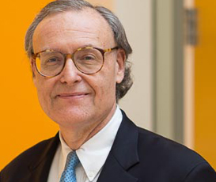
John Gabrieli
TITLE(S):
Grover Hermann Professor of Health Sciences and Technology and Professor of Brain and Cognitive Sciences, Massachusetts Institute of Technology
Director, Martinos Imaging Center at MIT
DEGREES:
PhD in Behavioral Neuroscience, MIT, 1987
BA in English, Yale University, 1978
“When we think about memory, we tend to think, ‘of the past’, because it would have occurred at some moment in order to be stored in our brain. But, of course the purpose of memory is not to reminisce, as enjoyable that is, the purpose of memory is for the future. Memory is from the past but for the future to empower us to use our knowledge and experiences to move forward successfully and thrive.”
https://techtv.mit.edu/videos/26694-the-science-of-remembering-and-forgetting

Slide 8
Jude 20-21
“But you, beloved, building yourselves up on your most holy faith, praying in the Holy Spirit, keep yourselves in the love of God, waiting anxiously for the mercy of our Lord Jesus Christ to eternal life.”

Slide 9
John 15:9
“Just as the Father has loved Me, I have also loved you; abide in My love.”

Slide 10
John 15:4-5
“Abide in Me, and I in you. As the branch cannot bear fruit of itself unless it abides in the vine, so neither can you unless you abide in Me. “I am the vine, you are the branches; he who abides in Me and I in him, he bears much fruit, for apart from Me you can do nothing..”

Slide 11
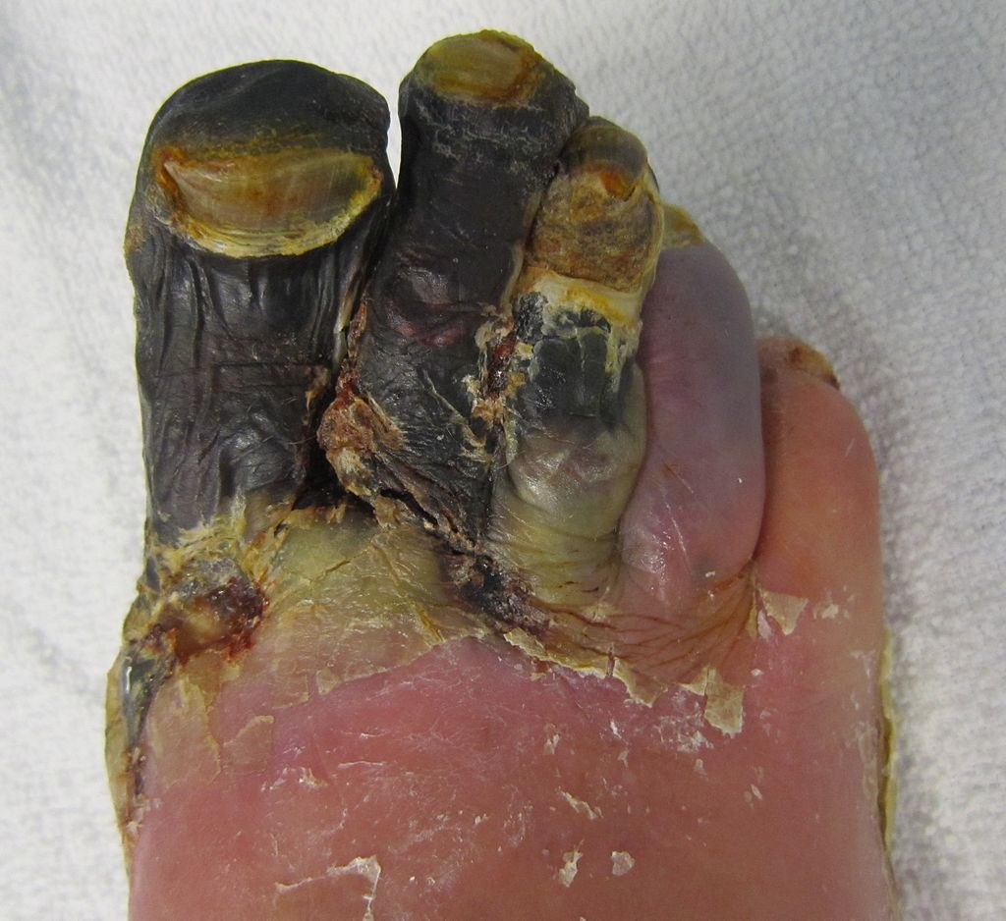
γάγγραινα [gaggraina /gang·grahee·nah/] n f. From graino (to gnaw); GK 1121; AV translates as “canker” once. 1 a gangrene, a disease by which any part of the body suffering from inflammation becomes so corrupted that, unless a remedy be seasonably applied, the evil continually spreads, attacks other parts, and at last eats away the bones.
James Strong, Enhanced Strong’s Lexicon (Woodside Bible Fellowship, 1995).
Gangrene Patient. Source: Wikipedia

Slide 12
The 3 Phases of Salvation
Phase | Justification | Sanctification | Glorification
Sense | Positional | Progressive/ Experiential | Ultimate
Tense | Past | Present | Future
Description | Accomplished: set apart thru body/shed blood of Christ | Experienced daily as believer surrenders to God | Sanctification reaches its completion
Scripture | 1 Cor 1:2 | Rom 12:1 | 1 John 3:2; 1 Thess 5:23

Slide 13
4 Sections in Jude
Salutation / Purpose Statement – vv. 1 - 4
Beware of Apostates– vv. 5-16
Exhortation to the Faithful – vv.17-23
Benediction – vv. 24-25
Outline adapted from Thomas Constable, Dr. Constable’s Expository Notes, Jude, (http://www.planobiblechapel.org/tcon/notes/html/nt/jude/jude.htm)

Slide 14
Jude 24-25
24 – “Now to Him who is able to keep you from stumbling, and to make you stand in the presence of His glory blameless with great joy,
25 to the only God our Savior, through Jesus Christ our Lord, be glory, majesty, dominion and authority, before all time and now and forever. Amen.”

Slide 15
4 Common elements to a doxology
The person praised
A word of praise
Indication of time
“Amen”
Douglas J. Moo, 2 Peter, Jude, The NIV Application Commentary (Grand Rapids, MI: Zondervan Publishing House, 1996), 302.

Slide 16
4 Common elements to a doxology
Tailored
The person praised
Christianized
A word of praise
Indication of time
“Amen”
Douglas J. Moo, 2 Peter, Jude, The NIV Application Commentary (Grand Rapids, MI: Zondervan Publishing House, 1996), 302.

Slide 17
6 elements to Jude’s doxology
Jude’s Tailoring
The person praised
Jude’s Christianizing
A word of Praise/glory
Indication of time
“amen.”
24 Now to Him who is able to keep you from stumbling, and to make you stand in the presence of His glory blameless with great joy,
25 to the only God our Savior, through Jesus Christ our Lord, be glory, majesty, dominion and authority, before all time and now and forever. Amen.
Adapted from Douglas J. Moo, 2 Peter, Jude, The NIV Application Commentary (Grand Rapids, MI: Zondervan Publishing House, 1996), 302.

Slide 18
6 elements to Jude’s doxology
Jude’s Tailoring
The person praised
Jude’s Christianizing
A word of Praise/glory
Indication of time
“amen.”
24 Now to Him who is able to keep you from stumbling, and to make you stand in the presence of His glory blameless with great joy,
25 to the only God our Savior, through Jesus Christ our Lord, be glory, majesty, dominion and authority, before all time and now and forever. Amen.
Adapted from Douglas J. Moo, 2 Peter, Jude, The NIV Application Commentary (Grand Rapids, MI: Zondervan Publishing House, 1996), 302.

Slide 19
Ephesians 3:20
20 “Now to Him who is able to do far more abundantly beyond all that we ask or think, according to the power that works within us…”

Slide 20
2 Corinthians 9:8
“And God is able to make all grace abound to you, so that always having all sufficiency in everything, you may have an abundance for every good deed

Slide 21
Hebrews 2:18
“For since He Himself was tempted in that which He has suffered, He is able to come to the aid of those who are tempted.”

Slide 22
Romans 16:25a
“Now to Him who is able to establish you according to my gospel and the preaching of Jesus Christ…”

Slide 23
1 Timothy 1:12
“For this reason I also suffer these things, but I am not ashamed; for I know whom I have believed and I am convinced that He is able to guard what I have entrusted to Him until that day.”

Slide 24
The 3 Phases of Salvation
Phase | Justification | Sanctification | Glorification
Sense | Positional | Progressive/ Experiential | Ultimate
Tense | Past | Present | Future
Description | Accomplished: set apart thru body/shed blood of Christ | Experienced daily as believer surrenders to God | Sanctification reaches its completion
Scripture | 1 Cor 1:2 | Rom 12:1 | 1 John 3:2; 1 Thess 5:23

Slide 25
The 3 Phases of Salvation
Phase | Justification | Sanctification | Glorification
Sense | Positional | Progressive/ Experiential | Ultimate
Tense | Past | Present | Future
Description | Accomplished: set apart thru body/shed blood of Christ | Experienced daily as believer surrenders to God | Sanctification reaches its completion
Scripture | 1 Cor 1:2 | Rom 12:1 | 1 John 3:2; 1 Thess 5:23
Jude 1
Jude 2-24a
Jude 24b-25

Slide 26
2 Corinthians 4:14
“knowing that He who raised the Lord Jesus will raise us also with Jesus and will present us with you.”

Slide 27
Ephesians 5:26-27
26 “so that He might sanctify her, having cleansed her by the washing of water with the word,
27 that He might present to Himself the church in all her glory, having no spot or wrinkle or any such thing; but that she would be holy and blameless.”

Slide 28
Colossians 1:22
“He has now reconciled you in His fleshly body through death, in order to present you before Him holy and blameless and beyond reproach.”

Slide 29
6 elements to Jude’s doxology
Jude’s Tailoring
The person praised
Jude’s Christianizing
A word of Praise/glory
Indication of time
“amen.”
24 Now to Him who is able to keep you from stumbling, and to make you stand in the presence of His glory blameless with great joy,
25 to the only God our Savior, through Jesus Christ our Lord, be glory, majesty, dominion and authority, before all time and now and forever. Amen.
Adapted from Douglas J. Moo, 2 Peter, Jude, The NIV Application Commentary (Grand Rapids, MI: Zondervan Publishing House, 1996), 302.

Slide 30
Isaiah 45:5
“I am the Lord, and there is no other; Besides Me there is no God...”

Slide 31
Isaiah 44:6
“Thus says the Lord, the King of Israel and his Redeemer, the Lord of hosts: ‘I am the first and I am the last, And there is no God besides Me.”

Slide 32
Psalm 14:1
“The fool has said in his heart, “There is no God.”

Slide 33
6 elements to Jude’s doxology
Jude’s Tailoring
The person praised
Jude’s Christianizing
A word of Praise/glory
Indication of time
“amen.”
24 Now to Him who is able to keep you from stumbling, and to make you stand in the presence of His glory blameless with great joy,
25 to the only God our Savior, through Jesus Christ our Lord, be glory, majesty, dominion and authority, before all time and now and forever. Amen.
Adapted from Douglas J. Moo, 2 Peter, Jude, The NIV Application Commentary (Grand Rapids, MI: Zondervan Publishing House, 1996), 302.

Slide 34
Acts 4:12
“And there is salvation in no one else; for there is no other name under heaven that has been given among men by which we must be saved.”

Slide 35
Luke 12:51-53
51 “Do you suppose that I came to grant peace on earth? I tell you, no, but rather division; 52 for from now on five members in one household will be divided, three against two and two against three. 53 “They will be divided, father against son and son against father, mother against daughter and daughter against mother, mother-in-law against daughter-in-law and daughter-in-law against mother-in-law.”

Slide 36
Jude 25
In a very Jewish sense, God is Savior in that he has and can physically deliver his chosen people (Jude 5) and present them untarnished (Jude 20–21). God is able to do both through Jesus, the one to whom Jude considers himself a slave (Jude 1a). Jude’s letter underscores Jesus’ messiahship (Jude 1, 4, 17, 21), and in keeping with a Jewish concept of Messiah, it is through the Messiah that God governs, protects, and grants stability to resist rebellion and eventually to stand untarnished by it.
Herbert W. Bateman IV, Jude: Evangelical Exegetical Commentary, ed. H. Wayne House, W. Hall Harris III, and Andrew W. Pitts, Evangelical Exegetical Commentary (Bellingham, WA: Lexham Press, 2015), 436.

Slide 37
6 elements to Jude’s doxology
Jude’s Tailoring
The person praised
Jude’s Christianizing
A word of Praise/glory
Indication of time
“amen.”
24 Now to Him who is able to keep you from stumbling, and to make you stand in the presence of His glory blameless with great joy,
25 to the only God our Savior, through Jesus Christ our Lord, be glory, majesty, dominion and authority, before all time and now and forever. Amen.
Adapted from Douglas J. Moo, 2 Peter, Jude, The NIV Application Commentary (Grand Rapids, MI: Zondervan Publishing House, 1996), 302.

Slide 38
6 elements to Jude’s doxology
Jude’s Tailoring
The person praised
Jude’s Christianizing
A word of Praise/glory
Indication of time
“amen.”
24 Now to Him who is able to keep you from stumbling, and to make you stand in the presence of His glory blameless with great joy,
25 to the only God our Savior, through Jesus Christ our Lord, be glory, majesty, dominion and authority, before all time and now and forever. Amen.
Adapted from Douglas J. Moo, 2 Peter, Jude, The NIV Application Commentary (Grand Rapids, MI: Zondervan Publishing House, 1996), 302.

Slide 39
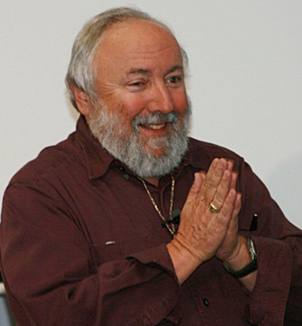
Jude 25
God is glory, which is a reference to the Shechinah Glory, the unique glory that belongs to God alone. It emphasizes God in all the fullness of His brightness. God is majesty. This emphasizes the greatness of God and states that He is regal. He is the royal God; He is the King of Kings and Lord of Lords. God is dominion. This emphasizes rule. The term majesty emphasizes God as the King of Kings, but the word dominion emphasizes God as the Lord of Lords. He rules over His entire creation and everything is under His control. Nothing happens outside of His control. Many things that occur do so because of His directive will. Many other things happen merely because of His permissive will. However, whatever does occur, whether it is by directive will or permissive will, is part of His control. He is never out of control. (7) God is power, a word that means “authority.” He has the authority to carry out His decretive will; God has the power and authority to carry out whatever He wills.
Arnold G. Fruchtenbaum, The Messianic Jewish Epistles: Hebrews, James, First Peter, Second Peter, Jude, 1st ed. (Tustin, CA: Ariel Ministries, 2005), 448.

Slide 40
Hebrews 1:3
“And He is the radiance of His glory and the exact representation of His nature, and upholds all things by the word of His power. When He had made purification of sins, He sat down at the right hand of the Majesty on high…”

Slide 41
6 elements to Jude’s doxology
Jude’s Tailoring
The person praised
Jude’s Christianizing
A word of Praise/glory
Indication of time
“amen.”
24 Now to Him who is able to keep you from stumbling, and to make you stand in the presence of His glory blameless with great joy,
25 to the only God our Savior, through Jesus Christ our Lord, be glory, majesty, dominion and authority, before all time and now and forever. Amen.
Adapted from Douglas J. Moo, 2 Peter, Jude, The NIV Application Commentary (Grand Rapids, MI: Zondervan Publishing House, 1996), 302.

Slide 42
Ecclesiastes 3:11
“He has made everything appropriate in its time. He has also set eternity in their heart, yet so that man will not find out the work which God has done from the beginning even to the end.”

Slide 43
6 elements to Jude’s doxology
Jude’s Tailoring
The person praised
Jude’s Christianizing
A word of Praise/glory
Indication of time
“amen.”
24 Now to Him who is able to keep you from stumbling, and to make you stand in the presence of His glory blameless with great joy,
25 to the only God our Savior, through Jesus Christ our Lord, be glory, majesty, dominion and authority, before all time and now and forever. Amen.
Adapted from Douglas J. Moo, 2 Peter, Jude, The NIV Application Commentary (Grand Rapids, MI: Zondervan Publishing House, 1996), 302.

Slide 44
6 elements to Jude’s doxology
Jude’s Tailoring
The person praised
Jude’s Christianizing
A word of Praise/glory
Indication of time
“amen.”
24 Now to Him who is able to keep you from stumbling, and to make you stand in the presence of His glory blameless with great joy,
25 to the only God our Savior, through Jesus Christ our Lord, be glory, majesty, dominion and authority, before all time and now and forever. Amen.
Adapted from Douglas J. Moo, 2 Peter, Jude, The NIV Application Commentary (Grand Rapids, MI: Zondervan Publishing House, 1996), 302.

Slide 45
The book of Jude
Deliverance from Apostasy

