Slide 1
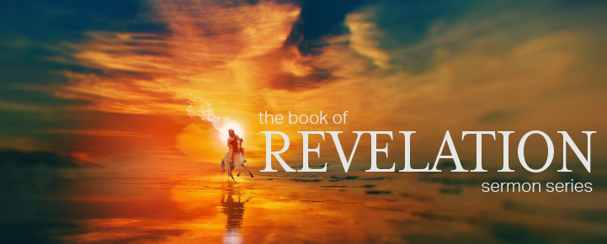

Dr. Andy Woods
Senior Pastor – Sugar Land Bible Church
President – Chafer Theological Seminary

Slide 2


Slide 3


Seven Trumpets
(Revelation 8‒11)
1st Trumpet (8:7) – 1/3 vegetation destroyed
2nd Trumpet (8:8-9) – 1/3 ocean destroyed
3rd Trumpet (8:10-11) – 1/3 water destroyed
4th Trumpet (8:12-13) – 1/3 luminaries darkened
5th Trumpet (9:1-12) – Demons released
6th Trumpet (9:13-21) – 1/3 humanity destroyed
7th Trumpet (11:14-19) – Legal transfer announced

Slide 4

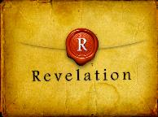
Revelation 11:15
“Then the seventh angel sounded; and there were loud voices in heaven, saying, ‘The kingdom of the world has become the kingdom of our Lord and of His Christ; and He will reign (basileuō) forever and ever.’” (cf. Matt. 6:10)

Slide 5
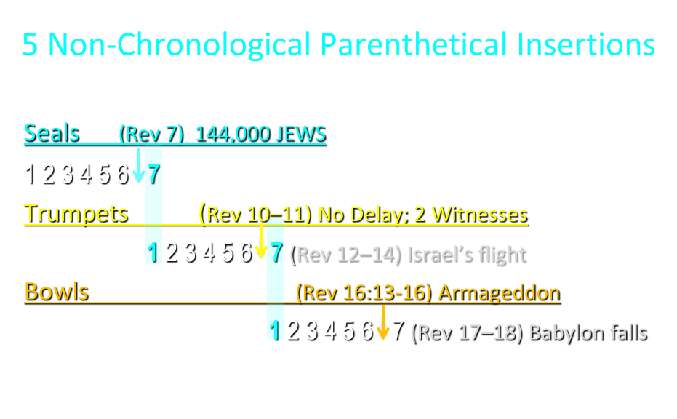

Slide 6
5 Non-Chronological Parenthetical Insertions
Rev 7 – 144,000 Jews
Rev 10:1-11:13 – Announcement of no more delay and the two witnesses
Rev 12-14 – Israel’s flight, two beasts, six scenes of hope
Rev 16:13-16 – Gathering of the nations to Armageddon
Rev 17:1-19:6 – Babylon’s fall

Slide 7
Revelation 12‒14
Rev 12 – Israel’s flight
Rev 13 – Two beasts
Rev 14 – Six scenes of hope

Slide 8
Revelation 12‒14
Rev 12 – Israel’s flight
Rev 13 – Two beasts
Rev 14 – Six scenes of hope

Slide 9
Revelation 12‒14
Rev 12 – Israel’s flight
Rev 13 – Two beasts
Rev 14 – Six scenes of hope

Slide 10
Revelation 12‒14
Rev 12 – Israel’s flight
Rev 13 – Two beasts
Rev 14 – Six scenes of hope

Slide 11
C. Six Scenes of Hope
Revelation 14:1-20
The Destiny of the 144,000 (1-5)
The Proclamation of the Eternal Gospel (6-7)
The Prediction of the Destruction of Babylon (8)
The Doom of the Beast’s Worshippers (9-12)
The Blessing Upon the Tribulation’s Martyrs (13)
The Judgement Harvest of Armageddon (14-20)

Slide 12
C. Six Scenes of Hope
Revelation 14:1-20
The Destiny of the 144,000 (1-5)
The Proclamation of the Eternal Gospel (6-7)
The Prediction of the Destruction of Babylon (8)
The Doom of the Beast’s Worshippers (9-12)
The Blessing Upon the Tribulation’s Martyrs (13)
The Judgement Harvest of Armageddon (14-20)

Slide 13
C. Six Scenes of Hope
Revelation 14:1-20
The Destiny of the 144,000 (1-5)
The Proclamation of the Eternal Gospel (6-7)
The Prediction of the Destruction of Babylon (8)
The Doom of the Beast’s Worshippers (9-12)
The Blessing Upon the Tribulation’s Martyrs (13)
The Judgement Harvest of Armageddon (14-20)

Slide 14
C. Six Scenes of Hope
Revelation 14:1-20
The Destiny of the 144,000 (1-5)
The Proclamation of the Eternal Gospel (6-7)
The Prediction of the Destruction of Babylon (8)
The Doom of the Beast’s Worshippers (9-12)
The Blessing Upon the Tribulation’s Martyrs (13)
The Judgement Harvest of Armageddon (14-20)

Slide 15
C. Six Scenes of Hope
Revelation 14:1-20
The Destiny of the 144,000 (1-5)
The Proclamation of the Eternal Gospel (6-7)
The Prediction of the Destruction of Babylon (8)
The Doom of the Beast’s Worshippers (9-12)
The Blessing Upon the Tribulation’s Martyrs (13)
The Judgement Harvest of Armageddon (14-20)

Slide 16

4. The Doom of the Beast’s Worshippers
(Revelation 14:9-12)
The Plea (9)
The Punishment (10-11)
The Perseverance (12)

Slide 17
4. The Doom of the Beast’s Worshippers
(Revelation 14:9-12)
The Plea (9)
The Punishment (10-11)
The Perseverance (12)

Slide 18
4. The Doom of the Beast’s Worshippers
(Revelation 14:9-12)
The Plea (9)
The Punishment (10-11)
The Perseverance (12)

Slide 19
4. The Doom of the Beast’s Worshippers
(Revelation 14:9-12)
The Plea (9)
The Punishment (10-11)
The Perseverance (12)

Slide 20

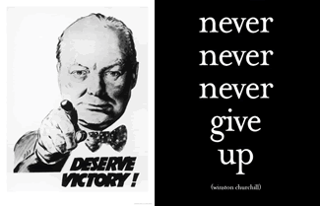
Matthew 24:13
“But the one who endures to the end, he will be saved.”

Slide 21
Revelation 1:19
“Therefore write the things which you have seen, and the things which are, and the things which will take place after these things [meta tauta].”

Slide 22
Revelation 1:19
Seen (Chapter 1)
Are (Chapters 2–3)
After these things (Chapters 4–22)

Slide 23

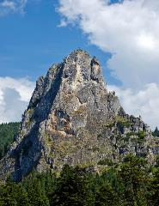
Matthew 16:18
I also say to you that you are Peter, and upon this rock I will build [oikodomeō] My church; and the gates of Hades will not overpower it.

Slide 24
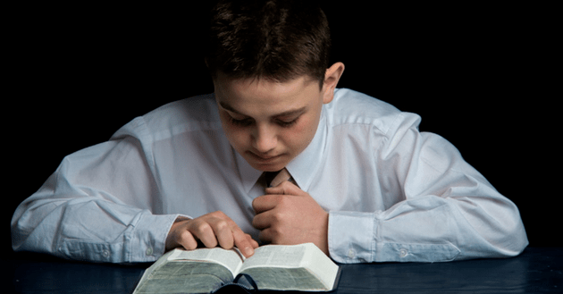
Psalm 50:5 (NKJV)
“Gather My saints together to Me,
Those who have made a covenant with Me by sacrifice.”

Slide 25
Psalm 149:1 (NKJV)
“Praise the Lord! Sing to the Lord a new song, And His praise in the assembly of saints.”

Slide 26
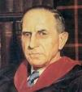
John Murray
Redemption Accomplished and Applied, pp. 152, 154-55.
“The crucial test of true faith is endurance to the end, abiding in Christ, and continuance in the Word…He cannot abandon himself to sin; he cannot come under the domination of sin; he cannot be guilty of certain kinds of unfaithfulness…Let us appreciate the doctrine of the perseverance of the saints and recognize that we may entertain the faith of our security in Christ only as we persevere in faith and holiness to the end.”

Slide 27
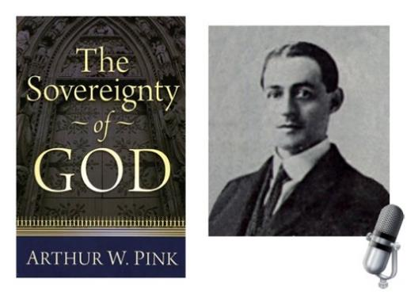
A. W. Pink
Practical Christianity, p. 16.
“Readers, if there is a reserve in your obedience, you are on your way to hell.”

Slide 28
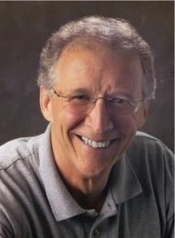
John Piper
John Piper and Pastoral Staff, TULIP: What We Believe about the Five Points of Calvinism: Position Paper of the Pastoral Staff (Desiring God Ministries, 1997), 25, cited in Dave Hunt, What Love is This?, 379.
“No Christian can be sure that he is a true believer. Hence, there is an ongoing need to be dedicated to the Lord and to deny ourselves so that we might make it.”

Slide 29
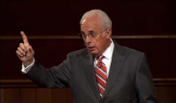
John MacArthur
Saved Without A Doubt, p. 177
“If a person fails to love and obey the Lord through the trials of life, then there is no evidence that he possesses saving faith. How many people do you know who came to church for a while, had a little trouble in their lives, and left? Although they may have made a profession of faith in Christ, they cannot be identified as those who love Him because their lives are not characterized by enduring obedience.”

Slide 30

R.C. Sproul – Bob Wilkin as quoted in:
http://www.gracebiblestudies.org/Resources/Web/www.duluthbible.org/g_f_j/EternalSecurity12.htm
“During the first message presented at Ligonier’s Conference in Orlando last June, Dr. R. C. Sproul indicated that Dr. James Boice, a scheduled speaker at the conference, was dying in faith that very night. Then at the end of the message he asked all 5,000 of us present to pray that Jim dies in faith. This struck me as sad. Here was a great pastor, theologian, teacher, and author. Yet Sproul was not sure that he was regenerate. (In Reformed thought, if a person fails to die in faith, he proved he was never saved in the first place.) I was reminded of R.T. Kendall’s remark that nearly to a man the Puritan divines died doubting whether they were saved and fearing they were going to hell. Dr. Boice died that very night, June 15th.”

Slide 31
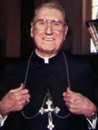
Cardinal John O’Connor of NY
quoted in Samuel Howe Verhovek, Cardinal Defends a Jailed Bishop Who Warned Cuomo on Abortion, New York Times, February 1, 1990.
“Church teaching is that I don't know, at any given moment, what my eternal future will be… I can hope, pray, do my very best – but I still don't know. Pope John II doesn't absolutely know that he will go to heaven, nor does mother Theresa of Calcutta, unless either has had a special divine revelation.”

Slide 32

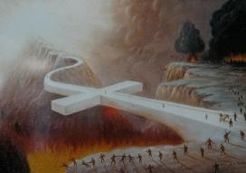
John 5:24
“Truly, truly, I say to you, he who hears My word, and believes Him who sent Me, has eternal life, and does not come into judgment, but has passed out of death into life.”

Slide 33
1 John 5:13
“These things I have written to you who believe in the name of the Son of God, so that you may know that you have eternal life.”

Slide 34
C. Six Scenes of Hope
Revelation 14:1-20
The Destiny of the 144,000 (1-5)
The Proclamation of the Eternal Gospel (6-7)
The Prediction of the Destruction of Babylon (8)
The Doom of the Beast’s Worshippers (9-12)
The Blessing Upon the Tribulation’s Martyrs (13)
The Judgement Harvest of Armageddon (14-20)

Slide 35
5. The Blessing Upon the Tribulation Martyrs
(Revelation 14:13)
Their Beatitude (13a)
Their Rest (13b)
Their Reward (13c)

Slide 36
5. The Blessing Upon the Tribulation Martyrs
(Revelation 14:13)
Their Beatitude (13a)
Their Rest (13b)
Their Reward (13c)

Slide 37
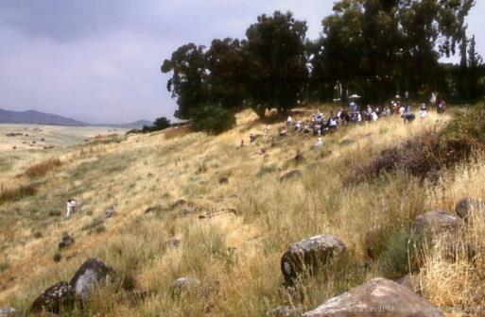
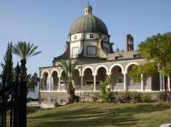
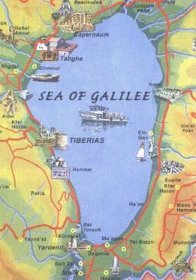
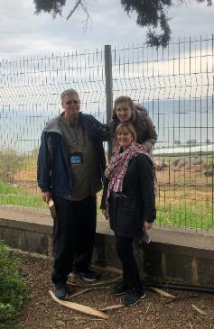
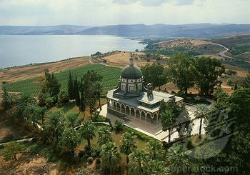
Mt of Beatitudes
Sermon on the Mount

Slide 38

Seven Beatitudes of Revelation:
“Blessed” (makarios)
Blessing upon the reader & heeder of Revelation (1:3)
Blessing upon the Tribulation martyrs (14:13)
Blessing upon the spiritually prepared (16:15)
Blessing upon the Marriage Supper invitees (19:9)
Blessing upon the First Resurrection’s participants (20:6)
Blessing upon the heeder of Revelation (22:7)
Blessing upon the eternal city’s citizens (22:14)
John F. Walvoord, "Revelation," in Bible Knowledge Commentary, ed. John F. Walvoord and Roy B. Zuck (Colorado Springs, CO: Victor, 1983), 929

Slide 39
Seven Beatitudes of Revelation:
“Blessed” (makarios)
Blessing upon the reader & heeder of Revelation (1:3)
Blessing upon the Tribulation martyrs (14:13)
Blessing upon the spiritually prepared (16:15)
Blessing upon the Marriage Supper invitees (19:9)
Blessing upon the First Resurrection’s participants (20:6)
Blessing upon the heeder of Revelation (22:7)
Blessing upon the eternal city’s citizens (22:14)
John F. Walvoord, "Revelation," in Bible Knowledge Commentary, ed. John F. Walvoord and Roy B. Zuck (Colorado Springs, CO: Victor, 1983), 929

Slide 40
Why God Became Man
(Heb. 2:5-18)
To restore God’s original purpose for man (5-8)
To taste death for every man (9)
To bring many to glory (10-13)
To break Satan’s rule over humanity (14)
To remove the fear of death (15)
To become our merciful high priest (16-17a)
To make a complete purification for sin (17b)
To sympathize with those tested (18)
Adapted from J. Dwight Pentecost, Faith that Endures (Grand Rapids, MI: Kregel, 2000), 60-71.

Slide 41

Hebrews 2:15
and release those who through fear of death were all their lifetime subject to bondage.

Slide 42
Hebrews 2:15
and release those who through fear of death were all their lifetime subject to bondage.

Slide 43
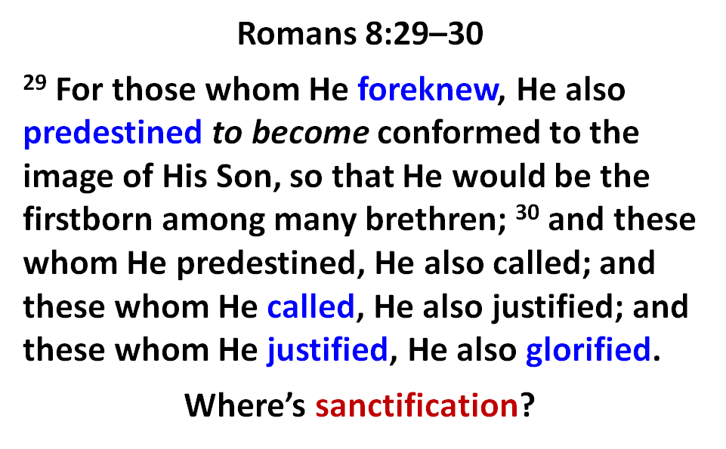

Slide 44
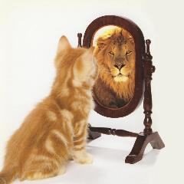
2 Corinthians 5:8
we are of good courage, I say, and prefer rather to be absent from the body and to be at home with the Lord.

Slide 45
2 Corinthians 5:8
we are of good courage, I say, and prefer rather to be absent from the body and to be at home with the Lord.

Slide 46
Philippians 1:21-24
²¹ For to me, to live is Christ and to die is gain. ²² But if I am to live on in the flesh, this will mean fruitful labor for me; and I do not know which to choose. ²³ But I am hard-pressed from both directions, having the desire to depart and be with Christ, for that is very much better; ²⁴ yet to remain on in the flesh is more necessary for your sake.

Slide 47
Philippians 1:21-24
²¹ For to me, to live is Christ and to die is gain. ²² But if I am to live on in the flesh, this will mean fruitful labor for me; and I do not know which to choose. ²³ But I am hard-pressed from both directions, having the desire to depart and be with Christ, for that is very much better; ²⁴ yet to remain on in the flesh is more necessary for your sake.

Slide 48
5. The Blessing Upon the Tribulation Martyrs
(Revelation 14:13)
Their Beatitude (13a)
Their Rest (13b)
Their Reward (13c)

Slide 49
Romans 8:19-22
¹⁹ For the anxious longing of the creation waits eagerly for the revealing of the sons of God. ²⁰ For the creation was subjected to futility, not willingly, but because of Him who subjected it, in hope ²¹ that the creation itself also will be set free from its slavery to corruption into the freedom of the glory of the children of God. ²² For we know that the whole creation groans and suffers the pains of childbirth together until now.

Slide 50
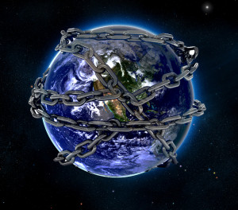

Slide 51
5. The Blessing Upon the Tribulation Martyrs
(Revelation 14:13)
Their Beatitude (13a)
Their Rest (13b)
Their Reward (13c)

Slide 52
Scripture’s Five Crowns (Rev 4:10: 3:11; 2 John 8)
SCRIPTURE | CROWN | PURPOSE
1 Cor. 9:24-27 | Incorruptible | Gaining mastery over the flesh
1 Thess. 2:19-20 | Rejoicing | Soul winning
Jas. 1:12; Rev. 2:10 | Life | Enduring trials
1 Pet. 5:2-4 | Glory | Shepherding God’s people
2 Tim. 4:8 | Righteousness | Longing for His appearing

Slide 53
C. Six Scenes of Hope
Revelation 14:1-20
The Destiny of the 144,000 (1-5)
The Proclamation of the Eternal Gospel (6-7)
The Prediction of the Destruction of Babylon (8)
The Doom of the Beast’s Worshippers (9-12)
The Blessing Upon the Tribulation’s Martyrs (13)
The Judgement Harvest of Armageddon (14-20)

Slide 54
6. The Armageddon Judgment Harvest
(Revelation 14:14-20)
The Judge (14-18a)
The Judged (18b)
The Judgment (19-20)

Slide 55
6. The Armageddon Judgment Harvest
(Revelation 14:14-20)
The Judge (14-18a)
The Judged (18b)
The Judgment (19-20)

Slide 56
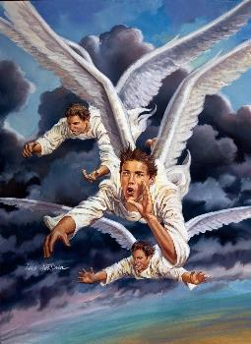
A. The Judge
(Revelation 14:14-18a)
The Son of Man (14)
The First Angel (15-16)
The Second Angel (17)
The Third Angel (18a)

Slide 57
A. The Judge
(Revelation 14:14-18a)
The Son of Man (14)
The First Angel (15-16)
The Second Angel (17)
The Third Angel (18a)

Slide 58
A. The Judge
(Revelation 14:14-18a)
The Son of Man (14)
The First Angel (15-16)
The Second Angel (17)
The Third Angel (18a)

Slide 59
A. The Judge
(Revelation 14:14-18a)
The Son of Man (14)
The First Angel (15-16)
The Second Angel (17)
The Third Angel (18a)

Slide 60
A. The Judge
(Revelation 14:14-18a)
The Son of Man (14)
The First Angel (15-16)
The Second Angel (17)
The Third Angel (18a)

Slide 61
6. The Armageddon Judgment Harvest
(Revelation 14:14-20)
The Judge (14-18a)
The Judged (18b)
The Judgment (19-20)

Slide 62
6. The Armageddon Judgment Harvest
(Revelation 14:14-20)
The Judge (14-18a)
The Judged (18b)
The Judgment (19-20)

Slide 63
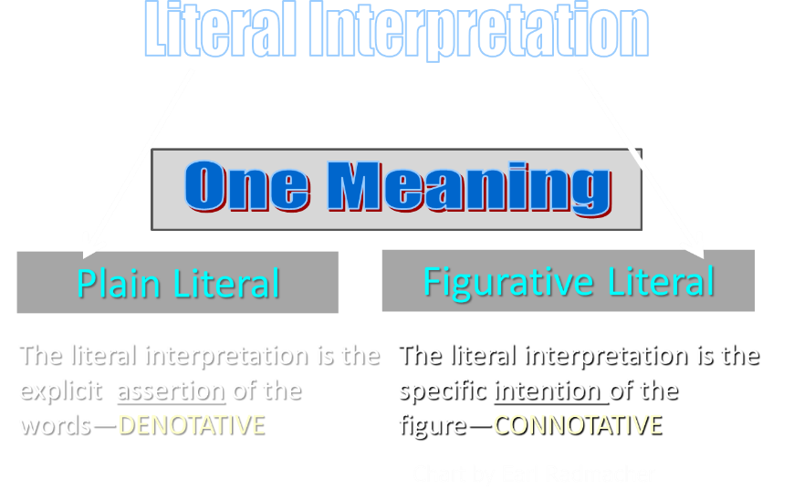

Slide 64
C. The Judgment
(Revelation 14:19-20)
Figurative language (19)
Plain language (20)

Slide 65
C. The Judgment
(Revelation 14:19-20)
Figurative language (19)
Plain language (20)

Slide 66

Promised Exemption from Divine Wrath
The promise (1 Thess 1:10; 5:9; Rom 5:9; 8:1; Rev 3:10)
Tribulation = divine wrath (Rev 6:16-17; 11:18; 15:1, 7; 16:1, 19)

Slide 67
C. The Judgment
(Revelation 14:19-20)
Figurative language (19)
Plain language (20)

Slide 68
Conclusion

Slide 69
C. Six Scenes of Hope
Revelation 14:1-20
The Destiny of the 144,000 (1-5)
The Proclamation of the Eternal Gospel (6-7)
The Prediction of the Destruction of Babylon (8)
The Doom of the Beast’s Worshippers (9-12)
The Blessing Upon the Tribulation’s Martyrs (13)
The Judgement Harvest of Armageddon (14-20)

Slide 70

“The Lord bless you and keep you; the Lord make his face shine on you and be gracious to you; the Lord turn his face toward you and give you peace.” (NIV)

