Slide 1
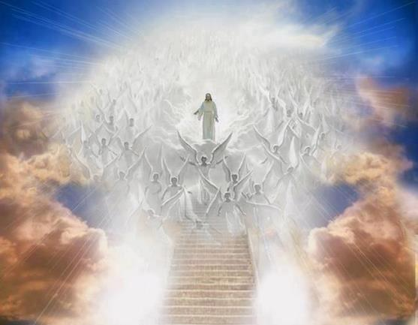
ANGELOLOGY
Dr. Andy Woods
Senior Pastor – Sugar Land Bible Church
President – Chafer Theological Seminary

Slide 2
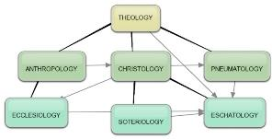
Areas of Systematic Theology
Prolegomena – Introduction
Theology – Study of God
Christology – Study of Christ
Pneumatology – Study of the Holy Spirit
Anthropology – Study of Man
Hamartiology – Study of sin
Soteriology – Study of salvation
Angelology – Study of angels
Ecclesiology – Study of the Church
Eschatology – Study of the end

Slide 3
Preview of Angelology
Good angels
Satanology
Demonology
Gen. 6:1-4 controversy

Slide 4
Preview
Existence
Origin
Nature
Appearance
Names and classifications
Abode
Activities

Slide 5
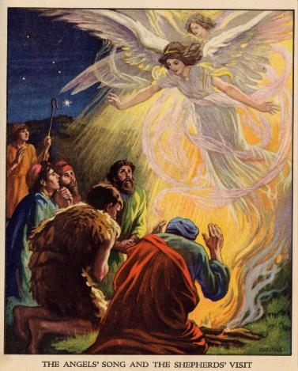
Existence
OT – 108 references
NT – 165 references
Lewis Sperry Chafer, Systematic Theology, 2:3

Slide 6
Preview
Existence
Origin
Nature
Appearance
Names and classifications
Abode
Activities

Slide 7
Origin
Created by God – Col 1:16
Time of creation
Before the earth (Job 38:4-7)
Perhaps on the first two creation days (Gen 1:1; Exod 20:11; Ps 148:2-5; Gen 2:1)
Created as angels
Not human (Heb 12:22-23)
Not deity (Rev 19:10)

Slide 8
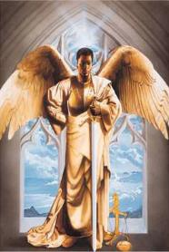
Origin (cont’d)
Created with creaturely limitations
Not omnipresent (Dan 9:22-23)
Not omnipotent (Dan 10:13)
Not omniscient (Matt 24:36; 1 Pet 1:12)

Slide 9
Preview
Existence
Origin
Nature
Appearance
Names and classifications
Abode
Activities

Slide 10
Nature
Personhood
Attributes
Intellect (1 Pet 1:12)
Emotions (Luke 15:10)
Will (Ps 103:20)
Actions
Desire (1 Pet 1:12)
Talk (Luke 1:13)
Confirmed in holiness (1 Tim 5:21; Rev 14:10)

Slide 11
Nature (cont’d)
Power
Relative to man (2 Pet 2:11)
Relative to God (2 Pet 2:11)
Material
Spiritual (Heb 1:7, 14)
Physical Gen 18–19; Heb 13:2)
Gender
Male? (Gen 19, masculine pronouns)
Neuter? Cannot reproduce, Spirit, no female angels

Slide 12
Preview
Existence
Origin
Nature
Appearance
Names and classifications
Abode
Activities

Slide 13
Appearance
On earth: men (Acts 1:10)
In heaven
Seraphim (Isa 6)
Cherubim (Ezek 1; 10)
Living creatures (Rev 4:6-8)
An angel (Rev 10:1-3)

Slide 14
Preview
Existence
Origin
Nature
Appearance
Names and classifications
Abode
Activities

Slide 15
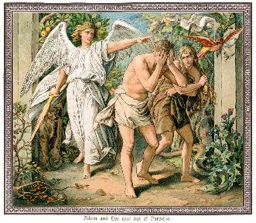
Names & Classifications of the Angels
General names and classifications
Specific names and classifications

Slide 16
Names & Classifications of the Angels
General names and classifications
Specific names and classifications

Slide 17
Names and Classifications
General
Angels
Ministering spirits (Heb 1:14)
Heavenly hosts (Luke 2:13)
Watchers (Dan 4:13-17)
Sons of God (Job 1:6; 2:1; 38:7)
Stars (Rev 12:3-4, 9)

Slide 18
Names & Classifications of the Angels
General names and classifications
Specific names and classifications

Slide 19
Names and Classifications (cont’d)
Specific
Cherub(im) – Gen 3:24; Exod 25:17-22
Seraph(im) – Isa 6:2, 6
Michael – Dan 12:1; Jude 9; Rev 12:7
Gabriel – Dan 8:16; 9:21; Luke 1:18-19, 26-38

Slide 20
Names and Classifications (cont’d)
Specific
Cherub(im) – Gen 3:24; Exod 25:17-22
Seraph(im) – Isa 6:2, 6
Michael – Dan 12:1; Jude 9; Rev 12:7
Gabriel – Dan 8:16; 9:21; Luke 1:18-19, 26-38

Slide 21
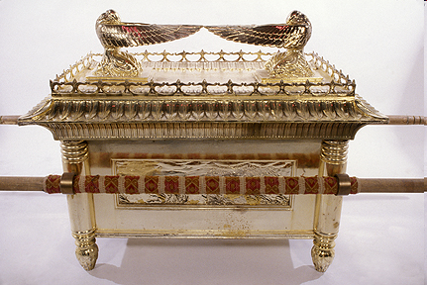
Ark of the Covenant

Slide 22
Names and Classifications (cont’d)
Specific
Cherub(im) – Gen 3:24; Exod 25:17-22
Seraph(im) – Isa 6:2, 6
Michael – Dan 12:1; Jude 9; Rev 12:7
Gabriel – Dan 8:16; 9:21; Luke 1:18-19, 26-38

Slide 23
Names and Classifications (cont’d)
Specific
Cherub(im) – Gen 3:24; Exod 25:17-22
Seraph(im) – Isa 6:2, 6
Michael – Dan 12:1; Jude 9; Rev 12:7
Gabriel – Dan 8:16; 9:21; Luke 1:18-19, 26-38

Slide 24
John Calvin
Commentary on the Prophet Daniel (Vol 2, p. 253, 370). Bellingham, WA: Logos Bible Software. Commentary on Daniel 10:13; 12:1. (2010).
“Some think the word Michael represents Christ, and I do not object to this opinion…Michael may mean an angel; but I embrace the opinion of those who refer this to the person of Christ, because it suits the subject best to represent him as standing forward for the defence of his elect people.”

Slide 25
Matthew Henry
Matthew Henry, Matthew Henry's Commentary on the Whole Bible, 6 vols. (Peabody, MA: Hendrickson, 1991), Daniel 12:1.
“Jesus Christ shall appear his church’s patron and protector: At that time, when the persecution is at the hottest, Michael shall stand up, v. 1. The angel had told Daniel what a firm friend Michael was to the church, ch. 10:21. He all along showed this friendship in the upper world; the angels knew it; but now Michael shall stand up in his providence, and work deliverance for the Jews, when he sees that their power is gone, Deu. 32:3. 6. Christ is that great prince, for he is the prince of the kings of the earth, Rev. 1:5. And, if he stand up for his church, who can be against it?...But this is not all: At that time (that is, soon after) Michael shall stand up for the working out of our eternal salvation; the Son of God shall …

Slide 26
Matthew Henry
Matthew Henry, Matthew Henry's Commentary on the Whole Bible, 6 vols. (Peabody, MA: Hendrickson, 1991), Daniel 12:1.
“… be incarnate, shall be manifested to destroy the works of the devil. Christ stood for the children of our people when he was made sin and a curse for them, stood in their stead as a sacrifice, bore the cure for them, to bear it from them. He stands for them in the intercession he ever lives to make within the veil, stands up for them, and stands their friend. And after the destruction of antichrist, of whom Antiochus was a type, Christ shall stand at the latter day upon the earth, shall appear for the complete redemption of all his…When Christ appears he will recompense tribulation to those that trouble his people.”

Slide 27
Why Michael the Archangel is Not Jesus Christ
Michael = one among many (Dan. 10:13) vs. Jesus = one of a kind (John 3:16; Rev. 19:16)
Jesus created the angels (Col. 1:16) including Michael
Jesus is higher than the angels (Heb. 1‒2)
Angels not Sons (Heb. 1:5) vs. Jesus a Son (Matt. 3:17)
Angels to worship Son (Heb. 1:6; Rev. 19:10; 22:8-9)
Angels not rule world (Heb. 2:5) vs. Jesus will (Ps. 2:6)

Slide 28
Why Michael the Archangel is Not Jesus Christ
Michael does not rebuke Satan (Jude 9) vs. Jesus does (Matt. 4:10; 16:23)
Michael is distinguished from the Lord (Jude 9; Philip. 2:11)
Jesus (Rev. 12:5) distinguished from Michael (Rev. 12:7)
Jesus does not actually speak with the voice of the Archangel (1 Thess. 4:16) but may be accompanied by Michael (2 Thess. 1:7)

Slide 29
Names and Classifications (cont’d)
Specific
Cherub(im) – Gen 3:24; Exod 25:17-22
Seraph(im) – Isa 6:2, 6
Michael – Dan 12:1; Jude 9; Rev 12:7
Gabriel – Dan 8:16; 9:21; Luke 1:18-19, 26-38

Slide 30
Preview
Existence
Origin
Nature
Appearance
Names and classifications
Abode
Activities

Slide 31
Abode of the Angels
Some earthly visitations (Gen 18–19; Heb 13:2)
Heaven is their main habitation (2 Chr 18:18; Luke 1:19; 15:10; John 1:51)

Slide 32
Abode of the Angels
Some earthly visitations (Gen 18–19; Heb 13:2)
Heaven is their main habitation (2 Chr 18:18; Luke 1:19; 15:10; John 1:51)

Slide 33
Abode of the Angels
Some earthly visitations (Gen 18–19; Heb 13:2)
Heaven is their main habitation (2 Chr 18:18; Luke 1:19; 15:10; John 1:51)

Slide 34
Preview
Existence
Origin
Nature
Appearance
Names and classifications
Abode
Activities

Slide 35
Activities of the Angels
Past activities
Present activities
Future activities

Slide 36
Activities of the Angels
Past activities
Present activities
Future activities

Slide 37
Activities of the Angels
Past
Witnessed creation (Job 38:7)
Brought judgment (Gen 19:22; Acts 12:22-23)
Accompanied the Law (Gal 3:19)
Announced births of John and Christ (Luke 1:11-13, 26-27)
Strengthened Christ (Matt 4:11)
Announced resurrection (Matt 28:1-7)
Observed Ascension (Acts 1:11)
Brought messages (Luke 1:13)

Slide 38
Activities of the Angels
Past activities
Present activities
Future activities

Slide 39
Activities of the Angels (cont’d)
Present
Protect believers (Ps 34:7; 91:11-12)
Deliver God’s answers to prayer (Dan 9:23; 10:12)
Take souls to heaven (Luke 16:22)
Involvement in government (Dan 10:21; 11:1; 12:1)

Slide 40
Activities of the Angels
Past activities
Present activities
Future activities

Slide 41
Activities of the Angels (cont’d)
Future
Rapture (1 Thess 4:16)
Judged by humans (1 Cor 6:3)
Tribulation judgments (Rev 8:2; 16:1)
Return of Christ (Matt 24:31; 25:31)
Bind Satan (Rev 20:1-2)

Slide 43
Activities of the Angels (cont’d)
Future
Rapture (1 Thess 4:16)
Judged by humans (1 Cor 6:3)
Tribulation judgments (Rev 8:2; 16:1)
Return of Christ (Matt 24:31; 25:31)
Bind Satan (Rev 20:1-2)

Slide 44
CONCLUSION

Slide 45
Review
Existence
Origin
Nature
Appearance
Names and classifications
Abode
Activities

