Slide 1
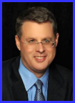
Dr. Andy Woods
Senior Pastor – Sugar Land Bible Church
President – Chafer Theological Seminary

Slide 3
Seven Trumpets (Revelation 8‒11)
1st Trumpet (8:7) – 1/3 vegetation destroyed
2nd Trumpet (8:8-9) – 1/3 ocean destroyed
3rd Trumpet (8:10-11) – 1/3 water destroyed
4th Trumpet (8:12-13) – 1/3 luminaries darkened
5th Trumpet (9:1-12) – Demons released
6th Trumpet (9:13-21) – 1/3 humanity destroyed
7th Trumpet (11:14-19) – Legal transfer announced

Slide 5
5 Non-Chronological Parenthetical Insertions
Rev 7 – 144,000 Jews
Rev 10:1-11:13 – Announcement of no more delay and the two witnesses
Rev 12-14 – Israel’s flight, two beasts, six scenes of hope
Rev 16:13-16 – Gathering of the nations to Armageddon
Rev 17:1-19:6 – Babylon’s fall

Slide 6
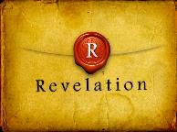
Revelation 11:15
“Then the seventh angel sounded; and there were loud voices in heaven, saying, ‘The kingdom of the world has become the kingdom of our Lord and of His Christ; and He will reign (basileuō) forever and ever.’” (cf. Matt. 6:10)

Slide 7
Revelation 12‒14
Rev 12 – Israel’s flight
Rev 13 – Two beasts
Rev 14 – Six scenes of hope

Slide 8
Revelation 12‒14
Rev 12 – Israel’s flight
Rev 13 – Two beasts
Rev 14 – Six scenes of hope

Slide 9
Revelation 12‒14
Rev 12 – Israel’s flight
Rev 13 – Two beasts
Rev 14 – Six scenes of hope

Slide 10
Revelation 12‒14
Rev 12 – Israel’s flight
Rev 13 – Two beasts
Rev 14 – Six scenes of hope

Slide 11
C. Six Scenes of Hope Revelation 14:1-20
The Destiny of the 144,000 (1-5)
The Proclamation of the Eternal Gospel (6-7)
The Prediction of the Destruction of Babylon (8)
The Doom of the Beast’s Worshippers (9-12)
The Blessing Upon the Tribulation’s Martyrs (13)
The Judgement Harvest of Armageddon (14-20)

Slide 12
C. Six Scenes of Hope Revelation 14:1-20
The Destiny of the 144,000 (1-5)
The Proclamation of the Eternal Gospel (6-7)
The Prediction of the Destruction of Babylon (8)
The Doom of the Beast’s Worshippers (9-12)
The Blessing Upon the Tribulation’s Martyrs (13)
The Judgement Harvest of Armageddon (14-20)

Slide 13
C. Six Scenes of Hope Revelation 14:1-20
The Destiny of the 144,000 (1-5)
The Proclamation of the Eternal Gospel (6-7)
The Prediction of the Destruction of Babylon (8)
The Doom of the Beast’s Worshippers (9-12)
The Blessing Upon the Tribulation’s Martyrs (13)
The Judgement Harvest of Armageddon (14-20)

Slide 14
C. Six Scenes of Hope Revelation 14:1-20
The Destiny of the 144,000 (1-5)
The Proclamation of the Eternal Gospel (6-7)
The Prediction of the Destruction of Babylon (8)
The Doom of the Beast’s Worshippers (9-12)
The Blessing Upon the Tribulation’s Martyrs (13)
The Judgement Harvest of Armageddon (14-20)

Slide 15
5 Non-Chronological Parenthetical Insertions
Rev 7 – 144,000 Jews
Rev 10:1-11:13 – Announcement of no more delay and the two witnesses
Rev 12-14 – Israel’s flight, two beasts, six scenes of hope
Rev 16:13-16 – Gathering of the nations to Armageddon
Rev 17:1-19:6 – Babylon’s fall

Slide 16
Literal Geography in Revelation
Asia | 1:4 | Philadelphia | 3:7
Ephesus | 2:1 | Laodicea | 3:14
Smyrna | 2:8 | Euphrates | 9:14;16:12
Pergamum | 2:12 | Jerusalem | 11:8
Thyatira | 2:18 | Armageddon | 16:16
Sardis | 3:1 | Jerusalem | 20:9

Slide 17
Iraq Celebrates Naming Babylon a UNESCO World Heritage Site
QASSIM ABDUL-ZAHRA of Times of Israel - July 6, 2019
“BAGHDAD (AP) — Iraq on Friday celebrated the UNESCO World Heritage Committee’s decision to name the historic city of Babylon a World Heritage Site in a vote held in Azerbaijan’s capital, years after Baghdad began campaigning for the site to be added to the list…The 4,300-year-old Babylon — now mainly an archaeological ruin and two important museums — is where dynasties have risen and fallen since the earliest days of settled human civilization. King Hammurabi wrote his famous code of laws in Babylon, while Nebuchadnezzar sent his vast army from the city to Jerusalem to put down an uprising and bring the Jews back as slaves.”

Slide 18
Iraq Celebrates Naming Babylon a UNESCO World Heritage Site
QASSIM ABDUL-ZAHRA of Times of Israel - July 6, 2019
“The Babylonian exile of the Jews lasted from 605 BCE until the Persian King Cyrus the Great conquered Babylon and in 539 BCE allowed the Jews to return home and build the Second Temple…Dozens of Iraqis waving their national flag gathered at the Ishtar Gate at the site celebrating their city’s new international status. Iraqi Prime Minister Adel Abdul-Mahdi described the vote as ‘another victory for the Iraq of civilizations that was and will always be a lighthouse to the world.’ President Barham Saleh tweeted that after Babylon, more ancient sites will be added to the list through which ‘Iraq will restore that status that it deserves.’”

Slide 19
John F. Walvoord John F. Walvoord, The Revelation of Jesus Christ: A Commentary (Chicago: Moody, 1966), 257, 263.
“The city here according to verse 5 is a mystery, not a literal city...The ultimate decision depends upon the judgment of the expositor, but in many respects it is simpler to postulate a rebuilt Babylon as fulfilling literally the Old Testament prophecies as well as that embodied in this chapter.”

Slide 20
C. Six Scenes of Hope Revelation 14:1-20
The Destiny of the 144,000 (1-5)
The Proclamation of the Eternal Gospel (6-7)
The Prediction of the Destruction of Babylon (8)
The Doom of the Beast’s Worshippers (9-12)
The Blessing Upon the Tribulation’s Martyrs (13)
The Judgement Harvest of Armageddon (14-20)

Slide 21
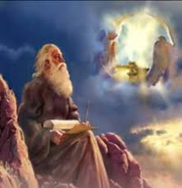
4. The Doom of the Beast’s Worshippers (Revelation 14:9-12)
The Plea (9)
The Punishment (10-11)
The Perseverance (12)

Slide 22
4. The Doom of the Beast’s Worshippers (Revelation 14:9-12)
The Plea (9)
The Punishment (10-11)
The Perseverance (12)

Slide 23
4. The Doom of the Beast’s Worshippers (Revelation 14:9-12)
The Plea (9)
The Punishment (10-11)
The Perseverance (12)

Slide 24
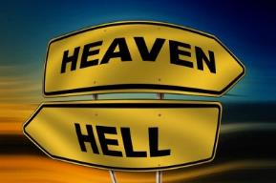
Daniel 12:2
“Many of those who sleep in the dust of the ground will awake, these to everlasting (olam) life, but the others to disgrace and everlasting (olam) contempt.”

Slide 25
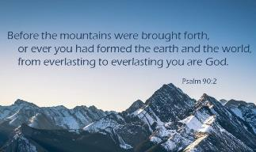
Psalm 90:2
“Before the mountains were born Or You gave birth to the earth and the world, Even from everlasting (olam) to everlasting (olam), You are God.”

Slide 26
Matthew 25:46
“These will go away into eternal (aiōnios) punishment (kolasis), but the righteous into eternal life.

Slide 27
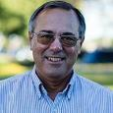
Dr. Alan W. Gomes (Summer 1991). “Evangelicals and the Annihilation of Hell” (Part 2). In the Christian Research Journal. Page 11.
“A punishment [such as torment] that is not felt is not a punishment. It is an odd use of language to speak of an insensate state (i.e., unfeeling), an inanimate object receiving punishment. To say, ‘I punished my car for not starting by slowly plucking out it’s spark plug wires, one by one,’ would invoke laughter, not serious consideration.”

Slide 28
Matthew 25:46
“These will go away into eternal (aiōnios) punishment, but the righteous into eternal (aiōnios) life.

Slide 29
Romans 16:26
“but now is manifested, and by the Scriptures of the prophets, according to the commandment of the eternal (aiōnios) God, has been made known to all the nations, leading to obedience of faith

Slide 30
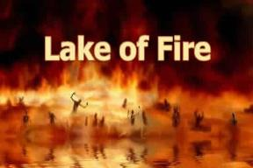
Revelation 20:10
“And the devil who deceived them was thrown into the lake of fire and brimstone, where the beast and the false prophet are also; and they will be tormented day and night forever (aiōn) and ever (aiōn).”

Slide 31
Revelation 14:11
“And the smoke of their torment goes up forever (aiōn) and ever (aiōn); they have no rest day and night, those who worship the beast and his image, and whoever receives the mark of his name.”

Slide 32
Dominoes in a Row

Slide 33
4. The Doom of the Beast’s Worshippers (Revelation 14:9-12)
The Plea (9)
The Punishment (10-11)
The Perseverance (12)

Slide 34
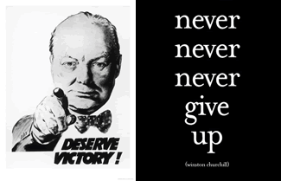
Matthew 24:13
“But the one who endures to the end, he will be saved.”

Slide 35
Revelation 1:19
“Therefore write the things which you have seen, and the things which are, and the things which will take place after these things [meta tauta].”

Slide 36
Revelation 1:19
Seen (Chapter 1)
Are (Chapters 2–3)
After these things (Chapters 4–22)

Slide 37
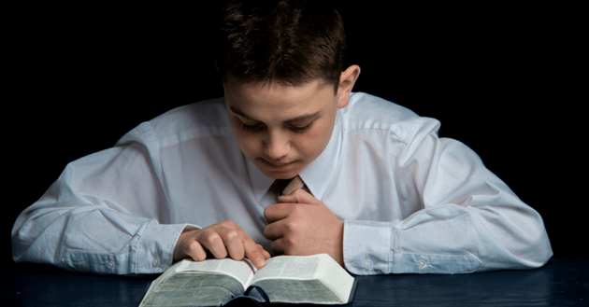
Psalm 50:5 (NKJV)
“Gather My saints together to Me, Those who have made a covenant with Me by sacrifice.”

Slide 38
Psalm 149:1 (NKJV)
“Praise the Lord! Sing to the Lord a new song, And His praise in the assembly of saints.”

Slide 39
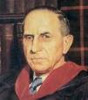
John Murray
Redemption Accomplished and Applied, pp. 152, 154-55.
“The crucial test of true faith is endurance to the end, abiding in Christ, and continuance in the Word…He cannot abandon himself to sin; he cannot come under the domination of sin; he cannot be guilty of certain kinds of unfaithfulness…Let us appreciate the doctrine of the perseverance of the saints and recognize that we may entertain the faith of our security in Christ only as we persevere in faith and holiness to the end.”

Slide 40
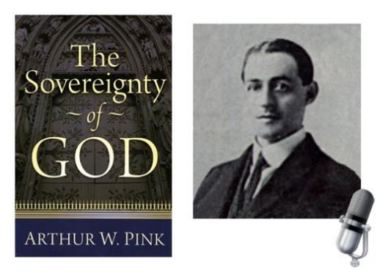
A. W. Pink
Practical Christianity, p. 16.
“Readers, if there is a reserve in your obedience, you are on your way to hell.”

Slide 41
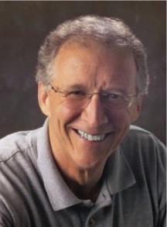
John Piper
John Piper and Pastoral Staff, TULIP: What We Believe about the Five Points of Calvinism: Position Paper of the Pastoral Staff (Desiring God Ministries, 1997), 25, cited in Dave Hunt, What Love is This?, 379.
“No Christian can be sure that he is a true believer. Hence, there is an ongoing need to be dedicated to the Lord and to deny ourselves so that we might make it.”

Slide 42
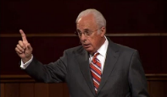
John MacArthur
Saved Without A Doubt, p. 177
“If a person fails to love and obey the Lord through the trials of life, then there is no evidence that he possesses saving faith. How many people do you know who came to church for a while, had a little trouble in their lives, and left? Although they may have made a profession of faith in Christ, they cannot be identified as those who love Him because their lives are not characterized by enduring obedience.”

Slide 43
R.C. Sproul – Bob Wilkin as quoted in:
http://www.gracebiblestudies.org/Resources/Web/www.duluthbible.org/g_f_j/EternalSecurity12.htm
“During the first message presented at Ligonier’s Conference in Orlando last June, Dr. R. C. Sproul indicated that Dr. James Boice, a scheduled speaker at the conference, was dying in faith that very night. Then at the end of the message he asked all 5,000 of us present to pray that Jim dies in faith. This struck me as sad. Here was a great pastor, theologian, teacher, and author. Yet Sproul was not sure that he was regenerate. (In Reformed thought, if a person fails to die in faith, he proved he was never saved in the first place.) I was reminded of R.T. Kendall’s remark that nearly to a man the Puritan divines died doubting whether they were saved and fearing they were going to hell. Dr. Boice died that very night, June 15th.”

Slide 44
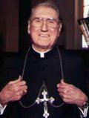
Cardinal John O’Connor of NY
quoted in Samuel Howe Verhovek, Cardinal Defends a Jailed Bishop Who Warned Cuomo on Abortion, New York Times, February 1, 1990.
“Church teaching is that I don't know, at any given moment, what my eternal future will be… I can hope, pray, do my very best – but I still don't know. Pope John II doesn't absolutely know that he will go to heaven, nor does mother Theresa of Calcutta, unless either has had a special divine revelation.”

Slide 45
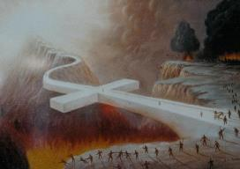
John 5:24
“Truly, truly, I say to you, he who hears My word, and believes Him who sent Me, has eternal life, and does not come into judgment, but has passed out of death into life.”

Slide 46
1 John 5:13
“These things I have written to you who believe in the name of the Son of God, so that you may know that you have eternal life.”

Slide 47
C. Six Scenes of Hope Revelation 14:1-20
The Destiny of the 144,000 (1-5)
The Proclamation of the Eternal Gospel (6-7)
The Prediction of the Destruction of Babylon (8)
The Doom of the Beast’s Worshippers (9-12)
The Blessing Upon the Tribulation’s Martyrs (13)
The Judgement Harvest of Armageddon (14-20)

Slide 48
5. The Blessing Upon the Tribulation Martyrs (Revelation 14:13)
Their Beatitude (13a)
Their Rest (13b)
Their Reward (13c)

Slide 49
5. The Blessing Upon the Tribulation Martyrs (Revelation 14:13)
Their Beatitude (13a)
Their Rest (13b)
Their Reward (13c)

Slide 50
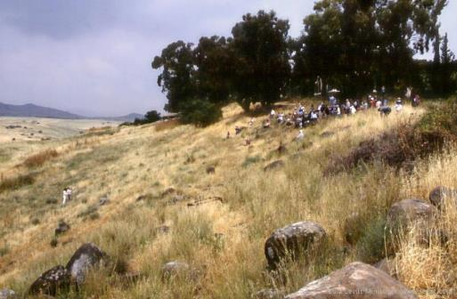
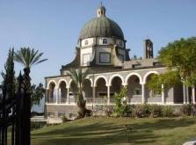
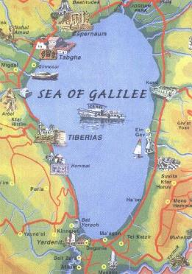
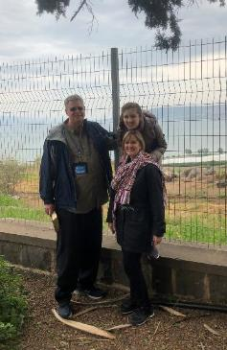
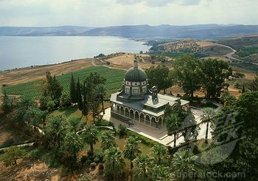
Mt of Beatitudes
Sermon on the Mount

Slide 51
Seven Beatitudes of Revelation: “Blessed” (makarios)
Blessing upon the reader & heeder of Revelation (1:3)
Blessing upon the Tribulation martyrs (14:13)
Blessing upon the spiritually prepared (16:15)
Blessing upon the Marriage Supper invitees (19:9)
Blessing upon the First Resurrection’s participants (20:6)
Blessing upon the heeder of Revelation (22:7)
Blessing upon the eternal city’s citizens (22:14)
John F. Walvoord, "Revelation," in Bible Knowledge Commentary, ed. John F. Walvoord and Roy B. Zuck (Colorado Springs, CO: Victor, 1983), 929

Slide 52
Seven Beatitudes of Revelation: “Blessed” (makarios)
Blessing upon the reader & heeder of Revelation (1:3)
Blessing upon the Tribulation martyrs (14:13)
Blessing upon the spiritually prepared (16:15)
Blessing upon the Marriage Supper invitees (19:9)
Blessing upon the First Resurrection’s participants (20:6)
Blessing upon the heeder of Revelation (22:7)
Blessing upon the eternal city’s citizens (22:14)
John F. Walvoord, "Revelation," in Bible Knowledge Commentary, ed. John F. Walvoord and Roy B. Zuck (Colorado Springs, CO: Victor, 1983), 929

Slide 53
5. The Blessing Upon the Tribulation Martyrs (Revelation 14:13)
Their Beatitude (13a)
Their Rest (13b)
Their Reward (13c)

Slide 54
5. The Blessing Upon the Tribulation Martyrs (Revelation 14:13)
Their Beatitude (13a)
Their Rest (13b)
Their Reward (13c)

Slide 55
Scripture’s Five Crowns (Rev 4:10: 3:11; 2 John 8)
SCRIPTURE | CROWN | PURPOSE
1 Cor. 9:24-27 | Incorruptible | Gaining mastery over the flesh
1 Thess. 2:19-20 | Rejoicing | Soul winning
Jas. 1:12; Rev. 2:10 | Life | Enduring trials
1 Pet. 5:2-4 | Glory | Shepherding God’s people
2 Tim. 4:8 | Righteousness | Longing for His appearing

Slide 56
C. Six Scenes of Hope Revelation 14:1-20
The Destiny of the 144,000 (1-5)
The Proclamation of the Eternal Gospel (6-7)
The Prediction of the Destruction of Babylon (8)
The Doom of the Beast’s Worshippers (9-12)
The Blessing Upon the Tribulation’s Martyrs (13)
The Judgement Harvest of Armageddon (14-20)

Slide 57
6. The Armageddon Judgment Harvest (Revelation 14:14-20)
The Judge (14-18a)
The Judged (18b)
The Judgment (19-20)

Slide 58
6. The Armageddon Judgment Harvest (Revelation 14:14-20)
The Judge (14-18a)
The Judged (18b)
The Judgment (19-20)

Slide 59
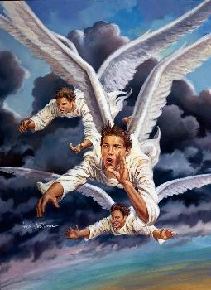
A. The Judge (Revelation 14:14-18a)
The Son of Man (14)
The First Angel (15-16)
The Second Angel (17)
The Third Angel (18a)

Slide 60
A. The Judge (Revelation 14:14-18a)
The Son of Man (14)
The First Angel (15-16)
The Second Angel (17)
The Third Angel (18a)

Slide 61
A. The Judge (Revelation 14:14-18a)
The Son of Man (14)
The First Angel (15-16)
The Second Angel (17)
The Third Angel (18a)

Slide 62
A. The Judge (Revelation 14:14-18a)
The Son of Man (14)
The First Angel (15-16)
The Second Angel (17)
The Third Angel (18a)

Slide 63
A. The Judge (Revelation 14:14-18a)
The Son of Man (14)
The First Angel (15-16)
The Second Angel (17)
The Third Angel (18a)

Slide 64
6. The Armageddon Judgment Harvest (Revelation 14:14-20)
The Judge (14-18a)
The Judged (18b)
The Judgment (19-20)

Slide 65
6. The Armageddon Judgment Harvest (Revelation 14:14-20)
The Judge (14-18a)
The Judged (18b)
The Judgment (19-20)

Slide 67
C. The Judgment (Revelation 14:19-20)
Figurative language (19)
Plain language (20)

Slide 68
C. The Judgment (Revelation 14:19-20)
Figurative language (19)
Plain language (20)

Slide 69
Promised Exemption from Divine Wrath
The promise (1 Thess 1:10; 5:9; Rom 5:9; 8:1; Rev 3:10)
Tribulation = divine wrath (Rev 6:16-17; 11:18; 15:1, 7; 16:1, 19)

Slide 70
C. The Judgment (Revelation 14:19-20)
Figurative language (19)
Plain language (20)

Slide 71
Conclusion

Slide 72
C. Six Scenes of Hope Revelation 14:1-20
The Destiny of the 144,000 (1-5)
The Proclamation of the Eternal Gospel (6-7)
The Prediction of the Destruction of Babylon (8)
The Doom of the Beast’s Worshippers (9-12)
The Blessing Upon the Tribulation’s Martyrs (13)
The Judgement Harvest of Armageddon (14-20)

Slide 73
“The Lord bless you and keep you; the Lord make his face shine on you and be gracious to you; the Lord turn his face toward you and give you peace.” (NIV)

