Slide 1
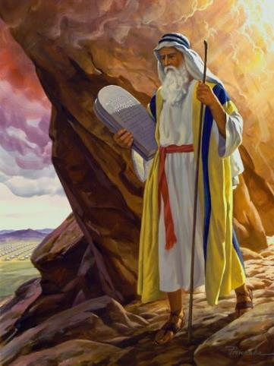
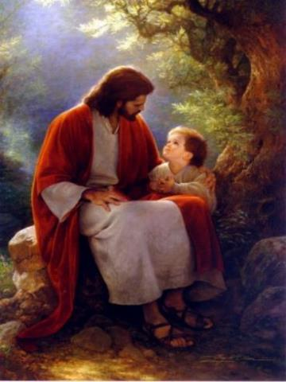
Law and Grace: An Overview Jim McGowan, Th.D. Sugar Land Bible Church 06-30-2019
…but grace and truth were realized through Jesus Christ - John 1:17
For the Law was given through Moses…
Special thanks to Dr. Vern Peterman for access to his insights and resources.

Slide 2
Session 20 Outline
Purpose, Aim, and Objective
The Gospel of Matthew
General Information
Comments and Commentary
Concluding Observations

Slide 3
OUR PURPOSE, AIM AND OBJECTIVE
Law and Grace
…is to Compare and Contrast Law and Grace so as to properly understand these two important themes and how they are related to the life of the New Testament Believer.

Slide 4
C. I. SCOFIELD, D. D.
The Grace of God, The Fundamentals Vol. 3, Chapter VII, p. 98
We have, most of us, been reared and now live under the influence of Galatianism. Protestant theology, alas, is for the most part, thoroughly Galatianized, in that neither law nor grace are given their distinct and separated places, as in the counsels of God, but are mingled together in one incoherent system.
The law is no longer, as in the Divine intent, a ministration of death (2 Cor. 3:7), of cursing (Gal. 3:10), of conviction (Rom. 3:19), because we are taught that we must try to keep it, and that by Divine help we may.
Nor, on the other hand, does grace bring us blessed deliverance from the dominion of sin, for we are kept under the law as a rule of life despite the plain declaration, “Sin shall not have dominion over you: for ye are not under the law, but under grace” (Rom. 6:14). (emphasis mine)

Slide 5
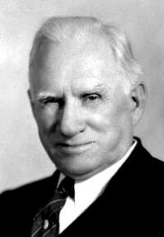
William R. Newell
Romans Verse-by-Verse (p. 274).
Grand Rapids, MI: Christian Classics Ethereal Library.
It is because Reformed theology has kept us Gentiles under the Law,—if not as a means of righteousness, then as “a rule of life,” that all the trouble has arisen. The Law is no more a rule of life than it is a means of righteousness. Walking in the Spirit has now taken the place of walking by ordinances. God has another principle under which He has put his saints: “Ye are not under law, but, under grace!” (italics mine)

Slide 6
Session 20 Outline
Purpose, Aim, and Objective
The Gospel of Matthew
General Information
Comments and Commentary
Concluding Observations

Slide 7
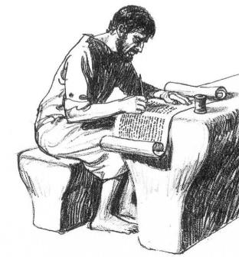
Law and Grace: Session 20
The Gospel of Matthew is very ‘Israelitish’!
Matthew 1:1-2:23
As we start into the text of the Gospel of Matthew, we will see that this book is very ‘Israelite-ish’ (Jewish in the context of ancient Israel).

Slide 8
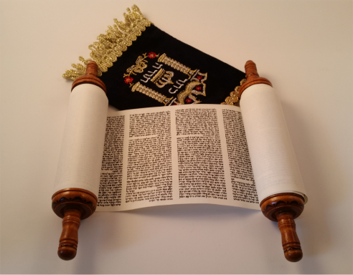
Law and Grace: Session 20
The Gospel of Matthew is very ‘Israelitish’!
Matthew 1:1-2:23
And we will also see that Matthew makes a great effort to convey a concern for the Law.

Slide 9
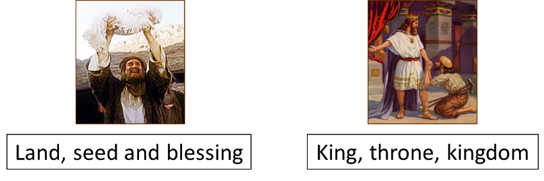
Law and Grace: Session 20
The Gospel of Matthew is very ‘Israelitish’!
Matthew 1:1-2:23
Even Matthew’s introduction, given for us in Matthew 1:1, reads, “…the genealogy of Jesus the Messiah, the son of David, the son of Abraham.”
Genealogy records were at the temple.

Slide 10
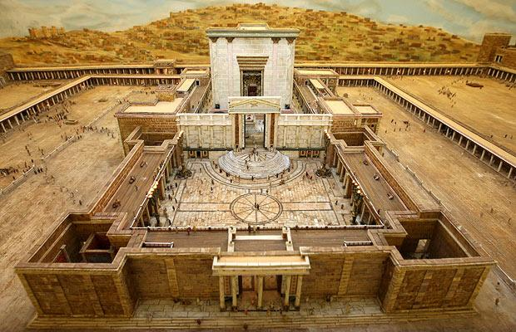
Law and Grace: Session 20
The Gospel of Matthew is very ‘Israelitish’!
Matthew 1:1-2:23

Slide 11
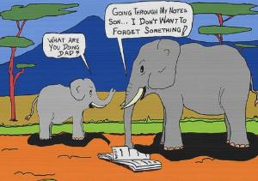
Law and Grace: Session 20
The Genealogy of Christ Matthew 1:1-17
Matthew begins with a genealogy made up of three lists of 14 names.
It starts with Abraham, then goes to David. David’s name is repeated, then the names go to the Babylonian exile, then to Christ.
The three lists of 14 names are designed to be a memory aid.

Slide 12
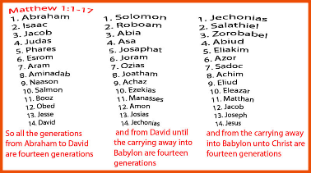
Matthew 1:1-17
Abraham was the father of Isaac… Jesse was the father of David the king. David was the father of Solomon… Josiah became the father of Jeconiah and his brothers, at the time of the deportation to Babylon… Jacob was the father of Joseph the husband of Mary, by whom Jesus was born, who is called the Messiah.

Slide 13
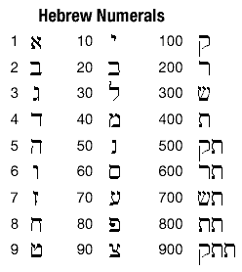
Law and Grace: Session 20
The Genealogy of Christ Matthew 1:1-17
In Hebrew, which is the language of most of the Old Testament, the letters are also the numbering system.

Slide 14
Law and Grace: Session 20
The Genealogy of Christ Matthew 1:1-17
The name ‘David’, in the Hebrew numbering system, adds up to 14! Interesting!
4 + 6 + 4 = 14

Slide 15
Law and Grace: Session 20
The Genealogy of Christ Matthew 1:1-17
God had made covenants with Abraham and David.

Slide 16
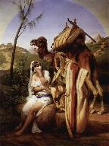
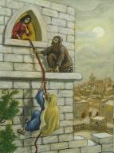
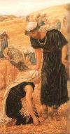
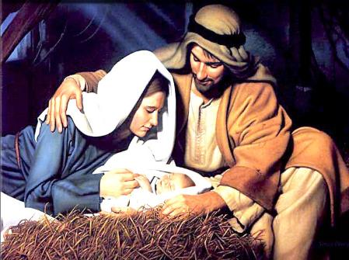
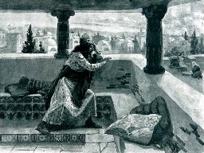
Law and Grace: Session 20
The Genealogy of Christ Matthew 1:1-17
Significant women are also named: Tamar, Rahab, Ruth, Bathsheba and Mary.

Slide 17
Law and Grace: Session 20
“…who is called the Messiah.” Matthew 1:16
At the very end of the genealogy in Matthew we see that Jesus is one “who is called the Messiah”.
Matthew 1:16
Jacob was the father of Joseph the husband of Mary, by whom Jesus was born, who is called the Messiah.

Slide 18
“…who is called the Messiah.” Matthew 1:16
Law and Grace: Session 20
This phrase should not be thought of as indicating that Jesus was merely called the Messiah, but He really wasn’t.
Matthew 1:16
Jacob was the father of Joseph the husband of Mary, by whom Jesus was born, who is called the Messiah.

Slide 19
“…who is called the Messiah.” Matthew 1:16
Law and Grace: Session 20
The words, “who is called”, in Israelite usage, means that a person is legitimately and genuinely called by that name (Isa. 43:7; 54:5 [used in Isaiah re: God]; Mat. 1:16; 10:2; Luke 1:61; John 4:25; 9:11; 11:16; Col. 4:11; Rev. 12:9).
Isaiah 43:7
Everyone who is called by My name,…
Isaiah 54:5
And your Redeemer is the Holy One of Israel, Who is called the God of all the earth.

Slide 20
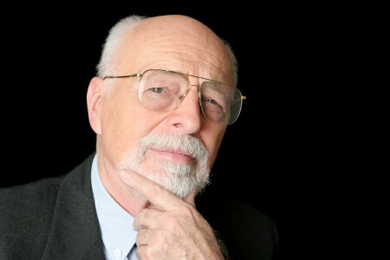
Christ’s two genealogies Matthew 1:1-17; Luke 3:23-38
Law and Grace: Session 20
Some critics of the Bible have said that the two genealogies of Christ are not at all consistent, but this is based on a misunderstanding.

Slide 21
Christ’s two genealogies Matthew 1:1-17; Luke 3:23-38
Law and Grace: Session 20
Matthew’s genealogy gives Joseph’s legal line of descent, proving that he descended not only from Abraham, the father of the Israelite nation, but also from David, the founder of Israel’s royal dynasty, through Solomon and Jechoniah.

Slide 22
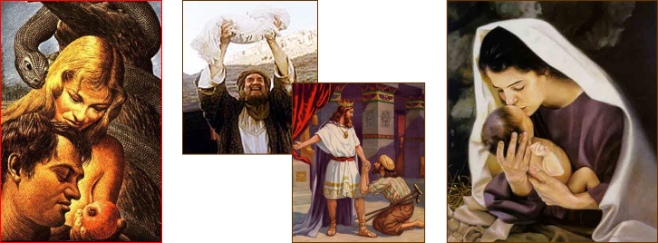
Christ’s two genealogies Matthew 1:1-17; Luke 3:23-38
Law and Grace: Session 20
Luke, on the other hand gives Mary’s legal line of descent, proving that she also descended not only from Abraham, the father of the Israelite nation, but also from David, the founder of Israel’s royal dynasty, through his son, Nathan.

Slide 23
Christ’s two genealogies Matthew 1:1-17; Luke 3:23-38
Law and Grace: Session 20
COMPARISON AND CONTRAST IN THE GOSPELS
Book / Gospel | Matthew | Mark | Luke | John
Audience | Jews | Specifically Romans | Hellenized Gentiles | All
Creature Symbol: Ezekiel chapter 1 & Revelation chapter 4 | Lion, as the Lion of Judah | Ox or Calf, as working | Man, Jesus as man | Eagle, Jesus’ deity

Slide 24
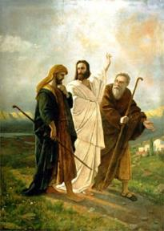
Law and Grace: Session 20
The Messiah Matthew 1:1-17
By double reference to King David in this genealogy, and by calling Jesus, ‘The Messiah’, Matthew points to the specific fulfillment of all the Old Testament prophecies of Jesus, who is ‘The Messiah’.

Slide 25
Law and Grace: Session 20
The Messiah Matthew 1:1-17
‘The Messiah’, who is ‘the Christ’, ‘The Anointed One’, is often ‘hidden in plain sight’ in many places in the New Testament. For example, Ephesians has, ‘The Christ’ 23 times throughout the book, beginning with 1:10.

Slide 26
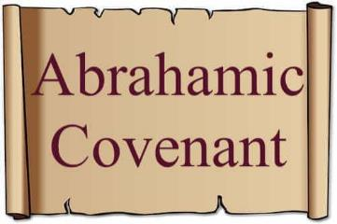
Ephesians 1:9-10
⁹ He made known to us the mystery of His will, according to His kind intention which He purposed in Him ¹⁰ with a view to an administration suitable to the fullness of the times, that is, the summing up of all things in the Christ…

Slide 27
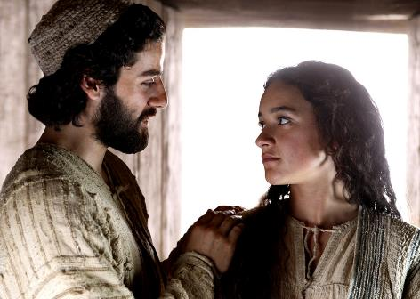
Law and Grace: Session 20
According to Jewish tradition Matthew 1:18-19
The betrothal and the ‘coming together’ only after marriage was all according to the Jewish law and traditions.

Slide 28
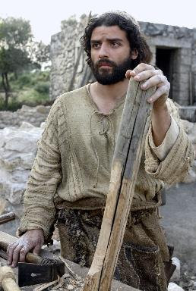
Law and Grace: Session 20
According to Jewish tradition Matthew 1:18-19
For Joseph to be righteous meant that he was observant of the Law of Moses and all of the traditions of Judaism.

Slide 29
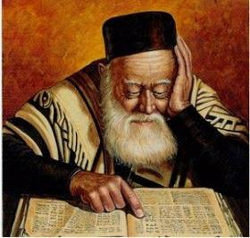
Law and Grace: Session 20
According to Jewish tradition Matthew 1:18-19
For Joseph to ‘send her away secretly’ meant that since she was pregnant before marriage, and he didn’t want to disgrace her, he would seek a divorce from the court of Rabbi Hillel, where they didn’t ask ‘why’ you wanted one.

Slide 30
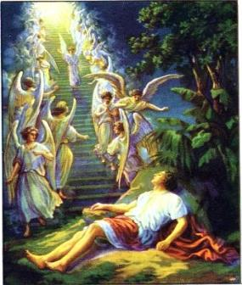
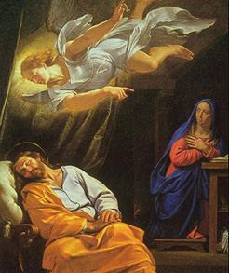
Law and Grace: Session 20
“Joseph, son of David…” Matthew 1:20
Somewhat like what happened to Jacob in Genesis 31:11, an angel appeared to Joseph just in time, in a dream, as happened to him twice again in Matthew 2:13, 19.

Slide 31
Matthew 1:20; 2:13, 19
²⁰ But when he had considered this, behold, an angel of the Lord appeared to him in a dream, saying, “Joseph, son of David, do not be afraid to take Mary as your wife; for the Child who has been conceived in her is of the Holy Spirit…^{2:13} Now when they had gone, behold, an angel of the Lord appeared to Joseph in a dream and said, “Get up! Take the Child and His mother and flee to Egypt, and remain there until I tell you; for Herod is going to search for the Child to destroy Him.”…^{2:19} But when Herod died, behold, an angel of the Lord appeared in a dream to Joseph in Egypt, and said, ²⁰ “Get up, take the Child and His mother, and go into the land of Israel; for those who sought the Child’s life are dead.”

Slide 32
Law and Grace: Session 20
“Joseph, son of David…” Matthew 1:20
The ‘angelic message pattern’ is:
Go ahead, it’s OK (don’t be afraid to take Mary as his wife because this birth is of the Holy Spirit Verses 18-20.)
Go away, fast!
Go back, it’s OK

Slide 33
Matthew 1:21-25
²¹ “She will bear a Son; and you shall call His name Jesus, [Savior] for He will save His people from their sins.” ²² Now all this took place to fulfill what was spoken by the Lord through the prophet: ²³ “Behold, the virgin shall be with child and shall bear a Son, and they shall call His name Immanuel,” which translated means, “God with us.” ²⁴ And Joseph awoke from his sleep and did as the angel of the Lord commanded him, and took Mary as his wife, ²⁵ but kept her a virgin until she gave birth to a Son; and he called His name Jesus [Savior].

Slide 34
Matthew 1:21-25
²¹ “She will bear a Son; and you shall call His name Jesus, for He will save His people from their sins.” ²² Now all this took place to fulfill what was spoken by the Lord through the prophet: ²³ “Behold, the virgin shall be with child and shall bear a Son, and they shall call His name Immanuel,” [Isaiah 7:14] which translated means, “God with us.” ²⁴ And Joseph awoke from his sleep and did as the angel of the Lord commanded him, and took Mary as his wife, ²⁵ but kept her a virgin until she gave birth to a Son; and he called His name Jesus.

Slide 35
Matthew 1:21-25
²¹ “She will bear a Son; and you shall call His name Jesus, for He will save His people from their sins.” ²² Now all this took place to fulfill what was spoken by the Lord through the prophet: ²³ “Behold, the virgin shall be with child and shall bear a Son, and they shall call His name Immanuel,” [Isaiah 7:14; 9:6, 7] which translated means, “God with us.” ²⁴ And Joseph awoke from his sleep and did as the angel of the Lord commanded him, and took Mary as his wife, ²⁵ but kept her a virgin until she gave birth to a Son; and he called His name Jesus.

Slide 36
Matthew 1:21-25
²¹ “She will bear a Son; and you shall call His name Jesus, for He will save His people from their sins.” ²² Now all this took place to fulfill what was spoken by the Lord through the prophet: ²³ “Behold, the virgin shall be with child and shall bear a Son, and they shall call His name Immanuel,” [Isaiah 7:14; 9:6, 7] which translated means, “God with us.” ²⁴ And Joseph awoke from his sleep and did as the angel of the Lord commanded him, and took Mary as his wife, ²⁵ but kept her a virgin [by Jewish tradition] until she gave birth to a Son; and he called His name Jesus.

Slide 37
Matthew 1:21-25
²¹ “She will bear a Son; and you shall call His name Jesus, for He will save His people from their sins.” ²² Now all this took place to fulfill what was spoken by the Lord through the prophet: ²³ “Behold, the virgin shall be with child and shall bear a Son, and they shall call His name Immanuel,” [Isaiah 7:14; 9:6, 7] which translated means, “God with us.” ²⁴ And Joseph awoke from his sleep and did as the angel of the Lord commanded him, and took Mary as his wife, ²⁵ but kept her a virgin [by Jewish tradition] until she gave birth to a Son; and he called His name Jesus.

Slide 38
Law and Grace: Session 20
Hebrew Speech patterns in Genesis
God & Hagar in Genesis 16:11
The angel of the Lord said to her further,
"Behold, you are with child,
and you will bear a son;
and you shall call his name Ishmael…
God & Abraham in Genesis 17:18-19
And Abraham said to God,
"Oh that Ishmael might live before You!"
19 But God said, "No, but
Sarah your wife will bear you a son,
and you shall call his name Isaac…

Slide 39
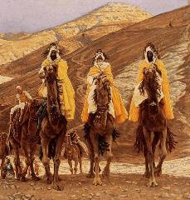
Law and Grace: Session 20
The Magi, Herod, & to Egypt & back Matthew 2:1-2:23
Matthew chapter 2 introduces the coming of the Magi, but ‘How did they know where to look for the King of the Jews?’
There is a clear series of Old Testament passages that could have directed the Magi.

Slide 40
Genesis 49:8-10
⁸ “Judah, your brothers shall praise you; Your hand shall be on the neck of your enemies; Your father’s sons shall bow down to you. ⁹ “Judah is a lion’s whelp; From the prey, my son, you have gone up. He couches, he lies down as a lion, And as a lion, who dares rouse him up? ¹⁰ “The scepter shall not depart from Judah, Nor the ruler’s staff from between his feet, Until Shiloh comes (literally - “until the one comes to whom it (the sceptre) belongs”), And to him shall be the obedience of the peoples.

Slide 41
Numbers 24:15-17
¹⁵ He took up his discourse and said, “The oracle of Balaam the son of Beor, And the oracle of the man whose eye is opened, ¹⁶ The oracle of him who hears the words of God, And knows the knowledge of the Most High, Who sees the vision of the Almighty, Falling down, yet having his eyes uncovered. ¹⁷ “I see him, but not now; I behold him, but not near; A star shall come forth from Jacob, A scepter shall rise from Israel, And shall crush through the forehead of Moab, And tear down all the sons of Sheth.

Slide 42
Psalm 45:6-7
⁶ Your throne, O God, is forever and ever; A scepter of uprightness is the scepter of Your kingdom. ⁷ You have loved righteousness and hated wickedness; Therefore God, Your God, has anointed You With the oil of joy above Your fellows.

Slide 43
Law and Grace: Session 20
The Magi, Herod, & to Egypt & back Matthew 2:1-2:23
The Magi, having likely received the prophecies of the Old Testament, first through Daniel (Dan. 5:11-12) and then through the other Jews living in the Babylonian and the Persian Empires, saw a special star which told them that the King of the Jews had been born!
The birth of Christ, as King of the Jews, had been prophesied for 18 centuries!

Slide 44
Law and Grace: Session 20
The Magi, Herod, & to Egypt & back Matthew 2:1-2:23
And then Joseph was directed by and angel to take Mary and Jesus to Egypt to flee Herod (2:13).
After Herod died in March/April of 4 BC, Joseph was then told by an angel return to Israel (2:19)
Finally, God warned Joseph not to return to Archelaus’ territory (Judea, Samaria, and Idumea), so they settled in Nazareth, Galilee. (2:22-23).

Slide 45
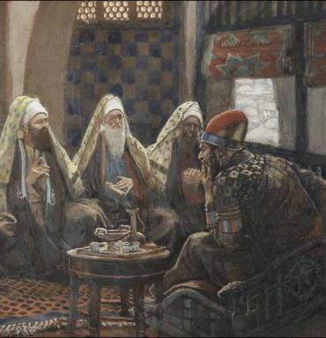
Law and Grace: Session 20
"Where is He who has been born King of the Jews? Matthew 2:1-2:23
This must have shaken Herod to his core. Herod had been given the title, “King of Judea” by the Roman Senate but Herod, an Idumean (Edomite) preferred the title, “King of the Jews!”

Slide 46
Session 20 Outline
Purpose, Aim, and Objective
The Gospel of Matthew
General Information
Comments and Commentary
Concluding Observations

Slide 47
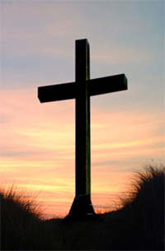
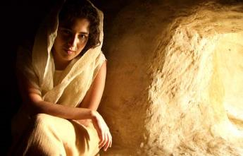
Law and Grace: Session 20
AT JESUS’ FIRST COMING…
He was born the King of the Jews, and came primarily to the Jews, as their Savior.

Slide 48
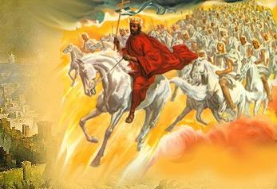
Law and Grace: Session 20
AT JESUS’ SECOND COMING…
He will come as King of the Jews and the King of Kings over the Gentiles.

Slide 49
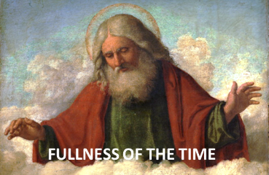
Galatians 4:4–5
⁴ But when the fullness of the time came, God sent forth His Son, born of a woman, born under the Law, ⁵ so that He might redeem those who were under the Law, that we might receive the adoption as sons.

Slide 50
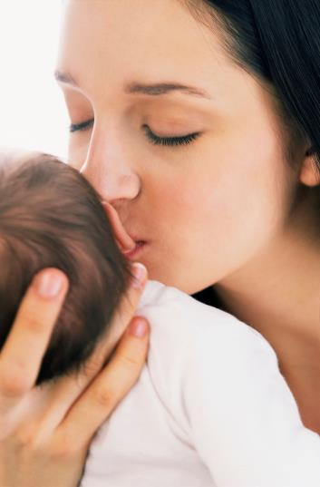
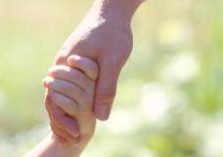
Law and Grace: Session 20
In our culture, when we think of adoption…

Slide 51
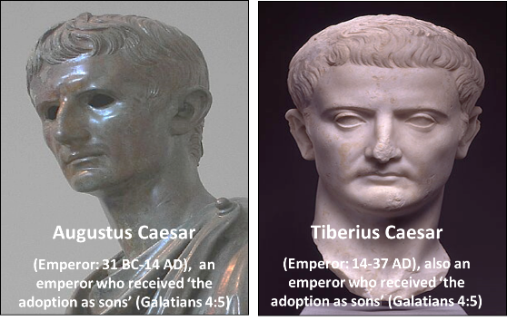
Law and Grace: Session 20
Adoption as sons
‘Adoption as sons’ was a new Roman legal process whereby a Roman Emperor would be assured of having an heir to the throne.

Slide 52
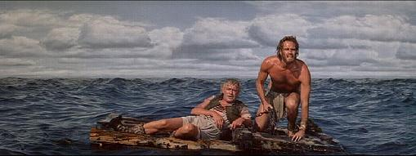
Law and Grace: Session 20
Adoption as sons
In the classic movie ‘Ben Hur’ based on the novel by Lew Wallace

Slide 53
Law and Grace: Session 20
Adoption as sons
Judah Ben Hur, the Jewish slave, rescues Roman General Quintus Arrius

Slide 54
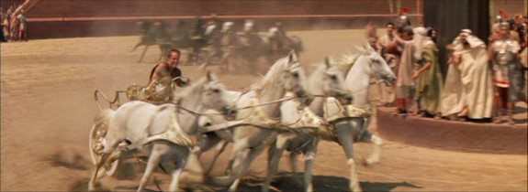
Law and Grace: Session 20
Adoption as sons
The grateful Roman General Quintus Arrius later adopted Judah Ben Hur as his son

Slide 55
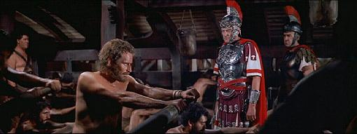
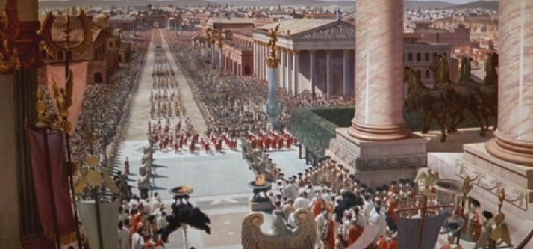
Law and Grace: Session 20
Adoption as sons
Judah Ben Hur went from being a slave, locked in chains and darkness…
…to having unrivaled wealth, power, and influence.

Slide 56
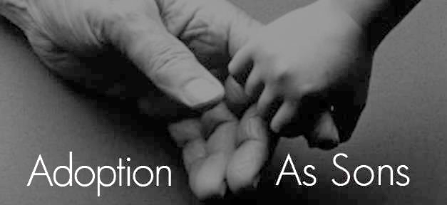
Law and Grace: Session 20
Key word in Galatians 4:5
adoption as sons (KJV: adoption of sons): The Greek word meant son position. If ever there was a statement of our position in Christ, this is it! (see also Ephesians 1:5 and Romans 8:15, 23, 24).

Slide 57
Ephesians 1:5
He predestined us to adoption as sons through Jesus Christ to Himself, according to the kind intention of His will,
Romans 8:15, 23, 24
¹⁵ For you have not received a spirit of slavery leading to fear again, but you have received a spirit of adoption as sons by which we cry out, “Abba! Father!”…²³ And not only this, but also we ourselves, having the first fruits of the Spirit, even we ourselves groan within ourselves, waiting eagerly for our adoption as sons, the redemption of our body. ²⁴ For in hope we have been saved, but hope that is seen is not hope; for who hopes for what he already sees?

Slide 58
Law and Grace: Session 20
Key word in Galatians 4:5
By Roman law the adopted son had a position far better than any natural-born son: a full heir, irreversible, and the adopted son was legally severed from any prior sonship (see Ephesians 2:2; 5:6 and Colossians 3:6).

Slide 59
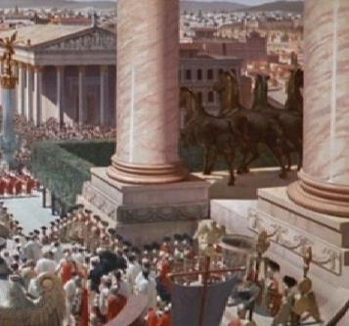
Law and Grace: Session 20
Consequences of adoption under Roman Law
The adopted son lost all rights in his old family and gained more rights than a fully legitimate son, in his new family.
He became an heir to his new father's estate, even if other sons were born afterwards.

Slide 60
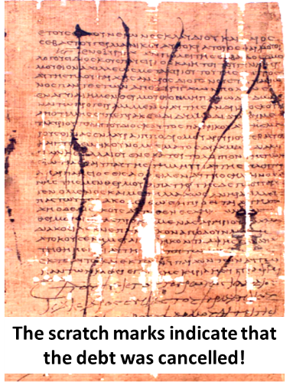
Law and Grace: Session 20
Consequences of adoption under Roman Law
The old life of the adopted son was completely wiped out, so that the adopted son was regarded as a new person entering into a new life.
Criminal Record

Slide 61
Law and Grace: Session 20
Consequences of adoption under Roman Law
The adopted son was literally and absolutely the son of his new father.

Slide 62
Law and Grace: Session 20
Consequences of our adoption!

Slide 63
Session 20 Outline
Purpose, Aim, and Objective
The Gospel of Matthew
General Information
Comments and Commentary
Concluding Observations

Slide 64
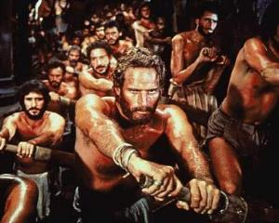
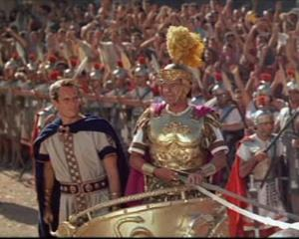
Galatians 4:4–5
⁴ But when the fullness of the time came, God sent forth His Son, born of a woman, born under the Law, ⁵ so that He might redeem those who were under the Law, that we might receive the adoption as sons.

Slide 65
Law and Grace: An Overview Jim McGowan, Th.D. Sugar Land Bible Church 02-10-2019
…but grace and truth were realized through Jesus Christ - John 1:17
For the Law was given through Moses…
Special thanks to Dr. Vern Peterman for access to his insights and resources.

