Slide 1
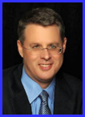
Dr. Andy Woods
Senior Pastor – Sugar Land Bible Church
President – Chafer Theological Seminary

Slide 3
Seven Trumpets (Revelation 8‒11)
1st Trumpet (8:7) – 1/3 vegetation destroyed
2nd Trumpet (8:8-9) – 1/3 ocean destroyed
3rd Trumpet (8:10-11) – 1/3 water destroyed
4th Trumpet (8:12-13) – 1/3 luminaries darkened
5th Trumpet (9:1-12) – Demons released
6th Trumpet (9:13-21) – 1/3 humanity destroyed
7th Trumpet (11:14-19) – Legal transfer announced

Slide 5
5 Non-Chronological Parenthetical Insertions
Rev 7 – 144,000 Jews
Rev 10:1-11:13 – Announcement of no more delay and the two witnesses
Rev 12-14 – Israel’s flight, two beasts, six scenes of hope
Rev 16:13-16 – Gathering of the nations to Armageddon
Rev 17:1-19:6 – Babylon’s fall

Slide 6
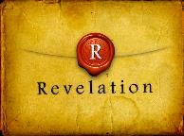
Revelation 11:15
“Then the seventh angel sounded; and there were loud voices in heaven, saying, ‘The kingdom of the world has become the kingdom of our Lord and of His Christ; and He will reign (basileuō) forever and ever.’” (cf. Matt. 6:10)

Slide 7
Revelation 12‒14
Rev 12 – Israel’s flight
Rev 13 – Two beasts
Rev 14 – Six scenes of hope

Slide 8
Revelation 12‒14
Rev 12 – Israel’s flight
Rev 13 – Two beasts
Rev 14 – Six scenes of hope

Slide 9
Revelation 12‒14
Rev 12 – Israel’s flight
Rev 13 – Two beasts
Rev 14 – Six scenes of hope

Slide 10
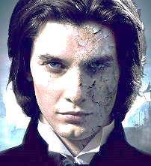
Two Beasts (Revelation 13)
First beast (13:1-10)
Second beast (13:11-18)

Slide 11
Revelation 12‒14
Rev 12 – Israel’s flight
Rev 13 – Two beasts
Rev 14 – Six scenes of hope

Slide 12
C. Six Scenes of Hope Revelation 14:1-20
The Destiny of the 144,000 (1-5)
The Proclamation of the Eternal Gospel (6-7)
The Prediction of the Destruction of Babylon (8)
The Doom of the Beast’s Worshippers (9-12)
The Blessing Upon the Tribulation’s Martyrs (13)
The Judgement Harvest of Armageddon (14-16)

Slide 13
C. Six Scenes of Hope Revelation 14:1-20
The Destiny of the 144,000 (1-5)
The Proclamation of the Eternal Gospel (6-7)
The Prediction of the Destruction of Babylon (8)
The Doom of the Beast’s Worshippers (9-12)
The Blessing Upon the Tribulation’s Martyrs (13)
The Judgement Harvest of Armageddon (14-16)

Slide 14
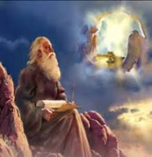
1. The Destiny of the 144,000 (Revelation 14:1-5)
Their Appearance (1)
Their Song (2-3)
Their Sanctification (4-5)

Slide 15
1. The Destiny of the 144,000 (Revelation 14:1-5)
Their Appearance (1)
Their Song (2-3)
Their Sanctification (4-5)

Slide 16
Distinctions Between 144,000 & Multitude
144,000 | MULTITUDE
Revelation 7:1-8 | Revelation 7:9-17
Numbered | Innumerable
Jews | All nations
Sealed | Slain
Sealed before the Tribulation | Converted out of the Tribulation
Hitchcock and Ice, The Truth Behind Left Behind, 77

Slide 17
1. The Destiny of the 144,000 (Revelation 14:1-5)
Their Appearance (1)
Their Song (2-3)
Their Sanctification (4-5)

Slide 18
1. The Destiny of the 144,000 (Revelation 14:1-5)
Their Appearance (1)
Their Song (2-3)
Their Sanctification (4-5)

Slide 19
C. Their Sanctification (Revelation 14:4-5)
Their virginity (4a)
Their loyalty (4b)
Their redemption (4c)
Their integrity (5a)
Their innocence (5b)

Slide 20
C. Their Sanctification (Revelation 14:4-5)
Their virginity (4a)
Their loyalty (4b)
Their redemption (4c)
Their integrity (5a)
Their innocence (5b)

Slide 21
C. Their Sanctification (Revelation 14:4-5)
Their virginity (4a)
Their loyalty (4b)
Their redemption (4c)
Their integrity (5a)
Their innocence (5b)

Slide 22
JUSTIFICATION – SALVATION | DISCIPLESHIP
FREE GIFT | COSTLY
RECEIVED THROUGH FAITH | ENTERED INTO THROUGH COMMITMENT AND OBEDIENCE THROUGH THE SPIRIT’S ENABLEMENT
NOT BY WORKS | INVOLVES OUR COOPERATION
INSTANT | LIFE-LONG PROCESS
JUSTIFICATION | SANCTIFICATION
JESUS PAID THE PRICE | BELIEVER PAYS THE PRICE
TRUSTING JESUS AS SAVIOR | FOLLOWING JESUS AS LORD
BELIEVE THE GOSPEL | OBEY THE COMMANDS
ONE CONDITION | MULTIPLE CONDITIONS
EXPERIENCED BY ALL CHRISTIANS | EXPERIENCED BY SOME CHRISTIANS
RESULTS IN ETERNAL LIFE | RESULTS IN REWARDS & AUTHORITY
Adapted from http://www.gracelife.org/resources/gracenotes.asp?id=23

Slide 23
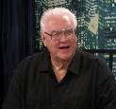
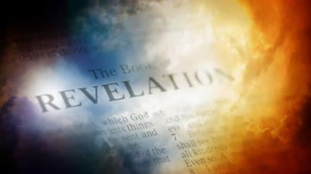
David Hocking
David Hocking, The Book of Revelation: Understanding the Future (Tustin, CA: Hope For Today Publications, 2014), 437.
“They are willing to go anywhere the Lord wanted them to go and to do whatever He wanted them to do. What marvelous examples they are to all of us who seek to follow our Lord Jesus Christ!”

Slide 24
C. Their Sanctification (Revelation 14:4-5)
Their virginity (4a)
Their loyalty (4b)
Their redemption (4c)
Their integrity (5a)
Their innocence (5b)

Slide 25
Distinctions Between 144,000 & Multitude
144,000 | MULTITUDE
Revelation 7:1-8 | Revelation 7:9-17
Numbered | Innumerable
Jews | All nations
Sealed | Slain
Sealed before the Tribulation | Converted out of the Tribulation
Hitchcock and Ice, The Truth Behind Left Behind, 77

Slide 26
C. Their Sanctification (Revelation 14:4-5)
Their virginity (4a)
Their loyalty (4b)
Their redemption (4c)
Their integrity (5a)
Their innocence (5b)

Slide 27
C. Their Sanctification (Revelation 14:4-5)
Their virginity (4a)
Their loyalty (4b)
Their redemption (4c)
Their integrity (5a)
Their innocence (5b)

Slide 28
C. Six Scenes of Hope Revelation 14:1-20
The Destiny of the 144,000 (1-5)
The Proclamation of the Eternal Gospel (6-7)
The Prediction of the Destruction of Babylon (8)
The Doom of the Beast’s Worshippers (9-12)
The Blessing Upon the Tribulation’s Martyrs (13)
The Judgement Harvest of Armageddon (14-16)

Slide 29
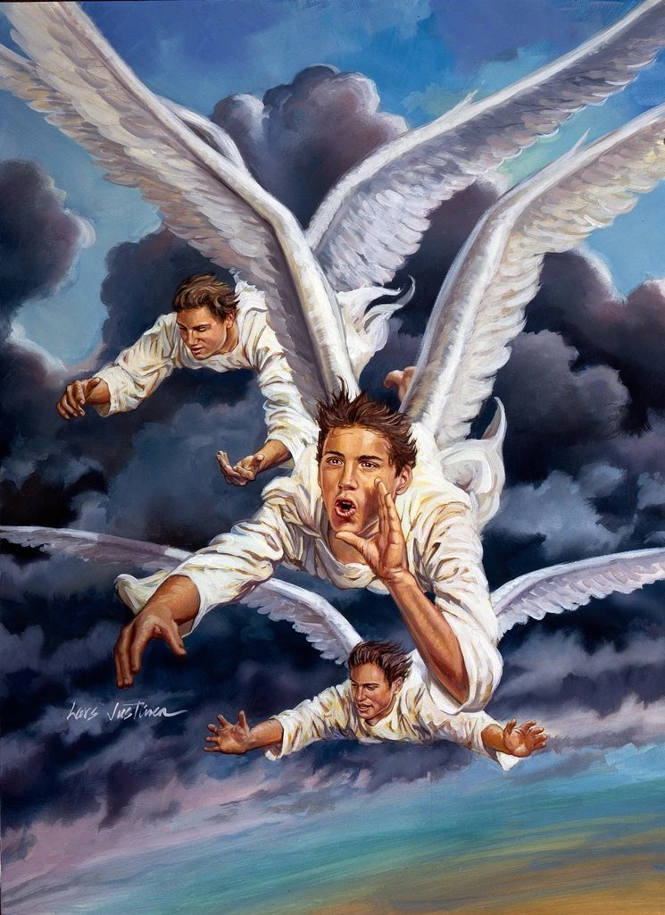
2. The Proclamation of the Eternal Gospel (Revelation 14:6-7)
Its proclamation (6)
Its emphasis (7)

Slide 30
2. The Proclamation of the Eternal Gospel (Revelation 14:6-7)
Its proclamation (6)
Its emphasis (7)

Slide 31
A. Its Proclamation (Revelation 14:6)
Its Eternality (6a)
Its Proclaimer & Audience (6b)
Its Universality (6c)

Slide 32
A. Its Proclamation (Revelation 14:6)
Its Eternality (6a)
Its Proclaimer & Audience (6b)
Its Universality (6c)

Slide 33
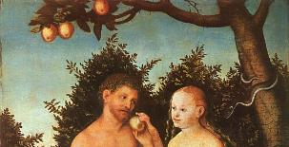
Genesis 3:15
“And I will put enmity between you and the woman, and between your seed and her seed; He shall bruise you on the head, and you shall bruise him on the heel.”

Slide 34
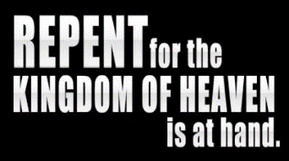
Matthew 3:1-2
“Now in those days John the Baptist came, preaching in the wilderness of Judea, saying, ‘Repent, for the kingdom of heaven is at hand (engizō).’”

Slide 35
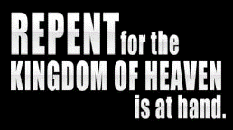
Matthew 10:5-7
“These twelve Jesus sent out after instructing them: “Do not go in the way of the Gentiles, and do not enter any city of the Samaritans; 6 but rather go to the lost sheep of the house of Israel. ⁷ And as you go, preach, saying, ‘The kingdom of heaven is at hand (engizō).’”

Slide 36
Messengers of the Kingdom In Matthew
John the Baptist – 3:2
Jesus Christ – 4:17
12 Apostles – 10:5-7
Seventy – Luke 10:1, 9
Toussaint, Behold the King, 18-20

Slide 37
Matthew Outline
Pedigree of the king (1–2)
Preparation of the king (3–4)
Pedagogy of the king (5–7)
Power of the king (8–9)
Program of the king (10)
Progressive rejection of the king (11–12)
Preparation of the king’s disciples (13–20)
Presentation & rejection of the king (21–23)
Prophecies of the king (24–25)
Passion of the king (26–27)
Proof of the king (28)

Slide 38
Matthew Outline
Pedigree of the king (1–2)
Preparation of the king (3–4)
Pedagogy of the king (5–7)
Power of the king (8–9)
Program of the king (10)
Progressive rejection of the king (11–12)
Preparation of the king’s disciples (13–20)
Presentation & rejection of the king (21–23)
Prophecies of the king (24–25)
Passion of the king (26–27)
Proof of the king (28)

Slide 39
Matthew 24:14
“This gospel of the kingdom shall be preached in the whole world as a testimony to all the nations, and then the end will come.”

Slide 40
A. Its Proclamation (Revelation 14:6)
Its Eternality (6a)
Its Proclaimer & Audience (6b)
Its Universality (6c)

Slide 41
A. Its Proclamation (Revelation 14:6)
Its Eternality (6a)
Its Proclaimer & Audience (6b)
Its Universality (6c)

Slide 42
2. The Proclamation of the Eternal Gospel (Revelation 14:6-7)
Its proclamation (6)
Its emphasis (7)

Slide 43
B. Its Emphasis (Revelation 14:7)
Fear God (7a)
Glorify God (7b)
Worship God (7c)

Slide 44
B. Its Emphasis (Revelation 14:7)
Fear God (7a)
Glorify God (7b)
Worship God (7c)

Slide 45
B. Its Emphasis (Revelation 14:7)
Fear God (7a)
Glorify God (7b)
Worship God (7c)

Slide 46
B. Its Emphasis (Revelation 14:7)
Fear God (7a)
Glorify God (7b)
Worship God (7c)

Slide 47
David Hocking
David Hocking, The Book of Revelation: Understanding the Future (Tustin, CA: Hope For Today Publications, 2014), 390.
“The number one priority of every believer should be the worship and praise of Almighty God. We were created to worship the God who made us. The action of falling down on their faces demonstrates a clear understanding of God‘s greatness and the believer’s humility before God.”

Slide 48
Seven Trumpets (Revelation 8‒11)
1st Trumpet (8:7) – 1/3 vegetation destroyed
2nd Trumpet (8:8-9) – 1/3 ocean destroyed
3rd Trumpet (8:10-11) – 1/3 water destroyed
4th Trumpet (8:12-13) – 1/3 luminaries darkened
5th Trumpet (9:1-12) – Demons released
6th Trumpet (9:13-21) – 1/3 humanity destroyed
7th Trumpet (11:14-19) – Legal transfer announced

Slide 49
C. Six Scenes of Hope Revelation 14:1-20
The Destiny of the 144,000 (1-5)
The Proclamation of the Eternal Gospel (6-7)
The Prediction of the Destruction of Babylon (8)
The Doom of the Beast’s Worshippers (9-12)
The Blessing Upon the Tribulation’s Martyrs (13)
The Judgement Harvest of Armageddon (14-16)

Slide 50
5 Non-Chronological Parenthetical Insertions
Rev 7 – 144,000 Jews
Rev 10:1-11:13 – Announcement of no more delay and the two witnesses
Rev 12-14 – Israel’s flight, two beasts, six scenes of hope
Rev 16:13-16 – Gathering of the nations to Armageddon
Rev 17:1-19:6 – Babylon’s fall

Slide 51
Literal Geography in Revelation
Asia | 1:4 | Philadelphia | 3:7
Ephesus | 2:1 | Laodicea | 3:14
Smyrna | 2:8 | Euphrates | 9:14;16:12
Pergamum | 2:12 | Jerusalem | 11:8
Thyatira | 2:18 | Armageddon | 16:16
Sardis | 3:1 | Jerusalem | 20:9

Slide 52
John F. Walvoord John F. Walvoord, The Revelation of Jesus Christ: A Commentary (Chicago: Moody, 1966), 257, 263.
“The city here according to verse 5 is a mystery, not a literal city...The ultimate decision depends upon the judgment of the expositor, but in many respects it is simpler to postulate a rebuilt Babylon as fulfilling literally the Old Testament prophecies as well as that embodied in this chapter.”

Slide 53
C. Six Scenes of Hope Revelation 14:1-20
The Destiny of the 144,000 (1-5)
The Proclamation of the Eternal Gospel (6-7)
The Prediction of the Destruction of Babylon (8)
The Doom of the Beast’s Worshippers (9-12)
The Blessing Upon the Tribulation’s Martyrs (13)
The Judgement Harvest of Armageddon (14-16)

Slide 54
4. The Doom of the Beast’s Worshippers (Revelation 14:9-12)
The Plea (9)
The Punishment (10-11)
The Perseverance (12)

Slide 55
4. The Doom of the Beast’s Worshippers (Revelation 14:9-12)
The Plea (9)
The Punishment (10-11)
The Perseverance (12)

Slide 56
4. The Doom of the Beast’s Worshippers (Revelation 14:9-12)
The Plea (9)
The Punishment (10-11)
The Perseverance (12)

Slide 57
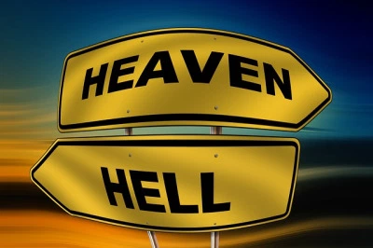
Daniel 12:2
“Many of those who sleep in the dust of the ground will awake, these to everlasting (olam) life, but the others to disgrace and everlasting (olam) contempt.”

Slide 58
Psalm 90:2
“Before the mountains were born Or You gave birth to the earth and the world, Even from everlasting (olam) to everlasting (olam), You are God.”

Slide 59
Matthew 25:46
“These will go away into eternal (aiōnios) punishment (kolasis), but the righteous into eternal life.

Slide 60
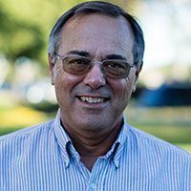
Dr. Alan W. Gomes (Summer 1991). “Evangelicals and the Annihilation of Hell” (Part 2). In the Christian Research Journal. Page 11.
“A punishment [such as torment] that is not felt is not a punishment. It is an odd use of language to speak of an insensate state (i.e., unfeeling), an inanimate object receiving punishment. To say, ‘I punished my car for not starting by slowly plucking out it’s spark plug wires, one by one,’ would invoke laughter, not serious consideration.”

Slide 61
Matthew 25:46
“These will go away into eternal (aiōnios) punishment, but the righteous into eternal (aiōnios) life.

Slide 62
Romans 16:26
“but now is manifested, and by the Scriptures of the prophets, according to the commandment of the eternal (aiōnios) God, has been made known to all the nations, leading to obedience of faith

Slide 63
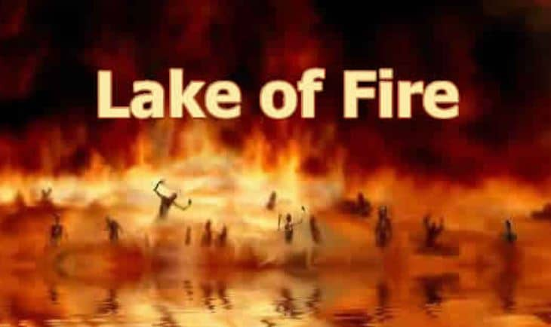
Revelation 20:10
“And the devil who deceived them was thrown into the lake of fire and brimstone, where the beast and the false prophet are also; and they will be tormented day and night forever (aiōn) and ever (aiōn).”

Slide 64
Revelation 14:11
“And the smoke of their torment goes up forever (aiōn) and ever (aiōn); they have no rest day and night, those who worship the beast and his image, and whoever receives the mark of his name.”

Slide 65
Dominoes in a Row

Slide 66
4. The Doom of the Beast’s Worshippers (Revelation 14:9-12)
The Plea (9)
The Punishment (10-11)
The Perseverance (12)

Slide 67
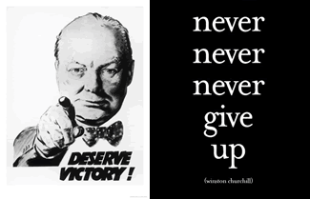
Matthew 24:13
“But the one who endures to the end, he will be saved.”

Slide 68
Revelation 1:19
“Therefore write the things which you have seen, and the things which are, and the things which will take place after these things [meta tauta].”

Slide 69
Revelation 1:19
Seen (Chapter 1)
Are (Chapters 2–3)
After these things (Chapters 4–22)

Slide 70
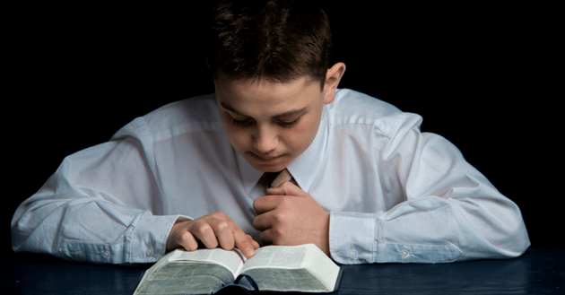
Psalm 50:5 (NKJV)
“Gather My saints together to Me, Those who have made a covenant with Me by sacrifice.”

Slide 71
Psalm 149:1 (NKJV)
“Praise the Lord! Sing to the Lord a new song, And His praise in the assembly of saints.”

Slide 72
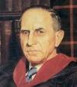
John Murray
Redemption Accomplished and Applied, pp. 152, 154-55.
“The crucial test of true faith is endurance to the end, abiding in Christ, and continuance in the Word…He cannot abandon himself to sin; he cannot come under the domination of sin; he cannot be guilty of certain kinds of unfaithfulness…Let us appreciate the doctrine of the perseverance of the saints and recognize that we may entertain the faith of our security in Christ only as we persevere in faith and holiness to the end.”

Slide 73
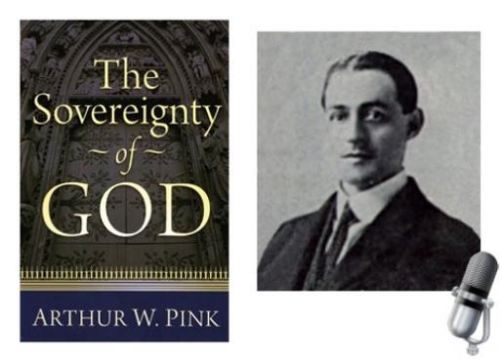
A. W. Pink
Practical Christianity, p. 16.
“Readers, if there is a reserve in your obedience, you are on your way to hell.”

Slide 74
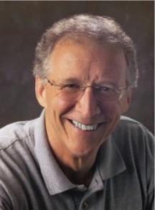
John Piper
John Piper and Pastoral Staff, TULIP: What We Believe about the Five Points of Calvinism: Position Paper of the Pastoral Staff (Desiring God Ministries, 1997), 25, cited in Dave Hunt, What Love is This?, 379.
“No Christian can be sure that he is a true believer. Hence, there is an ongoing need to be dedicated to the Lord and to deny ourselves so that we might make it.”

Slide 75
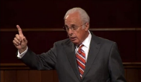
John MacArthur
Saved Without A Doubt, p. 177
“If a person fails to love and obey the Lord through the trials of life, then there is no evidence that he possesses saving faith. How many people do you know who came to church for a while, had a little trouble in their lives, and left? Although they may have made a profession of faith in Christ, they cannot be identified as those who love Him because their lives are not characterized by enduring obedience.”

Slide 76
R.C. Sproul – Bob Wilkin as quoted in:
http://www.gracebiblestudies.org/Resources/Web/www.duluthbible.org/g_f_j/EternalSecurity12.htm
“During the first message presented at Ligonier’s Conference in Orlando last June, Dr. R. C. Sproul indicated that Dr. James Boice, a scheduled speaker at the conference, was dying in faith that very night. Then at the end of the message he asked all 5,000 of us present to pray that Jim dies in faith. This struck me as sad. Here was a great pastor, theologian, teacher, and author. Yet Sproul was not sure that he was regenerate. (In Reformed thought, if a person fails to die in faith, he proved he was never saved in the first place.) I was reminded of R.T. Kendall’s remark that nearly to a man the Puritan divines died doubting whether they were saved and fearing they were going to hell. Dr. Boice died that very night, June 15th.”

Slide 77
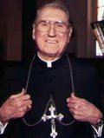
Cardinal John O’Connor of NY
quoted in Samuel Howe Verhovek, Cardinal Defends a Jailed Bishop Who Warned Cuomo on Abortion, New York Times, February 1, 1990.
“Church teaching is that I don't know, at any given moment, what my eternal future will be… I can hope, pray, do my very best – but I still don't know. Pope John II doesn't absolutely know that he will go to heaven, nor does mother Theresa of Calcutta, unless either has had a special divine revelation.”

Slide 78
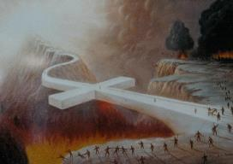
John 5:24
“Truly, truly, I say to you, he who hears My word, and believes Him who sent Me, has eternal life, and does not come into judgment, but has passed out of death into life.”

Slide 79
1 John 5:13
“These things I have written to you who believe in the name of the Son of God, so that you may know that you have eternal life.”

Slide 80
C. Six Scenes of Hope Revelation 14:1-20
The Destiny of the 144,000 (1-5)
The Proclamation of the Eternal Gospel (6-7)
The Prediction of the Destruction of Babylon (8)
The Doom of the Beast’s Worshippers (9-12)
The Blessing Upon the Tribulation’s Martyrs (13)
The Judgement Harvest of Armageddon (14-16)

Slide 81
5. The Blessing Upon the Tribulation Martyrs (Revelation 14:13)
Their Beatitude (13a)
Their Rest (13b)
Their Reward (13c)

Slide 82
5. The Blessing Upon the Tribulation Martyrs (Revelation 14:13)
Their Beatitude (13a)
Their Rest (13b)
Their Reward (13c)

Slide 83
Seven Beatitudes of Revelation: “Blessed” (makarios)
Blessing upon the reader & heeder of Revelation (1:3)
Blessing upon the Tribulation martyrs (14:13)
Blessing upon the spiritually prepared (16:15)
Blessing upon the Marriage Supper invitees (19:9)
Blessing upon the First Resurrection’s participants (20:6)
Blessing upon the heeder of Revelation (22:7)
Blessing upon the eternal city’s citizens (22:14)
John F. Walvoord, "Revelation," in Bible Knowledge Commentary, ed. John F. Walvoord and Roy B. Zuck (Colorado Springs, CO: Victor, 1983), 929

Slide 84
Seven Beatitudes of Revelation: “Blessed” (makarios)
Blessing upon the reader & heeder of Revelation (1:3)
Blessing upon the Tribulation martyrs (14:13)
Blessing upon the spiritually prepared (16:15)
Blessing upon the Marriage Supper invitees (19:9)
Blessing upon the First Resurrection’s participants (20:6)
Blessing upon the heeder of Revelation (22:7)
Blessing upon the eternal city’s citizens (22:14)
John F. Walvoord, "Revelation," in Bible Knowledge Commentary, ed. John F. Walvoord and Roy B. Zuck (Colorado Springs, CO: Victor, 1983), 929

Slide 85
5. The Blessing Upon the Tribulation Martyrs (Revelation 14:13)
Their Beatitude (13a)
Their Rest (13b)
Their Reward (13c)

Slide 86
5. The Blessing Upon the Tribulation Martyrs (Revelation 14:13)
Their Beatitude (13a)
Their Rest (13b)
Their Reward (13c)

Slide 87
Scripture’s Five Crowns (Rev 4:10: 3:11; 2 John 8)
SCRIPTURE | CROWN | PURPOSE
1 Cor. 9:24-27 | Incorruptible | Gaining mastery over the flesh
1 Thess. 2:19-20 | Rejoicing | Soul winning
Jas. 1:12; Rev. 2:10 | Life | Enduring trials
1 Pet. 5:2-4 | Glory | Shepherding God’s people
2 Tim. 4:8 | Righteousness | Longing for His appearing

Slide 88
C. Six Scenes of Hope Revelation 14:1-20
The Destiny of the 144,000 (1-5)
The Proclamation of the Eternal Gospel (6-7)
The Prediction of the Destruction of Babylon (8)
The Doom of the Beast’s Worshippers (9-12)
The Blessing Upon the Tribulation’s Martyrs (13)
The Judgement Harvest of Armageddon (14-16)

Slide 89
6. The Armageddon Judgment Harvest (Revelation 14:14-20)
The Judge (14-18a)
The Judged (18b)
The Judgment (19-20)

Slide 90
6. The Armageddon Judgment Harvest (Revelation 14:14-20)
The Judge (14-18a)
The Judged (18b)
The Judgment (19-20)

Slide 91
A. The Judge (Revelation 14:14-18a)
The Son of Man (14)
The First Angel (15-16)
The Second Angel (17)
The Third Angel (18a)

Slide 92
A. The Judge (Revelation 14:14-18a)
The Son of Man (14)
The First Angel (15-16)
The Second Angel (17)
The Third Angel (18a)

Slide 93
A. The Judge (Revelation 14:14-18a)
The Son of Man (14)
The First Angel (15-16)
The Second Angel (17)
The Third Angel (18a)

Slide 94
A. The Judge (Revelation 14:14-18a)
The Son of Man (14)
The First Angel (15-16)
The Second Angel (17)
The Third Angel (18a)

Slide 95
A. The Judge (Revelation 14:14-18a)
The Son of Man (14)
The First Angel (15-16)
The Second Angel (17)
The Third Angel (18a)

Slide 96
6. The Armageddon Judgment Harvest (Revelation 14:14-20)
The Judge (14-18a)
The Judged (18b)
The Judgment (19-20)

Slide 97
6. The Armageddon Judgment Harvest (Revelation 14:14-20)
The Judge (14-18a)
The Judged (18b)
The Judgment (19-20)

Slide 99
C. The Judgment (Revelation 14:19-20)
Figurative language (19)
Plain language (20)

Slide 100
C. The Judgment (Revelation 14:19-20)
Figurative language (19)
Plain language (20)

Slide 101
C. The Judgment (Revelation 14:19-20)
Figurative language (19)
Plain language (20)

Slide 102
Conclusion

Slide 103
C. Six Scenes of Hope Revelation 14:1-20
The Destiny of the 144,000 (1-5)
The Proclamation of the Eternal Gospel (6-7)
The Prediction of the Destruction of Babylon (8)
The Doom of the Beast’s Worshippers (9-12)
The Blessing Upon the Tribulation’s Martyrs (13)
The Judgement Harvest of Armageddon (14-16)

Slide 104
“The Lord bless you and keep you; the Lord make his face shine on you and be gracious to you; the Lord turn his face toward you and give you peace.” (NIV)

