Slide 1
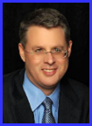
Dr. Andy Woods
Senior Pastor – Sugar Land Bible Church
President – Chafer Theological Seminary

Slide 3
Seven Trumpets (Revelation 8‒11)
1st Trumpet (8:7) – 1/3 vegetation destroyed
2nd Trumpet (8:8-9) – 1/3 ocean destroyed
3rd Trumpet (8:10-11) – 1/3 water destroyed
4th Trumpet (8:12-13) – 1/3 luminaries darkened
5th Trumpet (9:1-12) – Demons released
6th Trumpet (9:13-21) – 1/3 humanity destroyed
7th Trumpet (11:14-19) – Legal transfer announced

Slide 5
5 Non-Chronological Parenthetical Insertions
Rev 7 – 144,000 Jews
Rev 10:1-11:13 – Announcement of no more delay and the two witnesses
Rev 12-14 – Israel’s flight, two beasts, six scenes of hope
Rev 16:13-16 – Gathering of the nations to Armageddon
Rev 17:1-19:6 – Babylon’s fall

Slide 6
Revelation 11:15
“Then the seventh angel sounded; and there were loud voices in heaven, saying, ‘The kingdom of the world has become the kingdom of our Lord and of His Christ; and He will reign (basileuō) forever and ever.’” (cf. Matt. 6:10)

Slide 7
Revelation 12‒14
Rev 12 – Israel’s flight
Rev 13 – Two beasts
Rev 14 – Six scenes of hope

Slide 8
Revelation 12‒14
Rev 12 – Israel’s flight
Rev 13 – Two beasts
Rev 14 – Six scenes of hope

Slide 9
Revelation 12‒14
Rev 12 – Israel’s flight
Rev 13 – Two beasts
Rev 14 – Six scenes of hope

Slide 10
Two Beasts (Revelation 13)
First beast (13:1-10)
Second beast (13:11-18)

Slide 11
Two Beasts (Revelation 13)
First beast (13:1-10)
Second beast (13:11-18)

Slide 12
Two Beasts (Revelation 13)
First beast (13:1-10)
Second beast (13:11-18)

Slide 13
The Second Beast Revelation 13:11-18
His ethnic identity (11a)
His character (11b)
His purpose (12)
His miracles (13)
His deception (14a)
His image-statue (14b-15)
His economic system (16-18)

Slide 14
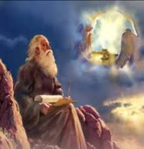
7. His Economic System (Revelation 13:16-18)
Global economy (16a)
Global numbering (16b-17)
The Beast’s number (18)

Slide 15
7. His Economic System (Revelation 13:16-18)
Global economy (16a)
Global numbering (16b-17)
The Beast’s number (18)

Slide 16
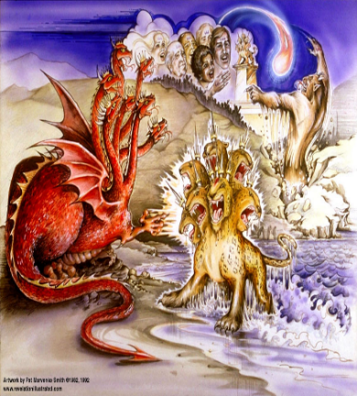
Satan’s Goal of Globalism
Dan. 7:23
Rev. 13:7-8; Rev. 5:9
Rev. 13:16-18
Rev. 17:15
Notes:
That’s good enough

Slide 17
Matthew 16:1-3
¹ The Pharisees and Sadducees came up, and testing Jesus, they asked Him to show them a sign from heaven. ² But He replied to them, “When it is evening, you say, ‘It will be fair weather, for the sky is red.’ ³ And in the morning, ‘There will be a storm today, for the sky is red and threatening.’ Do you know how to discern the appearance of the sky, but cannot discern the signs of the times?”

Slide 20
A Global Currency
"I think the dollar is now under question and I think the system will need to be reformed, so that the United States will be subject to the same discipline as is imposed on other countries….In the long run, having an international accounting unit rather than the dollar may, in fact, be to our advantage..."
Jennifer Ablan and Daniel Burns, "Soros Says U.S. Faces 'Lasting Slowdown,'" online: http://www.reuters.com/article/us-usa-economy-soros-exclusive-idUSTRE53537D20090406 , April 6 2009, accessed 21 January 2016.

Slide 21
7. His Economic System (Revelation 13:16-18)
Global economy (16a)
Global numbering (16b-17)
The Beast’s number (18)

Slide 22
Ezekiel 28:13, 15
“¹³ You were in Eden, the garden of God; Every precious stone was your covering: The ruby, the topaz and the diamond; The beryl, the onyx and the jasper; The lapis lazuli, the turquoise and the emerald; And the gold, the workmanship of your settings and sockets, Was in you. On the day that you were created They were prepared… ¹⁵ You were blameless in your ways From the day you were created Until unrighteousness was found in you.”

Slide 23
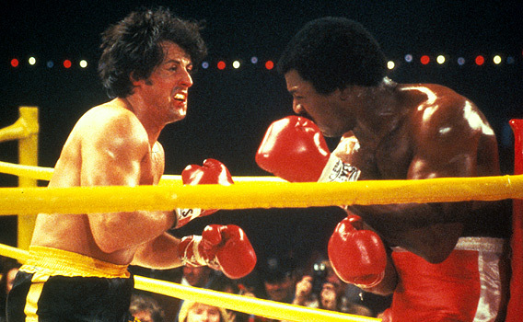

Slide 24
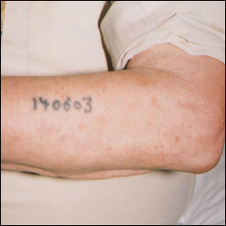
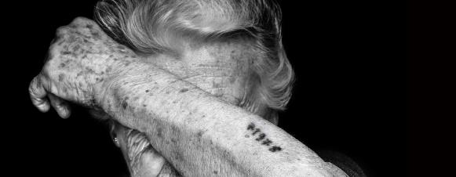
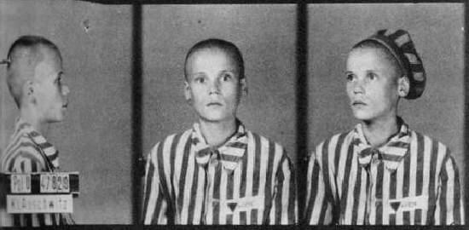

Slide 25
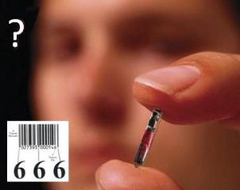
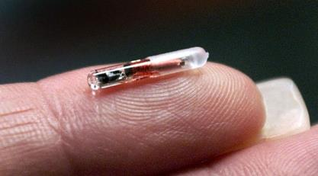
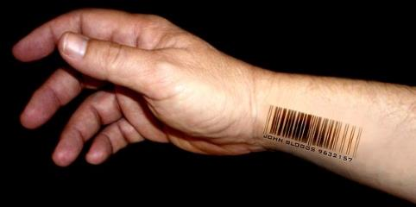

Slide 26
Wisconsin Company to Implant
Microchips In Employees
Josh Rosenthal of 5 Eyewitness ABC News - July 24, 2017
“A Wisconsin company is about to become the first in the U.S. to offer microchip implants to its employees. Yes, you read that right. Microchip implants. ‘It's the next thing that's inevitably going to happen, and we want to be a part of it,’ Three Square Market Chief Executive Officer Todd Westby said. The company designs software for break room markets that are commonly found in office complexes. Just as people are able to purchase items at the market using phones, Westby wants to do the same thing using a microchip implanted inside a person's hand. ‘We'll come up, scan the item,’ he explained, while . . .

Slide 27
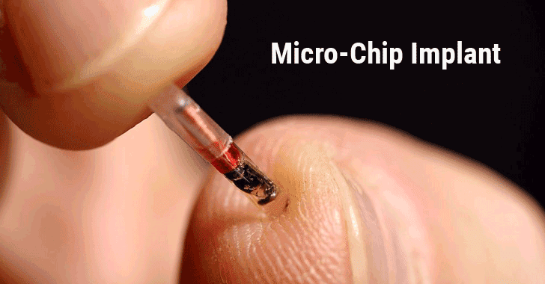
Wisconsin Company to Implant
Microchips In Employees (cont’d)
Josh Rosenthal of 5 Eyewitness ABC News - July 24, 2017
. . . showing how the process will work at an actual break room market kiosk. ‘We'll hit pay with a credit card, and it's asking to swipe my proximity payment now. I'll hold my hand up, just like my cell phone, and it'll pay for my product.’”
http://kstp.com/news/wisconsin-company-to-implant-microchips-in-employees-three-square-market/4549459/

Slide 28
Swedish Commuters Can Use
Futuristic Microchip Hand Implant:
The future is here – a Swedish rail company is trialing letting passengers use biometric chips as tickets Helen Coffey of The Independent - June 16, 2017
“Gone are the days when an e-ticket was seen as cutting edge – one Swedish rail company is offering passengers the option of using a biometric chip implanted into their hand in lieu of a paper train ticket…The tiny chip has the same technology as Oyster cards and contactless bank cards…to enable conductors to scan passengers’ hands…Around 2,000 Swedes have had the surgical implant to date, most of them employed in the tech industry.”
http://www.independent.co.uk/travel/news-and-advice/sj-rail-train-tickets-hand-implant-microchip-biometric-sweden-a7793641.html

Slide 29
Revelation 13:16
“And he causes all, the small and the great, and the rich and the poor, and the free men and the slaves, to be given a mark on [epi] their right hand or on [epi] their forehead.”

Slide 30
Mark of the Beast Technology
is Not What You Think
“A new candidate has arrived, and one that is garnering praise and attention worldwide as the next innovative breakthrough. More noticeably, hardly anyone is even talking about its potential as the mark of Revelation 13. These devices are known as electronic tattoos. Made out of flexible silicon and rubber, the tattoo is applied in a similar way as a temporary tattoo, and is completely non-invasive and pain free. People around the world, Christians included, are so focused on its application as a biomedical savior that can handle everything from giving you a weather report, to monitoring and adjusting blood sugar levels, and just about any other practical function for a modern world . . . The . . .

Slide 31
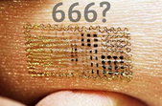
Mark of the Beast Technology
is Not What You Think
. . . difference in these devices and the RFID microchip, is that these devices are highly visible on the surface of the skin, and virtually any design can be used to cloak its very electronic look. One can easily imagine a design that somehow equates to the number of the beast being the required mark that all of mankind must accept at the hand of their new world leader.”
http://idontbuthedoes.com/mark-of-the-beast-that-n/

Slide 32
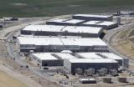
“Welcome to Utah, the NSA's Desert Home for Eavesdropping on America” - Rory Carroll
“Welcome to the Utah Data Center, a new home for the NSA's exponentially expanding information trove. The $1.7bn facility, two years in the making, will soon host supercomputers to store gargantuan quantities of data from emails, phone calls, Google searches and other sources...Since January 2011 a reported 10,000 labourers have built four 25,000-sq ft halls filled with servers and cables, plus an additional 900,000 sq ft of space for technical support and administration, James Bamford, . . .
http://www.theguardian.com/world/2013/jun/14/nsa-utah-data-facility. June 4, 2014, accessed 15 November 2014.

Slide 33
“Welcome to Utah, the NSA's Desert Home for Eavesdropping on America” (cont’d) - Rory Carroll
…author of The Shadow Factory…said the public had yet to grasp the significance of Utah's data-mining. ‘It's basically a hard-drive. It's also a cloud, a warehouse. It'll be storing not just text and audio but pictures and video. There's a lackadaisical attitude to this. People pay no attention until it's too late.’"
http://www.theguardian.com/world/2013/jun/14/nsa-utah-data-facility. June 4, 2014, accessed 15 November 2014.

Slide 34
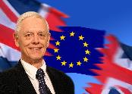
"Big Brother Is Watching"
“If you want to be a film star, come to Britain. We’re all on camera. All you have to do is walk through any town or drive down any road and you are watched, filmed, and monitored. When my wife, Pat, and I tour America, we feel neglected because the roadside cameras are no longer ever-present—not yet. As the world moves towards a ‘Big Brother’ society beyond the nightmares of author George Orwell, who predicted a world in which the state . . .
Alan Franklin, "Big Brother Is Watching," in The Departure: God's Next Catastrophic Intervention into Earth's History, ed. Terry James (Crane, MO: Defender, 2010), 341.

Slide 35
"Big Brother Is Watching"
. . . watched everyone in his 1948 classic novel, 1984, it is like we are inmates of a high-tech prison. Big Brother really is watching us in Europe. The rest of the world is not far behind.”
Alan Franklin, "Big Brother Is Watching," in The Departure: God's Next Catastrophic Intervention into Earth's History, ed. Terry James (Crane, MO: Defender, 2010), 341.

Slide 36
China Installs Surveillance Cameras in Churches to Monitor Christians By Michael Foust, ChristianHeadlines.com, Tuesday, June 11, 2019
“China’s Orwellian-like network of surveillance cameras now includes churches. Most churches…have government-mandated surveillance cameras that allow the communist government to monitor the congregation’s every move…The cameras are part of a massive network of cameras across China that allow the government to monitor citizens. There are an estimated 176 million surveillance cameras across China…That number could reach 450 million by 2020.”
https://www.christianheadlines.com/contributors/michael-foust/china-installs-surveillance-cameras-in-churches-to-monitor-christians.html

Slide 38
7. His Economic System (Revelation 13:16-18)
Global economy (16a)
Global numbering (16b-17)
The Beast’s number (18)

Slide 39
Revelation 13:17-18
“¹⁷ and he provides that no one will be able to buy or to sell, except the one who has the mark, either the name of the beast or the number of his name. ¹⁸ Here is wisdom. Let him who has understanding calculate the number of the beast, for the number is that of a man [anthrōpos]; and his number is six hundred and sixty-six.”

Slide 40
Revelation 13:17-18
“¹⁷ and he provides that no one will be able to buy or to sell, except the one who has the mark, either the name of the beast or the number of his name. ¹⁸ Here is wisdom [sophia]. Let him who has understanding [nous] calculate [psēphizo] the number of the beast, for the number is that of a man; and his number is six hundred and sixty-six.”

Slide 41
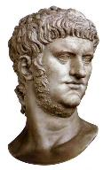

Slide 42
Preterism Advocates
Recent Preterist Commentators
R.C. Sproul
N.T. Wright
Scott Hahn
J. Massyngbaerde Ford
David Chilton
Hank Hanegraaff
Kenneth Gentry

Slide 44
Problems With Neronian Calculation
Transliteration from Greek to Hebrew
“Cherry picking” to fit an ordained outcome
Not suggested by the ancient commentators
Inconsistent use of numbers
Date of Revelation

Slide 45
Problems With Neronian Calculation
Transliteration from Greek to Hebrew
“Cherry picking” to fit an ordained outcome
Not suggested by the ancient commentators
Inconsistent use of numbers
Date of Revelation

Slide 48
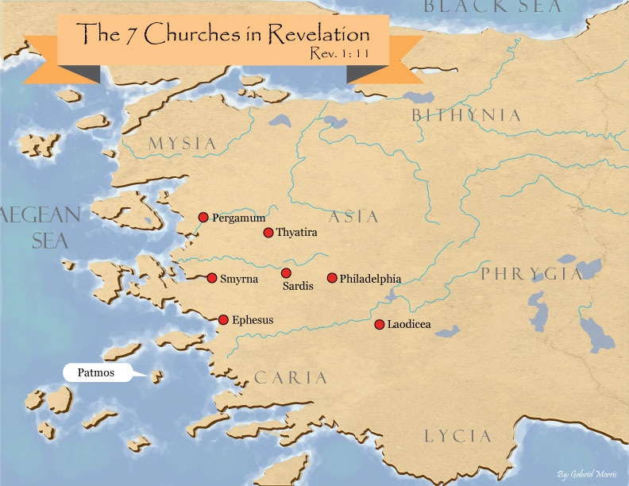

Slide 49
Problems With Neronian Calculation
Transliteration from Greek to Hebrew
“Cherry picking” to fit an ordained outcome
Not suggested by the ancient commentators
Inconsistent use of numbers
Date of Revelation

Slide 51
Revelation 13:17-18
“¹⁷ and he provides that no one will be able to buy or to sell, except the one who has the mark, either the name of the beast or the number of his name. ¹⁸ Here is wisdom. Let him who has understanding calculate the number of the beast, for the number is that of a man [anthrōpos]; and his number is six hundred and sixty-six.”

Slide 52
Problems With Neronian Calculation
Transliteration from Greek to Hebrew
“Cherry picking” to fit an ordained outcome
Not suggested by the ancient commentators
Inconsistent use of numbers
Date of Revelation

Slide 53
Problems With Neronian Calculation
Transliteration from Greek to Hebrew
“Cherry picking” to fit an ordained outcome
Not suggested by the ancient commentators
Inconsistent use of numbers
Date of Revelation

Slide 54
Problems With Neronian Calculation
Transliteration from Greek to Hebrew
“Cherry picking” to fit an ordained outcome
Not suggested by the ancient commentators
Inconsistent use of numbers
Date of Revelation

Slide 55
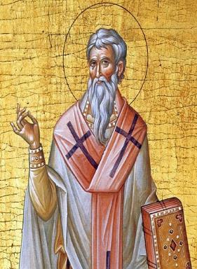
Late Date (A.D. 95) Irenaeus Against Heresies 5.30.3
“But if it had been necessary to announce his name plainly at the present time, it would have been spoken by him who saw the apocalypse. For it was not seen long ago, but almost in our own time, at the end of the reign of Domitian.”

Slide 56
DATE: EXTERNAL EVIDENCE
WITNESSES FOR DOMITIANIC DATE | WITNESSES FOR NERONIC DATE
Irenaeus (A.D. 180)
Victorinus (c.300)
Eusebius (c. 300)
Jerome (c. 400)
Sulpicius Severus (c.400)
The Acts of John (c. 650)
Primasius (c. 540) | Syriac Version of N.T. (550)
Orosius (c. 600)
Andreas (c. 600)
Venerable Bede (A.D. 700)
 | Arethas (c. 900)
 | Theophylact (d. 1107)
Mark Hitchcock, The End Times Controversy, 138.

Slide 57
Nero Does Not Fit the Facts of Revelation 13
Nero did not:
Usher in persecution for exactly 42 months (13:5)
Control the entire planet (13:7; 5:9)
Force people to receive a mark on their right hand or forehead in order to participate in the global economy (13:16-18)

Slide 58
Nero Does Not Fit the Facts of Revelation 13
Nero did not:
Coerce the entire world to worship a singular image of him (13:15)
Resurrect from the dead (13:14)
Associate with a miracle working false prophet (13:13, 15)
Receive global veneration (13:8)

Slide 59
Revelation 13:14
“And he deceives those who dwell on the earth because of the signs which it was given him to perform in the presence of the beast, telling those who dwell on the earth to make an image (eikōn) to the beast who had the wound of the sword and has come to life [záō].”

Slide 60
Nero Does Not Fit the Facts of Revelation 13
Nero did not:
Coerce the entire world to worship a singular image of him (13:15)
Resurrect from the dead (13:14)
Associate with a miracle working false prophet (13:13, 15)
Receive global veneration (13:8)

Slide 61
Conclusion

Slide 62
The Second Beast Revelation 13:11-18
His ethnic identity (11a)
His character (11b)
His purpose (12)
His miracles (13)
His deception (14a)
His image-statue (14b-15)
His economic system (16-18)

Slide 63
7. His Economic System (Revelation 13:16-18)
Global economy (16a)
Global numbering (16b-17)
The Beast’s number (18)

Slide 64
“The Lord bless you and keep you; the Lord make his face shine on you and be gracious to you; the Lord turn his face toward you and give you peace.” (NIV)

