Slide 1
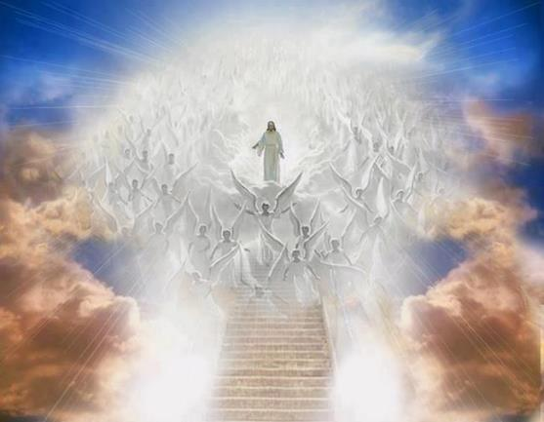
ANGELOLOGY
Dr. Andy Woods
Senior Pastor – Sugar Land Bible Church
President – Chafer Theological Seminary

Slide 2
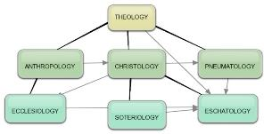
Areas of Systematic Theology
Prolegomena – Introduction
Theology – Study of God
Christology – Study of Christ
Pneumatology – Study of the Holy Spirit
Anthropology – Study of Man
Hamartiology – Study of sin
Soteriology – Study of salvation
Angelology – Study of angels
Ecclesiology – Study of the Church
Eschatology – Study of the end

Slide 3
Areas of Systematic Theology
Prolegomena – Introduction
Theology – Study of God
Christology – Study of Christ
Pneumatology – Study of the Holy Spirit
Anthropology – Study of Man
Hamartiology – Study of sin
Soteriology – Study of salvation
Angelology – Study of angels
Ecclesiology – Study of the Church
Eschatology – Study of the end

Slide 4
Preview of Angelology
Good angels
Satanology
Demonology
Gen. 6:1-4 controversy

Slide 5
Preview of Angelology
Good angels
Satanology
Demonology
Gen. 6:1-4 controversy

Slide 6
Preview
Existence
Origin
Nature
Appearance
Names and classifications
Abode
Activities

Slide 7
Preview
Existence
Origin
Nature
Appearance
Names and classifications
Abode
Activities

Slide 8
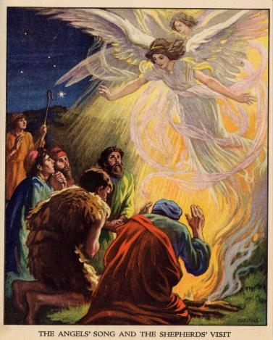
Existence
OT – 108 references
NT – 165 references
Lewis Sperry Chafer, Systematic Theology, 2:3

Slide 9
Preview
Existence
Origin
Nature
Appearance
Names and classifications
Abode
Activities

Slide 10
Origin
Created by God – Col 1:16
Time of creation
Before the earth (Job 38:4-7)
Perhaps on the first two creation days (Gen 1:1; Exod 20:11; Ps 148:2-5; Gen 2:1)
Created as angels
Not human (Heb 12:22-23)
Not deity (Rev 19:10)

Slide 11
Origin
Created by God – Col 1:16
Time of creation
Before the earth (Job 38:4-7)
Perhaps on the first two creation days (Gen 1:1; Exod 20:11; Ps 148:2-5; Gen 2:1)
Created as angels
Not human (Heb 12:22-23)
Not deity (Rev 19:10)

Slide 12
Origin
Created by God – Col 1:16
Time of creation
Before the earth (Job 38:4-7)
Perhaps on the first two creation days (Gen 1:1; Exod 20:11; Ps 148:2-5; Gen 2:1)
Created as angels
Not human (Heb 12:22-23)
Not deity (Rev 19:10)

Slide 13
Origin
Created by God – Col 1:16
Time of creation
Before the earth (Job 38:4-7)
Perhaps on the first two creation days (Gen 1:1; Exod 20:11; Ps 148:2-5; Gen 2:1)
Created as angels
Not human (Heb 12:22-23)
Not deity (Rev 19:10)

Slide 14
Origin
Created by God – Col 1:16
Time of creation
Before the earth (Job 38:4-7)
Perhaps on the first two creation days (Gen 1:1; Exod 20:11; Ps 148:2-5; Gen 2:1)
Created as angels
Not human (Heb 12:22-23)
Not deity (Rev 19:10)

Slide 15
Origin
Created by God – Col 1:16
Time of creation
Before the earth (Job 38:4-7)
Perhaps on the first two creation days (Gen 1:1; Exod 20:11; Ps 148:2-5; Gen 2:1)
Created as angels
Not human (Heb 12:22-23)
Not deity (Rev 19:10)

Slide 16
Origin
Created by God – Col 1:16
Time of creation
Before the earth (Job 38:4-7)
Perhaps on the first two creation days (Gen 1:1; Exod 20:11; Ps 148:2-5; Gen 2:1)
Created as angels
Not human (Heb 12:22-23)
Not deity (Rev 19:10)

Slide 17
Origin
Created by God – Col 1:16
Time of creation
Before the earth (Job 38:4-7)
Perhaps on the first two creation days (Gen 1:1; Exod 20:11; Ps 148:2-5; Gen 2:1)
Created as angels
Not human (Heb 12:22-23)
Not deity (Rev 19:10)

Slide 18
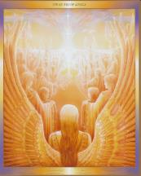
Origin (cont’d)
Created constant
Never die (Luke 20:35-36)
Never reproduce (Luke 20:35-36)
God’s completed works (Gen 2:3)
Created innumerable (Dan 7:10; Rev 5:11)
Created as servants (Heb 1:7, 14)
Created holy (Acts 10:22; Gen 1:31)
Created orderly (Col 1:16)

Slide 19
Origin (cont’d)
Created constant
Never die (Luke 20:35-36)
Never reproduce (Luke 20:35-36)
God’s completed works (Gen 2:3)
Created innumerable (Dan 7:10; Rev 5:11)
Created as servants (Heb 1:7, 14)
Created holy (Acts 10:22; Gen 1:31)
Created orderly (Col 1:16)

Slide 20
Origin (cont’d)
Created constant
Never die (Luke 20:35-36)
Never reproduce (Luke 20:35-36)
God’s completed works (Gen 2:3)
Created innumerable (Dan 7:10; Rev 5:11)
Created as servants (Heb 1:7, 14)
Created holy (Acts 10:22; Gen 1:31)
Created orderly (Col 1:16)

Slide 21
Origin (cont’d)
Created constant
Never die (Luke 20:35-36)
Never reproduce (Luke 20:35-36)
God’s completed works (Gen 2:3)
Created innumerable (Dan 7:10; Rev 5:11)
Created as servants (Heb 1:7, 14)
Created holy (Acts 10:22; Gen 1:31)
Created orderly (Col 1:16)

Slide 22
Origin (cont’d)
Created constant
Never die (Luke 20:35-36)
Never reproduce (Luke 20:35-36)
God’s completed works (Gen 2:3)
Created innumerable (Dan 7:10; Rev 5:11)
Created as servants (Heb 1:7, 14)
Created holy (Acts 10:22; Gen 1:31)
Created orderly (Col 1:16)

Slide 23
Origin (cont’d)
Created constant
Never die (Luke 20:35-36)
Never reproduce (Luke 20:35-36)
God’s completed works (Gen 2:3)
Created innumerable (Dan 7:10; Rev 5:11)
Created as servants (Heb 1:7, 14)
Created holy (Acts 10:22; Gen 1:31)
Created orderly (Col 1:16)

Slide 24
Origin (cont’d)
Created constant
Never die (Luke 20:35-36)
Never reproduce (Luke 20:35-36)
God’s completed works (Gen 2:3)
Created innumerable (Dan 7:10; Rev 5:11)
Created as servants (Heb 1:7, 14)
Created holy (Acts 10:22; Gen 1:31)
Created orderly (Col 1:16)

Slide 25
Origin (cont’d)
Created constant
Never die (Luke 20:35-36)
Never reproduce (Luke 20:35-36)
God’s completed works (Gen 2:3)
Created innumerable (Dan 7:10; Rev 5:11)
Created as servants (Heb 1:7, 14)
Created holy (Acts 10:22; Gen 1:31)
Created orderly (Col 1:16)

Slide 26
Origin (cont’d)
Created constant
Never die (Luke 20:35-36)
Never reproduce (Luke 20:35-36)
God’s completed works (Gen 2:3)
Created innumerable (Dan 7:10; Rev 5:11)
Created as servants (Heb 1:7, 14)
Created holy (Acts 10:22; Gen 1:31)
Created orderly (Col 1:16)

Slide 27
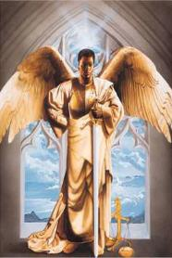
Origin (cont’d)
Created with creaturely limitations
Not omnipresent (Dan 9:22-23)
Not omnipotent (Dan 10:13)
Not omniscient (Matt 24:36; 1 Pet 1:12)

Slide 28
Origin (cont’d)
Created with creaturely limitations
Not omnipresent (Dan 9:22-23)
Not omnipotent (Dan 10:13)
Not omniscient (Matt 24:36; 1 Pet 1:12)

Slide 29
Origin (cont’d)
Created with creaturely limitations
Not omnipresent (Dan 9:22-23)
Not omnipotent (Dan 10:13)
Not omniscient (Matt 24:36; 1 Pet 1:12)

Slide 30
Origin (cont’d)
Created with creaturely limitations
Not omnipresent (Dan 9:22-23)
Not omnipotent (Dan 10:13)
Not omniscient (Matt 24:36; 1 Pet 1:12)

Slide 31
Origin (cont’d)
Created with creaturely limitations
Not omnipresent (Dan 9:22-23)
Not omnipotent (Dan 10:13)
Not omniscient (Matt 24:36; 1 Pet 1:12)

Slide 32
Preview
Existence
Origin
Nature
Appearance
Names and classifications
Abode
Activities

Slide 33
Nature
Personhood
Attributes
Intellect (1 Pet 1:12)
Emotions (Luke 15:10)
Will (Ps 103:20)
Actions
Desire (1 Pet 1:12)
Talk (Luke 1:13)
Confirmed in holiness (1 Tim 5:21; Rev 14:10)

Slide 34
Nature
Personhood
Attributes
Intellect (1 Pet 1:12)
Emotions (Luke 15:10)
Will (Ps 103:20)
Actions
Desire (1 Pet 1:12)
Talk (Luke 1:13)
Confirmed in holiness (1 Tim 5:21; Rev 14:10)

Slide 35
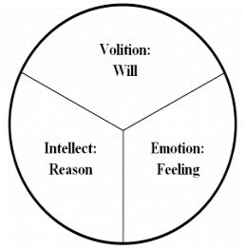
Nature
Personhood
Attributes
Intellect (1 Pet 1:12)
Emotions (Luke 15:10)
Will (Ps 103:20)
Actions
Desire (1 Pet 1:12)
Talk (Luke 1:13)
Confirmed in holiness (1 Tim 5:21; Rev 14:10)

Slide 36
Nature
Personhood
Attributes
Intellect (1 Pet 1:12)
Emotions (Luke 15:10)
Will (Ps 103:20)
Actions
Desire (1 Pet 1:12)
Talk (Luke 1:13)
Confirmed in holiness (1 Tim 5:21; Rev 14:10)

Slide 37
Nature
Personhood
Attributes
Intellect (1 Pet 1:12)
Emotions (Luke 15:10)
Will (Ps 103:20)
Actions
Desire (1 Pet 1:12)
Talk (Luke 1:13)
Confirmed in holiness (1 Tim 5:21; Rev 14:10)

Slide 38
Nature (cont’d)
Power
Relative to man (2 Pet 2:11)
Relative to God (1 Pet 3:22)
Material
Spiritual (Heb 1:7, 14)
Physical Gen 18–19; Heb 13:2)
Gender
Male? (Gen 19, masculine pronouns)
Neuter? Cannot reproduce, Spirit, no female angels

Slide 39
Nature (cont’d)
Power
Relative to man (2 Pet 2:11)
Relative to God (1 Pet 3:22)
Material
Spiritual (Heb 1:7, 14)
Physical Gen 18–19; Heb 13:2)
Gender
Male? (Gen 19, masculine pronouns)
Neuter? Cannot reproduce, Spirit, no female angels

Slide 40
Nature (cont’d)
Power
Relative to man (2 Pet 2:11)
Relative to God (1 Pet 3:22)
Material
Spiritual (Heb 1:7, 14)
Physical Gen 18–19; Heb 13:2)
Gender
Male? (Gen 19, masculine pronouns)
Neuter? Cannot reproduce, Spirit, no female angels

Slide 41
Nature (cont’d)
Power
Relative to man (2 Pet 2:11)
Relative to God (1 Pet 3:22)
Material
Spiritual (Heb 1:7, 14)
Physical Gen 18–19; Heb 13:2)
Gender
Male? (Gen 19, masculine pronouns)
Neuter? Cannot reproduce, Spirit, no female angels

Slide 42
Nature (cont’d)
Power
Relative to man (2 Pet 2:11)
Relative to God (1 Pet 3:22)
Material
Spiritual (Heb 1:7, 14)
Physical Gen 18–19; Heb 13:2)
Gender
Male? (Gen 19, masculine pronouns)
Neuter? Cannot reproduce, Spirit, no female angels

Slide 43
Nature (cont’d)
Power
Relative to man (2 Pet 2:11)
Relative to God (1 Pet 3:22)
Material
Spiritual (Heb 1:7, 14)
Physical Gen 18–19; Heb 13:2)
Gender
Male? (Gen 19, masculine pronouns)
Neuter? Cannot reproduce, Spirit, no female angels

Slide 44
Nature (cont’d)
Power
Relative to man (2 Pet 2:11)
Relative to God (1 Pet 3:22)
Material
Spiritual (Heb 1:7, 14)
Physical Gen 18–19; Heb 13:2)
Gender
Male? (Gen 19, masculine pronouns)
Neuter? Cannot reproduce, Spirit, no female angels

Slide 45
Nature (cont’d)
Power
Relative to man (2 Pet 2:11)
Relative to God (1 Pet 3:22)
Material
Spiritual (Heb 1:7, 14)
Physical Gen 18–19; Heb 13:2)
Gender
Male? (Gen 19, masculine pronouns)
Neuter? Cannot reproduce, Spirit, no female angels

Slide 46
Nature (cont’d)
Power
Relative to man (2 Pet 2:11)
Relative to God (1 Pet 3:22)
Material
Spiritual (Heb 1:7, 14)
Physical Gen 18–19; Heb 13:2)
Gender
Male? (Gen 19, masculine pronouns)
Neuter? Cannot reproduce, Spirit, no female angels

Slide 47
Nature (cont’d)
Power
Relative to man (2 Pet 2:11)
Relative to God (1 Pet 3:22)
Material
Spiritual (Heb 1:7, 14)
Physical Gen 18–19; Heb 13:2)
Gender
Male? (Gen 19, masculine pronouns)
Neuter? Cannot reproduce, Spirit, no female angels

Slide 48
Preview
Existence
Origin
Nature
Appearance
Names and classifications
Abode
Activities

Slide 49
Appearance
On earth: men (Acts 1:10)
In heaven
Seraphim (Isa 6)
Cherubim (Ezek 1; 10)
Living creatures (Rev 4:6-8)
An angel (Rev 10:1-3)

Slide 50
Appearance
On earth: men (Acts 1:10)
In heaven
Seraphim (Isa 6)
Cherubim (Ezek 1; 10)
Living creatures (Rev 4:6-8)
An angel (Rev 10:1-3)

Slide 51
Appearance
On earth: men (Acts 1:10)
In heaven
Seraphim (Isa 6)
Cherubim (Ezek 1; 10)
Living creatures (Rev 4:6-8)
An angel (Rev 10:1-3)

Slide 52
Appearance
On earth: men (Acts 1:10)
In heaven
Seraphim (Isa 6)
Cherubim (Ezek 1; 10)
Living creatures (Rev 4:6-8)
An angel (Rev 10:1-3)

Slide 53
Appearance
On earth: men (Acts 1:10)
In heaven
Seraphim (Isa 6)
Cherubim (Ezek 1; 10)
Living creatures (Rev 4:6-8)
An angel (Rev 10:1-3)

Slide 54
Appearance
On earth: men (Acts 1:10)
In heaven
Seraphim (Isa 6)
Cherubim (Ezek 1; 10)
Living creatures (Rev 4:6-8)
An angel (Rev 10:1-3)

Slide 55
Appearance
On earth: men (Acts 1:10)
In heaven
Seraphim (Isa 6)
Cherubim (Ezek 1; 10)
Living creatures (Rev 4:6-8)
An angel (Rev 10:1-3)

Slide 56
Preview
Existence
Origin
Nature
Appearance
Names and classifications
Abode
Activities

Slide 57
Names and Classifications
General
Angels
Ministering spirits (Heb 1:14)
Heavenly hosts (Luke 2:13)
Watchers (Dan 4:13-17)
Sons of God (Job 1:6; 2:1; 38:7)
Stars (Rev 12:3-4, 9)

Slide 58
Names and Classifications (cont’d)
Specific
Cherub(im)-Gen 3:24; Exod 25:17-22
Seraph(im)-Isa 6:2, 6
Michael-Dan 12:1; Jude 9; Rev 12:7
Gabriel-Dan 8:16; 9:21; Luke 1:18-19, 26-38

Slide 59
Names and Classifications (cont’d)
Specific
Cherub(im)-Gen 3:24; Exod 25:17-22
Seraph(im)-Isa 6:2, 6
Michael-Dan 12:1; Jude 9; Rev 12:7
Gabriel-Dan 8:16; 9:21; Luke 1:18-19, 26-38

Slide 60
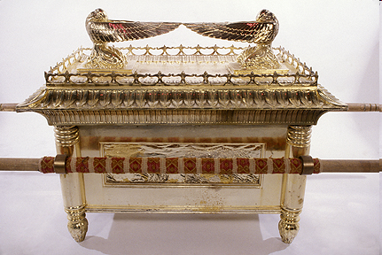
Ark of the Covenant

Slide 61
Names and Classifications (cont’d)
Specific
Cherub(im)-Gen 3:24; Exod 25:17-22
Seraph(im)-Isa 6:2, 6
Michael-Dan 12:1; Jude 9; Rev 12:7
Gabriel-Dan 8:16; 9:21; Luke 1:18-19, 26-38

Slide 62
Names and Classifications (cont’d)
Specific
Cherub(im)-Gen 3:24; Exod 25:17-22
Seraph(im)-Isa 6:2, 6
Michael-Dan 12:1; Jude 9; Rev 12:7
Gabriel-Dan 8:16; 9:21; Luke 1:18-19, 26-38

Slide 63
Names and Classifications (cont’d)
Specific
Cherub(im)-Gen 3:24; Exod 25:17-22
Seraph(im)-Isa 6:2, 6
Michael-Dan 12:1; Jude 9; Rev 12:7
Gabriel-Dan 8:16; 9:21; Luke 1:18-19, 26-38

Slide 64
Preview
Existence
Origin
Nature
Appearance
Names and classifications
Abode
Activities

Slide 65
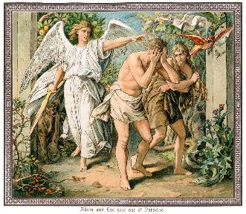
Abode of the Angels
Some earthly visitations (Gen 18–19; Heb 13:2)
Heaven is their main habitation (2 Chr 18:18; Luke 1:19; 15:10; John 1:51)

Slide 66
Abode of the Angels
Some earthly visitations (Gen 18–19; Heb 13:2)
Heaven is their main habitation (2 Chr 18:18; Luke 1:19; 15:10; John 1:51)

Slide 67
Abode of the Angels
Some earthly visitations (Gen 18–19; Heb 13:2)
Heaven is their main habitation (2 Chr 18:18; Luke 1:19; 15:10; John 1:51)

Slide 68
Preview
Existence
Origin
Nature
Appearance
Names and classifications
Abode
Activities

Slide 69
Activities of the Angels
Past
Witnessed creation (Job 38:7)
Brought judgment (Gen 19:22; Acts 12:22-23)
Accompanied the Law (Gal 3:19)
Announced births of John and Christ (Luke 1:11-13, 26-27)
Strengthened Christ (Matt 4:11)
Announced resurrection (Matt 28:1-7)
Observed Ascension (Acts 1:11)
Brought messages (Luke 1:13)

Slide 70
Activities of the Angels (cont’d)
Present
Protect believers (Ps 34:7; 91:11-12)
Deliver God’s answers to prayer (Dan 9:23; 10:12)
Take souls to heaven (Luke 16:22)
Involvement in government (Dan 10:21; 11:1; 12:1)

Slide 71
Activities of the Angels (cont’d)
Future
Rapture (1 Thess 4:16)
Judged by humans (1 Cor 6:3)
Tribulation judgments (Rev 8:2; 16:1)
Return of Christ (Matt 24:31; 25:31)
Bind Satan (Rev 20:1-2)

Slide 72
Preterism – It all happened in A.D. 70!

Slide 73
Activities of the Angels (cont’d)
Future
Rapture (1 Thess 4:16)
Judged by humans (1 Cor 6:3)
Tribulation judgments (Rev 8:2; 16:1)
Return of Christ (Matt 24:31; 25:31)
Bind Satan (Rev 20:1-2)

Slide 74
Review
Existence
Origin
Nature
Appearance
Names and classifications
Abode
Activities

