Slide 1
The book of Jude
An Appeal for Infected Believers

Slide 2
The Book of Jude
Who wrote the book? Jude, brother of James, half –brother of Jesus Christ.
Who was the book written to? Believers, Jews scattered in Asia Minor
When was the book written? Between 68-80 AD
Where was the book written from? Possibly in the Land of Canaan
What’s the Genre of the book? Epistolary
What’s the purpose of the book? To exhort believers to earnestly contend for the faith in the face of apostasy.
What’s in the book? A present threat of and defense against false teachers.
Is there an application? 1) grow spiritually (v.20); 2) be assured of your salvation (v.21; 24-25); and 3) also to help those who doubt (v.23-24).

Slide 3
4 Sections in Jude
Salutation / Purpose Statement – vv. 1 - 4
Beware of Apostates– vv. 5-16
Exhortation to the Faithful – vv.17-23
Benediction – vv. 24-25
Outline adapted from Thomas Constable, Dr. Constable’s Expository Notes, Jude, (http://www.planobiblechapel.org/tcon/notes/html/nt/jude/jude.htm)

Slide 4
4 Sections in Jude
Salutation / Purpose Statement – vv. 1 - 4
Beware of Apostates– vv. 5-16
Exhortation to the Faithful – vv.17-23
Benediction – vv. 24-25
Outline adapted from Thomas Constable, Dr. Constable’s Expository Notes, Jude, (http://www.planobiblechapel.org/tcon/notes/html/nt/jude/jude.htm)

Slide 5
4 Sections in Jude
Salutation / Purpose Statement – vv. 1 - 4
Beware of Apostates– vv. 5-16
Exhortation to the Faithful – vv.17-23
Benediction – vv. 24-25
Outline adapted from Thomas Constable, Dr. Constable’s Expository Notes, Jude, (http://www.planobiblechapel.org/tcon/notes/html/nt/jude/jude.htm)

Slide 6
Jude 20-21
“But you, beloved, building yourselves up on your most holy faith, praying in the Holy Spirit, keep yourselves in the love of God, waiting anxiously for the mercy of our Lord Jesus Christ to eternal life.”

Slide 7
Jude 20-21
“But you, beloved, building yourselves up on your most holy faith, praying in the Holy Spirit, keep yourselves in the love of God, waiting anxiously for the mercy of our Lord Jesus Christ to eternal life.”

Slide 8
Ephesians 4:2
“with all humility and gentleness, with patience, showing tolerance for one another in love…”

Slide 9
John 15:9
“Just as the Father has loved Me, I have also loved you; abide in My love.”

Slide 10
John 15:4-5
“Abide in Me, and I in you. As the branch cannot bear fruit of itself unless it abides in the vine, so neither can you unless you abide in Me. “I am the vine, you are the branches; he who abides in Me and I in him, he bears much fruit, for apart from Me you can do nothing..”

Slide 12
Jude 20-21
“But you, beloved, building yourselves up on your most holy faith, praying in the Holy Spirit, keep yourselves in the love of God, waiting anxiously for the mercy of our Lord Jesus Christ to eternal life.”

Slide 13
4 Sections in Jude
Salutation / Purpose Statement – vv. 1 - 4
Beware of Apostates– vv. 5-16
Exhortation to the Faithful – vv.17-23
An Exhortation to Remember - 17-19
An Appeal to Faithful Believers - 20-21
An Appeal for Infected Believers – 22-23
Benediction – vv. 24-25
Outline adapted from Thomas Constable, Dr. Constable’s Expository Notes, Jude, (http://www.planobiblechapel.org/tcon/notes/html/nt/jude/jude.htm)

Slide 14
An Appeal for infected believers Jude 22-23
General Observations
Jude’s commands on how to respond to infected believers.

Slide 15
An Appeal for infected believers Jude 22-23
General Observations
Jude’s commands on how to respond to infected believers.

Slide 16
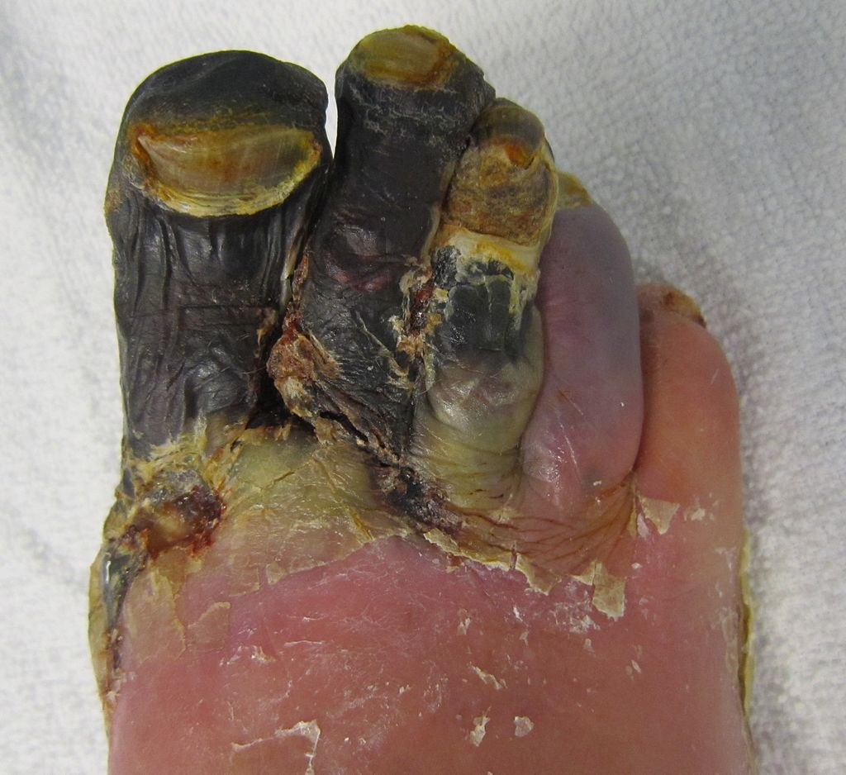
Gangrene Patient. Source: Wikipedia

Slide 17
γάγγραινα [gaggraina /gang·grahee·nah/] n f. From graino (to gnaw); GK 1121; AV translates as “canker” once. 1 a gangrene, a disease by which any part of the body suffering from inflammation becomes so corrupted that, unless a remedy be seasonably applied, the evil continually spreads, attacks other parts, and at last eats away the bones.
James Strong, Enhanced Strong’s Lexicon (Woodside Bible Fellowship, 1995).
Gangrene Patient. Source: Wikipedia

Slide 18
2 Timothy 2:17-18
…and their talk will spread like gangrene. Among them are Hymenaeus and Philetus, men who have gone astray from the truth saying that the resurrection has already taken place, and they upset the faith of some.”

Slide 19
An Appeal for infected believers vv. 22-23
General Observations
The reality of and concern for infected believers
Jude’s commands on how to respond to infected believers.

Slide 20
An Appeal for infected believers vv. 22-23
General Observations
The reality of and concern for infected believers
Reveals impartiality to believer’s maturity
Jude’s commands on how to respond to infected believers.

Slide 21
Acts 20:17
From Miletus he sent to Ephesus and called to him the elders of the church…

Slide 22
Acts 20:29-30
“Be on guard for yourselves and for all the flock, among which the Holy Spirit has made you overseers, to shepherd the church of God which He purchased with His own blood. 29 “I know that after my departure savage wolves will come in among you, not sparing the flock; 30 and from among your own selves men will arise, speaking perverse things, to draw away the disciples after them.

Slide 23
An Appeal for infected believers vv. 22-23
General Observations
The reality of and concern for infected believers
Reveals impartiality to believer’s maturity
Jude’s Triad
Jude’s commands on how to respond to infected believers.

Slide 24
An Appeal for infected believers vv. 22-23
General Observations
The reality of and concern for infected believers
Reveals impartiality to believer’s maturity
Jude’s Triad
Jude’s commands on how to respond to infected believers.
Have mercy.

Slide 25
Have mercy.

Slide 26
An Appeal for infected believers vv. 22-23
General Observations
The reality of and concern for infected believers
Reveals impartiality to believer’s maturity
Jude’s Triad
Jude’s commands on how to respond to infected believers.
Have mercy (vv. 22)
Save others, snatching them out of the fire (vv. 23a)

Slide 27
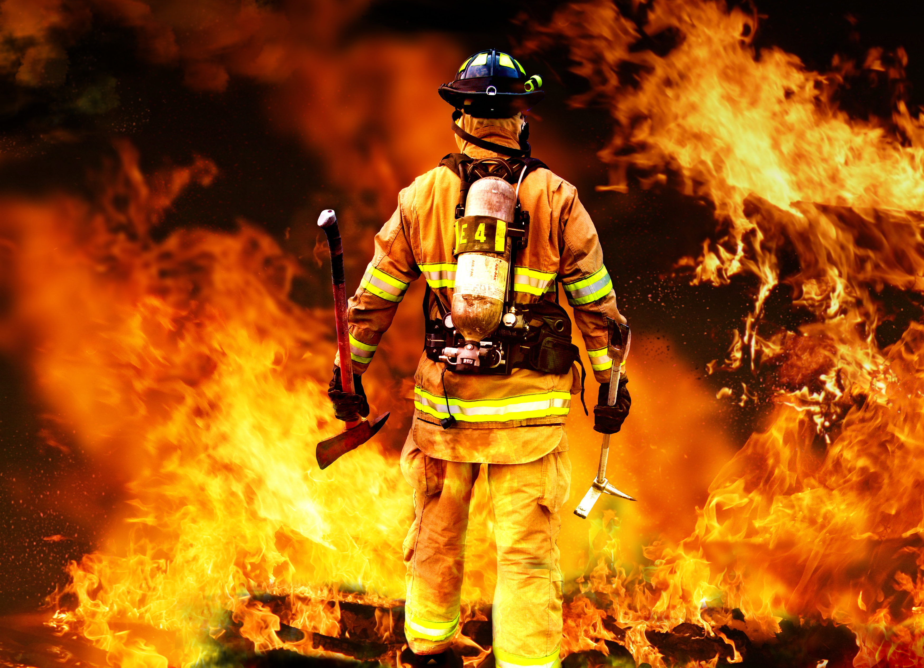

Slide 28
John 15:5-6
“I am the vine, you are the branches; he who abides in Me and I in him, he bears much fruit, for apart from Me you can do nothing. 6 “If anyone does not abide in Me, he is thrown away as a branch and dries up; and they gather them, and cast them into the fire and they are burned.

Slide 29
John 16:12-13
“I have many more things to say to you, but you cannot bear them now. But when He, the Spirit of truth, comes, He will guide you into all the truth; for He will not speak on His own initiative, but whatever He hears, He will speak; and He will disclose to you what is to come.”

Slide 30
Galatians 1:11-12
“For I would have you know, brethren, that the gospel which was preached by me is not according to man. For I neither received it from man, nor was I taught it, but I received it through a revelation of Jesus Christ.”

Slide 31
1 Corinthians 3:12-17
“12 Now if any man builds on the foundation with gold, silver, precious stones, wood, hay, straw, 13 each man’s work will become evident; for the day will show it because it is to be revealed with fire, and the fire itself will test the quality of each man’s work. 14 If any man’s work which he has built on it remains, he will receive a reward…”

Slide 32
1 Corinthians 3:12-17
“15 If any man’s work is burned up, he will suffer loss; but he himself will be saved, yet so as through fire. 16 Do you not know that you are a temple of God and that the Spirit of God dwells in you? 17 If any man destroys the temple of God, God will destroy him, for the temple of God is holy, and that is what you are.”

Slide 33
Amos 4:11
“ ‘I overthrew you, as God overthrew Sodom and Gomorrah, and you were like a firebrand snatched from a blaze; yet you have not returned to Me,’ declares the Lord.”

Slide 34
An Appeal for infected believers vv. 22-23
General Observations
The reality of and concern for infected believers
Reveals impartiality to believer’s maturity
Jude’s Triad
Jude’s commands on how to respond to infected believers.
Have mercy (vv. 22)…
Save others, snatching them out of the fire (vv. 23a).
…have mercy with fear, hating even the garment polluted by the flesh (vv.23b).

Slide 36
Malachi 2:16
“For I hate divorce,” says the Lord, the God of Israel, “and him who covers his garment with wrong,” says the Lord of hosts. “So take heed to your spirit, that you do not deal treacherously.”

Slide 37
Psalm 101:3
“I will set no worthless thing before my eyes;
I hate the work of those who fall away; It shall not fasten its grip on me.

Slide 38
Psalm 97:10a
“Hate evil, you who love the Lord…”

Slide 39
Psalm 119:104
“From Your precepts I get understanding; Therefore I hate every false way.”

Slide 40
John 13:35
“By this all men will know that you are My disciples, if you have love for one another.”

Slide 41
Rom 12:9-10
“Let love be without hypocrisy. Abhor what is evil; cling to what is good.10 Be devoted to one another in brotherly love; give preference to one another in honor…”

Slide 42
Jude 24-25
Now to Him who is able to keep you from stumbling, and to make you stand in the presence of His glory blameless with great joy, to the only God our Savior, through Jesus Christ our Lord, be glory, majesty, dominion and authority, before all time and now and forever. Amen.

Slide 43
Jude 24-25
In this final paragraph Jude exploded with a most elevated doxology, answering the unexpressed question, “But who will deliver us from the apostates and the apostasy into which they lead the unsuspecting?” Jude’s proclamation was, praise be to Him who is able to keep you from falling. Victory over apostasy is found in Jesus Christ! He is the One who will “keep” believers. Christ will present believers to His Father without fault and with great joy—joy both for Himself and for them. Here is the greatest theme of victory to be sounded, the highest note of praise and adoration possible, and the greatest assurance for the redeemed. Jude attributes to God—to the only God our Savior … glory, majesty, power, and authority, which are all available to believers through the Victor, Jesus Christ our Lord. And this exalted position is true of God in eternity past, in the present, and for all eternity in the future.
Edward C. Pentecost, “Jude,” in The Bible Knowledge Commentary: An Exposition of the Scriptures, ed. J. F. Walvoord and R. B. Zuck, vol. 2 (Wheaton, IL: Victor Books, 1985), 923–924.

Slide 44
An Appeal for infected believers vv. 22-23
General Observations
The reality of and concern for infected believers
Reveals impartiality to believer’s maturity
Jude’s Triad
Jude’s commands on how to respond to infected believers.
Have mercy (vv. 22)…
Save others, snatching them out of the fire (vv. 23a).
…have mercy with fear, hating even the garment polluted by the flesh (vv.23b).

Slide 45
The book of Jude
An Appeal for Infected Believers

