Slide 1
Law and Grace: An Overview Jim McGowan, Th.D. Sugar Land Bible Church 06-09-2019
…but grace and truth were realized through Jesus Christ - John 1:17
For the Law was given through Moses…
Special thanks to Dr. Vern Peterman for access to his insights and resources.

Slide 2
Session 18b Outline
Review
Purpose, Aim, and Objective
Session 18a
Introduction to the Gospel of Matthew Part 3
Comparisons (cont’d)
Contrasts
Concluding Observations

Slide 3
OUR PURPOSE, AIM AND OBJECTIVE
Law and Grace
…is to Compare and Contrast Law and Grace so as to properly understand these two important themes and how they are related to the life of the New Testament Believer.

Slide 4
C. I. SCOFIELD, D. D.
The Grace of God, The Fundamentals Vol. 3, Chapter VII, p. 98
We have, most of us, been reared and now live under the influence of Galatianism. Protestant theology, alas, is for the most part, thoroughly Galatianized, in that neither law nor grace are given their distinct and separated places, as in the counsels of God, but are mingled together in one incoherent system.
The law is no longer, as in the Divine intent, a ministration of death (2 Cor. 3:7), of cursing (Gal. 3:10), of conviction (Rom. 3:19), because we are taught that we must try to keep it, and that by Divine help we may.
Nor, on the other hand, does grace bring us blessed deliverance from the dominion of sin, for we are kept under the law as a rule of life despite the plain declaration, “Sin shall not have dominion over you: for ye are not under the law, but under grace” (Rom. 6:14). (emphasis mine)

Slide 5
William R. Newell
Romans Verse-by-Verse (p. 274).
Grand Rapids, MI: Christian Classics Ethereal Library.
It is because Reformed theology has kept us Gentiles under the Law,—if not as a means of righteousness, then as “a rule of life,” that all the trouble has arisen. The Law is no more a rule of life than it is a means of righteousness. Walking in the Spirit has now taken the place of walking by ordinances. God has another principle under which He has put his saints: “Ye are not under law, but, under grace! (Rom. 6:14)” (italics mine)
PDF Download Here: https://archive.org/details/Romans_Verse_By_Verse-NewellWR

Slide 6
Session 18b Outline
Review
Purpose, Aim, and Objective
Session 18a
Introduction to the Gospel of Matthew Part 3
Comparisons (cont’d)
Contrasts
Concluding Observations

Slide 7
Matthew’s Audience and Purposes
Law and Grace: Session 18a Review
To explain to Jewish unbelievers that Jesus was indeed the long-awaited Jewish Messiah.
To explain to Jewish believers why the kingdom had been postponed despite the fact that the king had arrived.
To explain to Jewish believers the interim program of God during the kingdom’s absence.

Slide 8
Matthew & the Kingdom
Law and Grace: Session 18a Review
Kingdom offered
Kingdom rejected
Kingdom postponed
Kingdom ultimately accepted
Interim program

Slide 9
Matthew’s Message
Law and Grace: Session 18a Review
Jesus is the predicted Jewish king who ushered in an interim program by building the sons of the kingdom into the church in between Israel’s past rejection and future acceptance of her king

Slide 10
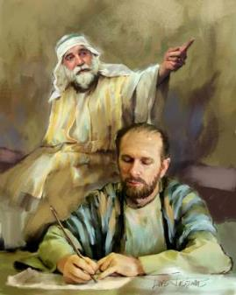
Law and Grace: Session 18a Review
How will we approach the Gospel of Matthew?
We will approach the Gospel of Matthew so that we will arrive at the one intended meaning for each passage that God, through Matthew intended to convey.
We continually ask the questions, “What message did God inspire and what meaning did the apostle Matthew intend to convey?”

Slide 11
The Doctrine of Perspicuity
Law and Grace: Session 18a Review
The doctrine of perspicuity means that the central message of the Bible is clear and understandable and that the Bible itself can be properly interpreted in a normal, literal sense.
God has a message He wants to convey.
God is able to convey His message.
God is not capricious (given to impulsive and unpredictable character and action).

Slide 12
Common Sense Method of interpretation
Law and Grace: Session 18a Review
Literal-Grammatical-Historical interpretation – This means giving to every word the same meaning it would have in normal usage, whether employed in writing, speaking, or thinking while taking into account grammatical and historical considerations.

Slide 13
What God inspired and the author intended.
Law and Grace: Session 18a Review
God did not give us His words so that we can make it say whatever we want. He had something specific in mind. That's the meaning. That's the intent. And that is what we will be looking for.
“The teachings of the Bible are not inaccessible to the average person, as some have suggested. Nor is the Bible written as a puzzle, a book of secrets and riddles given in jumbled incommunicable form. The fact that the Bible is a book means that it is to be read and understood.” (Italics mine)
Zuck, Roy B. (1991). Basic Bible Interpretation: A Practical Guide to Discovering Biblical Truth (p. 26). Colorado Springs, CO: David C. Cook.

Slide 14
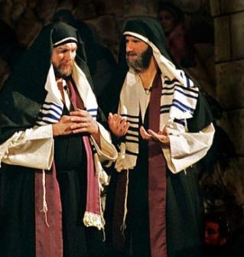
What God inspired and the author intended.
Law and Grace: Session 18a Review
To answer this question, we will look at elements of language, history and culture, not just because these are interesting, but so that we understand Matthew’s intent.

Slide 15
What God inspired and the author intended.
Law and Grace: Session 18a Review
It's all a matter of getting the FULL context!

Slide 16
Law and Grace: Session 18a Review
To Whom is Jesus talking?
Jesus spoke almost entirely to the people of Israel, only in the land of Israel, who were all under the entire Law of Moses. (Matt. 10:5–6)
Jesus made multiple references to the Law, Moses, the altar and the temple in Jerusalem. (Matt. 5:17-18; 23-24; 8:4; 21:12-13)

Slide 17
So don’t we TAKE EVERYTHING as if it directly applies to us?
Law and Grace: Session 18a Review
We must always recognize who is being addressed and interpret accordingly.

Slide 18
So do we just IGNORE EVERYTHING that directly applies only to the Jews?
Law and Grace: Session 18a Review
All Scripture is inspired by God and profitable…2 Tim. 3:16-17
For whatever was written in earlier times was written for our instruction... (cf. Rom. 15:4; 1 Cor. 10:11).

Slide 19
Law and Grace: Session 18a Review

Slide 20
Session 18b Outline
Review
Purpose, Aim, and Objective
Session 18a
Introduction to the Gospel of Matthew Part 3
Comparisons (cont’d)
Contrasts
Concluding Observations

Slide 21
Law and Grace: Session 19
WE COMPARE AND CONTRAST
When we compare we ask, ‘What about what is said in the gospels is the same or similar to what is addressed to the church, and why?’ (Note: similar is not same!)
When we contrast we ask, ‘What about what is said in the gospels is different from what is written to us who are in the church, and why?’

Slide 22
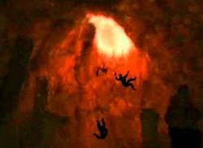
Law and Grace: Session 19
WE COMPARE AND CONTRAST
When we take this Compare and Contrast approach we will find that the Word of God can be very clearly understood and is consistent throughout.

Slide 23
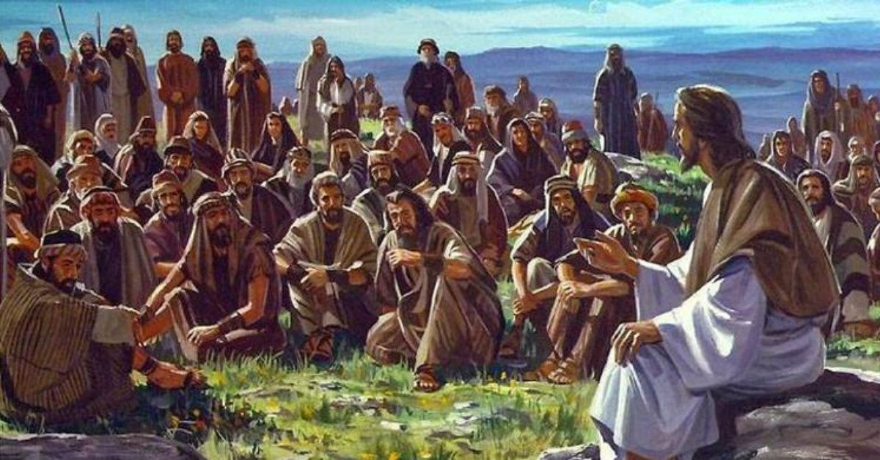
Law and Grace: Session 19
Comparison:
What is the same or similar
There are a number of ways in which the content in the gospel of Matthew, has application to believers in the church, the Body of Christ, and that content is going to provide valuable lessons for us!.

Slide 24
Law and Grace: Session 19
Comparison:
What is the same or similar
The character of God is always the same and He does not lie or capriciously change His mind (Num. 23:19; 1 Sam. 15:29; Mal. 3:6; Titus 1:2; Heb. 1:10-12; 6:18; 13:8; Jam. 1:17).

Slide 25
Numbers 23:19
“God is not a man, that He should lie, Nor a son of man, that He should repent; Has He said, and will He not do it? Or has He spoken, and will He not make it good?...”

Slide 26
Law and Grace: Session 19
Comparison:
What is the same or similar
God is always the Creator and all of creation has a creature relationship with reference to Him (Gen. 1:1; Matt. 19:4; Mark 13:19; Acts 14:15; 17:24,24; Col. 1:15).

Slide 27
Isaiah 44:24
Thus says the Lord, your Redeemer, and the one who formed you from the womb, “I, the Lord, am the maker of all things, Stretching out the heavens by Myself And spreading out the earth all alone,…”

Slide 28
Law and Grace: Session 19
Comparison:
What is the same or similar
Due to the Fall, all those ‘in Adam’ have inherited a ‘sin’ nature (Gen. 3:5; Isa. 53:6; Rom. 3:23; 5:14; 1 Cor. 15:20-22; 42-49).
The
Sin Nature

Slide 29
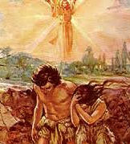
Romans 5:17-18
“By one man’s offense (the First Adam) death reigned by one … Therefore as by the offense of one (the First Adam), judgment came upon all men to condemnation”.
Notes:
Rom. 5:17-18 - “By one man’s offense (the First Adam) death reigned by one … Therefore as by the offense of one (the First Adam) judgment came upon all men to condemnation”. (NASB)

Slide 30
Law and Grace: Session 19
Our Personal History in the First Adam
3 FUNDAMENTAL ASPECTS
Our POSITION in sin (ADAM–SOURCE )
We are dead unto God, and alive unto sin (Ps. 51:5, Eph.2:1; 1Cor. 15:22).
Our NATURE of sin (ADAM–NATURE)
We are – natural, fleshly, and carnal, separated from God (Eph. 2:3; 1 Cor. 2:14; John 3:6).
Our PERSONAL sins (ADAM–PRACTICE)
We have grown up to be sinners by CHOICE and PRACTICE
Notes:
Our Personal History in the First Adam – The Problem
B. Our Historical Relationship in Adam – 3 Basic Aspects
With this information, we can now make note of three basic aspects of our historical relationship in Adam. They are:
Our position in sin (Adam-source);
Our nature of sin (Adam-nature);
Our personal sins (Adam-practice).
“Identification Truth” – The Foundation for Growth
Understanding the facts concerning the position and condition of our old life in Adam is the essential key to progressing in spiritual growth. Ignorance or neglect of these facts will guarantee defeat throughout the life of the believer.

Slide 31
Law and Grace: Session 19
Comparison:
What is the same or similar
Salvation for all those “in Adam” is ALWAYS by faith in God’s provision (Gen. 15:6; Hab. 2:4; Rom. 4:9, 22; Gal. 3:6; Jam. 2:23).

Slide 32
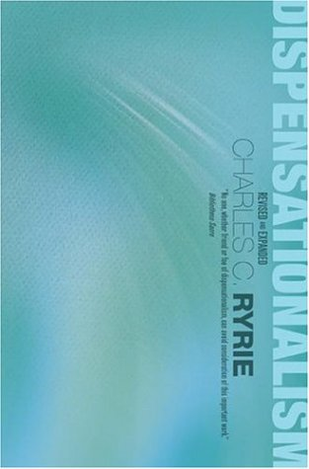
Law and Grace: Session 19
Charles Ryrie
Ryrie, C. C. (1995). Dispensationalism (Rev. and expanded., p. 134-135). Chicago: Moody Publishers.
“The basis of salvation in every age is the death of Christ; the requirement for salvation in every age is faith; the object of faith in every age is God; the content of faith changes in the various dispensations…When Adam looked upon the coats of skins with which God had clothed him and his wife, he did not see what the believer today sees looking back on the cross of Calvary… One must see two aspects to this entire matter—the unchanging basis of salvation in the grace of Christ and the changing content of revelation, which affects the conscious object of faith.”

Slide 33
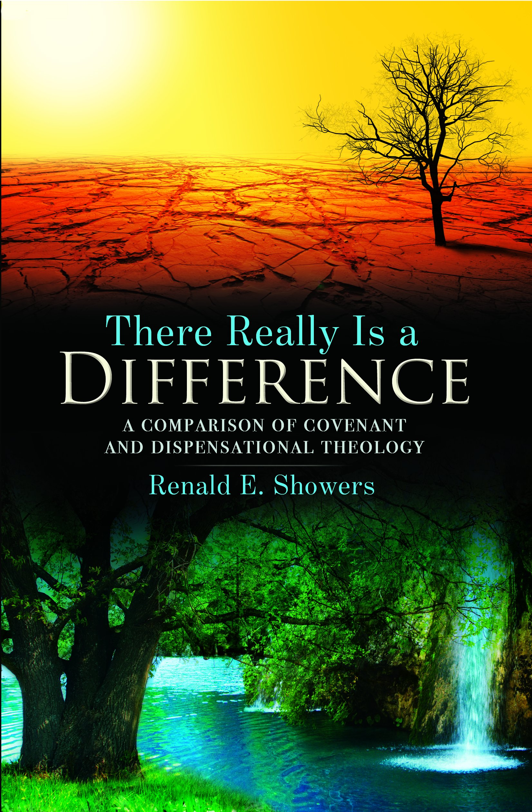
Law and Grace: Session 19
Renald Showers
Showers, R. E. (1990). There really is a difference!: a comparison of covenant and dispensational theology (p. 31). Bellmawr, NJ: The Friends of Israel Gospel Ministry, Inc.
“…the different dispensations are different ways of God’s administering His rule over the world. They are not different ways of salvation. Throughout history God has employed several dispensations but only one way of salvation. Salvation has always been by the grace of God through faith in the Word of God, and God has based salvation on the work of Jesus Christ.

Slide 34
Law and Grace: Session 19
William MacDonald
MacDonald, William (2001). Here's the Difference (p. 98). West Port Colborne, ON: Gospel Folio Press
“While there are differences among the various ages, there is one thing that never changes, and that is the gospel. Salvation always has been, is now, and always will be by faith in the Lord. And the basis of salvation for every age is the finished work of Christ on Calvary's cross. People in the Old Testament were saved by believing whatever revelation the Lord gave them...We must guard against any idea that people in the Dispensation of Law were saved by keeping the Law”.

Slide 35
Law and Grace: Session 19
Comparison:
What is the same or similar
The earth that we walk is cursed until the recreation. (Gen. 3:17-19; 5:29; Rom. 8:18-25; Rev. 21:1; 22:3).
Genesis 3:17-18
¹⁷ “Cursed is the ground because of you…¹⁸ Both thorns and thistles it shall grow for you…”

Slide 36
2 Peter 3:10
But the day of the Lord will come like a thief, in which the heavens will pass away with a roar and the elements will be destroyed with intense heat, and the earth and its works will be burned up.

Slide 37
Revelation 21:1; 22:3
¹ Then I saw a new heaven and a new earth; for the first heaven and the first earth passed away, and there is no longer any sea… ^{22:3} There will no longer be any curse; and the throne of God and of the Lamb will be in it, and His bond-servants will serve Him;
Notes:
Rom. 5:17-18 - “By one man’s offense (the First Adam) death reigned by one … Therefore as by the offense of one (the First Adam) judgment came upon all men to condemnation”. (NASB)

Slide 38
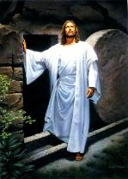
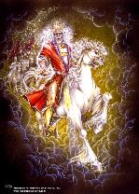
Law and Grace: Session 19
Comparison:
What is the same or similar
Israel has a unique relationship to the Millennial Kingdom that Christ addresses in the Gospel of Matthew.
However, we too have a place in, and a similar forward-looking time perspective, regarding the coming Millennial Kingdom (Acts 28:23, 31; 2 Thess. 1:5).

Slide 39
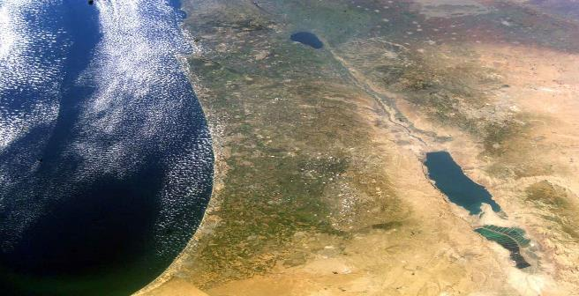
Law and Grace: Session 19
Comparison:
What is the same or similar
Like Israel, for us entrance into the kingdom is not on the basis of something earthly, but is spiritual (Rom. 9:6; 11:26; 14:7; Jam. 2:5).

Slide 40
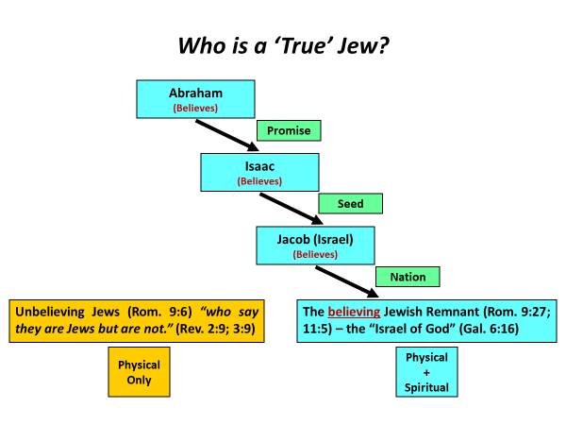
Romans 9:6b
For they are not all Israel who are descended from Israel;…

Slide 41
Romans 11:26
“…and so all Israel will be saved; just as it is written, “THE DELIVERER WILL COME FROM ZION, HE WILL REMOVE UNGODLINESS FROM JACOB.”
Isaiah 59:20
“A Redeemer will come to Zion, And to those who turn from transgression IN JACOB,” declares the LORD.

Slide 42
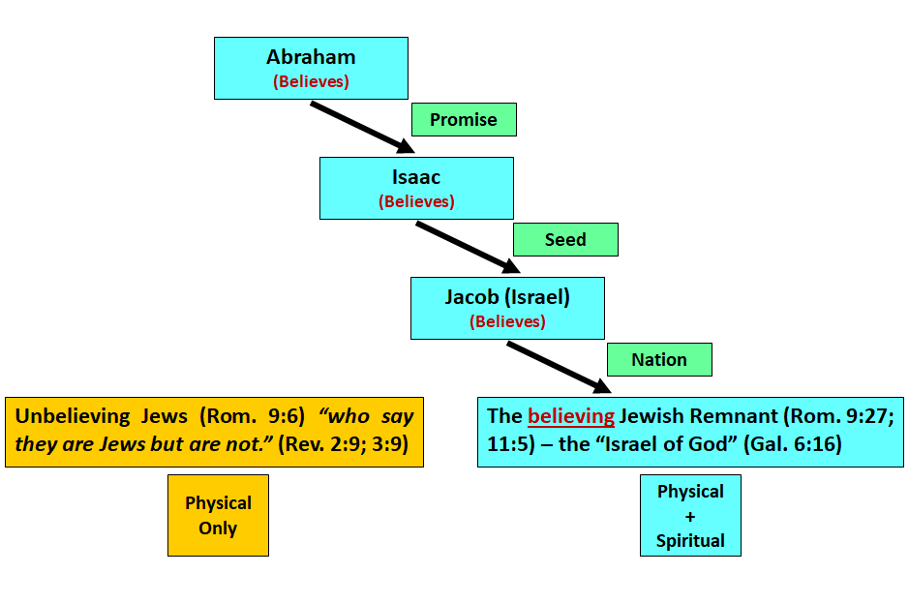
Law and Grace: Session 19
Who is a ‘True’ Jew?

Slide 43
Law and Grace: Session 19
Who is a ‘True’ Jew?
“In the age to come Abraham will sit at the gate of Gehenna [hell], and he will not permit a circumcised Israelite to go down there.” (Genesis Rabbah, “Vayera” 45:8)
https://thetorah.com/abraham-circumcision/

Slide 44
Law and Grace: Session 19
Comparison:
What is the same or similar

Slide 45
Law and Grace: Session 19
Comparison:
What is the same or similar
Salvation for all those “in Adam” is ALWAYS by faith in God’s provision (Gen. 15:6; Hab. 2:4; Rom. 4:9, 22; Gal. 3:6; Jam. 2:23).

Slide 46
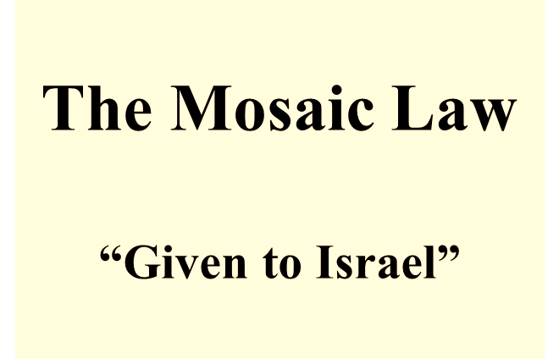
Law and Grace: Session 19
Comparison:
What is the same or similar
We are going to find that the ethics, morals, and even some of the spiritual principles conveyed in the Gospel of Matthew have much in common with what is revealed for Church Age believers in the New Testament epistles (Rom. 12:8-9; 1 Cor. 13:1-7).

Slide 47
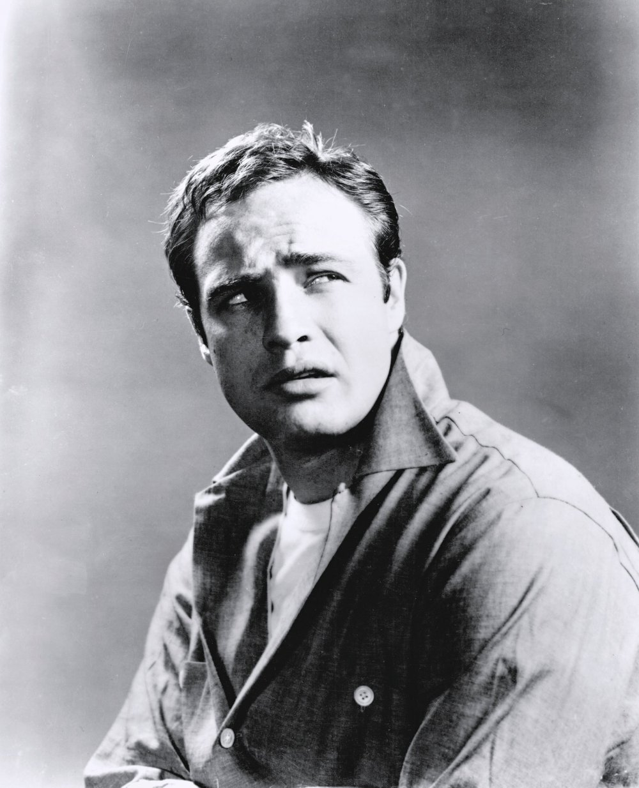
Law and Grace: Session 19
Comparison:
What is ‘My’ Motivation?

Slide 48
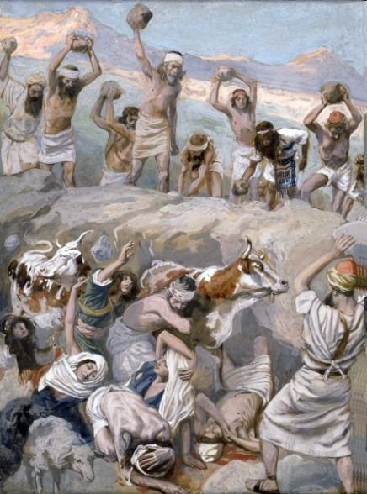
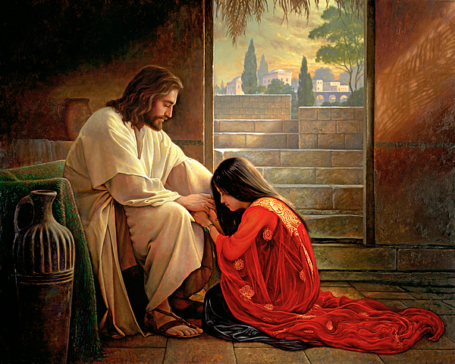
Law and Grace: Session 19
Comparison:
What is ‘My’ Motivation?

Slide 49
Matthew 6:14-15
¹⁴ “For if you forgive others for their transgressions, your heavenly Father will also forgive you. ¹⁵ But if you do not forgive others, then your Father will not forgive your transgressions.”
Ephesians 4:32
“Be kind to one another, tender-hearted, forgiving each other, just as God in Christ also has forgiven you.”

Slide 50
Exodus 20:15-16
¹⁵ "You shall not steal. ¹⁶ You shall not bear false witness…"
Ephesians 4:25, 28
²⁵ "Therefore, laying aside falsehood… ²⁸ He who steals must steal no longer…"

Slide 51
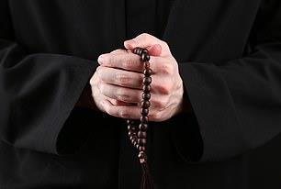
Law and Grace: Session 19
Comparison:
What is the same or similar
Neither the Gospel of Matthew nor the epistles to the Church encourage endless repetitions of the same prayer.

Slide 52
Session 18b Outline
Review
Purpose, Aim, and Objective
Session 18a
Introduction to the Gospel of Matthew Part 3
Comparisons (cont’d)
Contrasts
Concluding Observations

Slide 53
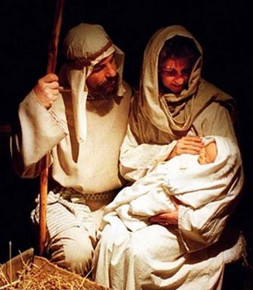
Law and Grace: Session 19
Contrast:
What is different
Jesus was born and presented Himself in the land of Israel, as the King of Israel, to the people of Israel, who were all under the Mosaic Law, given to Israel and to whom were promised earthly blessings, in the land of Israel, if they obeyed the Laws given Israel!

Slide 54
Law and Grace: Session 19
Contrast:
What is different
The rulers and leaders of Israel, with very few exceptions, rejected Jesus as their king, so, God postponed the Kingdom and temporarily shifted the focus from national Israel, to the Church, which under Grace partakes of all spiritual blessings in the heavenly places.

Slide 55
Law and Grace: Session 19
Contrast:
The Gospel of the Kingdom in the Gospels & Acts
In the Gospels, Jesus preached the POTENTIAL, IMMINENT, COMING of the Kingdom to national Israel, and…
Matthew 4:23
Jesus was going throughout all Galilee, teaching in their synagogues and proclaiming the gospel of the kingdom…
Matthew 9:35
Jesus was going through all the cities and villages, teaching in their synagogues and proclaiming the gospel of the kingdom…

Slide 56
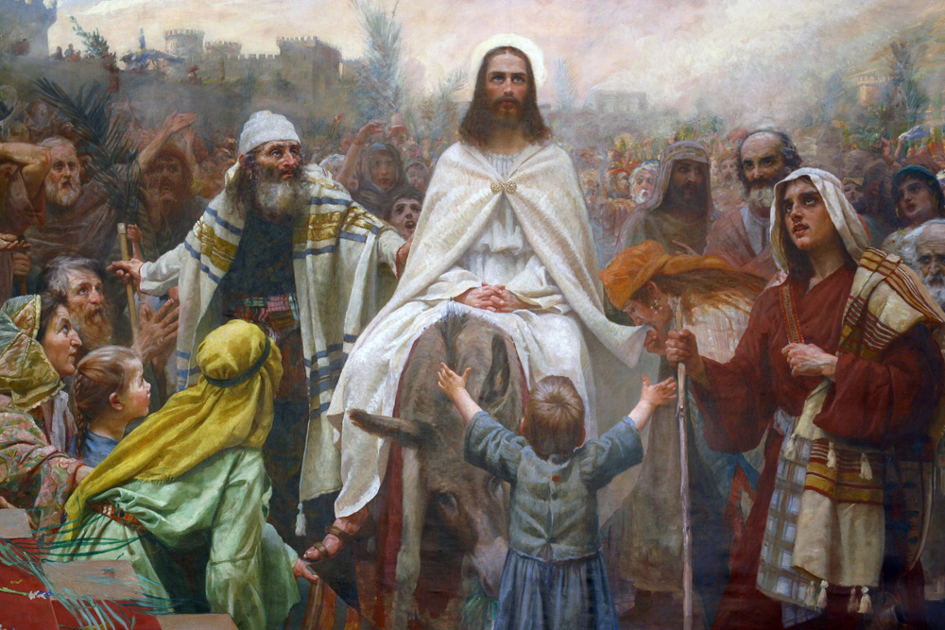
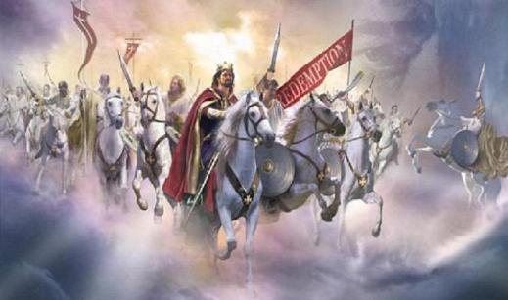
Law and Grace: Session 19
Contrast:
The Gospel of the Kingdom in the Gospels & Acts
…it is true that the Coming Kingdom continued to be presented through the end of the book of Acts…however, NOT AS a potential, imminent, national, reality, but AS A FUTURE, CERTAIN, EXPECTATION to individual Jews (and Gentiles, cf. Acts 28:23; 30-31)

Slide 57
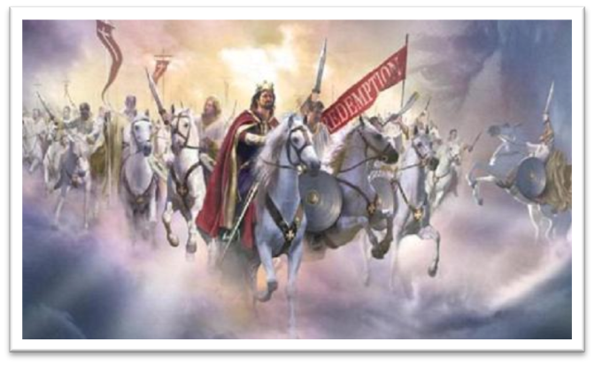
Acts 28:23; 30-31
“…[Paul] was explaining to them [the Roman Jews] by solemnly testifying about the kingdom of God AND trying to persuade them concerning Jesus, from both the Law of Moses and from the Prophets, from morning until evening… ³⁰ And [Paul] stayed two full years in his own rented quarters and was welcoming all who came to him, ³¹ preaching the kingdom of God AND teaching concerning the Lord Jesus Christ with all openness, unhindered.

Slide 58
Law and Grace: Session 19
Contrast:
The Gospel of the Grace in the Gospels & Acts
After His rejection in Matthew 12, Jesus introduced in seed form, the Gospel of Grace, that is, that He would die for our sins, would be buried, and then would rise from the dead (cf. 1 Cor. 15:1-4).
Matthew 16:21
…Jesus began to show His disciples that He must…suffer many things from the elders and chief priests and scribes, and be killed, and be raised up on the third day.
Matthew 20:18-19
¹⁸ “…the Son of Man will be delivered to the chief priests and scribes, and they will condemn Him to death, ¹⁹ …and on the third day He will be raised up.”

Slide 59
1 Corinthians 15:1–4
¹ Now I make known to you, brethren, the gospel which I preached to you, which also you received, in which also you stand, ² by which also you are saved, if you hold fast the word which I preached to you, unless you believed in vain. ³ For I delivered to you as of first importance what I also received, that Christ died for our sins according to the Scriptures, ⁴ and that He was buried, and that He was raised on the third day according to the Scriptures,

Slide 60
Law and Grace: Session 19
Contrast:
The Gospel of the Grace in the Gospels & Acts
This gospel of grace was preached to the Jews and then to Gentiles.
Acts 20:24
"But I do not consider my life of any account as dear to myself, so that I may finish my course and the ministry which I received from the Lord Jesus, to testify solemnly of the gospel of the grace of God."

Slide 61
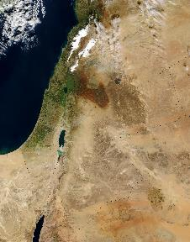
Law and Grace: Session 19
Contrast:
How do you live and how are you blessed?
During the coming earthly reign of Christ in the Millennial Kingdom, the people of Israel will all be blessed in the land, because they will all have the Holy Spirit indwelling them enabling them to know and perfectly live out Kingdom Law.

Slide 62
Law and Grace: Session 19
Contrast:
How do you live and how are you blessed?
In the Church, we in the Body of Christ, indwelt by the Holy Spirit, are already blessed heavenly in Christ, and Christ is right now living His life through us, apart from any Law.

Slide 63
Session 18b Outline
Review
Purpose, Aim, and Objective
Session 18a
Introduction to the Gospel of Matthew Part 3
Comparisons (cont’d)
Contrasts
Concluding Observations

Slide 64
OUR PURPOSE, AIM AND OBJECTIVE
Law and Grace
…is to Compare and Contrast Law and Grace so as to properly understand these two important themes and how they are related to the life of the New Testament Believer.

Slide 65
Law and Grace: Session 19
WE COMPARE AND CONTRAST
When we compare we ask, ‘What about what is said in the gospels is the same or similar to what is addressed to the church, and why?’ (Note: similar is not same!)
When we contrast we ask, ‘What about what is said in the gospels is different from what is written to us who are in the church, and why?’

Slide 66
Law and Grace: Session 19
“…you are not under Law,
but under Grace” (Rom. 6:14).
We want to come out from under the influence of Galatianism!
Walking in the Spirit has now taken the place of walking by ordinances!

Slide 67
Law and Grace: An Overview Jim McGowan, Th.D. Sugar Land Bible Church 06-09-2019
…but grace and truth were realized through Jesus Christ - John 1:17
For the Law was given through Moses…
Special thanks to Dr. Vern Peterman for access to his insights and resources.

