Slide 1
Dr. Andy Woods
Senior Pastor – Sugar Land Bible Church
President – Chafer Theological Seminary

Slide 3
Seven Trumpets (Revelation 8‒11)
1st Trumpet (8:7) – 1/3 vegetation destroyed
2nd Trumpet (8:8-9) – 1/3 ocean destroyed
3rd Trumpet (8:10-11) – 1/3 water destroyed
4th Trumpet (8:12-13) – 1/3 luminaries darkened
5th Trumpet (9:1-12) – Demons released
6th Trumpet (9:13-21) – 1/3 humanity destroyed
7th Trumpet (11:14-19) – Legal transfer announced

Slide 5
5 Non-Chronological Parenthetical Insertions
Rev 7 – 144,000 Jews
Rev 10:1-11:13 – Announcement of no more delay and the two witnesses
Rev 12-14 – Israel’s flight, two beasts, six scenes of hope
Rev 16:13-16 – Gathering of the nations to Armageddon
Rev 17:1-19:6 – Babylon’s fall

Slide 6
Revelation 11:15
“Then the seventh angel sounded; and there were loud voices in heaven, saying, ‘The kingdom of the world has become the kingdom of our Lord and of His Christ; and He will reign (basileuō) forever and ever.’” (cf. Matt. 6:10)

Slide 7
Revelation 12‒14
Rev 12 – Israel’s flight
Rev 13 – Two beasts
Rev 14 – Six scenes of hope

Slide 8
Revelation 12‒14
Rev 12 – Israel’s flight
Rev 13 – Two beasts
Rev 14 – Six scenes of hope

Slide 9
Revelation 12‒14
Rev 12 – Israel’s flight
Rev 13 – Two beasts
Rev 14 – Six scenes of hope

Slide 10
Two Beasts (Revelation 13)
First beast (13:1-10)
Second beast (13:11-18)

Slide 11
Two Beasts (Revelation 13)
First beast (13:1-10)
Second beast (13:11-18)

Slide 12
The First Beast Revelation 13:1-10
His sudden appearance in John’s vision (1a)
His Gentile ethnicity (1b)
His fulfillment of Daniel’s prophecies (1c-2a)
His Satanic empowerment (2b)
His resurrection (3)
His power-based adoration (4)
His oratory (5a)

Slide 13
The First Beast Revelation 13:1-10
His time of authority (5b)
His blasphemies (6)
His persecution of God’s people (7a)
His global jurisdiction (7b)
His unregenerate audience (8)
His oppressive influence (9-10)

Slide 14
Two Beasts (Revelation 13)
First beast (13:1-10)
Second beast (13:11-18)

Slide 15
The Second Beast Revelation 13:11-18
His ethnic identity (11a)
His character (11b)
His purpose (12)
His miracles (13)
His deception (14a)
His image-statue (14b-15)
His economic system (16-18)

Slide 16
The Second Beast Revelation 13:11-18
His ethnic identity (11a)
His character (11b)
His purpose (12)
His miracles (13)
His deception (14a)
His image-statue (14b-15)
His economic system (16-18)

Slide 17
Zechariah 12:12-13
“¹² The land will mourn, every family by itself; the family of the house of David by itself and their wives by themselves; the family of the house of Nathan by itself and their wives by themselves; ¹³ the family of the house of Levi by itself and their wives by themselves; the family of the Shimeites by itself and their wives by themselves.”

Slide 18
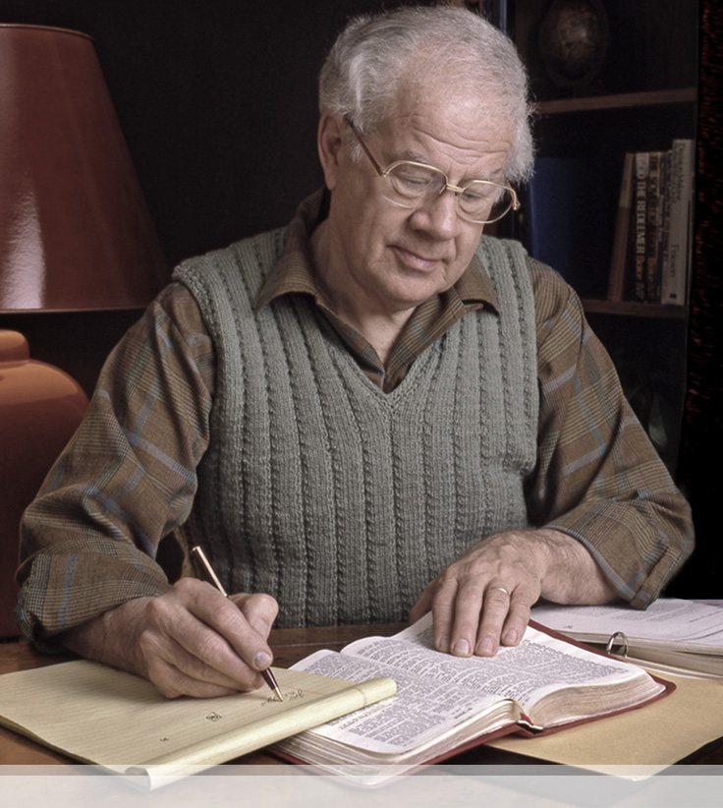
J. Dwight Pentecost
Things to Come, Page 336
“In close association with the Beast, the head of the federated empire, is another individual known as the ‘False Prophet’ (Rev. 19: 20; 20:10), called ‘the second beast’ in Revelation 13: 11-17, where his fullest description is given. In that passage of Scripture there are some important factors concerning him to be observed: (1) This individual is evidently a Jew, since he arises out of the earth, or land, that is Palestine (13: 11)...”

Slide 19
The Second Beast Revelation 13:11-18
His ethnic identity (11a)
His character (11b)
His purpose (12)
His miracles (13)
His deception (14a)
His image-statue (14b-15)
His economic system (16-18)

Slide 20
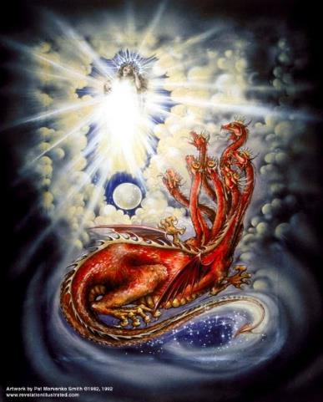
CAST OF 3 CHARACTERS Revelation 12:1-5
SON = MESSIAH
Ps. 2:9; Acts 1:9
DRAGON = SATAN
Rev. 12:9; 20:2
WOMAN = ISRAEL
Gen. 37:9-10

Slide 21
The Second Beast Revelation 13:11-18
His ethnic identity (11a)
His character (11b)
His purpose (12)
His miracles (13)
His deception (14a)
His image-statue (14b-15)
His economic system (16-18)

Slide 22
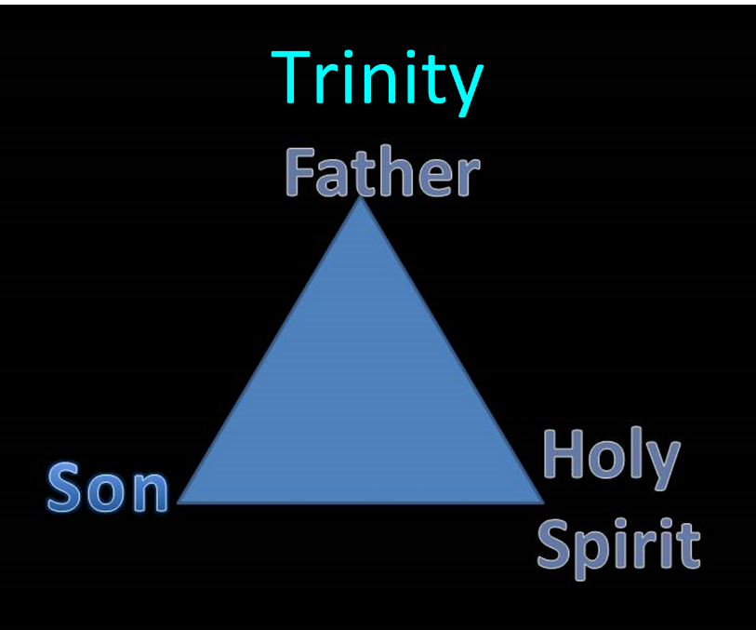

Slide 23
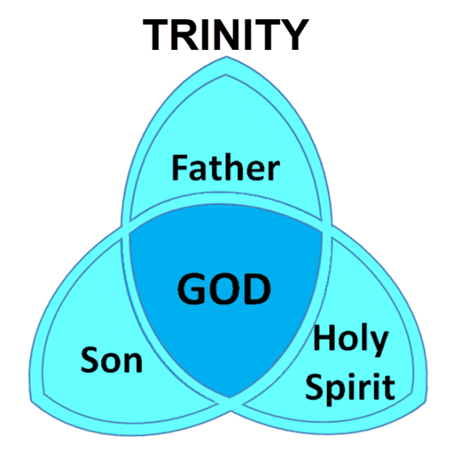

Slide 24
How Satan Imitates God and the Antichrist Imitates Jesus Christ
NO. | CATEGORY | JESUS CHRIST | ANTICHRIST
1. | World prepared in advance | Gal. 4:4 | 2 Thess. 2:7
2. | Revealed at the proper time | Gal. 4:4 | 2 Thess. 2:6
3. | Claim of deity | John 14:9 | 2 Thess. 2:4
4. | Heralded by a forerunner | John 1:23 | Rev. 13:12
5. | Forerunner comes in the Spirit and power of Elijah | Luke 1:17 | 1 Kgs. 8:37-38; Rev. 13:13
6. | Empowered by a higher source | 1 Cor. 6:14 | Rev. 13:14
7. | Member of a Trinity | Phil. 1:2; Acts 5:3-4; John 14:9 | Rev. 16:13; 20:10
8. | Head of a Church | Eph. 5:23 | Rev. 2:9; 3:9
9. | Miracle worker | Acts 2:22 | 2 Thess. 2:9
10. | Resurrection from the dead | 1 Cor. 15:3-6 | Rev. 13:3, 12, 14
11. | Given a throne | Rev. 3:21 | Rev. 13:2

Slide 25
How Satan Imitates God and the Antichrist Imitates Jesus Christ
NO. | CATEGORY | JESUS CHRIST | ANTICHRIST
12. | Ruling a political kingdom | Isa. 9:6-7 | Rev. 13:5
13. | Ushering in world peace | Isa. 9:6-7 | Rev. 6:1-4
14. | Activity in the Temple | Luke 2:41-50 | 2 Thess. 2:4
15. | Putting an end to animal sacrifices | Heb. 9:26-29 | Dan. 9:27
16. | Length of ministry | Over 3 years | Rev. 13:5
17. | Sealing ministry | Eph. 4:30 | Rev. 13:16-17
18. | Presentation to Israel as her Messiah | John 1:11 | John 5:43
19. | Covenant with Israel | Gen. 15:18 | Dan. 9:27
20. | Reception of worship | Zech. 14:16 | 2 Thess. 2:4
21. | Establishing Jerusalem as the center of worldwide worship | Zech. 14:17 | 2 Thess. 2:4

Slide 26
The Second Beast Revelation 13:11-18
His ethnic identity (11a)
His character (11b)
His purpose (12)
His miracles (13)
His deception (14a)
His image-statue (14b-15)
His economic system (16-18)

Slide 27
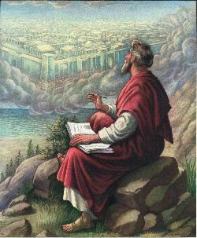
John 20:30-31
“Therefore many other signs [sēmeion] Jesus also performed in the presence of the disciples, which are not written in this book; but these have been written so that you may believe that Jesus is the Christ, the Son of God; and that believing you may have life in His name.”

Slide 29
2 Thessalonians 2:9
“that is, the one whose coming is in accord with the activity of Satan, with all power [dýnamis] and signs [sēmeion] and false wonders [téras].”

Slide 30
Antichrist’s Satanic Miracles 2 Thessalonians 2:9
Miracle | Greek Word | Christ’s Ministry
Powers | Dynamis | Matt. 11:20
Signs | Semēion | John 20:30
Wonders | Teras | Acts 2:22

Slide 31
Satanic/Demonic Miracles
Exod 7–8
Deut 13:1-3
Matt 7:21-23; 24:24
Acts 8:9; 16:16
Gal 1:6-9
2 Thess 2:9
Rev 13:3, 13, 15; 16:13-14

Slide 32
How Satan Imitates God and the Antichrist Imitates Jesus Christ
NO. | CATEGORY | JESUS CHRIST | ANTICHRIST
1. | World prepared in advance | Gal. 4:4 | 2 Thess. 2:7
2. | Revealed at the proper time | Gal. 4:4 | 2 Thess. 2:6
3. | Claim of deity | John 14:9 | 2 Thess. 2:4
4. | Heralded by a forerunner | John 1:23 | Rev. 13:12
5. | Forerunner comes in the Spirit and power of Elijah | Luke 1:17 | 1 Kgs. 8:37-38; Rev. 13:13
6. | Empowered by a higher source | 1 Cor. 6:14 | Rev. 13:14
7. | Member of a Trinity | Phil. 1:2; Acts 5:3-4; John 14:9 | Rev. 16:13; 20:10
8. | Head of a Church | Eph. 5:23 | Rev. 2:9; 3:9
9. | Miracle worker | Acts 2:22 | 2 Thess. 2:9
10. | Resurrection from the dead | 1 Cor. 15:3-6 | Rev. 13:3, 12, 14
11. | Given a throne | Rev. 3:21 | Rev. 13:2

Slide 33
The Second Beast Revelation 13:11-18
His ethnic identity (11a)
His character (11b)
His purpose (12)
His miracles (13)
His deception (14a)
His image-statue (14b-15)
His economic system (16-18)

Slide 34
Test the Spirits
Deut. 13:1-5
Isa. 8:19-20
Acts 17:11
Gal. 1:8-9
1 Thess. 5:20-21
1 John 4:1
Rev. 2:2

Slide 35
1 John 4:1
“Beloved, do not believe every spirit, but test the spirits to see whether they are from God, because many false prophets have gone out into the world.”

Slide 36
The Second Beast Revelation 13:11-18
His ethnic identity (11a)
His character (11b)
His purpose (12)
His miracles (13)
His deception (14a)
His image-statue (14b-15)
His economic system (16-18)

Slide 37
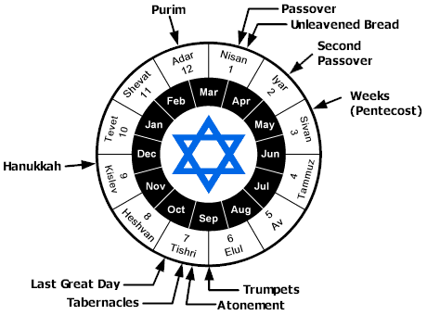

Slide 40
Revelation 13:14
“And he deceives those who dwell on the earth because of the signs which it was given him to perform in the presence of the beast, telling those who dwell on the earth to make an image (eikōn) to the beast who had the wound of the sword and has come to life [záō].”

Slide 41
How Satan Imitates God and the Antichrist Imitates Jesus Christ
NO. | CATEGORY | JESUS CHRIST | ANTICHRIST
1. | World prepared in advance | Gal. 4:4 | 2 Thess. 2:7
2. | Revealed at the proper time | Gal. 4:4 | 2 Thess. 2:6
3. | Claim of deity | John 14:9 | 2 Thess. 2:4
4. | Heralded by a forerunner | John 1:23 | Rev. 13:12
5. | Forerunner comes in the Spirit and power of Elijah | Luke 1:17 | 1 Kgs. 8:37-38; Rev. 13:13
6. | Empowered by a higher source | 1 Cor. 6:14 | Rev. 13:14
7. | Member of a Trinity | Phil. 1:2; Acts 5:3-4; John 14:9 | Rev. 16:13; 20:10
8. | Head of a Church | Eph. 5:23 | Rev. 2:9; 3:9
9. | Miracle worker | Acts 2:22 | 2 Thess. 2:9
10. | Resurrection from the dead | 1 Cor. 15:3-6 | Rev. 13:3, 12, 14
11. | Given a throne | Rev. 3:21 | Rev. 13:2

Slide 42
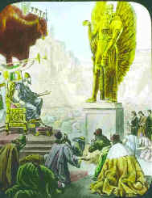
Nebuchadnezzar’s Image (Daniel 3:1)
90 feet high & 9 feet wide
8 stories

Slide 43
The Second Beast Revelation 13:11-18
His ethnic identity (11a)
His character (11b)
His purpose (12)
His miracles (13)
His deception (14a)
His image-statue (14b-15)
His economic system (16-18)

Slide 44
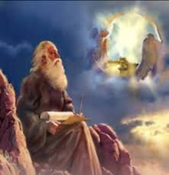
7. His Economic System (Revelation 13:16-18)
Global economy (16a)
Global numbering (16b-17)
The Beast’s number (18)

Slide 45
7. His Economic System (Revelation 13:16-18)
Global economy (16a)
Global numbering (16b-17)
The Beast’s number (18)

Slide 46
7. His Economic System (Revelation 13:16-18)
Global economy (16a)
Global numbering (16b-17)
The Beast’s number (18)

Slide 47
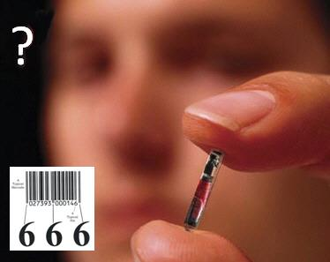
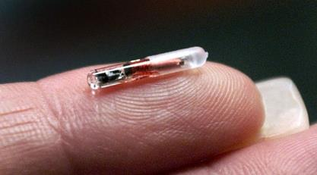
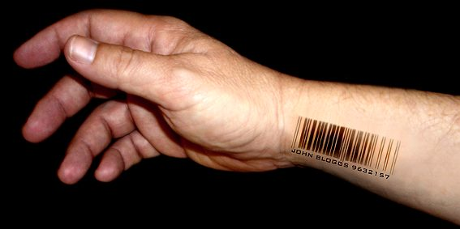

Slide 48
Wisconsin Company to Implant
Microchips In Employees
Josh Rosenthal of 5 Eyewitness ABC News - July 24, 2017
“A Wisconsin company is about to become the first in the U.S. to offer microchip implants to its employees. Yes, you read that right. Microchip implants. ‘It's the next thing that's inevitably going to happen, and we want to be a part of it,’ Three Square Market Chief Executive Officer Todd Westby said. The company designs software for break room markets that are commonly found in office complexes. Just as people are able to purchase items at the market using phones, Westby wants to do the same thing using a microchip implanted inside a person's hand. ‘We'll come up, scan the item,’ he explained, while . . .

Slide 49
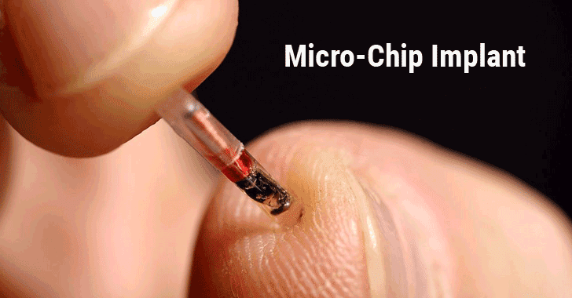
Wisconsin Company to Implant
Microchips In Employees (cont’d)
Josh Rosenthal of 5 Eyewitness ABC News - July 24, 2017
. . . showing how the process will work at an actual break room market kiosk. ‘We'll hit pay with a credit card, and it's asking to swipe my proximity payment now. I'll hold my hand up, just like my cell phone, and it'll pay for my product.’”
http://kstp.com/news/wisconsin-company-to-implant-microchips-in-employees-three-square-market/4549459/

Slide 50
Swedish Commuters Can Use
Futuristic Microchip Hand Implant:
The future is here – a Swedish rail company is trialing letting passengers use biometric chips as tickets Helen Coffey of The Independent - June 16, 2017
“Gone are the days when an e-ticket was seen as cutting edge – one Swedish rail company is offering passengers the option of using a biometric chip implanted into their hand in lieu of a paper train ticket…The tiny chip has the same technology as Oyster cards and contactless bank cards…to enable conductors to scan passengers’ hands…Around 2,000 Swedes have had the surgical implant to date, most of them employed in the tech industry.”
http://www.independent.co.uk/travel/news-and-advice/sj-rail-train-tickets-hand-implant-microchip-biometric-sweden-a7793641.html

Slide 51
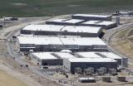
“Welcome to Utah, the NSA's Desert Home for Eavesdropping on America” - Rory Carroll
“Welcome to the Utah Data Center, a new home for the NSA's exponentially expanding information trove. The $1.7bn facility, two years in the making, will soon host supercomputers to store gargantuan quantities of data from emails, phone calls, Google searches and other sources...Since January 2011 a reported 10,000 labourers have built four 25,000-sq ft halls filled with servers and cables, plus an additional 900,000 sq ft of space for technical support and administration, James Bamford, . . .
http://www.theguardian.com/world/2013/jun/14/nsa-utah-data-facility. June 4, 2014, accessed 15 November 2014.

Slide 52
“Welcome to Utah, the NSA's Desert Home for Eavesdropping on America” (cont’d) - Rory Carroll
…author of The Shadow Factory…said the public had yet to grasp the significance of Utah's data-mining. ‘It's basically a hard-drive. It's also a cloud, a warehouse. It'll be storing not just text and audio but pictures and video. There's a lackadaisical attitude to this. People pay no attention until it's too late.’"
http://www.theguardian.com/world/2013/jun/14/nsa-utah-data-facility. June 4, 2014, accessed 15 November 2014.

Slide 53
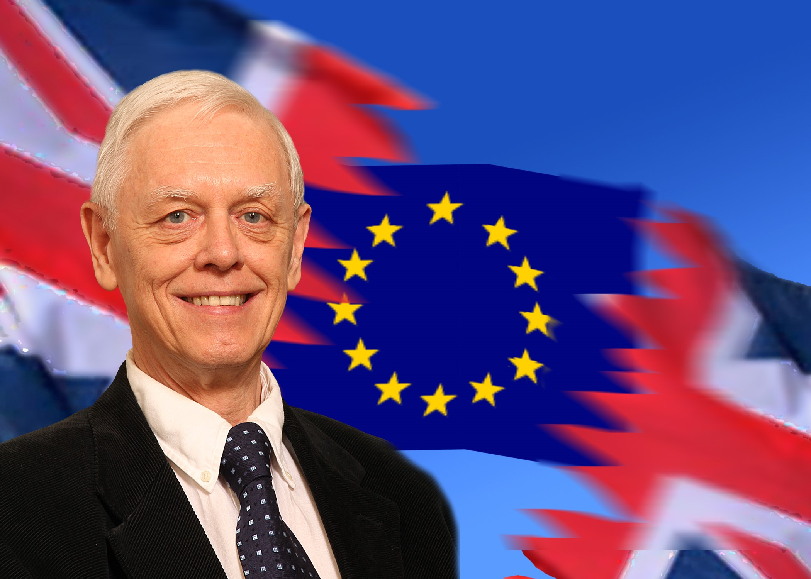
"Big Brother Is Watching"
“If you want to be a film star, come to Britain. We’re all on camera. All you have to do is walk through any town or drive down any road and you are watched, filmed, and monitored. When my wife, Pat, and I tour America, we feel neglected because the roadside cameras are no longer ever-present—not yet. As the world moves towards a ‘Big Brother’ society beyond the nightmares of author George Orwell, who predicted a world in which the state . . .
Alan Franklin, "Big Brother Is Watching," in The Departure: God's Next Catastrophic Intervention into Earth's History, ed. Terry James (Crane, MO: Defender, 2010), 341.

Slide 54
"Big Brother Is Watching"
. . . watched everyone in his 1948 classic novel, 1984, it is like we are inmates of a high-tech prison. Big Brother really is watching us in Europe. The rest of the world is not far behind.”
Alan Franklin, "Big Brother Is Watching," in The Departure: God's Next Catastrophic Intervention into Earth's History, ed. Terry James (Crane, MO: Defender, 2010), 341.

Slide 55
7. His Economic System (Revelation 13:16-18)
Global economy (16a)
Global numbering (16b-17)
The Beast’s number (18)

Slide 56
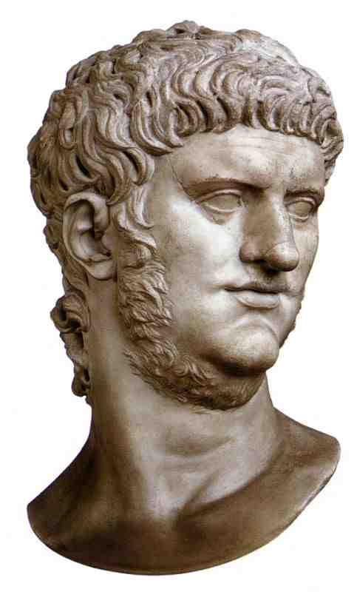

Slide 58
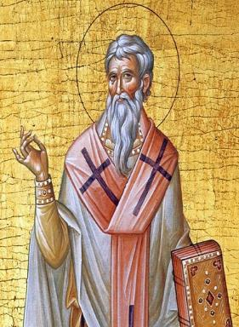
Late Date (A.D. 95) Irenaeus Against Heresies 5.30.3
“But if it had been necessary to announce his name plainly at the present time, it would have been spoken by him who saw the apocalypse. For it was not seen long ago, but almost in our own time, at the end of the reign of Domitian.”

Slide 59
Problems With Neronian Calculation
Inconsistent use of numbers
Transliteration from Greek to Hebrew
Not suggested by the ancient commentators
“Cherry picking” to fit an ordained outcome

Slide 60
Nero Does Not Fit the Facts of Revelation 13
Nero did not:
Usher in persecution for exactly 42 months (13:5)
Control the entire planet (13:7; 5:9)
Force people to receive a mark on their right hand or forehead in order to participate in the global economy (13:16-18)

Slide 61
Nero Does Not Fit the Facts of Revelation 13
Nero did not:
Coerce the entire world to worship a singular image of him (13:15)
Resurrect from the dead (13:14)
Associate with a miracle working false prophet (13:13, 15)
Receive global veneration (13:8)

Slide 62
Conclusion

Slide 63
The Second Beast Revelation 13:11-18
His ethnic identity (11a)
His character (11b)
His purpose (12)
His miracles (13)
His deception (14a)
His image-statue (14b-15)
His economic system (16-18)

Slide 64
“The Lord bless you and keep you; the Lord make his face shine on you and be gracious to you; the Lord turn his face toward you and give you peace.” (NIV)

