Slide 1


Slide 2

The Coming Kingdom
Chapter 20
Dr. Andy Woods
Senior Pastor – Sugar Land Bible Church
President – Chafer Theological Seminary

Slide 3

Kingdom Study Outline
What does the Bible Say About the Kingdom?
The Main Problem with Kingdom Now NT interpretations
Why do some believe that we are in the kingdom now?
Why does it matter?

Slide 4
Response to Kingdom Now Problem Passages
Passages from Christ’s ministry
Passages from Acts
Passages from Paul
Passages from the General letters
Passages from Revelation
Miscellaneous Arguments

Slide 5

4-5 Passages from:
The General Letters & Revelation
Receiving a kingdom (Heb. 12:28)
A kingdom of priests (1 Pet. 2:9)
A kingdom of priests (Rev. 1:6)
Fellow partaker in the kingdom (Rev. 1:9)
Jesus has the key of David (Rev. 3:7)
Jesus has already overcome (Rev 5:6)

Slide 6


1 Peter 2:9
“But you are a chosen race, a royal priesthood, a holy nation, a people for God’s own possession, so that you may proclaim the excellencies of Him who has called you out of darkness into His marvelous light.”

Slide 7


Slide 8
Exodus 19:5-6
“Now then, if you will indeed obey My voice and keep My covenant, then you shall be My own possession among all the peoples, for all the earth is Mine; and you shall be to Me a kingdom of priests and a holy nation.’ These are the words that you shall speak to the sons of Israel.”

Slide 9


Paul J. Achtemeier
Paul J. Achtemeier, 1 Peter: A Commentary on First Peter (Minneapolis: Augsburg Fortress, 1996), 152.
“The twofold description of the new community (2:5; 2:9–10) shows by its language that the church has now taken over the role of Israel.”

Slide 10
Two Issues
(1 Peter 2:9)
Similarity is not equality
1 Peter is not addressed to the Church at large

Slide 11
Two Issues
(1 Peter 2:9)
Similarity is not equality
1 Peter is not addressed to the Church at large

Slide 12
Two Issues
(1 Peter 2:9)
Similarity is not equality
1 Peter is not addressed to the Church at large

Slide 13

B. 1st Peter not Addressed to Church at Large
Evidence from 1 Peter
Answering arguments for a Gentile audience
Church Fathers
Conclusion
  Limited application of 1 Peter
  1 Peter 2:9 aimed at the Jewish remnant within the Church only

Slide 14
B. 1st Peter not Addressed to Church at Large
Evidence from 1 Peter
Answering arguments for a Gentile audience
Church Fathers
Conclusion
  Limited application of 1 Peter
  1 Peter 2:9 aimed at the Jewish remnant within the Church only

Slide 15
Evidence from 1 Peter
  Omission “to the Church/Churches of” (1 Pet. 1:1)
  “Scattered” or diaspora (1 Pet. 1:1)
  “Aliens” or “sojourners” or parepidēmois (1 Pet. 1:1; 2:11)
  Peter distinguishes his audience from the Gentiles (1 Pet. 2:12; 4:3)
  Singular nouns (1 Pet. 2:9)
  Peter’s sphere of ministry (Gal. 2:7-8)

Slide 16
Evidence from 1 Peter
  Omission “to the Church/Churches of” (1 Pet. 1:1)
  “Scattered” or diaspora (1 Pet. 1:1)
  “Aliens” or “sojourners” or parepidēmois (1 Pet. 1:1; 2:11)
  Peter distinguishes his audience from the Gentiles (1 Pet. 2:12; 4:3)
  Singular nouns (1 Pet. 2:9)
  Peter’s sphere of ministry (Gal. 2:7-8)

Slide 17
1 Peter 1:1
“Peter, an apostle of Jesus Christ, To those who reside as aliens, scattered throughout Pontus, Galatia, Cappadocia, Asia, and Bithynia, who are chosen.”

Slide 18
Evidence from 1 Peter
  Omission “to the Church/Churches of” (1 Pet. 1:1)
  “Scattered” or diaspora (1 Pet. 1:1)
  “Aliens” or “sojourners” or parepidēmois (1 Pet. 1:1; 2:11)
  Peter distinguishes his audience from the Gentiles (1 Pet. 2:12; 4:3)
  Singular nouns (1 Pet. 2:9)
  Peter’s sphere of ministry (Gal. 2:7-8)

Slide 19
1 Peter 1:1
“Peter, an apostle of Jesus Christ, To those who reside as aliens, scattered [diaspora] throughout Pontus, Galatia, Cappadocia, Asia, and Bithynia, who are chosen.”

Slide 20
Diaspora of 1 Peter 1:1
New Testament
  John 7:35; James 1:1
LXX (Septuagint)
  Deut 28:25; 30:4; Isa 49:6; Jer 41:17; Ps 174:2; 2 Macc 1:27; Jdt 5:19
Pseudepigraphical
  Pss. Sol. 8:28; T. Asher 7:2

Slide 21
1 Peter 1:1
“Peter, an apostle of Jesus Christ, To those who reside as aliens, scattered throughout Pontus, Galatia, Cappadocia, Asia, and Bithynia, who are chosen.”

Slide 22
Evidence from 1 Peter
  Omission “to the Church/Churches of” (1 Pet. 1:1)
  “Scattered” or diaspora (1 Pet. 1:1)
  “Aliens” or “sojourners” or parepidēmois (1 Pet. 1:1; 2:11)
  Peter distinguishes his audience from the Gentiles (1 Pet. 2:12; 4:3)
  Singular nouns (1 Pet. 2:9)
  Peter’s sphere of ministry (Gal. 2:7-8)

Slide 23
1 Peter 1:1
“Peter, an apostle of Jesus Christ, To those who reside as aliens [parepidēmois], scattered throughout Pontus, Galatia, Cappadocia, Asia, and Bithynia, who are chosen.”

Slide 24
1 Peter 2:11
“Beloved, I urge you as aliens [parepidēmois] and strangers to abstain from fleshly lusts which wage war against the soul.”

Slide 25

Hebrews 11:13
“All these died in faith, without receiving the promises, but having seen them and having welcomed them from a distance, and having confessed that they were strangers and exiles [parepidēmois] on the earth.”

Slide 26
Evidence from 1 Peter
  Omission “to the Church/Churches of” (1 Pet. 1:1)
  “Scattered” or diaspora (1 Pet. 1:1)
  “Aliens” or “sojourners” or parepidēmois (1 Pet. 1:1; 2:11)
  Peter distinguishes his audience from the Gentiles (1 Pet. 2:12; 4:3)
  Singular nouns (1 Pet. 2:9)
  Peter’s sphere of ministry (Gal. 2:7-8)

Slide 27
1 Peter 2:12
“Keep your behavior excellent among the Gentiles [ethnos], so that in the thing in which they slander you as evildoers, they may because of your good deeds, as they observe them, glorify God in the day of visitation.”

Slide 28
1 Peter 4:3
“For the time already past is sufficient for you to have carried out the desire of the Gentiles [ethnos], having pursued a course of sensuality, lusts, drunkenness, carousing, drinking parties and abominable idolatries.”

Slide 29

Arnold Fruchtenbaum
The Messianic Jewish Epistles, Ariel’s Bible Commentary (Tustin, CA: Ariel, 2005), 319.
“However, there is no exegetical basis for such a conclusion. That meaning is not consistent with the normal usage found elsewhere in the New Testament (i.e., Rom 11:11–14). The word Gentile should be understood in its common, primary meaning as a reference to non-Jews.”

Slide 30
Evidence from 1 Peter
  Omission “to the Church/Churches of” (1 Pet. 1:1)
  “Scattered” or diaspora (1 Pet. 1:1)
  “Aliens” or “sojourners” or parepidēmois (1 Pet. 1:1; 2:11)
  Peter distinguishes his audience from the Gentiles (1 Pet. 2:12; 4:3)
  Singular nouns (1 Pet. 2:9)
  Peter’s sphere of ministry (Gal. 2:7-8)

Slide 31
1 Peter 2:9
“But you are a chosen race, a royal priesthood, a holy nation, a people for God’s own possession, so that you may proclaim the excellencies of Him who has called you out of darkness into His marvelous light.”

Slide 32

Galatians 3:28
“There is neither Jew nor Greek, there is neither slave nor free man, there is neither male nor female; for you are all one in Christ Jesus.”

Slide 33
Romans 10:19
“But I say, surely Israel did not know, did they? First Moses says, ‘I will make you jealous by that which is not a nation [ethnos], By a nation without understanding will I anger you.’”

Slide 34
Evidence from 1 Peter
  Omission “to the Church/Churches of” (1 Pet. 1:1)
  “Scattered” or diaspora (1 Pet. 1:1)
  “Aliens” or “sojourners” or parepidēmois (1 Pet. 1:1; 2:11)
  Peter distinguishes his audience from the Gentiles (1 Pet. 2:12; 4:3)
  Singular nouns (1 Pet. 2:9)
  Peter’s sphere of ministry (Gal. 2:7-8)

Slide 35
Galatians 2:7-8
“⁷ But on the contrary, seeing that I had been entrusted with the gospel to the uncircumcised, just as Peter had been to the circumcised ⁸ (for He who effectually worked for Peter in his apostleship to the circumcised effectually worked for me also to the Gentiles).”

Slide 36
Order of Paul’s Letters
Galatians (A.D. 49)
1‒2 Thessalonians (A.D. 51)
1‒2 Corinthians (A.D. 56)
Romans (A.D. 57)
Ephesians, Colossians, Philemon, Philippians (A.D. 60‒62)
1 Timothy, Titus (A.D. 62‒66)
2 Timothy (A.D. 67)

Slide 37
B. 1st Peter not Addressed to Church at Large
Evidence from 1 Peter
Answering arguments for a Gentile audience
Church Fathers
Conclusion
  Limited application of 1 Peter
  1 Peter 2:9 aimed at the Jewish remnant within the Church only

Slide 38
Answering Arguments for a Gentile Audience
  “former ignorance” (1 Pet. 1:14)?
  “empty tradition handed down by your fathers” (1 Pet. 1:18)?
  Transition “from darkness to light” (1 Pet. 2:9)?
  “Idolatry” (1 Pet. 4:3)?
  Peter’s Greek name (1 Pet. 1:1)

Slide 39
Answering Arguments for a Gentile Audience
  “former ignorance” (1 Pet. 1:14)?
  “empty tradition handed down by your fathers” (1 Pet. 1:18)?
  Transition “from darkness to light” (1 Pet. 2:9)?
  “Idolatry” (1 Pet. 4:3)?
  Peter’s Greek name (1 Pet. 1:1)

Slide 40
1 Peter 1:14
“As obedient children, do not be conformed to the former lusts which were yours in your ignorance.”

Slide 41
Answering Arguments for a Gentile Audience
  “former ignorance” (1 Pet. 1:14)?
  “empty tradition handed down by your fathers” (1 Pet. 1:18)?
  Transition “from darkness to light” (1 Pet. 2:9)?
  “Idolatry” (1 Pet. 4:3)?
  Peter’s Greek name (1 Pet. 1:1)

Slide 42
1 Peter 1:18
“knowing that you were not redeemed with perishable things like silver or gold from your futile way of life inherited from your forefathers.”

Slide 43
Mark 7:13
“thus invalidating the word of God by your tradition which you have handed down; and you do many things such as that.”

Slide 44
Answering Arguments for a Gentile Audience
  “former ignorance” (1 Pet. 1:14)?
  “empty tradition handed down by your fathers” (1 Pet. 1:18)?
  Transition “from darkness to light” (1 Pet. 2:9)?
  “Idolatry” (1 Pet. 4:3)?
  Peter’s Greek name (1 Pet. 1:1)

Slide 45
1 Peter 2:9
“But you are a chosen race, a royal priesthood, a holy nation, a people for God’s own possession, so that you may proclaim the excellencies of Him who has called you out of darkness into His marvelous light.”

Slide 46
Answering Arguments for a Gentile Audience
  “former ignorance” (1 Pet. 1:14)?
  “empty tradition handed down by your fathers” (1 Pet. 1:18)?
  Transition “from darkness to light” (1 Pet. 2:9)?
  “Idolatry” (1 Pet. 4:3)?
  Peter’s Greek name (1 Pet. 1:1)

Slide 47
1 Peter 4:3
“For the time already past is sufficient for you to have carried out the desire of the Gentiles, having pursued a course of sensuality, lusts, drunkenness, carousing, drinking parties and abominable idolatries.”

Slide 48
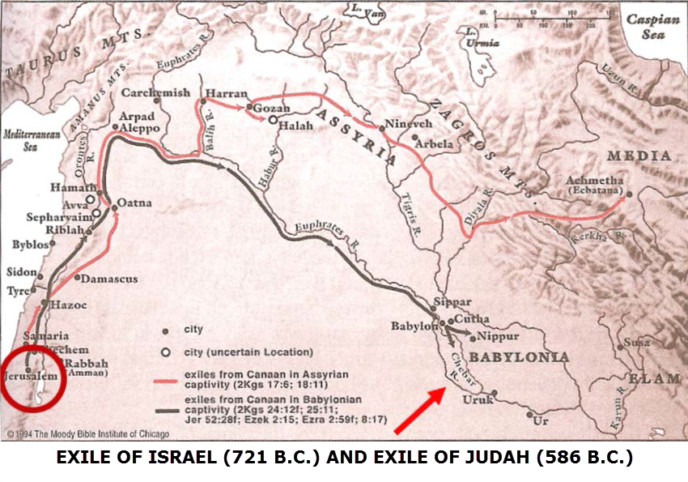

Slide 49
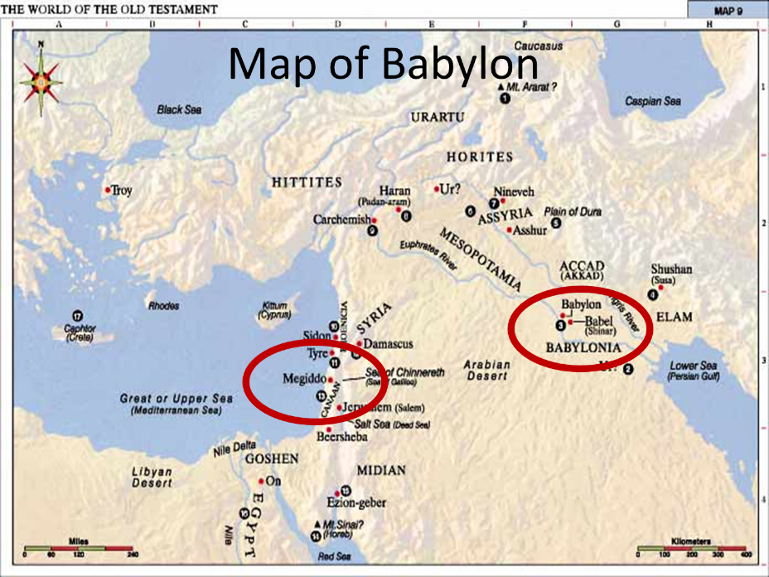

Slide 50
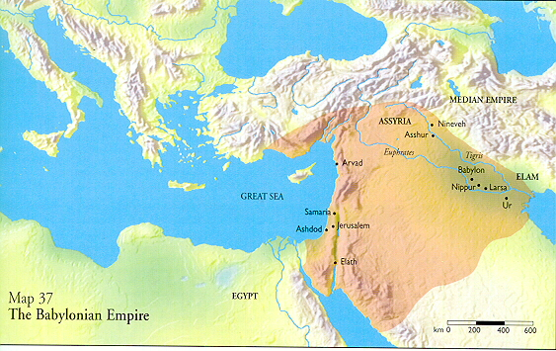

Slide 51

Galatians 5:20
“¹⁹ Now the deeds of the flesh are evident, which are: immorality, impurity, sensuality, ²⁰ idolatry, sorcery, enmities, strife, jealousy, outbursts of anger, disputes, dissensions, factions, ²¹ envying, drunkenness, carousing, and things like these, of which I forewarn you, just as I have forewarned you, that those who practice such things will not inherit the kingdom of God.”

Slide 52
Answering Arguments for a Gentile Audience
  “former ignorance” (1 Pet. 1:14)?
  “empty tradition handed down by your fathers” (1 Pet. 1:18)?
  Transition “from darkness to light” (1 Pet. 2:9)?
  “Idolatry” (1 Pet. 4:3)?
  Peter’s Greek name (1 Pet. 1:1)

Slide 53
1 Peter 1:1
“Peter [petros], an apostle of Jesus Christ, To those who reside as aliens, scattered throughout Pontus, Galatia, Cappadocia, Asia and Bithynia, who are chosen.”

Slide 54
1 Peter 1:1
“Peter [petros], an apostle of Jesus Christ, To those who reside as aliens, scattered throughout Pontus, Galatia, Cappadocia, Asia, and Bithynia, who are chosen.”

Slide 55
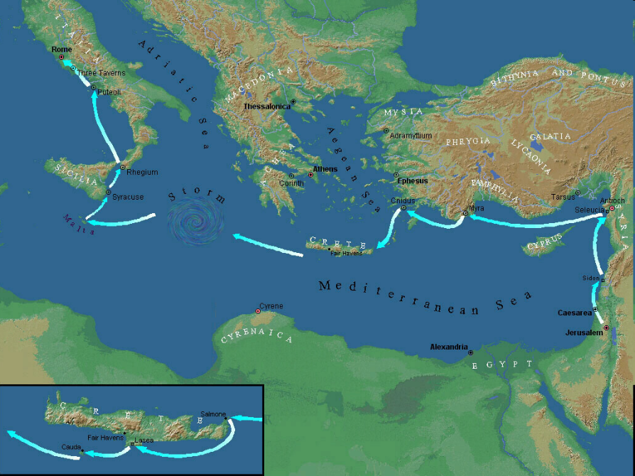

Slide 56
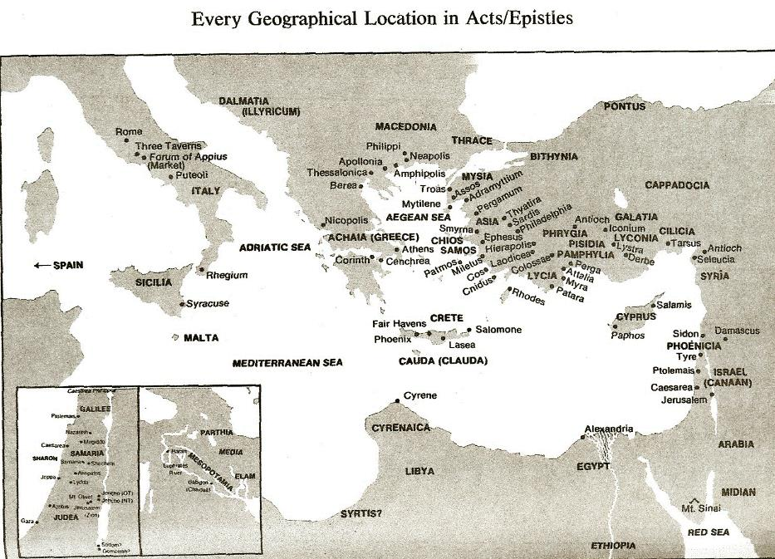

Slide 57
B. 1st Peter not Addressed to Church at Large
Evidence from 1 Peter
Answering arguments for a Gentile audience
Church Fathers
Conclusion
  Limited application of 1 Peter
  1 Peter 2:9 aimed at the Jewish remnant within the Church only

Slide 58
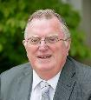
Gerald Bray
Gerald Bray, “James, 1‒2 Peter, 1‒3 John, Jude,” in Ancient Christian Commentary on Scripture: New Testament (Downers Grove, IL: InterVarsity, 2000), 65.
“With few exceptions, the Fathers believed that this letter was written by the apostle Peter and sent to Jewish Christians in the Diaspora (Eusebius of Caesarea, Didymus, Andreas, Oecumenius). They recognized that the letter has close resemblances to James, and they accounted for this by saying that both men were apostles to the Jews, though Peter seems to have concentrated more on those who lived outside Palestine (Andreas).”

Slide 59
B. 1st Peter not Addressed to Church at Large
Evidence from 1 Peter
Answering arguments for a Gentile audience
Church Fathers
Conclusion
  Limited application of 1 Peter
  1 Peter 2:9 aimed at the Jewish remnant within the Church only

Slide 60
B. 1st Peter not Addressed to Church at Large
Evidence from 1 Peter
Answering arguments for a Gentile audience
Church Fathers
Conclusion
  Limited application of 1 Peter
  1 Peter 2:9 aimed at the Jewish remnant within the Church only

Slide 61
Arnold Fruchtenbaum
The Messianic Jewish Epistles, Ariel’s Bible Commentary (Tustin, CA: Ariel, 2005), xvii.
“Of the twenty-one epistles in the New Testament, five were written to Jewish believers dealing with the needs of Jewish believers and specific issues that Jewish believers faced. There are things in these epistles applicable to all believers, but some are true only of Jewish believers. These five epistles are Hebrews, James, I & II Peter, and Jude.”

Slide 62

B. 1 Peter not Addressed to Church at Large
Evidence from 1 Peter
Answering arguments for a Gentile audience
Church Fathers
Conclusion
  Limited application of 1 Peter
  1 Peter 2:9 aimed at the Jewish remnant within the Church only

Slide 63
Arnold Fruchtenbaum
The Messianic Jewish Epistles, Ariel’s Bible Commentary (Tustin, CA: Ariel, 2005), 336, 344.
“It should be kept in mind that Peter is writing to Jewish believers. Throughout Scripture, there are always two Israels: Israel the whole that comprises all Jews; and, Israel the Remnant that comprises only believing Jews. Here, Peter distinguishes between the Remnant and the non-Remnant. Replacement Theology, however, relies on this passage as proof that the true Israel is the church. . . . .”

Slide 64
Arnold Fruchtenbaum
The Messianic Jewish Epistles, Ariel’s Bible Commentary (Tustin, CA: Ariel, 2005), 336, 344.
“This is a favorite passage for those who teach Replacement Theology. They teach that what the Old Testament stated to be true of Israel, Peter now applies and states to be true of the church. Thus, they conclude that the church has replaced Israel. However, there is no hint in the epistle that Peter is addressing the church as a whole. On the contrary, in the epistle’s introduction (1:1–2), he stated that he was addressing Jewish believers who specifically comprised what was the then Remnant of Israel— . . .

Slide 65
Arnold Fruchtenbaum
The Messianic Jewish Epistles, Ariel’s Bible Commentary (Tustin, CA: Ariel, 2005), 336, 344.
. . the Israel of God. It is important to recognize that the contrast Peter makes here is not between the church and Israel, or between believers and non-believers, or between unbelieving Jews and believing Gentiles. Rather, the contrast here is between the Remnant and the Non-Remnant of Israel. Peter’s point is that while Israel the whole failed to fulfill its calling, the Remnant of Israel has not failed to fulfill its calling.”

Slide 66

Two Issues
(1 Peter 2:9)
Similarity is not equality
1 Peter is not addressed to Church at large

Slide 67
4-5 Passages from:
The General Letters & Revelation
Receiving a kingdom (Heb. 12:28)
A kingdom of priests (1 Pet. 2:9)
A kingdom of priests (Rev. 1:6)
Fellow partaker in the kingdom (Rev. 1:9)
Jesus has the key of David (Rev. 3:7)
Jesus has already overcome (Rev 5:6)

Slide 68


Revelation 1:6
“and He has made us to be a kingdom, priests to His God and Father—to Him be the glory and the dominion forever and ever. Amen.”

Slide 69
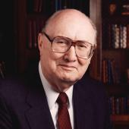
Two Rules of Interpretation
Search the immediate context
  Walvoord: 26X
Search the remote context
  Old Testament
  Thomas: 278 / 404 verses

Slide 70
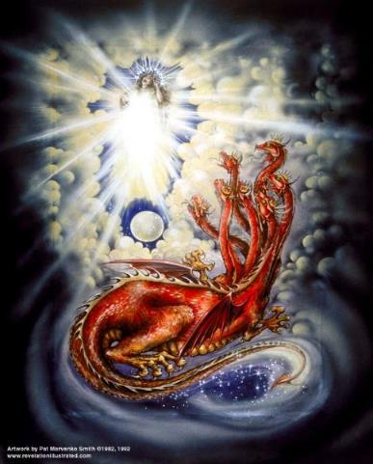
CAST OF 3 CHARACTERS
Revelation 12:1-5
SON = MESSIAH
  Ps. 2:9; Acts 1:9
DRAGON = SATAN
  Rev. 12:9; 20:2
WOMAN = ISRAEL
  Gen. 37:9-10

Slide 71
Revelation 5:10
“You have made them to be a kingdom and priests to our God; and they will reign [basileuō] upon the earth [gē].”

Slide 72


Slide 73
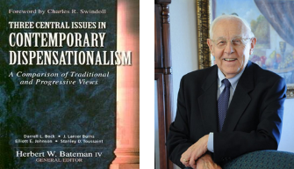
Stanley D. Toussaint
“Israel and the Church of a Traditional Dispensationalist,” in Three Central Issues in Contemporary Dispensationalism, ed. Herbert W. Bateman (Grand Rapids: Kregel, 1999), 248.
“The explanation of this verse is found in 5:10 (NASB), which anticipates the future reign of believers with Christ.”

Slide 74
4-5 Passages from:
The General Letters & Revelation
Receiving a kingdom (Heb. 12:28)
A kingdom of priests (1 Pet. 2:9)
A kingdom of priests (Rev. 1:6)
Fellow partaker in the kingdom (Rev. 1:9)
Jesus has the key of David (Rev. 3:7)
Jesus has already overcome (Rev 5:6)

Slide 75
Revelation 1:9
“I, John, your brother and fellow partaker in the tribulation and kingdom and perseverance which are in Jesus, was on the island called Patmos because of the word of God and the testimony of Jesus.”

Slide 76
Revelation 5:10
“You have made them to be a kingdom and priests to our God; and they will reign [basileuō] upon the earth [gē].”

Slide 77
Revelation 11:15
¹⁵ “Then the seventh angel sounded; and there were loud voices in heaven, saying, ‘The kingdom of the world has become the kingdom of our Lord and of His Christ; and He will reign forever and ever.’”

Slide 79

Dr. Robert Thomas
Revelation 1 to 7: An Exegetical Commentary (Chicago: Moody Press, 1992), 87.
Dr. Robert Thomas observes that, "Little difference of opinion exists over the meaning of basileia [kingdom] in 1:9. It is the millennial kingdom described more fully in Revelation 20.”

Slide 80
CONCLUSION

Slide 81
4-5 Passages from:
The General Letters & Revelation
Receiving a kingdom (Heb. 12:28)
A kingdom of priests (1 Pet. 2:9)
A kingdom of priests (Rev. 1:6)
Fellow partaker in the kingdom (Rev. 1:9)
Jesus has the key of David (Rev. 3:7)
Jesus has already overcome (Rev 5:6)

