Slide 1
Dr. Andy Woods
Senior Pastor – Sugar Land Bible Church
President – Chafer Theological Seminary

Slide 3
Seven Trumpets (Revelation 8‒11)
1st Trumpet (8:7) – 1/3 vegetation destroyed
2nd Trumpet (8:8-9) – 1/3 ocean destroyed
3rd Trumpet (8:10-11) – 1/3 water destroyed
4th Trumpet (8:12-13) – 1/3 luminaries darkened
5th Trumpet (9:1-12) – Demons released
6th Trumpet (9:13-21) – 1/3 humanity destroyed
7th Trumpet (11:14-19) – Legal transfer announced

Slide 5
5 Non-Chronological Parenthetical Insertions
Rev 7 – 144,000 Jews
Rev 10:1-11:13 – Announcement of no more delay and the two witnesses
Rev 12-14 – Israel’s flight, two beasts, six scenes of hope
Rev 16:13-16 – Gathering of the nations to Armageddon
Rev 17:1-19:6 – Babylon’s fall

Slide 6
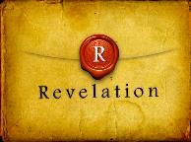
Revelation 11:15
“Then the seventh angel sounded; and there were loud voices in heaven, saying, ‘The kingdom of the world has become the kingdom of our Lord and of His Christ; and He will reign (basileuō) forever and ever.’” (cf. Matt. 6:10)

Slide 7
Revelation 12‒14
Rev 12 – Israel’s flight
Rev 13 – Two beasts
Rev 14 – Six scenes of hope

Slide 8
Revelation 12‒14
Rev 12 – Israel’s flight
Rev 13 – Two beasts
Rev 14 – Six scenes of hope

Slide 9
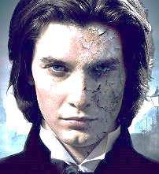
Two Beasts (Revelation 13)
First beast (13:1-10)
Second beast (13:11-18)

Slide 10
Two Beasts (Revelation 13)
First beast (13:1-10)
Second beast (13:11-18)

Slide 11
The First Beast Revelation 13:1-10
His sudden appearance in John’s vision (1a)
His Gentile ethnicity (1b)
His fulfillment of Daniel’s prophecies (1c-2a)
His Satanic empowerment (2b)
His resurrection (3)
His power-based adoration (4)
His oratory (5a)

Slide 12
The First Beast Revelation 13:1-10
His time of authority (5b)
His blasphemies (6)
His persecution of God’s people (7a)
His global jurisdiction (7b)
His unregenerate audience (8)
His oppressive influence (9-10)

Slide 13
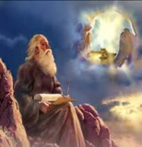
What (or Who) Does the Beast Blaspheme? (Rev. 13:6)
God (Rev. 4:9; 5:6-7)
God’s Name (Isa. 29:23; Ezek. 36:23)
God’s Tabernacle (Rev. 11:19; 15:5)
Heaven Dwellers (Rev. 5:11; 7:11)
Myriads of Angels
Four Living Creatures
Church (Rev. 1:20; 4:5)

Slide 14
What (or Who) Does the Beast Blaspheme? (Rev. 13:6)
God (Rev. 4:9; 5:6-7)
God’s Name (Isa. 29:23; Ezek. 36:23)
God’s Tabernacle (Rev. 11:19; 15:5)
Heaven Dwellers (Rev. 5:11; 7:11)
Myriads of Angels
Four Living Creatures
Church (Rev. 1:20; 4:5)

Slide 15
What (or Who) Does the Beast Blaspheme? (Rev. 13:6)
God (Rev. 4:9; 5:6-7)
God’s Name (Isa. 29:23; Ezek. 36:23)
God’s Tabernacle (Rev. 11:19; 15:5)
Heaven Dwellers (Rev. 5:11; 7:11)
Myriads of Angels
Four Living Creatures
Church (Rev. 1:20; 4:5)

Slide 16
What (or Who) Does the Beast Blaspheme? (Rev. 13:6)
God (Rev. 4:9; 5:6-7)
God’s Name (Isa. 29:23; Ezek. 36:23)
God’s Tabernacle (Rev. 11:19; 15:5)
Heaven Dwellers (Rev. 5:11; 7:11)
Myriads of Angels
Four Living Creatures
Church (Rev. 1:20; 4:5)

Slide 17
What (or Who) Does the Beast Blaspheme? (Rev. 13:6)
God (Rev. 4:9; 5:6-7)
God’s Name (Isa. 29:23; Ezek. 36:23)
God’s Tabernacle (Rev. 11:19; 15:5)
Heaven Dwellers (Rev. 5:11; 7:11)
Myriads of Angels
Four Living Creatures
Church (Rev. 1:20; 4:5)

Slide 18
What (or Who) Does the Beast Blaspheme? (Rev. 13:6)
God (Rev. 4:9; 5:6-7)
God’s Name (Isa. 29:23; Ezek. 36:23)
God’s Tabernacle (Rev. 11:19; 15:5)
Heaven Dwellers (Rev. 5:11; 7:11)
Myriads of Angels
Four Living Creatures
Church (Rev. 1:20; 4:5)

Slide 19
What (or Who) Does the Beast Blaspheme? (Rev. 13:6)
God (Rev. 4:9; 5:6-7)
God’s Name (Isa. 29:23; Ezek. 36:23)
God’s Tabernacle (Rev. 11:19; 15:5)
Heaven Dwellers (Rev. 5:11; 7:11)
Myriads of Angels
Four Living Creatures
Church (Rev. 1:20; 4:5)

Slide 20
What (or Who) Does the Beast Blaspheme? (Rev. 13:6)
God (Rev. 4:9; 5:6-7)
God’s Name (Isa. 29:23; Ezek. 36:23)
God’s Tabernacle (Rev. 11:19; 15:5)
Heaven Dwellers (Rev. 5:11; 7:11)
Myriads of Angels
Four Living Creatures
Church (Rev. 1:20; 4:5)

Slide 21
Twenty-Four Elders (Church) (Rev. 4:4; 5:8-10)
DESCRIPTION | SCRIPTURE
1. Crowned | (2:10)
2. Resurrected | (4:4)
3. Clothed in White | (3:5)
4. Redeemed | (5:8-10)
5. Global | (5:9; Matt. 28:19)
6. Enthroned | (3:21)
7. Elders | (1 Tim. 3:1-7)
8. Kingdom of Priests | (Rev. 1:6)
9. Twenty-four | (Rev. 1:6)

Slide 22
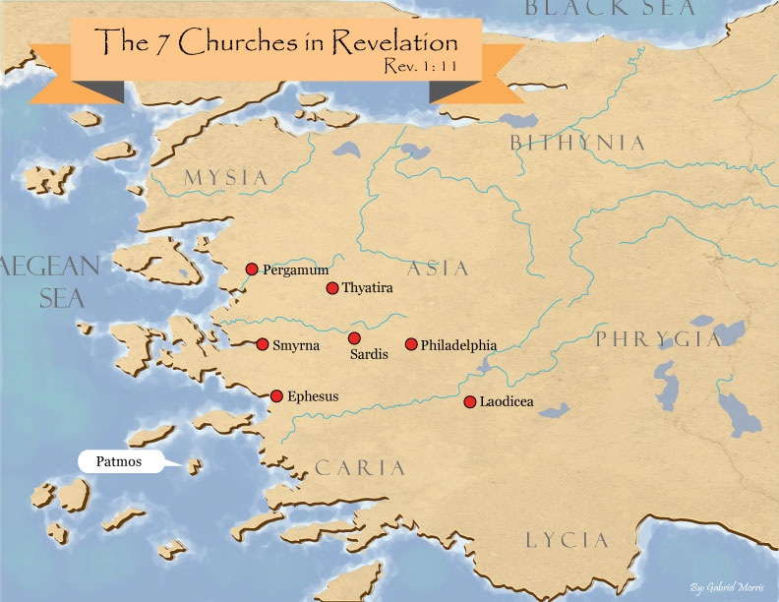

Slide 23
DESCRIPTION OF THE SEVEN CHURCHES Revelation 2‒3
CHURCH | SCRIPTURE | DESCRIPTION
Ephesus | 2:1-7 | Loveless
Smyrna | 2:8-11 | Persecuted
Pergamum | 2:12-17 | Compromised
Thyatira | 2:18-29 | Corrupt
Sardis | 3:1-6 | Dead
Philadelphia | 3:7-13 | Missionary
Laodicea | 3:14-22 | Man-centered

Slide 24
The Coming Synthesis
Alice A. Bailiey and Dijwhal Khul, The Seventh Ray: Revealer of the New Age (NY: Lucius Press, 1995), 198-99.
“The coming of the Aquarian age also stimulates in man a spirit of universality and a tendency towards fusion. This can be seen working out in the present trend towards synthesis in business, in religion and in politics. It produces an urge towards union, and among other unions, towards religious understanding and tolerance...False and true standards will emerge in man’s consciousness, and those choices will be made which will lay the foundation of the new order, which will inaugurate the new race, with its new laws and novel approaches, and so usher in the new religion of love and brotherhood, and that period wherein the group and the group-good will be the dominant note. Then separateness and hatreds will fade out and men will be merged in a true unity."

Slide 25
Explanation of the missing
Barbara Marx Hubbard, The Revelation: A Message of Hope for the New Millennium, 2nd ed. (Novato, CA: Nataraj, 1995), 65, 66, 195, 233, 240, 255.
“Your unfinished species is ready to evolve. The time has come on Earth for this quantum change to occur in many of you." Her "Christ" further informed her "I cannot 'return' until enough of you are attracted and linked." Hubbard's "Christ" explained, "I did not intend for you to deify me, but to deify yourselves as being at the same stage of evolution as I am." "Suffice it to say, that if you do not choose to evolve into a wholesome, co-creative human, then you shall not." "...the fundamental regression is self-centeredness, or the illusion that you are separate from God. I 'make war' on self-centeredness.”……Furthermore, "At the co-creative stage of…

Slide 26
Explanation of the missing (cont’d)
Barbara Marx Hubbard, The Revelation: A Message of Hope for the New Millennium, 2nd ed. (Novato, CA: Nataraj, 1995), 65, 66, 195, 233, 240, 255.
…evolution, one self-centered soul is like a lethal cancer cell in a body; deadly to itself and to the whole." Thus, "The surgeon dare leave no cancer in the body when he closes up the wound after a delicate operation. We dare leave no self-centered person on Earth after the selection process.”

Slide 27
The First Beast Revelation 13:1-10
His time of authority (5b)
His blasphemies (6)
His persecution of God’s people (7a)
His global jurisdiction (7b)
His unregenerate audience (8)
His oppressive influence (9-10)

Slide 28
Distinctions Between 144,000 & Multitude
144,000 | MULTITUDE
Revelation 7:1-8 | Revelation 7:9-17
Numbered | Innumerable
Jews | All nations
Sealed | Slain
Sealed before the Tribulation | Converted out of the Tribulation
Hitchcock and Ice, The Truth Behind Left Behind, 77

Slide 29
Revelation 1:19
“Therefore write the things which you have seen, and the things which are, and the things which will take place after these things [meta tauta].”

Slide 30
Revelation 1:19
Seen (Chapter 1)
Are (Chapters 2–3)
After these things (Chapters 4–22)

Slide 31
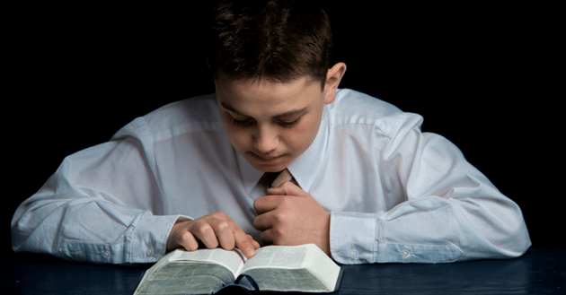
Psalm 50:5 (NKJV)
“Gather My saints together to Me, Those who have made a covenant with Me by sacrifice.”

Slide 32
Psalm 149:1 (NKJV)
“Praise the Lord! Sing to the Lord a new song, And His praise in the assembly of saints.”

Slide 33
Matthew 16:18
“I also say to you that you are Peter, and upon this rock I will build [oikodomeō] My church; and the gates of Hades will not overpower it.”

Slide 34
The First Beast Revelation 13:1-10
His time of authority (5b)
His blasphemies (6)
His persecution of God’s people (7a)
His global jurisdiction (7b)
His unregenerate audience (8)
His oppressive influence (9-10)

Slide 35
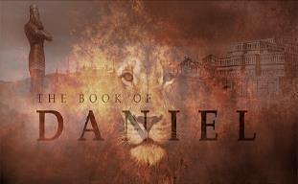
Daniel 7:23
“Thus he said: ‘The fourth beast will be a fourth kingdom on the earth, which will be different from all the other kingdoms and will devour the whole earth and tread it down and crush it.”

Slide 36
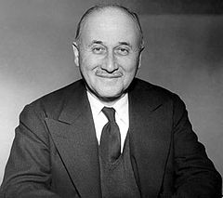
Jean Monnet (1888‒1979) Jean Monet, Memoirs (New York: Doubleday, 1978), 524.
“The sovereign nations of the past can no longer solve the problems of the present; they cannot ensure their own progress or control their own future… And the European community itself is only a stage on the way to the organized world of tomorrow.”

Slide 37
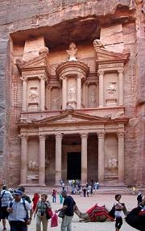
Place of Hebrew Refuge: Petra in Mt. Seir in S. Jordan
Prepared by God (Rev. 12:6)
Divine provision of food & water (Isa. 33:16; Rev. 12:6)
Wilderness (Rev. 12:6, 14)
Mountains (Isa. 33:16; Matt. 24:16)
Defensible (Isa. 33:16)
Jordan (Dan. 11:41)
Bozrah (Micah 2:12)
Fruchtenbaum, Footsteps of the Messiah, 294-97

Slide 38
Daniel 11:41
“He will also enter the Beautiful Land, and many countries will fall; but these will be rescued out of his hand: Edom, Moab and the foremost of the sons of Ammon.”

Slide 39
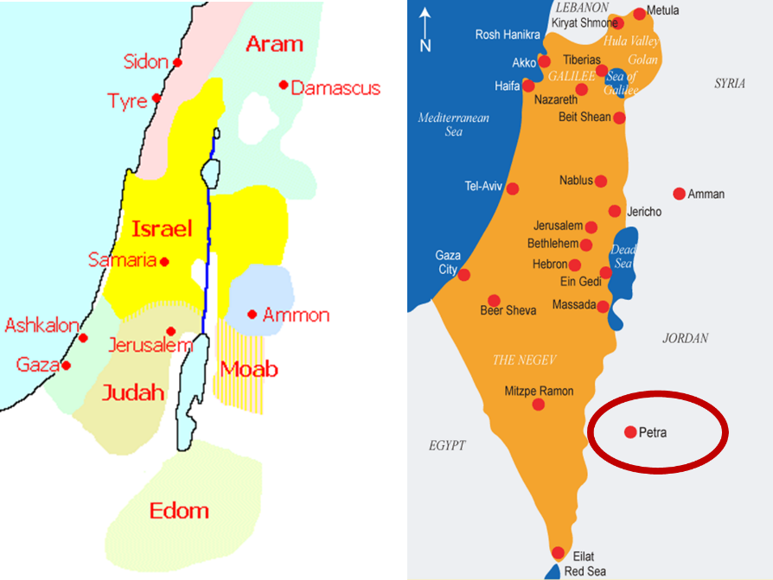

Slide 40
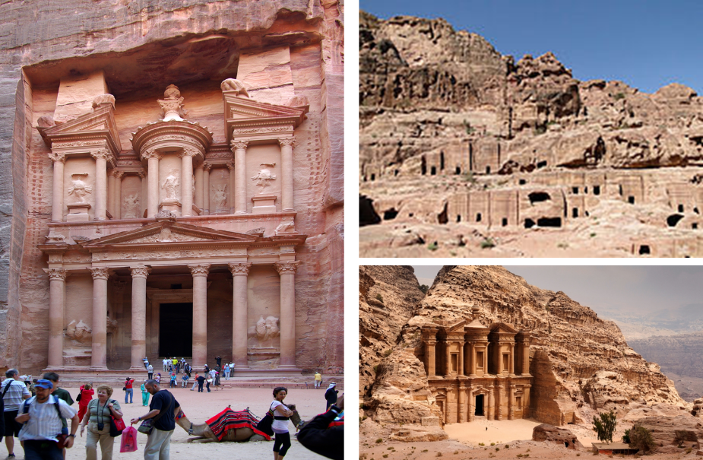

Slide 41
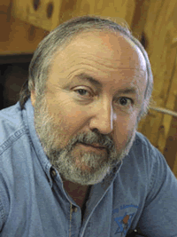
Arnold Fruchtenbaum Footseps of the Messiah, Page 296-97
“Another suggestion is the city now known as Petra…this author prefers the identification with Petra. Petra is located in a basin within Mount Seir, and is totally surrounded by mountains and cliffs. The only way in and out of the city is through a narrow passageway that extends for about a mile and can only be negotiated by foot or by horseback. This makes the city easy to defend, and its surrounding high cliffs give added meaning and confirmation to Isaiah 33:16. Only a few abreast can enter through this passage at any one time, giving this city even greater defensibility.”

Slide 42
Arnold Fruchtenbaum Footseps of the Messiah, Page 296-97
“The name Bozrah means ‘sheepfold.’ An ancient sheepfold had a narrow entrance so that the shepherd could count his sheep. Once inside the fold, the sheep had more room to move around. Petra is shaped like a giant sheepfold, with its narrow passage opening up to a spacious circle surrounded by cliffs. This is not true of the town of Buseira. Furthermore, by modern Petra is a site known as Butzeira, which retains the Hebrew Botzrah...It will be a very defensible city located in Mount Seir...Furthermore, as they flee and while they are living there, food and water will be miraculously provided.”

Slide 43
The First Beast Revelation 13:1-10
His time of authority (5b)
His blasphemies (6)
His persecution of God’s people (7a)
His global jurisdiction (7b)
His unregenerate audience (8)
His oppressive influence (9-10)

Slide 44
“…one of the mistakes that human beings make is believing that there is only one way…We don’t accept that there are diverse ways of being in the world; that there are millions of ways to be a human being. And many ways…many paths to what you call God. That her path might be something else and when she gets there she might call it the light. But her loving, and her kindness, and her generosity brings her to the…same point that it brings you…”
www.youtube.com/watch?v=Lb2RUpMDk34

Slide 45
The First Beast Revelation 13:1-10
His time of authority (5b)
His blasphemies (6)
His persecution of God’s people (7a)
His global jurisdiction (7b)
His unregenerate audience (8)
His oppressive influence (9-10)

Slide 46
Revelation 1:19
“Therefore write the things which you have seen, and the things which are, and the things which will take place after these things [meta tauta].”

Slide 47
Revelation 1:19
Seen (Chapter 1)
Are (Chapters 2–3)
After these things (Chapters 4–22)

Slide 49
DESCRIPTION OF THE SEVEN CHURCHES Revelation 2‒3
CHURCH | SCRIPTURE | DESCRIPTION
Ephesus | 2:1-7 | Loveless
Smyrna | 2:8-11 | Persecuted
Pergamum | 2:12-17 | Compromised
Thyatira | 2:18-29 | Corrupt
Sardis | 3:1-6 | Dead
Philadelphia | 3:7-13 | Missionary
Laodicea | 3:14-22 | Man-centered

Slide 50
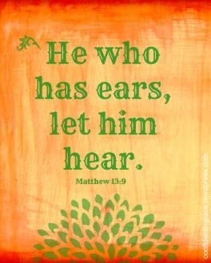
Matthew 13:9
“He who has ears, let him hear.”

Slide 51
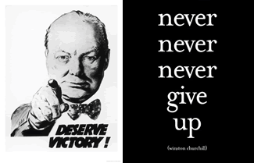
Matthew 24:13
“But the one who endures to the end, he will be saved.”

Slide 52
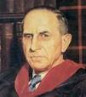
John Murray
Redemption Accomplished and Applied, pp. 152, 154-55.
“The crucial test of true faith is endurance to the end, abiding in Christ, and continuance in the Word…He cannot abandon himself to sin; he cannot come under the domination of sin; he cannot be guilty of certain kinds of unfaithfulness…Let us appreciate the doctrine of the perseverance of the saints and recognize that we may entertain the faith of our security in Christ only as we persevere in faith and holiness to the end.”

Slide 53
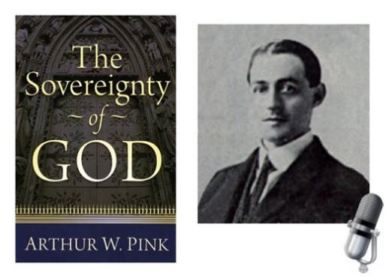
A. W. Pink
Practical Christianity, p. 16.
“Readers, if there is a reserve in your obedience, you are on your way to hell.”

Slide 54
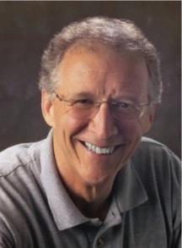
John Piper
John Piper and Pastoral Staff, TULIP: What We Believe about the Five Points of Calvinism: Position Paper of the Pastoral Staff (Desiring God Ministries, 1997), 25, cited in Dave Hunt, What Love is This?, 379.
“No Christian can be sure that he is a true believer. Hence, there is an ongoing need to be dedicated to the Lord and to deny ourselves so that we might make it.”

Slide 55
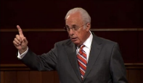
John MacArthur
Saved Without A Doubt, p. 177
“If a person fails to love and obey the Lord through the trials of life, then there is no evidence that he possesses saving faith. How many people do you know who came to church for a while, had a little trouble in their lives, and left? Although they may have made a profession of faith in Christ, they cannot be identified as those who love Him because their lives are not characterized by enduring obedience.”

Slide 56
R.C. Sproul – Bob Wilkin as quoted in:
http://www.gracebiblestudies.org/Resources/Web/www.duluthbible.org/g_f_j/EternalSecurity12.htm
“During the first message presented at Ligonier’s Conference in Orlando last June, Dr. R. C. Sproul indicated that Dr. James Boice, a scheduled speaker at the conference, was dying in faith that very night. Then at the end of the message he asked all 5,000 of us present to pray that Jim dies in faith. This struck me as sad. Here was a great pastor, theologian, teacher, and author. Yet Sproul was not sure that he was regenerate. (In Reformed thought, if a person fails to die in faith, he proved he was never saved in the first place.) I was reminded of R.T. Kendall’s remark that nearly to a man the Puritan divines died doubting whether they were saved and fearing they were going to hell. Dr. Boice died that very night, June 15th.”

Slide 57
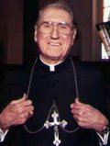
Cardinal John O’Connor of NY
quoted in Samuel Howe Verhovek, Cardinal Defends a Jailed Bishop Who Warned Cuomo on Abortion, New York Times, February 1, 1990.
“Church teaching is that I don't know, at any given moment, what my eternal future will be… I can hope, pray, do my very best – but I still don't know. Pope John II doesn't absolutely know that he will go to heaven, nor does mother Theresa of Calcutta, unless either has had a special divine revelation.”

Slide 58
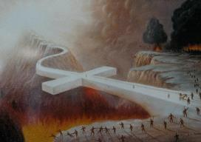
John 5:24
“Truly, truly, I say to you, he who hears My word, and believes Him who sent Me, has eternal life, and does not come into judgment, but has passed out of death into life.”

Slide 59
1 John 5:13
“These things I have written to you who believe in the name of the Son of God, so that you may know that you have eternal life.”

Slide 60
Psalm 50:5 (NKJV)
“Gather My saints together to Me, Those who have made a covenant with Me by sacrifice.”

Slide 61
Psalm 149:1 (NKJV)
“Praise the Lord! Sing to the Lord a new song, And His praise in the assembly of saints.”

Slide 62
Revelation 1:19
Seen (Chapter 1)
Are (Chapters 2–3)
After these things (Chapters 4–22)

Slide 63
Conclusion

Slide 64
The First Beast Revelation 13:1-10
His sudden appearance in John’s vision (1a)
His Gentile ethnicity (1b)
His fulfillment of Daniel’s prophecies (1c-2a)
His Satanic empowerment (2b)
His resurrection (3)
His power-based adoration (4)
His oratory (5a)

Slide 65
The First Beast Revelation 13:1-10
His time of authority (5b)
His blasphemies (6)
His persecution of God’s people (7a)
His global jurisdiction (7b)
His unregenerate audience (8)
His oppressive influence (9-10)

Slide 66
“The Lord bless you and keep you; the Lord make his face shine on you and be gracious to you; the Lord turn his face toward you and give you peace.” (NIV)

