Slide 1
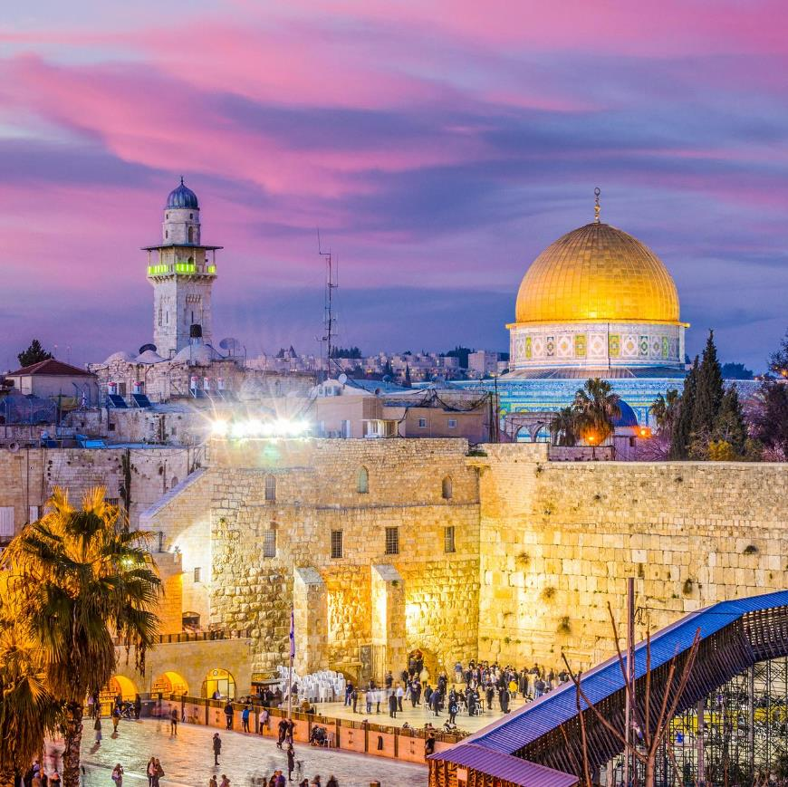
ISRAEL
2019
ANDY WOODS
Part 10

Slide 2
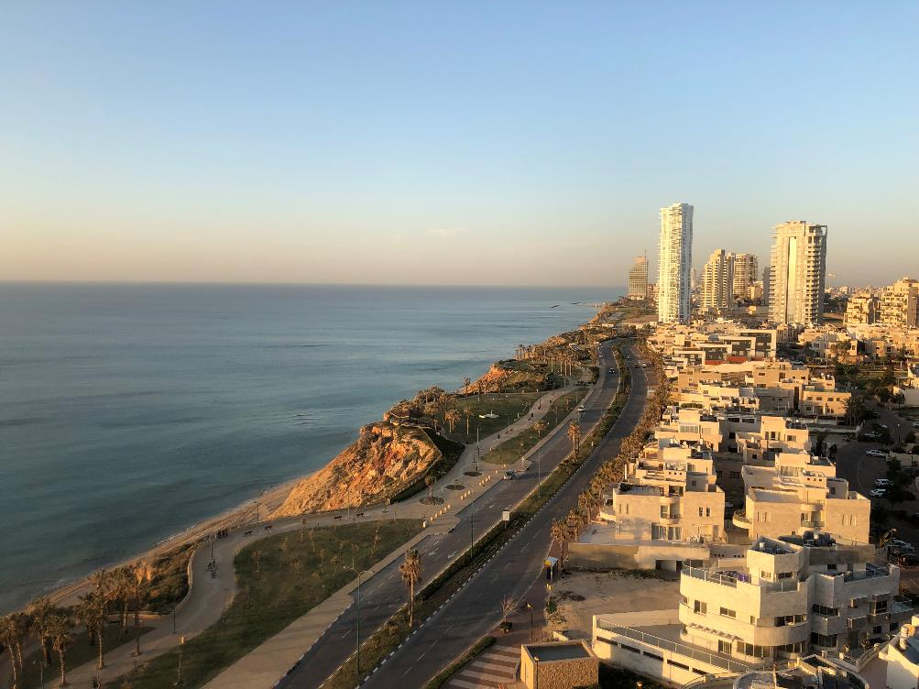
Tel Aviv, Joppa, Caesarea Maritma,
Mt. Carmel, Megiddo
Part 1

Slide 3
Sepphoris, Upper Galilee/Caesarea-Philippi andTel Dan, Sea of Galilee, Mt. of Beatitudes
Part 2

Slide 4
Capernaum, Tabgha
Part 3

Slide 5
Jordan River, Bet She 'An, Jericho, Dead Sea, Masada
Part 4

Slide 6
Qumran, En Gedi, Jerusalem
Part 5

Slide 7
Jerusalem –Mt. of Olives, Garden of Gethsemane, Southern Steps, Western Wall, Temple Institute
Part 6

Slide 8
Jerusalem – Garden Tomb, Golgotha, Upper Room, Pool of Siloam
Part 7

Slide 9
Jerusalem – Pool of Bethesda, Western Wall Tunnel, Hezekiah’s Tunnel, , US Embassy
Part 8

Slide 10
City of David, Valley of Elah, Shiloh
Part 9

Slide 11
Gideon’s Spring, Bethlehem, Yad Vashem
Part 10

Slide 12
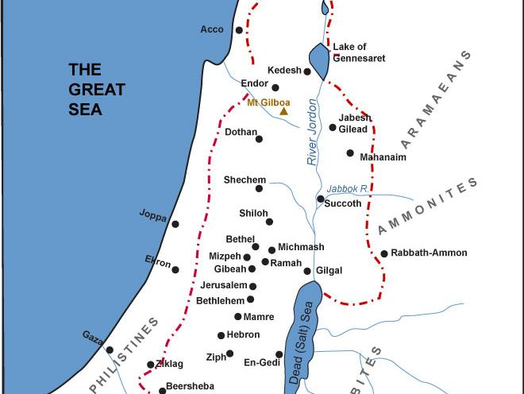

Slide 13

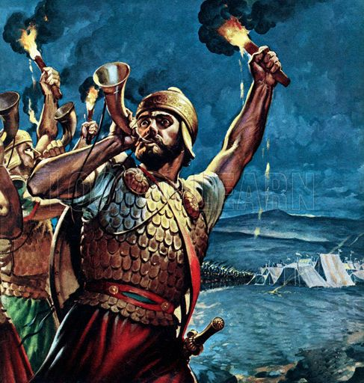
Judges 6:15
“He said to Him, ‘O Lord, how shall I deliver Israel? Behold, my family is the least in Manasseh, and I am the youngest in my father’s house.’”

Slide 14
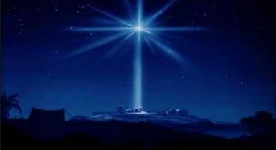
Micah 5:2
“But as for you, Bethlehem Ephrathah, Too little to be among the clans of Judah, From you One will go forth for Me to be ruler in Israel. His goings forth are from long ago, From the days of eternity (olam).”

Slide 15
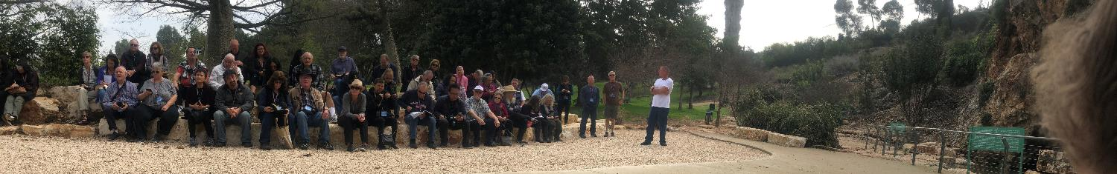
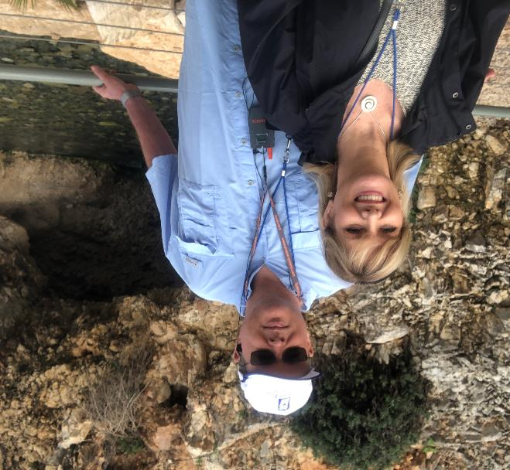
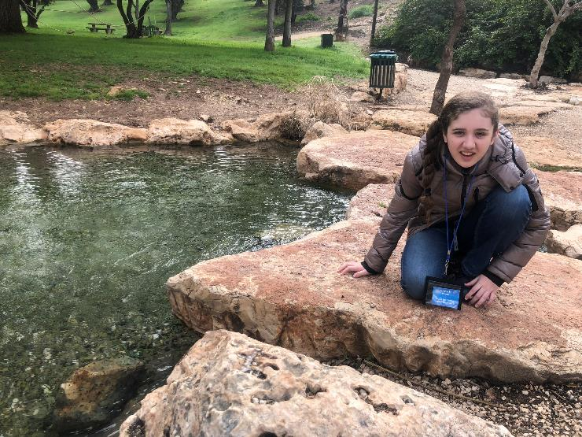
Gideon’s Spring

Slide 16
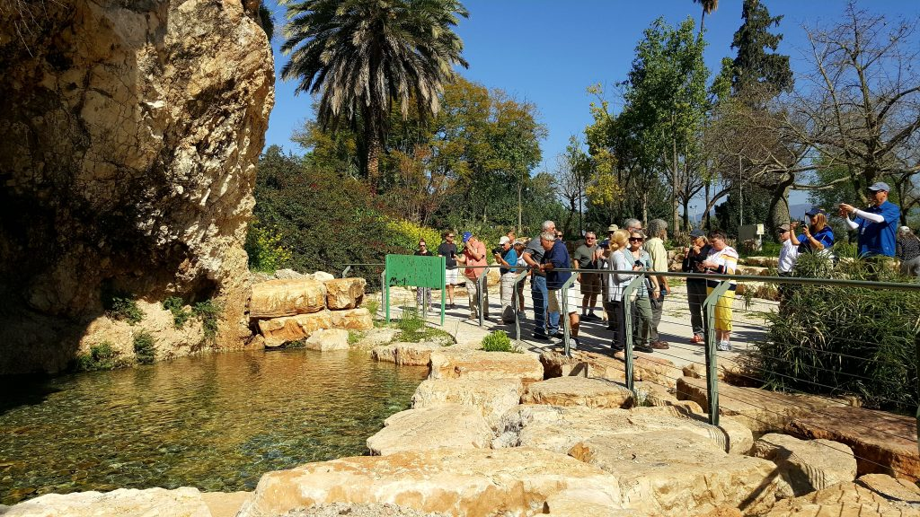
Gideon’s Spring

Slide 17
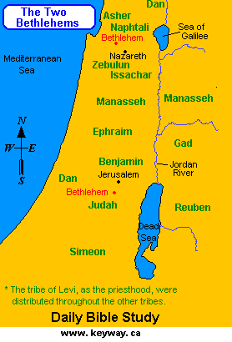

Slide 18
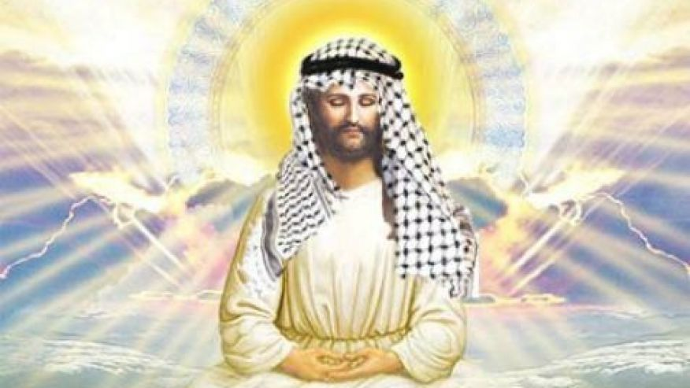

Slide 19
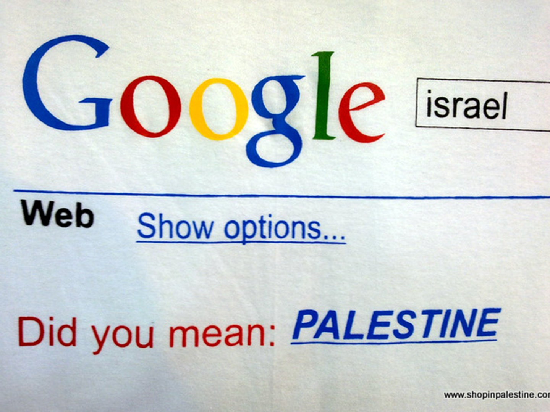

Slide 20
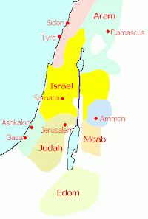

Slide 21
Micah 5:2
“But as for you, Bethlehem Ephrathah, Too little to be among the clans of Judah, From you One will go forth for Me to be ruler in Israel. His goings forth are from long ago, From the days of eternity (olam).”

Slide 22
Micah 5:2
“But as for you, Bethlehem Ephrathah, Too little to be among the clans of Judah, From you One will go forth for Me to be ruler in Israel. His goings forth are from long ago, From the days of eternity (olam).”

Slide 23


Psalm 90:2
“Before the mountains were born Or You gave birth to the earth and the world, Even from everlasting (olam) to everlasting (olam), You are God.”

Slide 24


Slide 25
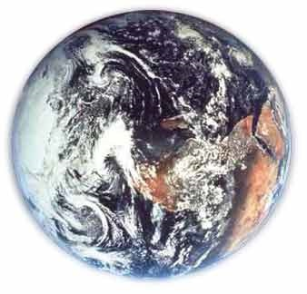
Modern Example
Hemisphere
Country
State
County
City
Zip code
Street name
Street address
Room
Person

Slide 26
Micah 5:2
“But as for you, Bethlehem Ephrathah, Too little to be among the clans of Judah, From you One will go forth for Me to be ruler in Israel. His goings forth are from long ago, From the days of eternity (olam).”

Slide 27
Micah 5:2
“But as for you, Bethlehem Ephrathah, Too little to be among the clans of Judah, From you One will go forth for Me to be ruler in Israel. His goings forth are from long ago, From the days of eternity (olam).”

Slide 28
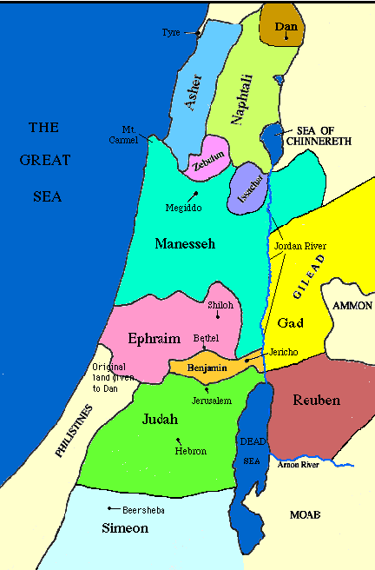

Slide 29
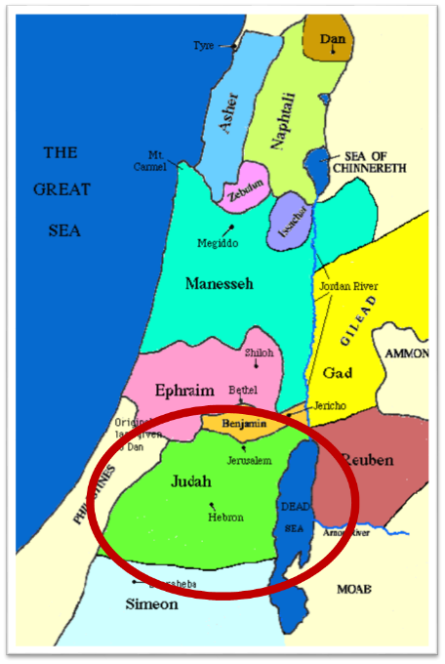

Slide 30
Messiah must be from the tribe of Judah
Genesis 49:10
Revelation 5:5

Slide 31
Micah 5:2
“But as for you, Bethlehem Ephrathah, Too little to be among the clans of Judah, From you One will go forth for Me to be ruler in Israel. His goings forth are from long ago, From the days of eternity (olam).”

Slide 32
Micah 5:2
“But as for you, Bethlehem Ephrathah, Too little to be among the clans of Judah, From you One will go forth for Me to be ruler in Israel. His goings forth are from long ago, From the days of eternity (olam).”

Slide 33
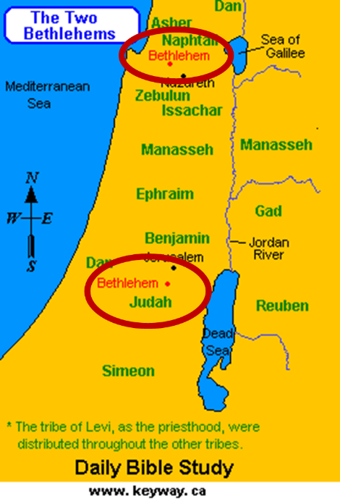

Slide 34
Micah 5:2
“But as for you, Bethlehem Ephrathah, Too little to be among the clans of Judah, From you One will go forth for Me to be ruler in Israel. His goings forth are from long ago, From the days of eternity (olam).”

Slide 35
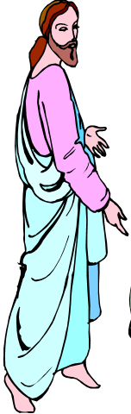
7 “I AM” statements in John
I am the Bread of Life | 6:35
I am the Light of the world | 8:12
I am the Gate for the sheep | 10:7; cf. v.9
I am the Good Shepherd | 10:11,14
I am the Resurrection and the Life | 11:25
I am the Way and the Truth and the Life | 14:6
I am the true Vine | 15:1; cf. v.5

Slide 36

Yad Vashem

Slide 37
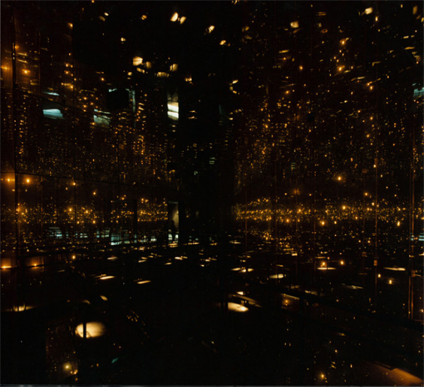
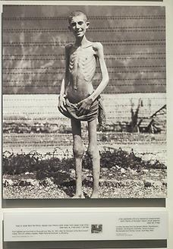
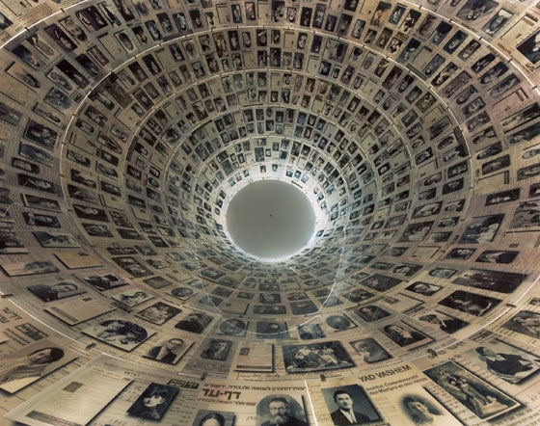
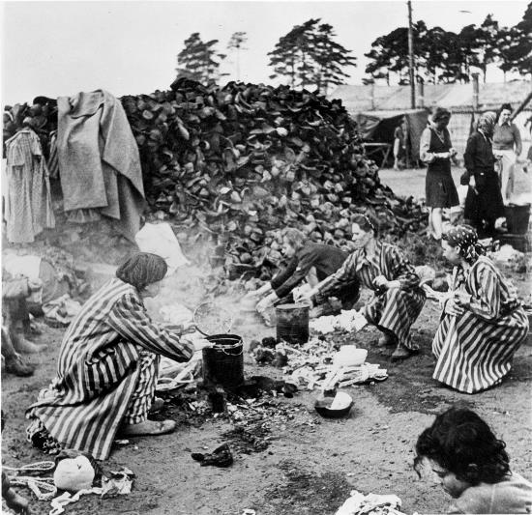
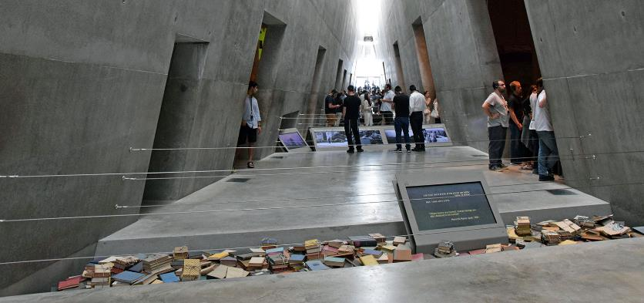
Yad Vashem

Slide 38
Ignorance about the Holocaust is growing
By Harry D. Wall
Updated 6:11 PM ET, Sun January 27, 2019
“Ignorance about the Holocaust is growing, particularly among young people. In the United States, a 2018 survey showed that 66% of millennials could not identify what the Auschwitz concentration and death camp was. A recent CNN poll in Europe revealed that about a third of the 7,000 European respondents across seven countries knew "just a little or nothing at all" about the Holocaust. In France, nearly 20% of young adults between the ages of 18 and 34 said they had never heard of the Holocaust.”
https://www.cnn.com/2019/01/27/opinions/holocaust-education-importance-wall/index.html

Slide 39
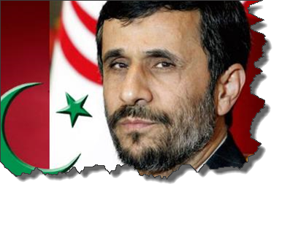
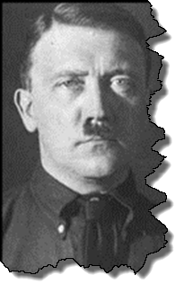
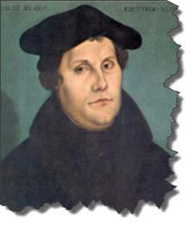
MODERN TRENDS IN ANTISEMITISM
Revelation 12

Slide 40

Christian Anti-Semitism
  “First, their synagogues should be set on fire…Secondly, their homes should likewise be broken down and destroyed…Thirdly, they should be deprived of their prayer books and Talmuds…”
Martin Luther, Concerning the Jews and Their Lies, cited in Michael Brown’s Our Hands Are Stained with Blood, pp. 14-15.

Slide 41
Christian Anti-Semitism
  “…Fourthly, their rabbis must be forbidden under threat of death to teach any more…Fifthly, passport and traveling privileges should be absolutely forbidden to the Jews…Sixthly, they ought to be stopped from usury (charging interest on loans…”
Martin Luther, Concerning the Jews and Their Lies, cited in Michael Brown’s Our Hands Are Stained with Blood, pp. 14-15.

Slide 42
Christian Anti-Semitism
“Seventhly, let the young and strong Jews and Jewesses be given the flail, the ax, the hoe, the spade, the distaff, and spindle, and let the earn their bread by the sweat of their noses…We ought to drive the rascally lazy bones out of our system...”
Martin Luther, Concerning the Jews and Their Lies, cited in Michael Brown’s Our Hands Are Stained with Blood, pp. 14-15.

Slide 43
Christian Anti-Semitism
“…Therefore away with them… To sum up, dear princes and nobles who have Jews in your domains, if this advice of mine does not suit you, then find a better one so that you and we may all be free of this insufferable devilish burden–the Jews.”
Martin Luther, Concerning the Jews and Their Lies, cited in Michael Brown’s Our Hands Are Stained with Blood, pp. 14-15.

Slide 44
The Encyclopaedia Judaica says “Short of the Auschwitz oven and the extermination, the whole Nazi holocaust is pre-outlined here.”
Martin Luther
“Luther, Martin,” in Encyclopaedia Judaica, Vol. 8, 693.

Slide 45
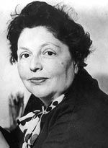
“…both Luther and Hitler were obsessed by the ‘demonologized universe’ inhabited by the Jews.”
Lucy Dawidowicz
“Luther, Martin,” in Encyclopaedia Judaica, Vol. 8, 693.

Slide 46
Lutheran Statement https://www.ccjr.us/dialogika-resources/documents-and-statements/interreligious/759-lwfijcic1983
  “We Lutherans take our name and much of our understanding of Christianity from Martin Luther. But we cannot accept or condone the violent verbal attacks that the Reformer made against the Jews…The sins of Luther’s anti-Jewish remarks, the violence of his attacks on the Jews, must be acknowledged with deep distress. And all occasions for similar sin in the present or the future must be removed from our churches…Lutherans of today refuse to be bound by all of Luther’s utterances on the Jews.”

Slide 47

John Calvin
Commentary on the Prophet Daniel (Vol 1, p. 185). Bellingham, WA: Logos Bible Software. Commentary on Daniel 2:44-45. (2010).
  “But here he [the rabbi] not only betrays his ignorance, but his utter stupidity, since God so blinded the whole people that they were like restive dogs. I have had much conversation with many Jews: I have never seen either a drop of piety or a grain of truth or ingenuousness—nay, I have never found common sense in any Jew. But this fellow, who seems so sharp and ingenious, displays his own impudence to his great disgrace.”

Slide 48
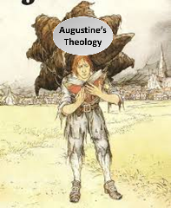
  Calvin repeatedly refers to the Jews as “profane unholy sacrilegious dogs,” describing them as “a barbarous nation” and “the people of Israel rejected by God.”
John Calvin
1. John Calvin, Ioannis Calvini opera quae supersunt Omnia, 50, 307; Sermon on Gal. 1:6–8; quoted in Selderhuis, Calvin Handbook, 145; 2. John Calvin, Supplementa Calviniana, V, 145, 10; Sermon on Mic. 40b–11; quoted in Selderhuis, Calvin Handbook, 145; 3. John Calvin, Ioannis Calvini opera quae supersunt Omnia, 27, 6; Sermon on Deut. 10:1–8; quoted in Selderhuis, Calvin Handbook, 145.

Slide 49
Yad Vashem

Slide 50
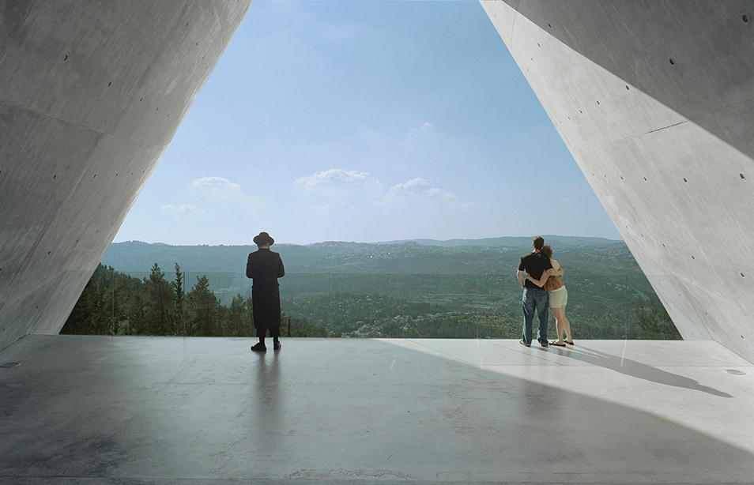
Yad Vashem

Slide 51

Zechariah 13:8-9
⁸“It will come about in all the land,” Declares the Lord, “That two parts in it will be cut off and perish; But the third will be left in it. ⁹“And I will bring the third part through the fire, Refine them as silver is refined, And test them as gold is tested. They will call on My name, And I will answer them; I will say, ‘They are My people,’ And they will say, ‘The Lord is my God.’ ”

Slide 52

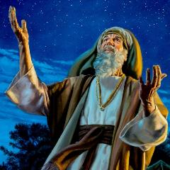
Genesis 12:3
“And I will bless those who bless you, And the one who curses you I will curse. And in you all the families of the earth will be blessed.”

Slide 53
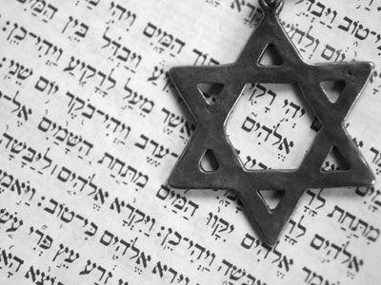
Israel’s Three Blessings to the World
(Gen 12:3b)
Scripture (Rom 3:2)
Savior (John 4:22)
Kingdom (Isa 2:2-3)

Slide 54
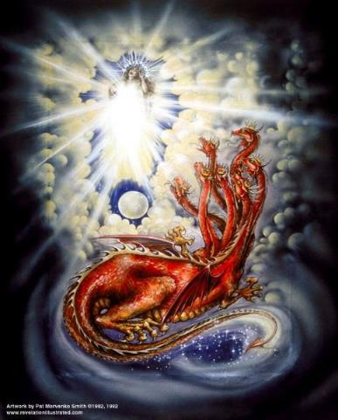
CAST OF CHARACTERS
Revelation 12:1-5
SON = MESSIAH
  Ps. 2:9; Acts 1:9
DRAGON = SATAN
  Rev. 12:9; 20:2
WOMAN = ISRAEL
  Gen. 37:9-10

Slide 55
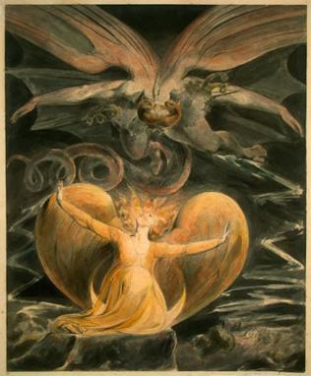
2 CYCLES OF SATANIC PERSECUTION
“Pursues the woman” = persecution of Israel 12:13-14
“Flood from his mouth” = tries to destroy Israel 12:15-16

