Slide 1


Slide 2

The Coming Kingdom
Chapter 19
Dr. Andy Woods
Senior Pastor – Sugar Land Bible Church
President – Chafer Theological Seminary

Slide 3

Kingdom Study Outline
What does the Bible Say About the Kingdom?
The Main Problem with Kingdom Now NT interpretations
Why do some believe that we are in the kingdom now?
Why does it matter?

Slide 4
Response to Kingdom Now Problem Passages
Passages from Christ’s ministry
Passages from Acts
Passages from Paul
Passages from the General letters
Passages from Revelation
Miscellaneous Arguments

Slide 5

3. Passages from Paul’s Writings
Walk worthy of the kingdom (1 Thess. 2:12)
Kingdom power (1 Cor. 4:20)
He must reign until… (1 Cor. 15:23-28)
Kingdom is not eating & drinking (Rom. 14:17)
King of Kings & Lord of Lords (1 Tim. 6:15)
Transferred into the Kingdom (Col 1:13)
Fellow workers for the Kingdom (Col. 4:11)

Slide 6


Colossians 1:13
“For He rescued us from the domain of darkness, and transferred us to the kingdom of His beloved Son.”

Slide 7
Acts 26:17-18
“¹⁷ rescuing you from the Jewish people and from the Gentiles, to whom I am sending you, ¹⁸ to open their eyes so that they may turn from darkness to light and from the dominion of Satan to God, that they may receive forgiveness of sins and an inheritance among those who have been sanctified by faith in Me.”

Slide 8

Charles Ryrie
Charles C. Ryrie, Basic Theology (Wheaton, IL: Victor, 1986), 298.
“Because the King was rejected, the messianic, Davidic kingdom was (from a human viewpoint) postponed. Though He never ceases to be King and, of course, is King today as always, Christ is never designated as King of the church (Acts 17:7 and 1 Timothy 1:17 are no exceptions, and Revelation 15:3, “King of saints,” ﻿kjv﻿, is “King of the nations” in the critical and majority texts). Though Christ is a King today, He does not rule as King. This awaits His second coming. Then the Davidic kingdom will be realized (Matt. 25:31; Rev. 19:15; 20). Then the Priest will sit on His throne, bringing to this earth the long-awaited Golden Age (Ps. 110).”

Slide 9
Colossians 1:18
“He is also head of the body, the church; and He is the beginning, the firstborn from the dead, so that He Himself will come to have first place in everything.”

Slide 10
Two Issues
(Colossians 1:13)
Universal vs. Theocratic kingdom
Dejure vs. Defacto distinction

Slide 11
Two Issues
(Colossians 1:13)
Universal vs. Theocratic kingdom
Dejure vs. Defacto distinction

Slide 12
Universal vs. Theocratic Kingdom
 | Universal Kingdom | Theocratic Kingdom
Time | Eternal (Ps 93:1-2) | Future (Dan 2:44)
Scope | Universal (Ps 103:19) | Earthly (Dan 2:35, 44-45)
Rule | God rules directly (Dan 4:17) | God rules indirectly through a human (Ps 2:6-9)
Existence | Always (Ps. 93:1-2) | Contingent upon a human response (Exod. 19:5-6; Matt. 3:2; 11:2-6, 14; 23:37-39)
Alva J. McClain, The Greatness of the Kingdom (Grand Rapids: Zondervan, 1959), 19-21

Slide 13
Colossians 1:13
“For He rescued us from the domain of darkness, and transferred us to the kingdom of His beloved Son.”

Slide 14
1 John 5:19
“We know that we are of God, and that the whole world lies in the power of the evil one.

Slide 15
Messengers of the Kingdom In Matthew
John the Baptist – 3:2
Jesus Christ – 4:17
12 Apostles – 10:5-7
Seventy – Luke 10:1, 9
Toussaint, Behold the King, 18-20

Slide 16
Matthew 3:1-2
“Now in those days John the Baptist came, preaching in the wilderness of Judea, saying, ‘Repent, for the kingdom of heaven is at hand.’”

Slide 17
Matthew 4:17
“From that time Jesus began to preach and say, ‘Repent, for the kingdom of heaven is at hand.’”

Slide 18
Matthew 10:5-7
“These twelve Jesus sent out after instructing them: “Do not go in the way of the Gentiles, and do not enter any city of the Samaritans; ⁶ but rather go to the lost sheep of the house of Israel. ⁷ And as you go, preach, saying, ‘The kingdom of heaven is at hand.’”

Slide 19
Colossians 1:13
“For He rescued us from the domain of darkness, and transferred us to the kingdom of His beloved Son.”

Slide 20
Two Issues
(Colossians 1:13)
Universal vs. Theocratic kingdom
Dejure vs. Defacto distinction

Slide 21
B. Dejure vs. Defacto distinction
(Colossians 1:13)
The nature of the prison letters
Inheritance
Domain
Redemption

Slide 22
B. Dejure vs. Defacto distinction
(Colossians 1:13)
The nature of the prison letters
Inheritance
Domain
Redemption

Slide 23
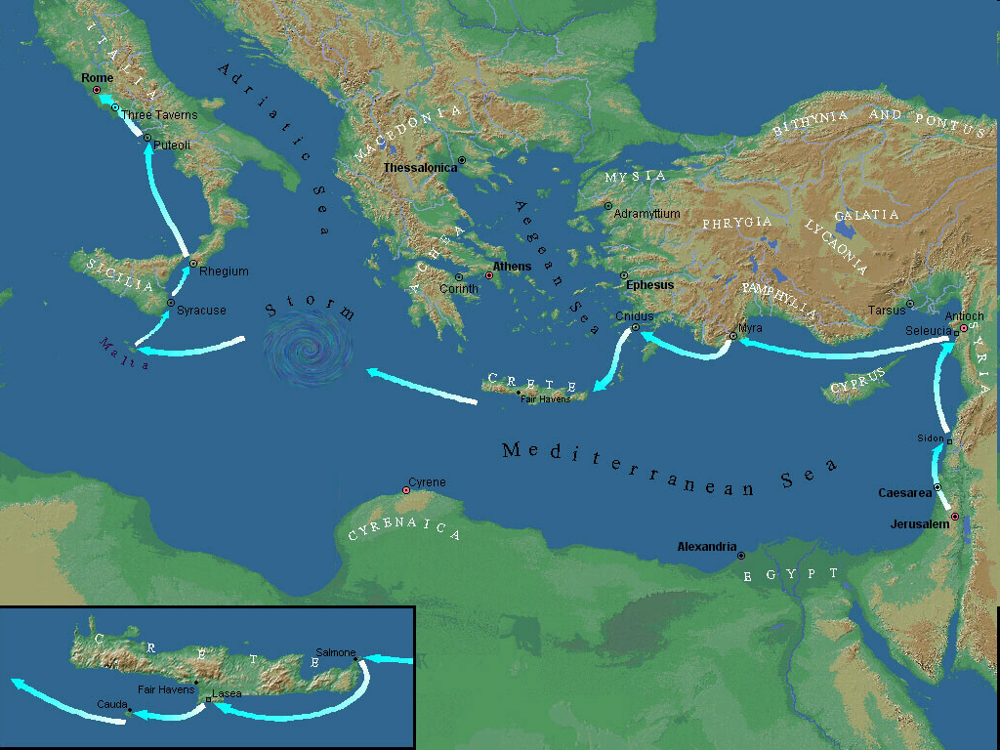

Slide 24
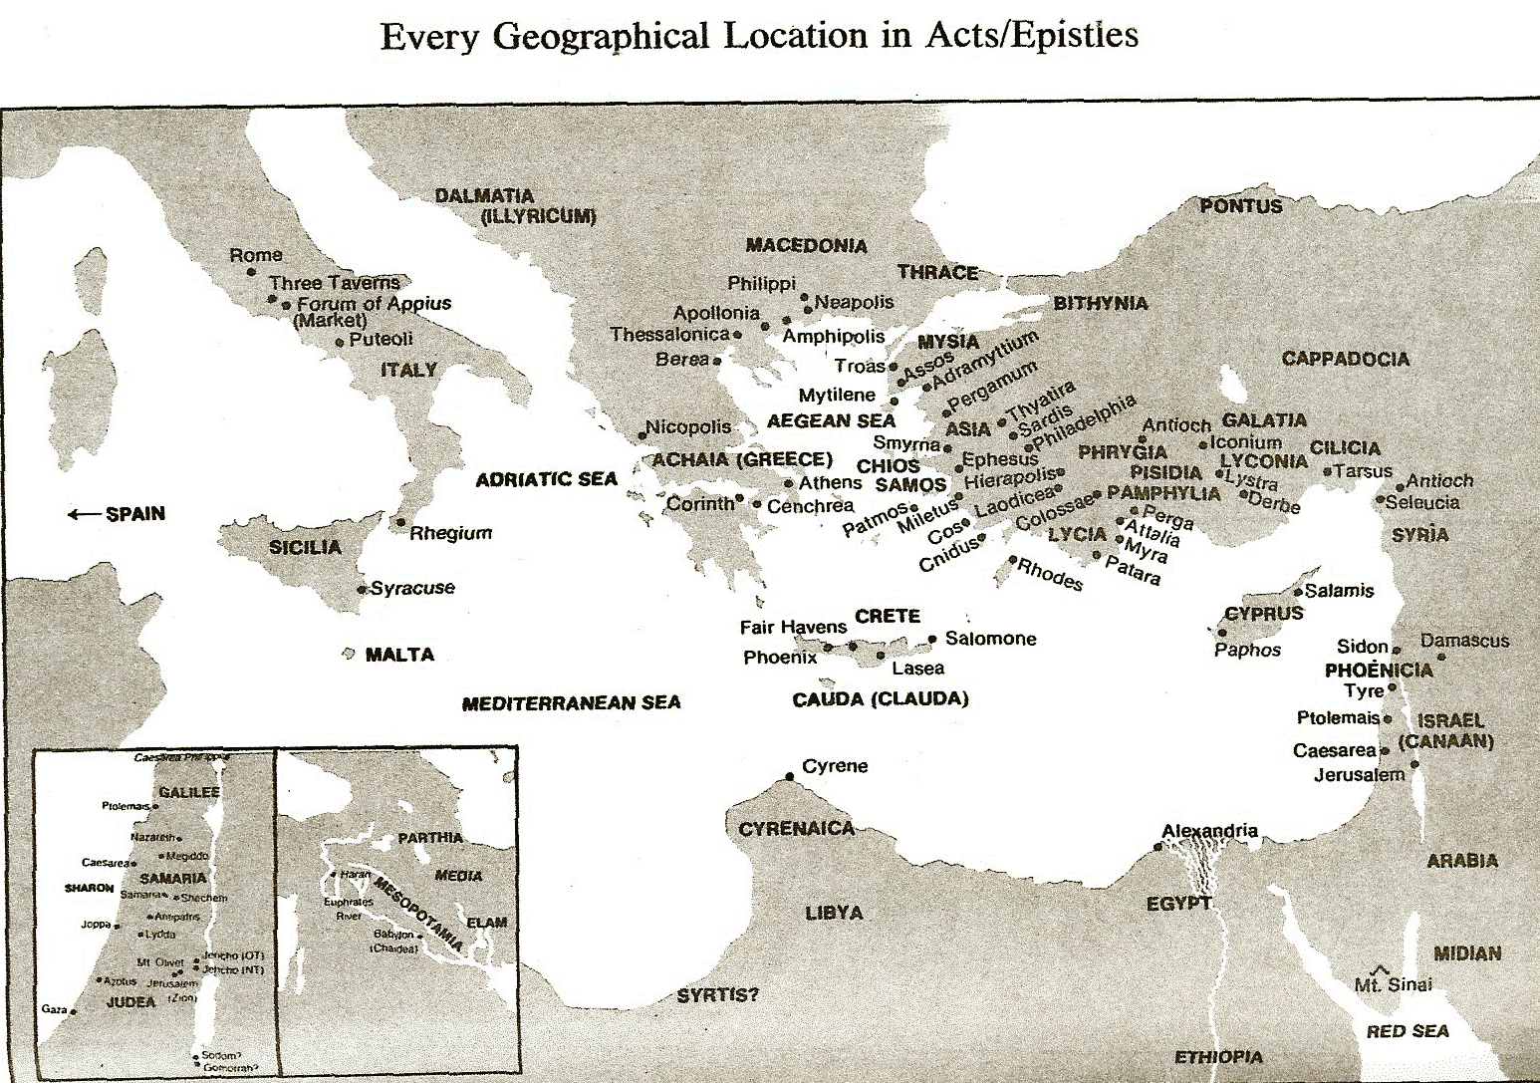

Slide 25

Philippians 3:20
“For our citizenship is in heaven, from which also we eagerly wait for a Savior, the Lord Jesus Christ.”

Slide 26
Ephesians 2:6
“and raised us up with Him, and seated us with Him in the heavenly places in Christ Jesus.”

Slide 28
Colossians 1:13
“For He rescued us from the domain of darkness, and transferred us to the kingdom of His beloved Son.”

Slide 29
B. Dejure vs. Defacto distinction
(Colossians 1:13)
The nature of the prison letters
Inheritance
Domain
Redemption

Slide 30
Colossians 1:12-13
“¹² giving thanks to the Father, who has qualified us to share in the inheritance [klēros] of the saints in Light. ¹³ For He rescued us from the domain of darkness, and transferred us to the kingdom of His beloved Son.”

Slide 31
Acts 26:17-18
“¹⁷ rescuing you from the Jewish people and from the Gentiles, to whom I am sending you, ¹⁸ to open their eyes so that they may turn from darkness to light and from the dominion of Satan to God, that they may receive forgiveness of sins and an inheritance [klēros] among those who have been sanctified by faith in Me.”

Slide 32
1 Peter 1:4-5
“⁴ to obtain an inheritance [klēronomia] which is imperishable and undefiled and will not fade away, reserved in heaven for you, ⁵ who are protected by the power of God through faith for a salvation ready to be revealed in the last time.”

Slide 33
B. Dejure vs. Defacto distinction
(Colossians 1:13)
The nature of the prison letters
Inheritance
Domain
Redemption

Slide 34
Colossians 1:13
“For He rescued us from the domain of darkness, and transferred us to the kingdom of His beloved Son.”

Slide 35
1 John 5:18
“We know that no one who is born of God sins; but He who was born of God keeps him, and the evil one does not touch him.”

Slide 36
Ephesians 6:12
“For our struggle is not against flesh and blood, but against the rulers, against the powers, against the world forces of this darkness, against the spiritual forces of wickedness in the heavenly places.”

Slide 37
Ephesians 6:12
“For our struggle is not against flesh and blood, but against the rulers, against the powers (exousia), against the world forces of this darkness, against the spiritual forces of wickedness in the heavenly places.”

Slide 38
Colossians 1:13
“For He rescued us from the domain [exousia] of darkness, and transferred us to the kingdom of His beloved Son.”

Slide 39
B. Dejure vs. Defacto distinction
(Colossians 1:13)
The nature of the prison letters
Inheritance
Domain
Redemption

Slide 40
Colossians 1:13-14
“¹³ For He rescued us from the domain of darkness, and transferred us to the kingdom of His beloved Son. ¹⁴ in whom we have redemption [apolytrōsis], the forgiveness of sins.”

Slide 41
Luke 21:28
“But when these things begin to take place, straighten up and lift up your heads, because your redemption [apolytrōsis] is drawing near.”

Slide 42
Romans 8:23
“And not only this, but also we ourselves, having the first fruits of the Spirit, even we ourselves groan within ourselves, waiting eagerly for our adoption as sons, the redemption [apolytrōsis] of our body.”

Slide 43
Ephesians 1:13-14
“¹³ In Him, you also, after listening to the message of truth, the gospel of your salvation—having also believed, you were sealed in Him with the Holy Spirit of promise, ¹⁴ who is given as a pledge of our inheritance, with a view to the redemption [apolytrōsis] of God’s own possession, to the praise of His glory.”

Slide 44
Ephesians 4:30
“Do not grieve the Holy Spirit of God, by whom you were sealed for the day of redemption [apolytrōsis].”

Slide 45

E.R. Craven
“Excursus on the Basileia,” in Revelation of John, J. P. Lange (New York: Scribner, 1874), 97.
“Col. 1:13. At first glance, the passage apparently teaches that believers are already translated de facto into the Basileia; it may however legitimately be regarded as teaching a de jure translation. Not only does this interpretation bring the passage into harmony with the great mass of Scripture, but it seems to be required by the immediately preceding and succeeding contexts; believers are not yet delivered de facto from the exousia of Satan (Eph. 6:12), nor have they yet received de facto, certainly not in completeness, the apolytrōsis (comp. Luke 21:28; Rom. 8:23; Eph. 1:14; 4:30).”

Slide 46

Alva J. McClain
Alva J. McClain, The Greatness of the Kingdom: An Inductive Study of the Kingdom of God as Set Forth in the Scriptures (Grand Rapids: Zondervan, 1959), 435.
“The context here suggests that the action must be regarded as de jure [by right] rather than de facto [in reality]. Believers have been “delivered . . . from the power of darkness,” the apostle declares. Yet in another place he warns that we must still wrestle “against the rulers of the darkness of this world” (Eph. 6:12). Our translation into the Kingdom of Christ, therefore, must be similar to that act of God when He “raised us up together, and made us sit together in heavenly places in Christ Jesus” (Eph. 2:6). Although we are not yet de facto seated in the heavenlies, the thing is so certain that God can speak of it as already done. In the same sense, we have been (aorist tense) transferred judicially into the Kingdom of our Lord even before its establishment.”

Slide 47
Two Issues
(Colossians 1:13)
Universal vs. Theocratic kingdom
Dejure vs. Defacto distinction

Slide 48
3. Passages from Paul’s Writings
Walk worthy of the kingdom (1 Thess. 2:12)
Kingdom power (1 Cor. 4:20)
He must reign until… (1 Cor. 15:23-28)
Kingdom is not eating & drinking (Rom. 14:17)
King of Kings & Lord of Lords (1 Tim. 6:15)
Transferred into the Kingdom (Col 1:13)
Fellow workers for the Kingdom (Col. 4:11)

Slide 49
Colossians 4:11
“and also Jesus who is called Justus; these are the only fellow workers for [eis] the kingdom of God who are from the circumcision, and they have proved to be an encouragement to me.”

Slide 50
Order of Paul’s Letters
Galatians (A.D. 49)
1‒2 Thessalonians (A.D. 51)
1‒2 Corinthians (A.D. 56)
Romans (A.D. 57)
Ephesians, Colossians, Philemon, Philippians (A.D. 60‒62)
1 Timothy, Titus (A.D. 62‒66)
2 Timothy (A.D. 67)

Slide 51
Galatians 5:21
“envying, drunkenness, carousing, and things like these, of which I forewarn you, just as I have forewarned you, that those who practice such things will not inherit the kingdom of God.”

Slide 52
1 Thessalonians 2:12
“so that you would walk in a manner worthy of the God who calls you into His own kingdom and glory.”

Slide 53
2 Thessalonians 1:5
“This is a plain indication of God’s righteous judgment so that you will be considered worthy of the kingdom of God, for which indeed you are suffering.”

Slide 54
1 Corinthians 6:9-10
“⁹ Or do you not know that the unrighteous will not inherit the kingdom of God? Do not be deceived; neither fornicators, nor idolaters, nor adulterers, nor effeminate, nor homosexuals, ¹⁰ nor thieves, nor the covetous, nor drunkards, nor revilers, nor swindlers, will inherit the kingdom of God.”

Slide 55
1 Corinthians 15:24
“then comes the end, when He hands over the kingdom to the God and Father, when He has abolished all rule and all authority and power.”

Slide 56
1 Corinthians 15:50
“Now I say this, brethren, that flesh and blood cannot inherit the kingdom of God; nor does the perishable inherit the imperishable.”

Slide 57
Ephesians 5:5
“For this you know with certainty, that no immoral or impure person or covetous man, who is an idolater, has an inheritance in the kingdom of Christ and God.”

Slide 58
2 Timothy 4:1, 8
“I solemnly charge you in the presence of God and of Christ Jesus, who is to judge the living and the dead, and by His appearing and His kingdom…In the future there is laid up for me the crown of righteousness, which the Lord, the righteous Judge, will award to me on that day; and not only to me, but also to all who have loved His appearing.”

Slide 59
Alva J. McClain
Alva J. McClain, The Greatness of the Kingdom: An Inductive Study of the Kingdom of God as Set Forth in the Scriptures (Grand Rapids: Zondervan, 1959), 436.
“The Greek preposition here is eis, and therefore the passage may be read in harmony with the idea of a future Kingdom, toward which as a glorious goal all the labors of the Church are directed.”

Slide 60
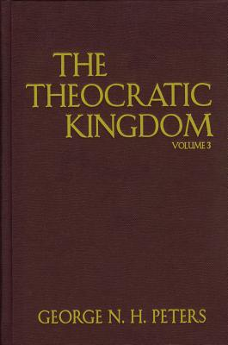
G.N.H. Peters
Theocratic Kingdom, 1:600
“There is only one kingdom. . . . and believers become ‘heirs’ of it. . . . The apostles represent themselves and co-laborers as working for it still future, Col. 4:11; 2 Thess. 1:5; 2 Tim. 4:18; Heb. 12:28, etc.”

Slide 61
CONCLUSION

Slide 62
Response to Kingdom Now Problem Passages
Passages from Christ’s ministry
Passages from Acts
Passages from Paul
Passages from the General letters
Passages from Revelation
Miscellaneous Arguments

