Slide 1


Dr. Andy Woods
Senior Pastor – Sugar Land Bible Church
President – Chafer Theological Seminary

Slide 2


Slide 3


Seven Trumpets
(Revelation 8‒11)
1st Trumpet (8:7) – 1/3 vegetation destroyed
2nd Trumpet (8:8-9) – 1/3 ocean destroyed
3rd Trumpet (8:10-11) – 1/3 water destroyed
4th Trumpet (8:12-13) – 1/3 luminaries darkened
5th Trumpet (9:1-12) – Demons released
6th Trumpet (9:13-21) – 1/3 humanity destroyed
7th Trumpet (11:14-19) – Legal transfer announced

Slide 4
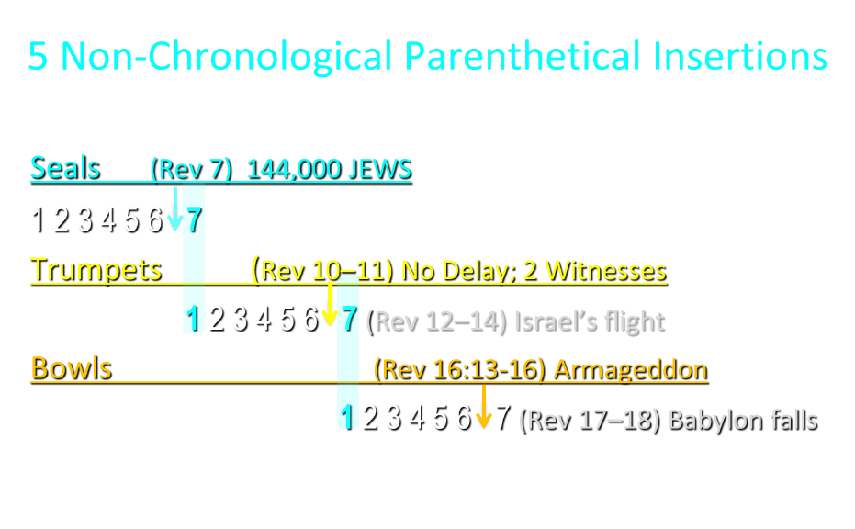

Slide 5
5 Non-Chronological Parenthetical Insertions
Rev 7 – 144,000 Jews
Rev 10:1-11:13 – Announcement of no more delay and the two witnesses
Rev 12-14 – Israel’s flight, two beasts, six scenes of hope
Rev 16:13-16 – Gathering of the nations to Armageddon
Rev 17:1-19:6 – Babylon’s fall

Slide 6


Revelation 11:15
“Then the seventh angel sounded; and there were loud voices in heaven, saying, ‘The kingdom of the world has become the kingdom of our Lord and of His Christ; and He will reign (basileuō) forever and ever.’” (cf. Matt. 6:10)

Slide 7
Revelation 12‒14
Rev 12 – Israel’s flight
Rev 13 – Two beasts
Rev 14 – Six scenes of hope

Slide 8
Revelation 12‒14
Rev 12 – Israel’s flight
Rev 13 – Two beasts
Rev 14 – Six scenes of hope

Slide 9
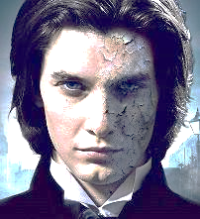
Two Beasts
(Revelation 13)
First beast (13:1-10)
Second beast (13:11-18)

Slide 10
Two Beasts
(Revelation 13)
First beast (13:1-10)
Second beast (13:11-18)

Slide 11

The First Beast
Revelation 13:1-10
His sudden appearance in John’s vision (1a)
His Gentile ethnicity (1b)
His fulfillment of Daniel’s prophecies (1c-2a)
His Satanic empowerment (2b)
His resurrection (3)
His power-based adoration (4)
His oratory (5a)

Slide 12
The First Beast
Revelation 13:1-10
His time of authority (5b)
His blasphemies (6)
His persecution of God’s people (7a)
His global jurisdiction (7b)
His unregenerate audience (8)
His oppressive influence (9-10)

Slide 13
The First Beast
Revelation 13:1-10
His sudden appearance in John’s vision (1a)
His Gentile ethnicity (1b)
His fulfillment of Daniel’s prophecies (1c-2a)
His Satanic empowerment (2b)
His resurrection (3)
His power-based adoration (4)
His oratory (5a)

Slide 14
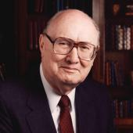
Two Rules of Interpretation
Search the immediate context
  Walvoord: 26X
Search the remote context
  Old Testament
  Thomas: 278 / 404 verses

Slide 15
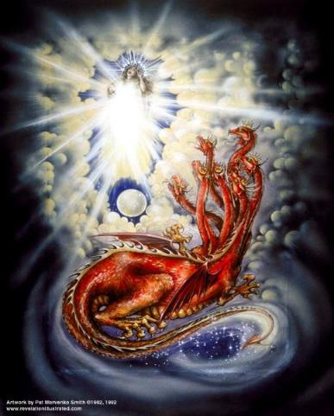
CAST OF 3 CHARACTERS
Revelation 12:1-5
SON = MESSIAH
  Ps. 2:9; Acts 1:9
DRAGON = SATAN
  Rev. 12:9; 20:2
WOMAN = ISRAEL
  Gen. 37:9-10

Slide 16
3 WARS
Revelation 12
WAR = PAST
  Rev. 12:1-5
WAR = HEAVEN
  Rev. 12:6-12
WAR = EARTH
  Rev. 12:13-17

Slide 17


2 Thessalonians 2:3
“Let no one in any way deceive you, for it will not come unless the apostasy comes first, and the man of lawlessness is revealed, the son of destruction.”

Slide 18
1 John 4:3
“and every spirit that does not confess Jesus is not from God; this is the spirit of the antichrist, of which you have heard that it is coming, and now it is already in the world.”

Slide 19
1 John 4:3
“and every spirit that does not confess Jesus is not from God; this is the spirit of the antichrist, of which you have heard that it is coming, and now it is already in the world.”

Slide 20
2 Thessalonians 2:3
“Let no one in any way deceive you, for it will not come unless the apostasy comes first, and the man of lawlessness is revealed, the son of destruction.”

Slide 21
Revelation 13:18
“Here is wisdom. Let him who has understanding calculate the number of the beast, for the number is that of a man; and his number is six hundred and sixty-six.”

Slide 22
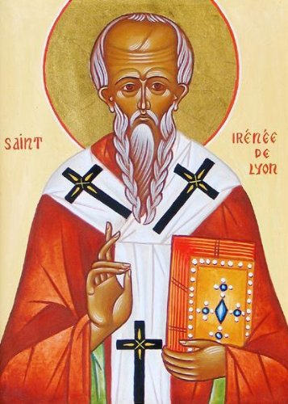
Irenaeus (AD 130‒202)
Against Heresies, 5.28.2. sections 1-2.
“(1) For when he (Antichrist) is come, and of his own accord concentrates in his own person the apostasy, and accomplishes whatever he shall do according to his own will and choice, sitting also in the temple of God, so that his dupes may adore him as the Christ; wherefore also shall he deservedly "be cast into the lake of fire:“ (2) [this will happen according to divine appointment], God by His prescience foreseeing all this, and at the proper time sending such a man...”

Slide 23

1 Peter 5:8 (NASB)
“Be of sober spirit, be on the alert. Your adversary, the devil, prowls around like a roaring lion, seeking someone to devour.”

Slide 24
The First Beast
Revelation 13:1-10
His sudden appearance in John’s vision (1a)
His Gentile ethnicity (1b)
His fulfillment of Daniel’s prophecies (1c-2a)
His Satanic empowerment (2b)
His resurrection (3)
His power-based adoration (4)
His oratory (5a)

Slide 25


Slide 26


Statue
&
Stone

Slide 27
The First Beast
Revelation 13:1-10
His sudden appearance in John’s vision (1a)
His Gentile ethnicity (1b)
His fulfillment of Daniel’s prophecies (1c-2a)
His Satanic empowerment (2b)
His resurrection (3)
His power-based adoration (4)
His oratory (5a)

Slide 28
Two Issues
(Revelation 13:1c-2a)
Ten Horns and Seven Heads (1c)
Four Animals (2a)

Slide 29
Two Issues
(Revelation 13:1c-2a)
Ten Horns and Seven Heads (1c)
Four Animals (2a)

Slide 30

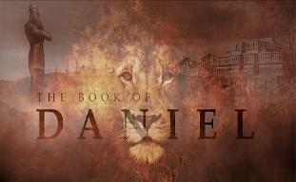
Daniel 7:23
“Thus he said: ‘The fourth beast will be a fourth kingdom on the earth, which will be different from all the other kingdoms and will devour the whole earth and tread it down and crush it.”

Slide 31

Daniel 2:44
“In the days of those kings the God of heaven will set up a kingdom which will never be destroyed, and that kingdom will not be left for another people; it will crush and put an end to all these kingdoms, but it will itself endure forever.”

Slide 32
Daniel 7:24
“As for the ten horns, out of this kingdom ten kings will arise; and another will arise after them, and he will be different from the previous ones and will subdue three kings.”

Slide 33
Revelation 17:9-10
“⁹ Here is the mind which has wisdom. The seven heads are seven mountains on which the woman sits, ¹⁰ and they are seven kings; five have fallen, one is, the other has not yet come; and when he comes, he must remain a little while.”

Slide 34
7 Kings or Kingdoms (Dan. 2:37-38)
(Revelation 17:9-10)
Egypt
Assyria
Babylon
Persian
Greece
Rome I
Rome II

Slide 35
Two Issues
(Revelation 13:1c-2a)
Ten Horns and Seven Heads (1c)
Four Animals (2a)

Slide 36

CHART1

Slide 37
Daniel 7:12
“As for the rest of the beasts, their dominion was taken away, but an extension of life was granted to them for an appointed period of time.”

Slide 38
The First Beast
Revelation 13:1-10
His sudden appearance in John’s vision (1a)
His Gentile ethnicity (1b)
His fulfillment of Daniel’s prophecies (1c-2a)
His Satanic empowerment (2b)
His resurrection (3)
His power-based adoration (4)
His oratory (5a)

Slide 39
CAST OF 3 CHARACTERS
Revelation 12:1-5
SON = MESSIAH
  Ps. 2:9; Acts 1:9
DRAGON = SATAN
  Rev. 12:9; 20:2
WOMAN = ISRAEL
  Gen. 37:9-10

Slide 40

Revelation 12:1-5
And a great sign appeared in heaven: a woman clothed in the sun, and the moon under her feet, and upon her head a crown of twelve stars; ²and she was with child; and she cried out, being in labor pain to give birth. ³And another sign was seen in heaven: and behold, a great red dragon, having seven heads and ten horns, and upon his heads seven diadems ⁴And his tail swept a third…

Slide 41
NO. | CATEGORY | JESUS CHRIST | ANTICHRIST
1. | World prepared in advance | Gal. 4:4 | 2 Thess. 2:7
2. | Revealed at the proper time | Gal. 4:4 | 2 Thess. 2:6
3. | Claim of deity | John 14:9 | 2 Thess. 2:4
4. | Heralded by a forerunner | John 1:23 | Rev. 13:12
5. | Forerunner comes in the Spirit and power of Elijah | Luke 1:17 | 1 Kgs. 8:37-38; Rev. 13:13
6. | Empowered by a higher source | 1 Cor. 6:14 | Rev. 13:14
7. | Member of a Trinity | Phil. 1:2; Acts 5:3-4; John 14:9 | Rev. 16:13; 20:10
8. | Head of a Church | Eph. 5:23 | Rev. 2:9; 3:9
9. | Miracle worker | Acts 2:22 | 2 Thess. 2:9
10. | Resurrection from the dead | 1 Cor. 15:3-6 | Rev. 13:3, 12, 14
11. | Given a throne | Rev. 3:21 | Rev. 13:2

Slide 42
NO. | CATEGORY | JESUS CHRIST | ANTICHRIST
12. | Ruling a political kingdom | Isa. 9:6-7 | Rev. 13:5
13. | Ushering in world peace | Isa. 9:6-7 | Rev. 6:1-4
14. | Activity in the Temple | Luke 2:41-50 | 2 Thess. 2:4
15. | Putting an end to animal sacrifices | Heb. 9:26-29 | Dan. 9:27
16. | Length of ministry | Over 3 years | Rev. 13:5
17. | Sealing ministry | Eph. 4:30 | Rev. 13:16-17
18. | Presentation to Israel as her Messiah | John 1:11 | John 5:43
19. | Covenant with Israel | Gen. 15:18 | Dan. 9:27
20. | Reception of worship | Zech. 14:16 | 2 Thess. 2:4
21. | Establishing Jerusalem as the center of worldwide worship | Zech. 14:17 | 2 Thess. 2:4

Slide 43
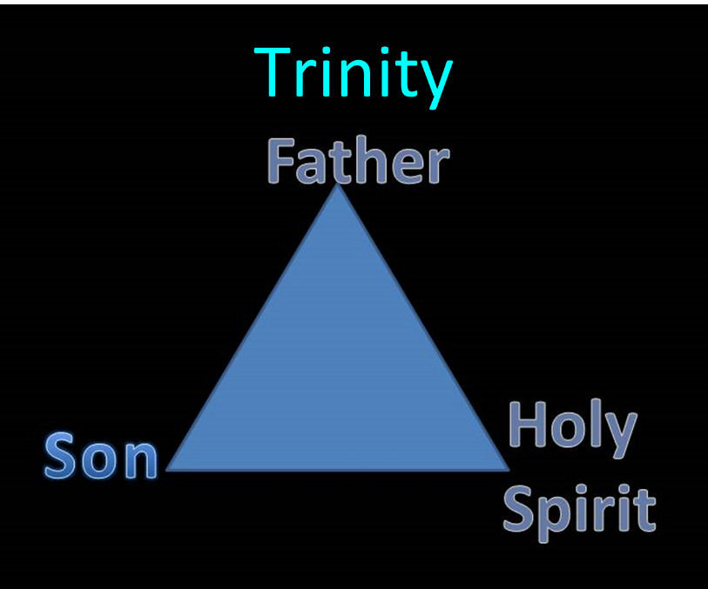

Slide 44
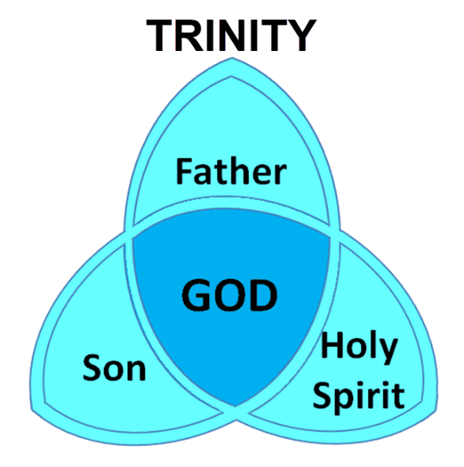

Slide 45
The First Beast
Revelation 13:1-10
His sudden appearance in John’s vision (1a)
His Gentile ethnicity (1b)
His fulfillment of Daniel’s prophecies (1c-2a)
His Satanic empowerment (2b)
His resurrection (3)
His power-based adoration (4)
His oratory (5a)

Slide 46
Two Issues
(Revelation 13:3)
A national or individual resurrection?
An authentic resurrection?

Slide 47
Two Issues
(Revelation 13:3)
A national or individual resurrection?
An authentic resurrection?

Slide 48
Daniel 7:24
“As for the ten horns, out of this kingdom ten kings will arise; and another will arise after them, and he will be different from the previous ones and will subdue three kings.”

Slide 49
Revelation 17:9-10
“⁹ Here is the mind which has wisdom. The seven heads are seven mountains on which the woman sits, ¹⁰ and they are seven kings; five have fallen, one is, the other has not yet come; and when he comes, he must remain a little while.”

Slide 50
7 Kings or Kingdoms (Dan. 2:37-38)
(Revelation 17:9-10)
Egypt
Assyria
Babylon
Persian
Greece
Rome I
Rome II

Slide 51
Revelation 13:14
“And he deceives those who dwell on the earth because of the signs which it was given him to perform in the presence of the beast, telling those who dwell on the earth to make an image to the beast who had the wound of the sword and has come to life.”

Slide 52
Two Issues
(Revelation 13:3)
A national or individual resurrection?
An authentic resurrection?

Slide 53

John F. Walvoord
John F. Walvoord, "Revelation," in Bible Knowledge Commentary, ed. John F. Walvoord and Roy B. Zuck (Colorado Springs, CO: Victor, 1983), 961
“Another plausible explanation is that the final world ruler receives a wound which normally would be fatal but is miraculously healed by Satan. While the resurrection of a dead person seems to be beyond Satan’s power, the healing of a wound would be possible for Satan, and this may be the explanation. The important point is that the final world ruler comes into power obviously supported by a supernatural and miraculous deliverance by Satan himself.”

Slide 54
Revelation 13:14
“And he deceives those who dwell on the earth because of the signs which it was given him to perform in the presence of the beast, telling those who dwell on the earth to make an image to the beast who had the wound of the sword and has come to life [zaō].”

Slide 55
Revelation 2:8
“And to the angel of the church in Smyrna write: The first and the last, who was dead, and has come to life [zaō], says this.”

Slide 56
2 Thessalonians 2:6-7
“⁶ And you know what restrains him now, so that in his time he will be revealed. ⁷ For the mystery of lawlessness is already at work; only he who now restrains will do so until he is taken out of the way.”

Slide 57
The First Beast
Revelation 13:1-10
His sudden appearance in John’s vision (1a)
His Gentile ethnicity (1b)
His fulfillment of Daniel’s prophecies (1c-2a)
His Satanic empowerment (2b)
His resurrection (3)
His power-based adoration (4)
His oratory (5a)

Slide 59

1st Six Seals (Revelation 6)
6:1-2 – Advent of antichrist
6:3-4 – War
6:5-6 – Famine
6:7-8 – Death
6:9-11 – Martyrdoms
6:12-17 – Cosmic disturbances

Slide 60
CAST OF 3 CHARACTERS
Revelation 12:1-5
SON = MESSIAH
  Ps. 2:9; Acts 1:9
DRAGON = SATAN
  Rev. 12:9; 20:2
WOMAN = ISRAEL
  Gen. 37:9-10

Slide 61
The First Beast
Revelation 13:1-10
His sudden appearance in John’s vision (1a)
His Gentile ethnicity (1b)
His fulfillment of Daniel’s prophecies (1c-2a)
His Satanic empowerment (2b)
His resurrection (3)
His power-based adoration (4)
His oratory (5a)

Slide 62
The First Beast
Revelation 13:1-10
His time of authority (5b)
His blasphemies (6)
His persecution of God’s people (7a)
His global jurisdiction (7b)
His unregenerate audience (8)
His oppressive influence (9-10)

Slide 64
Isaiah 9:6-7
“⁶ For a child will be born to us, a son will be given to us; And the government will rest on His shoulders; And His name will be called Wonderful Counselor, Mighty God, Eternal Father, Prince of Peace.⁷ There will be no end to the increase of His government or of peace, On the throne of David and over his kingdom, To establish it and to uphold it with justice and righteousness From then on and forevermore. The zeal of the Lord of hosts will accomplish this.”

Slide 65


Slide 66
The First Beast
Revelation 13:1-10
His time of authority (5b)
His blasphemies (6)
His persecution of God’s people (7a)
His global jurisdiction (7b)
His unregenerate audience (8)
His oppressive influence (9-10)

Slide 67

Twenty-Four Elders (Church) (Rev. 4:4; 5:8-10)
DESCRIPTION | SCRIPTURE
1. Crowned | (2:10)
2. Resurrected | (4:4)
3. Clothed in White | (3:5)
4. Redeemed | (5:8-10)
5. Global | (5:9; Matt. 28:19)
6. Enthroned | (3:21)
7. Elders | (1 Tim. 3:1-7)
8. Kingdom of Priests | (Rev. 1:6)
9. Twenty-four | (Rev. 1:6)

Slide 68



Slide 69
DESCRIPTION OF THE SEVEN CHURCHES Revelation 2‒3
CHURCH | SCRIPTURE | DESCRIPTION
Ephesus | 2:1-7 | Loveless
Smyrna | 2:8-11 | Persecuted
Pergamum | 2:12-17 | Compromised
Thyatira | 2:18-29 | Corrupt
Sardis | 3:1-6 | Dead
Philadelphia | 3:7-13 | Missionary
Laodicea | 3:14-22 | Man-centered

Slide 70

The Coming Synthesis
“The coming of the Aquarian age also stimulates in man a spirit of universality and a tendency towards fusion. This can be seen working out in the present trend towards synthesis in business, in religion and in politics. It produces an urge towards union, and among other unions, towards religious understanding and tolerance...False and true standards will emerge in man’s consciousness, and those choices will be made which will lay the foundation of the new order, which will inaugurate the new race, with its new laws and novel approaches, and so usher in the new religion of love and brotherhood, and that period wherein the group and the group-good will be the dominant note. Then separateness and hatreds will fade out and men will be merged in a true unity."
Alice A. Bailiey and Dijwhal Khul, The Seventh Ray: Revealer of the New Age (NY: Lucius Press, 1995), 198-99.

Slide 71

Explanation of the missing
“Your unfinished species is ready to evolve. The time has come on Earth for this quantum change to occur in many of you." Her "Christ" further informed her "I cannot 'return' until enough of you are attracted and linked." Hubbard's "Christ" explained, "I did not intend for you to deify me, but to deify yourselves as being at the same stage of evolution as I am." "Suffice it to say, that if you do not choose to evolve into a wholesome, co-creative human, then you shall not." "...the fundamental regression is self-centeredness, or the illusion that you are separate from God. I 'make war' on self-centeredness.”…
Barbara Marx Hubbard, The Revelation: A Message of Hope for the New Millennium, 2nd ed. (Novato, CA: Nataraj, 1995), 65, 66, 195, 233, 240, 255.

Slide 72
Explanation of the missing (cont’d)
…Furthermore, "At the co-creative stage of evolution, one self-centered soul is like a lethal cancer cell in a body; deadly to itself and to the whole." Thus, "The surgeon dare leave no cancer in the body when he closes up the wound after a delicate operation. We dare leave no self-centered person on Earth after the selection process.”
Barbara Marx Hubbard, The Revelation: A Message of Hope for the New Millennium, 2nd ed. (Novato, CA: Nataraj, 1995), 65, 66, 195, 233, 240, 255.

Slide 73
The First Beast
Revelation 13:1-10
His time of authority (5b)
His blasphemies (6)
His persecution of God’s people (7a)
His global jurisdiction (7b)
His unregenerate audience (8)
His oppressive influence (9-10)

Slide 74
Revelation 1:19
“Therefore write the things which you have seen, and the things which are, and the things which will take place after these things [meta tauta].”

Slide 75

Revelation 1:19
Seen (Chapter 1)
Are (Chapters 2–3)
After these things (Chapters 4–22)

Slide 76

Matthew 16:18
I also say to you that you are Peter, and upon this rock I will build [oikodomeō] My church; and the gates of Hades will not overpower it.

Slide 77
The First Beast
Revelation 13:1-10
His time of authority (5b)
His blasphemies (6)
His persecution of God’s people (7a)
His global jurisdiction (7b)
His unregenerate audience (8)
His oppressive influence (9-10)

Slide 78
Daniel 7:23
“Thus he said: ‘The fourth beast will be a fourth kingdom on the earth, which will be different from all the other kingdoms and will devour the whole earth and tread it down and crush it.”

Slide 79
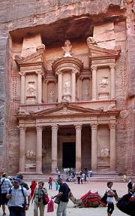
Place of Hebrew Refuge:
Petra in Mt. Seir in S. Jordan
Prepared by God (Rev. 12:6)
Divine provision of food & water (Isa. 33:16; Rev. 12:6)
Wilderness (Rev. 12:6, 14)
Mountains (Isa. 33:16; Matt. 24:16)
Defensible (Isa. 33:16)
Jordan (Dan. 11:41)
Bozrah (Micah 2:12)
Fruchtenbaum, Footsteps of the Messiah, 294-97

Slide 80
Daniel 11:41
“He will also enter the Beautiful Land, and many countries will fall; but these will be rescued out of his hand: Edom, Moab and the foremost of the sons of Ammon.”

Slide 81
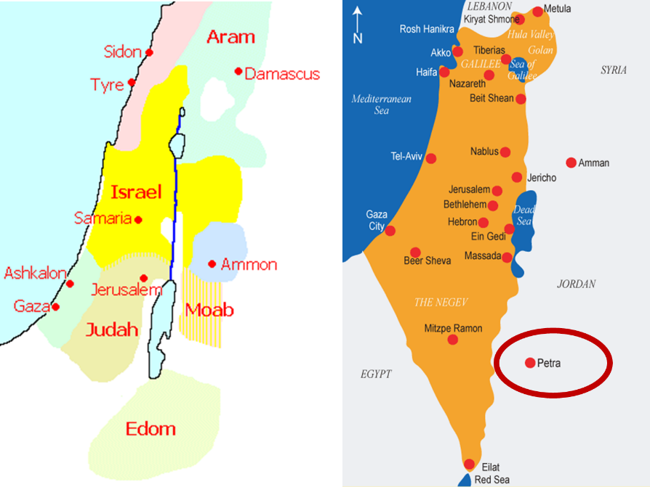

Slide 82
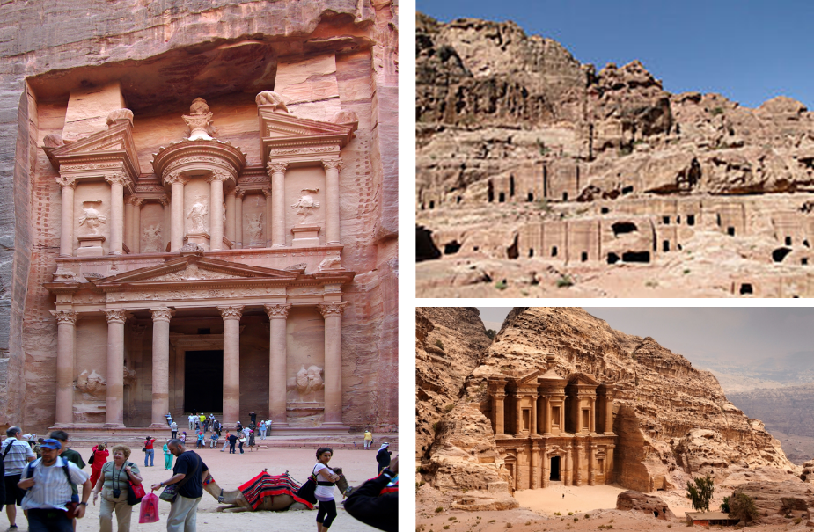

Slide 83

Arnold Fruchtenbaum
Footseps of the Messiah, Page 296-97
“Another suggestion is the city now known as Petra…this author prefers the identification with Petra. Petra is located in a basin within Mount Seir, and is totally surrounded by mountains and cliffs. The only way in and out of the city is through a narrow passageway that extends for about a mile and can only be negotiated by foot or by horseback. This makes the city easy to defend, and its surrounding high cliffs give added meaning and confirmation to Isaiah 33:16. Only a few abreast can enter through this passage at any one time, giving this city even greater defensibility.”

Slide 84
Arnold Fruchtenbaum
Footseps of the Messiah, Page 296-97
“The name Bozrah means ‘sheepfold.’ An ancient sheepfold had a narrow entrance so that the shepherd could count his sheep. Once inside the fold, the sheep had more room to move around. Petra is shaped like a giant sheepfold, with its narrow passage opening up to a spacious circle surrounded by cliffs. This is not true of the town of Buseira. Furthermore, by modern Petra is a site known as Butzeira, which retains the Hebrew Botzrah...It will be a very defensible city located in Mount Seir...Furthermore, as they flee and while they are living there, food and water will be miraculously provided.”

Slide 85
The First Beast
Revelation 13:1-10
His time of authority (5b)
His blasphemies (6)
His persecution of God’s people (7a)
His global jurisdiction (7b)
His unregenerate audience (8)
His oppressive influence (9-10)

Slide 86
The First Beast
Revelation 13:1-10
His time of authority (5b)
His blasphemies (6)
His persecution of God’s people (7a)
His global jurisdiction (7b)
His unregenerate audience (8)
His oppressive influence (9-10)

Slide 87
Revelation 1:19
“Therefore write the things which you have seen, and the things which are, and the things which will take place after these things [meta tauta].”

Slide 88
Revelation 1:19
Seen (Chapter 1)
Are (Chapters 2–3)
After these things (Chapters 4–22)

Slide 90
DESCRIPTION OF THE SEVEN CHURCHES Revelation 2‒3
CHURCH | SCRIPTURE | DESCRIPTION
Ephesus | 2:1-7 | Loveless
Smyrna | 2:8-11 | Persecuted
Pergamum | 2:12-17 | Compromised
Thyatira | 2:18-29 | Corrupt
Sardis | 3:1-6 | Dead
Philadelphia | 3:7-13 | Missionary
Laodicea | 3:14-22 | Man-centered

Slide 91

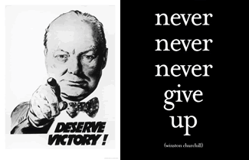
Matthew 24:13
“But the one who endures to the end, he will be saved.”

Slide 92
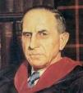
John Murray
Redemption Accomplished and Applied, pp. 152, 154-55.
“The crucial test of true faith is endurance to the end, abiding in Christ, and continuance in the Word…He cannot abandon himself to sin; he cannot come under the domination of sin; he cannot be guilty of certain kinds of unfaithfulness…Let us appreciate the doctrine of the perseverance of the saints and recognize that we may entertain the faith of our security in Christ only as we persevere in faith and holiness to the end.”

Slide 93
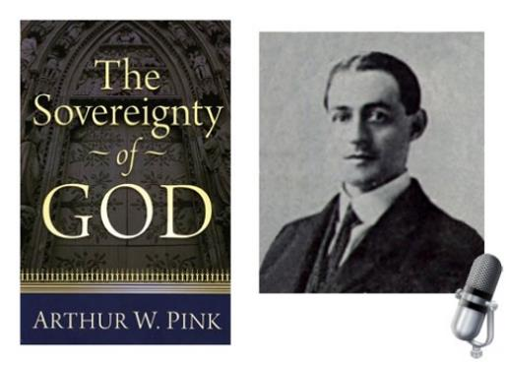
A. W. Pink
Practical Christianity, p. 16.
“Readers, if there is a reserve in your obedience, you are on your way to hell.”

Slide 94
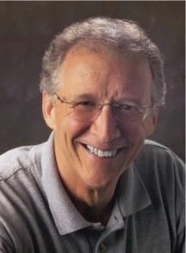
John Piper
John Piper and Pastoral Staff, TULIP: What We Believe about the Five Points of Calvinism: Position Paper of the Pastoral Staff (Desiring God Ministries, 1997), 25, cited in Dave Hunt, What Love is This?, 379.
“No Christian can be sure that he is a true believer. Hence, there is an ongoing need to be dedicated to the Lord and to deny ourselves so that we might make it.”

Slide 95
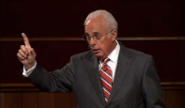
John MacArthur
Saved Without A Doubt, p. 177
“If a person fails to love and obey the Lord through the trials of life, then there is no evidence that he possesses saving faith. How many people do you know who came to church for a while, had a little trouble in their lives, and left? Although they may have made a profession of faith in Christ, they cannot be identified as those who love Him because their lives are not characterized by enduring obedience.”

Slide 96

R.C. Sproul – Bob Wilkin as quoted in:
http://www.gracebiblestudies.org/Resources/Web/www.duluthbible.org/g_f_j/EternalSecurity12.htm
“During the first message presented at Ligonier’s Conference in Orlando last June, Dr. R. C. Sproul indicated that Dr. James Boice, a scheduled speaker at the conference, was dying in faith that very night. Then at the end of the message he asked all 5,000 of us present to pray that Jim dies in faith. This struck me as sad. Here was a great pastor, theologian, teacher, and author. Yet Sproul was not sure that he was regenerate. (In Reformed thought, if a person fails to die in faith, he proved he was never saved in the first place.) I was reminded of R.T. Kendall’s remark that nearly to a man the Puritan divines died doubting whether they were saved and fearing they were going to hell. Dr. Boice died that very night, June 15th.”

Slide 97
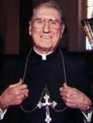
Cardinal John O’Connor of NY
quoted in Samuel Howe Verhovek, Cardinal Defends a Jailed Bishop Who Warned Cuomo on Abortion, New York Times, February 1, 1990.
“Church teaching is that I don't know, at any given moment, what my eternal future will be… I can hope, pray, do my very best – but I still don't know. Pope John II doesn't absolutely know that he will go to heaven, nor does mother Theresa of Calcutta, unless either has had a special divine revelation.”

Slide 98
John 5:24
“Truly, truly, I say to you, he who hears My word, and believes Him who sent Me, has eternal life, and does not come into judgment, but has passed out of death into life.” (NASB)

Slide 99
1 John 5:13
“These things I have written to you who believe in the name of the Son of God, so that you may know that you have eternal life.” (NASB)

Slide 100
Revelation 1:19
Seen (Chapter 1)
Are (Chapters 2–3)
After these things (Chapters 4–22)

Slide 101
Conclusion

Slide 102
The First Beast
Revelation 13:1-10
His sudden appearance in John’s vision (1a)
His Gentile ethnicity (1b)
His fulfillment of Daniel’s prophecies (1c-2a)
His Satanic empowerment (2b)
His resurrection (3)
His power-based adoration (4)
His oratory (5a)

Slide 103
The First Beast
Revelation 13:1-10
His time of authority (5b)
His blasphemies (6)
His persecution of God’s people (7a)
His global jurisdiction (7b)
His unregenerate audience (8)
His oppressive influence (9-10)

Slide 104

“The Lord bless you and keep you; the Lord make his face shine on you and be gracious to you; the Lord turn his face toward you and give you peace.” (NIV)

