Slide 1
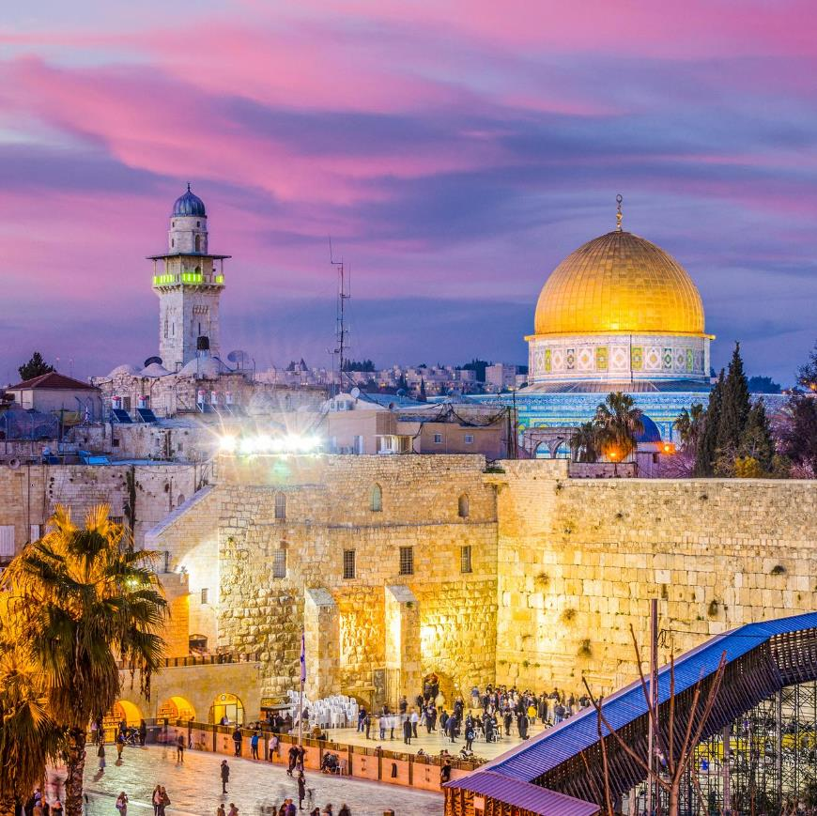
ISRAEL
2019
ANDY WOODS
Part 9

Slide 2
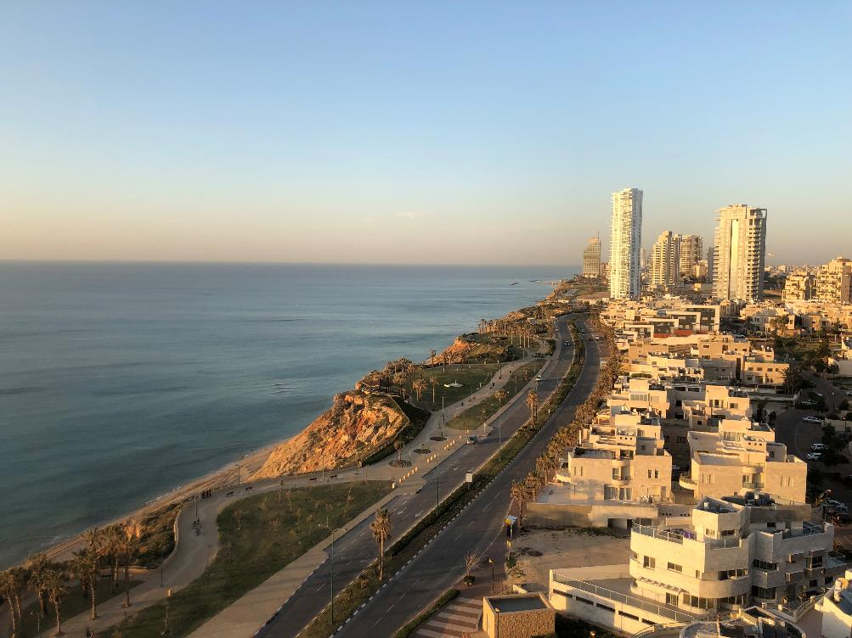
Tel Aviv, Joppa, Caesarea Maritma,
Mt. Carmel, Megiddo
Part 1

Slide 3
Sepphoris, Upper Galilee/Caesarea-Philippi andTel Dan, Sea of Galilee, Mt. of Beatitudes
Part 2

Slide 4
Capernaum, Tabgha
Part 3

Slide 5
Jordan River, Bet She 'An, Jericho, Dead Sea, Masada
Part 4

Slide 6
Qumran, En Gedi, Jerusalem
Part 5

Slide 7
Jerusalem –Mt. of Olives, Garden of Gethsemane, Southern Steps, Western Wall, Temple Institute
Part 6

Slide 8
Jerusalem – Garden Tomb, Golgotha, Upper Room, Pool of Siloam
Part 7

Slide 9
Jerusalem – Pool of Bethesda, Western Wall Tunnel, Hezekiah’s Tunnel, , US Embassy
Part 8

Slide 10
City of David, Valley of Elah, Shiloh, Gideon’s Spring, Behtlehem,Yad Vashem
Part 9

Slide 11
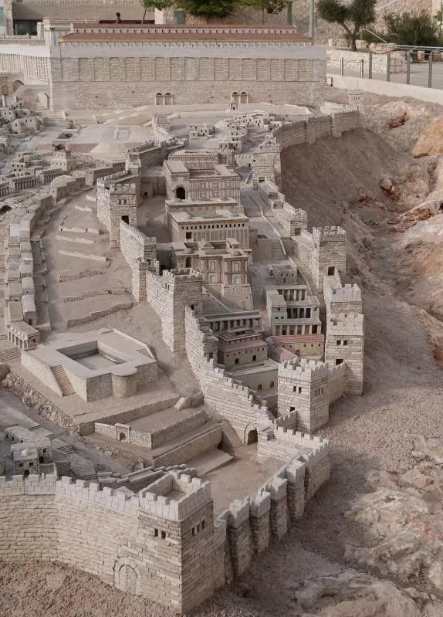
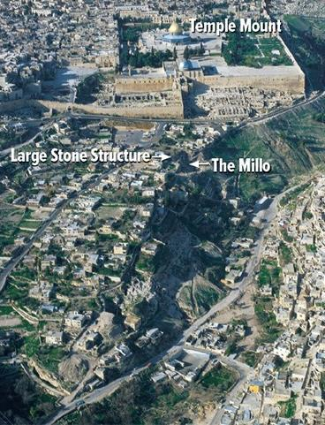
City of David
Ancient Modern

Slide 12

Land Promises Fulfilled in the Time of Joshua
(Josh. 11:23; 21:43-45) or Solomon (1 Kgs. 4:21)?
Extended context (Josh 13:1-7; Judges 1:19, 21, 27, 29, 30-36)
Land gained in conquest was only a fraction of what was promised (1 Kgs. 4:25)
Jerusalem not conquered in Joshua’s day (Josh 15:63; 2 Sam 5)
Solomon’s reign extended to the border of Egypt (1 Kgs. 4:21) and not the River of Egypt (Gen. 15:18)
Solomon’s reign was tributary only (1 Kgs. 4:21)
Forever? (Gen 17:7-8, 13, 19)
Reaffirmation of land promises long after Joshua and Solomon’s time (Amos 9:11-15)
Fruchtenbaum, Israelology, 521-22, 631-32

Slide 13
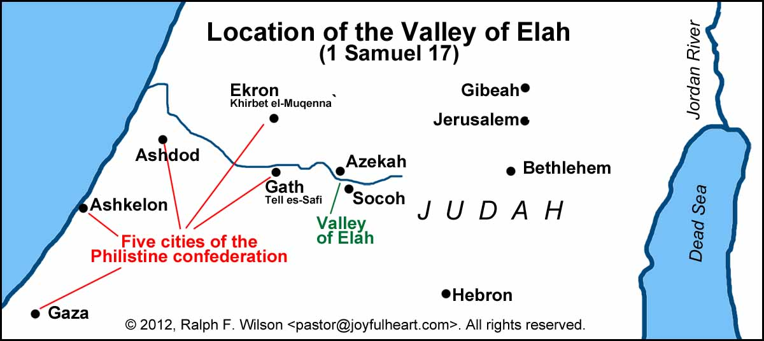

Slide 14

1 Samuel 16:13-14
“¹³ Then Samuel took the horn of oil and anointed him in the midst of his brothers; and the Spirit of the Lord came mightily upon David from that day forward. And Samuel arose and went to Ramah. ¹⁴ Now the Spirit of the Lord departed from Saul, and an evil spirit from the Lord terrorized him.”

Slide 15
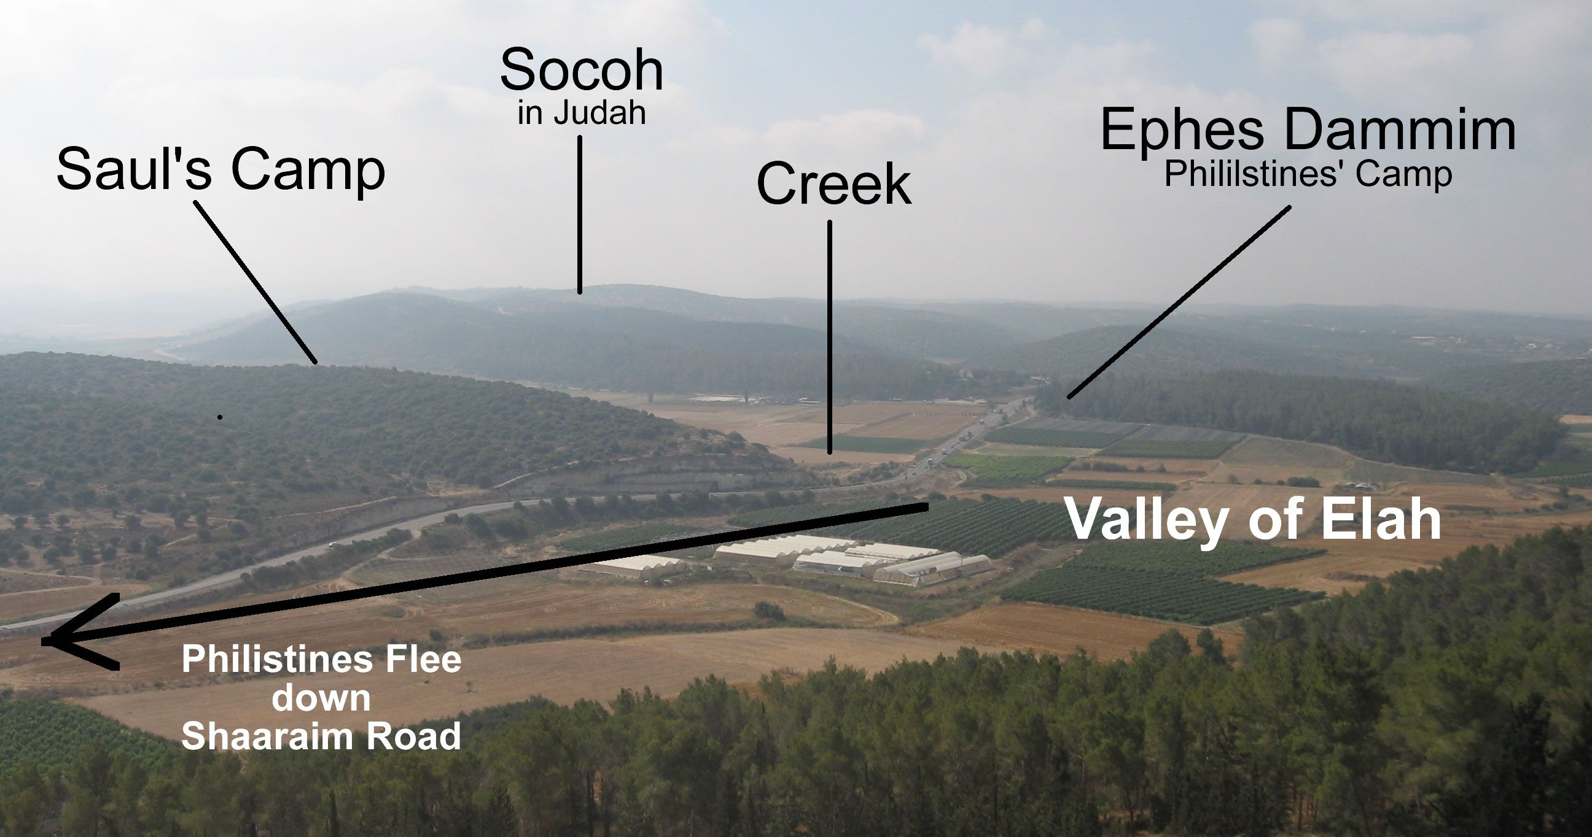
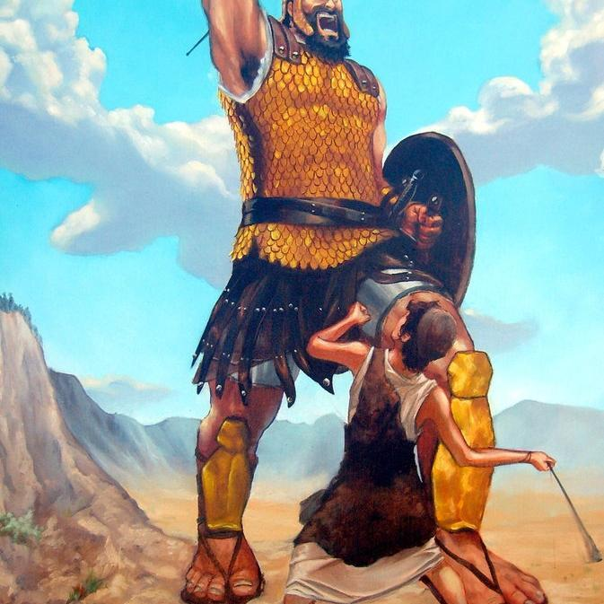
Elah Valley

Slide 16
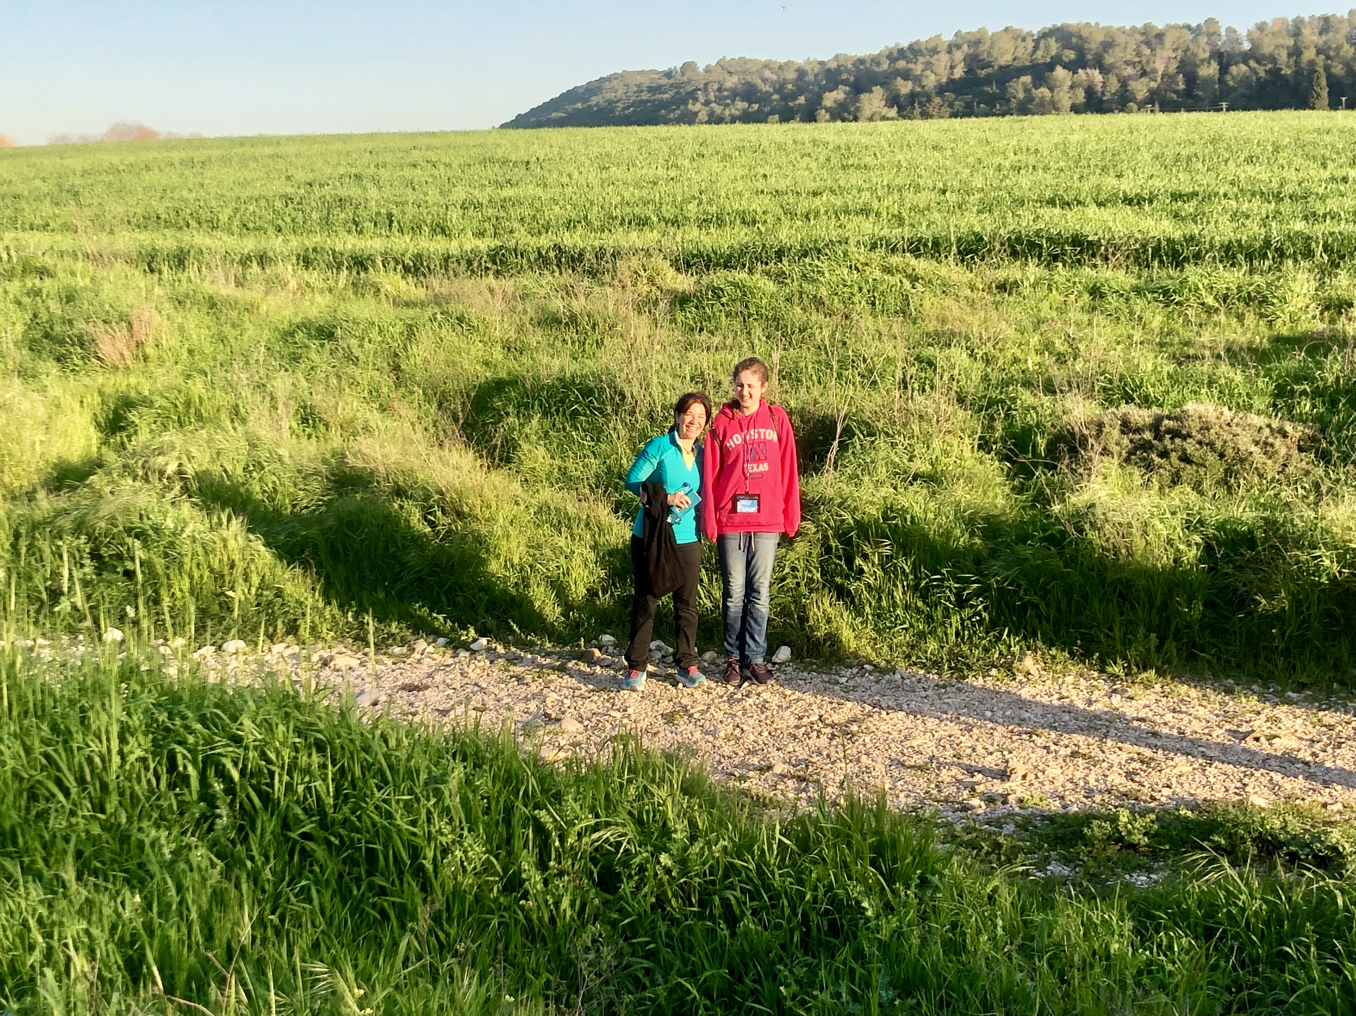
Elah Valley

Slide 17
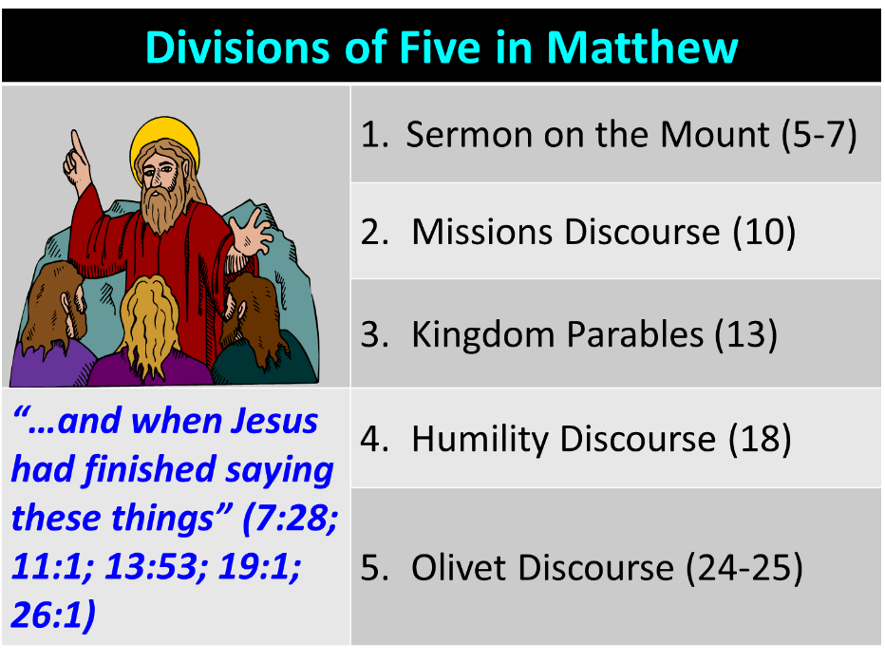

Slide 18
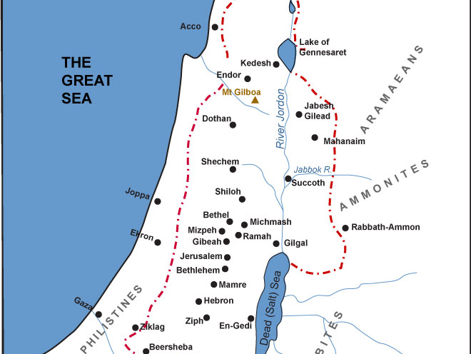

Slide 19
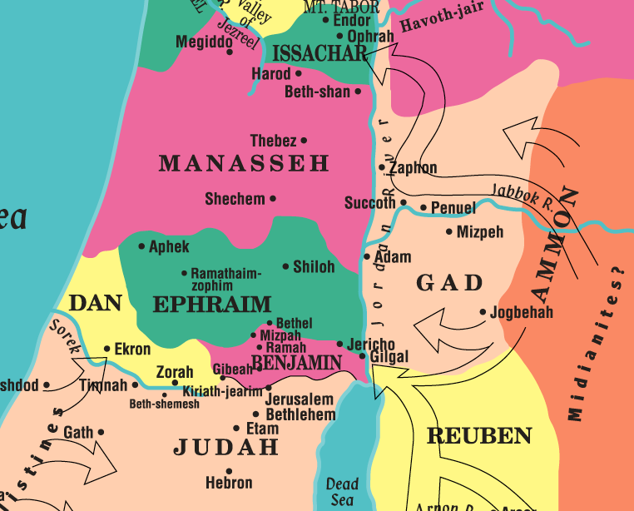

Slide 20
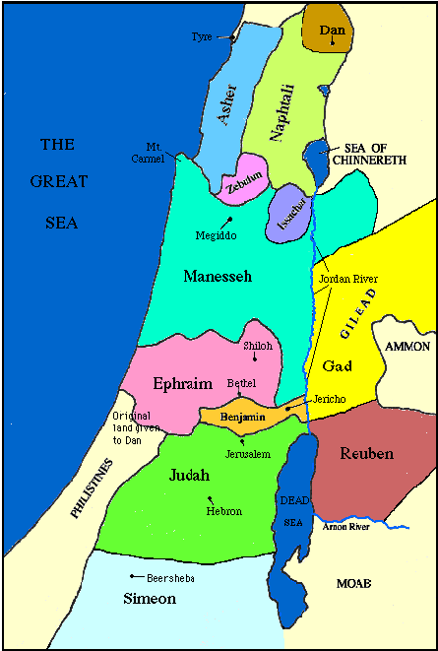

Slide 21
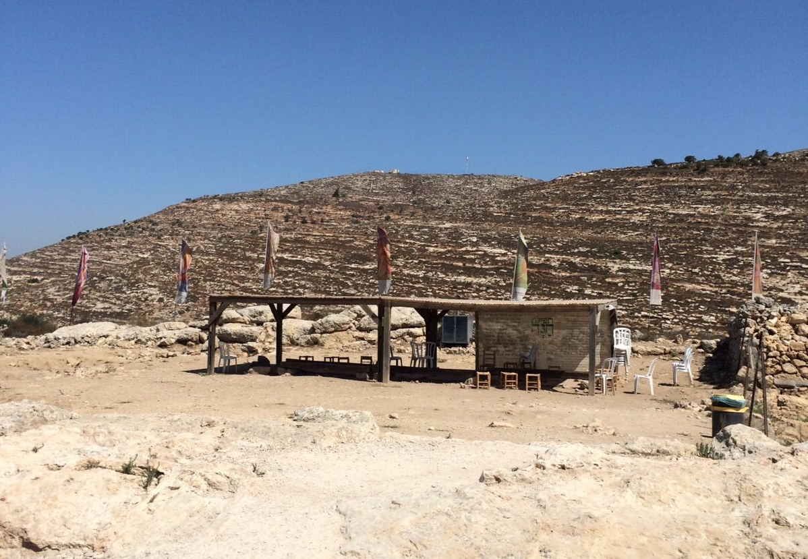
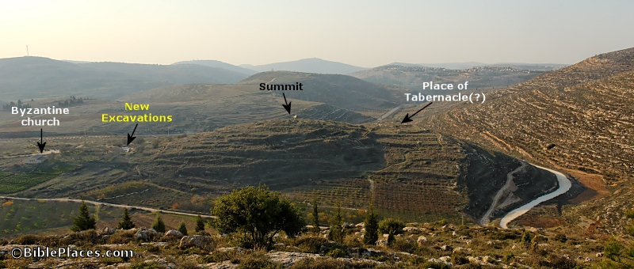
Shiloh

Slide 22
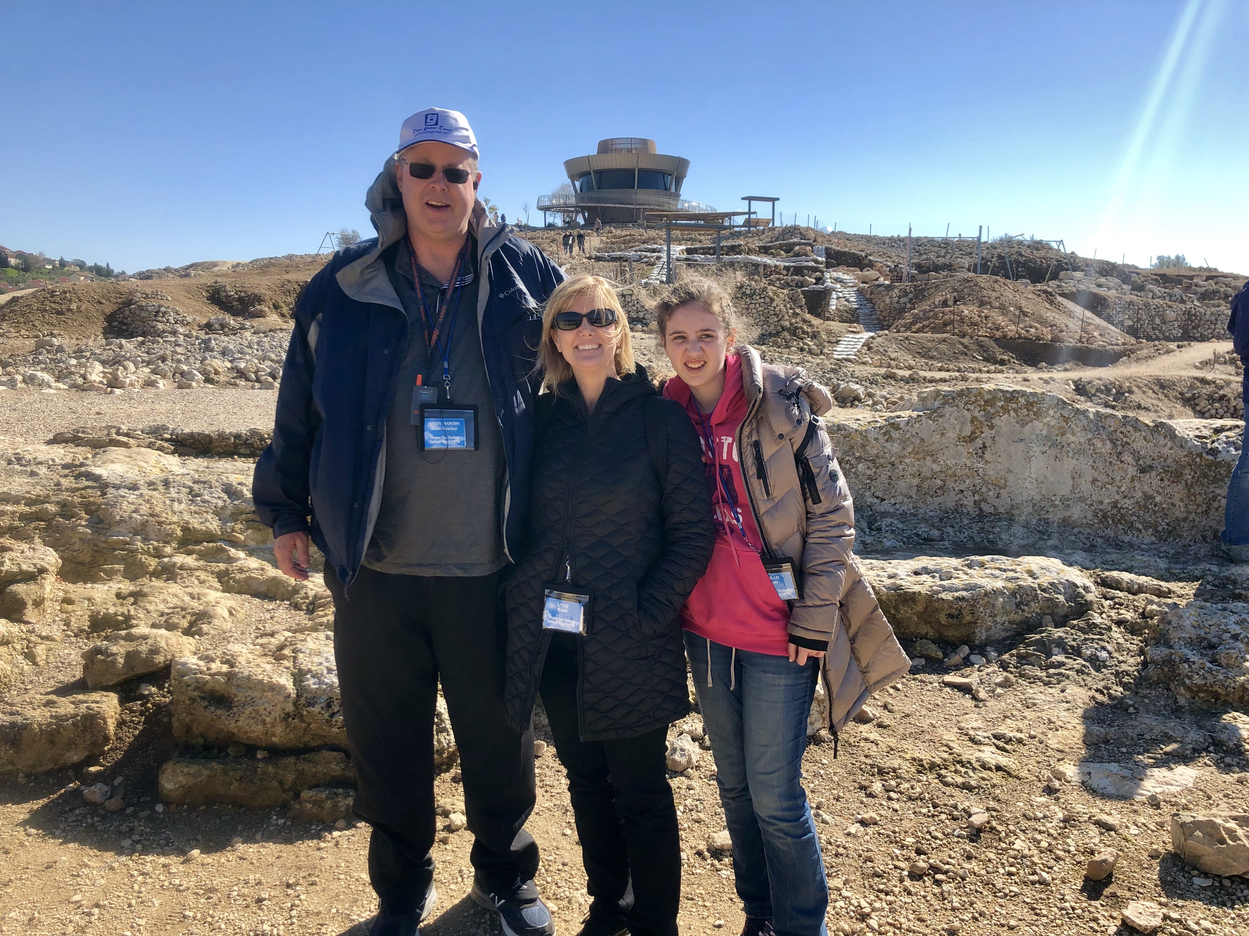
Shiloh

Slide 24

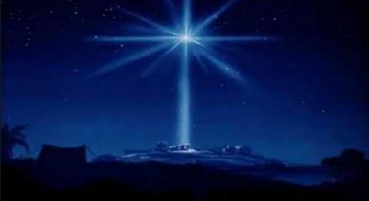
Micah 5:2
“But as for you, Bethlehem Ephrathah, Too little to be among the clans of Judah, From you One will go forth for Me to be ruler in Israel. His goings forth are from long ago, From the days of eternity (olam).”

Slide 25
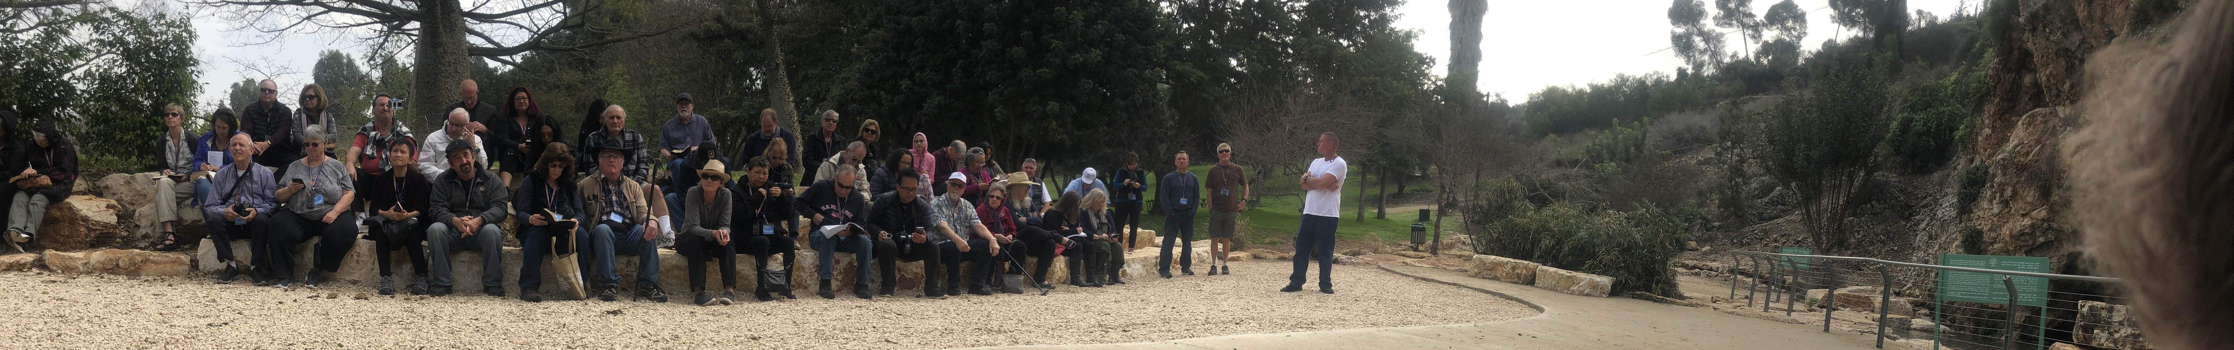
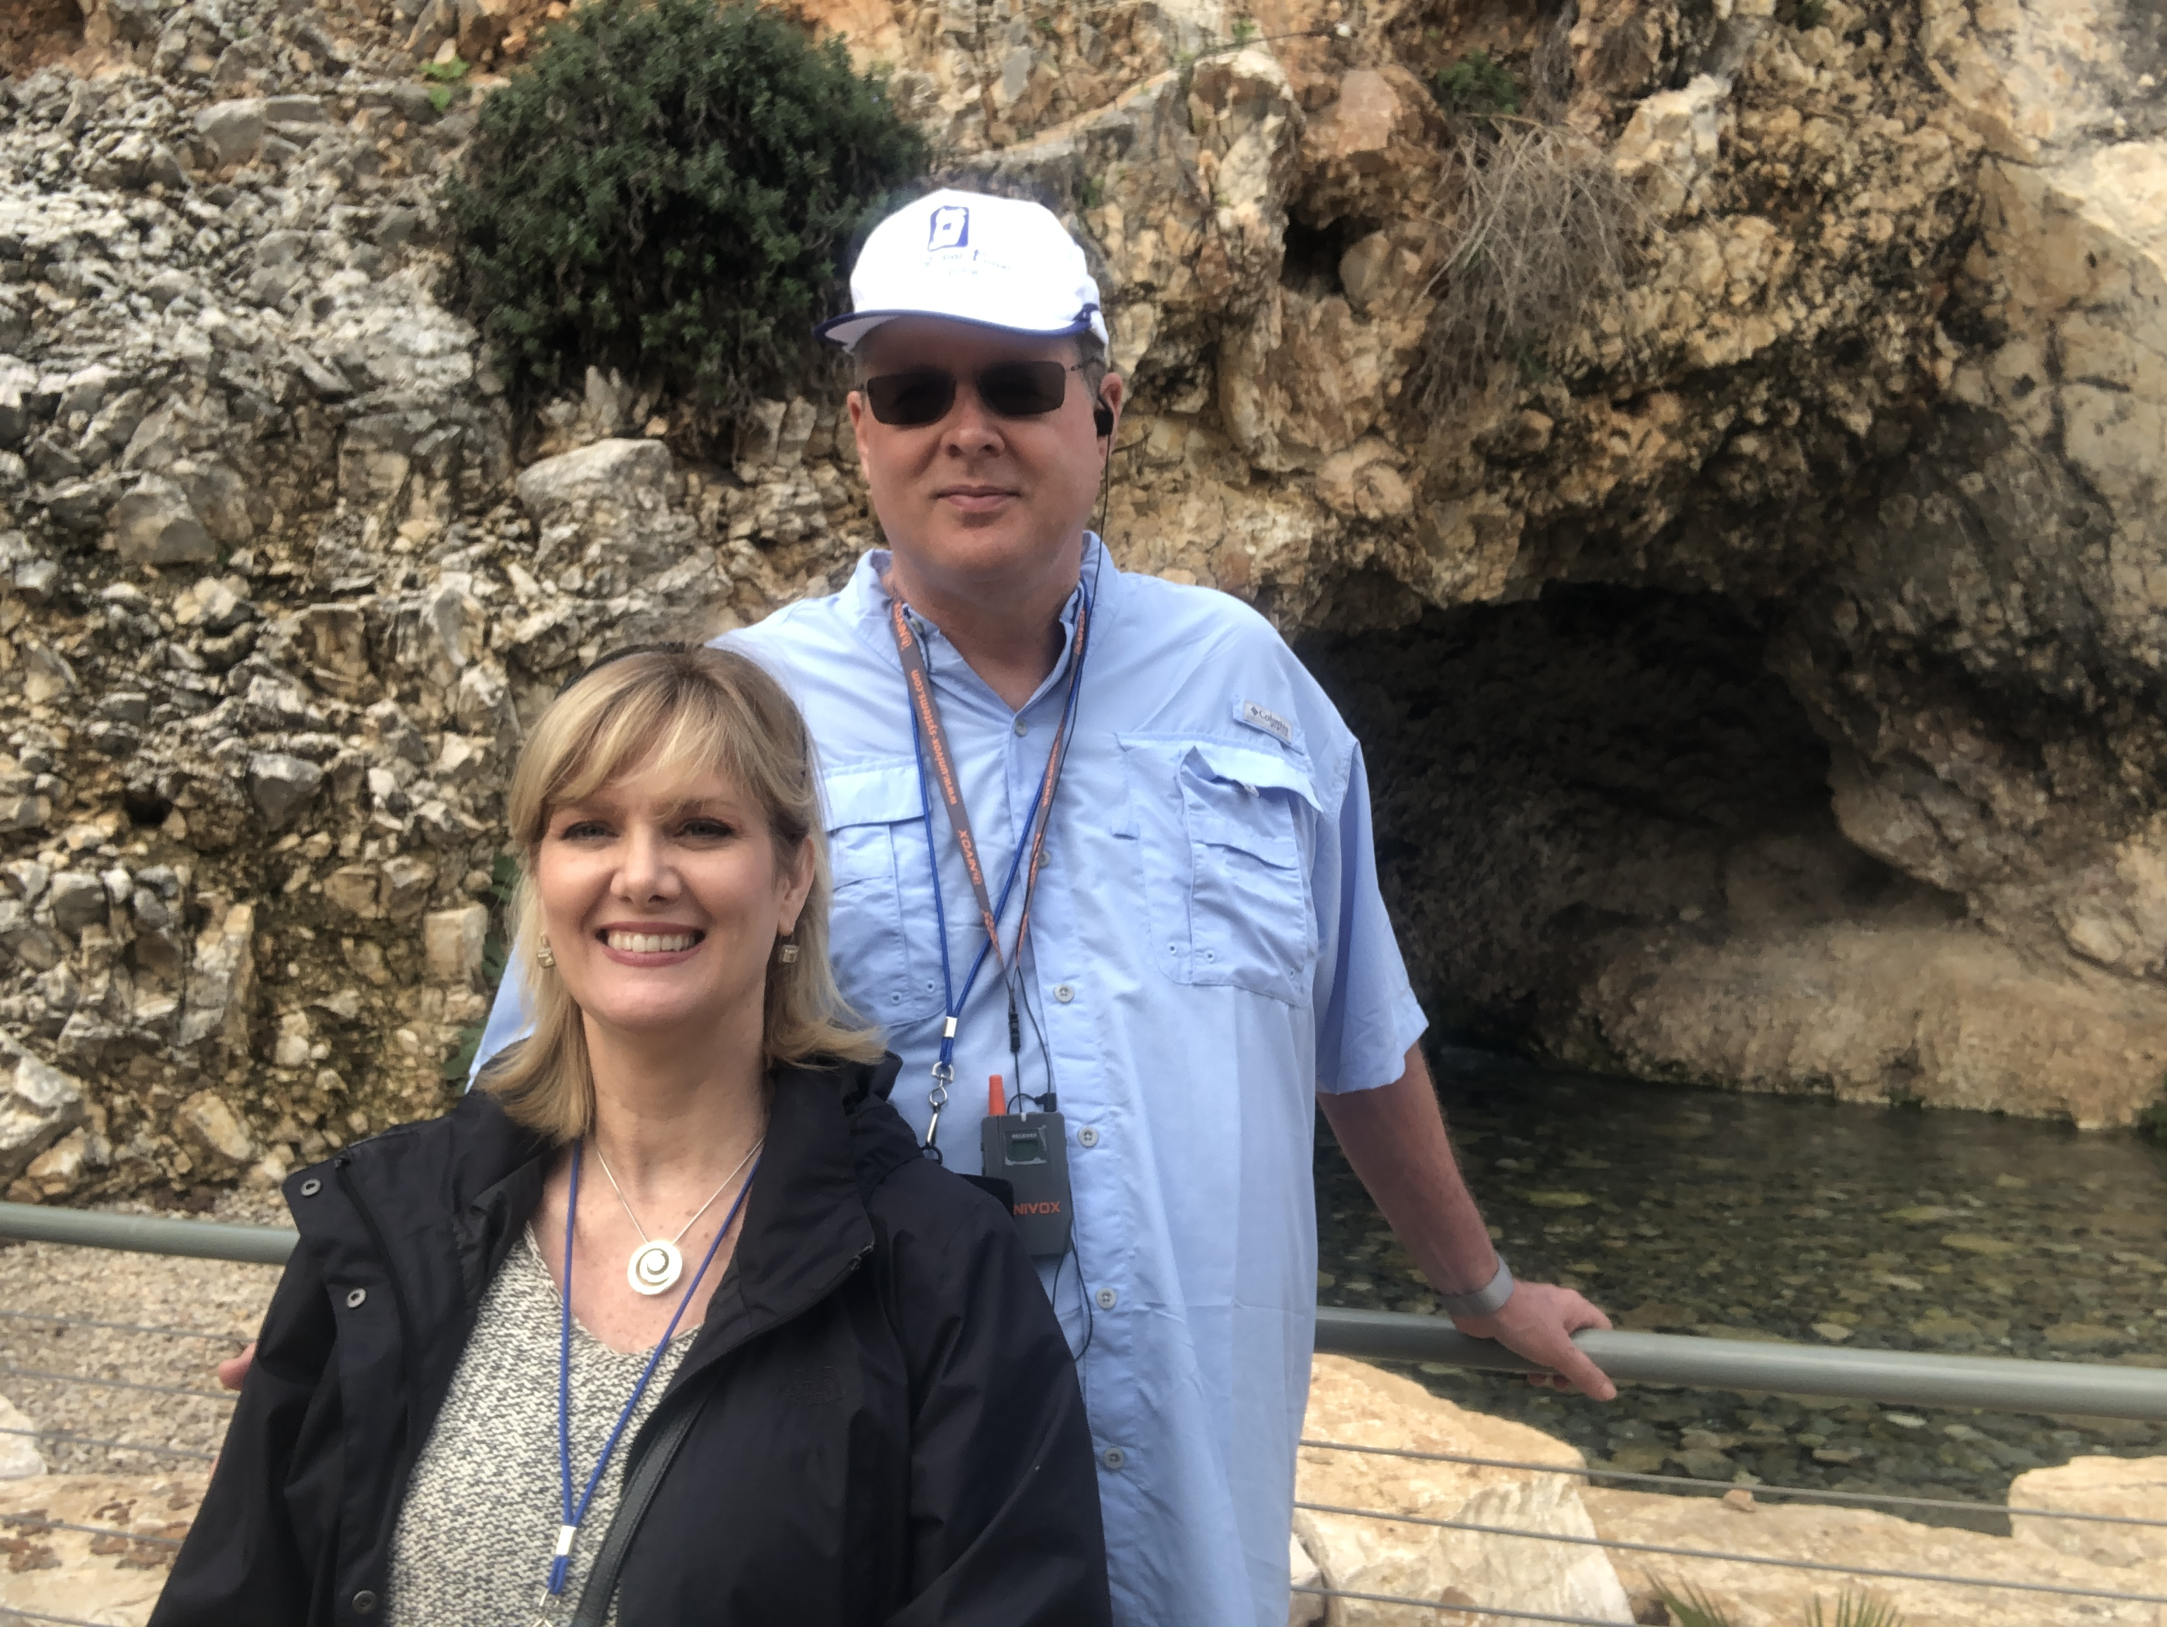
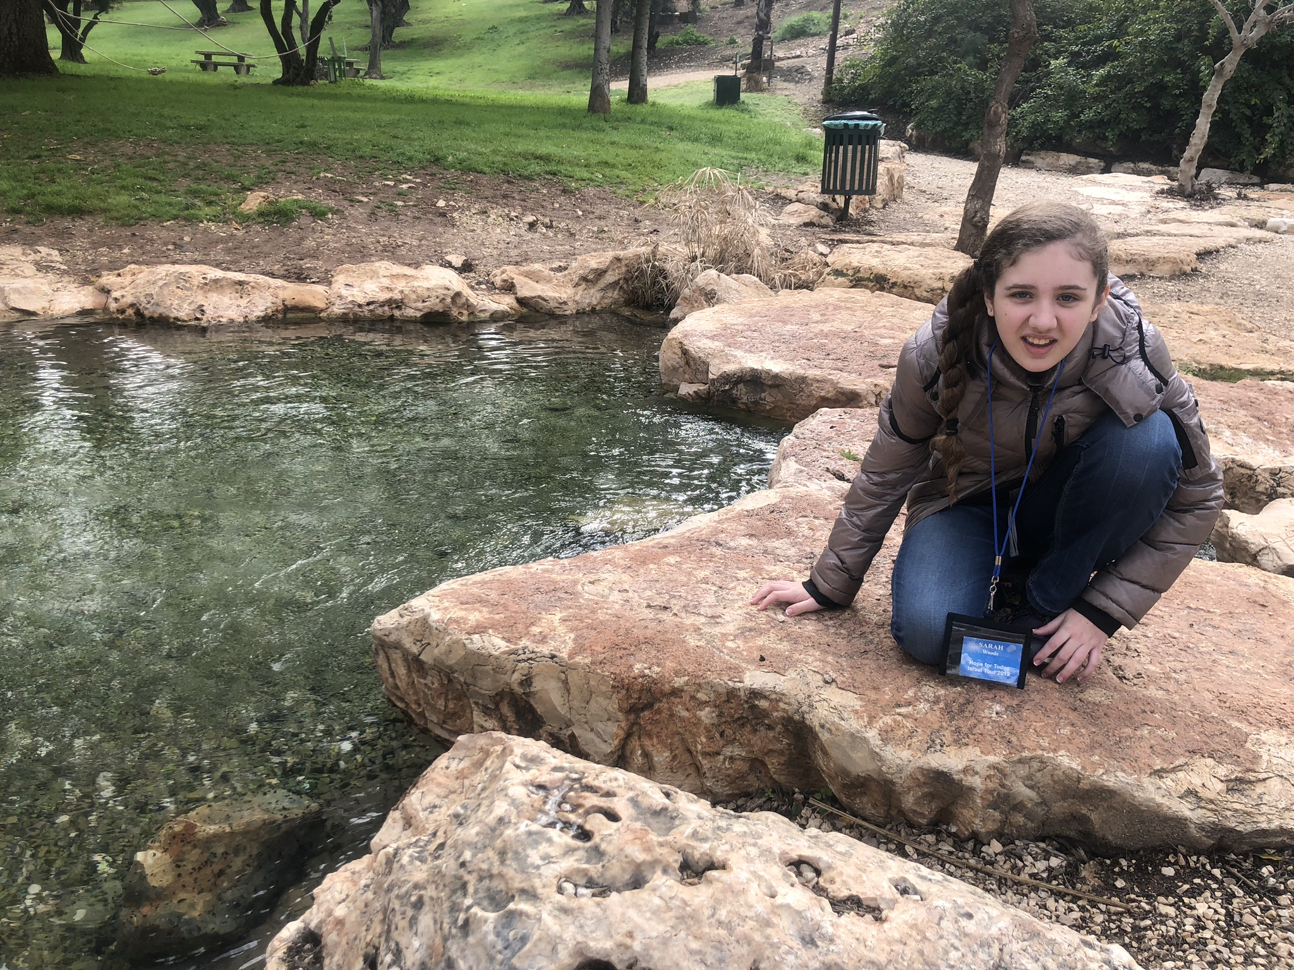
Gideon’s Spring

Slide 26
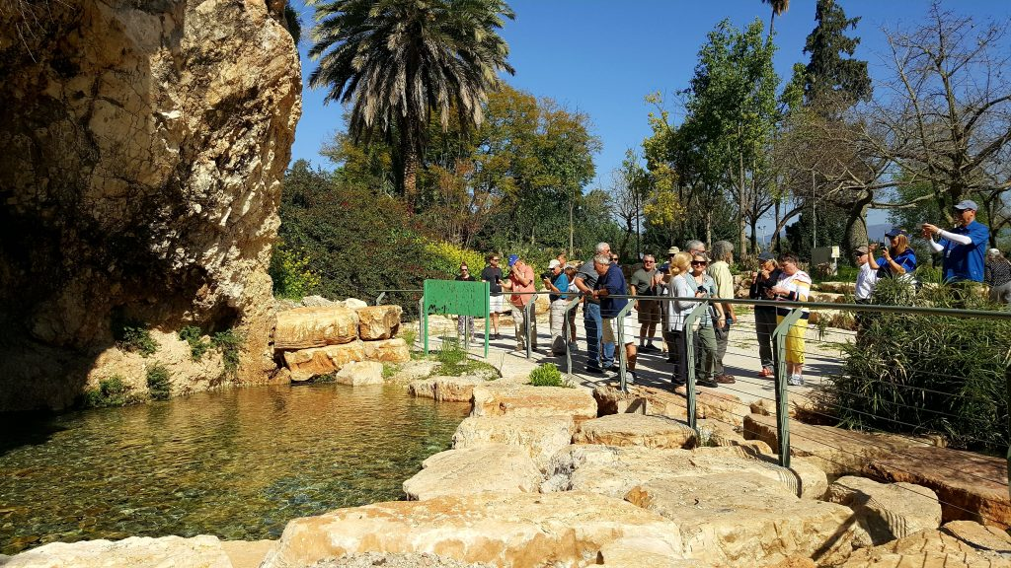
Gideon’s Spring

Slide 27
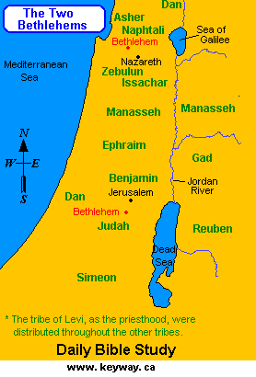

Slide 28
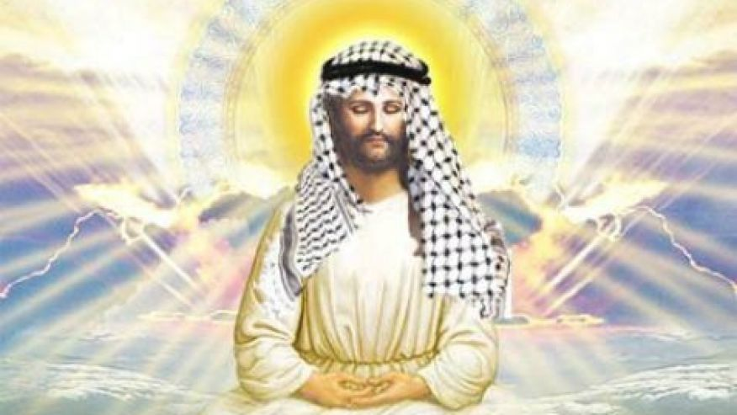

Slide 29
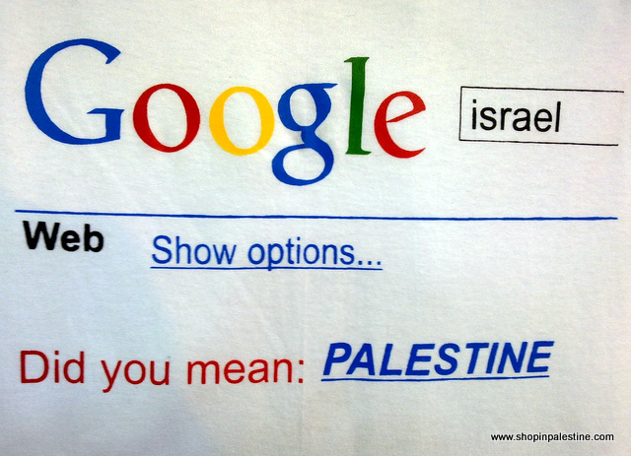

Slide 30
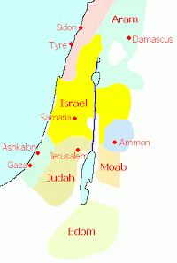

Slide 31
Micah 5:2
“But as for you, Bethlehem Ephrathah, Too little to be among the clans of Judah, From you One will go forth for Me to be ruler in Israel. His goings forth are from long ago, From the days of eternity (olam).”

Slide 32
Micah 5:2
“But as for you, Bethlehem Ephrathah, Too little to be among the clans of Judah, From you One will go forth for Me to be ruler in Israel. His goings forth are from long ago, From the days of eternity (olam).”

Slide 33


Psalm 90:2
“Before the mountains were born Or You gave birth to the earth and the world, Even from everlasting (olam) to everlasting (olam), You are God.”

Slide 34

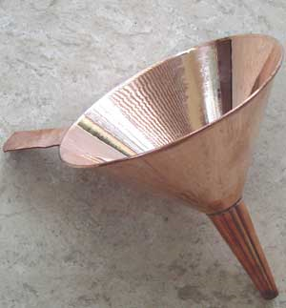

Slide 35
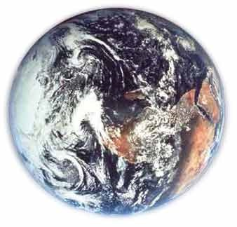
Modern Example
Hemisphere
Country
State
County
City
Zip code
Street name
Street address
Person

Slide 36
Micah 5:2
“But as for you, Bethlehem Ephrathah, Too little to be among the clans of Judah, From you One will go forth for Me to be ruler in Israel. His goings forth are from long ago, From the days of eternity (olam).”

Slide 37
Micah 5:2
“But as for you, Bethlehem Ephrathah, Too little to be among the clans of Judah, From you One will go forth for Me to be ruler in Israel. His goings forth are from long ago, From the days of eternity (olam).”

Slide 38
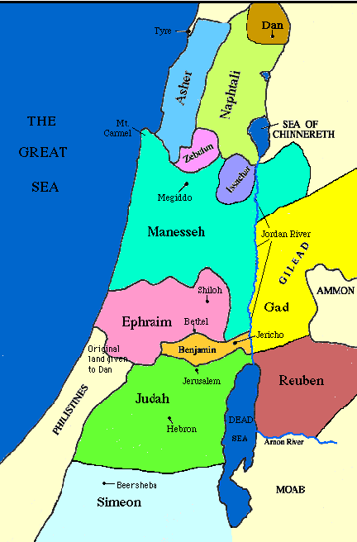

Slide 39
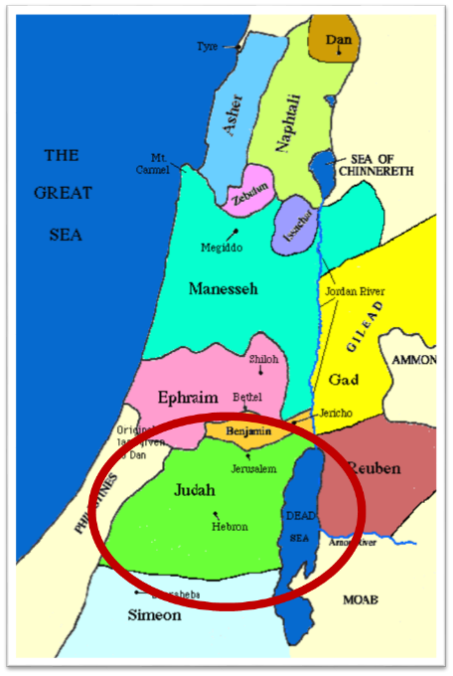

Slide 40
Messiah must be from the tribe of Judah
Genesis 49:10
Revelation 5:5

Slide 41
Micah 5:2
“But as for you, Bethlehem Ephrathah, Too little to be among the clans of Judah, From you One will go forth for Me to be ruler in Israel. His goings forth are from long ago, From the days of eternity (olam).”

Slide 42
Micah 5:2
“But as for you, Bethlehem Ephrathah, Too little to be among the clans of Judah, From you One will go forth for Me to be ruler in Israel. His goings forth are from long ago, From the days of eternity (olam).”

Slide 43
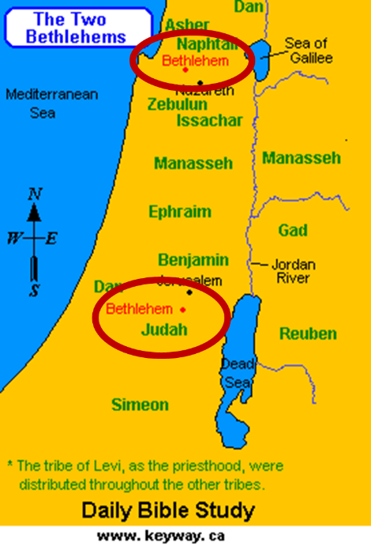

Slide 44
Micah 5:2
“But as for you, Bethlehem Ephrathah, Too little to be among the clans of Judah, From you One will go forth for Me to be ruler in Israel. His goings forth are from long ago, From the days of eternity (olam).”

Slide 45

7 “I AM” statements in John
I am the Bread of Life | 6:35
I am the Light of the world | 8:12
I am the Gate for the sheep | 10:7; cf. v.9
I am the Good Shepherd | 10:11,14
I am the Resurrection and the Life | 11:25
I am the Way and the Truth and the Life | 14:6
I am the true Vine | 15:1; cf. v.5

Slide 46
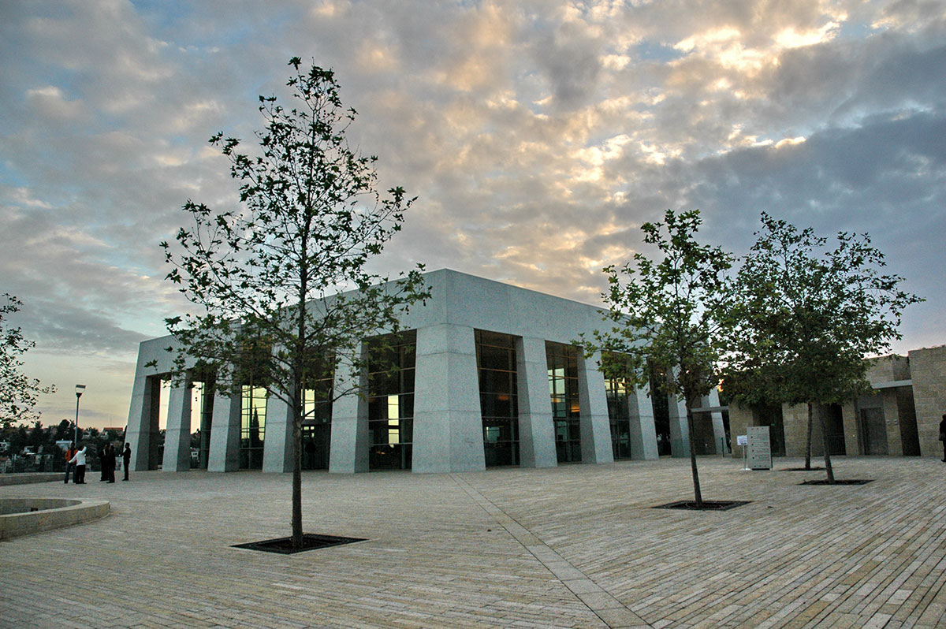
Yad Vashem

Slide 47

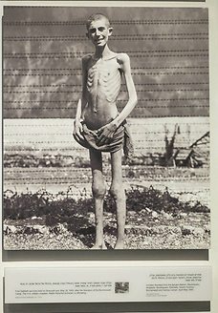
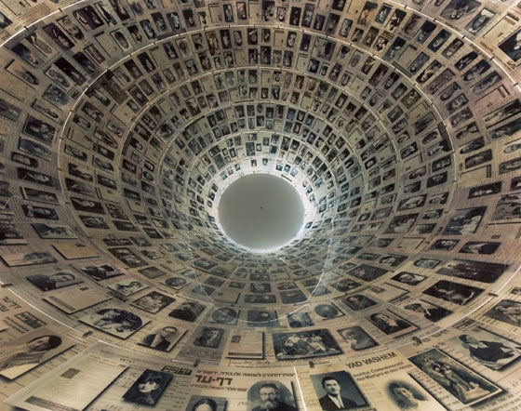
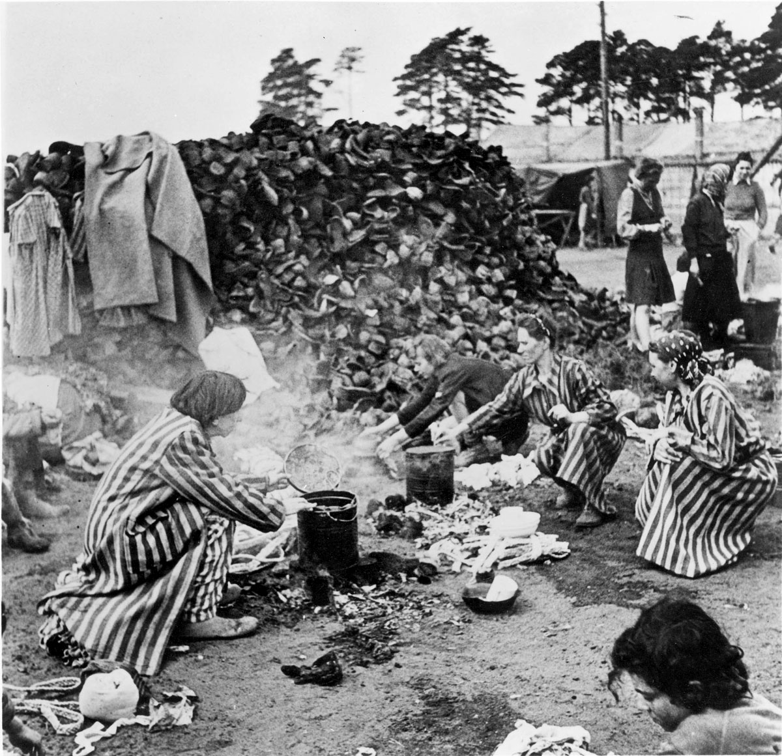
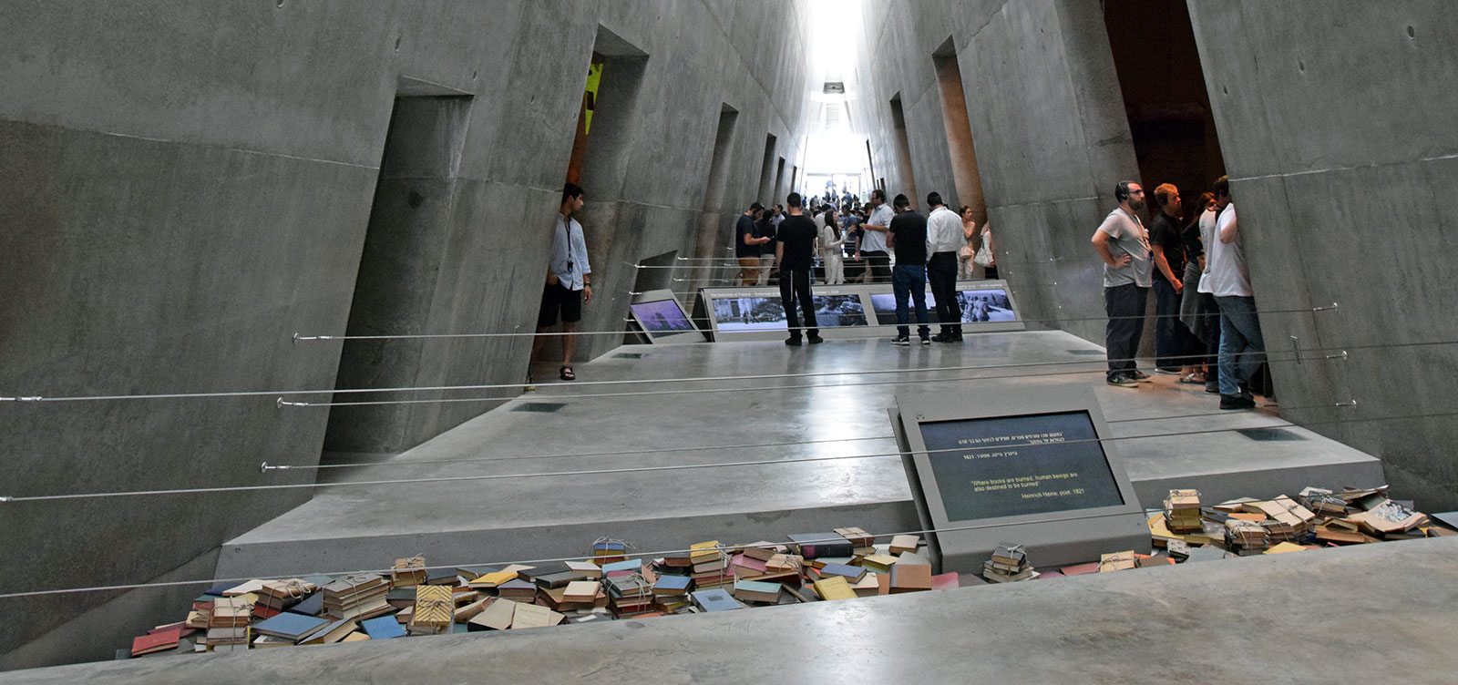
Yad Vashem

Slide 48
Ignorance about the Holocaust is growing
By Harry D. Wall
Updated 6:11 PM ET, Sun January 27, 2019
“Ignorance about the Holocaust is growing, particularly among young people. In the United States, a 2018 survey showed that 66% of millennials could not identify what the Auschwitz concentration and death camp was. A recent CNN poll in Europe revealed that about a third of the 7,000 European respondents across seven countries knew "just a little or nothing at all" about the Holocaust. In France, nearly 20% of young adults between the ages of 18 and 34 said they had never heard of the Holocaust.”
https://www.cnn.com/2019/01/27/opinions/holocaust-education-importance-wall/index.html

Slide 49
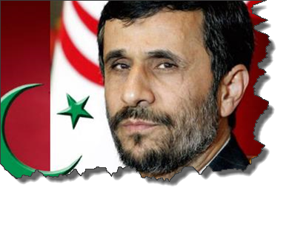
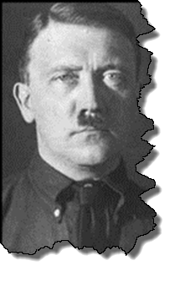
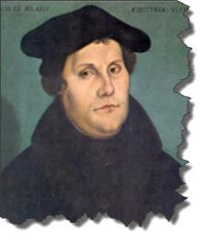
MODERN TRENDS IN ANTISEMITISM
Revelation 12

Slide 50

Christian Anti-Semitism
  “First, their synagogues should be set on fire…Secondly, their homes should likewise be broken down and destroyed…Thirdly, they should be deprived of their prayer books and Talmuds…”
Martin Luther, Concerning the Jews and Their Lies, cited in Michael Brown’s Our Hands Are Stained with Blood, pp. 14-15.

Slide 51
Christian Anti-Semitism
  “…Fourthly, their rabbis must be forbidden under threat of death to teach any more…Fifthly, passport and traveling privileges should be absolutely forbidden to the Jews…Sixthly, they ought to be stopped from usury (charging interest on loans…”
Martin Luther, Concerning the Jews and Their Lies, cited in Michael Brown’s Our Hands Are Stained with Blood, pp. 14-15.

Slide 52
Christian Anti-Semitism
“Seventhly, let the young and strong Jews and Jewesses be given the flail, the ax, the hoe, the spade, the distaff, and spindle, and let the earn their bread by the sweat of their noses…We ought to drive the rascally lazy bones out of our system...”
Martin Luther, Concerning the Jews and Their Lies, cited in Michael Brown’s Our Hands Are Stained with Blood, pp. 14-15.

Slide 53
Christian Anti-Semitism
“…Therefore away with them… To sum up, dear princes and nobles who have Jews in your domains, if this advice of mine does not suit you, then find a better one so that you and we may all be free of this insufferable devilish burden–the Jews.”
Martin Luther, Concerning the Jews and Their Lies, cited in Michael Brown’s Our Hands Are Stained with Blood, pp. 14-15.

Slide 54
The Encyclopaedia Judaica says “Short of the Auschwitz oven and the extermination, the whole Nazi holocaust is pre-outlined here.”
Martin Luther
“Luther, Martin,” in Encyclopaedia Judaica, Vol. 8, 693.

Slide 55
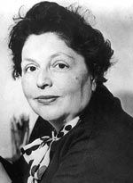
“…both Luther and Hitler were obsessed by the ‘demonologized universe’ inhabited by the Jews.”
Lucy Dawidowicz
“Luther, Martin,” in Encyclopaedia Judaica, Vol. 8, 693.

Slide 56
Lutheran Statement https://www.ccjr.us/dialogika-resources/documents-and-statements/interreligious/759-lwfijcic1983
  “We Lutherans take our name and much of our understanding of Christianity from Martin Luther. But we cannot accept or condone the violent verbal attacks that the Reformer made against the Jews…The sins of Luther’s anti-Jewish remarks, the violence of his attacks on the Jews, must be acknowledged with deep distress. And all occasions for similar sin in the present or the future must be removed from our churches…Lutherans of today refuse to be bound by all of Luther’s utterances on the Jews.”

Slide 57

John Calvin
Commentary on the Prophet Daniel (Vol 1, p. 185). Bellingham, WA: Logos Bible Software. Commentary on Daniel 2:44-45. (2010).
  “But here he [the rabbi] not only betrays his ignorance, but his utter stupidity, since God so blinded the whole people that they were like restive dogs. I have had much conversation with many Jews: I have never seen either a drop of piety or a grain of truth or ingenuousness—nay, I have never found common sense in any Jew. But this fellow, who seems so sharp and ingenious, displays his own impudence to his great disgrace.”

Slide 58
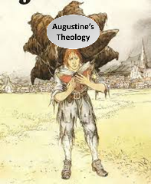
  Calvin repeatedly refers to the Jews as “profane unholy sacrilegious dogs,” describing them as “a barbarous nation” and “the people of Israel rejected by God.”
John Calvin
1. John Calvin, Ioannis Calvini opera quae supersunt Omnia, 50, 307; Sermon on Gal. 1:6–8; quoted in Selderhuis, Calvin Handbook, 145; 2. John Calvin, Supplementa Calviniana, V, 145, 10; Sermon on Mic. 40b–11; quoted in Selderhuis, Calvin Handbook, 145; 3. John Calvin, Ioannis Calvini opera quae supersunt Omnia, 27, 6; Sermon on Deut. 10:1–8; quoted in Selderhuis, Calvin Handbook, 145.

Slide 59
Yad Vashem

Slide 60
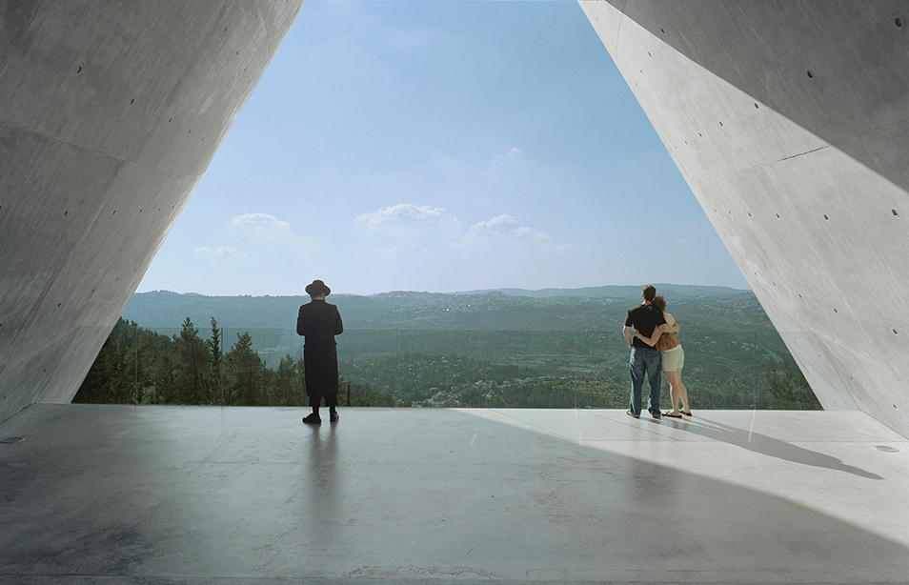
Yad Vashem

Slide 61

Zechariah 13:8-9
⁸“It will come about in all the land,” Declares the Lord, “That two parts in it will be cut off and perish; But the third will be left in it. ⁹“And I will bring the third part through the fire, Refine them as silver is refined, And test them as gold is tested. They will call on My name, And I will answer them; I will say, ‘They are My people,’ And they will say, ‘The Lord is my God.’ ”

Slide 62

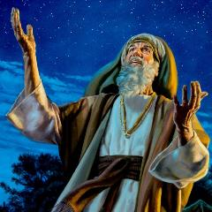
Genesis 12:3
“And I will bless those who bless you, And the one who curses you I will curse. And in you all the families of the earth will be blessed.”

Slide 63
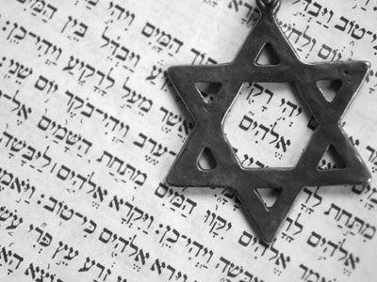
Israel’s Three Blessings to the World
(Gen 12:3b)
Scripture (Rom 3:2)
Savior (John 4:22)
Kingdom (Isa 2:2-3)

Slide 64
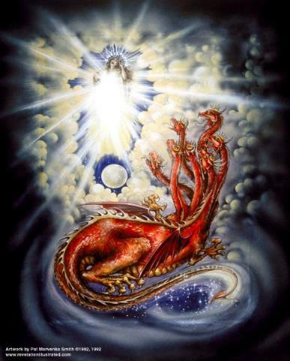
CAST OF CHARACTERS
Revelation 12:1-5
SON = MESSIAH
  Ps. 2:9; Acts 1:9
DRAGON = SATAN
  Rev. 12:9; 20:2
WOMAN = ISRAEL
  Gen. 37:9-10

Slide 65
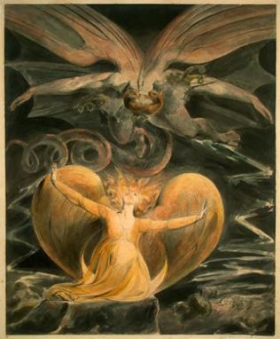
2 CYCLES OF SATANIC PERSECUTION
“Pursues the woman” = persecution of Israel 12:13-14
“Flood from his mouth” = tries to destroy Israel 12:15-16

