Slide 1
Law and Grace: An Overview Jim McGowan, Th.D. Sugar Land Bible Church 05-05-2019
…but grace and truth were realized through Jesus Christ - John 1:17
For the Law was given through Moses…
Special thanks to Dr. Vern Peterman for access to his insights and resources.

Slide 2
Session 18 Outline
Review
Purpose, Aim, and Objective
Session 17
Introduction to the Gospel of Matthew Part 2
General Information
Comparisons
Contrasts
Concluding Observations

Slide 3
OUR PURPOSE, AIM AND OBJECTIVE
Law and Grace
…is to Compare and Contrast Law and Grace so as to properly understand these two important themes and how they are related to the life of the New Testament Believer.

Slide 4
C. I. SCOFIELD, D. D.
The Grace of God, The Fundamentals Vol. 3, Chapter VII, p. 98
We have, most of us, been reared and now live under the influence of Galatianism. Protestant theology, alas, is for the most part, thoroughly Galatianized, in that neither law nor grace are given their distinct and separated places, as in the counsels of God, but are mingled together in one incoherent system.
The law is no longer, as in the Divine intent, a ministration of death (2 Cor. 3:7), of cursing (Gal. 3:10), of conviction (Rom. 3:19), because we are taught that we must try to keep it, and that by Divine help we may.
Nor, on the other hand, does grace bring us blessed deliverance from the dominion of sin, for we are kept under the law as a rule of life despite the plain declaration, “Sin shall not have dominion over you: for ye are not under the law, but under grace” (Rom. 6:14). (emphasis mine)

Slide 5
William R. Newell
Romans Verse-by-Verse (p. 274).
Grand Rapids, MI: Christian Classics Ethereal Library.
It is because Reformed theology has kept us Gentiles under the Law,—if not as a means of righteousness, then as “a rule of life,” that all the trouble has arisen. The Law is no more a rule of life than it is a means of righteousness. Walking in the Spirit has now taken the place of walking by ordinances. God has another principle under which He has put his saints: “Ye are not under law, but, under grace!” (italics mine)

Slide 6
Session 18 Outline
Review
Purpose, Aim, and Objective
Session 17
Introduction to the Gospel of Matthew Part 2
General Information
Comparisons
Contrasts
Concluding Observations

Slide 7
Matthew’s Purposes
Law and Grace: Session 17 Review
To explain that Jesus in whom they had believed was the long-awaited Jewish Messiah
To explain why the kingdom had been postponed despite the fact that the king had arrived
To explain the interim program of God during the kingdom’s absence

Slide 8
Matthew & the Kingdom
Law and Grace: Session 17 Review
Kingdom offered
Kingdom rejected
Kingdom postponed
Kingdom ultimately accepted
Interim program

Slide 9
Matthew’s Message
Law and Grace: Session 17 Review
Jesus is the predicted Jewish king who ushered in an interim program by building the sons of the kingdom into the church in between Israel’s past rejection and future acceptance of her king

Slide 10
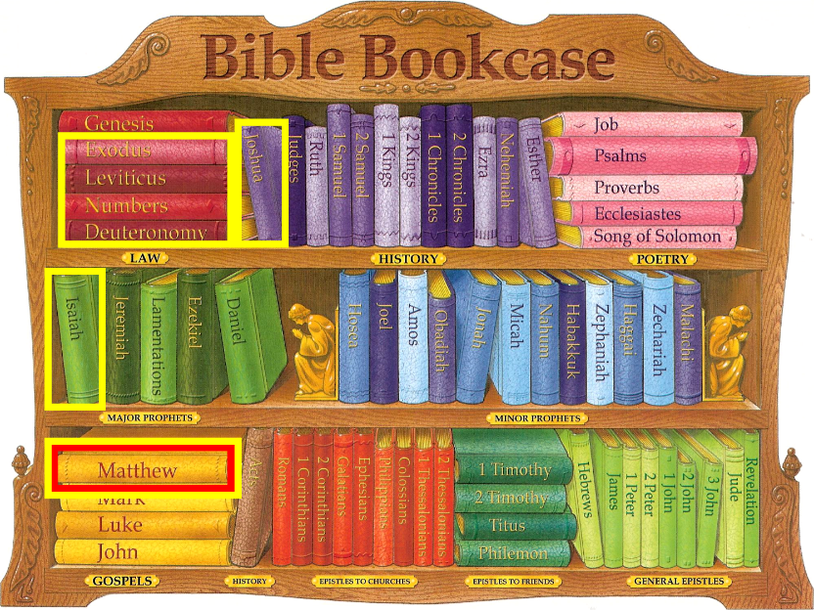
Law and Grace: Session 17 Review

Slide 11
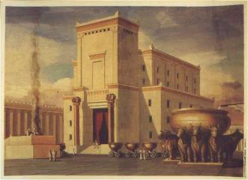
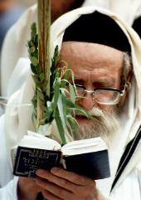
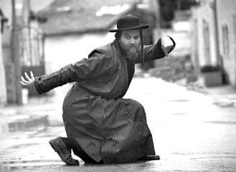
What? – Written to the Jews?
Law and Grace: Session 17 Review
The Gospel written by Matthew shows evidence of being written to the people of Israel (the Jews).

Slide 12
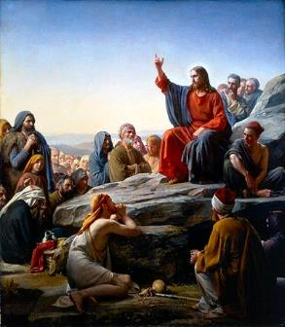
Only In the land of Israel and to people of Israel
Law and Grace: Session 17 Review
In Matthew, we will see that Christ will direct the people of Israel back to the original intent of the Law of Moses, and away from those traditions that added to or distorted the original Law as given by Moses (cf. Matt. 5:21, 27, 33, 38, and 43).

Slide 13
Kingdom of God vs. Kingdom of Heaven
Law and Grace: Session 17 Review
Only the Gospel of Matthew uses the term, ‘kingdom of heaven’, which it does 32 times.

Slide 14
Kingdom of God vs. Kingdom of Heaven
Law and Grace: Session 17 Review
The main reason Matthew replaced the usual expression ‘Kingdom of God’, with the *euphemism ‘Kingdom of heaven’, is due to the fact that the Jews didn’t want to risk saying the name of God [Yahweh] in vain.
* Definition of euphemism – the substitution of an agreeable or inoffensive expression for one that may offend… Merriam-Webster Online Dictionary.

Slide 15
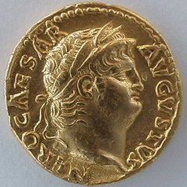
So who was Matthew?
Law and Grace: Session 17 Review
Matthew, who was also called ‘Levi’, was a son of a man named Alphaeus (Mark 2:14).
Matthew had been a tax collector for the hated Romans (Matt. 9:9; Luke 5:27-32).
“tax collectors and “sinners

Slide 16
Law and Grace: Session 17 Review
When and how did he write the book?
Matthew’s references to Jerusalem and the Sadducees point to a date of composition before 70 A.D. when the Romans destroyed Jerusalem. His references to Jerusalem assume its existence (e.g., 4:5; 27:53). Matthew recorded more warnings about the Sadducees than all the other New Testament writers combined, but after 70 A.D. they no longer existed as a significant authority in Israel. Consequently, Matthew probably wrote before 70 A.D.
References in the text to the customs of the Jews continuing “to this day” (27:8; 28:15) imply that some time had elapsed between the crucifixion of Jesus Christ and the composition of the Gospel. Since Jesus died in 33 A.D. Matthew may have composed his Gospel perhaps a decade or more later. A date between 40 and 70 A.D. is very probable.
Constable, T. (2003). Tom Constable’s Expository Notes on the Bible (Mal 4:6). Galaxie Software.

Slide 17
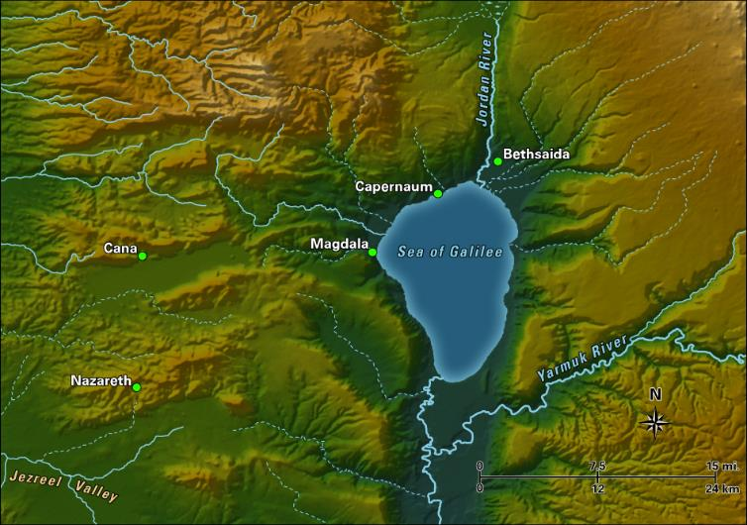
Law and Grace: Session 17 Review
Matthew was from where?

Slide 18
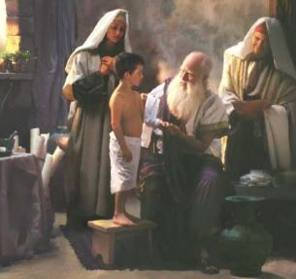
Law and Grace: Session 17 Review
What happened to Matthew later?
Matthew was last named in the New Testament in Acts 1:13, by Luke, the physician.
After that he is only referred to as one of the apostles, last mentioned in the book of Revelation (Rev. 21:14).

Slide 19
Law and Grace: Session 17 Review
SENIOR MOMENT CORRECTION
JAMES, THE BROTHER OF JOHN WAS THE FIRST APOSTLE TO DIE!

Slide 20
Session 18 Outline
Review
Purpose, Aim, and Objective
Session 17
Introduction to the Gospel of Matthew Part 2
General Information
Comparisons
Contrasts
Concluding Observations

Slide 21
Law and Grace: Session 18
How will we approach the Gospel of Matthew?

Slide 22
Law and Grace: Session 18
How will we approach the Gospel of Matthew?
The Gospel of Matthew contains one of four valid, inspired, records of the life of Christ. All other supposed gospels, are BOGUS, FAKE, AND PHONY.
The Gospel of Thomas is one of those you'll hear referenced often on the History Channel, the Discovery Channel, etc., but it too is BOGUS, FAKE, AND PHONY.

Slide 23
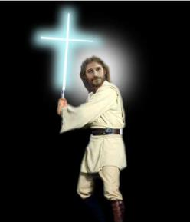
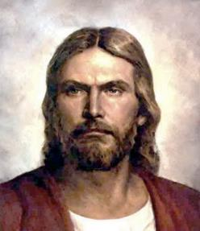
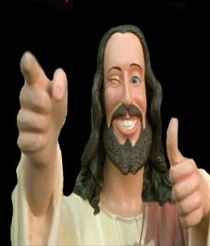
Law and Grace: Session 18
How will we approach the Gospel of Matthew?
Only the Gospels of Matthew, Mark, Luke, and John, contain valid, inspired, records of the life of Christ!
Interpretations of the Gospel of Matthew are numerous, varied, and at time, far-fetched, spreading across a broad doctrinal range. For example:

Slide 24
Law and Grace: Session 18
How will we approach the Gospel of Matthew?
We will approach the Gospel of Matthew so that we will arrive at the one intended meaning for each passage that God, through Matthew intended to convey.
Intended meaning

Slide 25
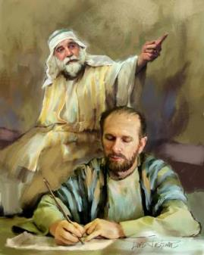
What God inspired and the author intended.
Law and Grace: Session 18
As we approach the book of Matthew we will continue to ask the question, “What message did God inspire and what meaning did the apostle Matthew intend to convey?” (2 Timothy 3:16-17)

Slide 26
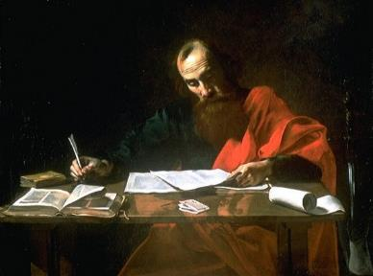
2 Timothy 3:16-17
¹⁶ All Scripture is inspired by God and profitable for teaching, for reproof, for correction, for training in righteousness; ¹⁷ so that the man of God may be adequate, equipped for every good work.

Slide 27
Law and Grace: Session 18

Slide 28
The Doctrine of Perspicuity
Law and Grace: Session 18
The doctrine of perspicuity means that the central message of the Bible is clear and understandable and that the Bible itself can be properly interpreted in a normal, literal sense.
God has a message He wants to convey.
God is able to convey His message.
God is not capricious (given to impulsive and unpredictable character and action).

Slide 29
Literal-Grammatical-Historical interpretation
Law and Grace: Session 18
This means giving to every word the same meaning it would have in normal usage, whether employed in writing, speaking, or thinking while taking into account grammatical and historical considerations.

Slide 30
SLBC CONSTITUTION & POSITION STATEMENTS, pg. 23
Law and Grace: Session 18
HERMENEUTICS – Hermeneutics is the art and sci­ence of interpretation. The goal of the Biblical in­terpreter is to discover what the text (the Bible) meant in the mind of its original author for his intended audi­ence. The means of accomplishing this is by applying a literal, grammatical, historical approach to interpre­tation. By literal, grammatical, historical we mean the customary, socially acknowledged meaning of a word or phrase within its context. The Bible uses figurative and poetic language and these portions should be interpreted accordingly. However, we reject any at­tempt to allegorize or spiritualize scripture which is not so intended.

Slide 31
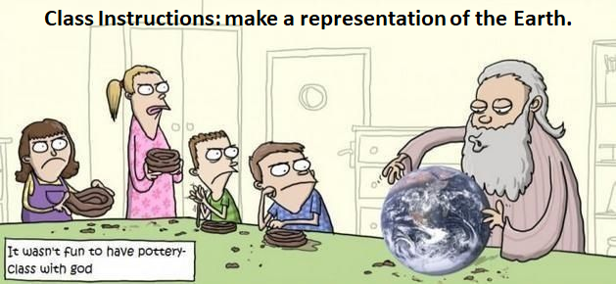
What God inspired and the author intended.
Law and Grace: Session 18
God did not give us His words so that we can make it say whatever we want. He had something specific in mind. That's the meaning. That's the intent. And that is what we will be looking for.

Slide 32
What God inspired and the author intended.
Law and Grace: Session 18
The teachings of the Bible are not inaccessible to the average person, as some have suggested. Nor is the Bible written as a puzzle, a book of secrets and riddles given in jumbled incommunicable form. The fact that the Bible is a book means that it is to be read and understood.
Zuck, Roy B. (1991). Basic Bible Interpretation: A Practical Guide to Discovering Biblical Truth (p. 26). Colorado Springs, CO: David C. Cook.

Slide 33
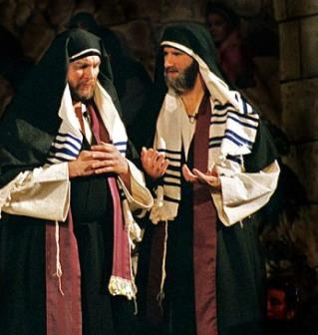
What God inspired and the author intended.
Law and Grace: Session 18
To answer this question, we will look at elements of language, history and culture, not just because these are interesting, but so that we understand Matthew’s intent.

Slide 34
What God inspired and the author intended.
Law and Grace: Session 18
It's all a matter of getting the FULL context!

Slide 35
Law and Grace: Session 18
To Whom is Jesus talking?
Jesus spoke almost entirely to the people of Israel, only in the land of Israel, who were all under the entire Law of Moses.

Slide 36
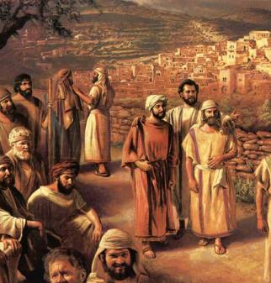
Law and Grace: Session 18
To Whom is Jesus talking?
Christ made it very clear that He was “sent only to the lost sheep of the house of Israel” (Matt. 15:24) and that He sent His disciples, at least at first, “only to the lost sheep of the house of Israel” (Matt. 10:6).

Slide 37
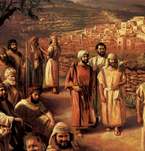
Matthew 10:5–6
⁵ These twelve Jesus sent out after instructing them: “Do not go in the way of the Gentiles, and do not enter any city of the Samaritans; ⁶ but rather go to the lost sheep of the house of Israel.
Matthew 15:24
But He answered and said, “I was sent only to the lost sheep of the house of Israel.”

Slide 38
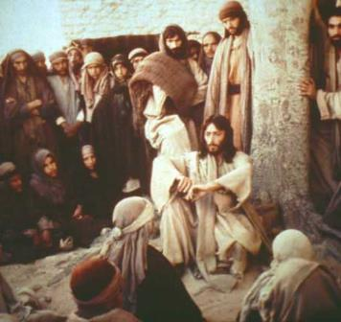
Law and Grace: Session 18
To Whom is Jesus talking?
Again and again Jesus referred to those who were Gentiles (non-Jews) as a another people, not a part of His intended audience (Matt. 5:47; 6:7, 32; 10:5, 18; 20:19; 20:25).
Jesus made multiple references to the Law, Moses, the altar and the temple in Jerusalem

Slide 39
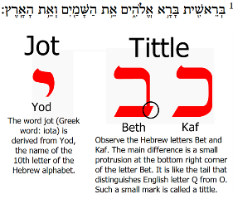
Matthew 5:17-18
“¹⁷ Do not think that I came to abolish THE LAW OR THE PROPHETS; I did not come to abolish but to fulfill. ¹⁸ For truly I say to you, until heaven and earth pass away, not the smallest letter or stroke shall pass from THE LAW until all is accomplished."

Slide 40
Matthew 5:23-24
“²³ Therefore if you are presenting your OFFERING at the ALTAR, and there remember that your brother [fellow Jew] has something against you, ²⁴ leave your OFFERING there before the ALTAR and go; first be reconciled to your brother, and then come and present your OFFERING."

Slide 41
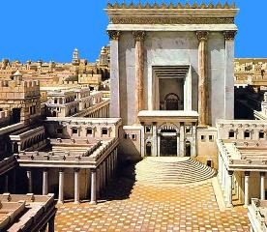
Matthew 8:4
'And Jesus said to him, "See that you tell no one; but go, show yourself to the PRIEST and present the OFFERING that MOSES commanded, as a testimony TO THEM."'

Slide 42
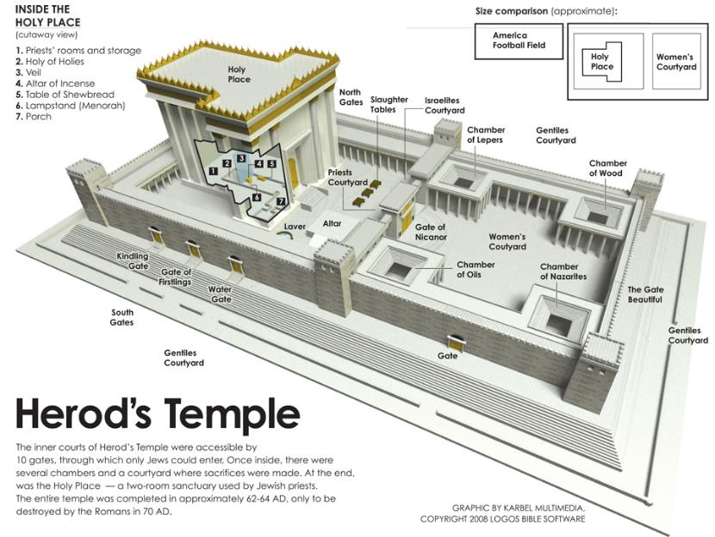
Law and Grace: Session 18

Slide 43
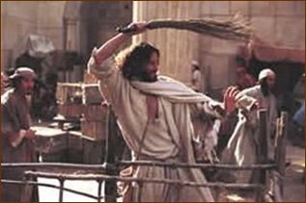
Matthew 21:12-13
‘¹² And Jesus entered the TEMPLE and drove out all those who were buying and selling in the TEMPLE, and overturned the tables of the money changers and the seats of those who were selling doves. ¹³ And He said to them, "It is written, 'My house shall be called a house of prayer'; but you are making it a robbers‘ den."'

Slide 44
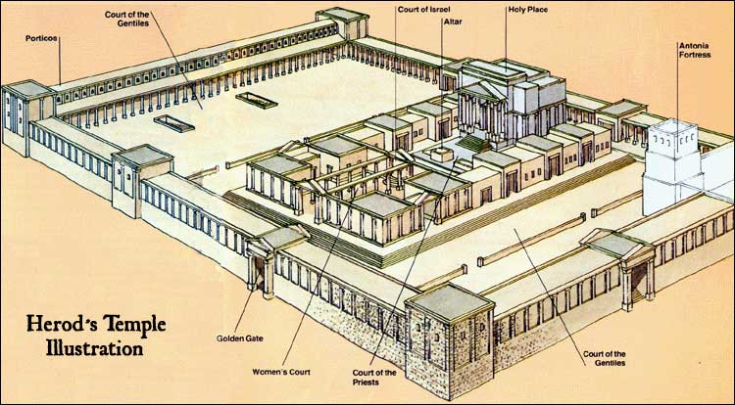
Law and Grace: Session 18

Slide 45
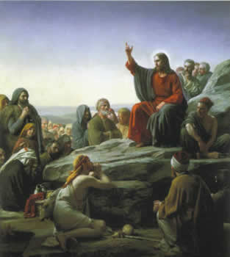
Law and Grace: Session 18
Jesus spoke almost entirely…
Jesus spoke to His disciples as people of Israel, only in the land of Israel, who were all under the Law of Moses.
It is only near the end of each of the gospels that Jesus begins to address the 12 disciples as apostles of the church, the Body of Christ.

Slide 46
So don’t we TAKE EVERYTHING as if it directly applies to us?
Law and Grace: Session 18
Doesn’t that apply to me?

Slide 47
So don’t we TAKE EVERYTHING as if it directly applies to us?
Law and Grace: Session 18
When Jesus said to Judas, “What you do, do quickly”, we don’t take that as a command to each of us, to betray Christ to the chief priests.

Slide 48
So don’t we TAKE EVERYTHING as if it directly applies to us?
Law and Grace: Session 18
We must always recognize who is being addressed and interpret accordingly.

Slide 49
So do we just IGNORE EVERYTHING that directly applies only to the Jews?
Law and Grace: Session 18

Slide 50
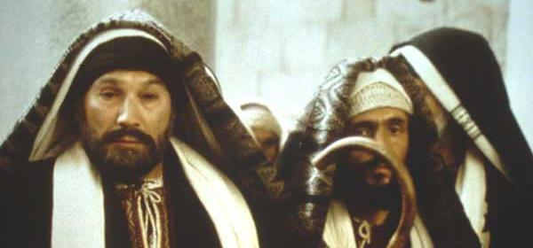
So do we just IGNORE EVERYTHING that directly applies only to the Jews?
Law and Grace: Session 18
No, we don’t just set aside as irrelevant what is directly written only to the people of Israel.

Slide 51
2 Timothy 3:16-17
¹⁶ All Scripture is inspired by God and profitable for teaching, for reproof, for correction, for training in righteousness; ¹⁷ so that the man of God may be adequate, equipped for every good work.
Romans 15:4
⁴ For whatever was written in earlier times was written for our instruction... (cf. 1 Corinthians 10:11).
1 Corinthians 10:11
Now these things happened to them as an example, and they were written for our instruction, upon whom the ends of the ages have come.

Slide 52
So do we just IGNORE EVERYTHING that directly applies only to the Jews?
Law and Grace: Session 18
The letters written to the church make many, many references to writings, people, events and truths written directly to the Jews.
70% of the Book of Revelation
is from the Old Testament

Slide 53
Law and Grace: Session 18
WE COMPARE AND CONTRAST
When we compare we ask, ‘What about what is said in the gospels is the same or similar to what is addressed to the church, and why?’ (Note: similar is not same!)
When we contrast we ask, ‘What about what is said in the gospels is different from what is written to us who are in the church, and why?’

Slide 54
Matthew 6:14-15
¹⁴ “For if you forgive others for their transgressions, your heavenly Father will also forgive you. ¹⁵ But if you do not forgive others, then your Father will not forgive your transgressions.”
Ephesians 4:32
“Be kind to one another, tender-hearted, forgiving each other, just as God in Christ also has forgiven you.”

Slide 55
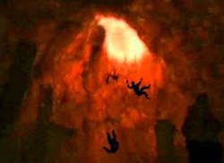
Law and Grace: Session 18
WE COMPARE AND CONTRAST
When we take this Compare and Contrast approach we will find that the Word of God can be very clearly understood and is consistent throughout.

Slide 56
Session 18 Outline
Review
Purpose, Aim, and Objective
Session 17
Introduction to the Gospel of Matthew Part 2
General Information
Comparisons
Contrasts
Concluding Observations

Slide 57
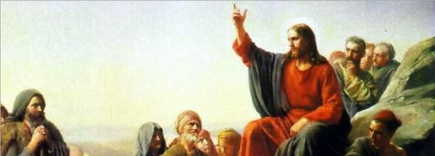
Law and Grace: Session 18
Comparison:
What is the same or similar
While we have said that the Gospel of Matthew is directed to the Jews, in keeping with the anticipation of the still coming kingdom, we do not want to convey that the Gospel of Matthew has nothing for us in the Church.

Slide 58
Law and Grace: Session 18
Comparison:
What is the same or similar
The character of God is always the same and He does not lie or change His mind (1 Samuel 15:29; Malachi 3:6; Titus 1:2; Hebrews 1:10-12; 6:18; 13:8; James 1:17).
God is always the Creator and all of creation has a creature relationship with reference to Him (Genesis 1:1; Matthew 19:4; Mark 13:19; Acts 14:15; 17:24,24; Colossians 1:15).

Slide 59
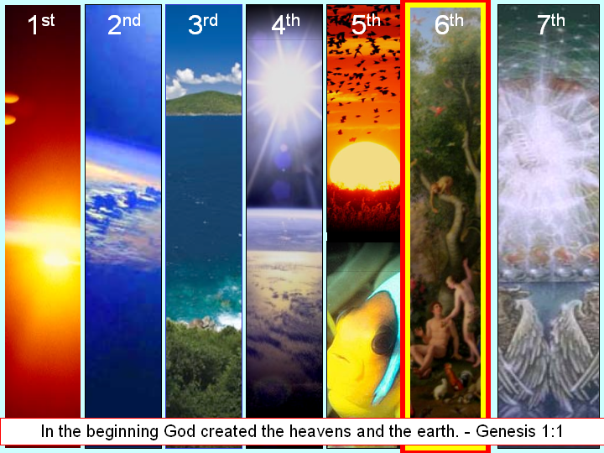
Law and Grace: Session 18
Comparison:
What is the same or similar

Slide 60
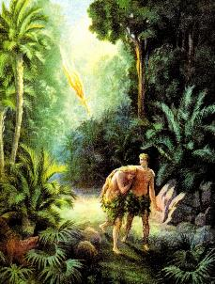
Law and Grace: Session 18
Comparison:
What is the same or similar
Once having fallen, all those “in Adam” have the same nature (Genesis 3:5; Isaiah 53:6; Romans 3:23; 5:14; 1 Corinthians 15:20-22; 42-49).
The
Sin Nature

Slide 61
Law and Grace: Session 18
Comparison:
What is the same or similar
Salvation for all those “in Adam” is ALWAYS by faith in God’s provision (Genesis 22:1-14; Isaiah 12:2; Habakkuk 2:4; Romans 4:1-25; Galatians 3:6-9).

Slide 62
Law and Grace: Session 18
Comparison:
What is the same or similar
The earth that we walk is cursed until the recreation. (Gen. 3:17-19; 5:29; Rom. 8:18-25; Rev. 21:1; 22:3).
Genesis 3:17-18
¹⁷ “Cursed is the ground because of you…¹⁸ Both thorns and thistles it shall grow for you…”

Slide 63
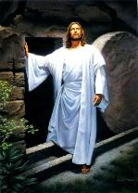
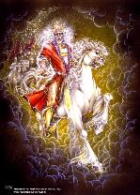
Law and Grace: Session 18
Comparison:
What is the same or similar
Israel has a unique relationship to the kingdom that Christ addresses in the Gospel of Matthew.
However, we too have a place in, and a similar forward-looking time perspective, regarding the coming kingdom (Acts 28:23, 31; 2 Thessalonians 1:5).

Slide 64
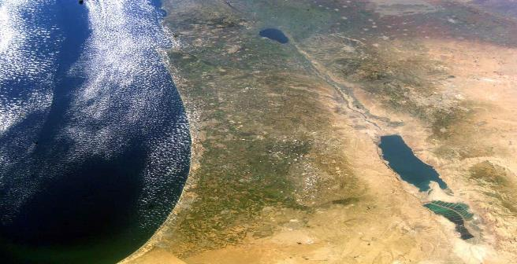
Law and Grace: Session 18
Comparison:
What is the same or similar
Like Israel, the entrance into the kingdom is not on the basis of something earthly, but is spiritual (Romans 9:6; 11:26; 14:7; James 2:5).

Slide 65
CONCLUSION

Slide 66
Session 18 Outline
Review
Purpose, Aim, and Objective
Session 17
Introduction to the Gospel of Matthew Part 2
General Information
Comparisons - CONTINUED
Contrasts
Concluding Observations

Slide 67
Law and Grace: An Overview Jim McGowan, Th.D. Sugar Land Bible Church 05-05-2019
…but grace and truth were realized through Jesus Christ - John 1:17
For the Law was given through Moses…
Special thanks to Dr. Vern Peterman for access to his insights and resources.

