Slide 1
The book of Jude
An Appeal to Faithful Believers

Slide 2
The Book of Jude
Who wrote the book? Jude, brother of James, half –brother of Jesus Christ.
Who was the book written to? Believers, Jews scattered in Asia Minor
When was the book written? Between 68-80 AD
Where was the book written from? Possibly in the Land of Canaan
What’s the Genre of the book? Epistolary
What’s the purpose of the book? To exhort believers to earnestly contend for the faith in the face of apostasy.
What’s in the book? A present threat of and defense against false teachers.
Is there an application? 1) grow spiritually (v.20); 2) be assured of your salvation (v.21; 24-25); and 3) also to help those who doubt (v.23-24).

Slide 3
4 Sections in Jude
Salutation / Purpose Statement – vv. 1 - 4
Beware of Apostates– vv. 5-16
Exhortation to the Faithful – vv.17-23
Benediction – vv. 24-25
Outline adapted from Thomas Constable, Dr. Constable’s Expository Notes, Jude, (http://www.planobiblechapel.org/tcon/notes/html/nt/jude/jude.htm)

Slide 4
4 Sections in Jude
Salutation / Purpose Statement – vv. 1 - 4
Beware of Apostates– vv. 5-16
Exhortation to the Faithful – vv.17-23
Benediction – vv. 24-25
Outline adapted from Thomas Constable, Dr. Constable’s Expository Notes, Jude, (http://www.planobiblechapel.org/tcon/notes/html/nt/jude/jude.htm)

Slide 5
4 Sections in Jude
Salutation / Purpose Statement – vv. 1 - 4
Beware of Apostates– vv. 5-16
Exhortation to the Faithful – vv.17-23
Benediction – vv. 24-25
Outline adapted from Thomas Constable, Dr. Constable’s Expository Notes, Jude, (http://www.planobiblechapel.org/tcon/notes/html/nt/jude/jude.htm)

Slide 6
Jude 17
But you, beloved, ought to remember the words that were spoken beforehand by the apostles of our Lord Jesus Christ,

Slide 7
Genesis 9:15
And I will remember My covenant, which is between Me and you and every living creature of all flesh; and never again shall the water become a flood to destroy all flesh.

Slide 8
Leviticus 26:45
“I will remember My covenant with Jacob, and I will remember also My covenant with Isaac, and My covenant with Abraham as well, and I will remember the land.”

Slide 9
Luke 1:54
“He has given help to Israel His servant,
in remembrance of His mercy.”

Slide 10
Psalm 98:3
“He has remembered His lovingkindness and His faithfulness to the house of Israel…”

Slide 11
Psalm 106:1
“Praise The Lord! Oh give thanks to the Lord, for He is good; for His lovingkindness is everlasting.” ”

Slide 12
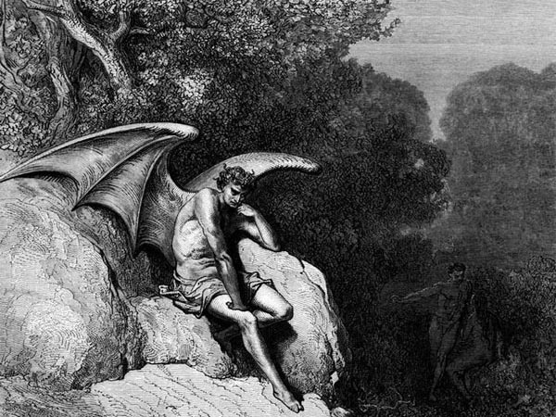

Slide 13
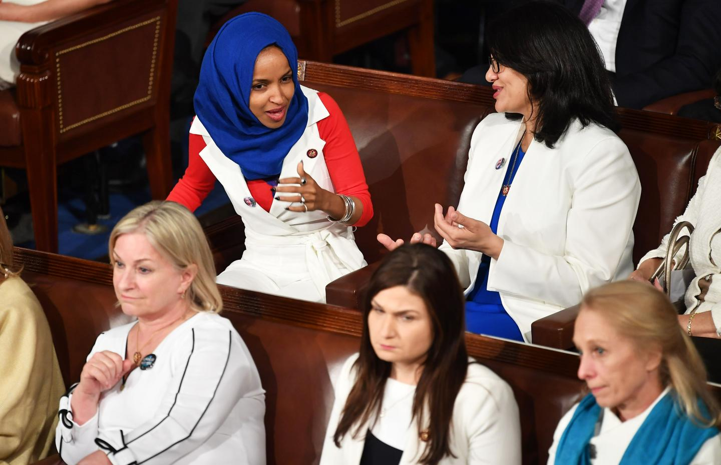

Slide 14
Jude 17
But you, beloved, ought to remember the words that were spoken beforehand by the apostles of our Lord Jesus Christ,

Slide 15
Jude 18-19
“that they were saying to you, ‘In the last time there will be mockers, following after their own ungodly lusts.’ These are the ones who cause divisions, worldly-minded, devoid of the Spirit.”

Slide 16
4 Sections in Jude
Salutation / Purpose Statement – vv. 1 - 4
Beware of Apostates– vv. 5-16
Exhortation to the Faithful – vv.17-23
An Appeal to Faithful Believers - 20-21
An Appeal for Infected Believers – 22-23
Benediction – vv. 24-25
Outline adapted from Thomas Constable, Dr. Constable’s Expository Notes, Jude, (http://www.planobiblechapel.org/tcon/notes/html/nt/jude/jude.htm)

Slide 17
Jude 20-21
“But you, beloved, building yourselves up on your most holy faith, praying in the Holy Spirit, keep yourselves in the love of God, waiting anxiously for the mercy of our Lord Jesus Christ to eternal life.”

Slide 18
Ephesians 4:2
“with all humility and gentleness, with patience, showing tolerance for one another in love…”

Slide 19
John 15:9
“Just as the Father has loved Me, I have also loved you; abide in My love.”

Slide 20
Jude 20-21
“But you, beloved, building yourselves up on your most holy faith, praying in the Holy Spirit, keep yourselves in the love of God, waiting anxiously for the mercy of our Lord Jesus Christ to eternal life.”

Slide 21
The 3 Phases of Salvation
Phase | Justification | Sanctification | Glorification
Sense | Positional | Progressive/ Experiential | Ultimate
Tense | Past | Present | Future
Description | Accomplished: set apart thru body/shed blood of Christ | Experienced daily as believer surrenders to God | Sanctification reaches its completion
Scripture | 1 Cor 1:2 | Rom 12:1 | 1 John 3:2; 1 Thess 5:23

Slide 22
John 15:9
“Just as the Father has loved Me, I have also loved you; abide in My love.”

Slide 23
John 15:4-5
“Abide in Me, and I in you. As the branch cannot bear fruit of itself unless it abides in the vine, so neither can you unless you abide in Me. “I am the vine, you are the branches; he who abides in Me and I in him, he bears much fruit, for apart from Me you can do nothing..”

Slide 24
Galatians 2:20
“I have been crucified with Christ; and it is no longer I who live, but Christ lives in me; and the life which I now live in the flesh I live by faith in the Son of God, who loved me and gave Himself up for me.”

Slide 25
Romans 8:37
“But in all these things we overwhelmingly conquer through Him who loved us.”

Slide 26
1 John 4:10-11
“Beloved, let us love one another, for love is from God; and everyone who loves is born of God and knows God. The one who does not love does not know God, for God is love. By this the love of God was manifested in us, that God has sent His only begotten Son into the world so that we might live through Him. In this is love, not that we loved God, but that He loved us and sent His Son to be the propitiation for our sins. Beloved, if God so loved us, we also ought to love one another.

Slide 27
Jude 20-21
“But you, beloved, building yourselves up on your most holy faith, praying in the Holy Spirit, keep yourselves in the love of God, waiting anxiously for the mercy of our Lord Jesus Christ to eternal life.”

Slide 28
1 Corinthians 3:10-11
“According to the grace of God which was given to me, like a wise master builder I laid a foundation, and another is building on it. But each man must be careful how he builds on it. For no man can lay a foundation other than the one which is laid, which is Jesus Christ.”

Slide 29
Ephesians 2:20-22
“having been built on the foundation of the apostles and prophets, Christ Jesus Himself being the corner stone, in whom the whole building, being fitted together, is growing into a holy temple in the Lord, in whom you also are being built together into a dwelling of God in the Spirit.”

Slide 30
2 Peter 1:2
“Grace and peace be multiplied to you in the knowledge of God and of Jesus our Lord; seeing that His divine power has granted to us everything pertaining to life and godliness…”

Slide 31
Acts 20:32
“And now I commend you to God and to the word of His grace, which is able to build you up and to give you the inheritance among all those who are sanctified.”

Slide 32
2 Timothy 2:15
“Be diligent to present yourself approved to God as a workman who does not need to be ashamed, accurately handling the word of truth.”

Slide 33
Jude 20-21
“But you, beloved, building yourselves up on your most holy faith, praying in the Holy Spirit, keep yourselves in the love of God, waiting anxiously for the mercy of our Lord Jesus Christ to eternal life.”

Slide 34
Romans 8:26-27
“In the same way the Spirit also helps our weakness; for we do not know how to pray as we should, but the Spirit Himself intercedes for us with groanings too deep for words and He who searches the hearts knows what the mind of the Spirit is, because He intercedes for the saints according to the will of God.”

Slide 35
1 John 5:14
“This is the confidence which we have before Him, that, if we ask anything according to His will, He hears us. And if we know that He hears us in whatever we ask, we know that we have the requests which we have asked from Him.””

Slide 36
Romans 8:26-27
“In the same way the Spirit also helps our weakness; for we do not know how to pray as we should, but the Spirit Himself intercedes for us with groanings too deep for words and He who searches the hearts knows what the mind of the Spirit is, because He intercedes for the saints according to the will of God.”

Slide 37
Ephesians 6:18
“With all prayer and petition pray at all times in the Spirit, and with this in view, be on the alert with all perseverance and petition for all the saints, and pray on my behalf, that utterance may be given to me in the opening of my mouth, to make known with boldness the mystery of the gospel…”

Slide 38
Jude 20-21
“But you, beloved, building yourselves up on your most holy faith, praying in the Holy Spirit, keep yourselves in the love of God, waiting anxiously for the mercy of our Lord Jesus Christ to eternal life.”

Slide 39
Jude 20-21
“But you, beloved, building yourselves up on your most holy faith, praying in the Holy Spirit, keep yourselves in the love of God, waiting anxiously for the mercy of our Lord Jesus Christ to eternal life.”

Slide 40
Romans 8:23-25
“And not only this, but also we ourselves, having the first fruits of the Spirit, even we ourselves groan within ourselves, waiting eagerly for our adoption as sons, the redemption of our body. For in hope we have been saved, but hope that is seen is not hope; for who hopes for what he already sees? But if we hope for what we do not see, with perseverance we wait eagerly for it.

Slide 41
1 John 3:3
And everyone who has this hope fixed on Him purifies himself, just as He is pure.

Slide 42
4 Sections in Jude
Salutation / Purpose Statement – vv. 1 - 4
Beware of Apostates– vv. 5-16
Exhortation to the Faithful – vv.17-23
An Appeal to Faithful Believers - 20-21
Keep Yourselves…
Building, Praying, Waiting
An Appeal for Infected Believers – 22-23
Benediction – vv. 24-25
Outline adapted from Thomas Constable, Dr. Constable’s Expository Notes, Jude, (http://www.planobiblechapel.org/tcon/notes/html/nt/jude/jude.htm)

Slide 43
The book of Jude
An Appeal to Faithful Believers

