Slide 1
ISRAEL 2019
ANDY WOODS
Part 8

Slide 2
Tel Aviv, Joppa, Caesarea Maritma,
Mt. Carmel, Megiddo
Part 1

Slide 3
Sepphoris, Upper Galilee/Caesarea-Philippi andTel Dan, Sea of Galilee, Mt. of Beatitudes
Part 2

Slide 4
Capernaum, Tabgha
Part 3

Slide 5
Jordan River, Bet She 'An, Jericho, Dead Sea, Masada
Part 4

Slide 6
Qumran, En Gedi, Jerusalem
Part 5

Slide 7
Jerusalem –Mt. of Olives, Garden of Gethsemane, Southern Steps, Western Wall, Temple Institute
Part 6

Slide 8
Jerusalem – Garden Tomb, Golgotha, Upper Room, Pool of Siloam
Part 7

Slide 9
Jerusalem – Pool of Bethesda, Western Wall Tunnel, Hezekiah’s Tunnel, , US Embassy, City of David
Part 8

Slide 10
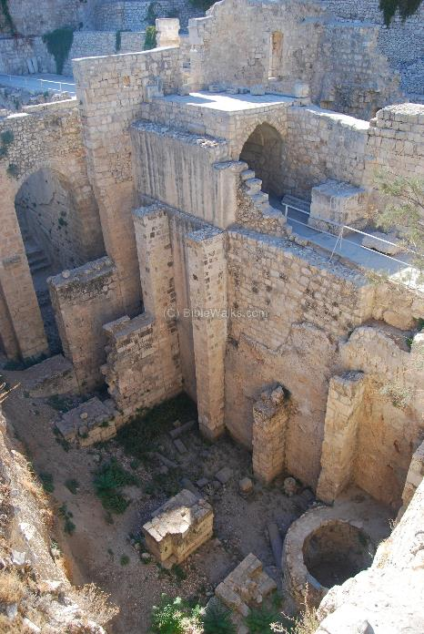
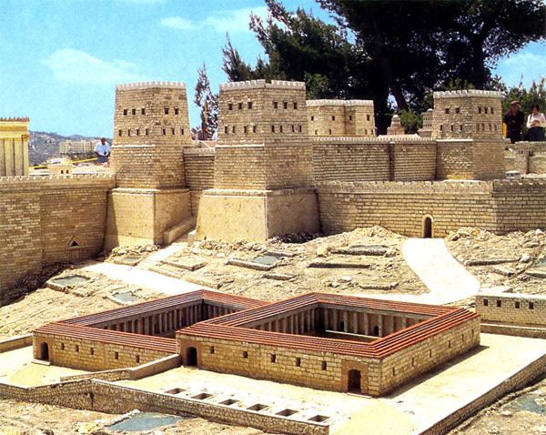
Pool of Bethesda

Slide 11
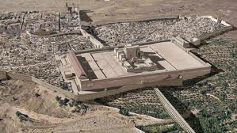
Christ’s Five Trips to Jerusalem in John’s Gospel
Feast | Verse
Passover | 2:23
Unnamed | 5:1
Tabernacles | 7:2
Dedication | 10:22
Passover | 13:1

Slide 13
Galatians 4:13-14
“¹³ but you know that it was because of a bodily illness that I preached the gospel to you the first time; ¹⁴ and that which was a trial to you in my bodily condition you did not despise or loathe, but you received me as an angel of God, as Christ Jesus Himself.”

Slide 14
John 3:19-21
“¹⁹ This is the judgment, that the Light has come into the world, and men loved the darkness rather than the Light, for their deeds were evil. ²⁰ For everyone who does evil hates the Light, and does not come to the Light for fear that his deeds will be exposed. ²¹ But he who practices the truth comes to the Light, so that his deeds may be manifested as having been wrought in God.”

Slide 15
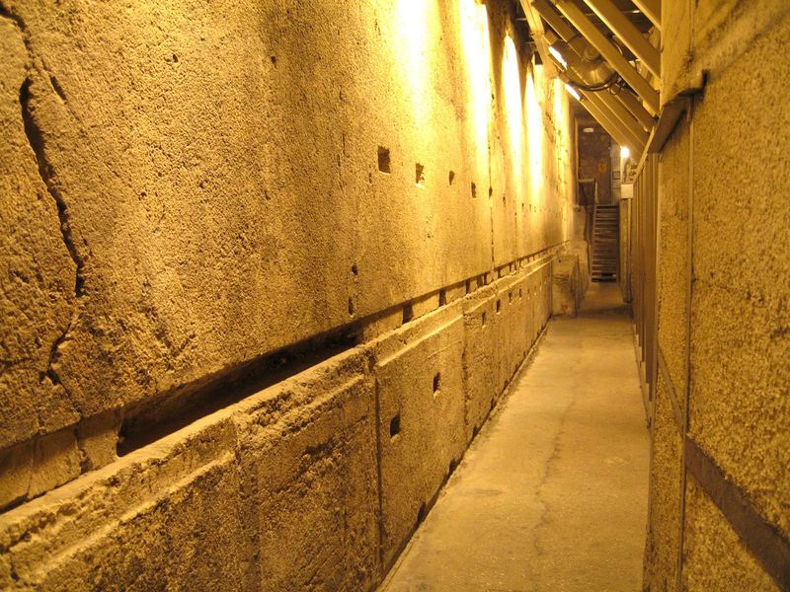
Rabbi’s Tunnel

Slide 16
John 2:19-21
“¹⁹ Jesus answered them, ‘Destroy this temple, and in three days I will raise it up.’ ²⁰ The Jews then said, ‘It took forty-six years to build this temple, and will You raise it up in three days?’ ²¹ But He was speaking of the temple of His body.”

Slide 17
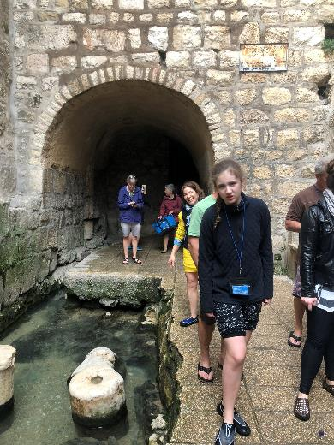
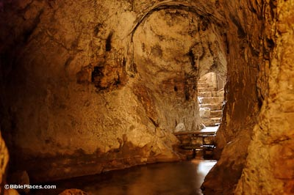
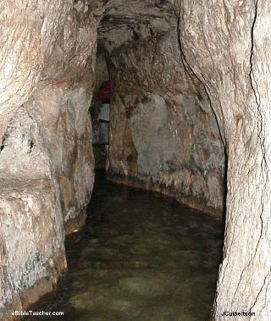
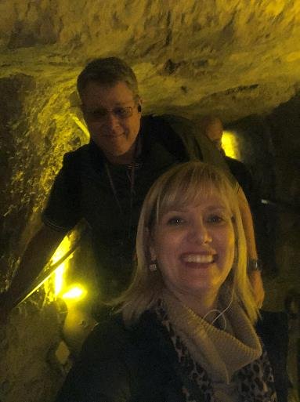
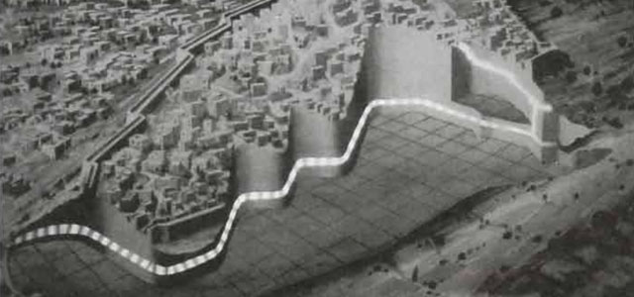
Hezekiah’s Tunnel

Slide 18
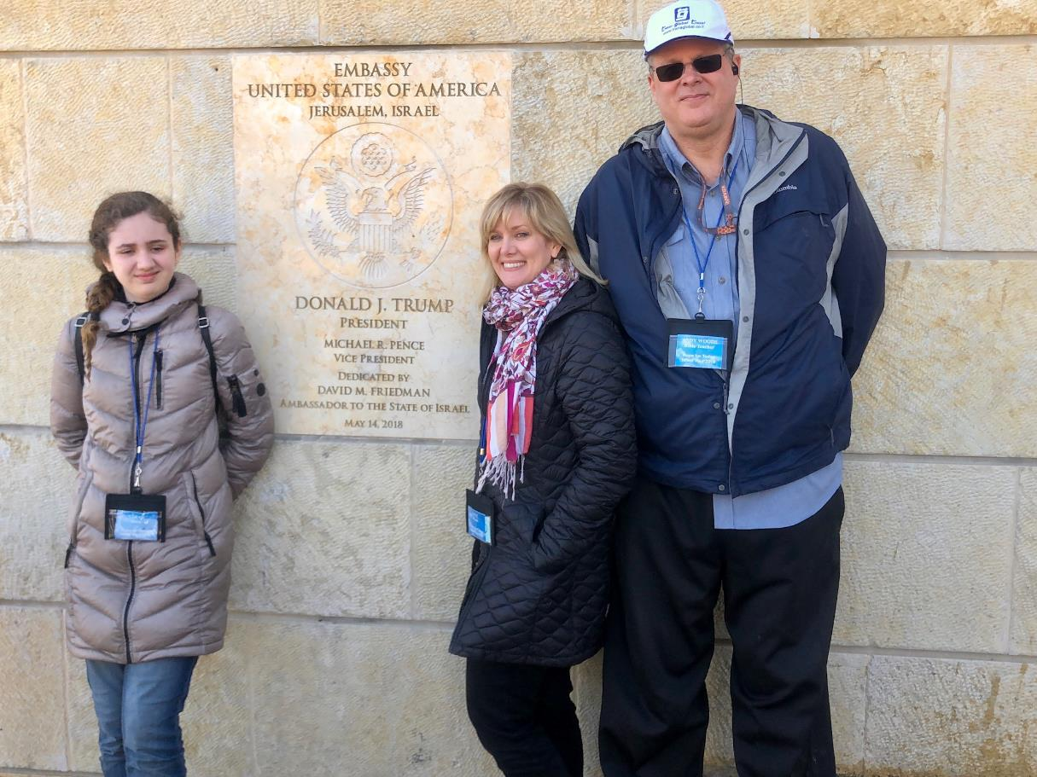
US Jerusalem Embassy

Slide 19
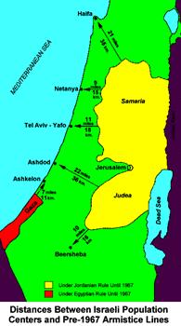

Slide 20
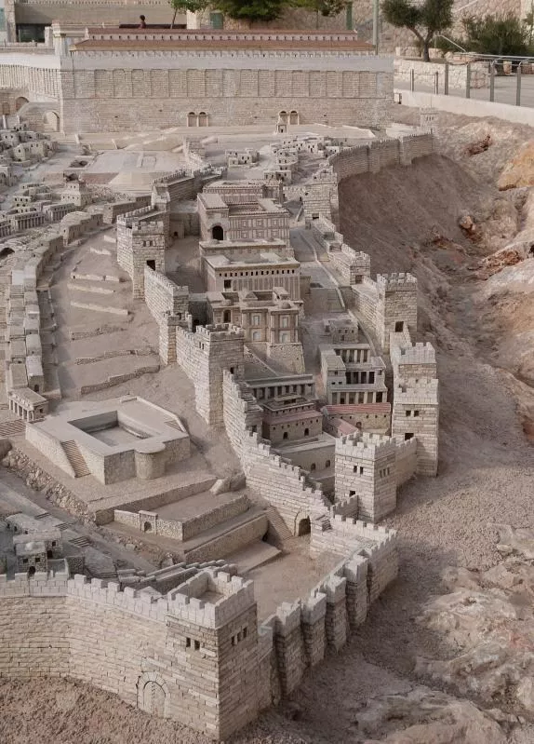
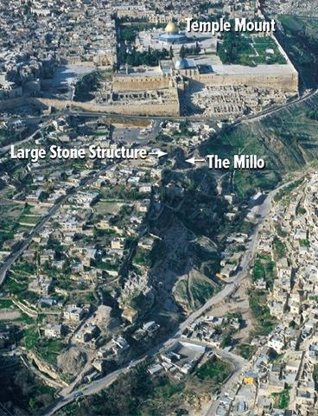
City of David
Ancient Modern

Slide 21
Land Promises Fulfilled in the Time of Joshua (Josh. 11:23; 21:43-45) or Solomon (1 Kgs. 4:21)?
Extended context (Josh 13:1-7; Judges 1:19, 21, 27, 29, 30-36)
Land gained in conquest was only a fraction of what was promised (1 Kgs. 4:25)
Jerusalem not conquered in Joshua’s day (Josh 15:63; 2 Sam 5)
Solomon’s reign extended to the border of Egypt (1 Kgs. 4:21) and not the River of Egypt (Gen. 15:18)
Solomon’s reign was tributary only (1 Kgs. 4:21)
Forever? (Gen 17:7-8, 13, 19)
Reaffirmation of land promises long after Joshua and Solomon’s time (Amos 9:11-15)
Fruchtenbaum, Israelology, 521-22, 631-32

Slide 22
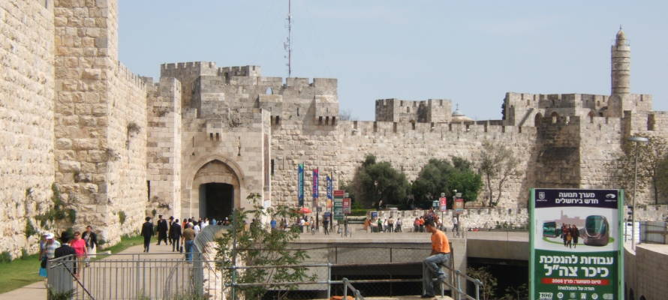
Jaffa Gate

