Slide 1


Jesus: One of a Kind
Dr. Andy Woods
Senior Pastor – Sugar Land Bible Church
President – Chafer Theological Seminary

Slide 2
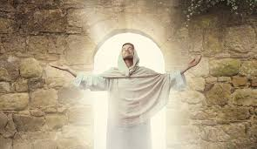
The Uniqueness of Jesus Christ
A man of verifiable history
A man of fulfilled prophecy
A man of predictive prophecy
A man of unimpeachable morality
A man of profound teaching
A man of authentic miracles
A man of bodily resurrection

Slide 3
The Uniqueness of Jesus Christ
A man of verifiable history
A man of fulfilled prophecy
A man of predictive prophecy
A man of unimpeachable morality
A man of profound teaching
A man of authentic miracles
A man of bodily resurrection

Slide 4
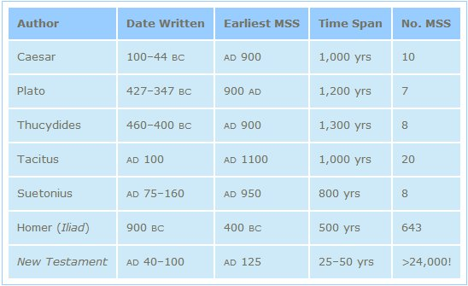
http://creationrevolution.com/2012/05/should-we-trust-the-bible/

Slide 5
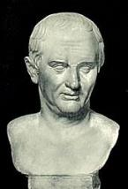
Cornelius Tacitus (AD 55‒120)
Annals XV, 44
“Consequently, to get rid of the report, Nero fastened the guilt and inflicted the most exquisite tortures on a class hated for their abominations, called Christians by the populace. Christus, from whom the name had its origin, suffered the extreme penalty during the reign of Tiberius at the hands of one of our procurators, Pontius Pilatus, and a most mischievous superstition, thus checked for the moment, again broke out not only in Judea, the first source of the evil, but even in Rome, where all things hideous and shameful from every part of the world find their centre and become popular.”

Slide 6
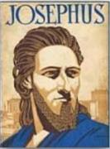
Josephus
Josephus, Antiquities 18.3.3
“About this time there lived Jesus, a wise man, if indeed one ought to call him a man. For he was one who performed surprising deeds and was a teacher of such people as accept the truth gladly. He won over many Jews and many of the Greeks. He was the Christ. And when, upon the accusation of the principal men among us, Pilate had condemned him to a cross, those who had first come to love him did not cease. He appeared to them spending a third day restored to life, for the prophets of God had foretold these things and a thousand other marvels about him. And the tribe of the Christians, so called after him, has still to this day not disappeared.”

Slide 7
Secular Historians Mentioning Christ
Secular Historian | Date
Tacitus | AD 55‒120
Lucian | AD Second Century
Suetonius | AD 69‒122
Pliny the Younger | AD 112
Thallus | AD 52
Mar Bar Serapion | AD 70
Josephus | AD 78

Slide 8
The Uniqueness of Jesus Christ
A man of verifiable history
A man of fulfilled prophecy
A man of predictive prophecy
A man of unimpeachable morality
A man of profound teaching
A man of authentic miracles
A man of bodily resurrection

Slide 9

Luke 24:44
“Now He said to them, “These are My words which I spoke to you while I was still with you, that all things which are written about Me in the Law of Moses and the Prophets and the Psalms must be fulfilled.”

Slide 10
Josephus
Josephus, Antiquities 18.3.3
“About this time there lived Jesus, a wise man, if indeed one ought to call him a man. For he was one who performed surprising deeds and was a teacher of such people as accept the truth gladly. He won over many Jews and many of the Greeks. He was the Christ. And when, upon the accusation of the principal men among us, Pilate had condemned him to a cross, those who had first come to love him did not cease. He appeared to them spending a third day restored to life, for the prophets of God had foretold these things and a thousand other marvels about him. And the tribe of the Christians, so called after him, has still to this day not disappeared.”

Slide 11
OT Prophecies About Christ
Prophecy | Scripture | Years in Advance
Manner of Birth | Isaiah 7:14 | 700 years
Place of Birth | Micah 5:2 | 700 years
Nationality | Numbers 24:17 | 1400 years
Tribe | Genesis 49:10 | 1800 years
Time of & Response to His Messiahship | Dan. 9:25-26 | 600 years

Slide 12
OT Prophecies About Christ
Prophecy | Scripture | Years in Advance
Crucified Between Thieves | Isaiah 53:9 | 700 years
Pierced | Isaiah 53:5 | 700 years
No Broken Bones | Psalm 22:17 | 1000 years
Gamble for His Clothing | Psalm 22:18 | 1000 years
Buried in Rich Man’s Tomb | Isaiah 53:9 | 1000 years

Slide 13
The Uniqueness of Jesus Christ
A man of verifiable history
A man of fulfilled prophecy
A man of predictive prophecy
A man of unimpeachable morality
A man of profound teaching
A man of authentic miracles
A man of bodily resurrection

Slide 14

John 13:19; 14:29
“¹⁹ From now on I am telling you before it comes to pass, so that when it does occur, you may believe that I am He… ^{14:29} Now I have told you before it happens, so that when it happens, you may believe.”

Slide 15
Christ’s Short-Term Predictions
Prophecy | Scripture
Betrayal by a Friend | John 13:21
Three-fold Denial by Peter | Matthew 26:34, 75
Manner of His Own Death | Matthew 20:18-19
Manner of Disciples’ Deaths | John 21:18-22
AD 70 Events | Luke 19:41-44

Slide 16
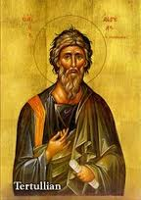
Tertullian, Prescription Against Heretics, 36
“…where the Apostle John was first plunged, unhurt, into boiling oil, and thence remitted to his island-exile!”

Slide 17



Slide 18
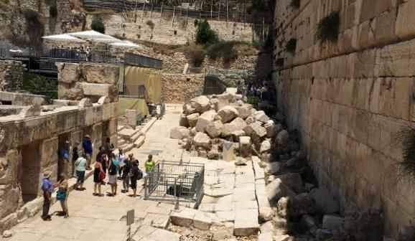
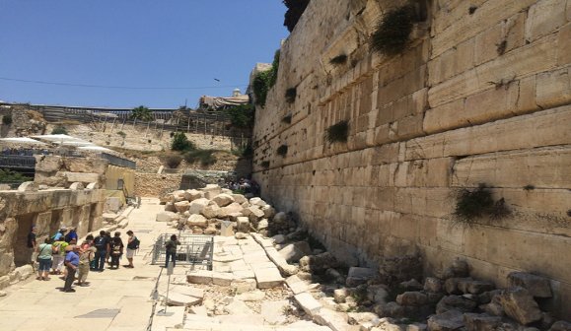

Slide 19
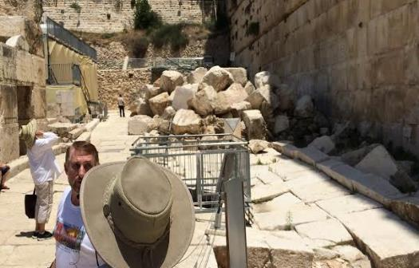
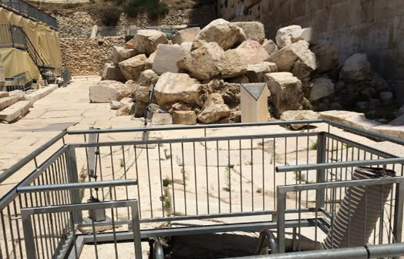

Slide 20
The Uniqueness of Jesus Christ
A man of verifiable history
A man of fulfilled prophecy
A man of predictive prophecy
A man of unimpeachable morality
A man of profound teaching
A man of authentic miracles
A man of bodily resurrection

Slide 21
Cornelius Tacitus (AD 55‒120)
Annals XV, 44
“Consequently, to get rid of the report, Nero fastened the guilt and inflicted the most exquisite tortures on a class hated for their abominations, called Christians by the populace. Christus, from whom the name had its origin, suffered the extreme penalty during the reign of Tiberius at the hands of one of our procurators, Pontius Pilatus, and a most mischievous superstition, thus checked for the moment, again broke out not only in Judea, the first source of the evil, but even in Rome, where all things hideous and shameful from every part of the world find their centre and become popular.”

Slide 22
Josephus
Josephus, Antiquities 18.3.3
“About this time there lived Jesus, a wise man, if indeed one ought to call him a man. For he was one who performed surprising deeds and was a teacher of such people as accept the truth gladly. He won over many Jews and many of the Greeks. He was the Christ. And when, upon the accusation of the principal men among us, Pilate had condemned him to a cross, those who had first come to love him did not cease. He appeared to them spending a third day restored to life, for the prophets of God had foretold these things and a thousand other marvels about him. And the tribe of the Christians, so called after him, has still to this day not disappeared.”

Slide 23
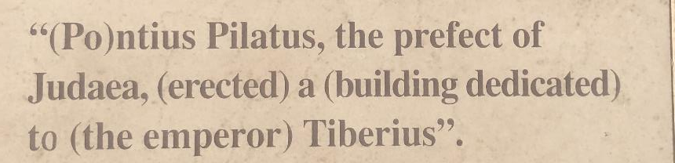
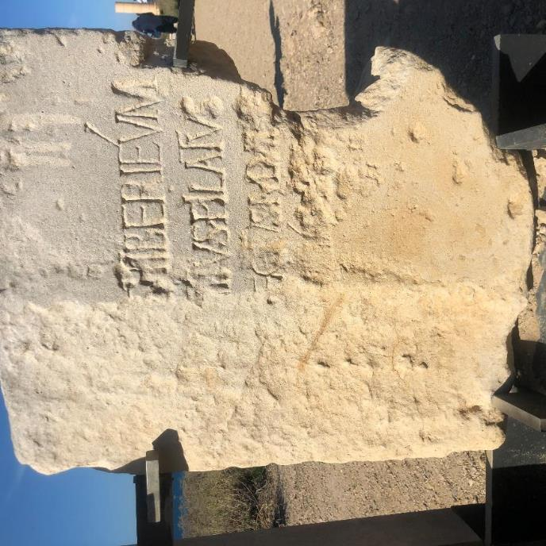


Slide 24
The Uniqueness of Jesus Christ
A man of verifiable history
A man of fulfilled prophecy
A man of predictive prophecy
A man of unimpeachable morality
A man of profound teaching
A man of authentic miracles
A man of bodily resurrection

Slide 25
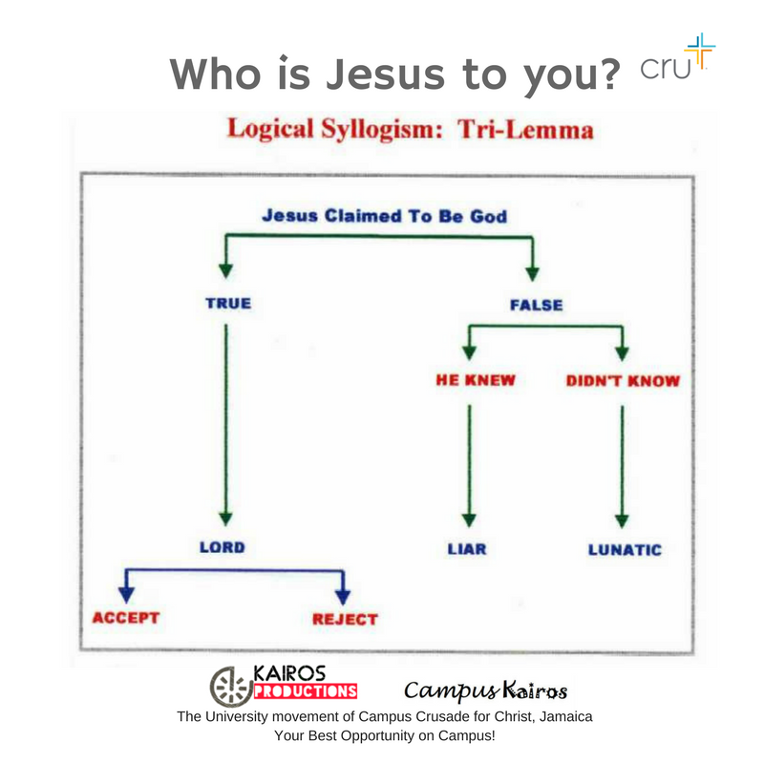

Slide 26
The Uniqueness of Jesus Christ
A man of verifiable history
A man of fulfilled prophecy
A man of predictive prophecy
A man of unimpeachable morality
A man of profound teaching
A man of authentic miracles
A man of bodily resurrection

Slide 27

John 20:30-31
“Therefore many other signs Jesus also performed in the presence of the disciples, which are not written in this book; but these have been written so that you may believe that Jesus is the Christ, the Son of God; and that believing you may have life in His name.”

Slide 28
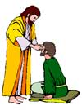
“SEVEN SIGNS” in Gospel of John
Changing Water into Wine | 2:11
Healing official’s son | 4:46-54
Healing an invalid at the Pool of Bethesda | 5:1-18
Feeding the 5,000 | 6:5-14
Walking on water | 6:16-21
Healing a blind man | 9:1-7
Raising dead Lazarus | 11:1-45

Slide 29


Matthew 12:24
“But when the Pharisees heard this, they said, ‘This man casts out demons only by Beelzebul the ruler of the demons.’”

Slide 30
Josephus
Josephus, Antiquities 18.3.3
“About this time there lived Jesus, a wise man, if indeed one ought to call him a man. For he was one who performed surprising deeds and was a teacher of such people as accept the truth gladly. He won over many Jews and many of the Greeks. He was the Christ. And when, upon the accusation of the principal men among us, Pilate had condemned him to a cross, those who had first come to love him did not cease. He appeared to them spending a third day restored to life, for the prophets of God had foretold these things and a thousand other marvels about him. And the tribe of the Christians, so called after him, has still to this day not disappeared.”

Slide 31
Josephus
Josephus, Antiquities 18.3.3
“About this time there lived Jesus, a wise man, if indeed one ought to call him a man. For he was one who performed surprising deeds and was a teacher of such people as accept the truth gladly. He won over many Jews and many of the Greeks. He was the Christ. And when, upon the accusation of the principal men among us, Pilate had condemned him to a cross, those who had first come to love him did not cease. He appeared to them spending a third day restored to life, for the prophets of God had foretold these things and a thousand other marvels about him. And the tribe of the Christians, so called after him, has still to this day not disappeared.”

Slide 32
The Uniqueness of Jesus Christ
A man of verifiable history
A man of fulfilled prophecy
A man of predictive prophecy
A man of unimpeachable morality
A man of profound teaching
A man of authentic miracles
A man of bodily resurrection

Slide 33

1 Corinthians 15:6-7
“⁶ After that He appeared to more than five hundred brethren at one time, most of whom remain until now, but some have fallen asleep; ⁷ then He appeared to James, then to all the apostles…”

Slide 34
Naturalistic Theories
Swoon theory
Theft theory
Hallucination theory
Wrong tomb theory

Slide 35
Naturalistic Theories
Swoon theory
Theft theory
Hallucination theory
Wrong tomb theory

Slide 36
Naturalistic Theories
Swoon theory
Theft theory
Hallucination theory
Wrong tomb theory

Slide 37

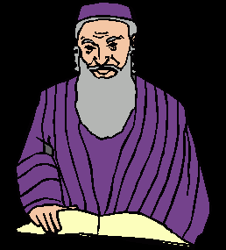
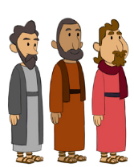
2. Theft Theories
Rome
Jews
Disciples

Slide 38
2. Theft Theories
Rome
Jews
Disciples

Slide 39
2. Theft Theories
Rome
Jews
Disciples

Slide 40
2. Theft Theories
Rome
Jews
Disciples

Slide 41
Naturalistic Theories
Swoon theory
Theft theory
Hallucination theory
Wrong tomb theory

Slide 42
Naturalistic Theories
Swoon theory
Theft theory
Hallucination theory
Wrong tomb theory

Slide 43
How Does Jesus Compare?
Deity | Tomb Status
Confucius | Occupied
Buddha | Occupied
Mohammed | Occupied
Jesus | ***EMPTY***
G.B. Hardy, Countdown

Slide 44
Conclusion

Slide 45
The Uniqueness of Jesus Christ
A man of verifiable history
A man of fulfilled prophecy
A man of predictive prophecy
A man of unimpeachable morality
A man of profound teaching
A man of authentic miracles
A man of bodily resurrection

Slide 46
John 11:25-27
“²⁵ Jesus said to her, ‘I am the resurrection and the life; he who believes in Me will live even if he dies, ²⁶ and everyone who lives and believes in Me will never die. Do you believe this?’ ²⁷ She said to Him, ‘Yes, Lord; I have believed that You are the Christ, the Son of God, even He who comes into the world.’”

Slide 47

“The Lord bless you and keep you; the Lord make his face shine on you and be gracious to you; the Lord turn his face toward you and give you peace.” (NIV)

