Slide 1
ISRAEL 2019
ANDY WOODS
Part 7

Slide 2
Tel Aviv, Joppa, Caesarea Maritma,
Mt. Carmel, Megiddo
Part 1

Slide 3
Sepphoris, Upper Galilee/Caesarea-Philippi andTel Dan, Sea of Galilee, Mt. of Beatitudes
Part 2

Slide 4
Capernaum, Tabgha
Part 3

Slide 5
Jordan River, Bet She 'An, Jericho, Dead Sea, Masada
Part 4

Slide 6
Qumran, En Gedi, Jerusalem
Part 5

Slide 7
Jerusalem –Mt. of Olives, Garden of Gethsemane, Southern Steps, Western Wall, Temple Institute
Part 6

Slide 8
Jerusalem – Garden Tomb, Golgotha, Upper Room, Pool of Siloam, Pool of Bethesda
Part 7

Slide 9
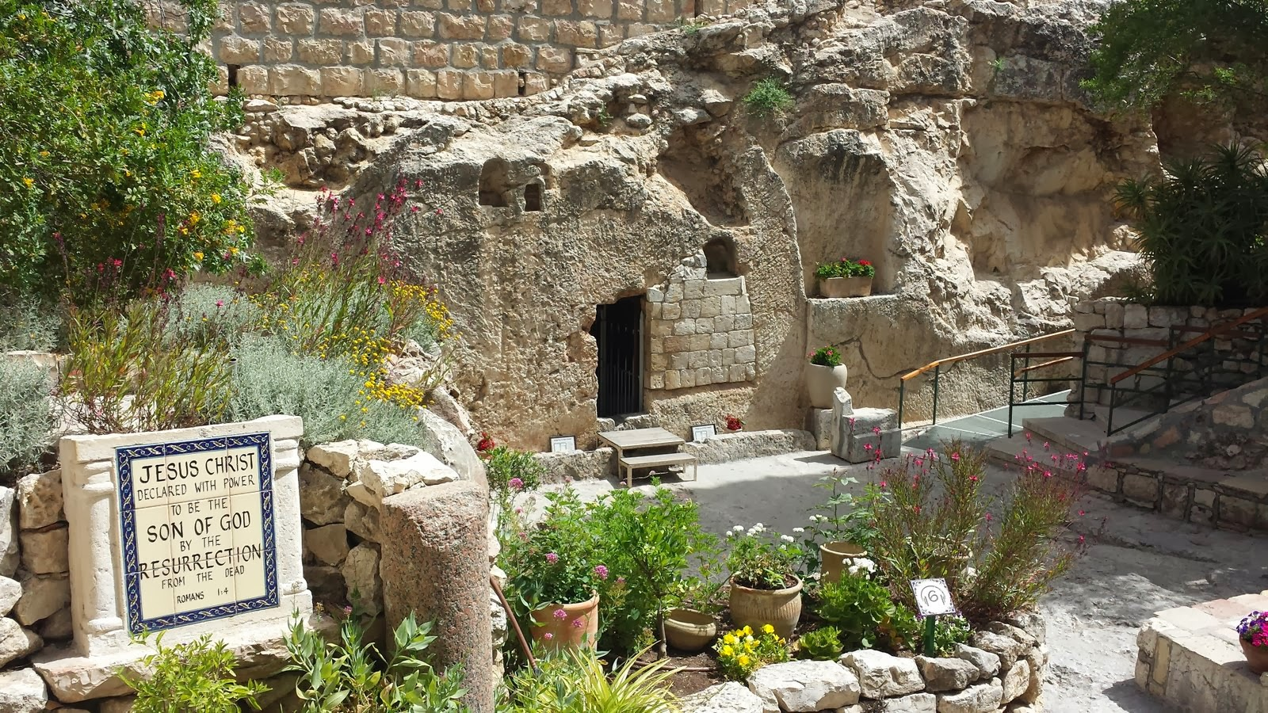
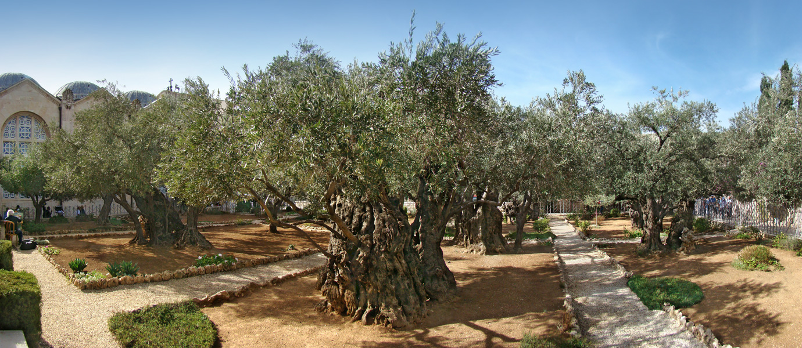
Garden Tomb

Slide 11
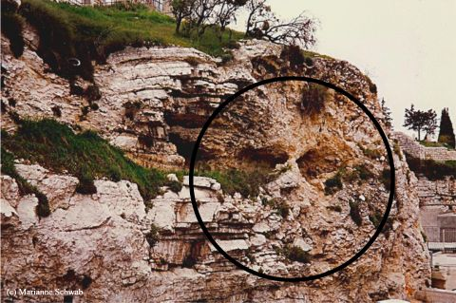
Golgotha

Slide 12
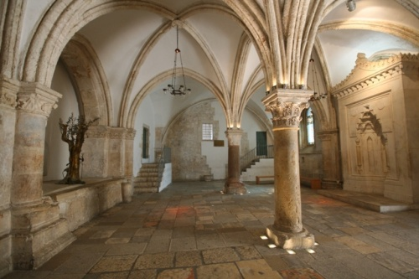
Upper Room

Slide 13
John 14:16-17
“¹⁶ I will ask the Father, and He will give you another Helper, that He may be with you forever; ¹⁷ that is the Spirit of truth, whom the world cannot receive, because it does not see Him or know Him, but you know Him because He abides with you and will be in you.”

Slide 14
1 Samuel 16:13-14
“¹³ Then Samuel took the horn of oil and anointed him in the midst of his brothers; and the Spirit of the Lord came mightily upon David from that day forward. And Samuel arose and went to Ramah. ¹⁴ Now the Spirit of the Lord departed from Saul, and an evil spirit from the Lord terrorized him.”

Slide 15
A Comparison of the Olivet and Upper Room Discourses
Discourse | Olivet | Upper Room
Scripture | Matt 24─25 | John 13─17
Location | Mount of Olives | Upper Room
Passion week | Third day | Sixth day
General focus | Farewell: Israel | Hello: Church
Specific focus | Israel’s future | Divine provisions
Prompting | Temple's destruction | Christ's imminent departure
Explanations | Written OT | Unwritten NT
Apostles | Israel (Matt. 19:28) | Church (Eph. 2:20)

Slide 16
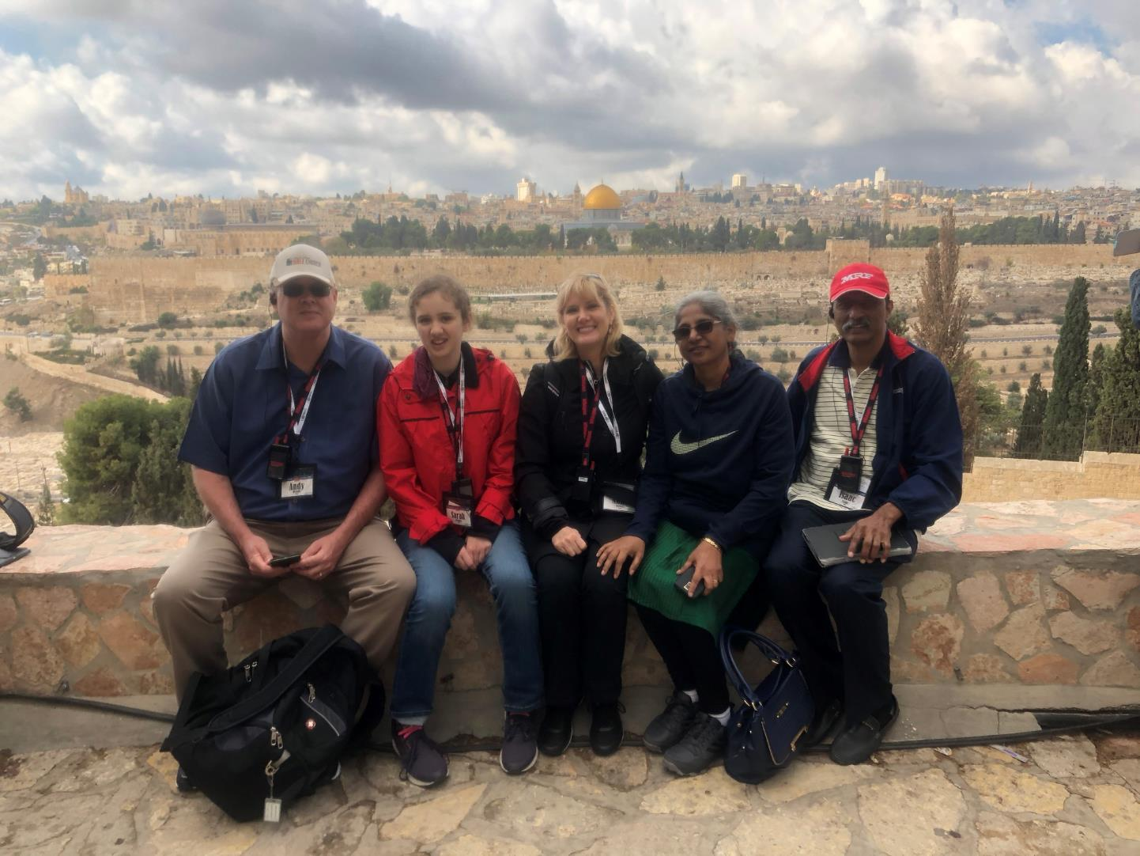

Slide 17
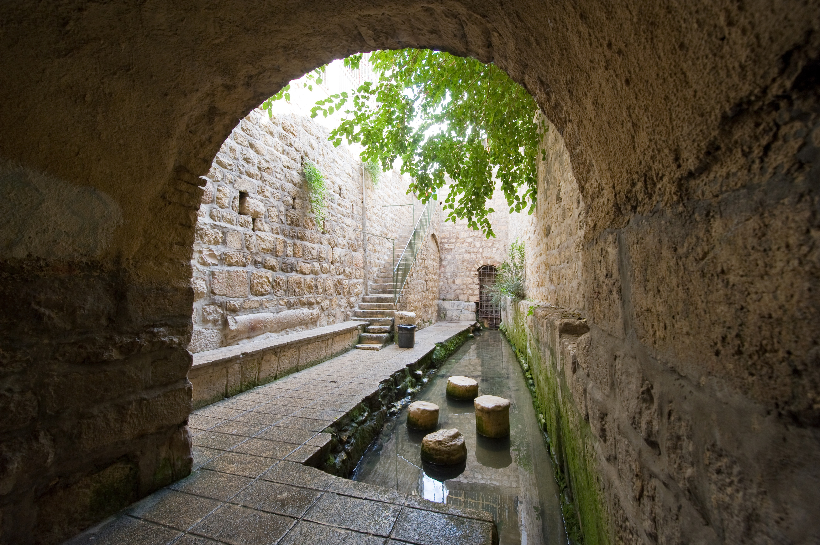
Pool of Siloam

Slide 18
7 “I AM” statements in John
I am the Bread of Life | 6:35
I am the Light of the world | 8:12
I am the Gate for the sheep | 10:7; cf. v.9
I am the Good Shepherd | 10:11,14
I am the Resurrection and the Life | 11:25
I am the Way and the Truth and the Life | 14:6
I am the true Vine | 15:1; cf. v.5

Slide 20
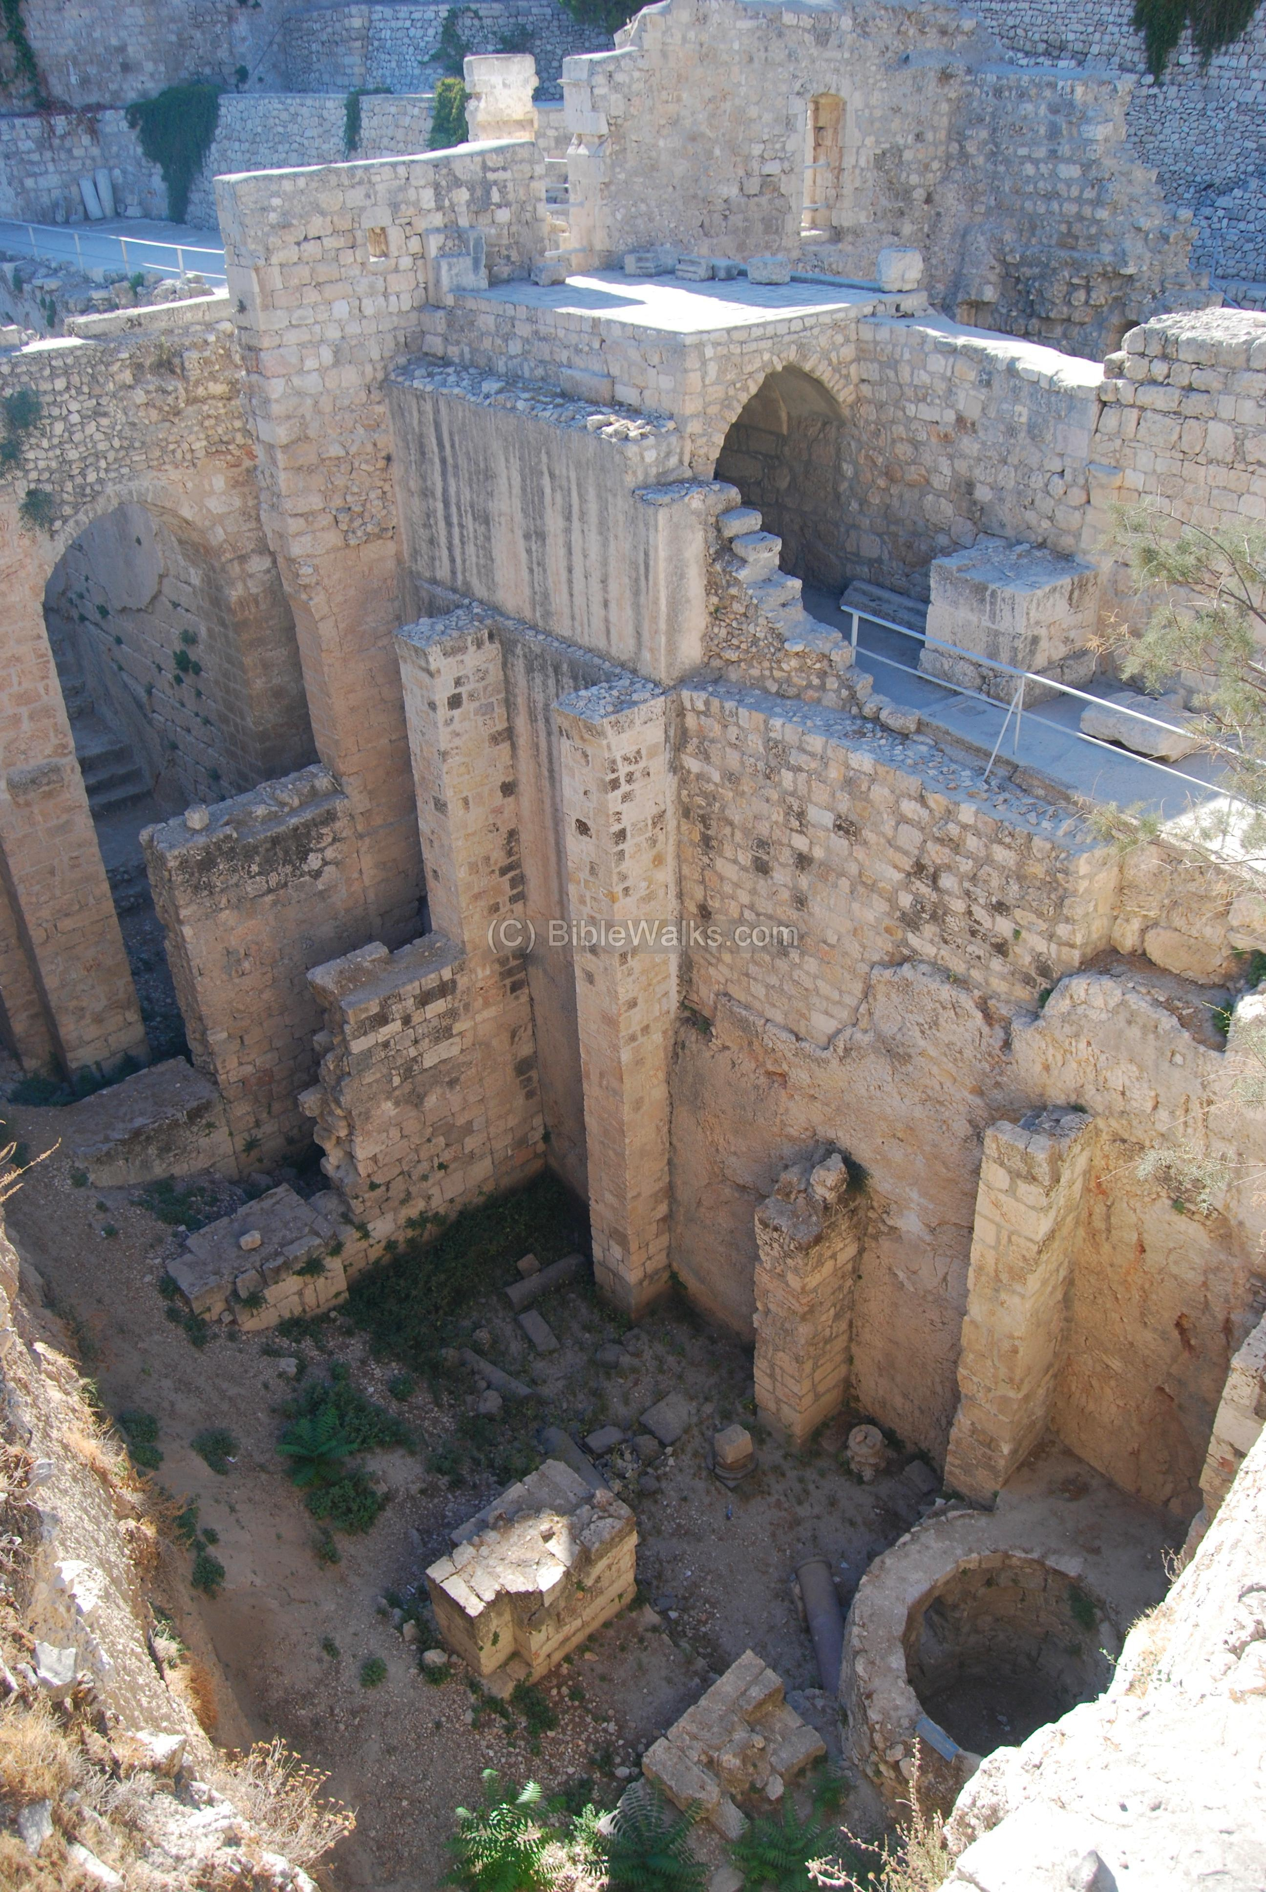
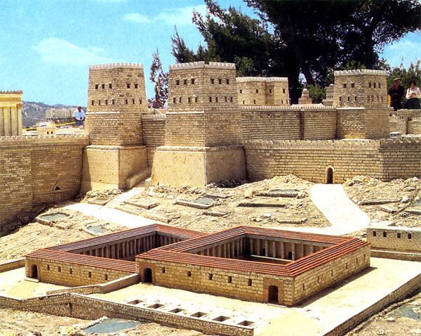
Pool of Bethesda

Slide 21
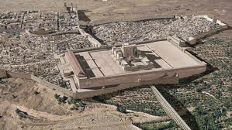
Christ’s Five Trips to Jerusalem in John’s Gospel
Feast | Verse
Passover | 2:23
Unnamed | 5:1
Tabernacles | 7:2
Dedication | 10:22
Passover | 13:1

Slide 23
Galatians 4:13-14
“¹³ but you know that it was because of a bodily illness that I preached the gospel to you the first time; ¹⁴ and that which was a trial to you in my bodily condition you did not despise or loathe, but you received me as an angel of God, as Christ Jesus Himself.”

Slide 24
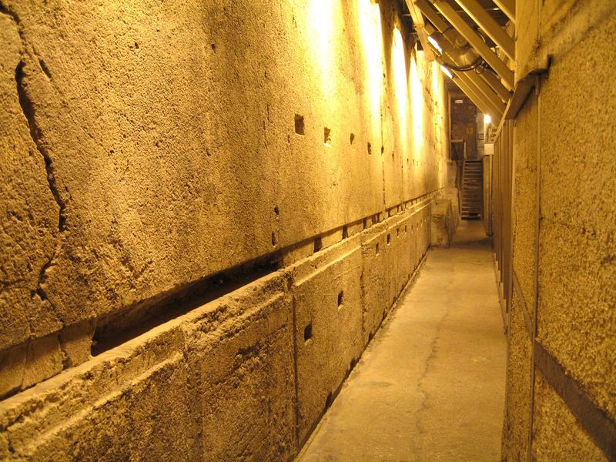
Rabbi’s Tunnel

Slide 25
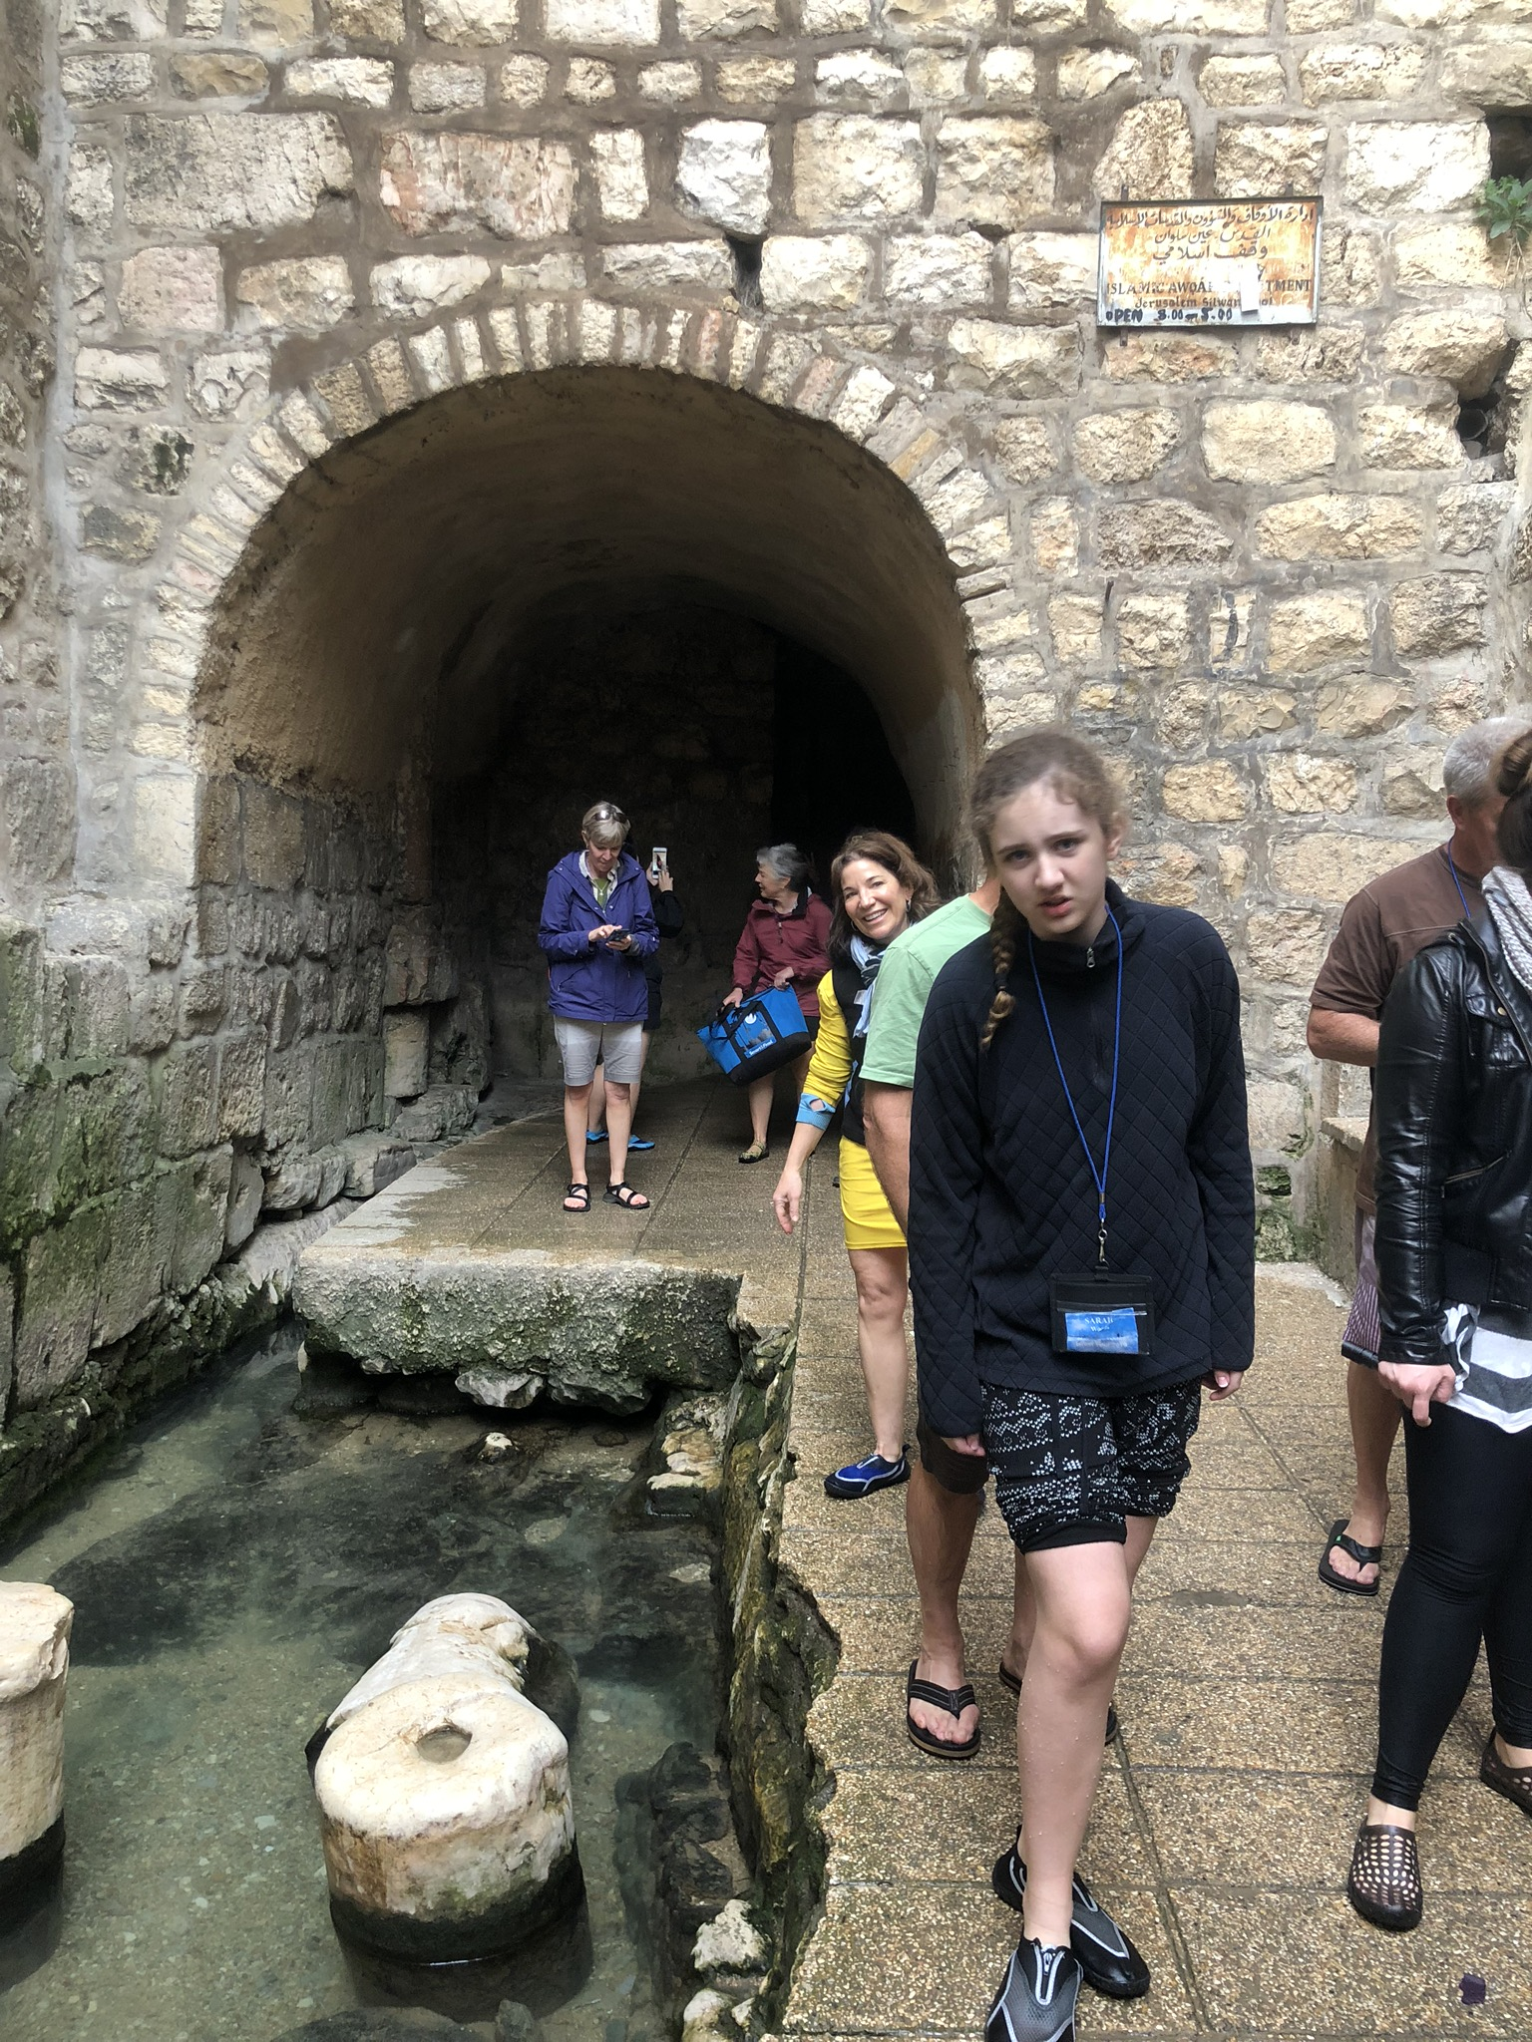
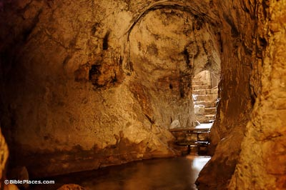
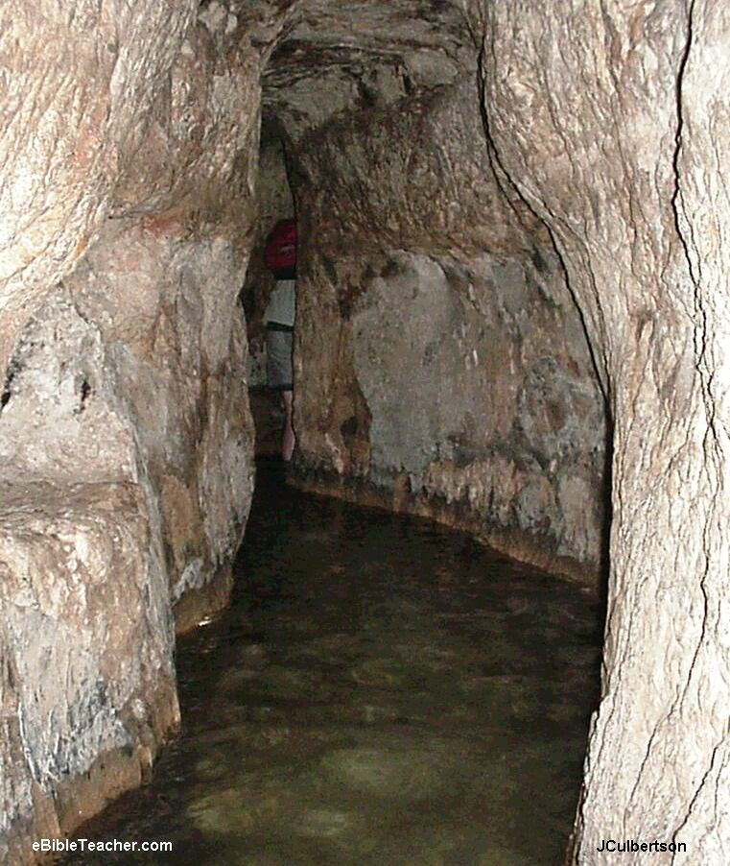
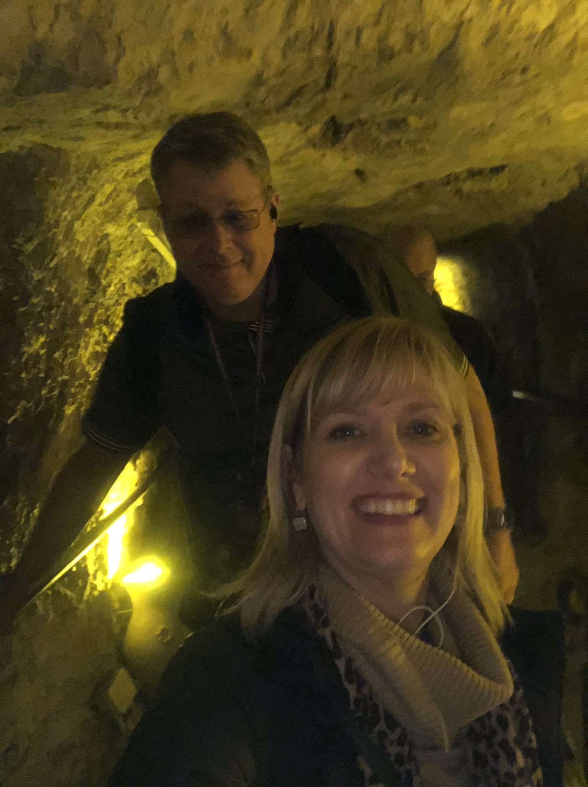
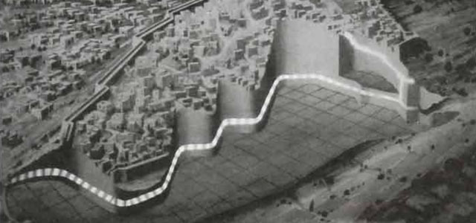
Hezekiah’s Tunnel

Slide 26
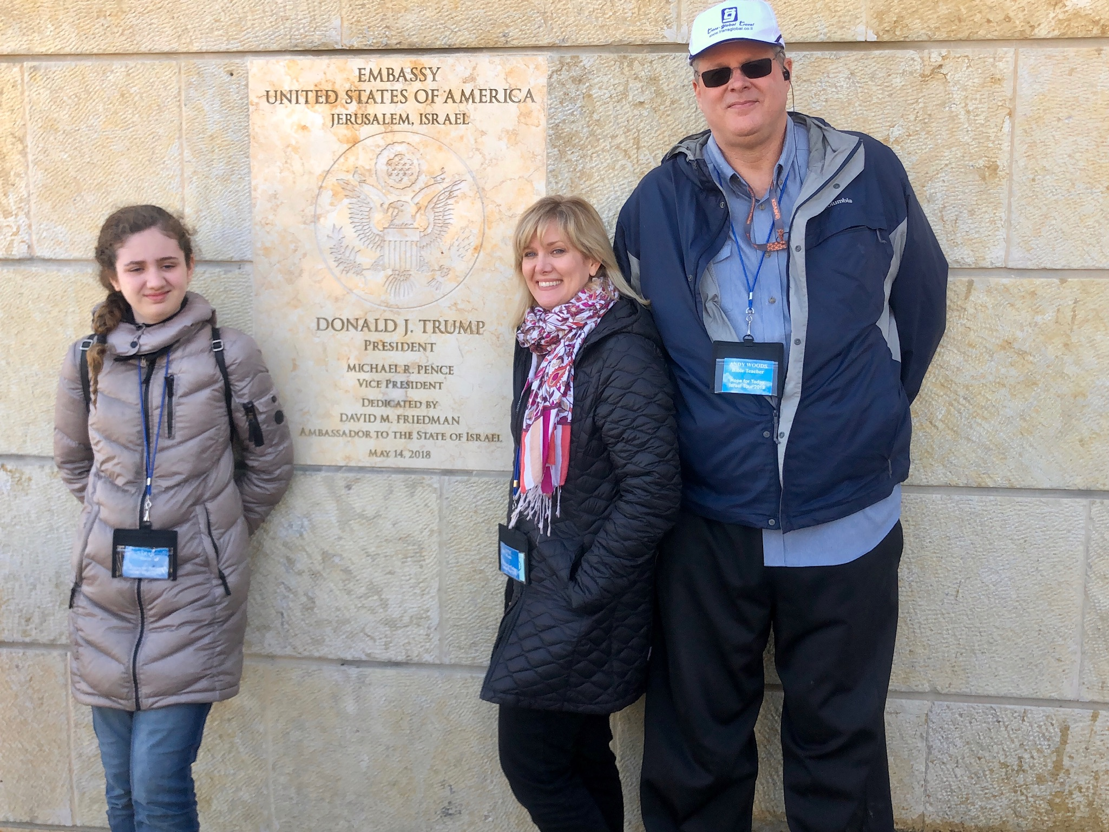
US Jerusalem Embassy

Slide 27
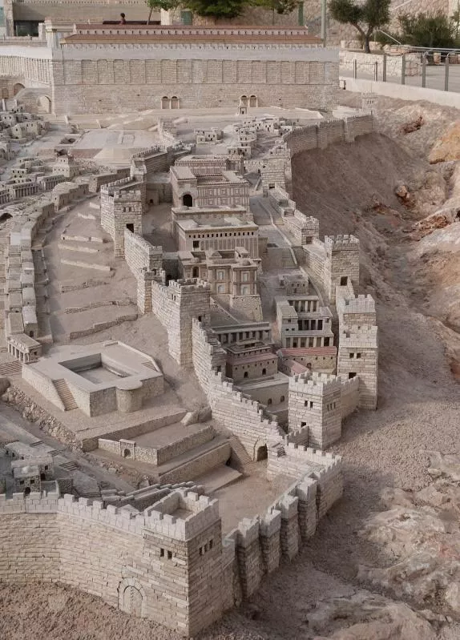
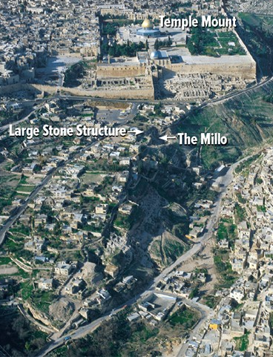
City of David
Ancient Modern

Slide 28
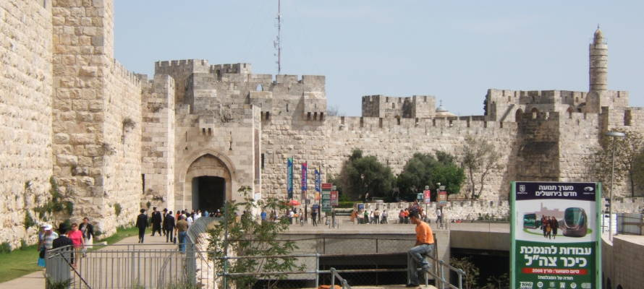
Jaffa Gate

