Slide 1


Dr. Andy Woods
Senior Pastor – Sugar Land Bible Church
President – Chafer Theological Seminary

Slide 2


Slide 3


Seven Trumpets
(Revelation 8‒11)
1st Trumpet (8:7) – 1/3 vegetation destroyed
2nd Trumpet (8:8-9) – 1/3 ocean destroyed
3rd Trumpet (8:10-11) – 1/3 water destroyed
4th Trumpet (8:12-13) – 1/3 luminaries darkened
5th Trumpet (9:1-12) – Demons released
6th Trumpet (9:13-21) – 1/3 humanity destroyed
7th Trumpet (11:14-19) – Legal transfer announced

Slide 4
Seven Trumpets
(Revelation 8‒11)
1st Trumpet (8:7) – 1/3 vegetation destroyed
2nd Trumpet (8:8-9) – 1/3 ocean destroyed
3rd Trumpet (8:10-11) – 1/3 water destroyed
4th Trumpet (8:12-13) – 1/3 luminaries darkened
5th Trumpet (9:1-12) – Demons released
6th Trumpet (9:13-21) – 1/3 humanity destroyed
7th Trumpet (11:14-19) – Legal transfer announced

Slide 5


Revelation 11:15
“Then the seventh angel sounded; and there were loud voices in heaven, saying, ‘The kingdom of the world has become the kingdom of our Lord and of His Christ; and He will reign (basileuō) forever and ever.’” (cf. Matt. 6:10)

Slide 6
The Seventh Trumpet
(Revelation 11:14-19)
The Transference (11:14-15)
The praise (11:16-18)
The Anticipation (11:19)

Slide 7
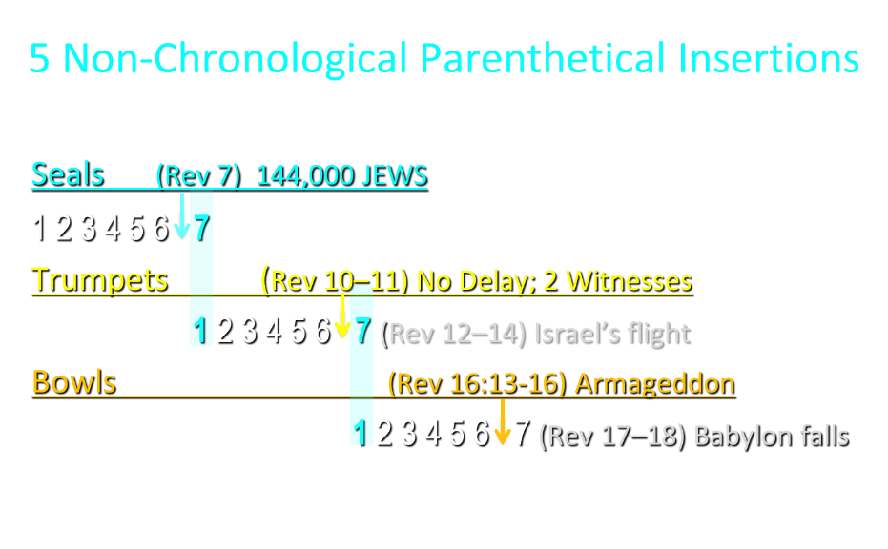

Slide 8
5 Non-Chronological Parenthetical Insertions
Rev 7 – 144,000 Jews
Rev 10:1-11:13 – Announcement of no more delay and the two witnesses
Rev 12-14 – Israel’s flight, two beasts, six scenes of hope
Rev 16:13-16 – Gathering of the nations to Armageddon
Rev 17:1-19:6 – Babylon’s fall

Slide 9
5 Non-Chronological Parenthetical Insertions
Rev 7 – 144,000 Jews
Rev 10:1-11:13 – Announcement of no more delay and the two witnesses
Rev 12-14 – Israel’s flight, two beasts, six scenes of hope
Rev 16:13-16 – Gathering of the nations to Armageddon
Rev 17:1-19:6 – Babylon’s fall

Slide 10
Revelation 12‒14
Rev 12 – Israel’s flight
Rev 13 – Two beasts
Rev 14 – Six scenes of hope

Slide 11
Revelation 12‒14
Rev 12 – Israel’s flight
Rev 13 – Two beasts
Rev 14 – Six scenes of hope

Slide 12
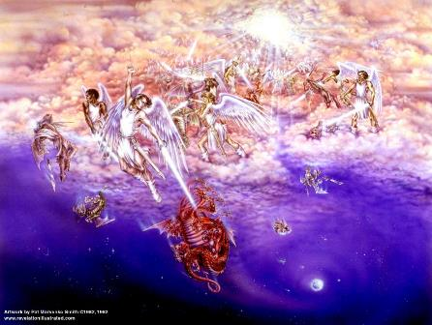
Biblical Reality of the Angelic World
Job 1:12
2 Kings 6:15-17
1 Chron 21:1
Dan 10:12-13, 20
Matt 16:21-23
Luke 22:31-32
Eph 6:12

Slide 13
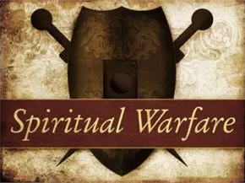
2 Corinthians 2:11
“so that no advantage would be taken of us by Satan, for we are not ignorant of his schemes.”

Slide 14

Ezekiel 28:17
“Your heart was lifted up because of your beauty; You corrupted your wisdom by reason of your splendor.”

Slide 15

Satan’s Two Strategies
Rev 12:1-5 – Past failed strategy
Rev 12:6-17 – Present & future strategy

Slide 16
Satan’s Two Strategies
Rev 12:1-5 – Past failed strategy
Rev 12:6-17 – Present & future strategy

Slide 17
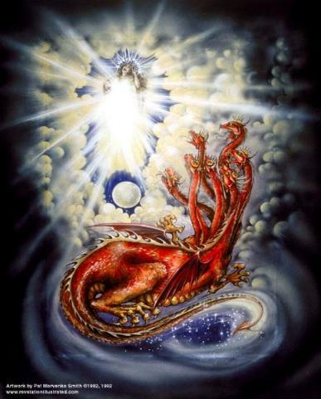
CAST OF 3 CHARACTERS
Revelation 12:1-5
SON = MESSIAH
  Ps. 2:9; Acts 1:9
DRAGON = SATAN
  Rev. 12:9; 20:2
WOMAN = ISRAEL
  Gen. 37:9-10

Slide 18

Revelation 12:4-5 (KJV)
⁴And his tail drew a third part of the stars of heaven, and did cast them to the earth: and the dragon stood before the woman that is about to give birth, so that when she gave birth he may devour her child. ⁵And she gave birth to a son, a man child, who is to rule all the nations with a rod of iron: and her child was caught up unto God, and to his throne.

Slide 19
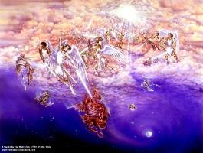
Different Perspectives – Same Event
Matt 2 – Physical World
Rev 12:1-5 – Spiritual World

Slide 20


Genesis 3:15
“And I will put enmity between you and the woman, and between your seed and her seed; He shall bruise you on the head, and you shall bruise him on the heel.”

Slide 21
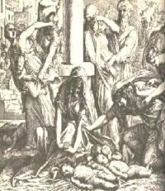
Satanic Attempts to Stop Messiah
Cain; Gen. 4, 1 Jn. 3:12
Sons of God; Gen. 6:1-4
Pharaoh; Ex. 1
Athaliah; 2 Chron. 22
Haman; Esther
Matt 4:5-7; John 8:59
Herod; Mt.2

Slide 22
Revelation 11:15
“Then the seventh angel sounded; and there were loud voices in heaven, saying, ‘The kingdom of the world has become the kingdom of our Lord and of His Christ; and He will reign (basileuō) forever and ever.’” (cf. Matt. 6:10)

Slide 23
Satan’s Two Strategies
Rev 12:1-5 – Past failed strategy
Rev 12:6-17 – Present & future strategy

Slide 24
Satan as Ruler of this World
Job 1:7; 2:2
Luke 4:5-7
John 12:31; 14:30; 16:11
2 Corinthians 4:4
Ephesians 2:2
1 John 4:4; 5:19

Slide 25

Names & Titles Demonstrating Satan’s Post-Fall, Earthly Authority
(Job 1:7; 2:2; Luke 4:5-8; Rom. 8:19-22)
Prince of this world (John 12:31; 14:30; 16:11)
God of this age (2 Cor. 4:4)
Prince and power of the air (Eph. 2:2)
Who the believer wrestles with (Eph. 6:12)
Roaring lion (1 Pet. 5:8)
Whole world lies in his power (1 John 5:19)

Slide 26

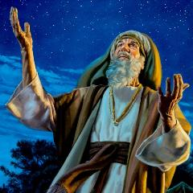
Genesis 12:3
“And I will bless those who bless you, And the one who curses you I will curse. And in you all the families of the earth will be blessed.”

Slide 27
Genesis 12:3
“And I will bless those who bless you, And the one who curses you I will curse. And in you all the families of the earth will be blessed.”

Slide 28
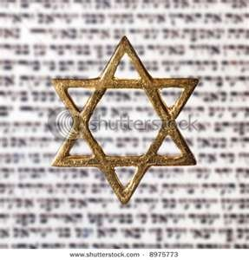
Israel’s Three Blessings to the World
(Gen 12:3b)
Scripture (Rom 3:2)
Savior (John 4:22)
Kingdom (Isa 2:2-3)

Slide 29
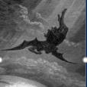
Satan’s Progressive Defeat
Initial eviction from heaven (Isa 14:12-15; Ezek 28:12-17)
Eden (Gen 3:15)
Pre-diluvian world (1 Pet 3:19-20)
Cross (John 12:31; 16:11; Col 2:15; Heb 2:14; 1 John 3:8)
Mid point of the Tribulation (Rev 12:9)
Beginning of millennium (Rev 20:2-3)
End of millennium (Rev 20:10)

Slide 30

WHAT MOTIVATES ANTI-SEMITISM?
Fallen angelic world

Slide 31
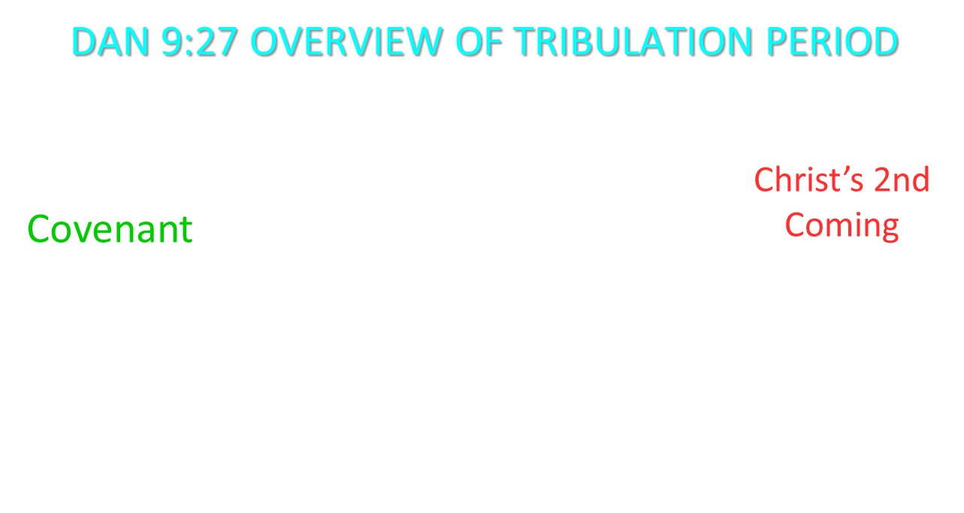

Slide 32
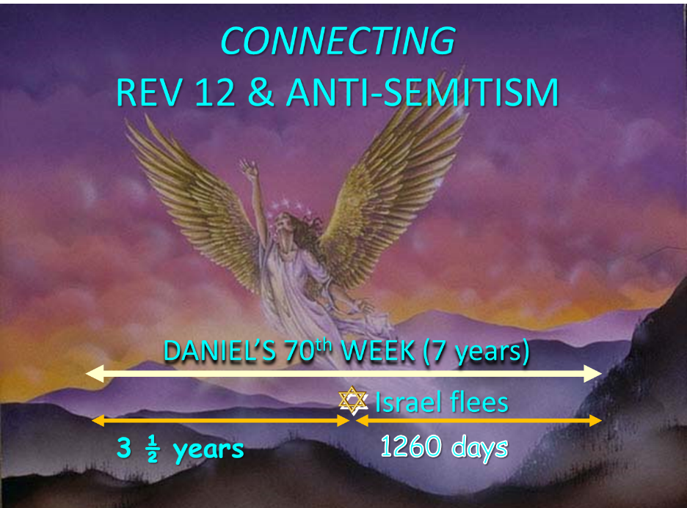

Slide 33
CAST OF 3 CHARACTERS
Revelation 12:1-5
SON = MESSIAH
  Ps. 2:9; Acts 1:9
DRAGON = SATAN
  Rev. 12:9; 20:2
WOMAN = ISRAEL
  Gen. 37:9-10

Slide 34
Place of Hebrew Refuge:
Petra in Mt. Seir in S. Jordan
Prepared by God (Rev. 12:6)
Divine provision of food & water (Isa. 33:16; Rev. 12:6)
Wilderness (Rev. 12:6, 14)
Mountains (Isa. 33:16; Matt. 24:16)
Defensible (Isa. 33:16)
Jordan (Dan. 11:41)
Bozrah (Micah 2:12)
Fruchtenbaum, Footsteps of the Messiah, 294-97

Slide 35
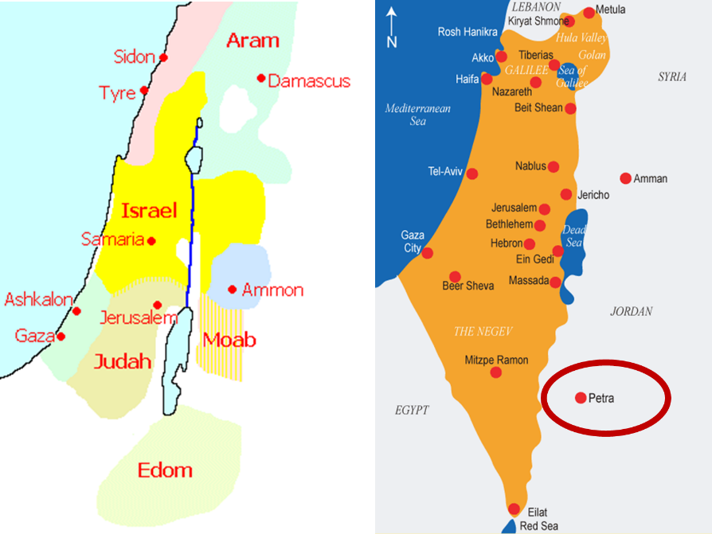

Slide 36
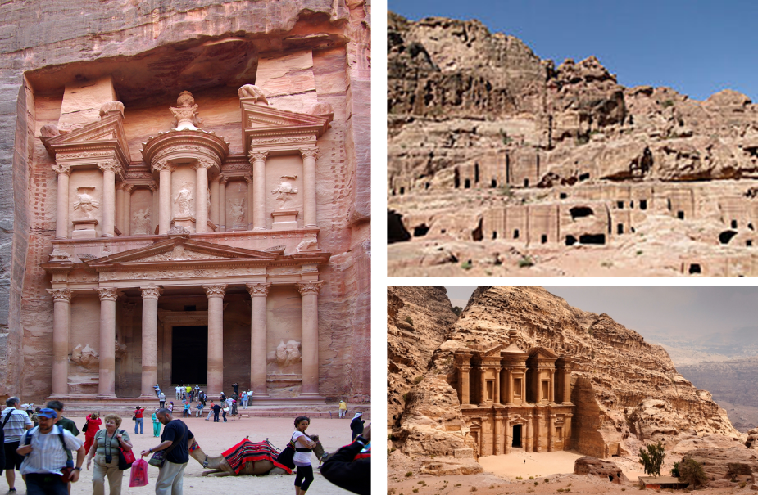

Slide 37

Arnold Fruchtenbaum
Footseps of the Messiah, Page 296-97
“Another suggestion is the city now known as Petra…this author prefers the identification with Petra. Petra is located in a basin within Mount Seir, and is totally surrounded by mountains and cliffs. The only way in and out of the city is through a narrow passageway that extends for about a mile and can only be negotiated by foot or by horseback. This makes the city easy to defend, and its surrounding high cliffs give added meaning and confirmation to Isaiah 33:16. Only a few abreast can enter through this passage at any one time, giving this city even greater defensibility.”

Slide 38
Arnold Fruchtenbaum
Footseps of the Messiah, Page 296-97
“The name Bozrah means ‘sheepfold.’ An ancient sheepfold had a narrow entrance so that the shepherd could count his sheep. Once inside the fold, the sheep had more room to move around. Petra is shaped like a giant sheepfold, with its narrow passage opening up to a spacious circle surrounded by cliffs. This is not true of the town of Buseira. Furthermore, by modern Petra is a site known as Butzeira, which retains the Hebrew Botzrah...It will be a very defensible city located in Mount Seir...Furthermore, as they flee and while they are living there, food and water will be miraculously provided.”

Slide 39
Different Perspectives – Same Event
Matt 24:15-22 – Physical World
Rev 12:6-17 – Spiritual World

Slide 40
Different Perspectives – Same Event
Matt 2 – Physical World
Rev 12:1-5 – Spiritual World

Slide 41
Satan Now Retains Heavenly Access
Job 1:6
Job 2:1
Zech. 3:1
Luke 22:31
Rev. 12:10

Slide 43
Satan’s Progressive Defeat
Initial eviction from heaven (Isa 14:12-15; Ezek 28:12-17)
Eden (Gen 3:15)
Pre-diluvian world (1 Pet 3:19-20)
Cross (John 12:31; 16:11; Col 2:15; Heb 2:14; 1 John 3:8)
Mid point of the Tribulation (Rev 12:9)
Beginning of millennium (Rev 20:2-3)
End of millennium (Rev 20:10)

Slide 44
CAST OF 3 CHARACTERS
Revelation 12:1-5
SON = MESSIAH
  Ps. 2:9; Acts 1:9
DRAGON = SATAN
  Rev. 12:9; 20:2
WOMAN = ISRAEL
  Gen. 37:9-10

Slide 45
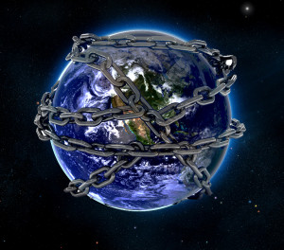

Slide 46
Revelation 11:15
“Then the seventh angel sounded; and there were loud voices in heaven, saying, ‘The kingdom of the world has become the kingdom of our Lord and of His Christ; and He will reign (basileuō) forever and ever.’” (cf. Matt. 6:10)

Slide 47
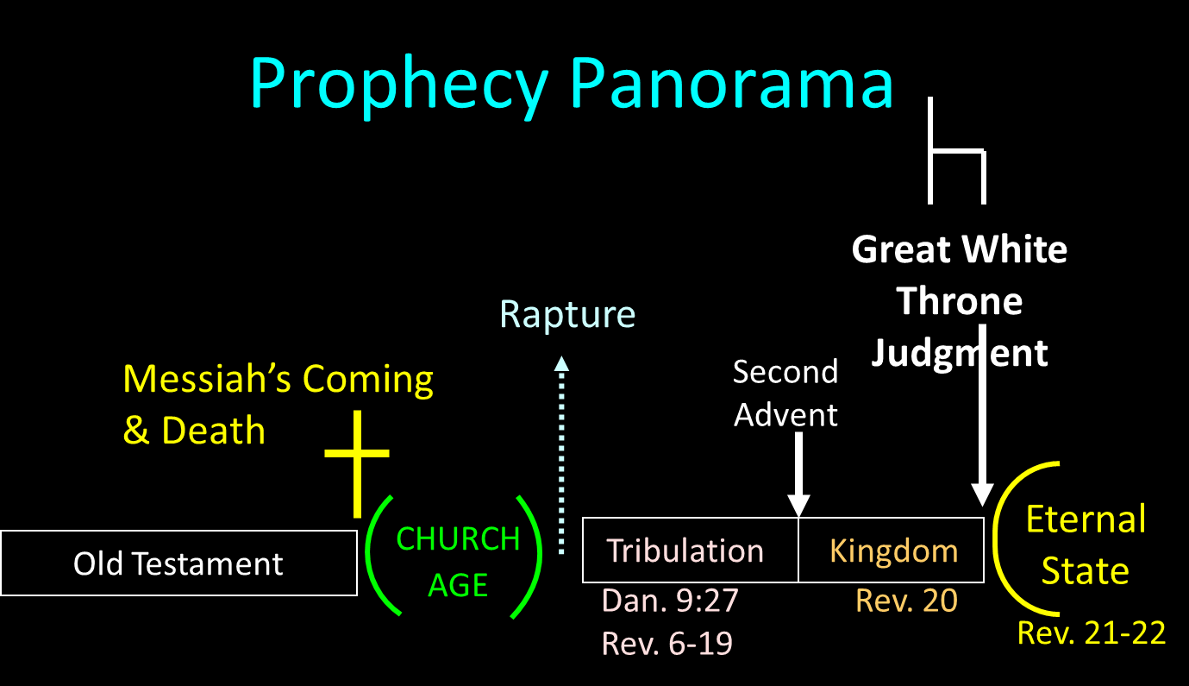

Slide 48

1st Six Seals (Revelation 6)
6:1-2 – Advent of antichrist
6:3-4 – War
6:5-6 – Famine
6:7-8 – Death
6:9-11 – Martyrdoms
6:12-17 – Cosmic disturbances

Slide 50
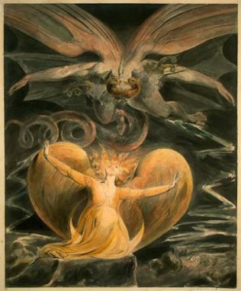
2 CYCLES OF SATANIC PERSECUTION
“Pursues the woman” = persecution of Israel 12:13-14
“Flood from his mouth” = tries to destroy Israel 12:15-16

Slide 51
2 CYCLES OF SATANIC PERSECUTION
“Pursues the woman” = persecution of Israel 12:13-14
“Flood from his mouth” = tries to destroy Israel 12:15-16

Slide 52
CAST OF 3 CHARACTERS
Revelation 12:1-5
SON = MESSIAH
  Ps. 2:9; Acts 1:9
DRAGON = SATAN
  Rev. 12:9; 20:2
WOMAN = ISRAEL
  Gen. 37:9-10

Slide 53
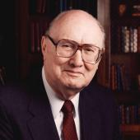
Two Rules of Interpretation
Search the immediate context
  Walvoord: 26X
Search the remote context
  Old Testament
  Thomas: 278 / 404 verses

Slide 54
Place of Hebrew Refuge:
Petra in Mt. Seir in S. Jordan
Prepared by God (Rev. 12:6)
Divine provision of food & water (Isa. 33:16; Rev. 12:6)
Wilderness (Rev. 12:6, 14)
Mountains (Isa. 33:16; Matt. 24:16)
Defensible (Isa. 33:16)
Jordan (Dan. 11:41)
Bozrah (Micah 2:12)
Fruchtenbaum, Footsteps of the Messiah, 294-97

Slide 56
2 CYCLES OF SATANIC PERSECUTION
“Pursues the woman” = persecution of Israel 12:13-14
“Flood from his mouth” = tries to destroy Israel 12:15-16

Slide 57
Daniel 9:26
Then after the sixty-two weeks the Messiah will be cut off and have nothing, and the people of the prince who is to come will destroy the city and the sanctuary. And its end will come with a flood; even to the end there will be war; desolations are determined.

Slide 58
Descriptions of Satanic Hatred
Wrath 12:12
Persecution 12:13
Sweep away 12:15
Enraged 12:17
War 12:17

Slide 59
How Israel Has Blessed the World
(Gen 12:3; Rom 9:4-5)
Patriarchs
Law
Prophets
Messiah (John 4:22; Rom 9:5)
Apostles
Biblical writers
Early church
Early Christian martyrs
Paul
Future kingdom

Slide 60
Matthew 23:37-39
³⁷ “Jerusalem, Jerusalem, who kills the prophets and stones those who are sent to her! How often I wanted to gather your children together, the way a hen gathers her chicks under her wings, and you were unwilling. ³⁸ Behold, your house is being left to you desolate! ³⁹ For I say to you, from now on you will not see Me until you say, ‘Blessed is He who comes in the name of the Lord!’”

Slide 61
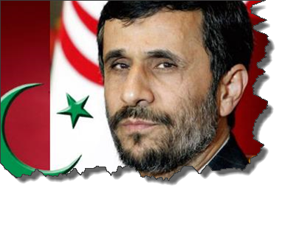
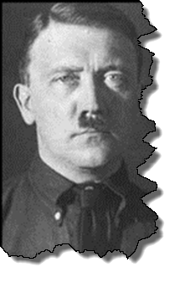
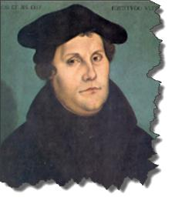
MODERN TRENDS IN ANTISEMITISM
Revelation 12

Slide 62

Christian Anti-Semitism
  “First, their synagogues should be set on fire…Secondly, their homes should likewise be broken down and destroyed…Thirdly, they should be deprived of their prayer books and Talmuds…”
Martin Luther, Concerning the Jews and Their Lies, cited in Michael Brown’s Our Hands Are Stained with Blood, pp. 14-15.

Slide 63
Christian Anti-Semitism
  “…Fourthly, their rabbis must be forbidden under threat of death to teach any more…Fifthly, passport and traveling privileges should be absolutely forbidden to the Jews…Sixthly, they ought to be stopped from usury (charging interest on loans…”
Martin Luther, Concerning the Jews and Their Lies, cited in Michael Brown’s Our Hands Are Stained with Blood, pp. 14-15.

Slide 64
Christian Anti-Semitism
“Seventhly, let the young and strong Jews and Jewesses be given the flail, the ax, the hoe, the spade, the distaff, and spindle, and let the earn their bread by the sweat of their noses…We ought to drive the rascally lazy bones out of our system...”
Martin Luther, Concerning the Jews and Their Lies, cited in Michael Brown’s Our Hands Are Stained with Blood, pp. 14-15.

Slide 65
Christian Anti-Semitism
“…Therefore away with them… To sum up, dear princes and nobles who have Jews in your domains, if this advice of mine does not suit you, then find a better one so that you and we may all be free of this insufferable devilish burden–the Jews.”
Martin Luther, Concerning the Jews and Their Lies, cited in Michael Brown’s Our Hands Are Stained with Blood, pp. 14-15.

Slide 66

John Calvin
Commentary on the Prophet Daniel (Vol 1, p. 185). Bellingham, WA: Logos Bible Software. Commentary on Daniel 2:44-45. (2010).
  “But here he [the rabbi] not only betrays his ignorance, but his utter stupidity, since God so blinded the whole people that they were like restive dogs. I have had much conversation with many Jews: I have never seen either a drop of piety or a grain of truth or ingenuousness—nay, I have never found common sense in any Jew. But this fellow, who seems so sharp and ingenious, displays his own impudence to his great disgrace.”

Slide 67
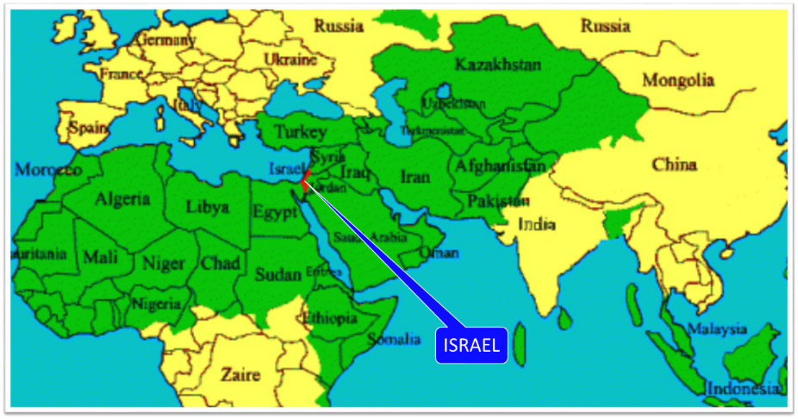

Slide 68
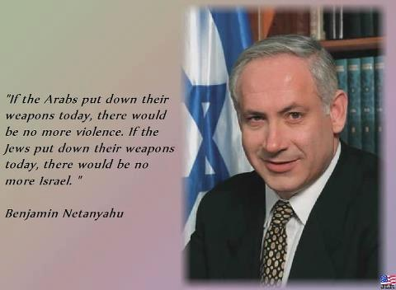

Slide 69
Conclusion

Slide 70
Application
Recognize Anti-Semitism and its source
Do not take part
Expose it (Eph. 5:11)
Do not be surprised by it

Slide 71

“The Lord bless you and keep you; the Lord make his face shine on you and be gracious to you; the Lord turn his face toward you and give you peace.” (NIV)

