Slide 1
ISRAEL 2019
ANDY WOODS
Part 6

Slide 2
Tel Aviv, Joppa, Caesarea Maritma,
Mt. Carmel, Megiddo
Part 1

Slide 3
Sepphoris, Upper Galilee/Caesarea-Philippi andTel Dan, Sea of Galilee, Mt. of Beatitudes
Part 2

Slide 4
Capernaum, Tabgha
Part 3

Slide 5
Jordan River, Bet She 'An, Jericho, Dead Sea, Masada
Part 4

Slide 6
Qumran, En Gedi, Jerusalem
Part 5

Slide 7
Jerusalem –Mt. of Olives, Garden of Gethsemane, Southern Steps, Western Wall, Temple Institute
Part 6

Slide 8
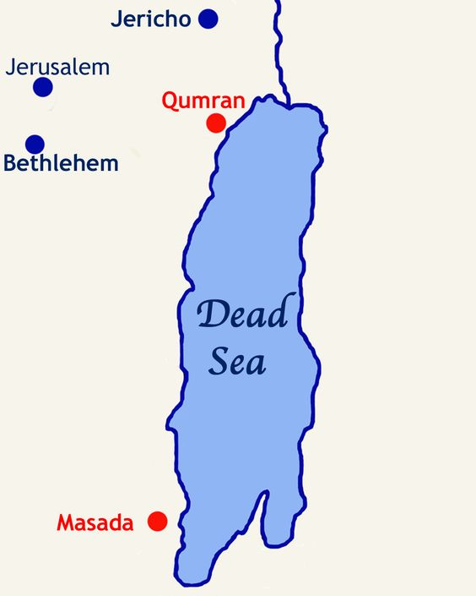

Slide 9
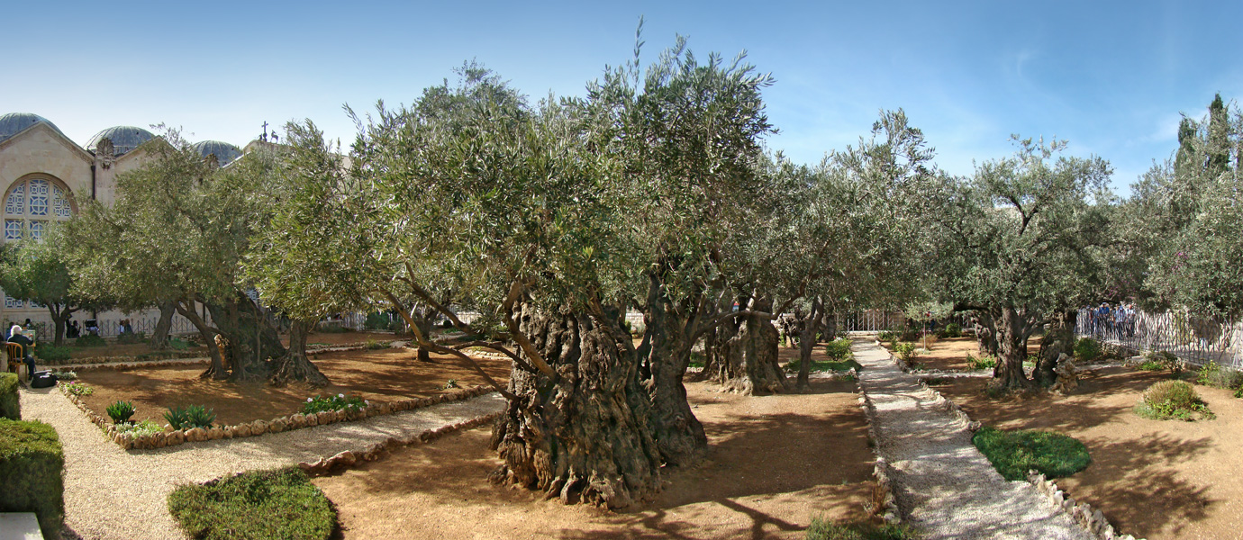
Mt. of Olives

Slide 10
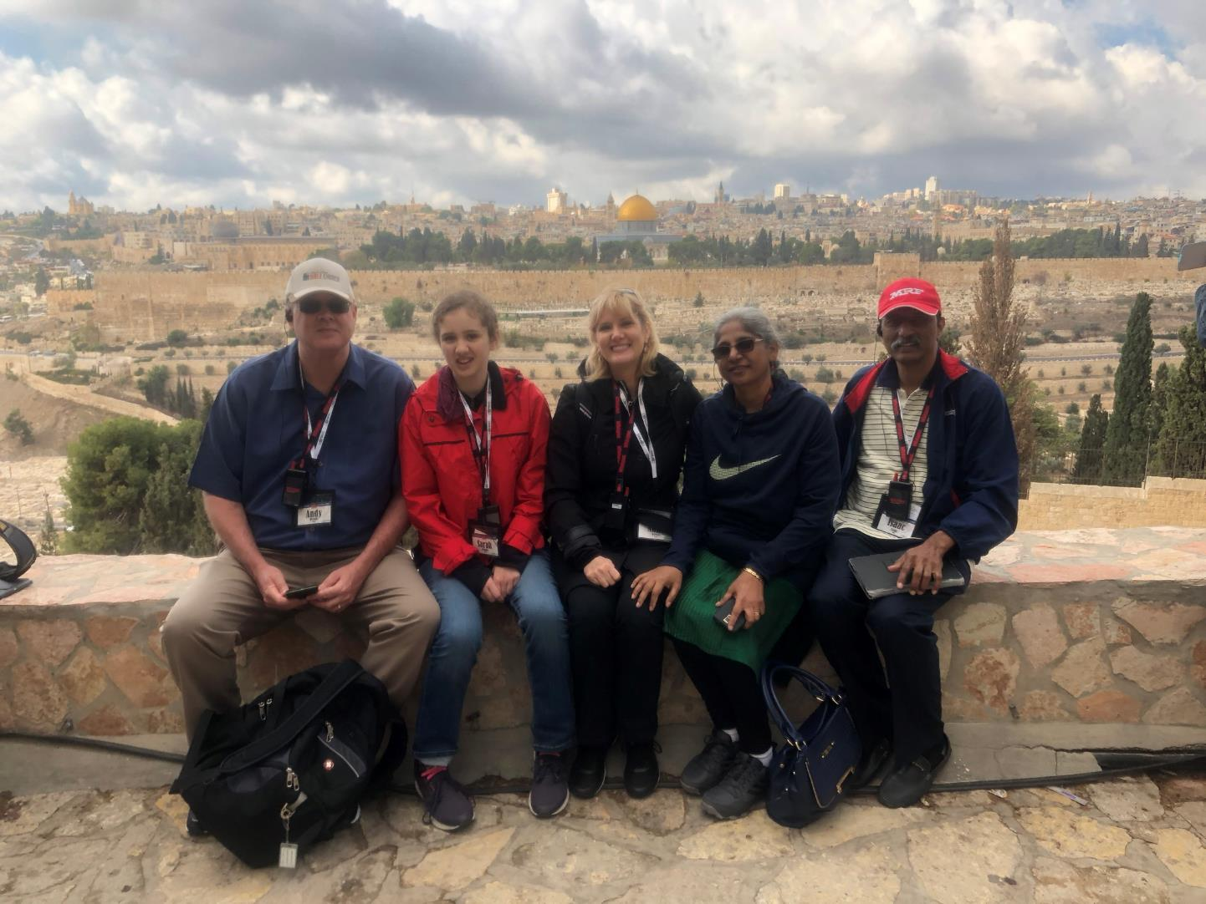

Slide 11
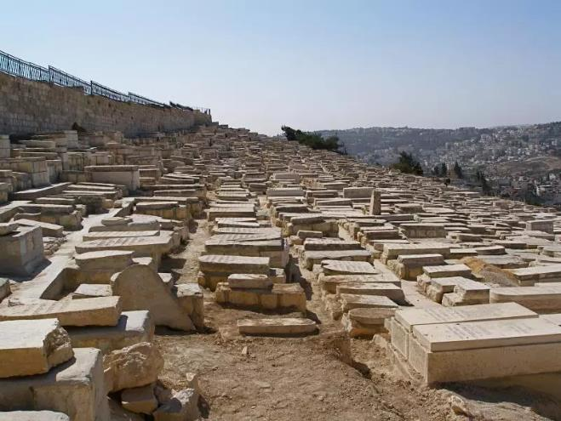
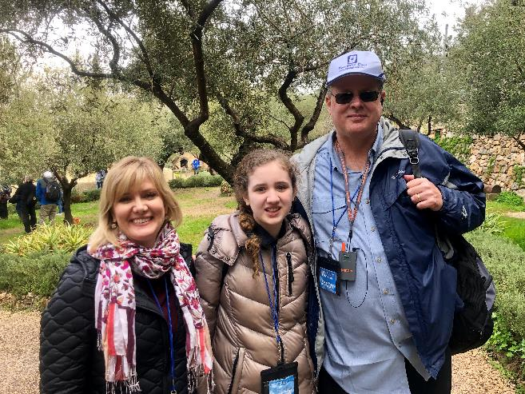
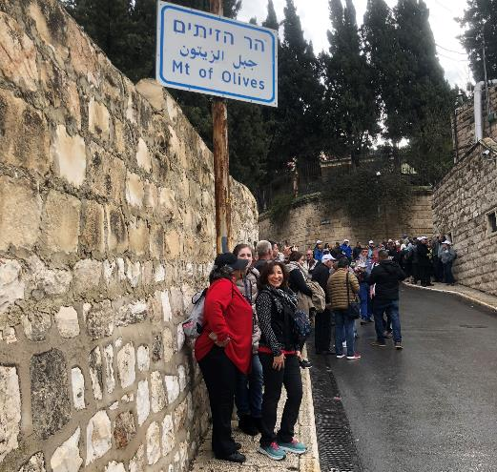
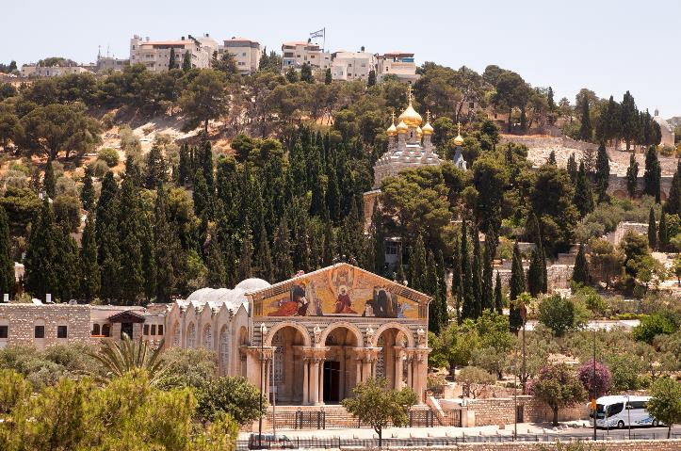
Mt of Olives

Slide 12
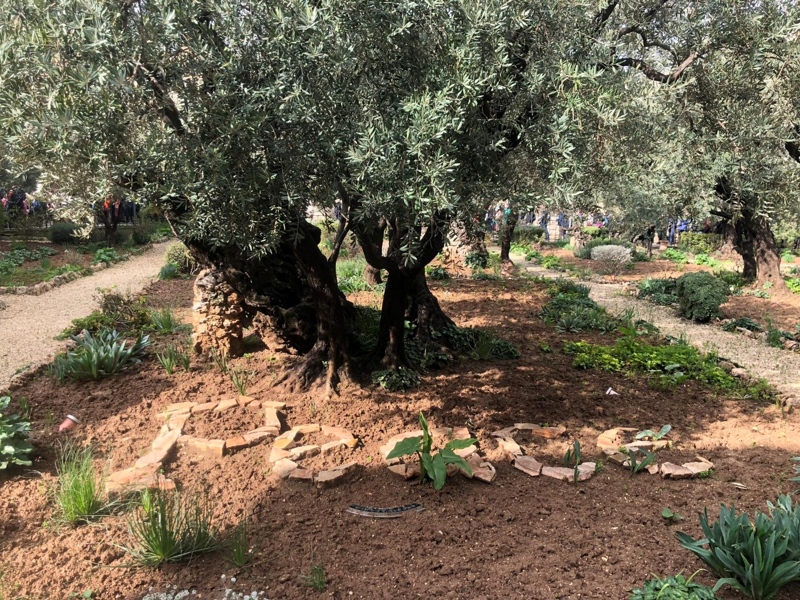
Gethsemane

Slide 13
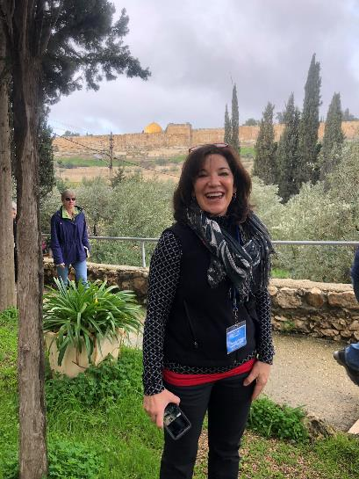
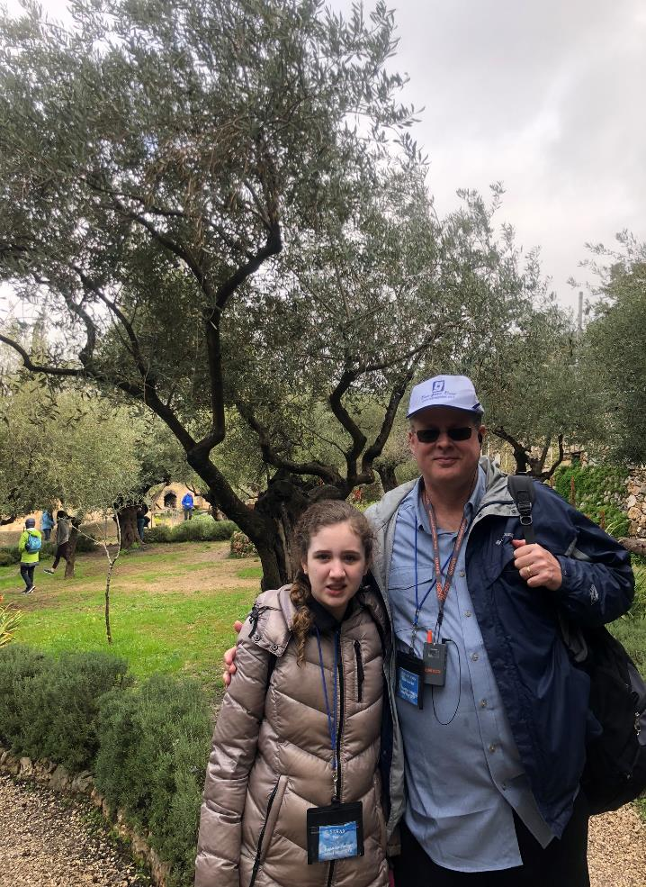
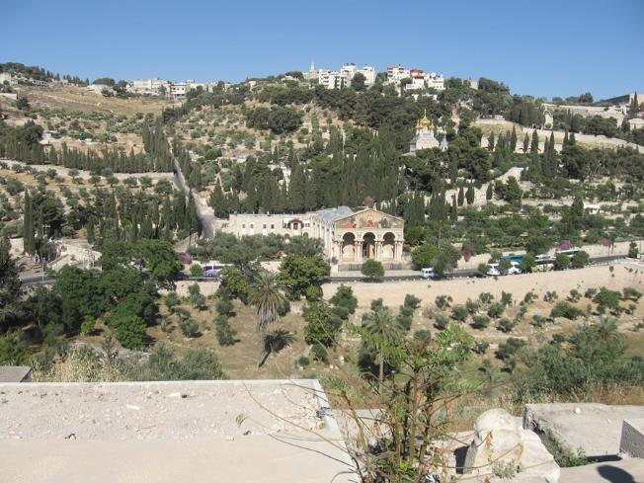

Slide 14
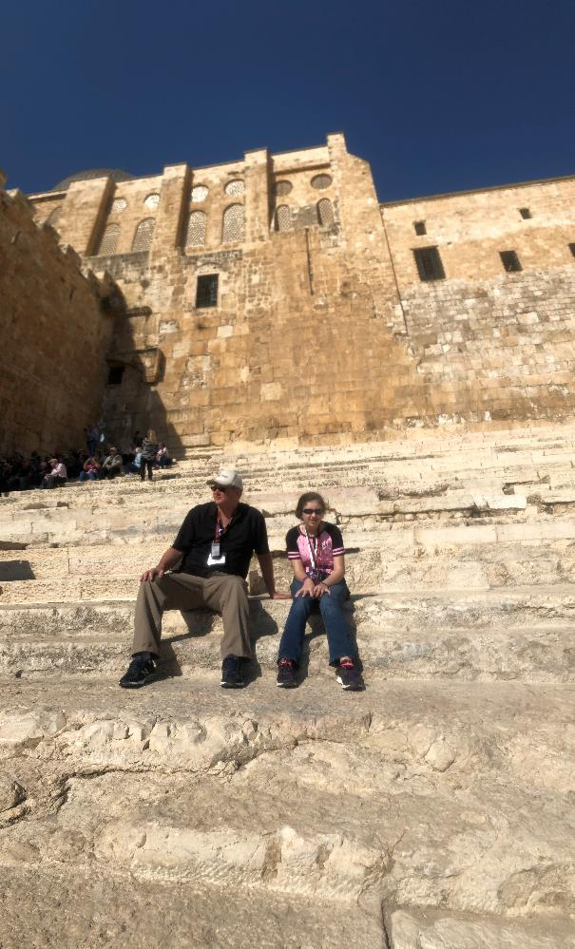
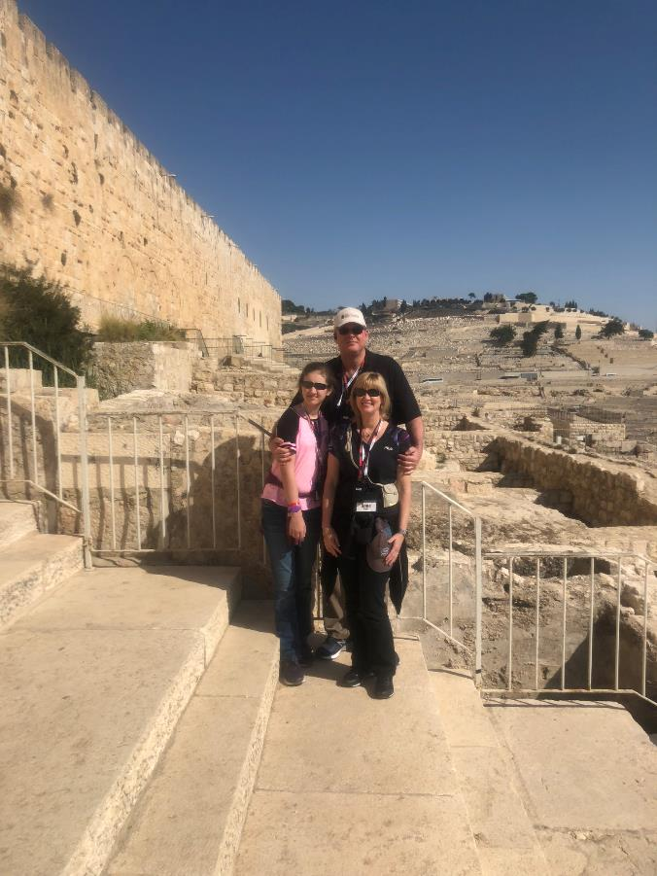
Southern Steps

Slide 15
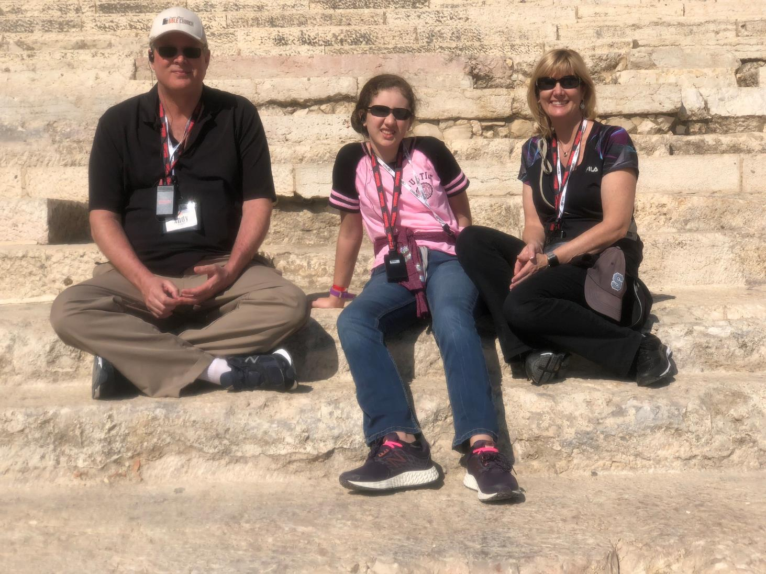

Slide 16
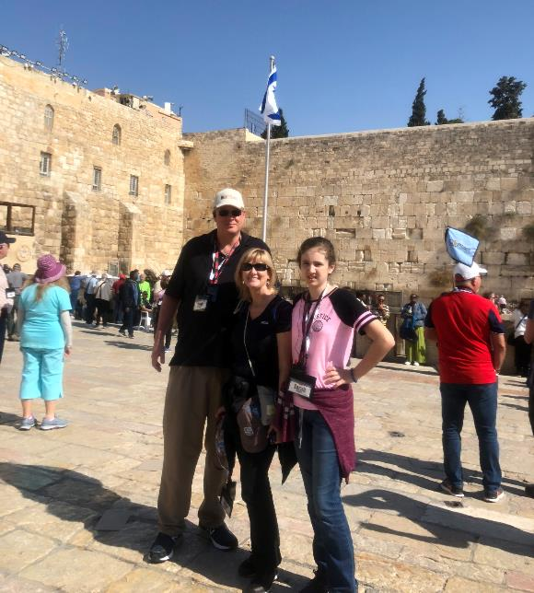
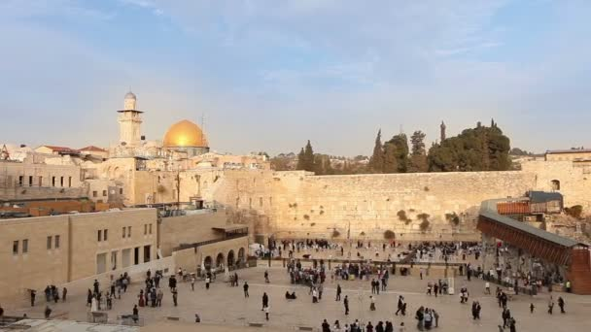
Western Wall

Slide 17
Daniel 9:26
“Then after the sixty-two weeks the Messiah will be cut off and have nothing, and the people of the prince who is to come will destroy the city and the sanctuary. And its end will come with a flood; even to the end there will be war; desolations are determined.”

Slide 18
Western Wall

Slide 19
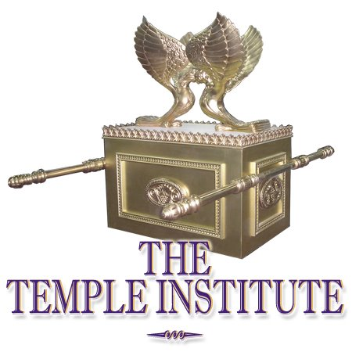

Slide 21
Israel’s Four Temples
Solomon’s pre exilic temple (Kings and Chronicles)
Zerubbabel’s post exilic temple (Ezra 1-6; John 2:20)
Antichrist's temple (Dan 9:27; Matt 24:15; 2 Thess 2:4; Rev 11:1-2)
Millennial temple (Ezek 40-48)

Slide 22
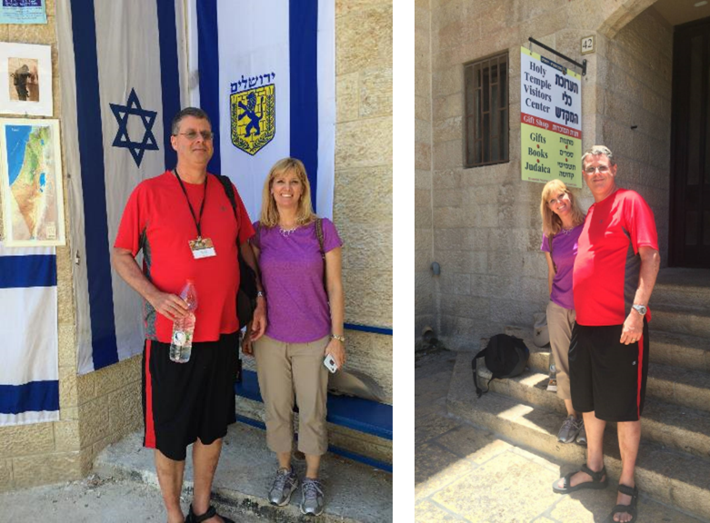

Slide 23
“The menorah weighs one-half ton. It contains forty-five kilograms of twenty-four karat gold. Its estimated value is approximately three million dollars.” http://www.templeinstitute.org/history-holy-temple-menorah-1.htm

Slide 24
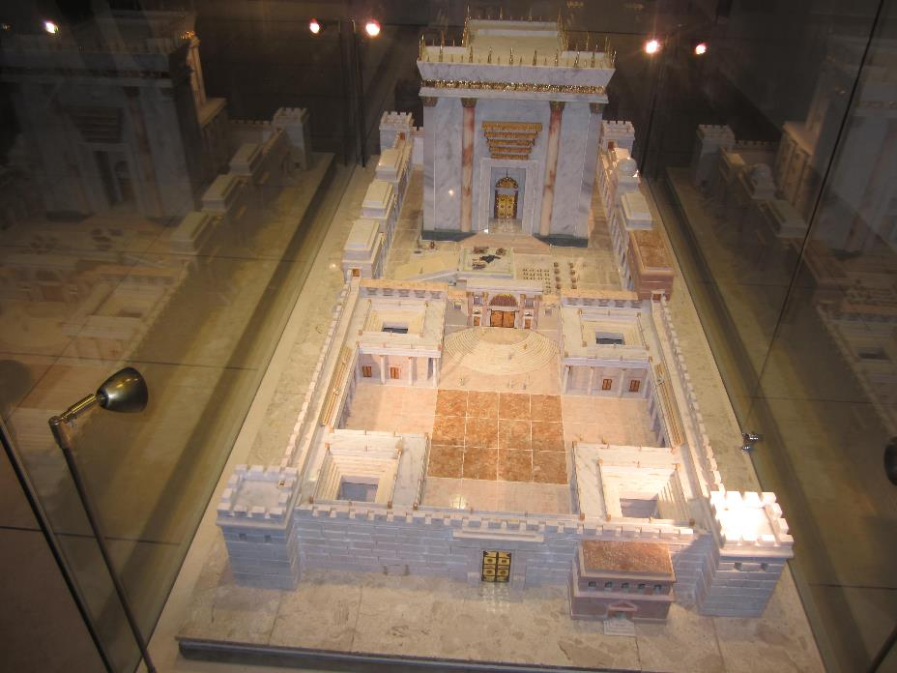

Slide 25
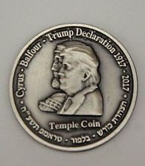
Half Shekel King Cyrus-Balfour-Trump Jewish Temple Mount Israel Coin

Slide 26
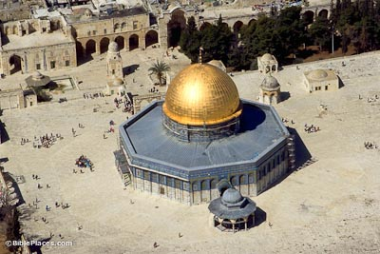
THE TEMPLE MOUNT

Slide 27
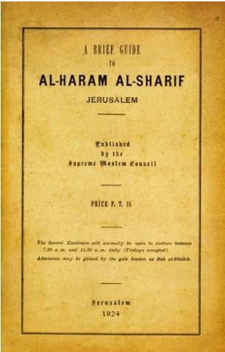
A Brief Guide to Al-Haram Al-Sharif Jerusalem
published in 1924 (and unchanged in all later editions through the 1950s), p. 4.
“The site is one of the oldest in the world. Its sanctity dates from the earliest (perhaps from pre-historic) times. Its identity with the site of Solomon’s Temple is beyond dispute. This, too, is the spot, according to the universal belief, on which ‘David built there an altar unto the Lord, and offered burnt offerings and peace offerings.’”

Slide 28
The Times of Israel April 6, 2017 In first, sheep slaughtered in Jerusalem Old City in reenactment of Passover sacrifice
“With priests blowing silver trumpets, a group of religious Jews slaughtered a sheep on Thursday in Jerusalem’s Old City to demonstrate the traditional paschal sacrifice, the first time such a reenactment has been held inside the city walls in 2,000 years.”
http://www.timesofisrael.com/in-a-first-sheep-slaughtered-in-jerusalem-old-city-in-reenactment-of-passover-sacrifice/#comments

Slide 29
The Times of Israel March 28, 2018 Palestinians to Protest Friday after Jews Sacrifice Lambs Near Temple Mount
“The Jerusalem District Court gave the go-ahead for the Bible-mandated ritual of slaughtering the paschal lamb not on the Temple Mount, the holiest site for Jews, but just below it, in the Davidson complex…Though only religiously mandated during the time of the Jewish Temples, in recent years, fringe groups of right-wing, religious Jews committed to rebuilding the Temple have been working to revive ancient rituals “in preparation” for its return to the Temple Mount.”
https://www.timesofisrael.com/palestinians-to-protest-friday-after-jews-sacrifice-lambs-near-temple-mount/

