Slide 1


Dr. Andy Woods
Senior Pastor – Sugar Land Bible Church
President – Chafer Theological Seminary

Slide 2


Slide 3


Seven Trumpets
(Revelation 8‒11)
1st Trumpet (8:7) – 1/3 vegetation destroyed
2nd Trumpet (8:8-9) – 1/3 ocean destroyed
3rd Trumpet (8:10-11) – 1/3 water destroyed
4th Trumpet (8:12-13) – 1/3 luminaries darkened
5th Trumpet (9:1-12) – Demons released
6th Trumpet (9:13-21) – 1/3 humanity destroyed
7th Trumpet (11:14-19) – Legal transfer announced

Slide 4
Seven Trumpets
(Revelation 8‒11)
1st Trumpet (8:7) – 1/3 vegetation destroyed
2nd Trumpet (8:8-9) – 1/3 ocean destroyed
3rd Trumpet (8:10-11) – 1/3 water destroyed
4th Trumpet (8:12-13) – 1/3 luminaries darkened
5th Trumpet (9:1-12) – Demons released
6th Trumpet (9:13-21) – 1/3 humanity destroyed
7th Trumpet (11:14-19) – Legal transfer announced

Slide 5


Revelation 11:15
“Then the seventh angel sounded; and there were loud voices in heaven, saying, ‘The kingdom of the world has become the kingdom of our Lord and of His Christ; and He will reign (basileuō) forever and ever.’” (cf. Matt. 6:10)

Slide 6
The Seventh Trumpet
(Revelation 11:14-19)
The Transference (11:14-15)
The praise (11:16-18)
The Anticipation (11:19)

Slide 7
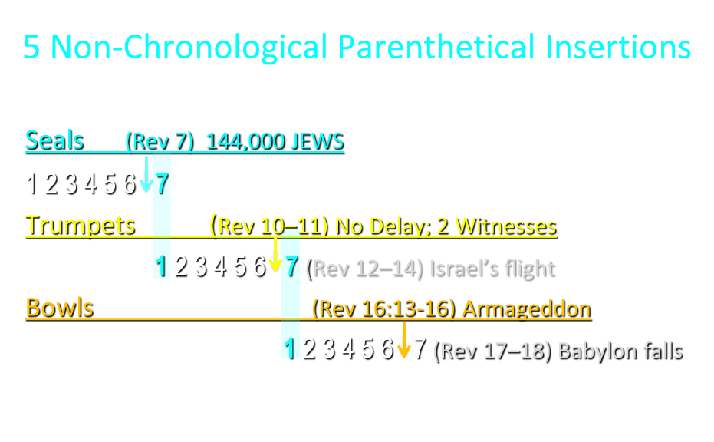

Slide 8
5 Non-Chronological Parenthetical Insertions
Rev 7 – 144,000 Jews
Rev 10:1-11:13 – Announcement of no more delay and the two witnesses
Rev 12-14 – Israel’s flight, two beasts, six scenes of hope
Rev 16:13-16 – Gathering of the nations to Armageddon
Rev 17:1-19:6 – Babylon’s fall

Slide 9
5 Non-Chronological Parenthetical Insertions
Rev 7 – 144,000 Jews
Rev 10:1-11:13 – Announcement of no more delay and the two witnesses
Rev 12-14 – Israel’s flight, two beasts, six scenes of hope
Rev 16:13-16 – Gathering of the nations to Armageddon
Rev 17:1-19:6 – Babylon’s fall

Slide 10
Revelation 12‒14
Rev 12 – Israel’s flight
Rev 13 – Two beasts
Rev 14 – Six scenes of hope

Slide 11
Revelation 12‒14
Rev 12 – Israel’s flight
Rev 13 – Two beasts
Rev 14 – Six scenes of hope

Slide 12
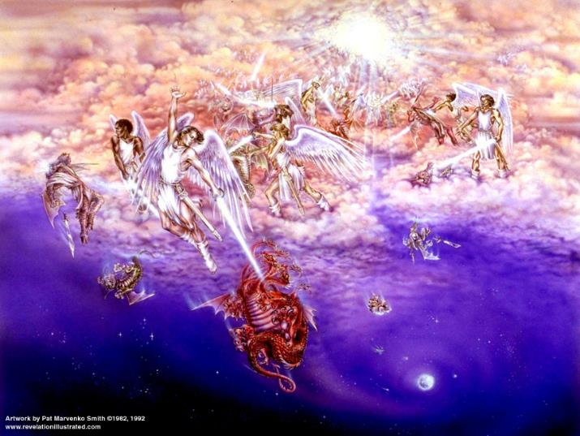
WHAT MOTIVATES ANTI-SEMITISM?
Fallen angelic world

Slide 13

Biblical Reality of the Angelic World
Job 1:12
2 Kings 6:15-17
1 Chron 21:1
Dan 10:12-13, 20
Matt 16:21-23
Luke 22:31-32
Eph 6:12

Slide 14
2 Corinthians 2:11
“so that no advantage would be taken of us by Satan, for we are not ignorant of his schemes.”

Slide 15
Ezekiel 28:17
“Your heart was lifted up because of your beauty; You corrupted your wisdom by reason of your splendor.”

Slide 16

Satan’s Two Strategies
Rev 12:1-5 – Past failed strategy
Rev 12:6-17 – Present & future strategy

Slide 17
Satan’s Two Strategies
Rev 12:1-5 – Past failed strategy
Rev 12:6-17 – Present & future strategy

Slide 18

Revelation 12:1-5
And a great sign appeared in heaven: a woman clothed in the sun, and the moon under her feet, and upon her head a crown of twelve stars; ²and she was with child; and she cried out, being in labor pain to give birth. ³And another sign was seen in heaven: and behold, a great red dragon, having seven heads and ten horns, and upon his heads seven diadems ⁴And his tail swept a third…

Slide 19
Revelation 12:1-5 (cont’d)
…a third part of the stars of heaven, and did cast them to the earth: and the dragon stood before the woman that is about to give birth, so that when she gave birth he may devour her child. ⁵And she gave birth to a son, a man child, who is to rule all the nations with a rod of iron: and her child was caught up unto God, and to his throne.

Slide 20
Revelation 12:1-5
And a great sign (sēmeion) appeared in heaven: a woman clothed in the sun, and the moon under her feet, and upon her head a crown of twelve stars; ²and she was with child; and she cried out, being in labor pain to give birth. ³And another sign (sēmeion) was seen in heaven: and behold, a great red dragon, having seven heads and ten horns, and upon his heads seven diadems…

Slide 21
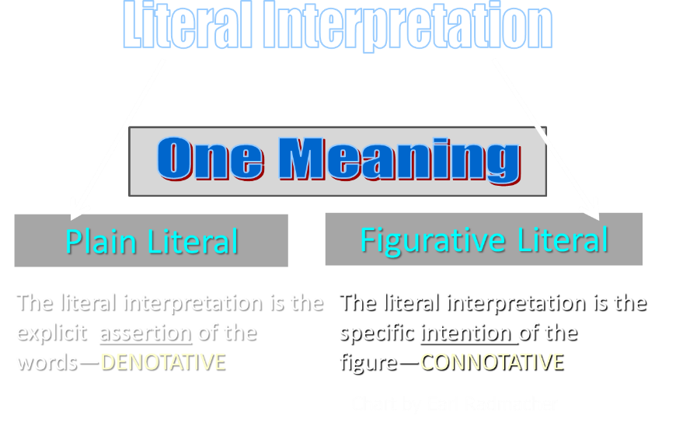

Slide 22
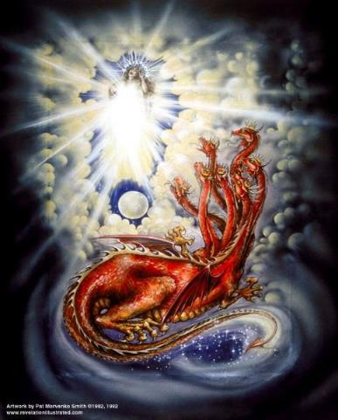
CAST OF 3 CHARACTERS
Revelation 12:1-5
SON (v.5)
DRAGON (v. 3)
WOMAN (v.1)

Slide 23
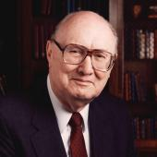
Two Rules of Interpretation
Search the immediate context
  Walvoord: 26X
Search the remote context
  Old Testament
  Thomas: 278 / 404 verses

Slide 24
CAST OF 3 CHARACTERS
Revelation 12:1-5
SON = MESSIAH
  Ps. 2:9; Acts 1:9
DRAGON = SATAN
  Rev. 12:9; 20:2
WOMAN = ISRAEL
  Gen. 37:9-10

Slide 25

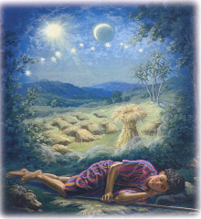
Genesis 37:9
Now he had still another dream, and related it to his brothers, and said, “Lo, I have had still another dream; and behold, the sun and the moon and eleven stars were bowing down to me.

Slide 26

Genesis 37:10
He related it to his father and to his brothers; and his father rebuked him and said to him, “What is this dream that you have had? Shall I and your mother and your brothers actually come to bow ourselves down before you to the ground?”

Slide 27

Sun = Jacob
Moon = Leah
11 Stars = Joseph’s brothers
12th Star = Joseph
12 Stars = Israel’s twelve tribes

Slide 28

Morris
The Revelation Record, 323
“At the very least, it would be confusing to John’s first century readers, as well as to later generations, for him to write so much about Babylon when he really meant Rome (Paul was not afraid to speak directly against Rome in his writings, so why should John be?) or ‘the false church’ (all the apostles , including John, wrote plainly and scathingly about false teachers and false doctrines in the church and would not hide their teachings by symbols). It must be stressed that Revelation means ‘unveiling,’ not ‘veiling.’ In the absence of any statement in the text to the contrary, therefore, we must assume that the term Babylon applies to the real city of Babylon…”

Slide 29
Revelation 1:1
“The Revelation [apokalypsis] of Jesus Christ, which God gave Him to show to His bond-servants, the things which must soon take place; and He sent and communicated it by His angel to His bond-servant John.”

Slide 30
Revelation 12:1-5 (cont’d)
…a third part of the stars of heaven, and did cast them to the earth: and the dragon stood before the woman that is about to give birth, so that when she gave birth he may devour her child. ⁵And she gave birth to a son, a man child, who is to rule all the nations with a rod of iron: and her child was caught up unto God, and to his throne.

Slide 31
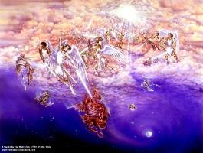
Different Perspectives – Same Event
Matt 2 – Physical World
Rev 12:1-5 – Spiritual World

Slide 32


Genesis 3:15
“And I will put enmity between you and the woman, and between your seed and her seed; He shall bruise you on the head, and you shall bruise him on the heel.”

Slide 33
Ezekiel 28:17
“Your heart was lifted up because of your beauty; You corrupted your wisdom by reason of your splendor.”

Slide 34
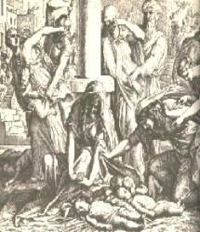
Satanic Attempts to Stop Messiah
Cain; Gen. 4, 1 Jn. 3:12
Sons of God; Gen. 6:1-4
Pharaoh; Ex. 1
Athaliah; 2 Chron. 22
Haman; Esther
Matt 4:5-7; John 8:59
Herod; Mt.2

Slide 35
Revelation 11:15
“Then the seventh angel sounded; and there were loud voices in heaven, saying, ‘The kingdom of the world has become the kingdom of our Lord and of His Christ; and He will reign (basileuō) forever and ever.’” (cf. Matt. 6:10)

Slide 36
Satan’s Two Strategies
Rev 12:1-5 – Past failed strategy
Rev 12:6-17 – Present & future strategy

Slide 37

“The Lord bless you and keep you; the Lord make his face shine on you and be gracious to you; the Lord turn his face toward you and give you peace.” (NIV)

Slide 38
WHAT MOTIVATES ANTI-SEMITISM?
Fallen angelic world

Slide 39
Biblical Reality of the Angelic World
Job 1:12
2 Kings 6:15-17
1 Chron 21:1
Dan 10:12-13, 20
Matt 16:21-23
Eph 6:12

Slide 40
Satan as Ruler of this World
Job 1:7; 2:2
Luke 4:5-7
John 12:31; 14:30; 16:11
2 Corinthians 4:4
Ephesians 2:2
1 John 4:4; 5:19

Slide 41

Names & Titles Demonstrating Satan’s Post-Fall, Earthly Authority
(Job 1:7; 2:2; Luke 4:5-8; Rom. 8:19-22)
Prince of this world (John 12:31; 14:30; 16:11)
God of this age (2 Cor. 4:4)
Prince and power of the air (Eph. 2:2)
Who the believer wrestles with (Eph. 6:12)
Roaring lion (1 Pet. 5:8)
Whole world lies in his power (1 John 5:19)

Slide 42
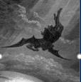
Satan’s Progressive Defeat
Initial eviction from heaven (Isa 14:12-15; Ezek 28:12-17)
Eden (Gen 3:15)
Pre-diluvian world (1 Pet 3:19-20)
Cross (John 12:31; 16:11; Col 2:15; Heb 2:14; 1 John 3:8)
Mid point of the Tribulation (Rev 12:9)
Beginning of millennium (Rev 20:2-3)
End of millennium (Rev 20:10)

Slide 43
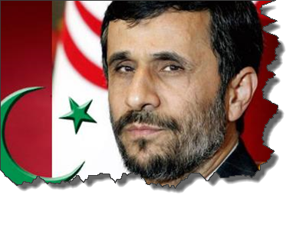
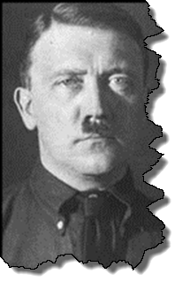
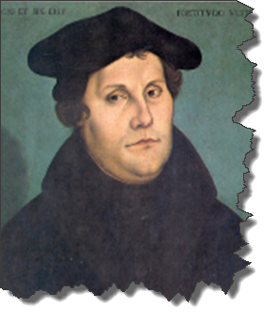
MODERN TRENDS IN ANTISEMITISM
Revelation 12

Slide 44

Christian Anti-Semitism
  “First, their synagogues should be set on fire…Secondly, their homes should likewise be broken down and destroyed…Thirdly, they should be deprived of their prayer books and Talmuds…”

Slide 45
Christian Anti-Semitism
  “…Fourthly, their rabbis must be forbidden under threat of death to teach any more…Fifthly, passport and traveling privileges should be absolutely forbidden to the Jews…Sixthly, they ought to be stopped from usury (charging interest on loans…”

Slide 46
Christian Anti-Semitism
“Seventhly, let the young and strong Jews and Jewesses be given the flail, the ax, the hoe, the spade, the distaff, and spindle, and let the earn their bread by the sweat of their noses…We ought to drive the rascally lazy bones out of our system...”
Martin Luther, Concerning the Jews and Their Lies, cited in Michael Brown’s Our Hands Are Stained with Blood, pp. 14-15.

Slide 47
Christian Anti-Semitism
“…Therefore away with them… To sum up, dear princes and nobles who have Jews in your domains, if this advice of mine does not suit you, then find a better one so that you and we may all be free of this insufferable devilish burden–the Jews.”
Martin Luther, Concerning the Jews and Their Lies, cited in Michael Brown’s Our Hands Are Stained with Blood, pp. 14-15.

Slide 48

John Calvin
Commentary on the Prophet Daniel (Vol 1, p. 185). Bellingham, WA: Logos Bible Software. Commentary on Daniel 2:44-45. (2010).
  “But here he [the rabbi] not only betrays his ignorance, but his utter stupidity, since God so blinded the whole people that they were like restive dogs. I have had much conversation with many Jews: I have never seen either a drop of piety or a grain of truth or ingenuousness—nay, I have never found common sense in any Jew. But this fellow, who seems so sharp and ingenious, displays his own impudence to his great disgrace.”

Slide 49

Genesis 12:3
“And I will bless those who bless you, And the one who curses you I will curse. And in you all the families of the earth will be blessed.”

Slide 50
Genesis 12:3
“And I will bless those who bless you, And the one who curses you I will curse. And in you all the families of the earth will be blessed.”

Slide 51
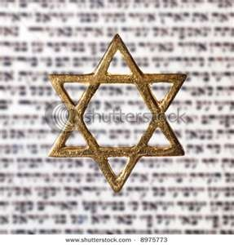
Israel’s Three Blessings to the World
(Gen 12:3b)
Scripture (Rom 3:2)
Savior (John 4:22)
Kingdom (Isa 2:2-3)

Slide 52
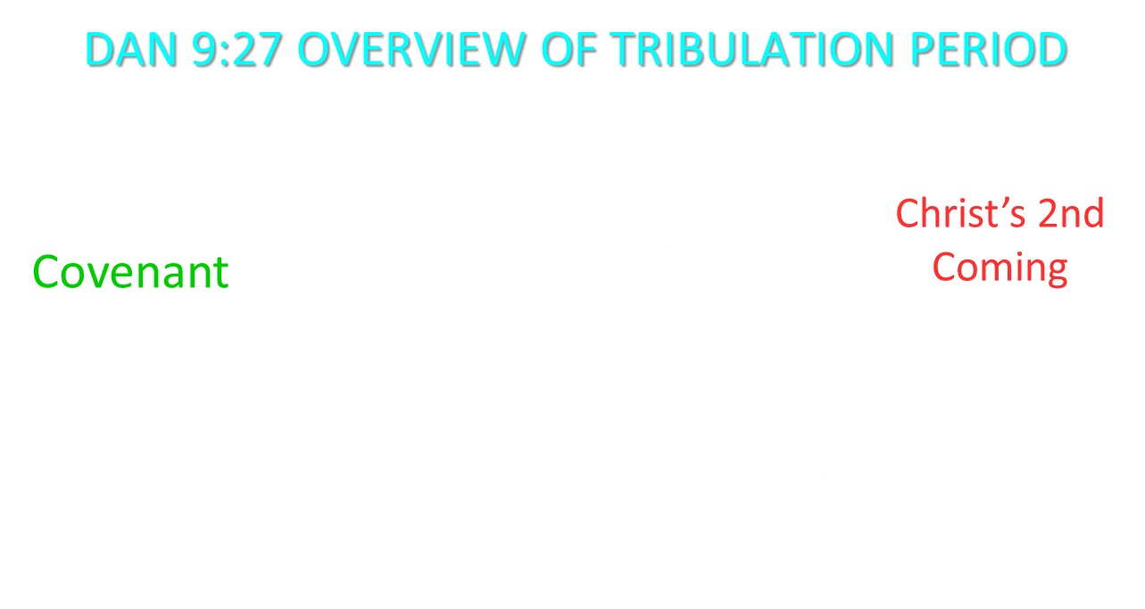

Slide 53
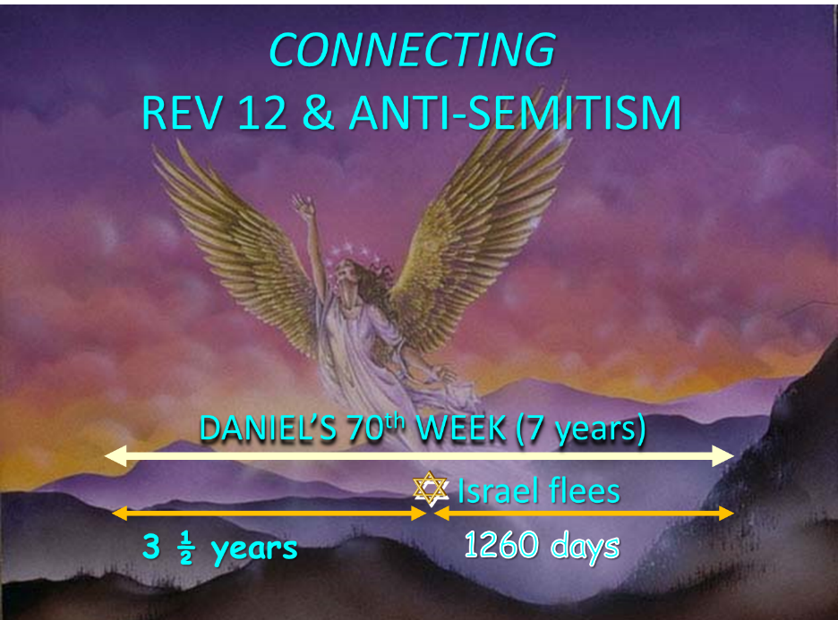

Slide 54
Different Perspectives – Same Event
Matt 24:15-22 – Physical World
Rev 12:6-17 – Spiritual World

Slide 55
Different Perspectives – Same Event
Matt 2 – Physical World
Rev 12:1-5 – Spiritual World

Slide 56
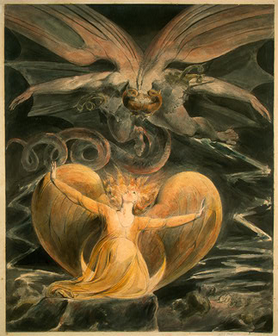
2 CYCLES OF SATANIC PERSECUTION
“Pursues the woman” = persecution of Israel 12:13-14
“Flood from his mouth” = tries to destroy Israel 12:15-16

Slide 57
2 CYCLES OF SATANIC PERSECUTION
“Pursues the woman” = persecution of Israel 12:13-14
“Flood from his mouth” = tries to destroy Israel 12:15-16

Slide 58
Two Rules of Interpretation
Search the immediate context
  Walvoord: 26X
Search the remote context
  Old Testament
  Thomas: 278 / 404 verses

Slide 59
2 CYCLES OF SATANIC PERSECUTION
“Pursues the woman” = persecution of Israel 12:13-14
“Flood from his mouth” = tries to destroy Israel 12:15-16

Slide 60
Descriptions of Satanic Hatred
Wrath 12:12
Persecution 12:13
Sweep away 12:15
Enraged 12:17
War 12:17

Slide 61
How Israel Has Blessed the World
(Gen 12:3; Rom 9:4-5)
Patriarchs
Law
Prophets
Messiah (John 4:22; Rom 9:5)
Apostles
Biblical writers
Early church
Early Christian martyrs
Paul
Future kingdom

Slide 62
Matthew 23:37-39
³⁷ “Jerusalem, Jerusalem, who kills the prophets and stones those who are sent to her! How often I wanted to gather your children together, the way a hen gathers her chicks under her wings, and you were unwilling. ³⁸ Behold, your house is being left to you desolate! ³⁹ For I say to you, from now on you will not see Me until you say, ‘Blessed is He who comes in the name of the Lord!’”

Slide 63
Conclusion

Slide 64
CONCLUSION
Recognize Anti-Semitism and its source
Do not take part
Expose it (Eph 5:11)
Do not be surprised by it

Slide 65
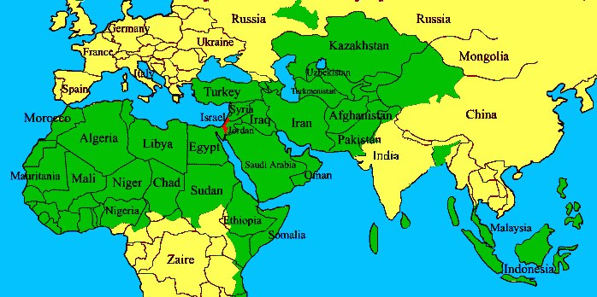

Slide 66
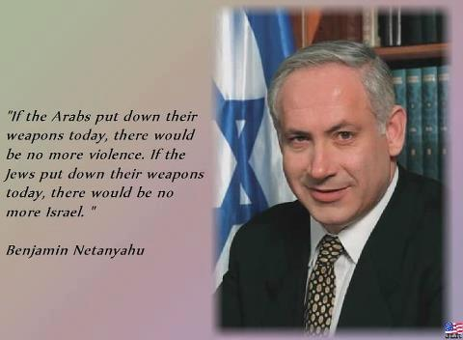

Slide 67
“The Lord bless you and keep you; the Lord make his face shine on you and be gracious to you; the Lord turn his face toward you and give you peace.” (NIV)

