Slide 1
ISRAEL 2019
ANDY WOODS
Part 5

Slide 2
Tel Aviv, Joppa, Caesarea Maritma,
Mt. Carmel, Megiddo
Part 1

Slide 3
Sepphoris, Upper Galilee/Caesarea-Philippi andTel Dan, Sea of Galilee, Mt. of Beatitudes
Part 2

Slide 4
Capernaum, Tabgha
Part 3

Slide 5
Jordan River, Bet She 'An, Jericho, Dead Sea, Masada
Part 4

Slide 6
Qumran, En Gedi, Jerusalem –Mt. of Olives, Garden of Gethsemane, Southern Steps
Part 5

Slide 7
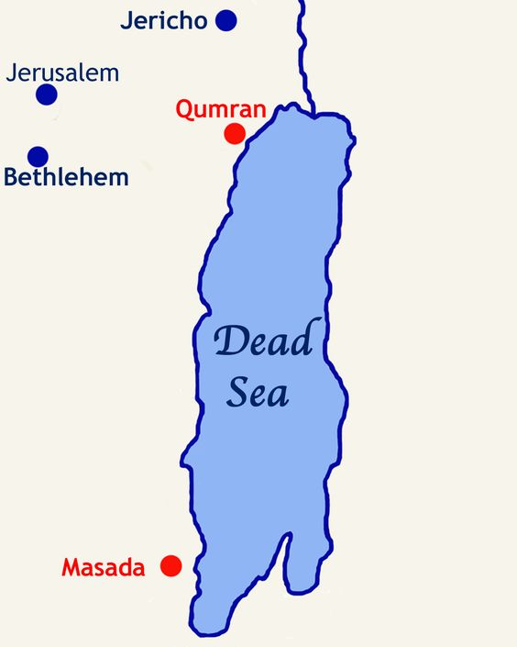

Slide 8
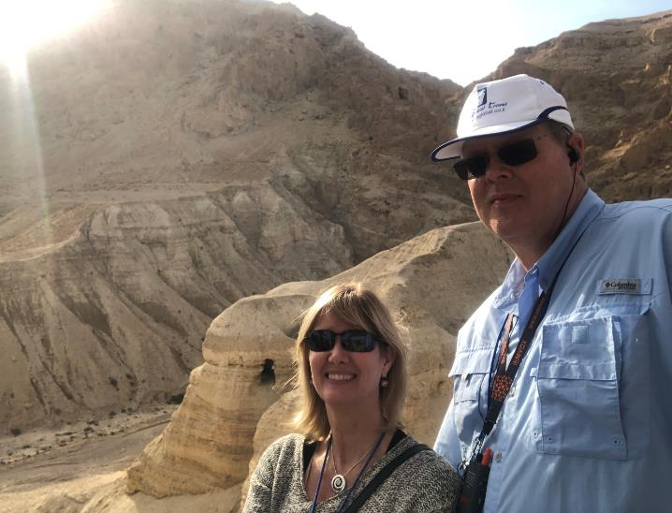
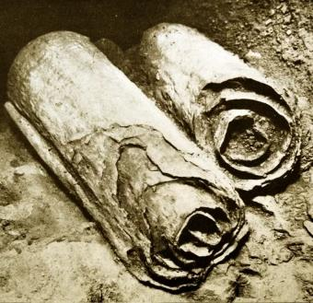
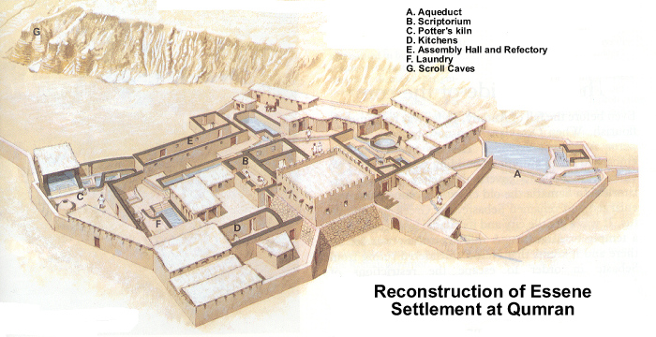
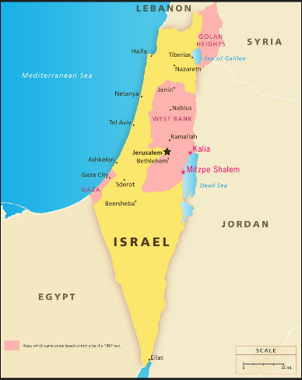
Qumran
Dead Sea Scrolls

Slide 9
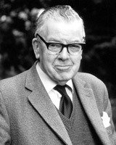
F.F. Bruce
F.F. Bruce, The Books and the Parchments, 117.
“The Masoretes were well disciplined and treated the text with the greatest imaginable reverence, and devised a complicated system of safeguards against scribal slips. They counted, for example, the number of times each letter of the alphabet occurs in each book; they pointed out the middle letter of the Pentateuch and the middle letter of the whole Hebrew Bible, and made even more detailed calculations than these. ‘Everything countable seems to be counted,’ says Wheeler Robinson, and they made up mnemonics by which the various totals might be readily remembered.”

Slide 11
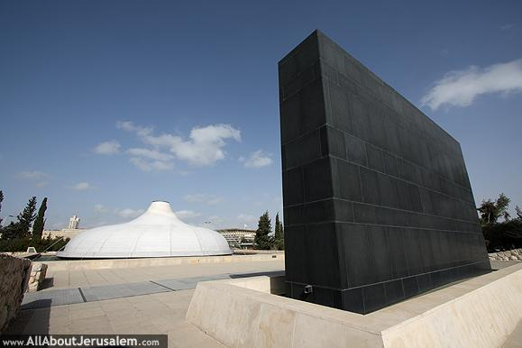
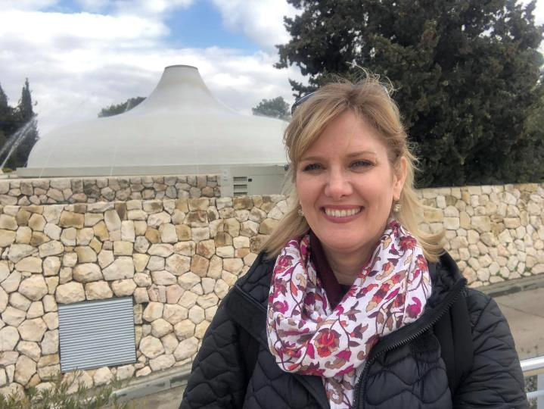
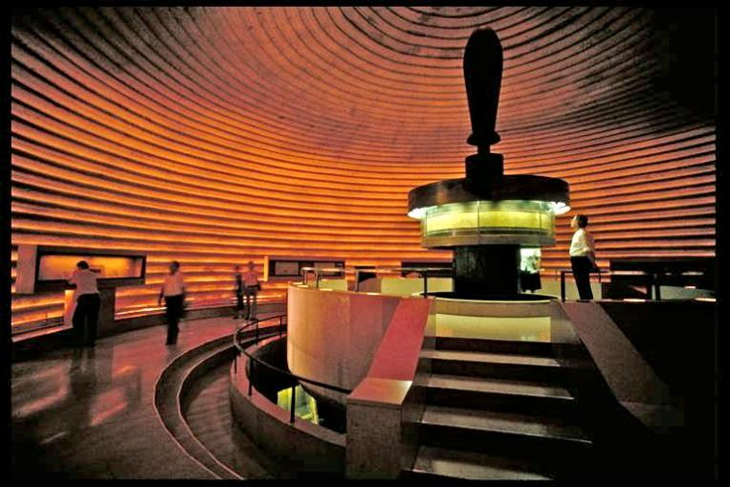
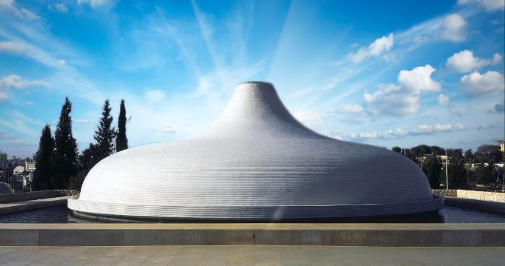

Slide 13
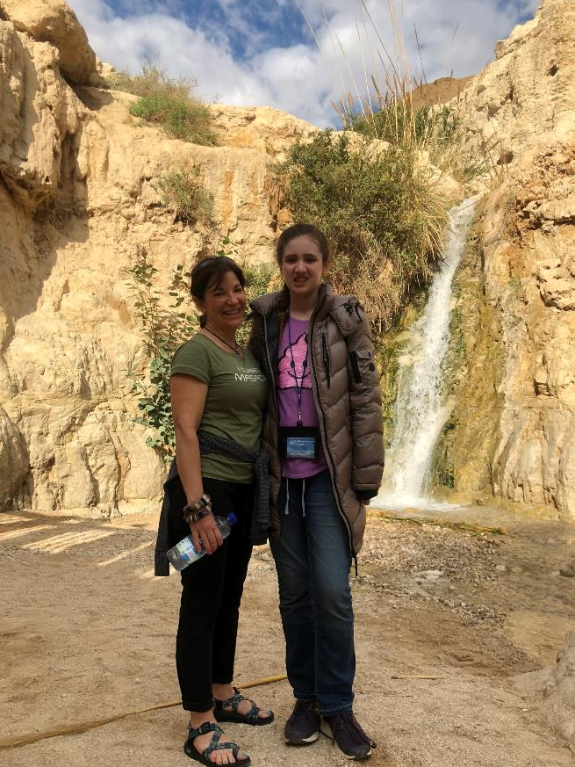
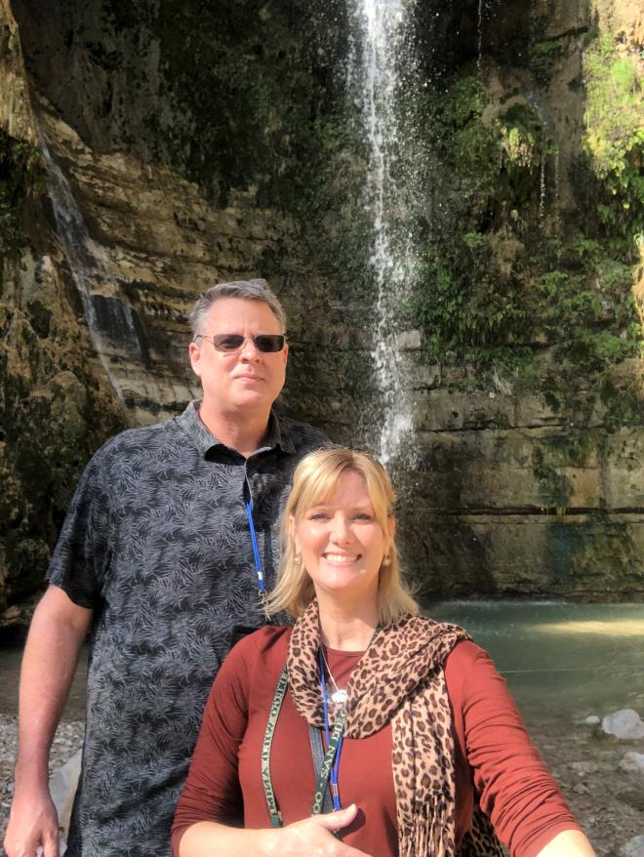
En Gedi

Slide 14
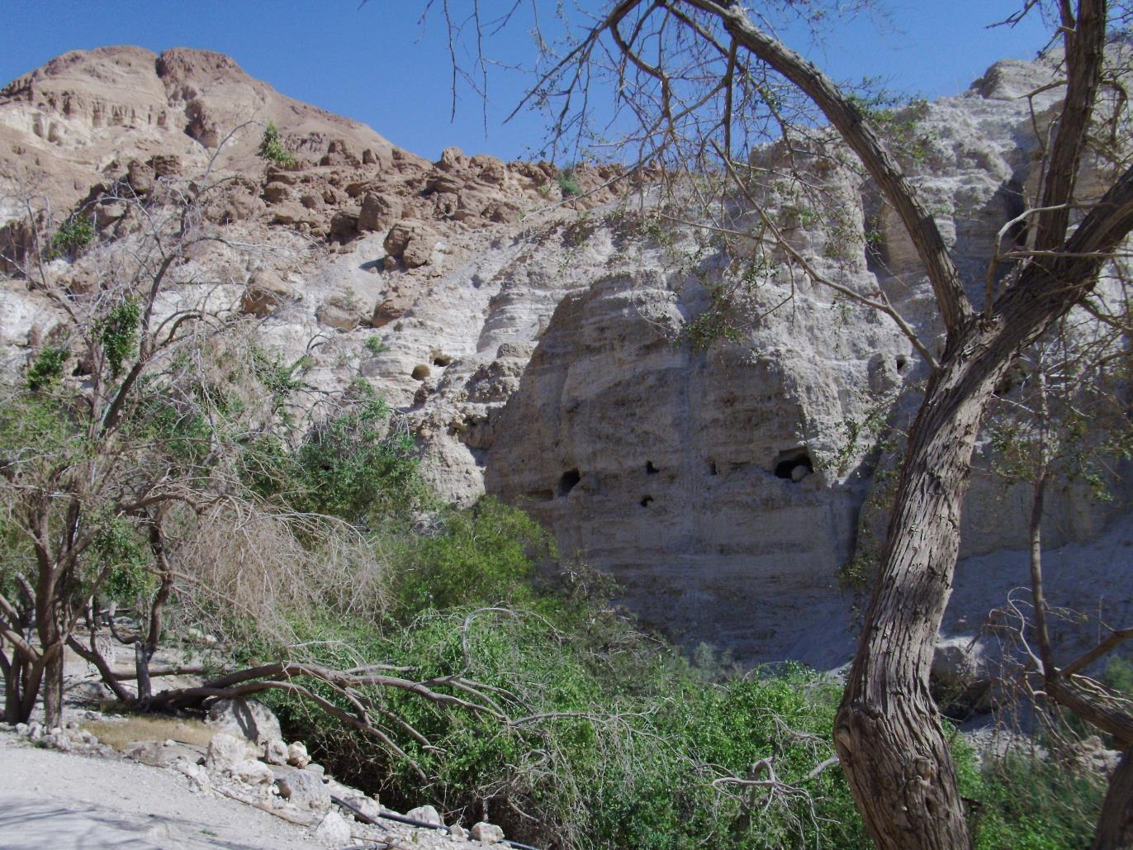

Slide 15
Parallels | Davidic | Jesus
Anointing: | 1 Sam. 16 | Acts 2:33-35
Inauguration: | 2 Sam. 5 | Matt. 25:31
Usurper: | Saul | Satan
Interim: | 1 Sam. 24; 26 | 1 John 5:19
Choice (sight v. faith): | Saul v. David | Satan v. Jesus
Majority v. Minority | David’s Men | Matt. 7:13-14

Slide 17
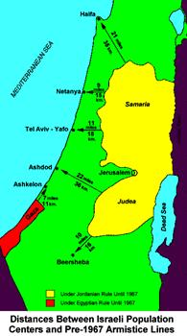

Slide 19
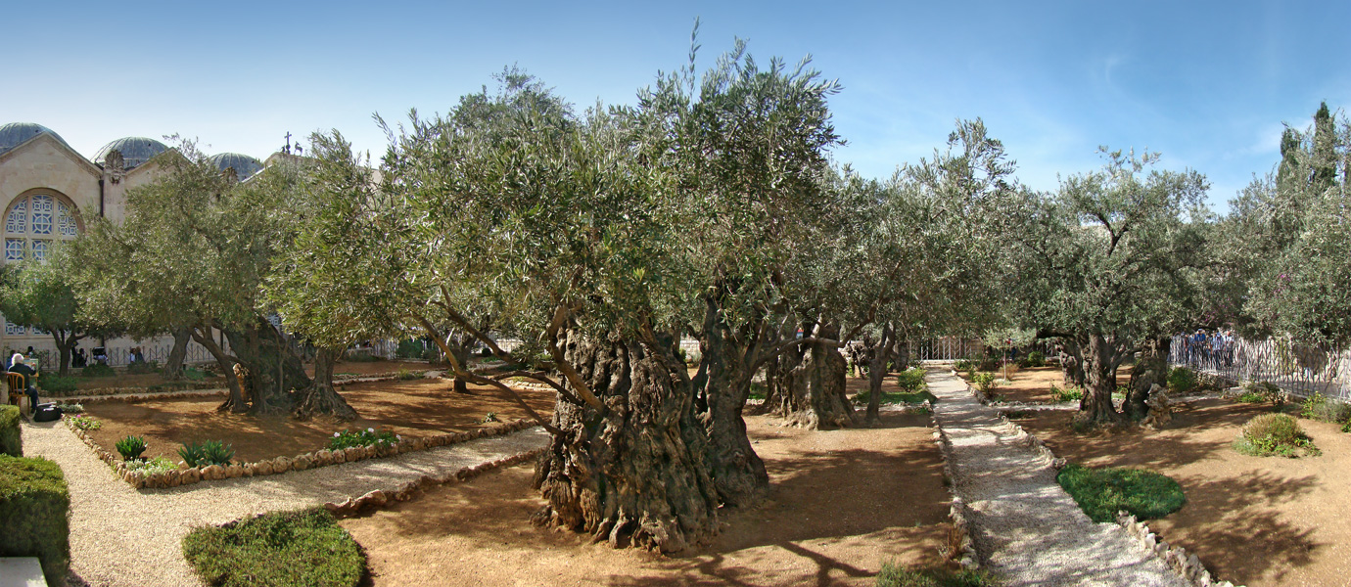
Mt. of Olives

Slide 20
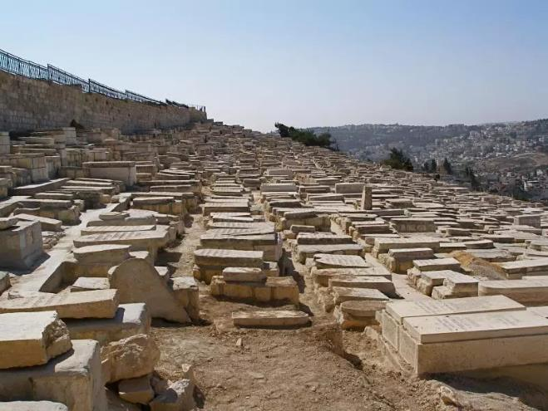
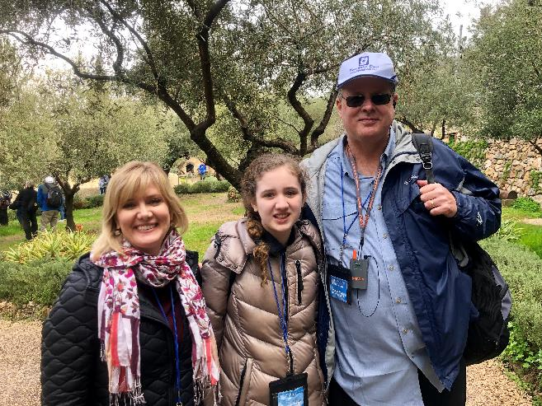
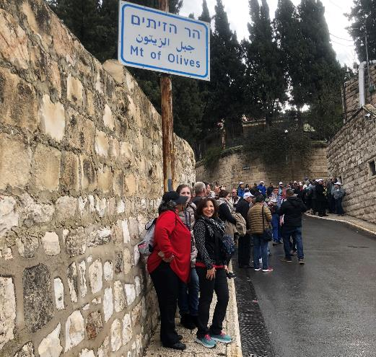
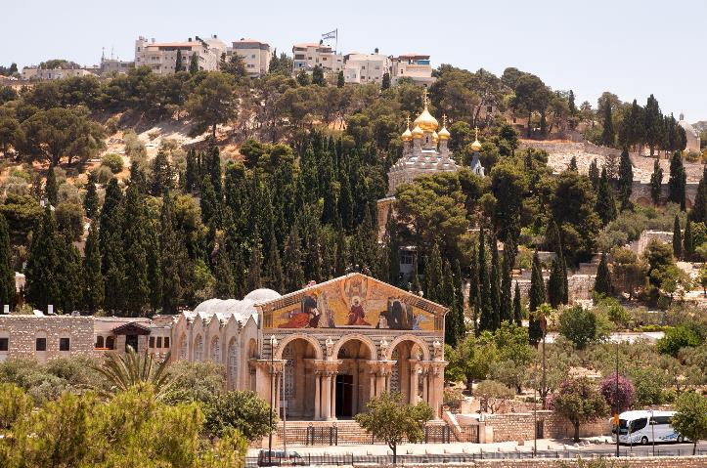
Mt of Olives

Slide 21
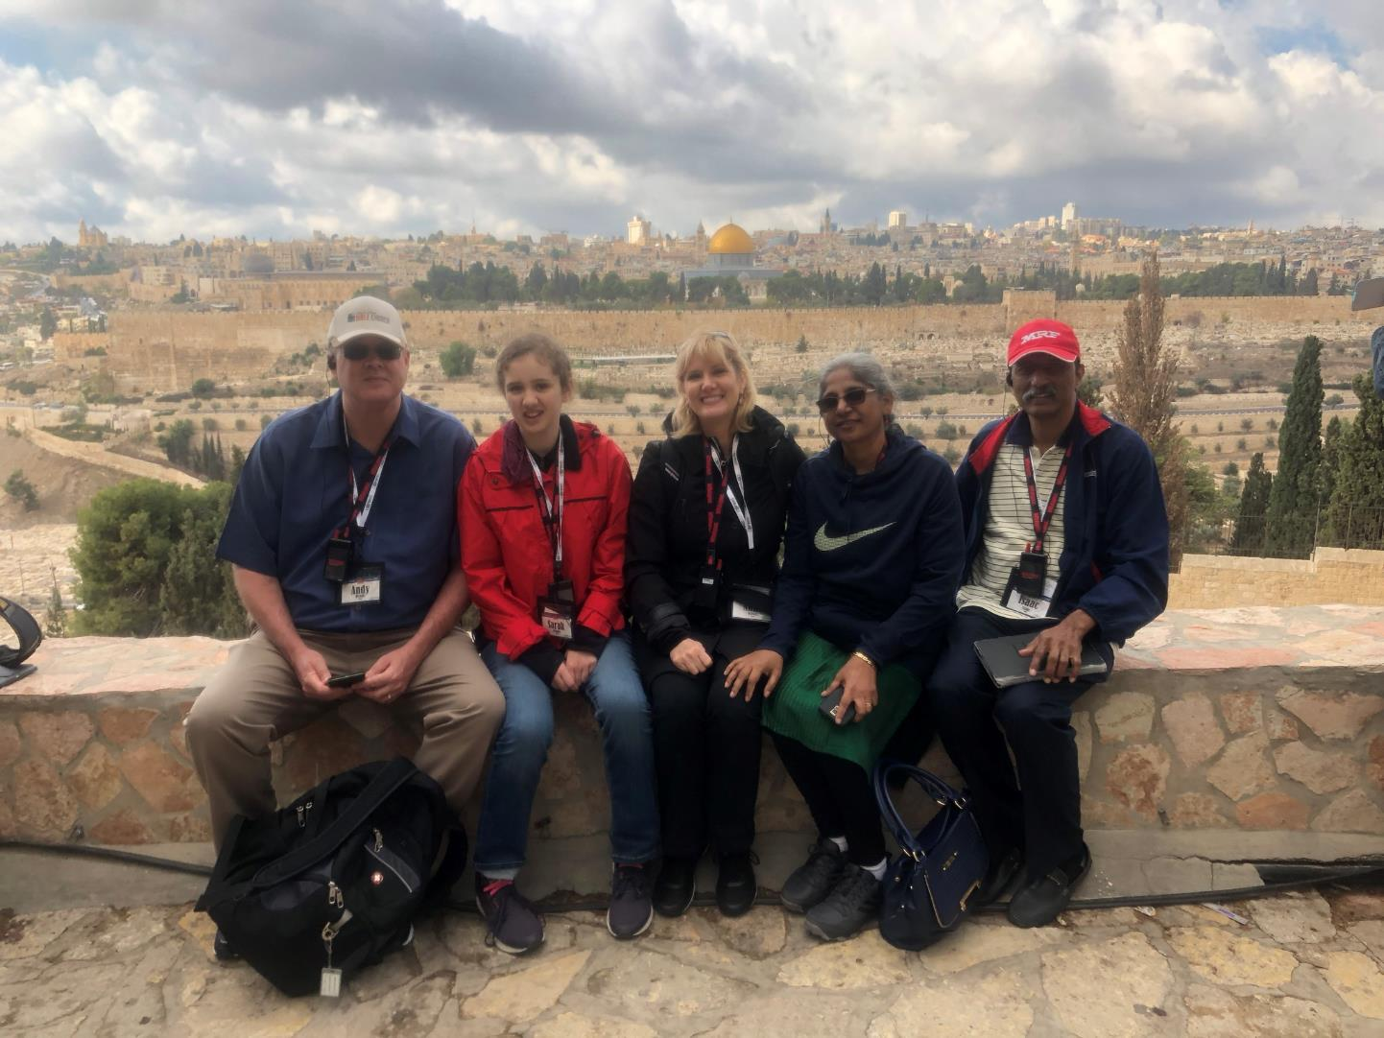

Slide 22
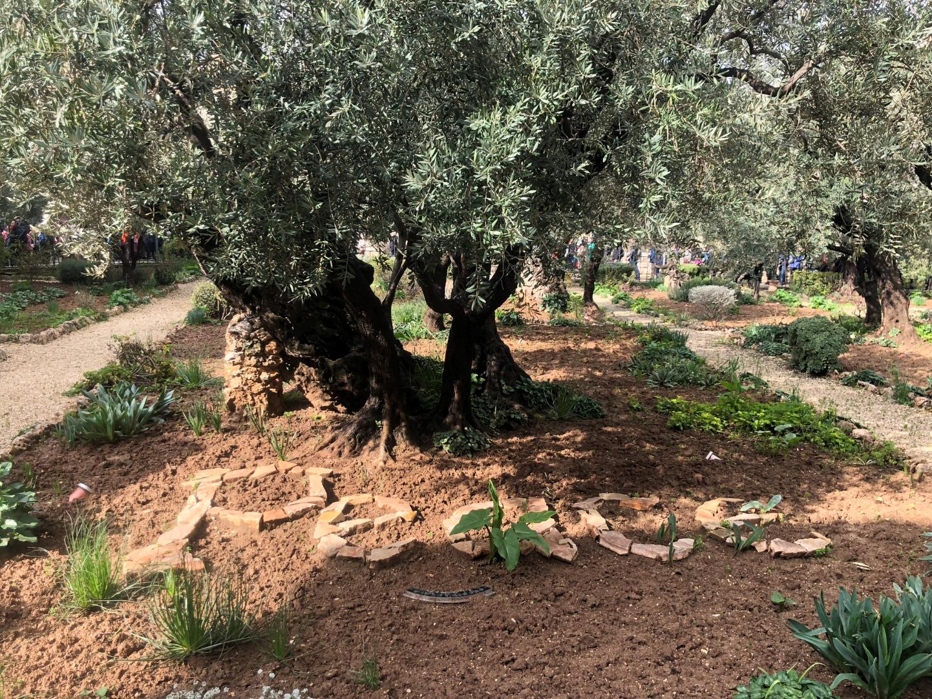
Gethsemane

Slide 23
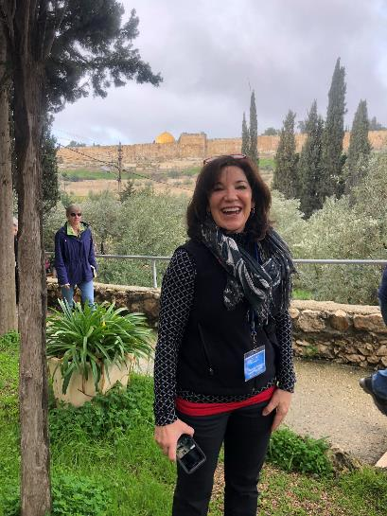
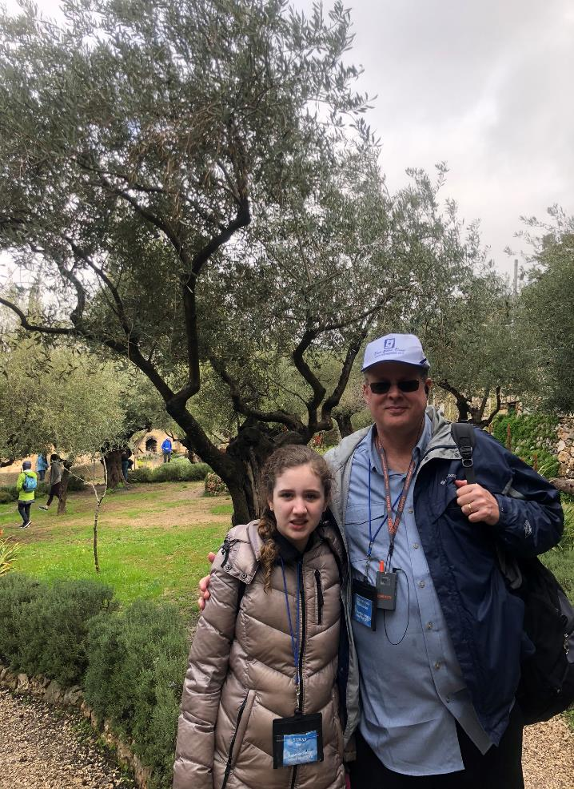
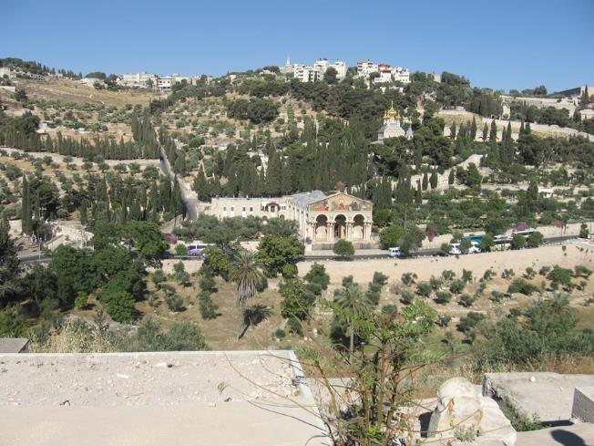

Slide 24
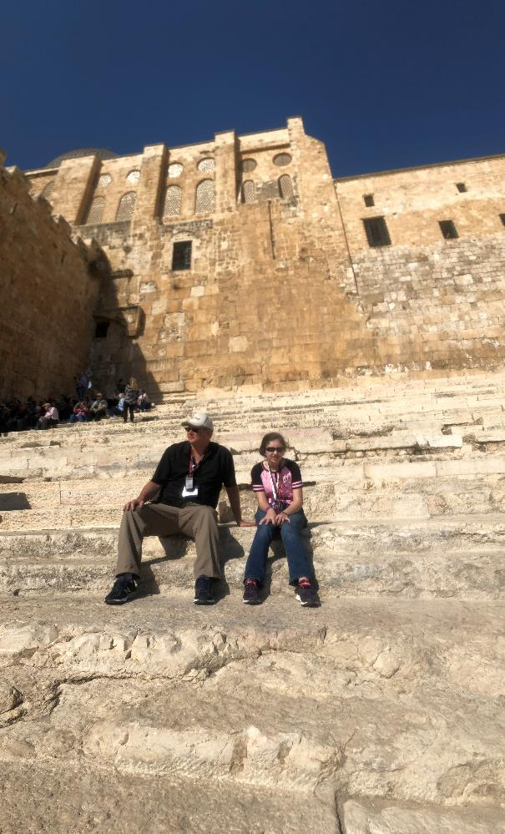
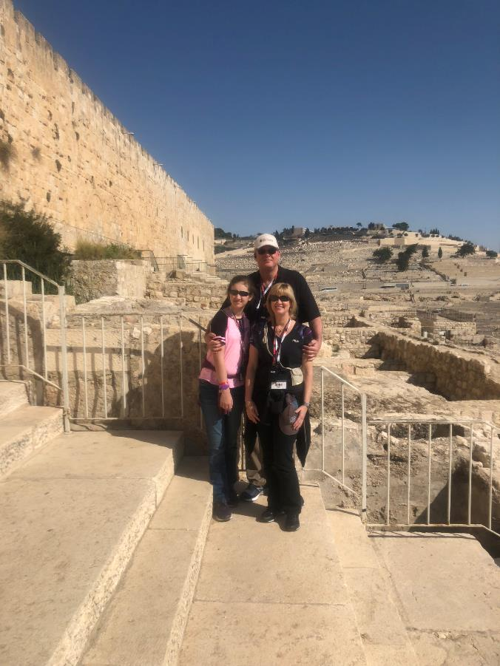
Southern Steps

Slide 25
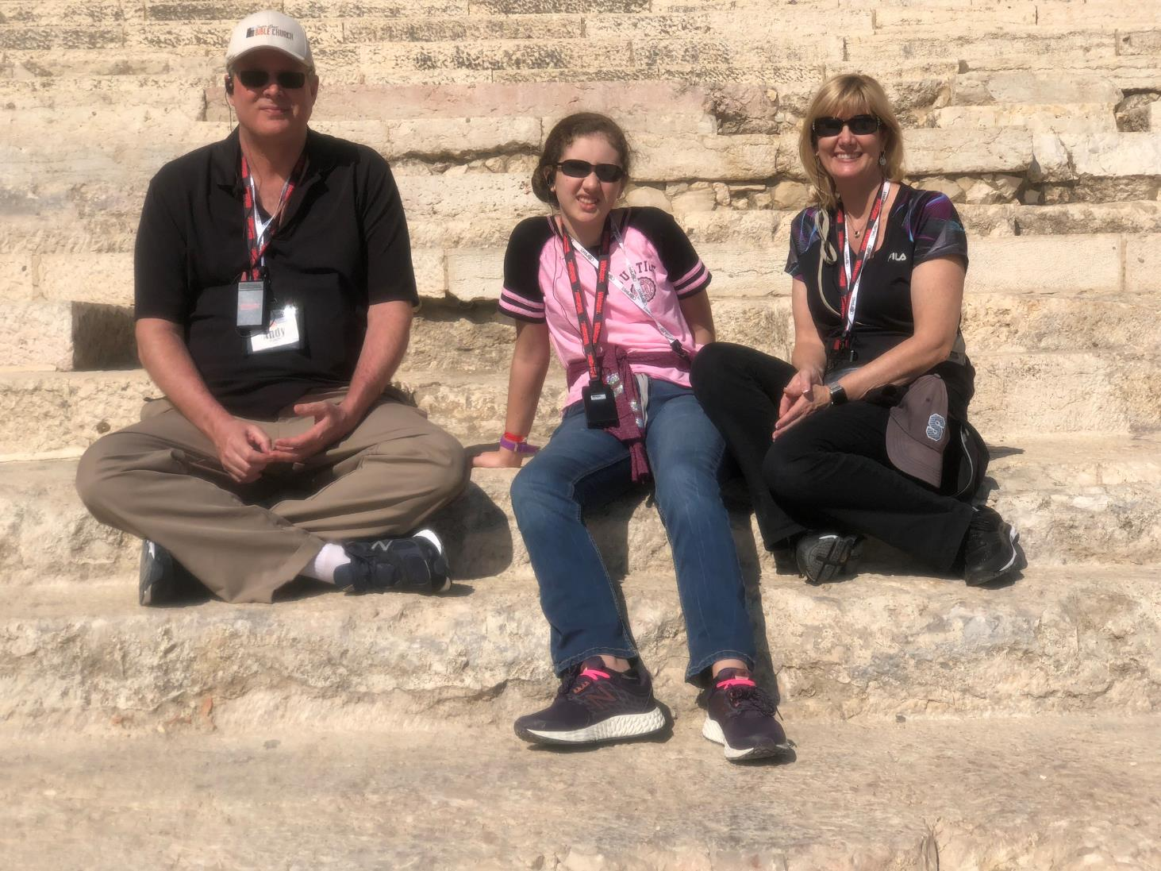

Slide 26
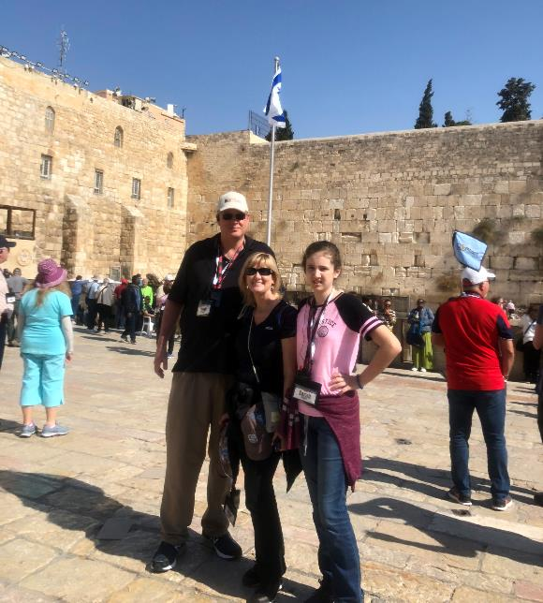
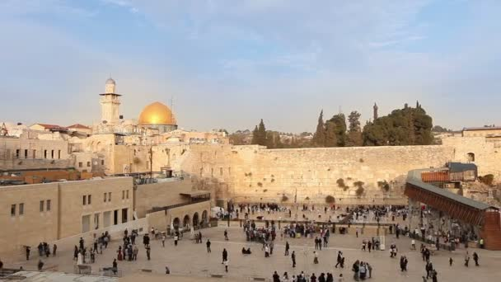
Western Wall

