Slide 1
Biblical Dispensationalism
Jim McGowan, MTS, Th.D.

Slide 3
Biblical Dispensationalism
Session 6
History of Biblical Dispensationalism

Slide 4
Overview
The Early Church
The Alexandrian Abdication
The Dark Ages
Positive Contributions of the Reformers
THE REFORMERS’ INCOMPLETE REFORMS
Contemporary Reformation Theology
Dispensationalism's Contribution
Notes:
Outline

Slide 5
V. The Reformers’ Incomplete Reforms
Selective literalism
“Irresponsibly” dealt with eschatology
Retained and Perpetuated Augustinian Amillennialism
Perpetuated Roman Catholicism’s Errors
Wanted to ‘reform’ not leave the Church
Infant baptism
Consubstantiation
Church = the earthly kingdom
Anti-Semitism
Notes:
Outline

Slide 6
The Reformers’ Report Card
‘A+’ – because they laid the groundwork for future generations by providing the right method whereby future generations could continue to reform the church through a consistent application of the Reformers’ interpretive approach.
‘F’ – because they did not make a clean break with the Roman Catholic Church and forced a ‘selective’ literal approach to Scripture upon the Protestant Church.

Slide 7
Overview
The Early Church
The Alexandrian Abdication
The Dark Ages
Positive Contributions Of The Reformers
The Reformers’ Incomplete Reforms
CONTEMPORARY REFORMATION THEOLOGY
Dispensationalism's Contribution
Notes:
Outline

Slide 8
VI. Contemporary Reformation Theology
Erroneously assumes no further theological progress to be made.
Has Frozen theological progress into creeds and confessions: Creeds and confessions = authority rather than Scripture.
Augustinian Amillennialism fossilized into RT.
Allegorizing of biblical Eschatological texts is common.
Zech. 14:4; Rev. 21-22; Ezek. 40-48
Inconsistent literal hermeneutic.
Notes:
Outline

Slide 9
The Contemporary Reformation’s Report Card
‘F’ – because they, like the early reformers, have not made a clean break with the Roman Catholic Church and they continue to force a ‘selective’ literal approach to Scripture upon the Protestant Church.

Slide 11
Biblical Dispensationalism
Session 7
History of Biblical Dispensationalism

Slide 12
Overview
The Early Church
The Alexandrian Abdication
The Dark Ages
Positive Contributions Of The Reformers
The Reformers’ Incomplete Reforms
Contemporary Reformation Theology
DISPENSATIONALISM'S CONTRIBUTION
Notes:
Outline

Slide 13
VII. Dispensationalism's Contribution
Dispensational movement
Dispensational Systematized in 19th century
Key Dispensational Leaders
Reformers’ hermeneutic applied to the whole bible
Retrieved key doctrines: Chiliasm, Israel-church distinction, Pretribulationalism
Notes:
Outline

Slide 14
VII. Dispensationalism's Contribution
Dispensational movement
Dispensational Systematized in 19th century
Key Dispensational Leaders
Reformers’ hermeneutic applied to the whole bible
Retrieved key doctrines: Chiliasm, Israel-church distinction, Pretribulationalism
Notes:
Outline

Slide 15
Dispensational Theology is a System of Theology
Traditional-normative dispensational theology is a system that embodies three essential, fundamental concepts called the sine qua non (lit. “without which is not”):
The consistent use of a plain, normal, literal, grammatical-historical method of interpretation;
Which reveals that the Church is distinct from Israel;
God’s overall purpose is to bring glory to Himself (Eph. 1:6, 12, 14).
Dr. Charles Ryrie, Dispensationalism, pp. 38-41

Slide 16
VII. Dispensationalism's Contribution
Dispensational movement
Dispensational Systematized in 19th century
Key Dispensational Leaders
Reformers’ hermeneutic applied to the whole bible
Retrieved key doctrines: Chiliasm, Israel-church distinction, Pretribulationalism
Notes:
Outline

Slide 17
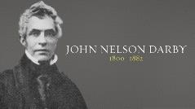
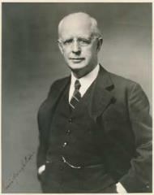
VII. Dispensationalism's Contribution
Key Dispensational Leaders
John Nelson Darby (1800–1882)
Sir Robert Anderson (1841–1918)
Cyrus Ingerson Scofield (1843–1921)
William Eugene Blackstone (1841–1935)
Henry Allen Ironside (1876–1951)
Lewis Sperry Chafer (1871–1952)

Slide 18
VII. Dispensationalism's Contribution
Key Dispensational Leaders
John Nelson Darby (1800–1882)
Sir Robert Anderson (1841–1918)
Cyrus Ingerson Scofield (1843–1921)
William Eugene Blackstone (1841–1935)
Henry Allen Ironside (1876–1951)
Lewis Sperry Chafer (1871–1952)

Slide 19
John Nelson Darby (1800–1882)
While Darby did not originate the system, he was an important figure in systematizing dispensationalism. Darby graduated from Trinity College in Dublin at age eighteen and was admitted to the bar at twenty-two. After his conversion he left his law practice and was ordained in the Church of England but eventually left the Church of England, settling in Plymouth, England. By 1840 eight hundred people were attending services together there and these believers came to be referred to, as “Plymouth Brethren.”
Darby wrote forty, 600 page volumes which demonstrated his expertise in the biblical languages, philosophy, and church history.

Slide 20
John Nelson Darby (1800–1882)
Darby advanced the scheme of dispensationalism by noting that each dispensation places man under some condition; man has some responsibility before God. Darby also noted that each dispensation culminates in failure.

Slide 21
VII. Dispensationalism's Contribution
Key Dispensational Leaders
John Nelson Darby (1800–1882)
Sir Robert Anderson (1841–1918)
Cyrus Ingerson Scofield (1843–1921)
William Eugene Blackstone (1841–1935)
Henry Allen Ironside (1876–1951)
Lewis Sperry Chafer (1871–1952)

Slide 22
Sir Robert Anderson (1841–1918)
Sir Robert Anderson was an intelligence officer, theologian and writer. He was also an investigator with Scotland Yard, who turned his investigative skills to the book of Daniel.
His book, The Coming Prince - examines the 9th chapter of Daniel, especially the 70 weeks, and the coming of the Antichrist and is one of the most exhaustive works ever written these subjects.
Anderson taught alongside of some of the greatest biblical teachers of his day, including James Martin Gray, Cyrus Scofield, and John Nelson Darby, with whom he preached in the West of Ireland.

Slide 23
VII. Dispensationalism's Contribution
Key Dispensational Leaders
John Nelson Darby (1800–1882)
Sir Robert Anderson (1841–1918)
Cyrus Ingerson Scofield (1843–1921)
William Eugene Blackstone (1841–1935)
Henry Allen Ironside (1876–1951)
Lewis Sperry Chafer (1871–1952)

Slide 24
Cyrus Ingerson Scofield (1843–1921)
Scofield was a trained lawyer and biblical scholar who, after his conversion, became associated with evangelists D. L. Moody and Robert A. Torrey.
Scofield later pastored the First Congregational Church of Dallas, Texas (now Scofield Memorial Church, founded the Central American Mission in 1890 (now Camino Global), and prepared correspondence Bible study courses which became the basis for his Scofield Reference Bible which was first published in 1909 and took the country by storm.
He also author of the pamphlet "Rightly Dividing the Word of Truth“ in 1888 which along with his Scofield Reference Bible encouraged the Bible and Prophecy Conference Movements of the early 1900s.

Slide 25
Cyrus Ingerson Scofield (1843–1921)
Among those impacted by Scofield were James H. Brookes, a Presbyterian pastor and popular conference speaker, and James M. Gray who became president of Moody Bible Institute.
Some pioneering features of the Scofield Bible include:
Commentary notes alongside the biblical text
A cross-referencing system (i.e., "chain references") that enabled the reader to trace biblical themes throughout the entire bible.
Chronological information regarding events in the Bible such as the date of Creation.
By the end of World War II, sales of the Scofield Reference Bible exceeded two million copies.

Slide 26
Cyrus Ingerson Scofield (1843–1921)
The impact of the Scofield Reference Bible cannot be ignored. No other written work has done as much to introduce and promote dispensation theology and a fuller knowledge of the Scriptures.
As a result of it’s influence, the Bible Church movement of the early 1900s was birthed which led in turn to the establishment of numerous dispensational schools, including:
Dallas Theological Seminary
Grace Theological Seminary
Talbot Theological Seminary
Western Conservative Baptist Seminary
Multnomah School of the Bible
Moody Bible Institute
Philadelphia College of the Bible, and many others.

Slide 27
VII. Dispensationalism's Contribution
Key Dispensational Leaders
John Nelson Darby (1800–1882)
Sir Robert Anderson (1841–1918)
Cyrus Ingerson Scofield (1843–1921)
William Eugene Blackstone (1841–1935)
Henry Allen Ironside (1876–1951)
Lewis Sperry Chafer (1871–1952)

Slide 28
William Eugene Blackstone (1841–1935)
William Eugene Blackstone was an American evangelist and Christian Zionist best know for authoring the Blackstone Memorial of 1891, a petition which called upon America to actively return the Holy Land to the Jewish people. In part it read:
“Why shall not the powers which under the treaty of Berlin, in 1878, gave Bulgaria to the Bulgarians and Servia to the Servians now give Palestine back to the Jews?…These provinces, as well as Romania, Montenegro, and Greece, were wrested from the Turks and given to their natural owners. Does not Israel as rightfully belong to the Jews?”
In 1878, Blackstone wrote, Jesus is Coming, which became the veritable reference source of American dispensationalist thought. Over the next 50 years, his book sold multi-millions of copies worldwide and was translated into 48 languages.
Blackstone was influenced by Dwight Lyman Moody, James H. Brookes, and John Nelson Darby.

Slide 29
William Eugene Blackstone (1841–1935)
A revised version of the Blackstone Memorial of 1891 was providentially used by God to influence President Wilson to accept and endorse American Zionism and the later British Balfour Declaration of 1917, which set the course for the establishment of the State of Israel.
Without Blackstone's lifelong efforts to build American political support and American prophetic understanding of dispensationalism and restorationism, American support for Zionism and the State of Israel might have been very different.

Slide 30
VII. Dispensationalism's Contribution
Key Dispensational Leaders
John Nelson Darby (1800–1882)
Sir Robert Anderson (1841–1918)
Cyrus Ingerson Scofield (1843–1921)
William Eugene Blackstone (1841–1935)
Henry Allen Ironside (1876–1951)
Lewis Sperry Chafer (1871–1952)

Slide 31
Henry Allen Ironside (1876–1951)
As a member of the Plymouth Brethren, Harry" Ironside was an avid dispensationalist and premillennialist who, over the course of 50 years, was one of the most prolific Bible teachers of the past century publishing over 100 books and pamphlets.
He was dedicated to the literal interpretation of prophecy and the resultant belief and hope in the pretribulational premillennial coming of Jesus Christ.
Ironside had no formal theological training having only completed the 8th grade, but his tremendous mental capacity, photographic memory and zeal for truth led DTS in 1926, to invite him to a full-time faculty position. He turned it down, but remained a regular, visiting lecturer there from 1925 to 1943.
In 1930, Wheaton College conferred upon him an honorary Doctorate degree, and in 1942 Bob Jones University did the same.

Slide 32
Henry Allen Ironside (1876–1951)
Ironside pastored for eighteen years (1930-1948) at the Moody Memorial Church in Chicago.
Along with others such as Cyrus Scofield, Ironside was influential in popularizing dispensationalism among Protestants in North America.

Slide 33
VII. Dispensationalism's Contribution
Key Dispensational Leaders
John Nelson Darby (1800–1882)
Sir Robert Anderson (1841–1918)
Cyrus Ingerson Scofield (1843–1921)
William Eugene Blackstone (1841–1935)
Henry Allen Ironside (1876–1951)
Lewis Sperry Chafer (1871–1952)

Slide 34
Lewis Sperry Chafer (1871–1952)
Chafer was raised in a Christian home. His father was a pastor, educated at Auburn Theological Seminary.
He attended Oberlin College and Conservatory of Music from 1889 to 1892 and was ordained into the gospel ministry in 1900.
From 1897-1924, Chafer along with his wife, formed a traveling evangelistic music ministry in which he sang and preached and she played the organ.
Chafer moved to East Northfield, Massachusetts, where he met Dr. C. I. Scofield who was pastor of the Congregational Church of Northfield, which had been organized by D. L. Moody. The two men became close friends and Scofield mentored Chafer until Dr. Scofield’s death in 1921.

Slide 35
Lewis Sperry Chafer (1871–1952)
In 1922, Chafer moved to Dallas, Texas, and in 1924 the Evangelical Theological College was founded (changed to DTS in 1936). Chafer served as President of the Seminary from its beginning until the time of his death in 1952.
He authored many pamphlets, magazine articles, and books, including:
True Evangelism, 1911
The Kingdom in History and Prophecy, 1915.
Salvation: A Clear Doctrinal Analysis, 1917. Reprint, 1955.
Seven Biblical Signs of the Times, 1919
He That is Spiritual, 1918. Reprint, 1967.
True Evangelism: Winning Souls by Prayer, 1919. Reprint, 1978.
Satan: His Motive and Methods, 1919. Reprint, 1964.

Slide 36
Lewis Sperry Chafer (1871–1952)
Must We Dismiss the Millennium? 1921
Grace: The Glorious Theme, 1922. Reprint, 1950.
Major Bible Themes, 1926. Reprint, 1974.
The Epistle to the Ephesians, 1935. Reprint, 1991.
Systematic Theology, 1947 (after 10 yrs. of work). Reprint, 1993.
Dr. Chafer is quoted as saying, “the very fact that I did not study a prescribed course in theology made it possible for me to approach the subject [of Systematic Theology] with an unprejudiced mind and to be concerned only with what the Bible actually teaches.”
Dr. Chafer was a premillennial, pretribulational dispensationalist. His overall theology was based on the inductive study of the entire Bible.

Slide 37
VII. Dispensationalism's Contribution
Dispensational movement
Dispensational Systematized in 19th century
Key Dispensational Leaders
Reformers’ hermeneutic applied to the whole bible
Retrieved key doctrines: Chiliasm, Israel-church distinction, Pretribulationalism
Notes:
Outline

Slide 38
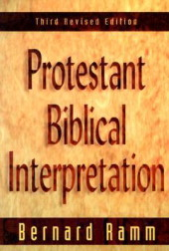
VII. Dispensationalism's Contribution
“A literal hermeneutic attaches to every word the same meaning that it would have in normal usage, whether employed in speaking, writing, or thinking.”
Bernard, Ramm, Protestant Biblical Interpretation (Boston: W.A. Wilde, 1956), 89-92.

Slide 39
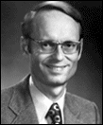
Charles Ryrie Dispensationalism (Chicago: Moody Press, 1965), 86.
Literal interpretation “…might also be called plain interpretation so that no one receives the mistaken notion that the literal principle rules out figures of speech.”

Slide 40
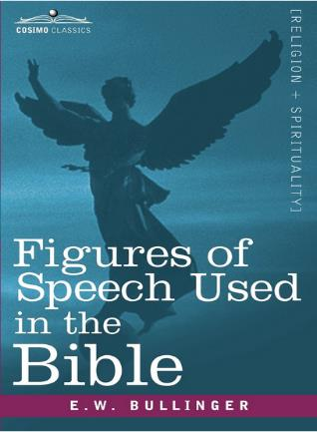
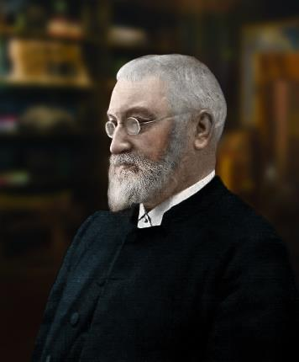
E.W. Bullinger (1837‒1913)
Bullinger clarifies 217 distinct figures of speech used in the Bible and cites nearly 8000 Bible passages, where the figures of speech are used.

Slide 41
VII. Dispensationalism's Contribution

Slide 42
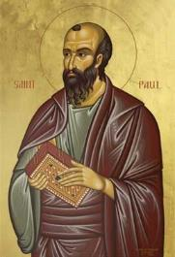
Galatians 4:24
“This is allegorically speaking, for these women are two covenants: one proceeding from Mount Sinai bearing children who are to be slaves; she is Hagar.”

Slide 43
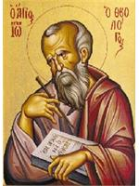
Revelation 11:8
“And their dead bodies will lie in the street of the great city which mystically is called Sodom and Egypt, where also their Lord was crucified.”

Slide 44
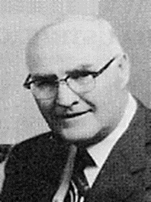
“When the plain sense of Scripture makes common sense, seek no other sense; therefore, take every word at its primary, ordinary, usual, literal meaning unless the facts of the immediate context, studied in light of related passages and axiomatic and fundamental truths, indicate clearly otherwise.”
David L. Cooper
The World’s Greatest Library Graphically Illustrated (Los Angeles: Biblical Research Society, 1970), 11.

Slide 46
VII. Dispensationalism's Contribution
Dispensational movement
Dispensational Systematized in 19th century
Key Dispensational Leaders
Reformers’ hermeneutic applied to the whole bible
Retrieved key doctrines: Chiliasm, Israel-church distinction, Pretribulationalism
Notes:
Outline

Slide 47
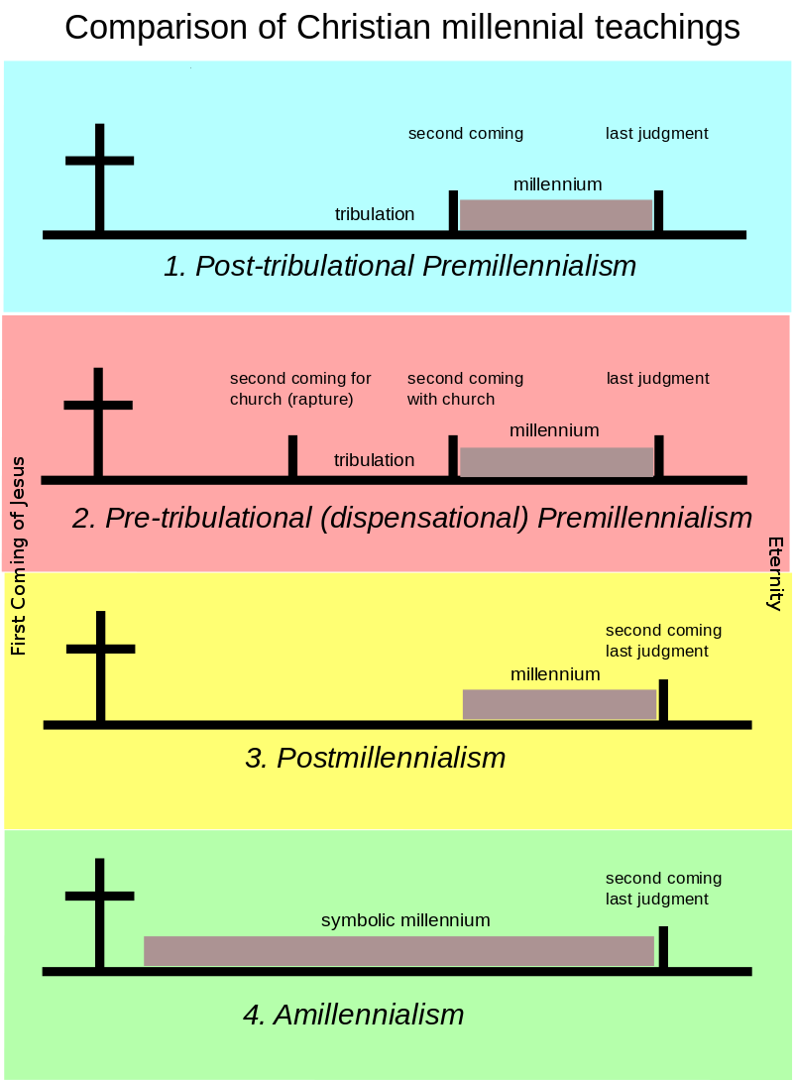
Chiliasm (Millennialism)
Chiliasm (from Greek for "a thousand years"), is the biblical doctrine that teaches Christ’s literal, physical, return to earth to reign for 1000 years (The Millennium) in Israel, on the throne of David.

Slide 48
Dispensational Theology is a System of Theology
Traditional-normative dispensational theology is a system that embodies three essential, fundamental concepts called the sine qua non (lit. “without which is not”):
The consistent use of a plain, normal, literal, grammatical-historical method of interpretation;
Which reveals that the Church is distinct from Israel;
God’s overall purpose is to bring glory to Himself (Eph. 1:6, 12, 14).
Dr. Charles Ryrie, Dispensationalism, pp. 38-41

Slide 49
Doxological Purpose
God’s ultimate purpose for the ages is to glorify Himself. Scripture is not human-centered, as though salvation were the principle point, but God-centered, because His glory is at the center.
The glory of God is the primary principle that unifies all dispensations, the program of salvation being just one of the means by which God glorifies Himself. Each successive revelation of God’s plan for the ages, as well as His dealing with the elect, non-elect, angels, and nations all manifest His glory.
Dictionary of Premillennial Theology, Charles Ryrie, p. 94

Slide 51
Israel-Church distinctions
Biblical Covenants will be fulfilled

Slide 52
Israel-Church distinctions
National Israel – Judged and Saved

Slide 53
Israel-Church distinctions
Church – Pretribulational Rapture

Slide 54
Review
The Early Church
The Alexandrian Abdication
The Dark Ages
Positive Contributions Of The Reformers
The Reformers’ Incomplete Reforms
Contemporary Reformation Theology
Dispensationalism's Contribution
Notes:
Outline

Slide 55
VII. Dispensationalism's Contribution
Dispensational movement
Dispensational Systematized in 19th century
Key Dispensational Leaders
Reformers’ hermeneutic applied to the whole bible
Retrieved key doctrines: Chiliasm, Israel-church distinction, Pretribulationalism
Notes:
Outline

Slide 56
Biblical Dispensationalism
Session 8
False Charges Against Dispensationalism

Slide 57
Resources
Alva J. McClain, Law & Grace, Moody, 1967 978-088469-001-6
Arnold H. Ehlert, “A Bibliography of Dispensationalism,” Bibliotheca Sacra (January 1944–January 1946): 101:95–101, 199–209, 319–28, 447–60; 102:84–92, 207–19, 322–34, 455–67; 103:57–67.
Charles C. Ryrie, Dispensationalism, Moody, 2007, 080242189X
Christopher Cone, gen. ed., Dispensationalism Tomorrow & Beyond, Tyndale Seminary Press, 2008 9780981479101
Christopher Cone, gen. ed., An Introduction To The New Covenant, Tyndale Seminary Press, 2013, 9781938484100
Walvoord, J. F., The Prophecy Knowledge Handbook. Wheaton, IL: Victor Books. 1990.
Lewis S. Chafer, Major Bible Themes, Zondervan, 1974, 0-310-22390-3
Mike Stallard, gen .ed., Dispensational Understanding of the New Covenant, Regular Baptist Books, 2012, 9781607764946
Paul Enns, The Moody Handbook of Theology, Moody 1989,
Renald E. Showers, There Really Is A Difference, Friend of Israel Gospel Ministry, 1990, 0915540509
Rene Pache, The Inspiration and Authority of Scripture, Sheffield Pub Co, 1992
Roy B. Zuck, Basic Bible Interpretation, SP Publications, 1991
Charting the End Times CD-Rom: A Visual Guide to Understanding Bible Prophecy, ISBN-10: 0736917624
Materials from:
Dr. Andy Woods, Sugar Land Bible Church, www.slbc.org
Dr. Vern Peterman, Holly Hills Bible Church, www.hollyhillsbiblechurch.org
George Zeller, Middletown Bible Church, www.middletownbiblechurch.org
Ed Allsteadt, Sugar Land Bible Church, www.slbc.org

