Slide 1
Dr. Andy Woods
Senior Pastor – Sugar Land Bible Church
President – Chafer Theological Seminary

Slide 3
7th Seal & 1st Six Trumpets (Revelation 8‒9)
7th Seal (8:1-6) – Trumpet preparation
1st Trumpet (8:7) – 1/3 vegetation destroyed
2nd Trumpet (8:8-9) – 1/3 ocean destroyed
3rd Trumpet (8:10-11) – 1/3 water destroyed
4th Trumpet (8:12-13) – 1/3 luminaries darkened
5th Trumpet (9:1-12) – Demons released
6th Trumpet (9:13-21) – 1/3 humanity destroyed

Slide 5
5 Non-Chronological Parenthetical Insertions
Rev 7 – 144,000 Jews
Rev 10:1-11:13 – Announcement of no more delay and the two witnesses
Rev 12-14 – Israel’s flight, two beasts, six scenes of hope
Rev 16:13-16 – Gathering of the nations to Armageddon
Rev 17:1-19:6 – Babylon’s fall

Slide 6
5 Non-Chronological Parenthetical Insertions
Rev 7 – 144,000 Jews
Rev 10:1-11:13 – Announcement of no more delay and the two witnesses
Rev 12-14 – Israel’s flight, two beasts, six scenes of hope
Rev 16:13-16 – Gathering of the nations to Armageddon
Rev 17:1-19:6 – Babylon’s fall

Slide 7
2. Revelation 10:1‒11:13
Rev 10 – Announcement of no more delay
Rev 11:1-2 – End of the Times of the Gentiles
Rev 11:3-13 – Ministry of the Two Witnesses

Slide 8
The Seventh Trumpet
(Revelation 11:14-19)
The Transference (11:14-15)
The praise (11:16-18)
The Anticipation (11:19)

Slide 9
The Seventh Trumpet
(Revelation 11:14-19)
The Transference (11:14-15)
The praise (11:16-18)
The Anticipation (11:19)

Slide 10
7th Seal & 1st Six Trumpets (Revelation 8‒9)
7th Seal (8:1-6) – Trumpet preparation
1st Trumpet (8:7) – 1/3 vegetation destroyed
2nd Trumpet (8:8-9) – 1/3 ocean destroyed
3rd Trumpet (8:10-11) – 1/3 water destroyed
4th Trumpet (8:12-13) – 1/3 luminaries darkened
5th Trumpet (9:1-12) – Demons released
6th Trumpet (9:13-21) – 1/3 humanity destroyed

Slide 11
Telescoping
7th judgment releases 1st in next series
Seals: 1 2 3 4 5 6 7
Trumpets: 1 2 3 4 5 6 7
Bowls: 1 2 3 4 5 6 7

Slide 12
Genesis 1:26-28
²⁶ Then God said, “Let Us make man in Our image, according to Our likeness; and let them rule over the fish of the sea and over the birds of the sky and over the cattle and over all the earth, and over every creeping thing that creeps on the earth.” ²⁷ God created man in His own image, in the image of God He created him; male and female He created them. ²⁸ God blessed them; and God said to them, “Be fruitful and multiply, and fill the earth, and subdue it; and rule over the fish of the sea and over the birds of the sky and over every living thing that moves on the earth.”

Slide 14
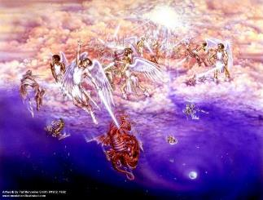
Satan as Ruler of this World
Job 1:7; 2:2
Luke 4:5-7
John 12:31; 14:30; 16:11
2 Corinthians 4:4
Ephesians 2:2
1 John 4:4; 5:19

Slide 15
Names & Titles Demonstrating Satan’s Post-Fall, Earthly Authority (Job 1:7; 2:2; Luke 4:5-8; Rom. 8:19-22)
Prince of this world (John 12:31; 14:30; 16:11)
God of this age (2 Cor. 4:4)
Prince and power of the air (Eph. 2:2)
Who the believer wrestles with (Eph. 6:12)
Roaring lion (1 Pet. 5:8)
Whole world lies in his power (1 John 5:19)

Slide 16
Romans 8:19-23
¹⁹ “For the anxious longing of the creation waits eagerly for the revealing of the sons of God. ²⁰ For the creation was subjected to futility, not willingly, but because of Him who subjected it, in hope ²¹ that the creation itself also will be set free from its slavery to corruption into the freedom of the glory of the children of God. ²² For we know that the whole creation groans and suffers the pains of childbirth together until now. ²³ And not only this, but also we ourselves, having the first fruits of the Spirit, even we ourselves groan within ourselves, waiting eagerly for our adoption as sons, the redemption of our body.”

Slide 17
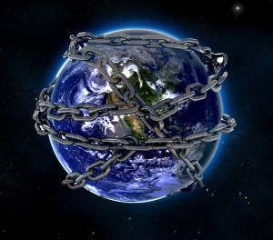

Slide 18
Ultimate Exodus (Rev 11:15)
Sores: 6th plague (Ex 9:8-12), 1st bowl (Rev 16:1-2)
Rivers to blood: 1st plague (Ex 7:19-21), 3rd bowl (Rev 16:4-7)
Darkness: 9th plague (Ex 10:21-23), 5th bowl (Rev 16:10-11)
Frogs: 2nd plague (Ex 7:25‒8;15), 6th bowl (Rev 16:13)
Hail: 7th plague (Ex 9:22-26), 7th bowl (Rev 16:17-21)

Slide 19
Revelation 11:15
“Then the seventh angel sounded; and there were loud voices in heaven, saying, ‘The kingdom of the world has become the kingdom of our Lord and of His Christ; and He will reign (basileuō) forever and ever.’” (cf. Matt. 6:10)

Slide 20
Revelation 11:15
“Then the seventh angel sounded; and there were loud voices in heaven, saying, ‘The kingdom of the world has become the kingdom of our Lord and of His Christ; and He will reign (basileuō) forever and ever.’” (cf. Matt. 6:10)

Slide 21
Revelation 11:15
“Then the seventh angel sounded; and there were loud voices in heaven, saying, ‘The kingdom of the world has become the kingdom of our Lord and of His Christ; and He will reign (basileuō) forever and ever.’” (cf. Matt. 6:10)

Slide 23
The Seventh Trumpet
(Revelation 11:14-19)
The Transference (11:14-15)
The praise (11:16-18)
The Anticipation (11:19)

Slide 24
II. The Praise
(Revelation 11:16-18)
The Worshippers (11:16)
The Worship’s Content (11:17-18)
The Coming Reign (11:17)
The Coming Justice (11:18)

Slide 25
II. The Praise
(Revelation 11:16-18)
The Worshippers (11:16)
The Worship’s Content (11:17-18)
The Coming Reign (11:17)
The Coming Justice (11:18)

Slide 26
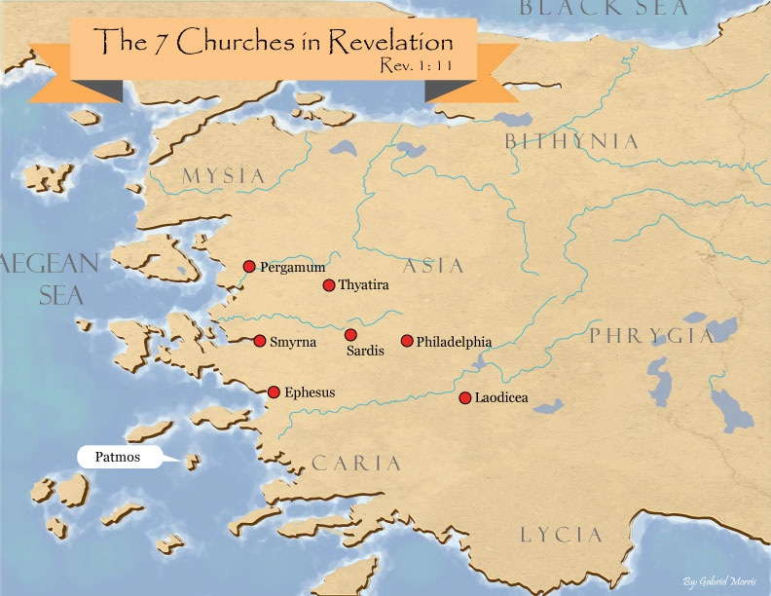

Slide 27
DESCRIPTION OF THE SEVEN CHURCHES Revelation 2‒3
CHURCH | SCRIPTURE | DESCRIPTION
Ephesus | 2:1-7 | Loveless
Smyrna | 2:8-11 | Persecuted
Pergamum | 2:12-17 | Compromised
Thyatira | 2:18-29 | Corrupt
Sardis | 3:1-6 | Dead
Philadelphia | 3:7-13 | Missionary
Laodicea | 3:14-22 | Man-centered

Slide 28
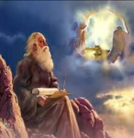
Twenty-Four Elders (Rev. 4:4)
Church
Crowned (2:10)
Clothed in White (3:5)
Redeemed (5:8-10)
Enthroned (3:21)
Elders (1 Tim. 3:1-7)
Kingdom of Priests (Rev. 1:6)
Twenty-four (Rev. 1:6)

Slide 30
Twenty-Four Elders (Rev. 4:4)
Church
Crowned (2:10)
Clothed in White (3:5)
Redeemed (5:8-10)
Enthroned (3:21)
Elders (1 Tim. 3:1-7)
Kingdom of Priests (Rev. 1:6)
Twenty-four (Rev. 1:6)

Slide 31
Rev 3:21
“He who overcomes, I will grant to him to sit down with Me on My throne, as I also overcame and sat down with My Father on His throne.”

Slide 32
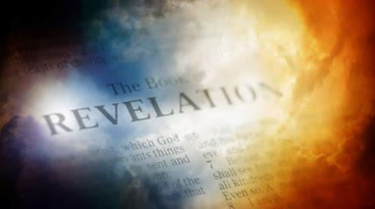
David Hocking
David Hocking, The Book of Revelation: Understanding the Future (Tustin, CA: Hope For Today Publications, 2014), 390.
“The number one priority of every believer should be the worship and praise of Almighty God. We were created to worship the God who made us. The action of falling down on their faces demonstrates a clear understanding of God‘s greatness and the believer’s humility before God.”

Slide 33
II. The Praise
(Revelation 11:16-18)
The Worshippers (11:16)
The Worship’s Content (11:17-18)
The Coming Reign (11:17)
The Coming Justice (11:18)

Slide 34
II. The Praise
(Revelation 11:16-18)
The Worshippers (11:16)
The Worship’s Content (11:17-18)
The Coming Reign (11:17)
The Coming Justice (11:18)

Slide 35
II. The Praise
(Revelation 11:16-18)
The Worshippers (11:16)
The Worship’s Content (11:17-18)
The Coming Reign (11:17)
The Coming Justice (11:18)

Slide 36
2. The Coming Justice
(Revelation 11:18)
Nations rage (11:18a)
Divine wrath (11:18b)
Dead will be judged (11:18c)
Saints will be rewarded (11:18d)
Destroyer will be destroyed (11:18e)

Slide 37
2. The Coming Justice
(Revelation 11:18)
Nations rage (11:18a)
Divine wrath (11:18b)
Dead will be judged (11:18c)
Saints will be rewarded (11:18d)
Destroyer will be destroyed (11:18e)

Slide 38
2. The Coming Justice
(Revelation 11:18)
Nations rage (11:18a)
Divine wrath (11:18b)
Dead will be judged (11:18c)
Saints will be rewarded (11:18d)
Destroyer will be destroyed (11:18e)

Slide 39
Promised Exemption from Divine Wrath
The promise (1 Thess 1:10; 5:9; Rom 5:9; Rev 3:10)
Tribulation = divine wrath (Rev 6:16-17; 11:18; 15:1, 7; 16:19)

Slide 41
2. The Coming Justice
(Revelation 11:18)
Nations rage (11:18a)
Divine wrath (11:18b)
Dead will be judged (11:18c)
Saints will be rewarded (11:18d)
Destroyer will be destroyed (11:18e)

Slide 43
2. The Coming Justice
(Revelation 11:18)
Nations rage (11:18a)
Divine wrath (11:18b)
Dead will be judged (11:18c)
Saints will be rewarded (11:18d)
Destroyer will be destroyed (11:18e)

Slide 44
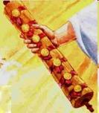
1st Six Seals (Revelation 6)
6:1-2 – Advent of antichrist
6:3-4 – War
6:5-6 – Famine
6:7-8 – Death
6:9-11 – Martyrdoms
6:12-17 – Cosmic disturbances

Slide 45
2. The Coming Justice
(Revelation 11:18)
Nations rage (11:18a)
Divine wrath (11:18b)
Dead will be judged (11:18c)
Saints will be rewarded (11:18d)
Destroyer will be destroyed (11:18e)

Slide 46
Romans 8:19-23
¹⁹ “For the anxious longing of the creation waits eagerly for the revealing of the sons of God. ²⁰ For the creation was subjected to futility, not willingly, but because of Him who subjected it, in hope ²¹ that the creation itself also will be set free from its slavery to corruption into the freedom of the glory of the children of God. ²² For we know that the whole creation groans and suffers the pains of childbirth together until now. ²³ And not only this, but also we ourselves, having the first fruits of the Spirit, even we ourselves groan within ourselves, waiting eagerly for our adoption as sons, the redemption of our body.”

Slide 48
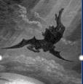
Satan’s Progressive Defeat
Initial eviction from heaven (Isa 14:12-15; Ezek 28:12-17)
Eden (Gen 3:15)
Pre-diluvian world (1 Pet 3:19-20)
Cross (John 12:31; 16:11; Col 2:15; Heb 2:14; 1 John 3:8)
Mid point of the Tribulation (Rev 12:9)
Beginning of millennium (Rev 20:2-3)
End of millennium (Rev 20:10)

Slide 49
The Seventh Trumpet
(Revelation 11:14-19)
The Transference (11:14-15)
The praise (11:16-18)
The Anticipation (11:19)

Slide 50
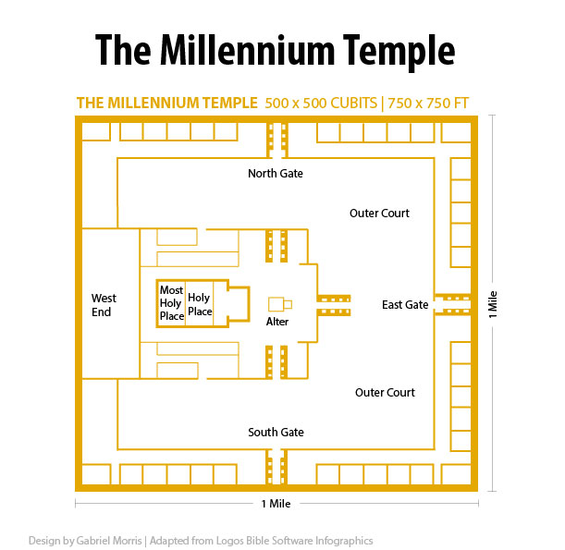

Slide 51
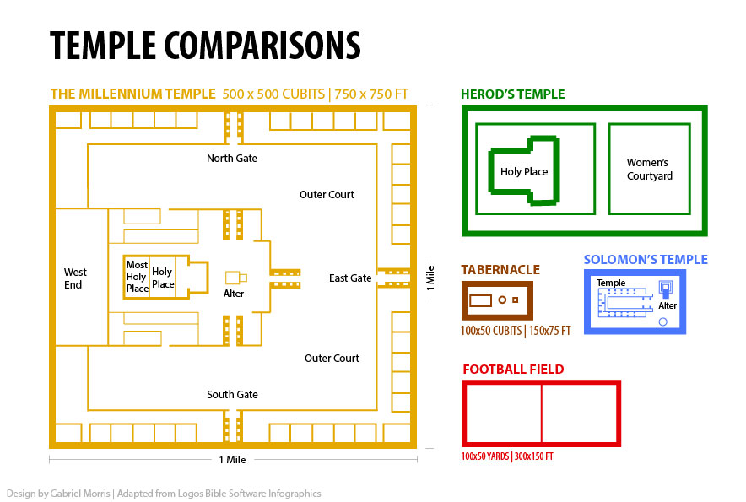

Slide 52
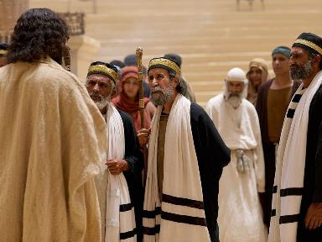
Matthew 4:17
“From that time Jesus began to preach and say, ‘Repent, for the kingdom of heaven is at hand.’”

Slide 53
Messengers of the Kingdom In Matthew Toussaint, Behold the King, 18-20
John the Baptist – 3:2
Jesus Christ – 4:17
12 Apostles – 10:5-7
Seventy – Luke 10:1, 9

Slide 54
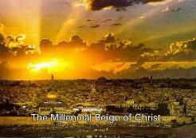
Daniel 2:44
“In the days of those kings the God of heaven will set up a kingdom which will never be destroyed, and that kingdom will not be left for another people; it will crush and put an end to all these kingdoms, but it will itself endure forever.”

Slide 57
5 Non-Chronological Parenthetical Insertions
Rev 7 – 144,000 Jews
Rev 10:1-11:13 – Announcement of no more delay and the two witnesses
Rev 12-14 – Israel’s flight, two beasts, six scenes of hope
Rev 16:13-16 – Gathering of the nations to Armageddon
Rev 17:1-19:6 – Babylon’s fall

Slide 58
Conclusion

Slide 59
The Seventh Trumpet
(Revelation 11:14-19)
The Transference (11:14-15)
The praise (11:16-18)
The Anticipation (11:19)

Slide 60
“The Lord bless you and keep you; the Lord make his face shine on you and be gracious to you; the Lord turn his face toward you and give you peace.” (NIV)

