Slide 1
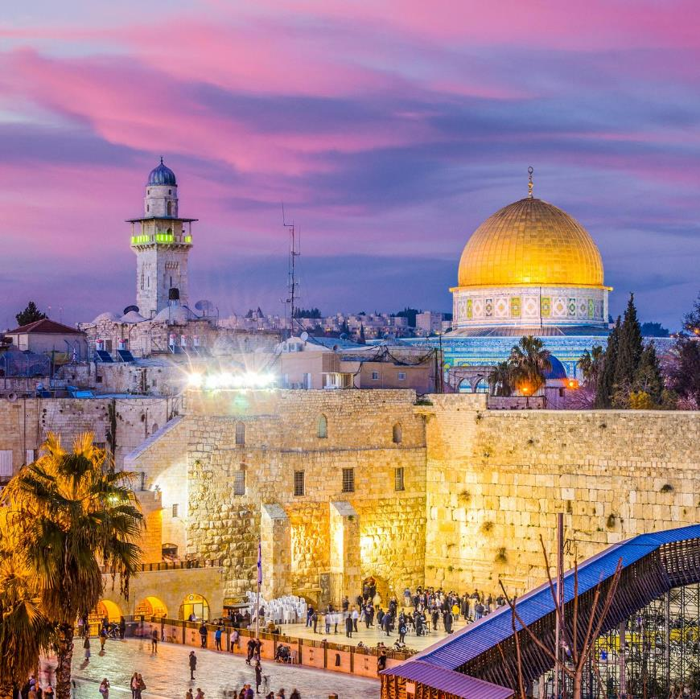
ISRAEL
2019
ANDY WOODS
Part 4

Slide 2
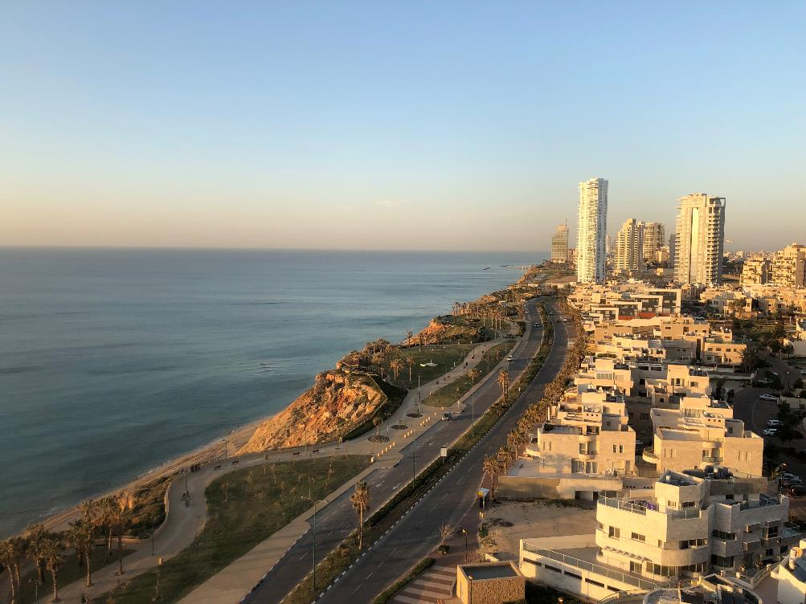
Tel Aviv, Joppa, Caesarea Maritma,
Mt. Carmel, Megiddo
Part 1

Slide 3
Sepphoris, Upper Galilee/Caesarea-Philippi andTel Dan, Sea of Galilee, Mt. of Beatitudes
Part 2

Slide 4
Capernaum, Tabgha
Part 3

Slide 5
Jordan River, Bet She 'An, Jericho, Dead Sea, Masada, Qumran
Part 4

Slide 6
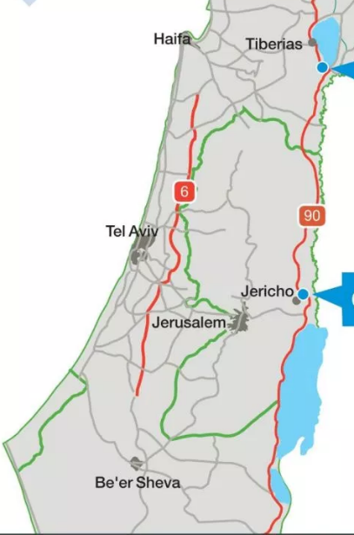
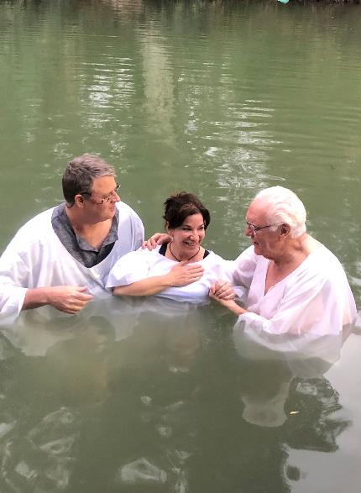
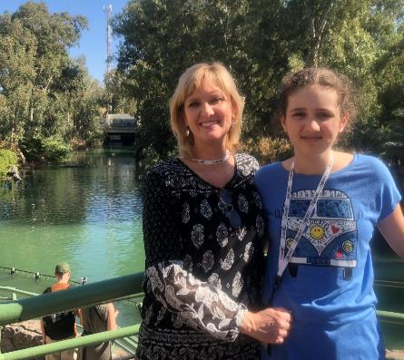
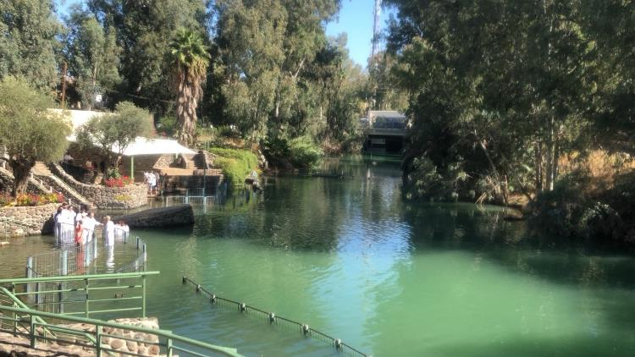
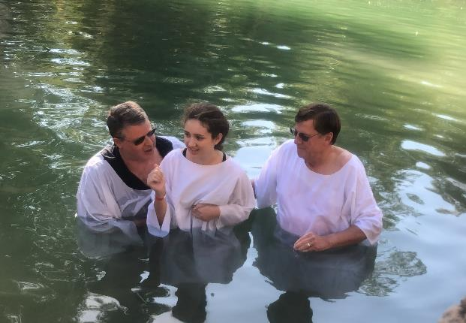
Jordan River
Yardernit
Yardernit
Baptisms

Slide 7

Matthew 28:18-20
^{18 “}And Jesus came up and spoke to them, saying, ‘All authority has been given to Me in heaven and on earth. ¹⁹ Go therefore and make disciples of all the nations, baptizing them in the name of the Father and the Son and the Holy Spirit, ²⁰ teaching them to observe all that I commanded you; and lo, I am with you always, even to the end of the age.’”

Slide 8
Messengers of the Kingdom In Matthew
John the Baptist – 3:2
Jesus Christ – 4:17
12 Apostles – 10:5-7
Seventy – Luke 10:1, 9
Toussaint, Behold the King, 18-20

Slide 9

Matthew 3:1-2
“Now in those days John the Baptist came, preaching in the wilderness of Judea, saying, ‘Repent, for the kingdom of heaven is at hand.’”

Slide 10
Matthew 21:32
“For John came to you in the way of righteousness and you did not believe him; but the tax collectors and prostitutes did believe him; and you, seeing this, did not even feel remorse afterward so as to believe him.”

Slide 11
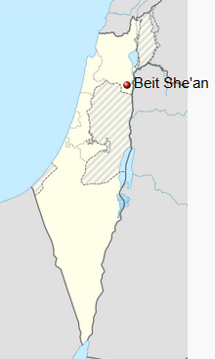
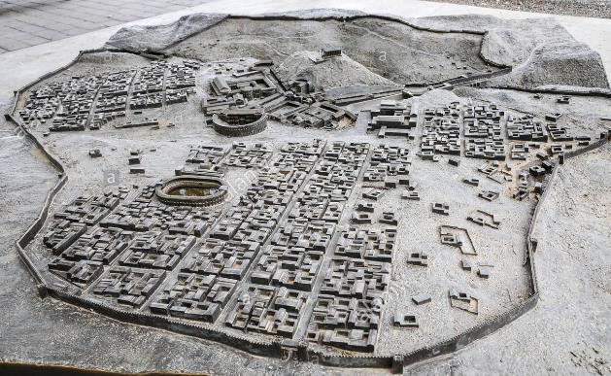
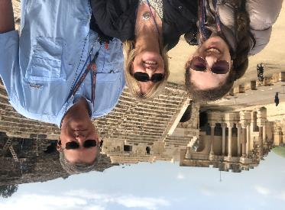
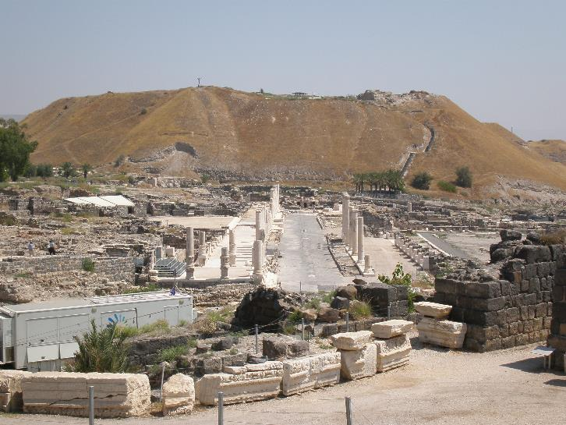
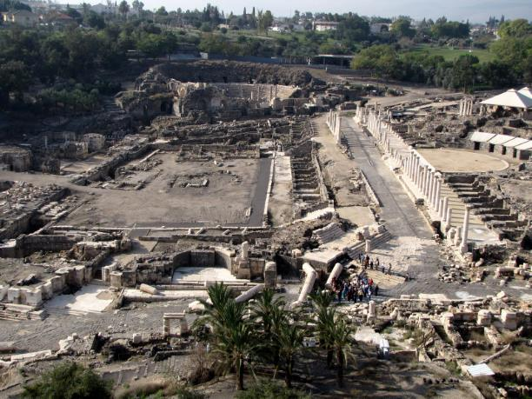
Bet She’An
Roman Ruins
Joshua, Saul, Jonathan

Slide 12
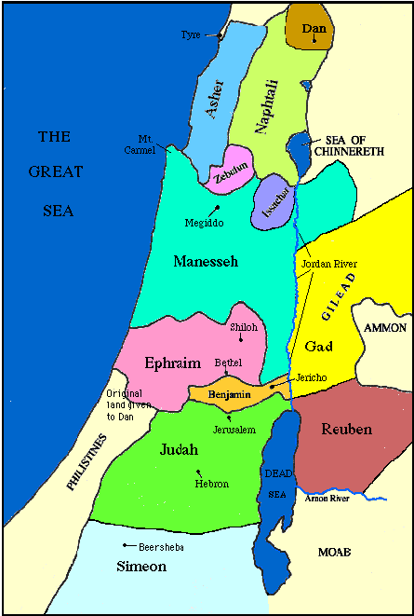

Slide 13
Levitical Feasts (Lev. 23)
Feast | Season | Purpose | Type
Passover | Spring | Redemption | 1 Cor. 5:7
Unleavened Bread | Spring | Separation | John 6:35
1st fruits | Spring | Praise | 1 Cor. 15:20
Pentecost | Spring | Praise | Acts 2:1-4
Trumpets | Fall | New Year | Matt. 24:31
Atonement | Fall | Lev 16 | Zech. 12:10
Booths | Fall | Wilderness provision | Zech. 14:16-18

Slide 14
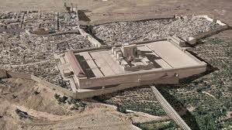
Christ’s Five Trips to Jerusalem in John’s Gospel
Feast | Verse
Passover | 2:23
Unnamed | 5:1
Tabernacles | 7:2
Dedication | 10:22
Passover | 13:1

Slide 15

Revelation 11:8-10
“⁸ And their dead bodies will lie in the street of the great city which mystically is called Sodom and Egypt, where also their Lord was crucified. ⁹ Those from the peoples and tribes and tongues and nations will look at their dead bodies for three and a half days, and will not permit their dead bodies to be laid in a tomb. ¹⁰ And those who dwell on the earth will rejoice over them and celebrate; and they will send gifts to one another, because these two prophets tormented those who dwell on the earth.”

Slide 16
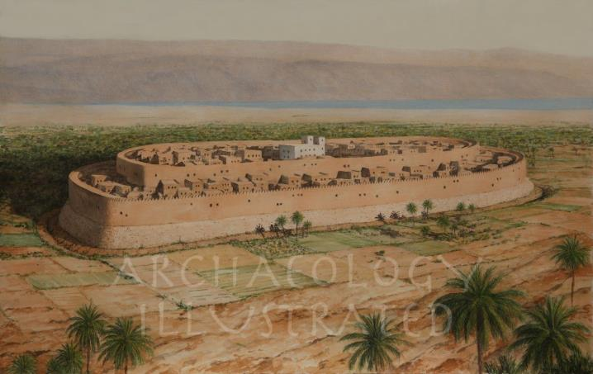
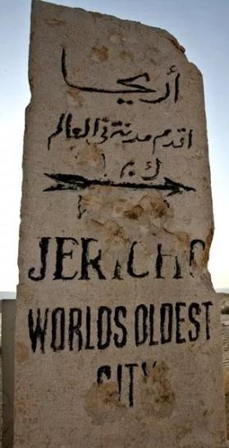
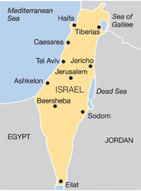
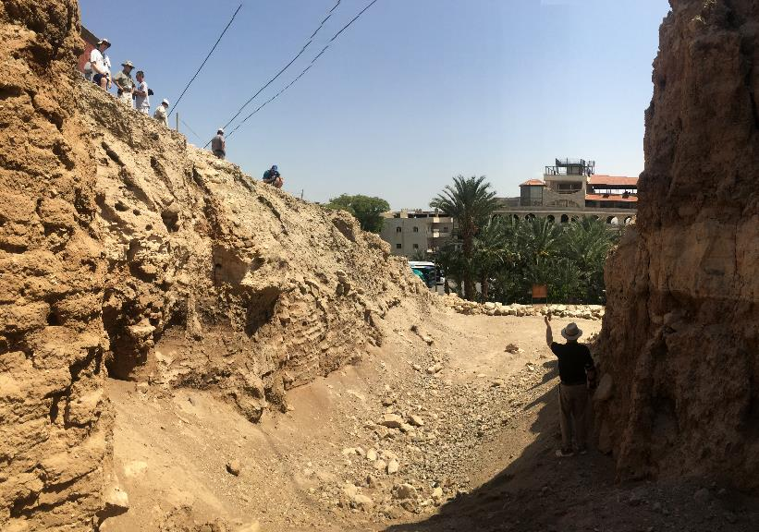
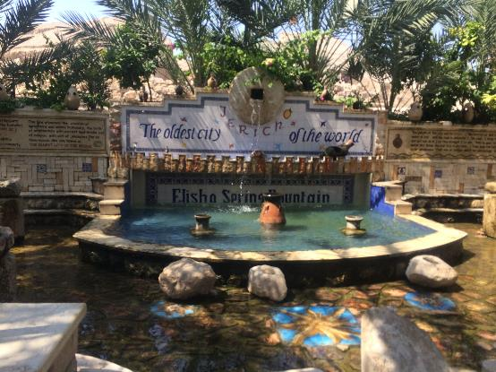
Jericho
Joshua, Elijah
Walls

Slide 18
Levitical Feasts (Lev. 23)
Feast | Season | Purpose | Type
Passover | Spring | Redemption | 1 Cor. 5:7
Unleavened Bread | Spring | Separation | John 6:35
1st fruits | Spring | Praise | 1 Cor. 15:20
Pentecost | Spring | Praise | Acts 2:1-4
Trumpets | Fall | New Year | Matt. 24:31
Atonement | Fall | Lev 16 | Zech. 12:10
Booths | Fall | Wilderness provision | Zech. 14:16-18

Slide 19
Christ’s Five Trips to Jerusalem in John’s Gospel
Feast | Verse
Passover | 2:23
Unnamed | 5:1
Tabernacles | 7:2
Dedication | 10:22
Passover | 13:1

Slide 20
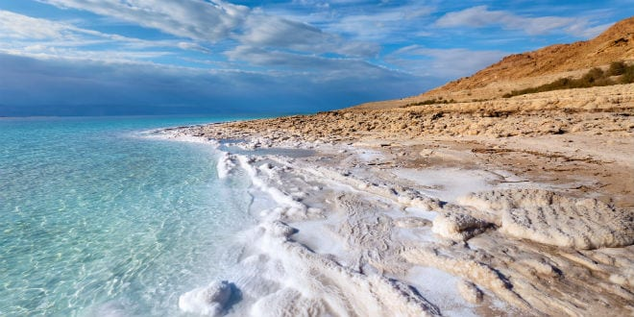
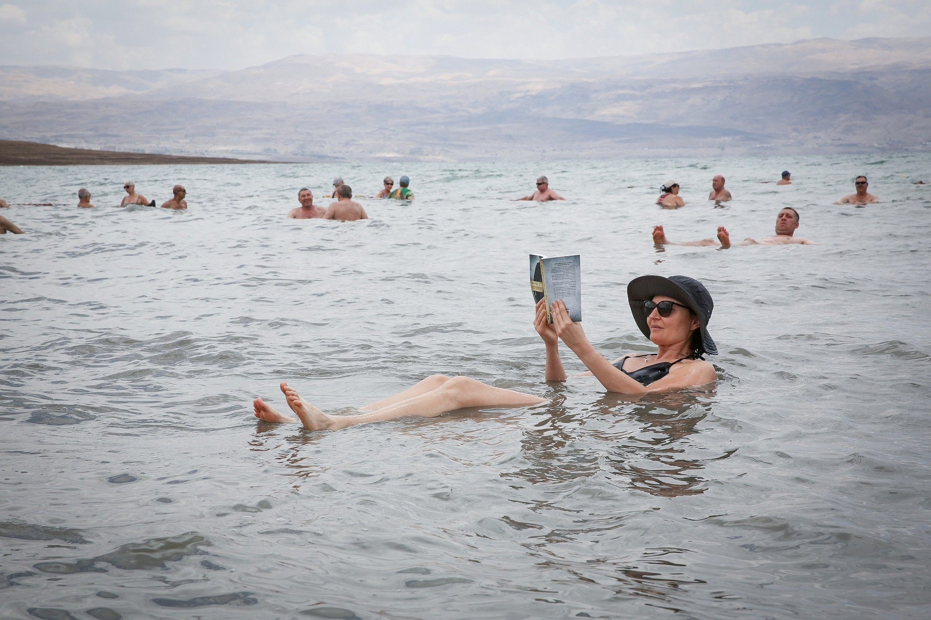
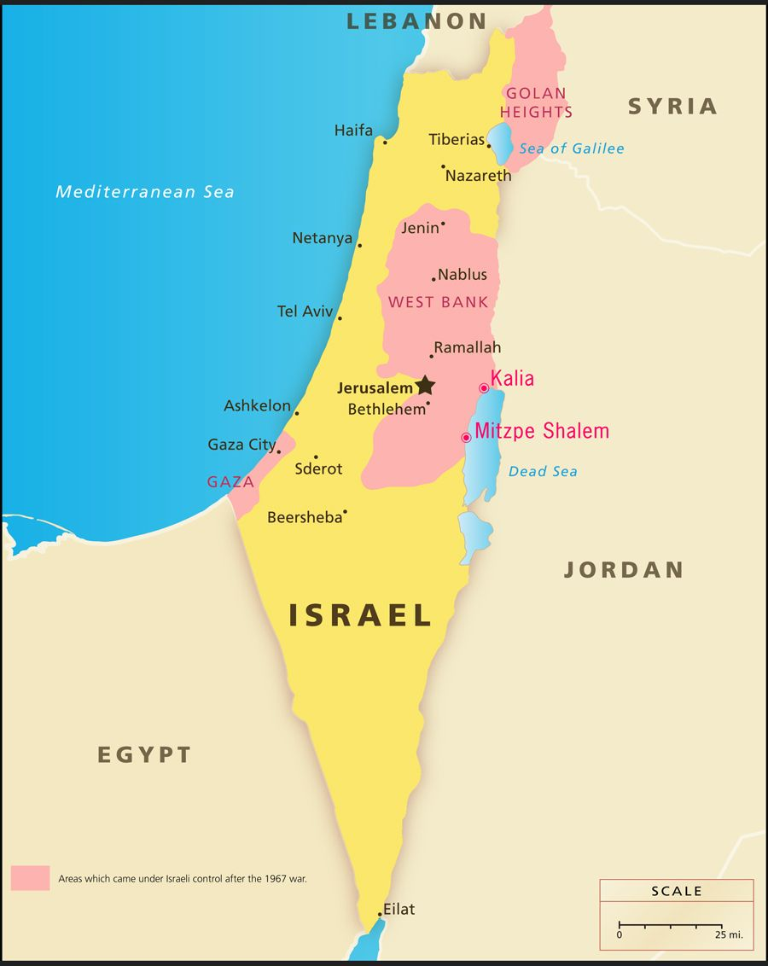
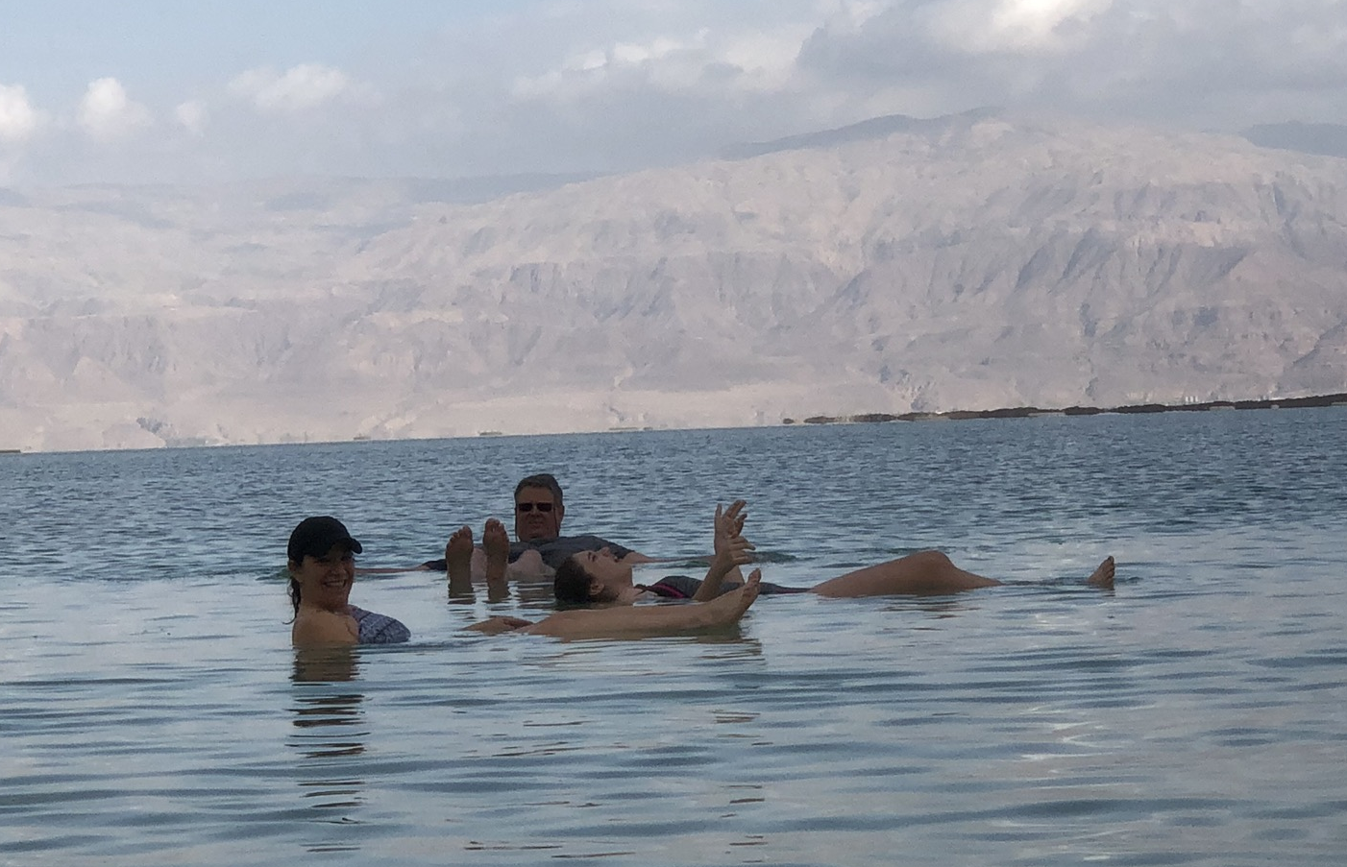
Dead Sea
Ezekiel’s Vision

Slide 21
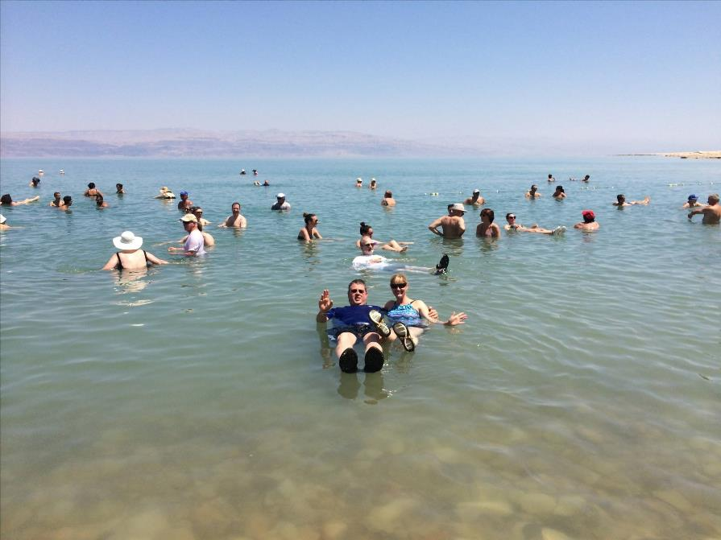

Slide 22
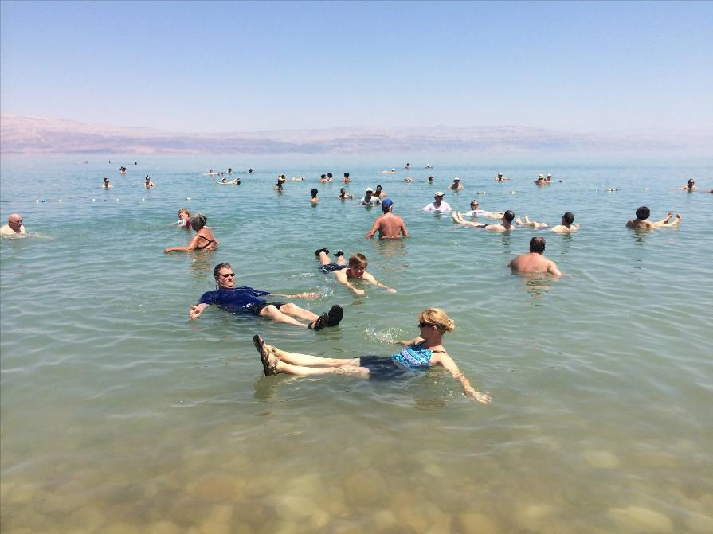

Slide 23


Slide 24
DIFFERENCES BETWEEN THE MILLENNIUM & ETERNAL STATE
Millennium (Rev. 20:1-10) | Eternal State (Rev. 21‒22)
Present earth (Gen. 13:17) | New Earth (Rev. 21:1)
Waters (Gen. 15:18-21) | No sea (Rev. 21:1)
Rebellion (Zech. 14:16-18) | No rebellion (Rev. 21:4)
Tribal land (Ezek. 47:13-23) | Tribal city gates (Rev. 21:12)
Sin exists (Ezek 45:22) | No sin (Rev. 21:4)
Temple (Ezek. 40‒46) | No temple (Rev. 21:22)
Rod of iron (Ps. 2:6-8) | No rod needed (Rev. 21:8)
Death (Isa. 65:20) | No death (Rev. 21:4)
Sun exists (Isa. 30:26) | No sun (Rev. 21:23; 22:5)

Slide 25
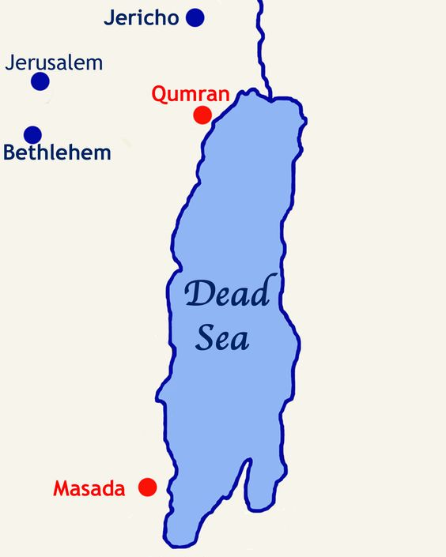

Slide 26
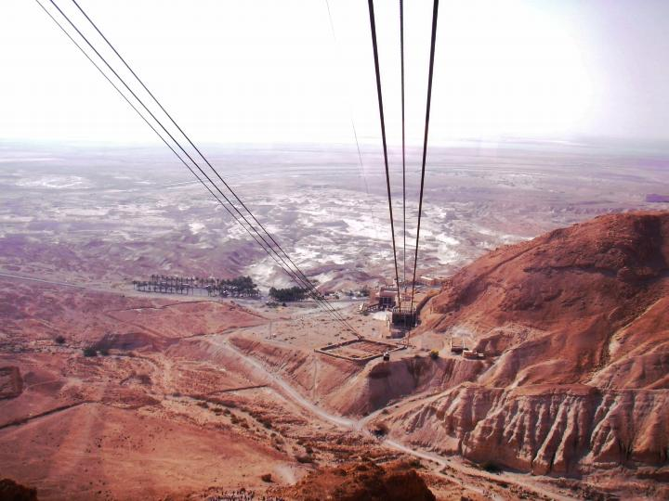

Slide 27
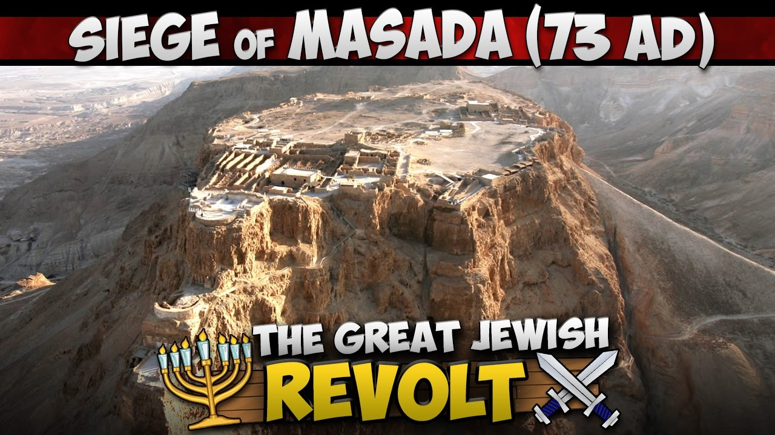
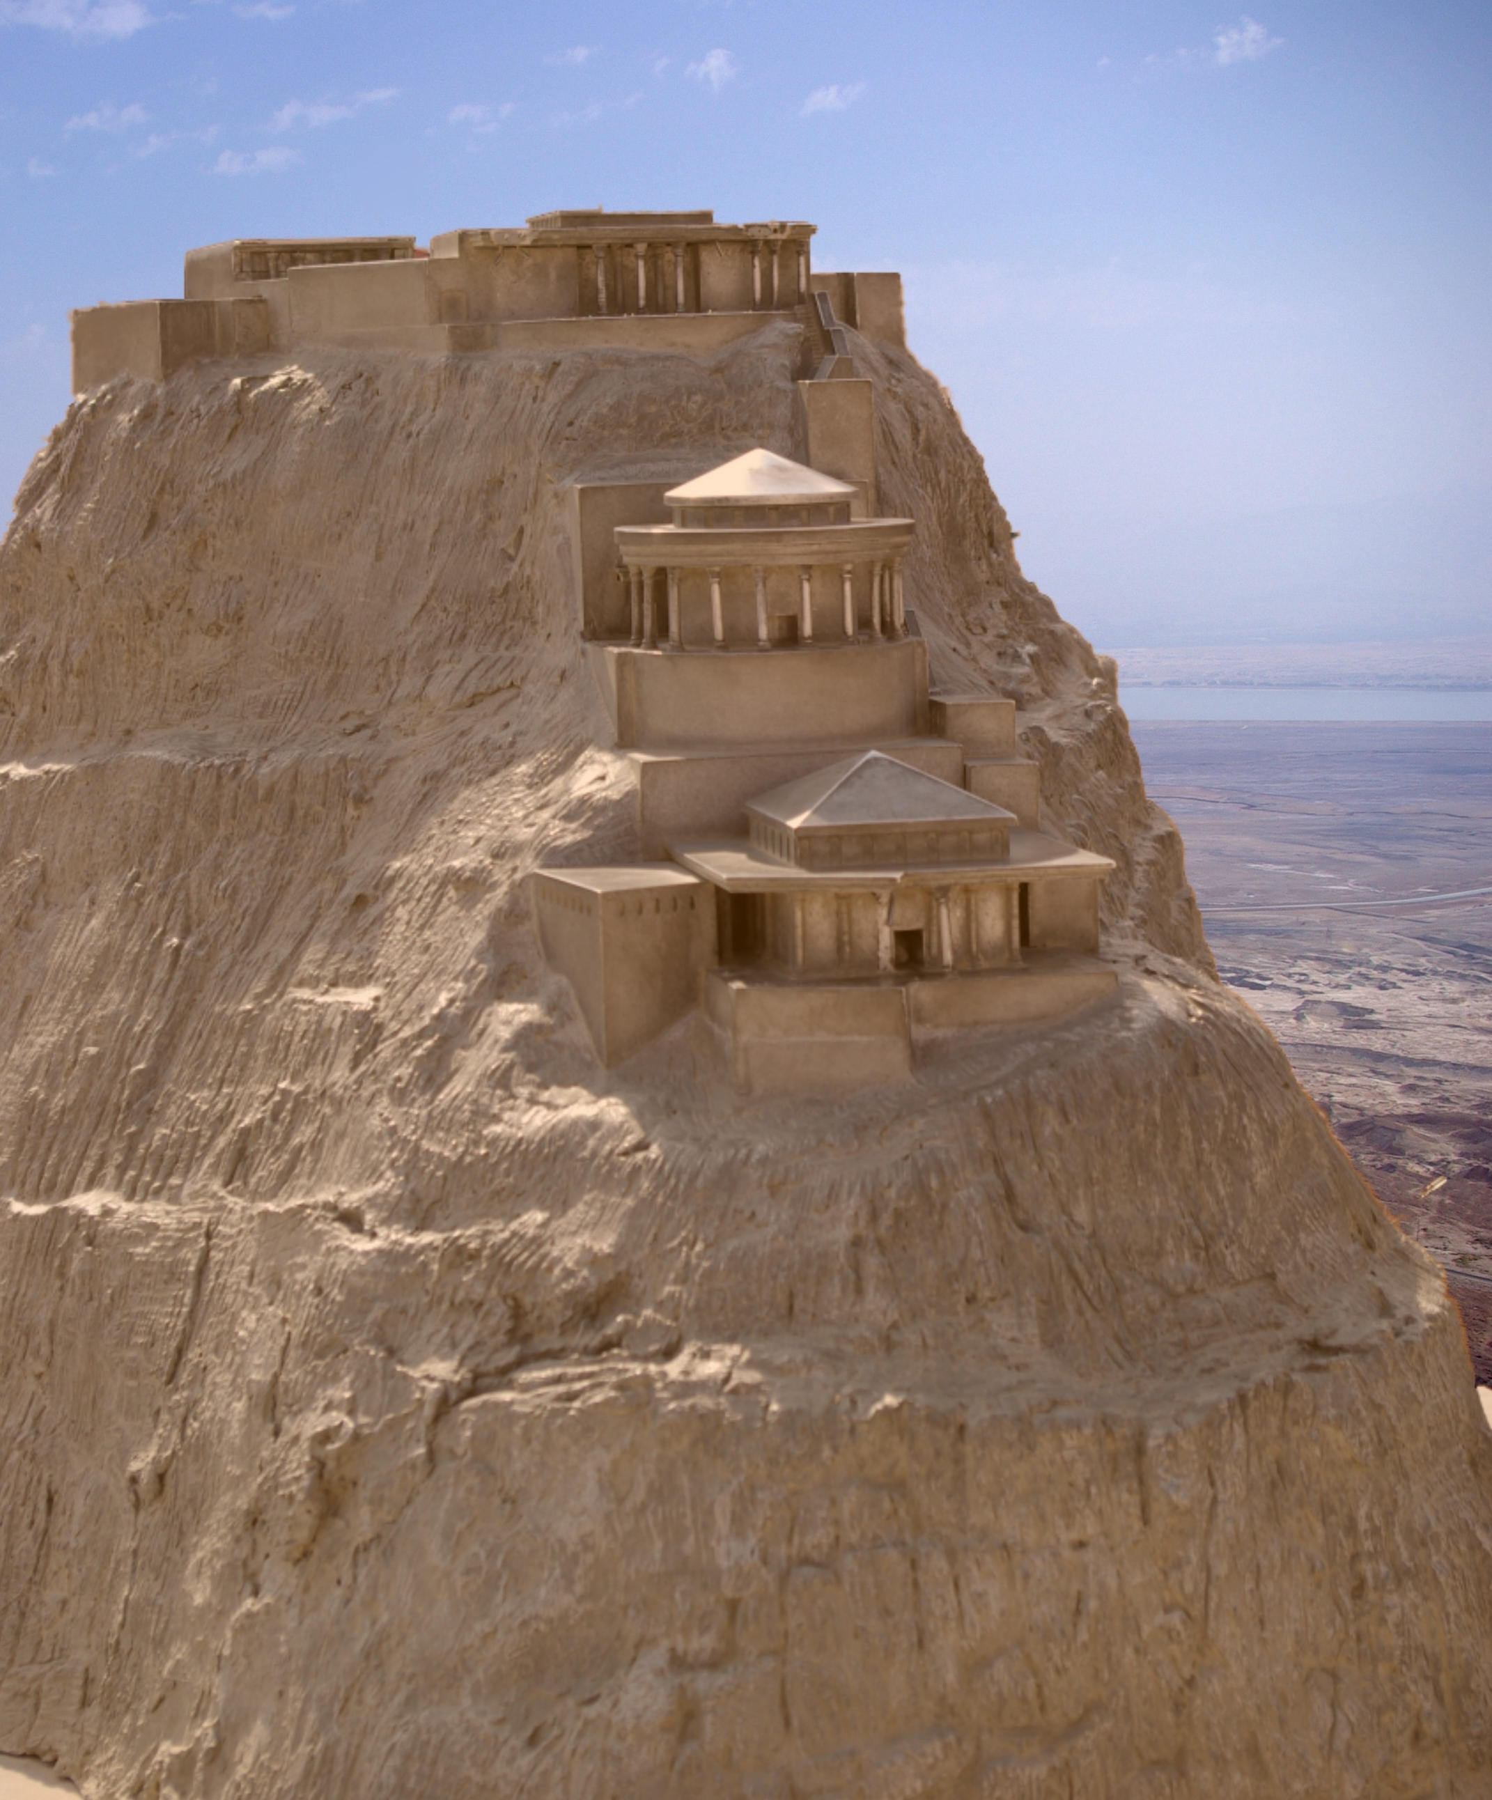
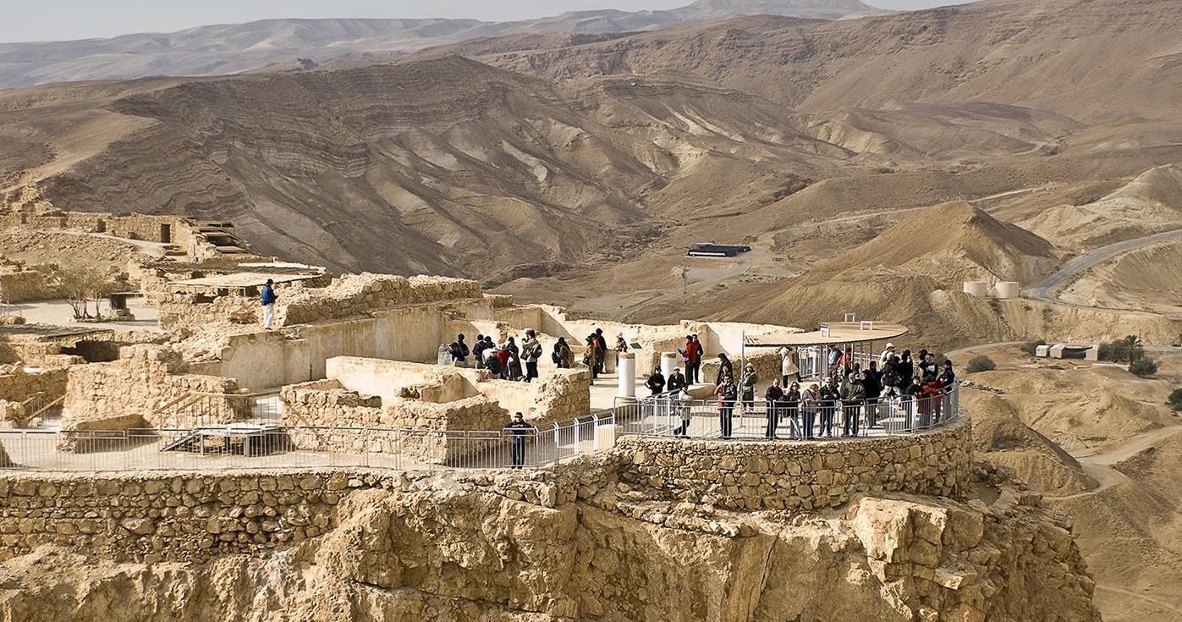
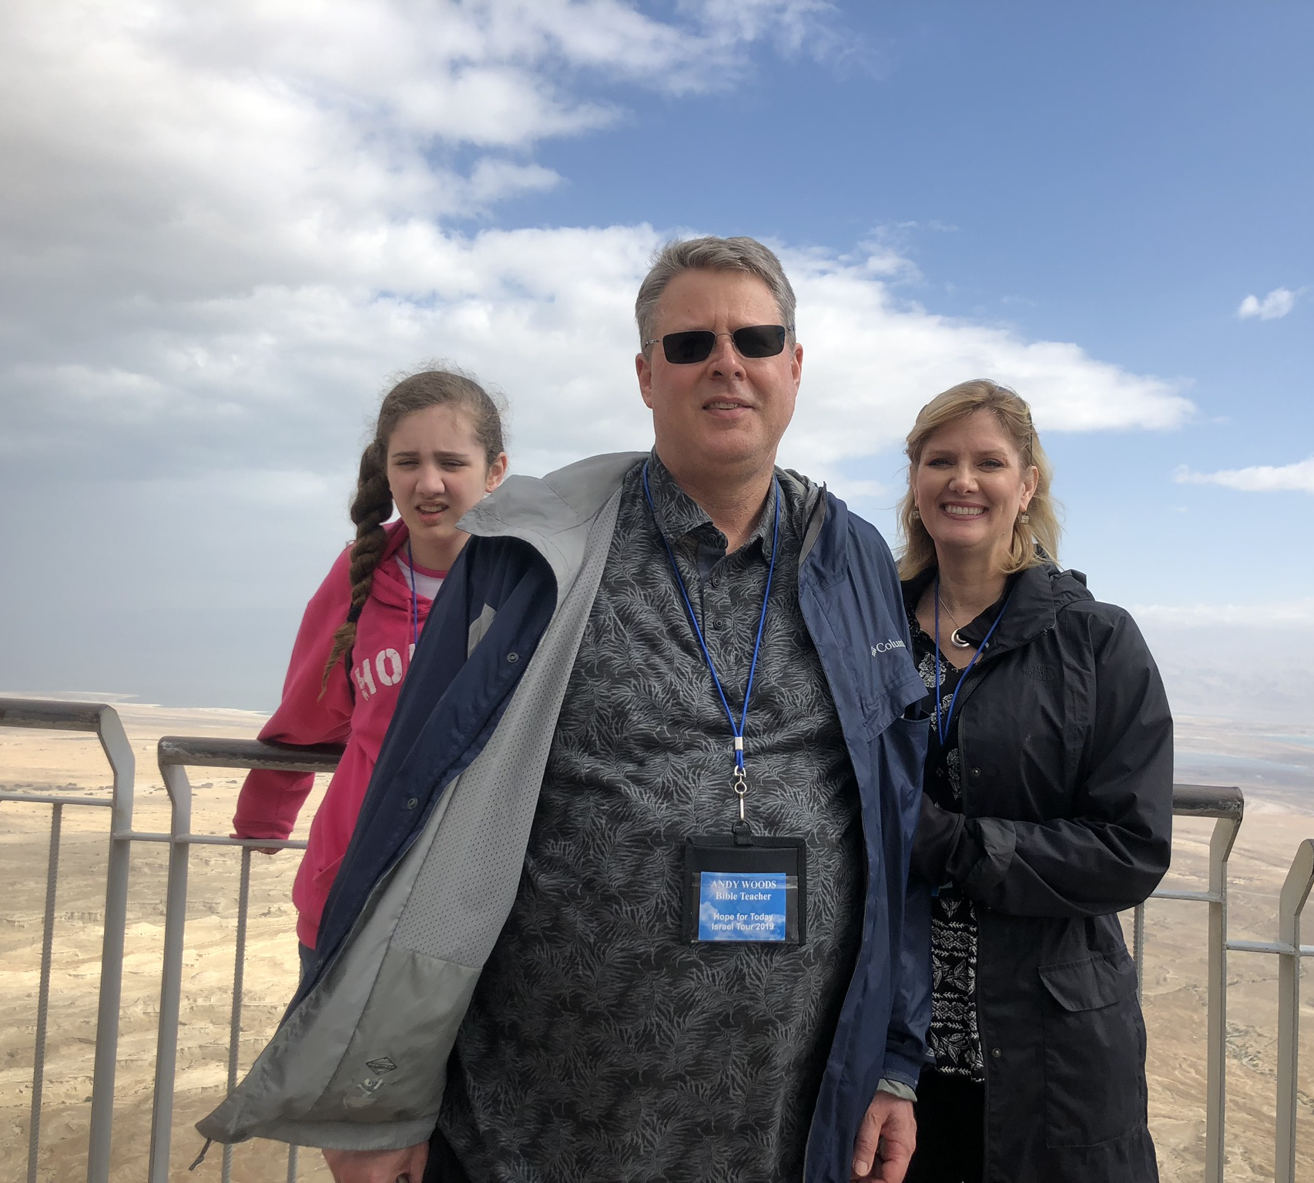
Masada

Slide 28
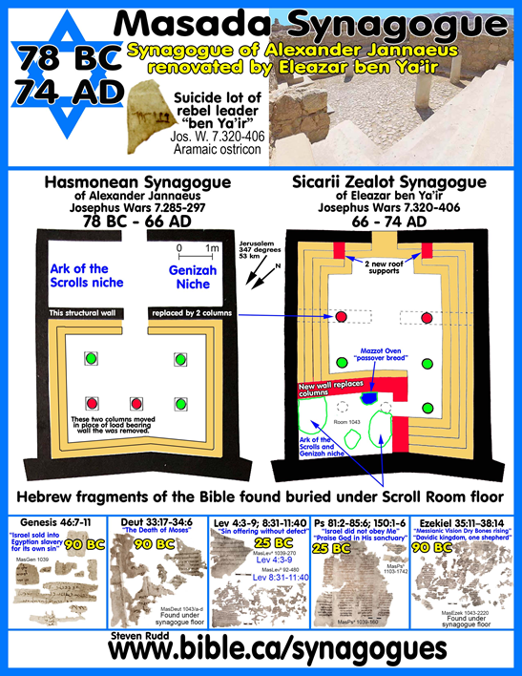
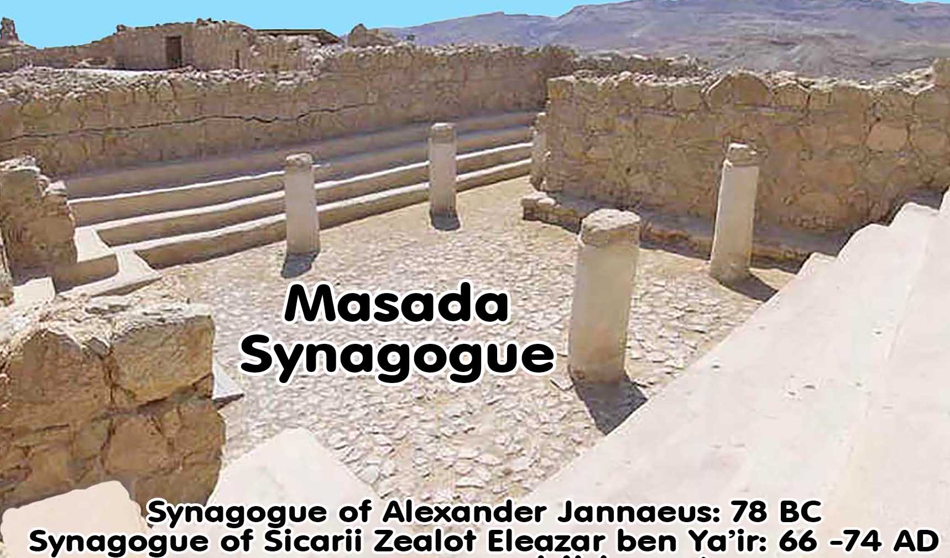
Masada

Slide 29

Ezekiel 36:24-28
“For I will take you from the nations, gather you from all the lands and bring you into your own land. ²⁵ Then I will sprinkle clean water on you, and you will be clean; I will cleanse you from all your filthiness and from all your idols. ²⁶ Moreover, I will give you a new heart and put a new spirit within you; and I will remove the heart of stone from your flesh and give you a heart of flesh. ²⁷ I will put My Spirit within you and cause you to walk in My statutes, and you will be careful to observe My ordinances. ²⁸ You will live in the land that I gave to your forefathers; so you will be My people, and I will be your God.”

Slide 30
Ezekiel 37:7-11
So I prophesied as I was commanded; and as I prophesied, there was a noise, and behold, a rattling; and the bones came together, bone to its bone. ⁸ And I looked, and behold, sinews were on them, and flesh grew and skin covered them; but there was no breath in them. ⁹ Then He said to me, “Prophesy to the breath, prophesy, son of man, and say to the breath, ‘Thus says the Lord God, “Come from the four winds, O breath, and breathe on these slain, that they come to life.”’” ¹⁰ So I prophesied as He commanded me, and the breath came into them, and they came to life and stood on their feet, an exceedingly great army. ¹¹ Then He said to me, “Son of man, these bones are the whole house of Israel; behold, they say, ‘Our bones are dried up and our hope has perished. We are completely cut off’.”

Slide 31
Six Parts of a Suzerain-Vassal Treaty in Deuteronomy
Preamble (1:1-5)
Prologue (1:6–4:40)
Covenant obligations (5–26)
Storage and reading instructions (27:2-3; 31:9, 24, 26)
Witnesses (32:1)
Blessings and curses (28)

Slide 32
Israel's Judgments
Division of the kingdom in 931 B.C. (1 Kgs. 12)
Assyrian judgment in 722 B.C. (2 Kgs. 17)
Babylonian captivity in 586 B.C. (2 Kgs. 25)
Romans in A.D. 70 (Luke 19:41-44)

Slide 34
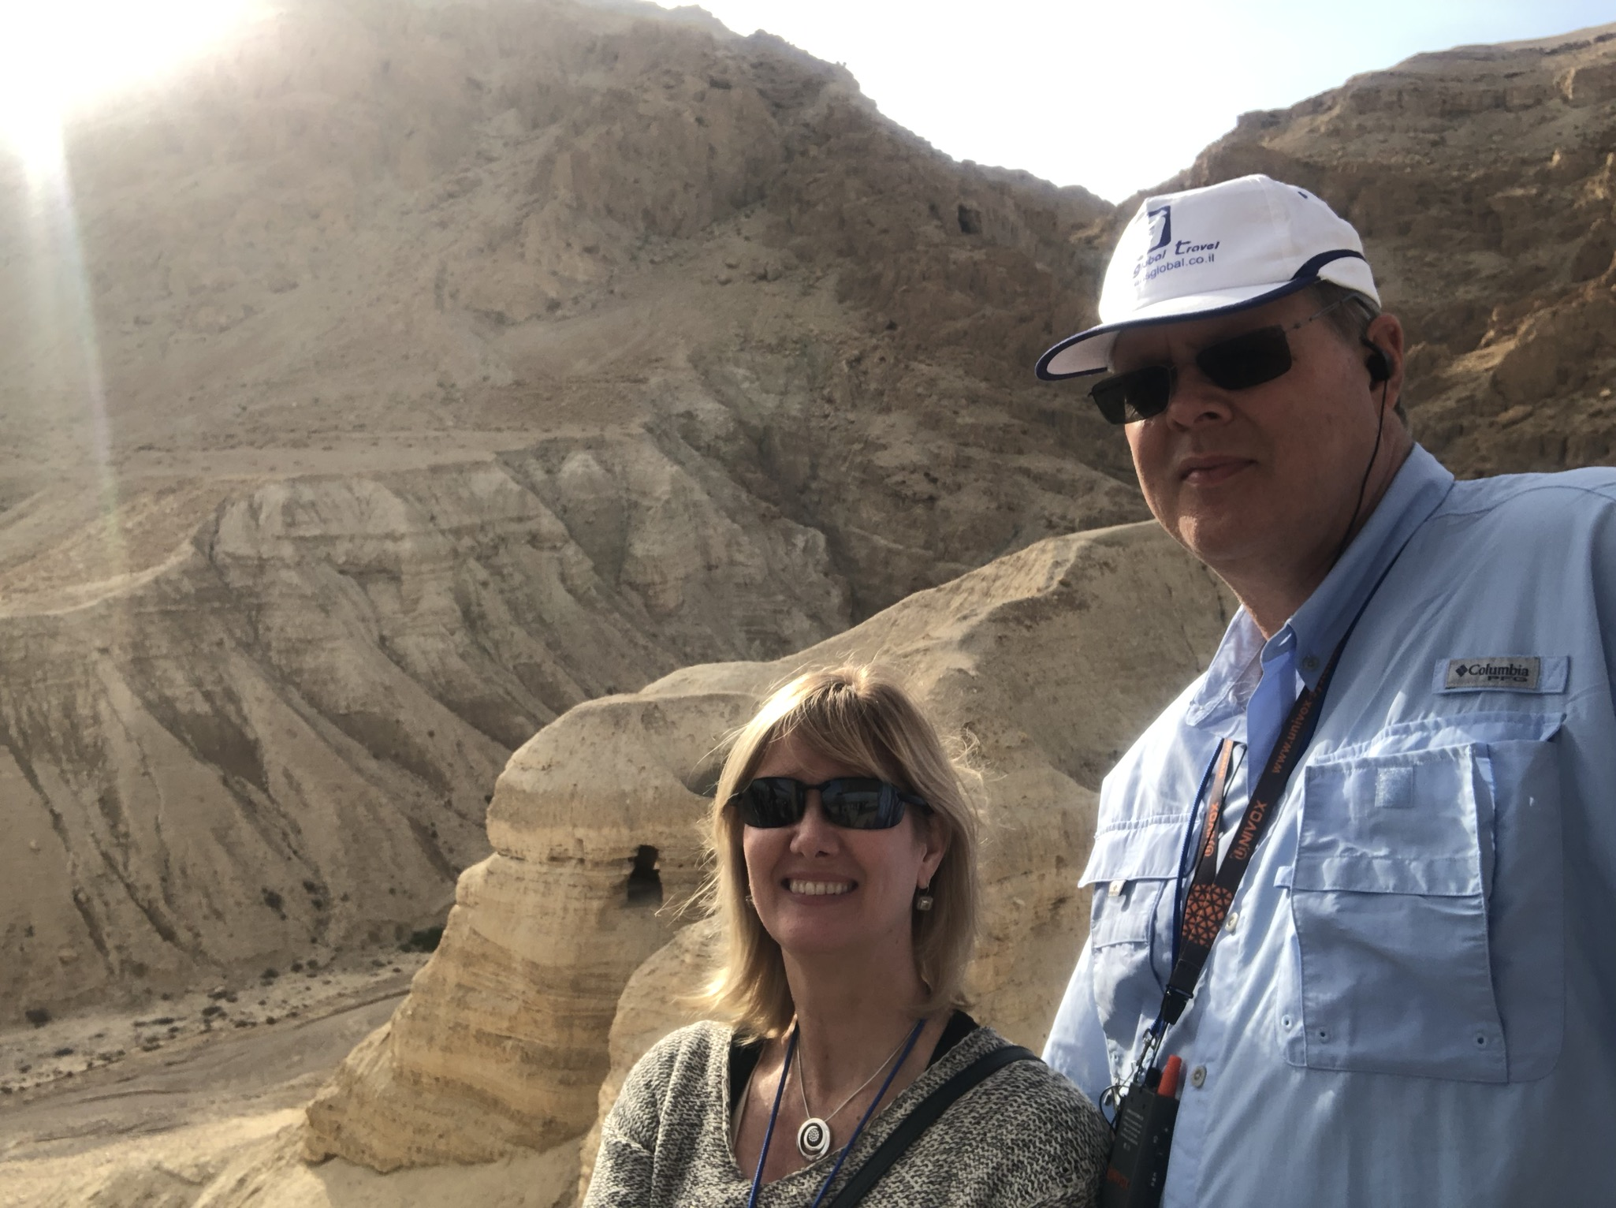
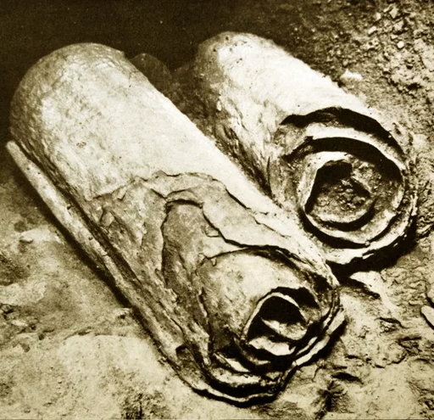
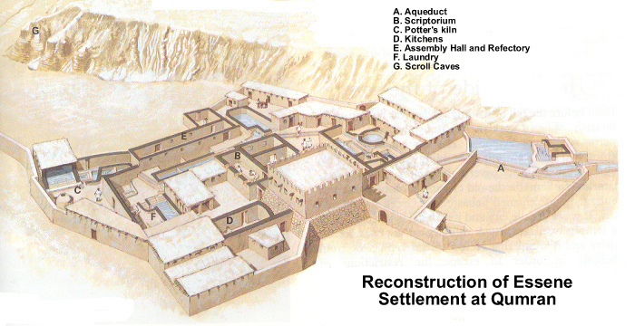
Qumran
Dead Sea Scrolls

Slide 35
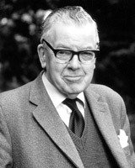
F.F. Bruce
F.F. Bruce, The Books and the Parchments, 117.
“The Masoretes were well disciplined and treated the text with the greatest imaginable reverence, and devised a complicated system of safeguards against scribal slips. They counted, for example, the number of times each letter of the alphabet occurs in each book; they pointed out the middle letter of the Pentateuch and the middle letter of the whole Hebrew Bible, and made even more detailed calculations than these. ‘Everything countable seems to be counted,’ says Wheeler Robinson, and they made up mnemonics by which the various totals might be readily remembered.”

Slide 37
