Slide 1
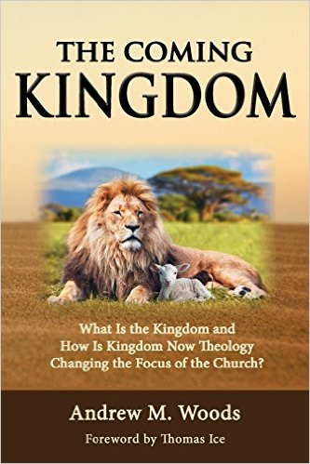

Slide 2

The Coming Kingdom
Chapter 19
Dr. Andy Woods
Senior Pastor – Sugar Land Bible Church
President – Chafer Theological Seminary

Slide 3

Kingdom Study Outline
What does the Bible Say About the Kingdom?
The Main Problem with Kingdom Now NT interpretations
Why do some believe that we are in the kingdom now?
Why does it matter?

Slide 4
Response to Kingdom Now Problem Passages
Passages from Christ’s ministry
Passages from Acts
Passages from Paul
Passages from the General letters
Passages from Revelation
Miscellaneous Arguments

Slide 5
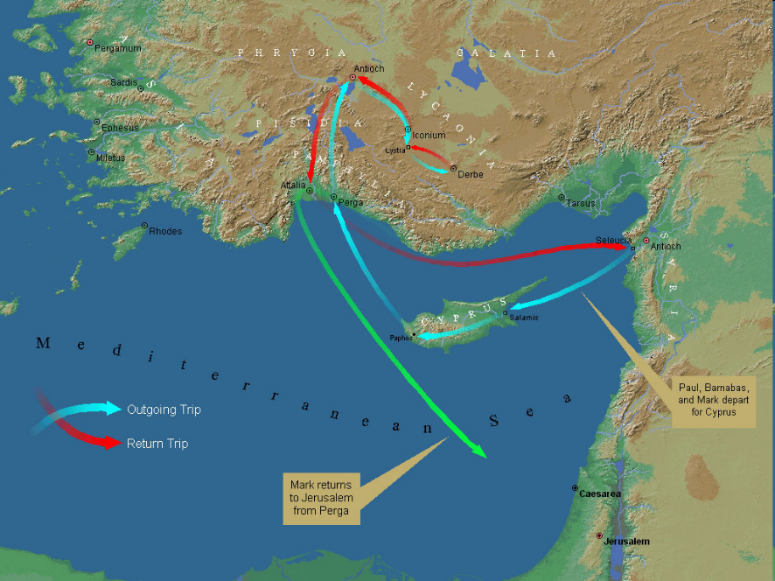
First Missionary Journey
(Acts 13‒14)

Slide 6
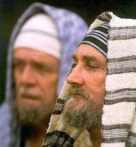
Types of Pharisees
Type | Overthrown
Justification | Matt 5:20
Sanctification | Galatians
Ecclesiology | Acts 15

Slide 7
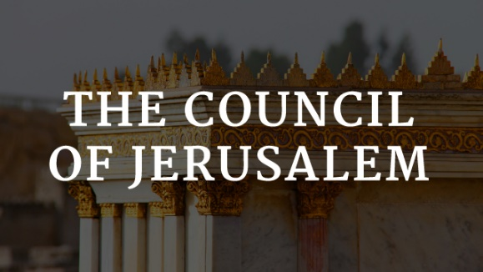
Acts 15:1-35
The Council at Jerusalem
15:1-6 – Necessity of Paul & Barnabas to travel to Jerusalem (15:1-6)
15:7-21 – Deliberations (15:7-21)
  Peter’s speech (15:7-11)
  Paul & Barnabas’ speeches (15:12)
  James’ speech (15:13-21)
15:22-35 – Resolution (15:22-35)
  Antioch delegation: Paul, Barnabas, & Silas (15:22)
  Letter (15:23-29)
  Ministry in Antioch (15:30-35)

Slide 8
Acts 15:1-35
The Council at Jerusalem
15:1-6 – Necessity of Paul & Barnabas to travel to Jerusalem (15:1-6)
15:7-21 – Deliberations (15:7-21)
  Peter’s speech (15:7-11)
  Paul & Barnabas’ speeches (15:12)
  James’ speech (15:13-21)
15:22-35 – Resolution (15:22-35)
  Antioch delegation: Paul, Barnabas, & Silas (15:22)
  Letter (15:23-29)
  Ministry in Antioch (15:30-35)

Slide 9

Acts 15:14-21
¹⁴ “Simeon has related how God first concerned Himself about taking from among the Gentiles a people for His name. ¹⁵ With this the words of the Prophets agree, just as it is written, ¹⁶ ‘After these things I will return, And I will rebuild the tabernacle of David which has fallen, And I will rebuild its ruins, And I will restore it, ¹⁷ So that the rest of mankind may seek the Lord, And all the Gentiles who are called by My name,’ ¹⁸ Says the Lord, who makes these things known from long ago.”

Slide 10
Acts 15:19-21
“¹⁹ Therefore it is my judgment that we do not trouble those who are turning to God from among the Gentiles, ²⁰ but that we write to them that they abstain from things contaminated by idols and from fornication and from what is strangled and from blood. ²¹ For Moses from ancient generations has in every city those who preach him, since he is read in the synagogues every Sabbath.”

Slide 11
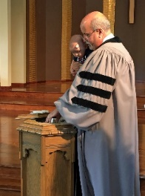
Kim Riddlebarger
Kim Riddlebarger, A Case for Amillennialism: Understanding the End Times (Grand Rapids: Baker, 2003), 39-40.
“In Acts 15, the church in Antioch appointed Paul and Barnabas to report to the Jerusalem council regarding the salvation of the Gentiles and to seek help in resolving the question that had been troubling the church as a result. Should Gentile converts be circumcised in order to be saved? Once in the city, Paul and Barnabas reported to the elders and apostles on all the things God was doing among the Gentiles (v. 4). When certain converted Pharisees declared that Gentiles must be circumcised and obey the law of Moses (v. 5), Peter refuted their arguments by pointing out that it was God who had given these Gentiles the Holy Spirit:”

Slide 12
Kim Riddlebarger
Kim Riddlebarger, A Case for Amillennialism: Understanding the End Times (Grand Rapids: Baker, 2003), 39-40.
“‘We believe it is through the grace of our Lord Jesus that we are saved, just as they are’ (v. 11). Then James, the leader of the church, spoke (vv. 13ff.): ‘God at first showed his concern by taking from the Gentiles a people for himself. The words of the prophets are in agreement with this, as it is written,’ and James cited a passage from Amos 9:11–12: ‘After this I will return and rebuild David’s fallen tent. Its ruins I will rebuild, and I will restore it, that the remnant of men may seek the Lord, and all the Gentiles who bear my name, says the Lord, who does these things’ that have been known for ages.’”

Slide 13
Kim Riddlebarger
Kim Riddlebarger, A Case for Amillennialism: Understanding the End Times (Grand Rapids: Baker, 2003), 39-40.
“James saw the prophecy as fulfilled in Christ’s resurrection and exaltation and in the reconstitution of his disciples as the new Israel. The presence of both Jew and Gentile in the church was proof that the prophecy of Amos had been fulfilled.[ 15] David’s fallen tent had been rebuilt by Christ. In Amos’s prophecy, ‘after this’ indicated that the prophecy referred to what God would do for Israel after the exile. When James applied this prophecy to the church, was he spiritualizing an Old Testament text? Or was James reading the Old Testament through a Christ-centered lens typical of the greater light of the messianic age?”

Slide 14
Kim Riddlebarger
Kim Riddlebarger, A Case for Amillennialism: Understanding the End Times (Grand Rapids: Baker, 2003), 39-40.
“This question lies at the heart of the debate between amillenarians and dispensationalists. The famous notes of the Scofield Reference Bible (1909) say that from a dispensational perspective James’s speech is the most important in the New Testament. According to Scofield, James is describing what will happen after the church age concludes (‘after this’), i.e., in the millennium, when God will reestablish a Davidic rule over Israel. If this is true, when Paul and Barnabas sought guidance for a concern that was immediate to them (Should Gentile converts be circumcised?), James responded by pointing to a future millennium thousands of years distant.”

Slide 15
Kim Riddlebarger
Kim Riddlebarger, A Case for Amillennialism: Understanding the End Times (Grand Rapids: Baker, 2003), 39-40.
“Here is one instance in which dispensational presuppositions get in the way of the plain sense of the text. Scofield interprets the text literalistically, not literally. Dispensationalists are often forced to reinterpret any New Testament data that does not fit in their Old Testament–derived prophetic scheme. Dispensational presuppositions will not fit with much of the interpretation supplied to Old Testament data by New Testament authors. A thorough survey of both Old Testament and New Testament eschatological categories will demonstrate the dispensational hermeneutic to be untenable.”

Slide 16
Kim Riddlebarger
Kim Riddlebarger, A Case for Amillennialism: Understanding the End Times (Grand Rapids: Baker, 2003), 39-40.
“More importantly, such a survey gives us the proper framework and external controls to interpret prophetic sections of Scripture correctly. The irony is that dispensationalists’ practice of interpreting all prophetic texts in a literalistic fashion amounts to a repudiation of the historic Protestant hermeneutic and the principle of the analogy of faith. If amillenarians adopt the New Testament writers’ interpretation of the Old Testament, are they not following the literal sense of Scripture, even if the New Testament writers universalize something that was limited to Israel in the Old Testament?”

Slide 17
Kim Riddlebarger
Kim Riddlebarger, A Case for Amillennialism: Understanding the End Times (Grand Rapids: Baker, 2003), 39-40.
“The dispensationalists’ literalistic reading of prophetic passages must not be confused with a literal reading. A literal reading—a reading that gets at the plain sense of the text—will allow the New Testament to interpret the Old. It is amillenarians, not dispensationalists, who interpret prophecy literally in that they follow the literal sense of how the writers of the New Testament interpret Old Testament prophecy.”

Slide 18

Analogical Fulfillment View
(Amos 9:11-12; Acts 15:14-16)
Presupposition that NT reinterprets OT
Absence of “kingdom”
Absence of “Fulfilled”
Meaning of “after this”
Church = a mystery
A mere analogy

Slide 19
Analogical Fulfillment View
(Amos 9:11-12; Acts 15:14-16)
Presupposition that NT reinterprets OT
Absence of “kingdom”
Absence of “Fulfilled”
Meaning of “after this”
Church = a mystery
A mere analogy

Slide 20
Kim Riddlebarger
Kim Riddlebarger, A Case for Amillennialism: Understanding the End Times (Grand Rapids: Baker, 2003), 39-40.
“James saw the prophecy as fulfilled in Christ’s resurrection and exaltation and in the reconstitution of his disciples as the new Israel. The presence of both Jew and Gentile in the church was proof that the prophecy of Amos had been fulfilled.[ 15] David’s fallen tent had been rebuilt by Christ. In Amos’s prophecy, ‘after this’ indicated that the prophecy referred to what God would do for Israel after the exile. When James applied this prophecy to the church, was he spiritualizing an Old Testament text? Or was James reading the Old Testament through a Christ-centered lens typical of the greater light of the messianic age?”

Slide 21
Kim Riddlebarger
Kim Riddlebarger, A Case for Amillennialism: Understanding the End Times (Grand Rapids: Baker, 2003), 39-40.
“More importantly, such a survey gives us the proper framework and external controls to interpret prophetic sections of Scripture correctly. The irony is that dispensationalists’ practice of interpreting all prophetic texts in a literalistic fashion amounts to a repudiation of the historic Protestant hermeneutic and the principle of the analogy of faith. If amillenarians adopt the New Testament writers’ interpretation of the Old Testament, are they not following the literal sense of Scripture, even if the New Testament writers universalize something that was limited to Israel in the Old Testament?”

Slide 22
Analogical Fulfillment View
(Amos 9:11-12; Acts 15:14-16)
Presupposition that NT reinterprets OT
Absence of “kingdom”
Absence of “Fulfilled”
Meaning of “after this”
Church = a mystery
A mere analogy

Slide 23
Analogical Fulfillment View
(Amos 9:11-12; Acts 15:14-16)
Presupposition that NT reinterprets OT
Absence of “kingdom”
Absence of “Fulfilled”
Meaning of “after this”
Church = a mystery
A mere analogy

Slide 24

Acts 1:16
“Brethren, the Scripture had to be fulfilled (plēroō), which the Holy Spirit foretold by the mouth of David concerning Judas, who became a guide to those who arrested Jesus.”

Slide 25
Analogical Fulfillment View
(Amos 9:11-12; Acts 15:14-16)
Presupposition that NT reinterprets OT
Absence of “kingdom”
Absence of “Fulfilled”
Meaning of “after this”
Church = a mystery
A mere analogy

Slide 26
Acts 15:14-21
¹⁴ “Simeon has related how God first concerned Himself about taking from among the Gentiles a people for His name. ¹⁵ With this the words of the Prophets agree, just as it is written, ¹⁶ ‘After these things I will return, And I will rebuild the tabernacle of David which has fallen, And I will rebuild its ruins, And I will restore it, ¹⁷ So that the rest of mankind may seek the Lord, And all the Gentiles who are called by My name,’ ¹⁸ Says the Lord, who makes these things known from long ago.”

Slide 27


Thomas Ice
Tim LaHaye Prophecy Study Bible, p. 1304.
“James explains how the decision of the council at Jerusalem was an outworking of God‘s purpose for this age. God‘s plan for history relates to the past ages with Israel and to Israel‘s role in the coming age (the Millennium), but the current Church Age will center around the Gentiles. After the Church Age is concluded, the Lord will return, and ‘rebuild the tabernacle of David’ [verse 16], i.e., the nation of Israel. This Old Testament reference is from Amos 9:11–12. During the Tribulation the Lord will work to convert the nation of Israel to Himself, ending with the second coming and the millennial reign of Christ. God‘s plans for history will come to pass just as He ordained.”

Slide 28
Analogical Fulfillment View
(Amos 9:11-12; Acts 15:14-16)
Presupposition that NT reinterprets OT
Absence of “kingdom”
Absence of “Fulfilled”
Meaning of “after this”
Church = a mystery
A mere analogy

Slide 29

Ephesians 2:14-16
¹⁴ “For He Himself is our peace, who made both groups into one and broke down the barrier of the dividing wall, ¹⁵ by abolishing in His flesh the enmity, which is the Law of commandments contained in ordinances, so that in Himself He might make the two into one new man, thus establishing peace, ¹⁶ and might reconcile them both in one body to God through the cross, by it having put to death the enmity.”

Slide 30
Ephesians 3:3-6
³ “that by revelation there was made known to me the mystery, as I wrote before in brief. ⁴ By referring to this, when you read you can understand my insight into the mystery of Christ, ⁵ which in other generations was not made known to the sons of men, as it has now been revealed to His holy apostles and prophets in the Spirit; ⁶ to be specific, that the Gentiles are fellow heirs and fellow members of the body, and fellow partakers of the promise in Christ Jesus through the gospel”.

Slide 31

Ephesians 3:9
“and to bring to light what is the administration of the mystery which for ages has been hidden in God who created all things.”

Slide 32
“Mystery” Defined
“In the N.T, it [mustērion] denotes, not the mysterious (as with the Eng. word), but that which, being outside the range of unassisted natural apprehension, can be made known only by Divine revelation, and is made known in a manner and at a time appointed by God, and to those who are illumined by His Spirit.”
W. E. Vine, Merrill F. Unger, and William White, Vine's Complete Expository Dictionary of the Old and New Testament Words (Nashville: Nelson, 1996), 424.

Slide 33
Romans 16:25-26
^{25 “}Now to Him who is able to establish you according to my gospel and the preaching of Jesus Christ, according to the revelation of the mystery which has been kept secret for long ages past, ²⁶ but now is manifested, and by the Scriptures of the prophets, according to the commandment of the eternal God, has been made known to all the nations, leading to obedience of faith

Slide 34

Colossians 1:26
“that is, the mystery which has been hidden from the past ages and generations, but has now been manifested to His.”

Slide 35
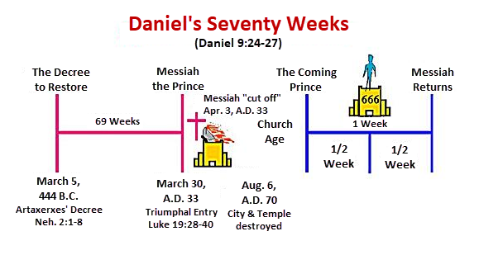

Slide 36
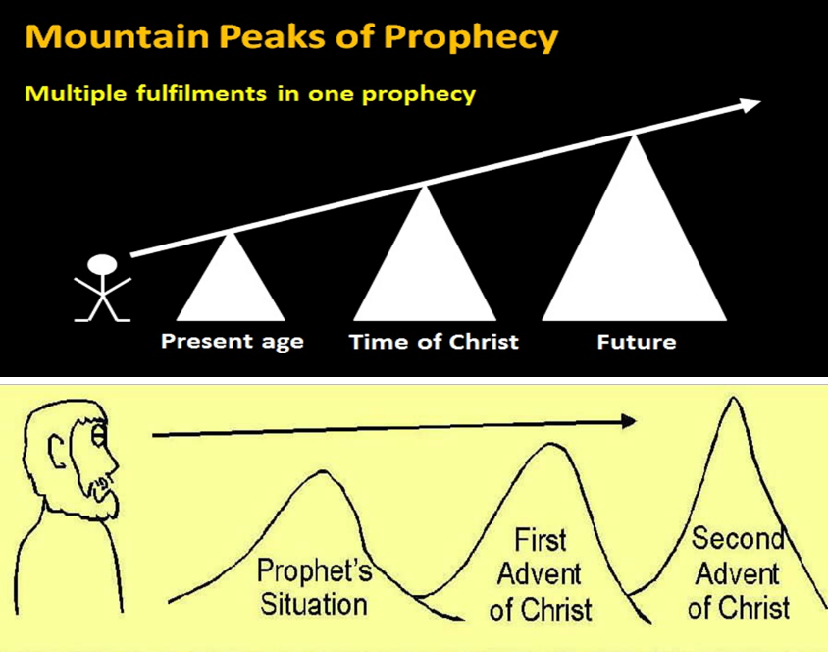

Slide 37


Statue
&
Stone

Slide 38

1 Peter 1:10-11
¹⁰ As to this salvation, the prophets who prophesied of the grace that would come to you made careful searches and inquiries, ¹¹ seeking to know what person or time the Spirit of Christ within them was indicating as He predicted the sufferings of Christ and the glories to follow.

Slide 39
Analogical Fulfillment View
(Amos 9:11-12; Acts 15:14-16)
Presupposition that NT reinterprets OT
Absence of “kingdom”
Absence of “Fulfilled”
Meaning of “after this”
Church = a mystery
A mere analogy

Slide 40

J. Dwight Pentecost
Thy Kingdom Come, Page 279-80
“Afterward a question was raised concerning whether it was necessary for the Gentiles who had believed and had been brought into the church to abide by the precepts of the Mosaic Law. Judaizers insisted that in order to please God as believers and members of the kingdom of God, it was necessary for all men to live under the precepts of the Mosaic Law. This question was submitted to the apostles in Jerusalem, and Peter testified to the salvation of the Gentiles by faith in Jesus Christ apart from the Law (15:7–11).”

Slide 41
J. Dwight Pentecost
Thy Kingdom Come, Page 279-80
“His testimony is further corroborated by Barnabas and Paul (v. 12), and James who presided at this council hearing rendered the decision of the council. It was evident that God for the first time in dealing with men was dealing with Gentiles as Gentiles ‘taking from the Gentiles a people for Himself (v. 14). James found this in keeping with the prophetic program. In Amos 9:11–12 it was prophesied that after the period in which Israel was disciplined because of disobedience (vv. 1–10) and the Davidic throne left empty for a time, the Davidic throne would be restored and the Davidic kingdom would be instituted.”

Slide 42
J. Dwight Pentecost
Thy Kingdom Come, Page 279-80
“When it is reinstituted, the kingdom will include not only the physical descendants of Abraham, but also a multitude of Gentiles as well. Therefore the restored Davidic kingdom under its rightful Davidic king would be composed of both Jews and Gentiles. In that kingdom Gentiles would not be made into Jews; instead they would be in the kingdom as Gentiles. This allowed James to conclude that if God had a program for Gentiles as Gentiles in the future Davidic kingdom established here on the earth, there was no reason to deny that God could include Gentiles as Gentiles in this present form of the theocracy.”

Slide 43
J. Dwight Pentecost
Thy Kingdom Come, Page 279-80
“Therefore the issue was settled—the Gentiles did not need to be circumcised and bring themselves under the Mosaic Law in order to participate in the present form of the kingdom. Rather, apart from the Mosaic Law, through faith in Jesus Christ they are equal participants with believing Jews in the present form of the kingdom of God”

Slide 44
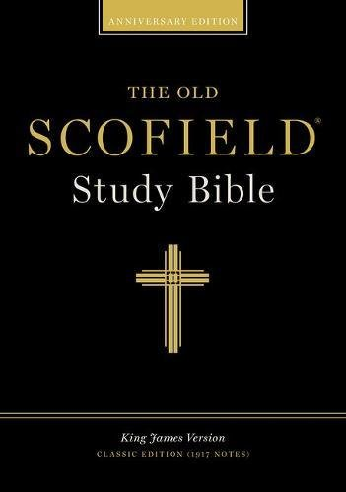
Scofield Reference Bible
Page 1520
“...begins with the words ‘on that day.’ James introduced this quotation in such a way as to show what day Amos was talking about, namely, the time after the present world witness (Acts 1:8), when Christ will return. James showed that there will be Gentile believers at that time, as well as Jewish believers; hence he concluded that Gentiles are not required to become Jewish proselytes by circumcision.”

Slide 45
Analogical Fulfillment View
(Amos 9:11-12; Acts 15:14-16)
Presupposition that NT reinterprets OT
Absence of “kingdom”
Absence of “Fulfilled”
Meaning of “after this”
Church = a mystery
A mere analogy

Slide 46
Response to Kingdom Now Problem Passages
Passages from Christ’s ministry
Passages from Acts
Passages from Paul
Passages from the General letters
Passages from Revelation
Miscellaneous Arguments

Slide 47
Generic References to the Kingdom in Acts
(Acts 1:3, 6; 8:12; 14:22; 19:8; 20:25; 28:23, 31)
Lack of a definition of the kingdom
Teaching about the unrealized does not necessarily make it realized in the present
Kingdom mentioned 45x in Luke’s prequel

Slide 48

Alva J. McClain
Alva J. McClain, The Greatness of the Kingdom: An Inductive Study of the Kingdom of God as Set Forth in the Scriptures (Grand Rapids: Zondervan, 1959), 424-26.
“The term ‘kingdom’ (Grk. basileia) occurs eight times in Acts as referring to the divine rule. . . . In the Book of Acts this ‘kingdom of God’ appears as something future, the term being used, as James Orr has observed, ‘in an almost exclusively eschatological sense.’ The Old Testament prophecies of the Messianic Kingdom, occasionally quoted by the apostles (cf. Acts 2:25–36; 3:22–36; 13:22–39) are used to show the regal rights of Jesus the Messiah. But nowhere do they ever assert that the Kingdom has been established. In passages about which there can be no dispute, this is a matter which belongs to the future when the King returns from heaven (cf. 1:6–11; 3:19–21; 15:13–16).”

Slide 49
Alva J. McClain
Alva J. McClain, The Greatness of the Kingdom: An Inductive Study of the Kingdom of God as Set Forth in the Scriptures (Grand Rapids: Zondervan, 1959), 424-26.
“The passage in 14:22, ‘we must through much tribulation enter into the kingdom of God,’ is sometimes used to prove a present Messianic Kingdom established on earth in the church. But such a use would prove too much. . . . But in the Old Testament prophetic picture of the coming Messianic Kingdom, as every intelligent Jew understood, a period of terrible tribulation always precedes its establishment on earth. . . . Therefore the passage in 14:22 is in complete harmony with the historical situation and the progress of revelation. . . .”

Slide 50
Alva J. McClain
Alva J. McClain, The Greatness of the Kingdom: An Inductive Study of the Kingdom of God as Set Forth in the Scriptures (Grand Rapids: Zondervan, 1959), 424-26.
“The argument advanced by some, that since the apostles throughout the Acts period preached ‘the things concerning the kingdom of God’ (19:8), therefore the Kingdom must have already been established, is not very good logic. Most of us preach and teach many things in the Christian faith which are not yet realized in experience. No sensible person would argue that because the apostles continually preached the resurrection of the dead, therefore, it must have already taken place.”

Slide 51
Generic References to the Kingdom in Acts
(Acts 1:3, 6; 8:12; 14:22; 19:8; 20:25; 28:23, 31)
Lack of a definition of the kingdom
Teaching about the unrealized does not necessarily make it realized in the present
Kingdom mentioned 45x in Luke’s prequel

Slide 52

OT PROPHETS DESCRIBE THE KINGDOM
Kingdom Characteristics
Is. 2:1-4; 11:6-9; 65:17-25
  Jerusalem = center of world spiritual and political authority
  Perfect justice
  World peace
  Peace in the animal kingdom
  Universal spiritual knowledge.

Slide 53
Generic References to the Kingdom in Acts
(Acts 1:3, 6; 8:12; 14:22; 19:8; 20:25; 28:23, 31)
Lack of a definition of the kingdom
Teaching about the unrealized does not necessarily make it realized in the present
Kingdom mentioned 45x in Luke’s prequel

Slide 54
Alva J. McClain
Alva J. McClain, The Greatness of the Kingdom: An Inductive Study of the Kingdom of God as Set Forth in the Scriptures (Grand Rapids: Zondervan, 1959), 424-26.
“The argument advanced by some, that since the apostles throughout the Acts period preached ‘the things concerning the kingdom of God’ (19:8), therefore the Kingdom must have already been established, is not very good logic. Most of us preach and teach many things in the Christian faith which are not yet realized in experience. No sensible person would argue that because the apostles continually preached the resurrection of the dead, therefore, it must have already taken place.”

Slide 55
Generic References to the Kingdom in Acts
(Acts 1:3, 6; 8:12; 14:22; 19:8; 20:25; 28:23, 31)
Lack of a definition of the kingdom
Teaching about the unrealized does not necessarily make it realized in the present
Kingdom mentioned 45x in Luke’s prequel

Slide 56
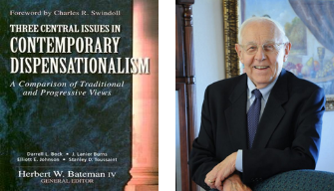
Stanley D. Toussaint
“Israel and the Church of a Traditional Dispensationalist,” in Three Central Issues in Contemporary Dispensationalism, ed. Herbert W. Bateman (Grand Rapids: Kregel, 1999), 242.
“It is difficult to explain why Luke does not use the term if the kingdom is being inaugurated. He employs it forty-five times in the gospel. . . . [O]ne would expect Luke to use the word if such a startling thing as the inauguration of the kingdom had taken place. The fact that Luke uses kingdom only eight times in Acts after such heavy usage in his gospel implies that the kingdom had not begun but was in fact, postponed.”

Slide 57
Messengers of the Kingdom In Matthew
John the Baptist – 3:2
Jesus Christ – 4:17
12 Apostles – 10:5-7
Seventy – Luke 10:1, 9
Toussaint, Behold the King, 18-20

Slide 58
CONCLUSION

Slide 59
Generic References to the Kingdom in Acts
(Acts 1:3, 6; 8:12; 14:22; 19:8; 20:25; 28:23, 31)
Lack of a definition of the kingdom
Teaching about the unrealized does not necessarily make it realized in the present
Kingdom mentioned 45x in Luke’s prequel

Slide 60
Response to Kingdom Now Problem Passages
Passages from Christ’s ministry
Passages from Acts
Passages from Paul
Passages from the General letters
Passages from Revelation
Miscellaneous Arguments

Slide 61

3. Passages from Paul’s Writings
Walk worthy of the kingdom (1 Thess. 2:12)
Kingdom power (1 Cor. 4:20)
He must reign until… (1 Cor. 15:23-28)
Kingdom is not eating & drinking (Rom. 14:17)
King of Kings & Lord of Lords (1 Tim. 6:15)
Transferred into the Kingdom (Col 1:13)
Fellow workers for the Kingdom (Col. 4:11)

