Slide 1
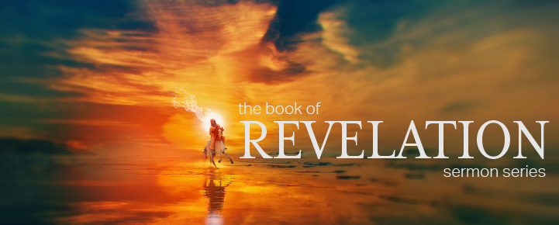
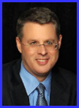
Dr. Andy Woods
Senior Pastor – Sugar Land Bible Church
President – Chafer Theological Seminary

Slide 3
7th Seal & 1st Six Trumpets (Revelation 8‒9)
7th Seal (8:1-6) – Trumpet preparation
1st Trumpet (8:7) – 1/3 vegetation destroyed
2nd Trumpet (8:8-9) – 1/3 ocean destroyed
3rd Trumpet (8:10-11) – 1/3 water destroyed
4th Trumpet (8:12-13) – 1/3 luminaries darkened
5th Trumpet (9:1-12) – Demons released
6th Trumpet (9:13-21) – 1/3 humanity destroyed

Slide 5
5 Non-Chronological Parenthetical Insertions
Rev 7 – 144,000 Jews
Rev 10:1-11:13 – Announcement of no more delay and the two witnesses
Rev 12-14 – Israel’s flight, two beasts, six scenes of hope
Rev 16:13-16 – Gathering of the nations to Armageddon
Rev 17:1-19:6 – Babylon’s fall

Slide 6
5 Non-Chronological Parenthetical Insertions
Rev 7 – 144,000 Jews
Rev 10:1-11:13 – Announcement of no more delay and the two witnesses
Rev 12-14 – Israel’s flight, two beasts, six scenes of hope
Rev 16:13-16 – Gathering of the nations to Armageddon
Rev 17:1-19:6 – Babylon’s fall

Slide 7
2. Revelation 10:1‒11:13
Rev 10 – Announcement of no more delay
Rev 11:1-2 – End of the Times of the Gentiles
Rev 11:3-13 – Ministry of the Two Witnesses

Slide 8
2. Revelation 10:1‒11:13
Rev 10 – Announcement of no more delay
Rev 11:1-2 – End of the Times of the Gentiles
Rev 11:3-13 – Ministry of the Two Witnesses

Slide 9
2. Revelation 10:1‒11:13
Rev 10 – Announcement of no more delay
Rev 11:1-2 – End of the Times of the Gentiles
Rev 11:3-13 – Ministry of the Two Witnesses

Slide 10
2. Revelation 10:1‒11:13
Rev 10 – Announcement of no more delay
Rev 11:1-2 – End of the Times of the Gentiles
Rev 11:3-13 – Ministry of the Two Witnesses

Slide 11
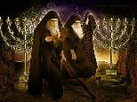
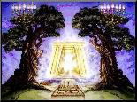
The Two Witnesses
(Revelation 11:3-13)
Their Ministry (11:3-6)
Their Martyrdom (11:7-10)
Their Revival (11:11-13)

Slide 12
The Two Witnesses
(Revelation 11:3-13)
Their Ministry (11:3-6)
Their Martyrdom (11:7-10)
Their Revival (11:11-13)

Slide 13
I. Their Ministry (Revelation 11:3-6)
Its Duration (11:3)
Its Empowerment (11:4)
Its Activity (11:5-6)
Fire (11:5)
Drought (11:6a)
Waters (11:6b)
Plagues (11:6c)

Slide 14
The Two Witnesses
(Revelation 11:3-13)
Their Ministry (11:3-6)
Their Martyrdom (11:7-10)
Their Revival (11:11-13)

Slide 15
II. Their Martyrdom (Revelation 11:7-10)
Its Cause (11:7)
Its Place (11:8)
Its Contempt (11:9)
Its Celebration (11:10)

Slide 16
II. Their Martyrdom (Revelation 11:7-10)
Its Cause (11:7)
Its Place (11:8)
Its Contempt (11:9)
Its Celebration (11:10)

Slide 17
II. Their Martyrdom (Revelation 11:7-10)
Its Cause (11:7)
Its Place (11:8)
Its Contempt (11:9)
Its Celebration (11:10)

Slide 18
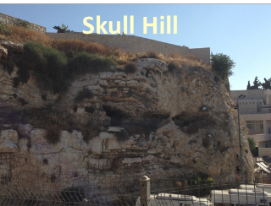
Revelation 11:8
“And their dead bodies will lie in the street of the great city which mystically is called Sodom and Egypt, where also their Lord was crucified.”

Slide 19
II. Their Martyrdom (Revelation 11:7-10)
Its Cause (11:7)
Its Place (11:8)
Its Contempt (11:9)
Its Celebration (11:10)

Slide 20
Revelation 11:8-10
“⁸ And their dead bodies will lie in the street of the great city which mystically is called Sodom and Egypt, where also their Lord was crucified. ⁹ Those from the peoples and tribes and tongues and nations will look at their dead bodies for three and a half days, and will not permit their dead bodies to be laid in a tomb. ¹⁰ And those who dwell on the earth will rejoice over them and celebrate; and they will send gifts to one another, because these two prophets tormented those who dwell on the earth.”

Slide 21
PROPHETIC CHESS BOARD IS BEING SET UP

Slide 22
Israel Installs Security Cameras as Jerusalem Tensions Build By Oren Liebermann and Ian Lee, CNN - July 24, 2017
“Jerusalem (CNN). Israel has installed security cameras near the entrance to one of the holiest sites in Jerusalem as tensions between Israelis and Palestinians edge higher after a violent week…Israel installed security cameras near the entrance to Old City of Jerusalem holy site early Sunday morning.”
http://www.cnn.com/2017/07/23/middleeast/israeli-palestinian-jerusalem-security/index.html

Slide 23
II. Their Martyrdom (Revelation 11:7-10)
Its Cause (11:7)
Its Place (11:8)
Its Contempt (11:9)
Its Celebration (11:10)

Slide 24
Thomas Ice Thomas Ice, “Kept From the Hour,” online: www.pre-trib.org, accessed 4 September 2014, 2.
“This phrase ‘earth dwellers’ is used eleven times in nine verses in Revelation (3:10; 6:10; 8:13; 11:10 2xs; 13:8, 12, 14 2xs; 14:6; 17:8). As you examine each individual use…you will see that all refer to a special class of stubborn sinners who are set in their rebellion against the God of heaven. You will also find that the phrase is only used to refer to those during the tribulation period. Therefore, since the future hour spoken of in 3:10 is set in contrast with the present set of believers in the church age, and the future ‘earth dwellers’ will be active during the time period in which believers are said to be kept from, it is clear that John speaks of the time or hour of the tribulation. This is why 3:10 is a clear promise that Christ will keep believers from the time of the seven year tribulation.”

Slide 25
The Two Witnesses
(Revelation 11:3-13)
Their Ministry (11:3-6)
Their Martyrdom (11:7-10)
Their Revival (11:11-13)

Slide 26
III. Their Revival (Revelation 11:11-13)
Their Resuscitation (11:11)
Their Rapture (11:12)
Revival’s Result (11:13)
Earthquake (11:13a)
City’s One-Tenth (11:13b)
7000 Killed (11:13c)
Holy Fear (11:13d)

Slide 27
III. Their Revival (Revelation 11:11-13)
Their Resuscitation (11:11)
Their Rapture (11:12)
Revival’s Result (11:13)
Earthquake (11:13a)
City’s One-Tenth (11:13b)
7000 Killed (11:13c)
Holy Fear (11:13d)

Slide 28
III. Their Revival (Revelation 11:11-13)
Their Resuscitation (11:11)
Their Rapture (11:12)
Revival’s Result (11:13)
Earthquake (11:13a)
City’s One-Tenth (11:13b)
7000 Killed (11:13c)
Holy Fear (11:13d)

Slide 29
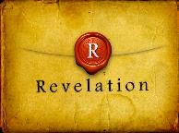
Revelation 4:1
“After these things I looked, and behold, a door standing open in heaven, and the first voice which I had heard, like the sound of a trumpet speaking with me, said, ‘Come up here, and I will show you what must take place after these things.’”

Slide 30
Exemption from Death (1 Cor 15:54-56)
Enoch (Gen 5)
Elijah (2 Kings 2)
Christ (Acts 1:11; Rev 12:5)
Philip (Acts 8:39)
Paul (2 Cor 12:2, 4)
John (Rev 4:1-2)
Two witnesses (Rev 11)

Slide 31
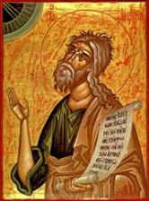
Jeremiah 30:7 (LXX)
“Alas! for that day is great, There is none like it; And it is the time of Jacob’s distress (Gen. 32:8; 35:10), But he will be saved [sōzō] from [apo] it.”

Slide 32
Daniel 9:24
Seventy weeks have been decreed for your people and your holy city, to finish the transgression, to make an end of sin, to make atonement for iniquity, to bring in everlasting righteousness, to seal up vision and prophecy and to anoint the most holy place.

Slide 34
Revelation 11:8
“And their dead bodies will lie in the street of the great city which mystically is called Sodom and Egypt, where also their Lord was crucified.”

Slide 35
Revelation 11:8-10
“⁸ And their dead bodies will lie in the street of the great city which mystically is called Sodom and Egypt, where also their Lord was crucified. ⁹ Those from the peoples and tribes and tongues and nations will look at their dead bodies for three and a half days, and will not permit their dead bodies to be laid in a tomb. ¹⁰ And those who dwell on the earth will rejoice over them and celebrate; and they will send gifts to one another, because these two prophets tormented those who dwell on the earth.”

Slide 36
III. Their Revival (Revelation 11:11-13)
Their Resuscitation (11:11)
Their Rapture (11:12)
Revival’s Result (11:13)
Earthquake (11:13a)
City’s One-Tenth (11:13b)
7000 Killed (11:13c)
Holy Fear (11:13d)

Slide 37
III. Their Revival (Revelation 11:11-13)
Their Resuscitation (11:11)
Their Rapture (11:12)
Revival’s Result (11:13)
Earthquake (11:13a)
City’s One-Tenth (11:13b)
7000 Killed (11:13c)
Holy Fear (11:13d)

Slide 38
Times of Israel 14 July 2018
After tremors, experts warn a huge quake is the greatest threat facing Israel
“Scientists say thousands could die because Israel, which sits on a major fault line, has ignored warnings to strengthen homes and schools. After a series of minor tremors rattled northern Israel over the last two weeks, experts warned that the country is negligently unprepared for a major earthquake that would likely kill thousands of people, including many children. ‘The threat of an earthquake, is in my eyes, the greatest threat facing the state of Israel,’ geologist Ariel Heimann told Hadashot news on Friday... ‘It is definitely a greater threat than the Qassam [rockets] fired … ”
https://www.timesofisrael.com/after-tremors-experts-warn-a-huge-quake-is-the-greatest-threat-facing-israel/14 July 2018.

Slide 39
Times of Israel 14 July 2018
After tremors, experts warn a huge quake is the greatest threat facing Israel
“… from Gaza, and it is a far greater danger than the Iranian threat.’ Israel sits on the Syrian-African rift, a tear in the earth’s crust running the length of the border separating Israel and Jordan, and is part of the Great Rift Valley, which extends from northern Syria to Mozambique. ‘If, God forbid, we have an earthquake like this, it will leave thousands dead and hundreds of thousands of people will have to leave their homes. Houses will be destroyed, there will be massive economic damage that will set the country back dozens of years,’ Heimann warned.”
https://www.timesofisrael.com/after-tremors-experts-warn-a-huge-quake-is-the-greatest-threat-facing-israel/14 July 2018.

Slide 40
III. Their Revival (Revelation 11:11-13)
Their Resuscitation (11:11)
Their Rapture (11:12)
Revival’s Result (11:13)
Earthquake (11:13a)
City’s One-Tenth (11:13b)
7000 Killed (11:13c)
Holy Fear (11:13d)

Slide 41
Revelation 11:8
“And their dead bodies will lie in the street of the great city which mystically is called Sodom and Egypt, where also their Lord was crucified.”

Slide 42
III. Their Revival (Revelation 11:11-13)
Their Resuscitation (11:11)
Their Rapture (11:12)
Revival’s Result (11:13)
Earthquake (11:13a)
City’s One-Tenth (11:13b)
7000 Killed (11:13c)
Holy Fear (11:13d)

Slide 43
III. Their Revival (Revelation 11:11-13)
Their Resuscitation (11:11)
Their Rapture (11:12)
Revival’s Result (11:13)
Earthquake (11:13a)
City’s One-Tenth (11:13b)
7000 Killed (11:13c)
Holy Fear (11:13d)

Slide 44
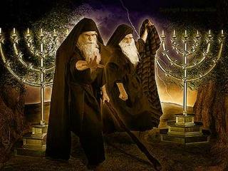
Identity of the Two Witnesses?
Symbolic view
Elijah and Enoch
Moses and Elijah like
Moses and Elijah literal

Slide 45
Identity of the Two Witnesses?
Symbolic view
Elijah and Enoch
Moses and Elijah like
Moses and Elijah literal

Slide 46
Revelation 11:8
“And their dead bodies will lie in the street of the great city which mystically is called Sodom and Egypt, where also their Lord was crucified.”

Slide 47
Identity of the Two Witnesses?
Symbolic view
Elijah and Enoch
Moses and Elijah like
Moses and Elijah literal

Slide 48
Hebrews 9:27
“And inasmuch as it is appointed for men to die once and after this comes judgment.”

Slide 49
Jeremiah 30:7 (LXX)
“Alas! for that day is great, There is none like it; And it is the time of Jacob’s distress (Gen. 32:8; 35:10), But he will be saved [sōzō] from [apo] it.”

Slide 50
Daniel 9:24
Seventy weeks have been decreed for your people and your holy city, to finish the transgression, to make an end of sin, to make atonement for iniquity, to bring in everlasting righteousness, to seal up vision and prophecy and to anoint the most holy place.

Slide 51
Identity of the Two Witnesses?
Symbolic view
Moses and Enoch
Moses and Elijah like
Moses and Elijah literal

Slide 52
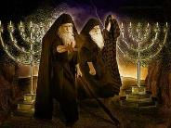
Malachi 4:5-6
⁵ “Behold, I am going to send you Elijah the prophet before the coming of the great and terrible day of the Lord. ⁶ He will restore the hearts of the fathers to their children and the hearts of the children to their fathers, so that I will not come and smite the land with a curse.”

Slide 53
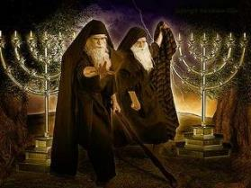
Matthew 11:13-14
“¹³ For all the prophets and the Law prophesied until John. ¹⁴ And if you are willing to accept it, John himself is Elijah who was to come.”

Slide 54
Identity of the Two Witnesses?
Symbolic view
Elijah and Enoch
Moses and Elijah like
Moses and Elijah literal

Slide 55
Identity of the Two Witnesses
Category | Revelation 11 | Moses & Elijah
Protection | Rev. 11:5 | Num. 16:35; 2 Kgs. 1:10-14
Activities | Rev. 11:6 | Exod. 7:12-21; 1 Kgs. 17:1
Duration | Rev. 11:3 | Luke 4:25; Jas. 5:17
Rapture | Rev. 11:12 | 2 Kgs. 2:11

Slide 56
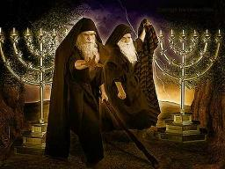
Identity of the 2 Witnesses: Moses and Elijah
Transfiguration (Matt 17:3)
Ministries cut short in the OT (2 Kgs 2:11-12; Num 20:12)
Future appearance predicted in the OT (Mal 4:5-6; Jude 9)
Never fulfilled in the NT (Luke 1:17; John 1:21)

Slide 57
Identity of the 2 Witnesses: Moses and Elijah
Transfiguration (Matt 17:3)
Ministries cut short in the OT (2 Kgs 2:11-12; Num 20:12)
Future appearance predicted in the OT (Mal 4:5-6; Jude 9)
Never fulfilled in the NT (Luke 1:17; John 1:21)

Slide 58
Matthew 17:1-3
¹ “Six days later Jesus took with Him Peter and James and John his brother, and led them up on a high mountain by themselves. ² And He was transfigured before them; and His face shone like the sun, and His garments became as white as light. ³ And behold, Moses and Elijah appeared to them, talking with Him.”

Slide 59
Identity of the 2 Witnesses: Moses and Elijah
Transfiguration (Matt 17:3)
Ministries cut short in the OT (2 Kgs 2:11-12; Num 20:12)
Future appearance predicted in the OT (Mal 4:5-6; Jude 9)
Never fulfilled in the NT (Luke 1:17; John 1:21)

Slide 60
Identity of the 2 Witnesses: Moses and Elijah
Transfiguration (Matt 17:3)
Ministries cut short in the OT (2 Kgs 2:11-12; Num 20:12)
Future appearance predicted in the OT (Mal 4:5-6; Jude 9)
Never fulfilled in the NT (Luke 1:17; John 1:21)

Slide 61
Malachi 4:5-6
⁵ “Behold, I am going to send you Elijah the prophet before the coming of the great and terrible day of the Lord. ⁶ He will restore the hearts of the fathers to their children and the hearts of the children to their fathers, so that I will not come and smite the land with a curse.”

Slide 62
Jude 9
“But Michael the archangel, when he disputed with the devil and argued about the body of Moses, did not dare pronounce against him a railing judgment, but said, ‘The Lord rebuke you!’”

Slide 63
Identity of the 2 Witnesses: Moses and Elijah
Transfiguration (Matt 17:3)
Ministries cut short in the OT (2 Kgs 2:11-12; Num 20:12)
Future appearance predicted in the OT (Mal 4:5-6; Jude 9)
Never fulfilled in the NT (Luke 1:17; John 1:21)

Slide 64
Malachi 4:5-6
⁵ “Behold, I am going to send you Elijah the prophet before the coming of the great and terrible day of the Lord. ⁶ He will restore the hearts of the fathers to their children and the hearts of the children to their fathers, so that I will not come and smite the land with a curse.”

Slide 65
Luke 1:17
“It is he who will go as a forerunner before Him in the spirit and power of Elijah, to turn the hearts of the fathers back to the children, and the disobedient to the attitude of the righteous, so as to make ready a people prepared for the Lord.”

Slide 66
John 1:19-21
“¹⁹ This is the testimony of John, when the Jews sent to him priests and Levites from Jerusalem to ask him, ‘Who are you?’ ²⁰ And he confessed and did not deny, but confessed, ‘I am not the Christ.’ ²¹ They asked him, ‘What then? Are you Elijah?’ And he said, ‘I am not.’ ‘Are you the Prophet?’ And he answered, ‘No.’”

Slide 67
Identity of the 2 Witnesses: Moses and Elijah
Transfiguration (Matt 17:3)
Ministries cut short in the OT (2 Kgs 2:11-12; Num 20:12)
Future appearance predicted in the OT (Mal 4:5-6; Jude 9)
Never fulfilled in the NT (Luke 1:17; John 1:21)

Slide 68
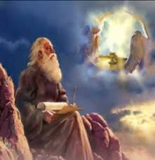
God’s Work Through Israel
Revelation 7 – 144,000 Jews
Revelation 11 – Two Jewish witnesses
Revelation 12 – Israel flees
Revelation 20:9 – Jerusalem in the kingdom
Revelation 21:12 – 13-Gates of the eternal city

Slide 69
God’s Work Through Israel
Revelation 7 – 144,000 Jews
Revelation 11 – Two Jewish witnesses
Revelation 12 – Israel flees
Revelation 20:9 – Jerusalem in the kingdom
Revelation 21:12 – 13-Gates of the eternal city

Slide 71
Conclusion

Slide 72
The Two Witnesses
(Revelation 11:3-13)
Their Ministry (11:3-6)
Their Martyrdom (11:7-10)
Their Revival (11:11-13)

Slide 73
“The Lord bless you and keep you; the Lord make his face shine on you and be gracious to you; the Lord turn his face toward you and give you peace.” (NIV)

