Slide 1
ISRAEL 2019
ANDY WOODS
Part 3

Slide 2
Tel Aviv, Joppa, Caesarea Maritma,
Mt. Carmel, Megiddo

Slide 3
Sepphoris, Upper Galilee/Caesarea-Philippi andTel Dan, Sea of Galilee, Mt. of Beatitudes

Slide 4
Capernaum, Tabgha, Jordan River,
Bet She 'An, Jericho

Slide 5
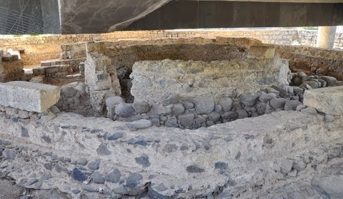
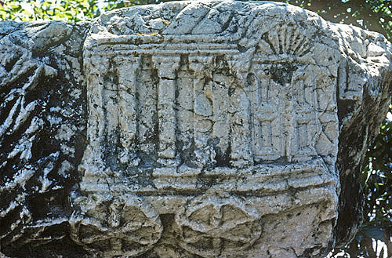
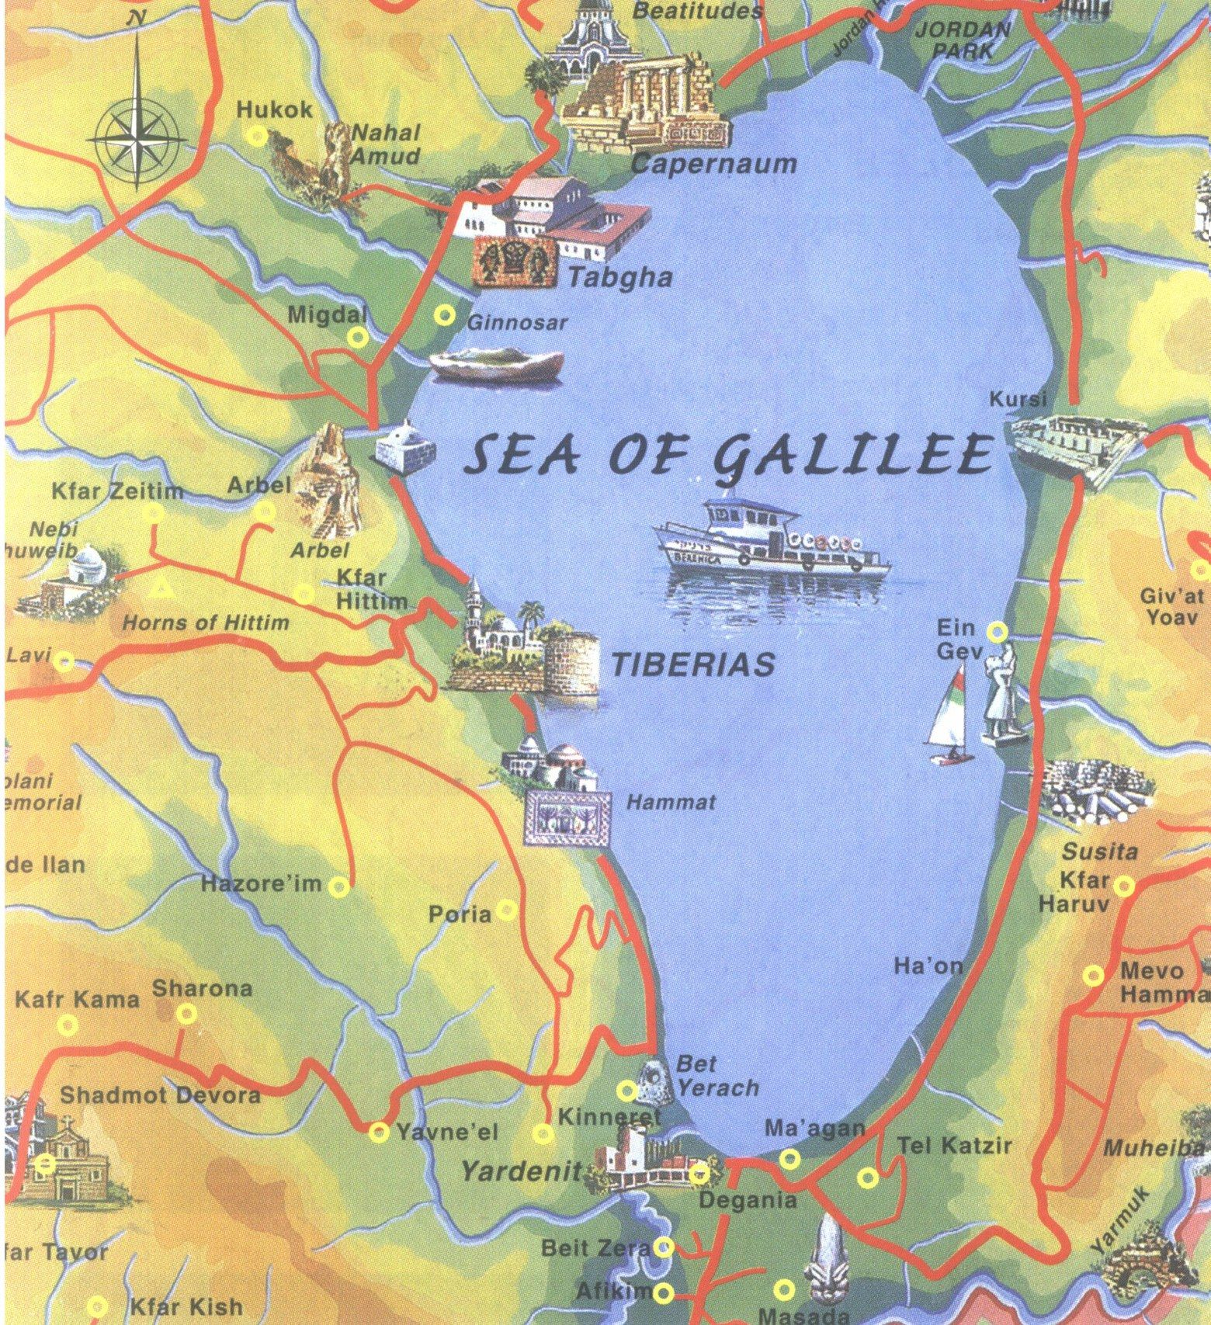
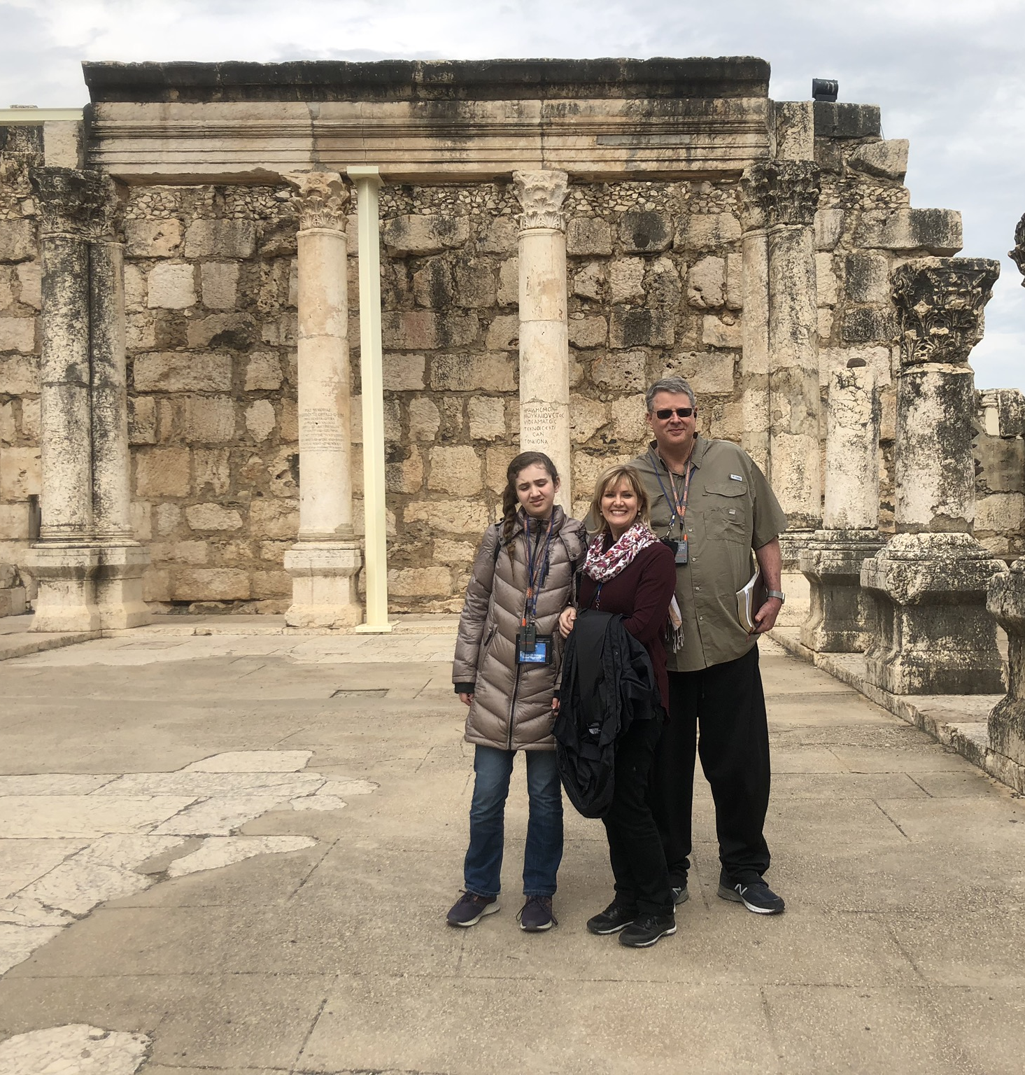
Capernaum
Peter’s family home
Synagogue

Slide 6
7 “I AM” statements in John
I am the Bread of Life | 6:35
I am the Light of the world | 8:12
I am the Gate for the sheep | 10:7; cf. v.9
I am the Good Shepherd | 10:11,14
I am the Resurrection and the Life | 11:25
I am the Way and the Truth and the Life | 14:6
I am the true Vine | 15:1; cf. v.5

Slide 7
Capernaum
Peter’s family home
Synagogue

Slide 8
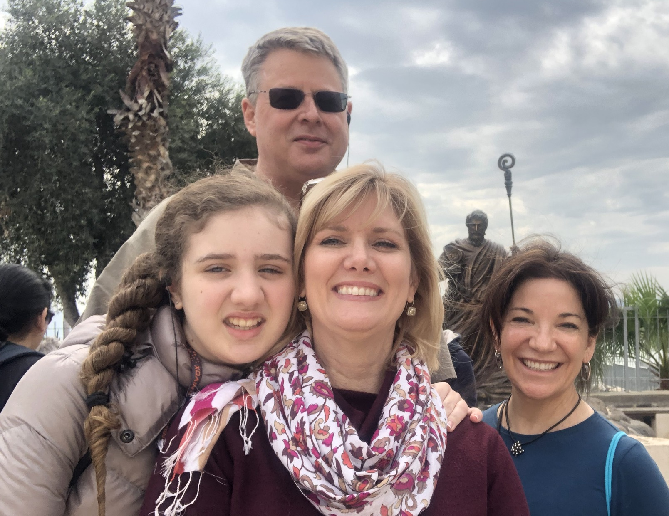
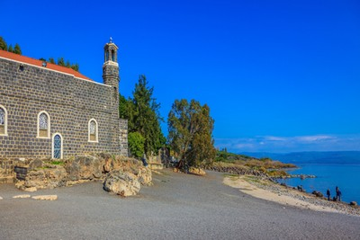
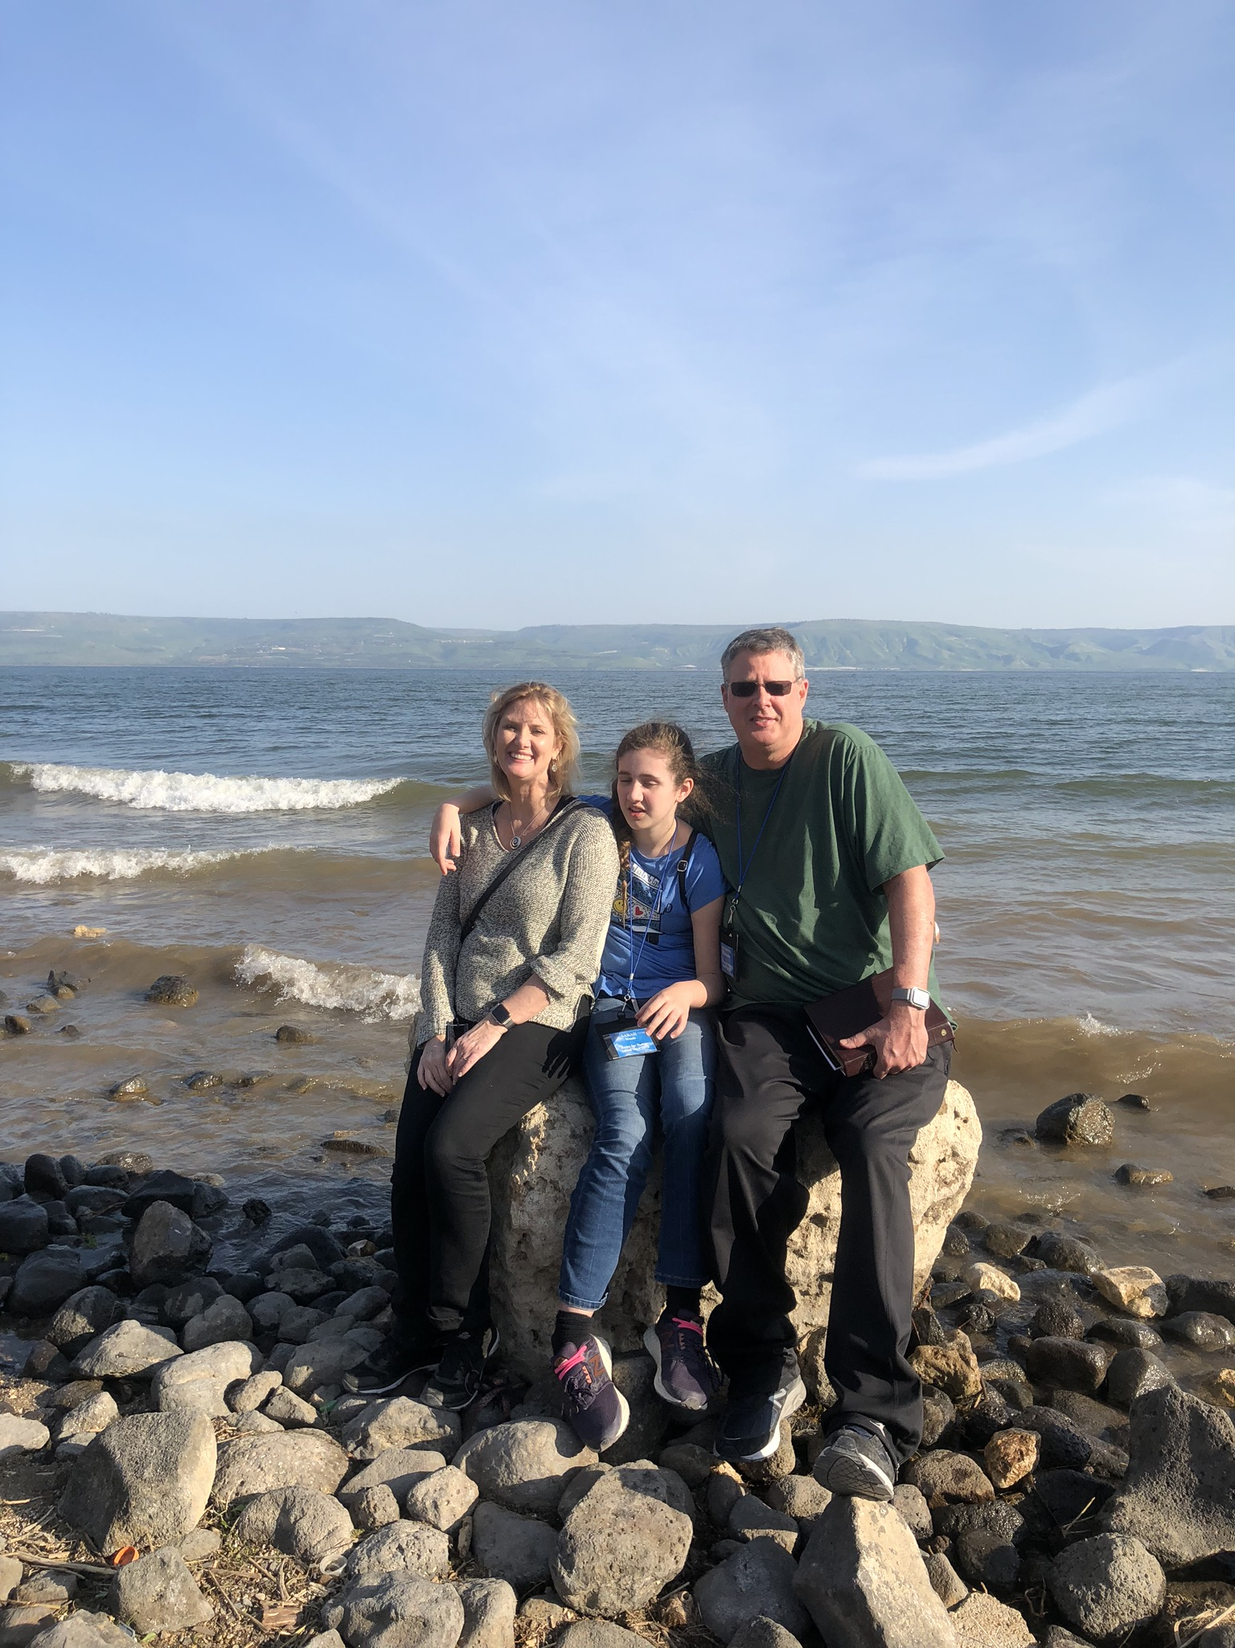
Tabgha
Peter’s Primacy
Feeding of 5000

Slide 9
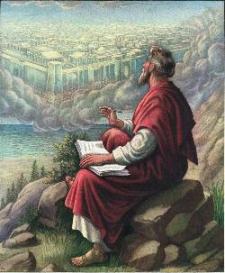
John 20:30-31
“Therefore many other signs Jesus also performed in the presence of the disciples, which are not written in this book; but these have been written so that you may believe that Jesus is the Christ, the Son of God; and that believing you may have life in His name.”

Slide 11
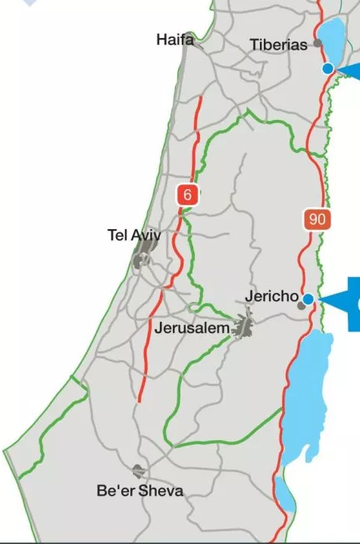
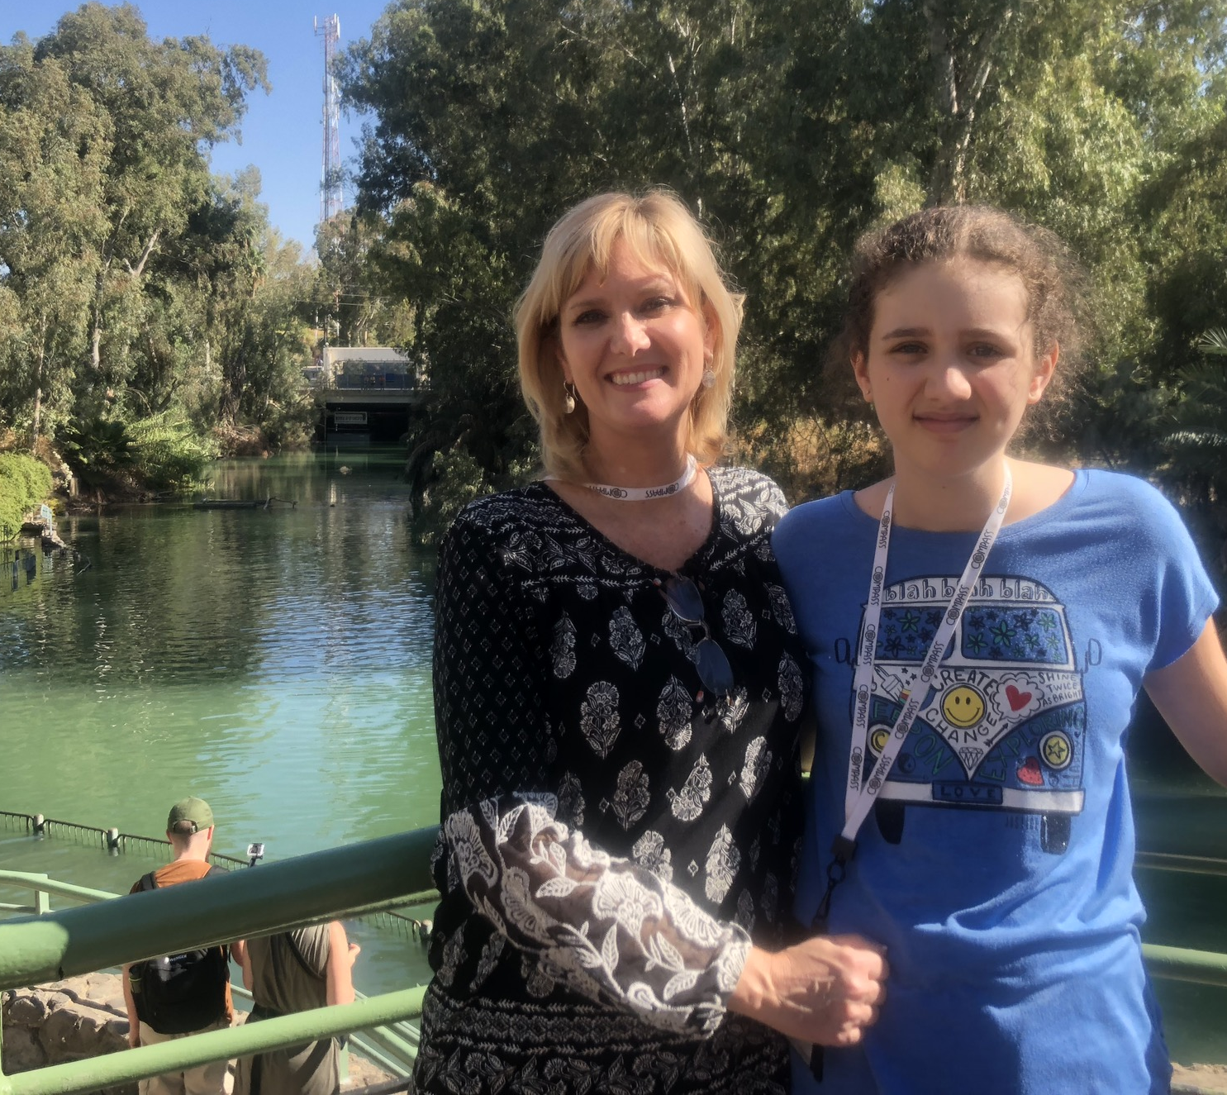
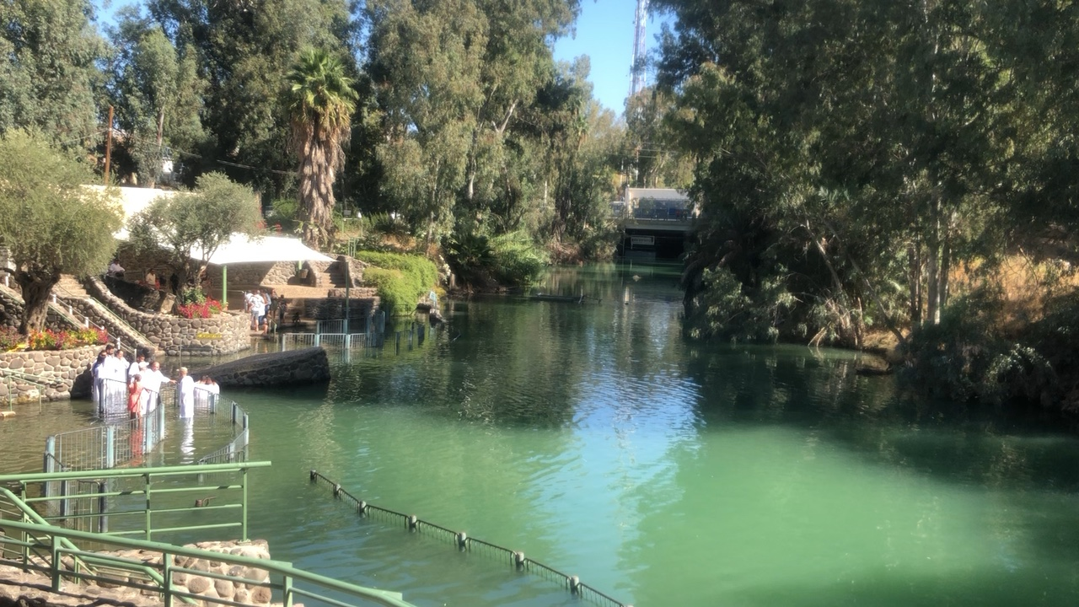
Jordan River
Yardernit
Yardernit
Baptisms

Slide 12
Matthew 28:18-20
^{18 “}And Jesus came up and spoke to them, saying, ‘All authority has been given to Me in heaven and on earth. ¹⁹ Go therefore and make disciples of all the nations, baptizing them in the name of the Father and the Son and the Holy Spirit, ²⁰ teaching them to observe all that I commanded you; and lo, I am with you always, even to the end of the age.’”

Slide 13
Messengers of the Kingdom In Matthew
John the Baptist – 3:2
Jesus Christ – 4:17
12 Apostles – 10:5-7
Seventy – Luke 10:1, 9
Toussaint, Behold the King, 18-20

Slide 14
Matthew 3:1-2 (NASB)
“Now in those days John the Baptist came, preaching in the wilderness of Judea, saying, ‘Repent, for the kingdom of heaven is at hand.’”

Slide 15
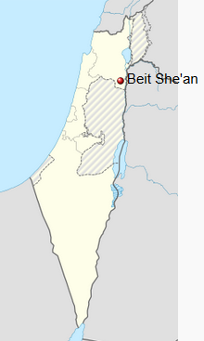
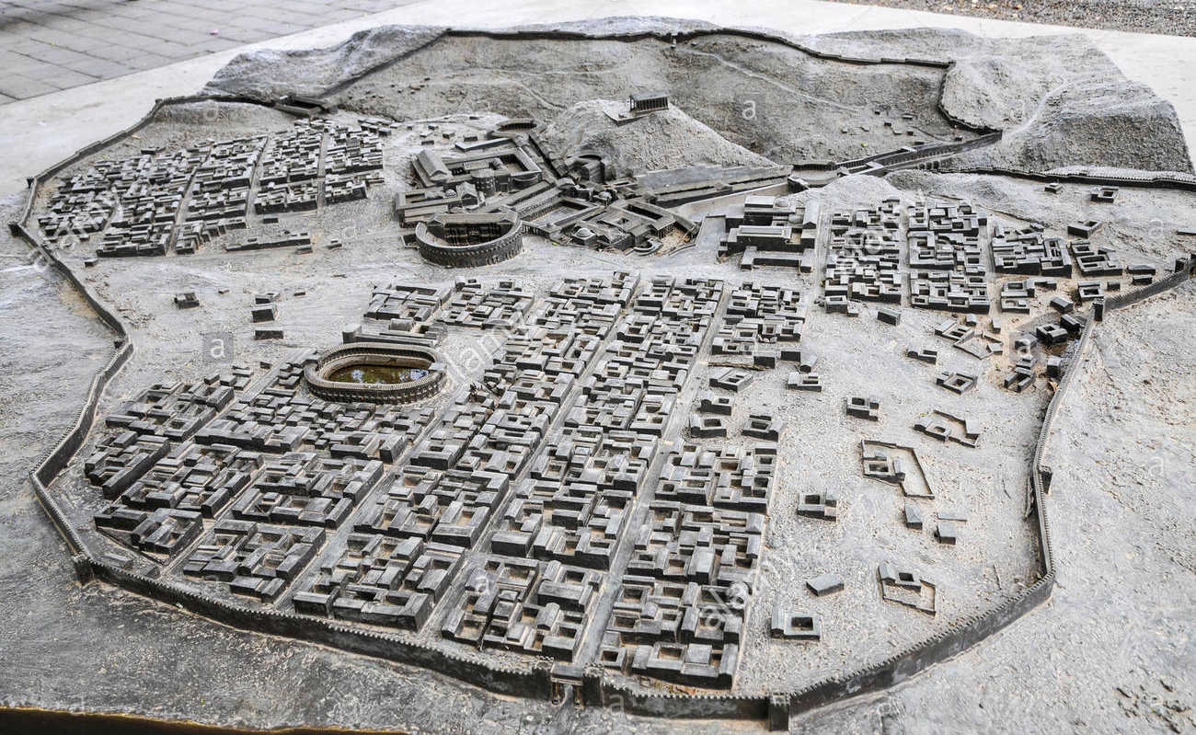
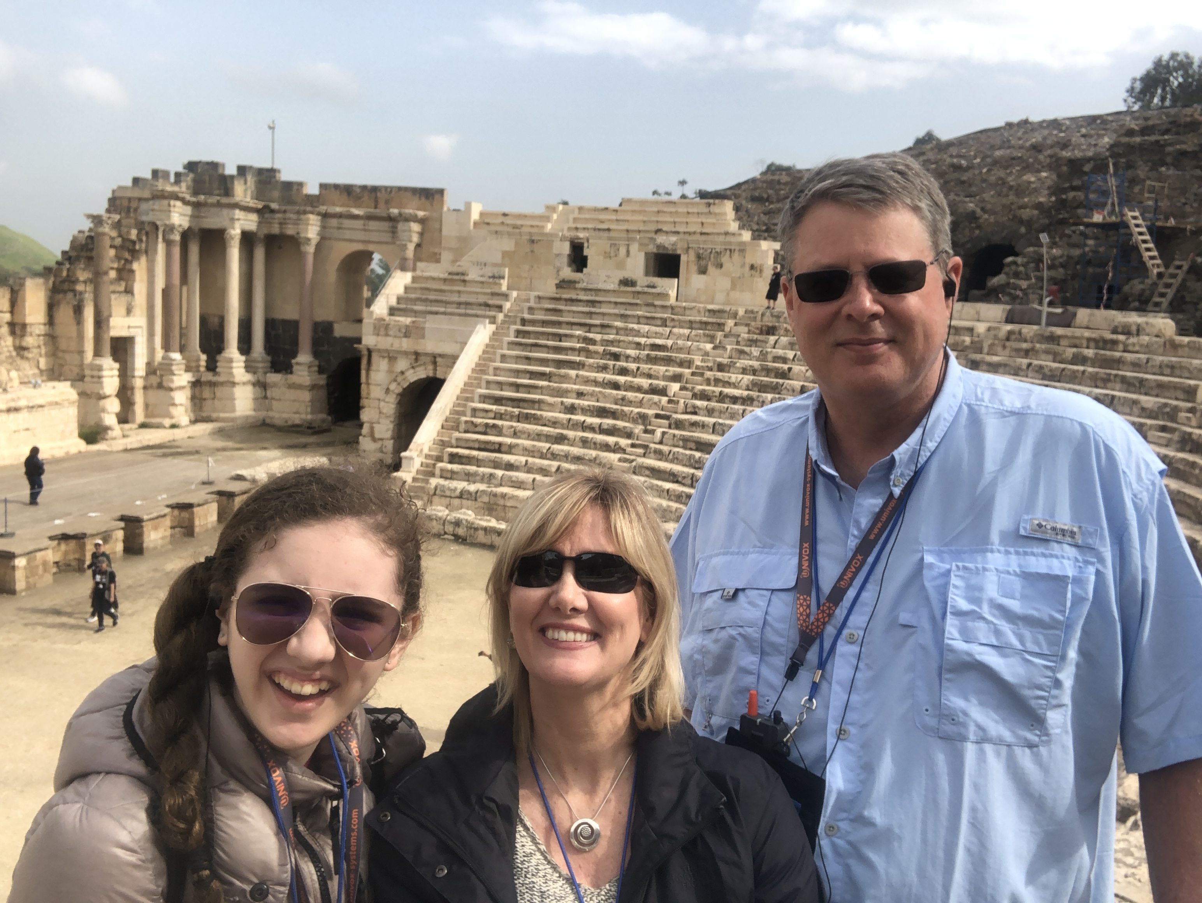
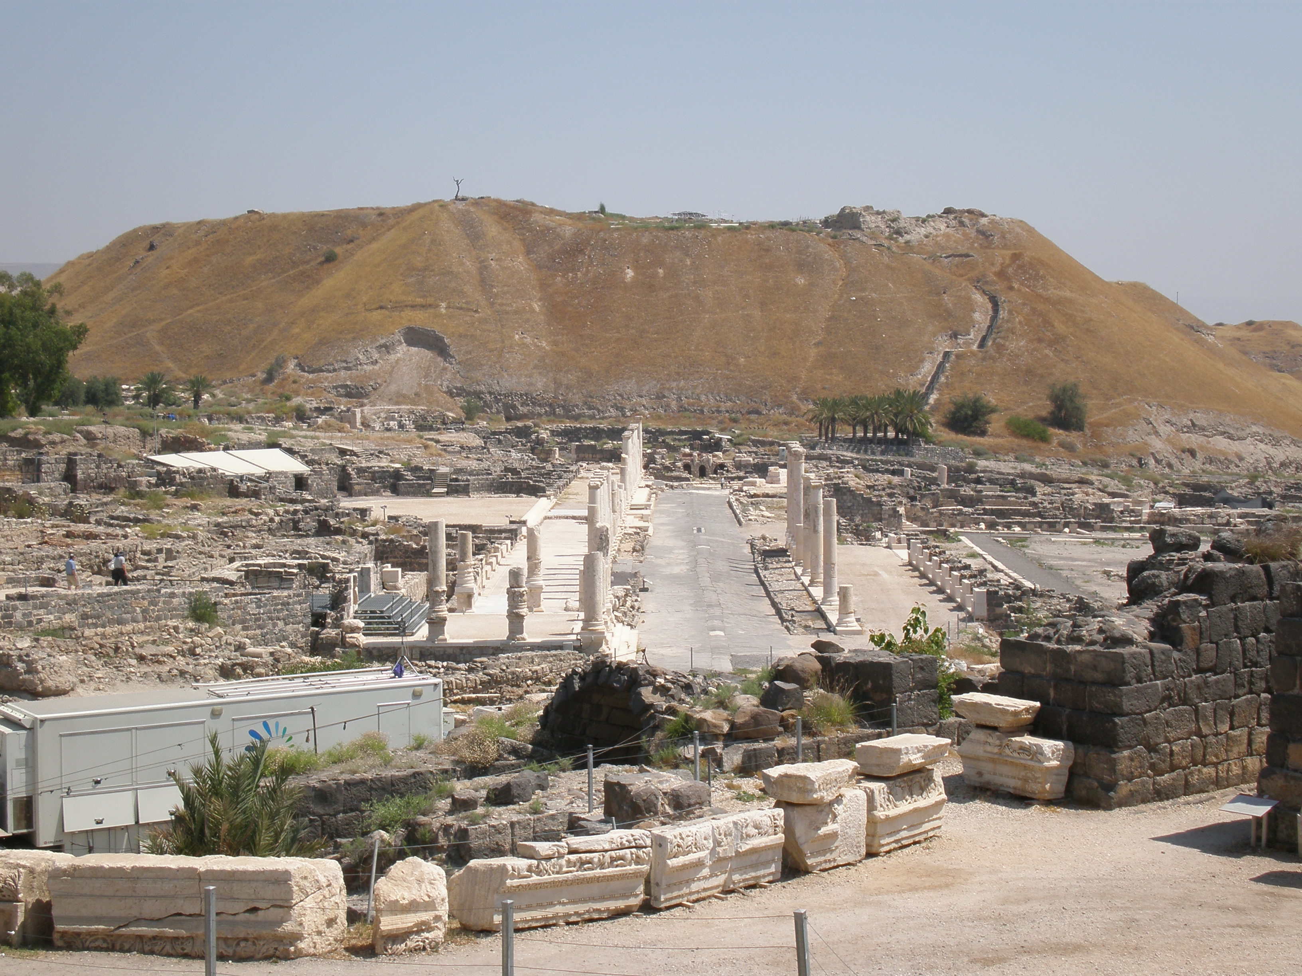
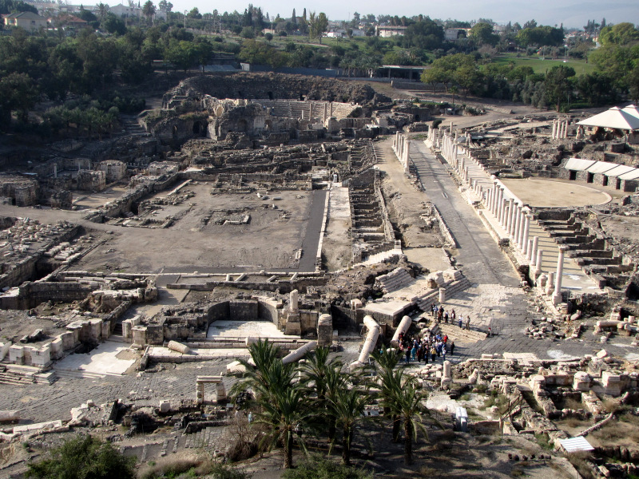
Bet She’An
Roman Ruins
Joshua, Saul, Jonathan

Slide 16
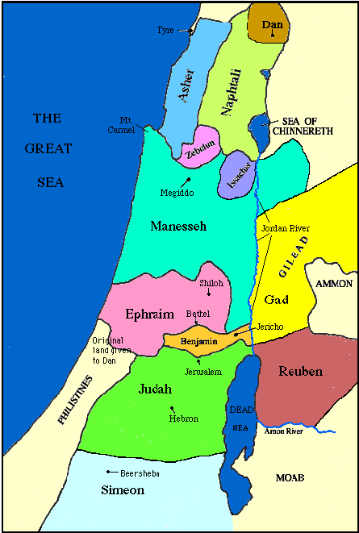

Slide 17
Levitical Feasts (Lev. 23)
Feast | Season | Purpose | Type
Passover | Spring | Redemption | 1 Cor. 5:7
Unleavened Bread | Spring | Separation | John 6:35
1st fruits | Spring | Praise | 1 Cor. 15:20
Pentecost | Spring | Praise | Acts 2:1-4
Trumpets | Fall | New Year | Matt. 24:31
Atonement | Fall | Lev 16 | Zech. 12:10
Booths | Fall | Wilderness provision | Zech. 14:16-18

Slide 18
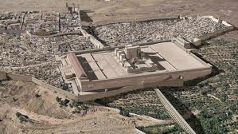
Christ’s Five Trips to Jerusalem
Feast | Verse
Passover | 2:23
Unnamed | 5:1
Tabernacles | 7:2
Dedication | 10:22
Passover | 13:1

Slide 19
Revelation 11:8-10
“⁸ And their dead bodies will lie in the street of the great city which mystically is called Sodom and Egypt, where also their Lord was crucified. ⁹ Those from the peoples and tribes and tongues and nations will look at their dead bodies for three and a half days, and will not permit their dead bodies to be laid in a tomb. ¹⁰ And those who dwell on the earth will rejoice over them and celebrate; and they will send gifts to one another, because these two prophets tormented those who dwell on the earth.”

Slide 20
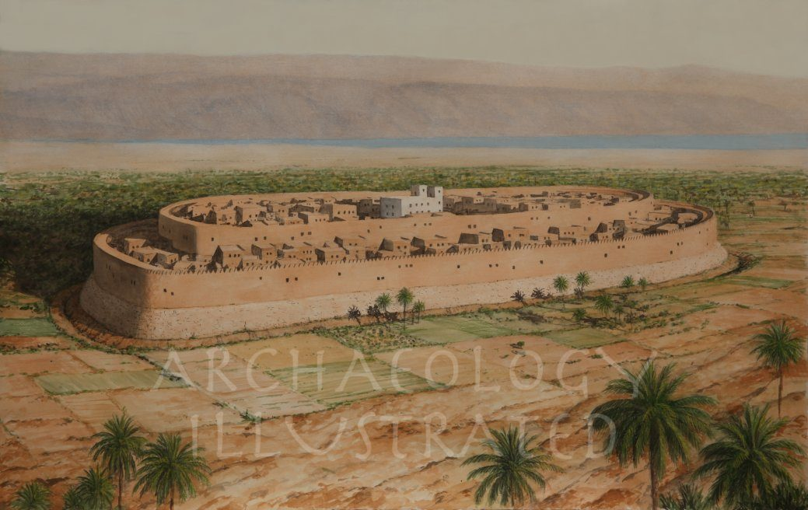
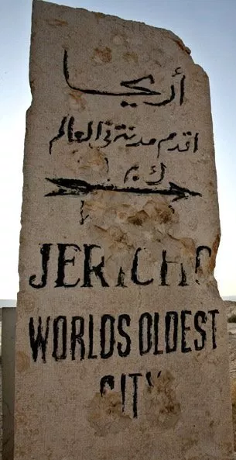
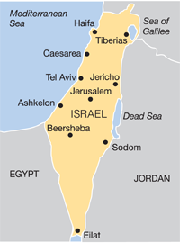
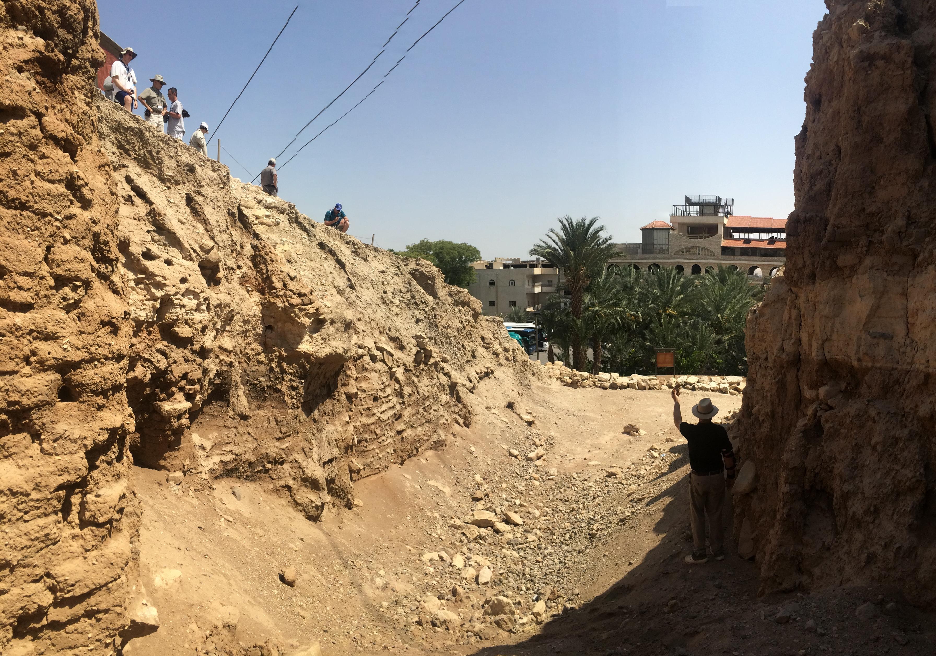
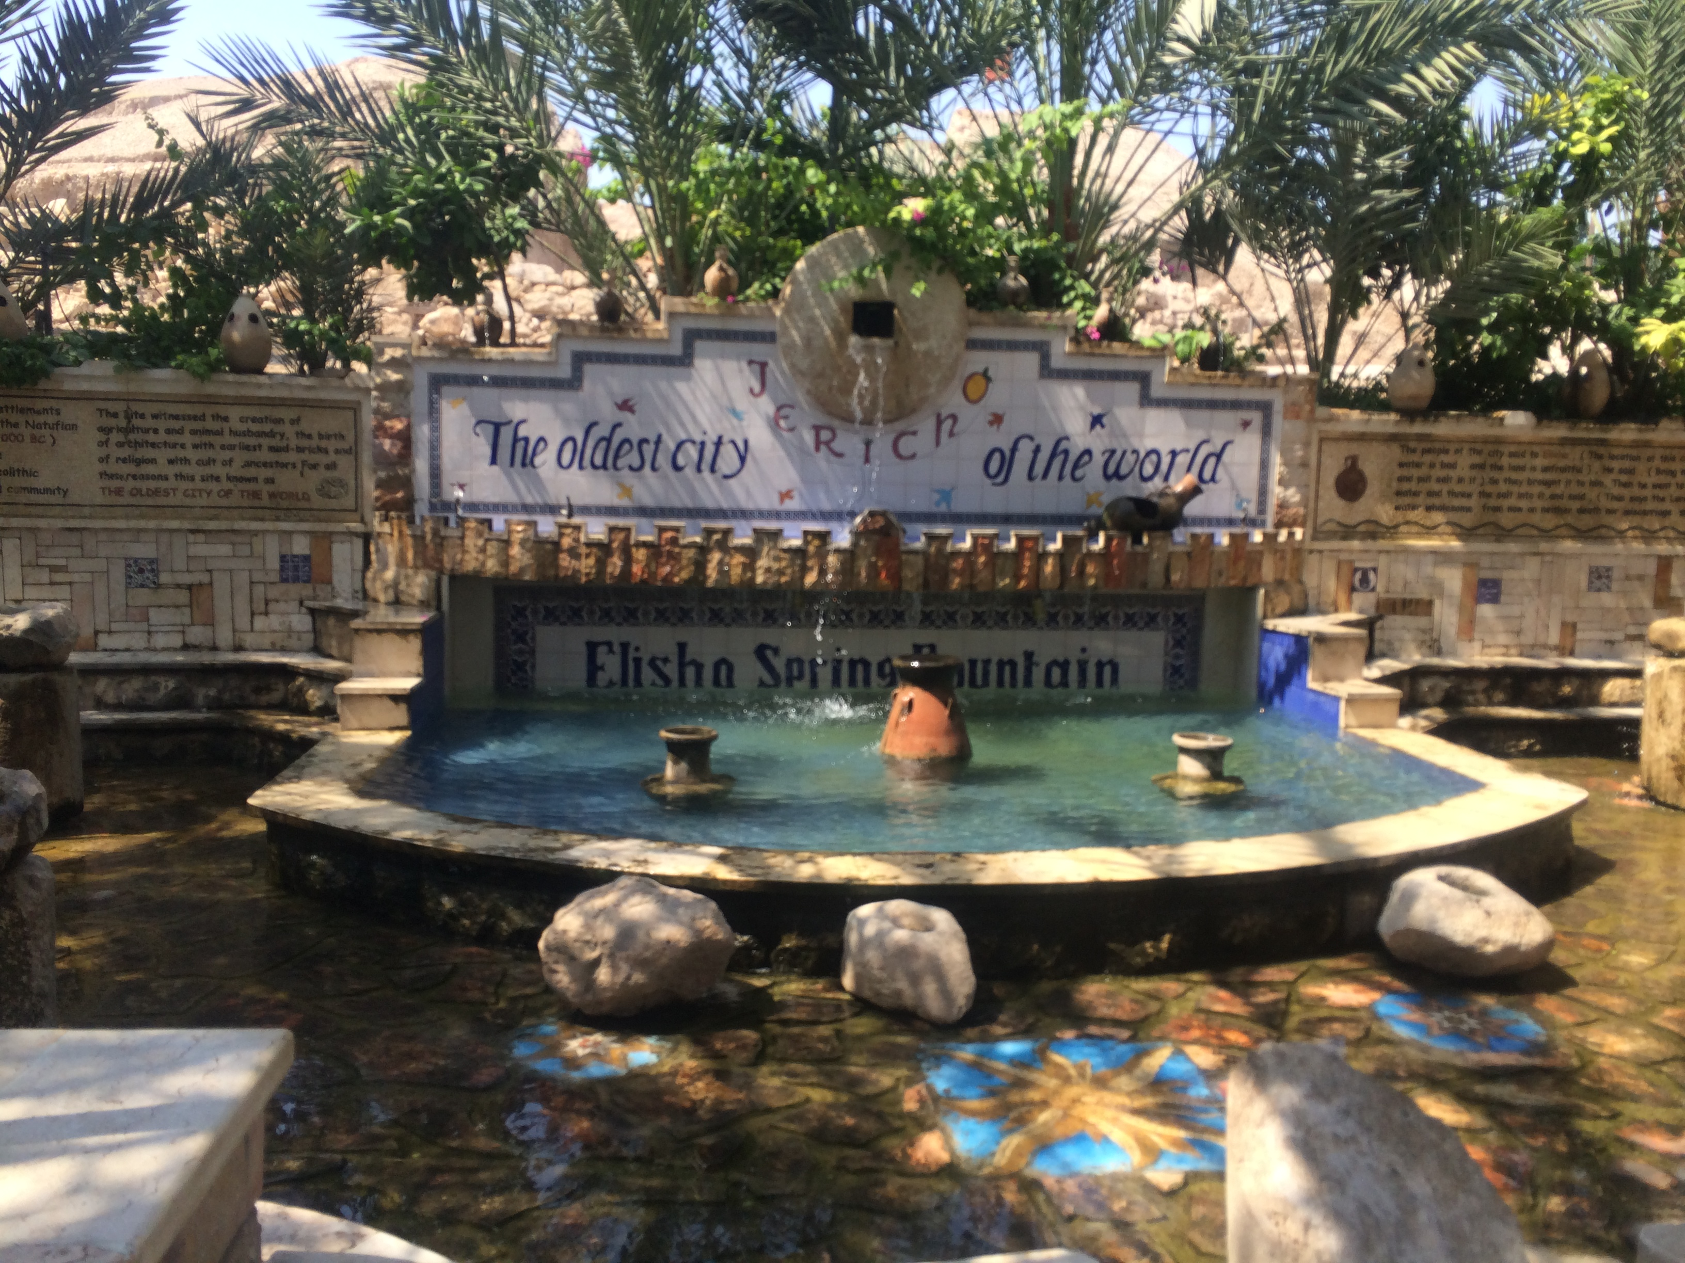
Jericho
Joshua, Elijah
Walls

Slide 22
Levitical Feasts (Lev. 23)
Feast | Season | Purpose | Type
Passover | Spring | Redemption | 1 Cor. 5:7
Unleavened Bread | Spring | Separation | John 6:35
1st fruits | Spring | Praise | 1 Cor. 15:20
Pentecost | Spring | Praise | Acts 2:1-4
Trumpets | Fall | New Year | Matt. 24:31
Atonement | Fall | Lev 16 | Zech. 12:10
Booths | Fall | Wilderness provision | Zech. 14:16-18

Slide 23
Christ’s Five Trips to Jerusalem
Feast | Verse
Passover | 2:23
Unnamed | 5:1
Tabernacles | 7:2
Dedication | 10:22
Passover | 13:1

