Slide 1
Biblical Dispensationalism
Jim McGowan, MTS, Th.D.

Slide 2
Introduction to Biblical Dispensationalism Sessions 1-3 Outline
Important Assumptions and Prerequisites
Definition of Biblical Dispensationalism
Origins of Biblical Dispensationalism
Evidence for Dispensationalism
What is a Dispensation?

Slide 4
Session 1-2 Outline
Important Assumptions and Prerequisites
The Inspiration & Authority of Scripture
Revelation
Inspiration
Inerrancy
Canon
Hermeneutics

Slide 6
Session 3 Outline
Definition of Biblical Dispensationalism
A Common Misconception
Some Anti-Dispensationalists
Definition
Literal Interpretation
Biblical Distinctions
Dispensations

Slide 7
Session 3 Outline
Origins of Biblical Dispensationalism
According to the writing of the church fathers, Dispensational concepts were held early and throughout the history of the church.
Chaldeans (1000 B.C.), Etruscan Religion (800 B.C.); The Persians (500 B.C.), Israel (200 B.C.)
Notes:
Economy = an orderly management or arrangement of parts; organization or system

Slide 8
Session 3 Outline
Evidence for Dispensationalism
Law vs. Grace
The Coming Kingdom
Logic and Additional Dispensations

Slide 9
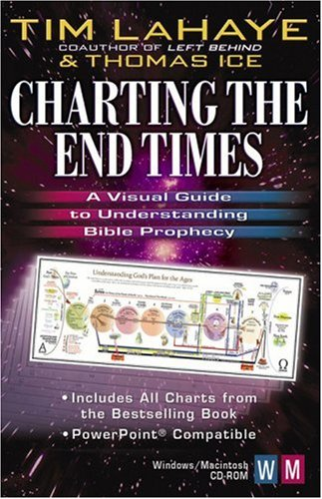
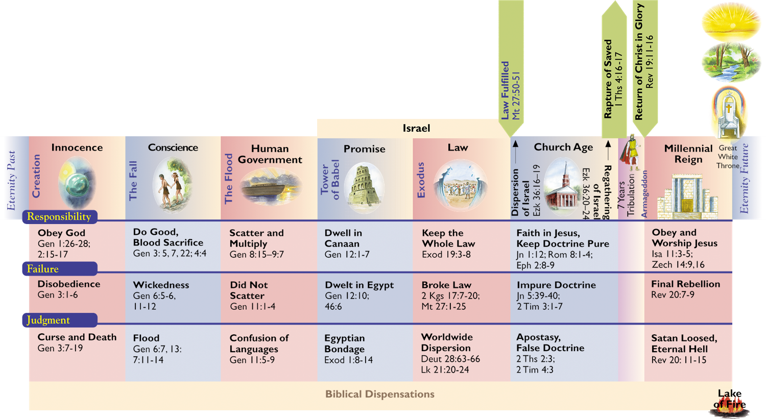
Session 3 Outline
Dispensations or Administrations

Slide 10
Session 3 Outline
What is a Dispensation?
“As far as the use of the word in Scripture is concerned, a dispensation may be defined as a stewardship, administration, oversight, or management of others’ property.…this involves responsibility, accountability, and faithfulness on the part of the steward…A concise definition of a dispensation is this: A dispensation is a distinguishable economy in the outworking of God’s purpose….The differentiation of viewpoints in this definition is a helpful distinction. A dispensation is from God’s viewpoint an economy; from man’s, a responsibility; and in relation to progressive revelation, a stage in it.
Ryrie, C. C. (1995). Dispensationalism (Rev. and expanded., p. 33, 36). Chicago: Moody Publishers.
Notes:
Economy - the management of household or private affairs

Slide 12
Overview
The Early Church
The Alexandrian Abdication
The Dark Ages
Positive Contributions of the Reformers
The Reformers’ Incomplete Reforms
Contemporary Reformation Theology
Dispensationalism's Contribution
Notes:
Outline

Slide 13
Overview
The Early Church
Justin Martyr (A.D. 110–165)
Irenaeus (A.D. 110–165)
Clement of Alexandria (A.D. 150–220)
Augustine (A.D. 354–430)
Notes:
Outline

Slide 14
Charles C. Ryrie Ryrie, C. C. (1995). Dispensationalism (Rev. and expanded., p. 74). Chicago: Moody Publishers.
Ryrie concludes, “It is not suggested nor should it be inferred that these early Church Fathers were dispensationalists in the modern sense of the word. But it is true that some of them enunciated principles which later developed into dispensationalism, and it may be rightly said that they held to primitive or early dispensational concepts.”
Enns, P. P. (1989). The Moody Handbook of Theology (p. 514). Chicago, IL: Moody Press.

Slide 15
Overview
The Early Church
The Alexandrian Abdication
The Dark Ages
Positive Contributions of the Reformers
The Reformers’ Incomplete Reforms
Contemporary Reformation Theology
Dispensationalism's Contribution
Notes:
Outline

Slide 16
Allegorization
Allegorizing is searching for a hidden or a secret meaning underlying but remote from and unrelated in reality to the more obvious meaning of a text. In other words the literal reading is a sort of code, which needs to be deciphered to determine the more significant and hidden meaning. In this approach the literal is superficial; the allegorical is the true meaning.
Zuck, Roy B. Basic Bible Interpretation: A Practical Guide to Discovering Biblical Truth (p. 29). Edited by Craig Bubeck Sr. Colorado Springs, CO: David C. Cook, 1991.

Slide 17
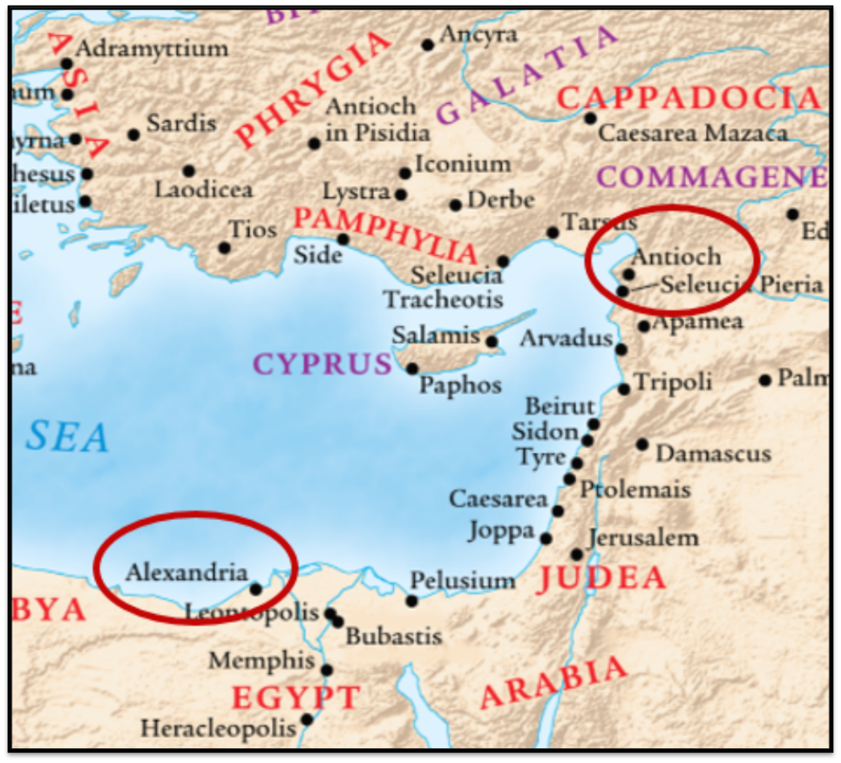
Alexandrian and Antiochene Fathers
Two [Christian] schools of thought developed about 200 years or so after Christ, schools of hermeneutical views that had a strong impact on the church for centuries to come.
Zuck, Roy B. Basic Bible Interpretation: A Practical Guide to Discovering Biblical Truth (p. 35). Edited by Craig Bubeck Sr. Colorado Springs, CO: David C. Cook, 1991.

Slide 18
5 Causes for the Shift to Allegorism
Need for immediate relevance
Incorporation of human philosophy into interpretation
Gnostic dualism (Gen. 1:31; 1 John 2:22; 4:2-3; Acts 17:32; 1 Cor. 15:12)
Decline of the church's Jewish population
Constantine’s Edict of Milan (A.D. 313)

Slide 19
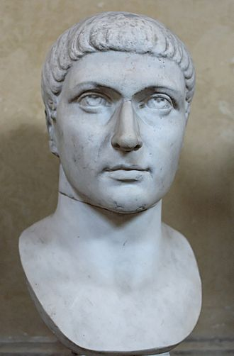
Constantine’s Edict of Milan (A.D. 313)
This agreement to treat Christians benevolently, was made in February 313 a.d. and it gave Christianity legal status within the Roman Empire. It did not however, make Christianity the official religion of the Roman empire, as some have mistakenly concluded. This took place under Emperor Theodosius I in 380 a.d.

Slide 20
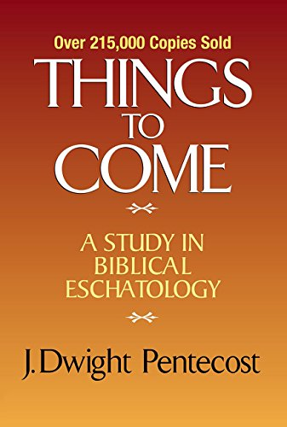
Dangers of Allegorization
Text is not being interpreted
Authority is transferred from text to interpreter
There is no way to test the interpreter
No mechanism for controlling the interpreter’s imagination
Pentecost, Things to Come, pps. 4-5

Slide 22
Overview
The Early Church
The Alexandrian Abdication
The Dark Ages
Positive Contributions of the Reformers
The Reformers’ Incomplete Reforms
Contemporary Reformation Theology
Dispensationalism's Contribution
Notes:
Outline

Slide 23
III. The Dark Ages (or the Middle Ages)
Lasted from the 4th to the 16th centuries
Only one church: Roman Catholicism
Dominated by Augustinian Amillennialism
Amillennialism deemphasized prophetic studies
The Bible is removed from the people
Allegorization
Illiteracy
Mass read in Latin
Church in need of rescue
Notes:
Outline

Slide 24
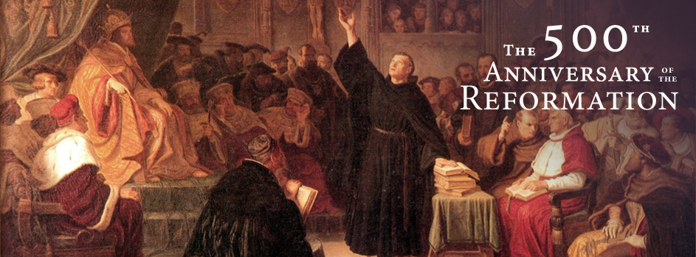
October 31, 1517
October 31, 2017

Slide 25
Overview
The Early Church
The Alexandrian Abdication
The Dark Ages
Positive Contributions of the Reformers
The Reformers’ Incomplete Reforms
Contemporary Reformation Theology
Dispensationalism's Contribution
Notes:
Outline

Slide 26
IV. Positive Contributions of the Reformers
Emphasis on literal interpretation
Denunciation of allegorization
Rejection of church tradition as a guide
Priesthood of all believers
Bible translations
Literacy
Rejection of celibacy of the priesthood
Five solas
Notes:
Outline

Slide 27
IV. Positive Contributions of the Reformers
Number | Latin | Meaning
1. | Sola Scriptura | Scripture Alone
2. | Solus Christus | Christ Alone
3. | Sola Fide | Faith Alone
4. | Sola Graetia | Grace Alone
5. | Soli Deo Gloria | To the Glory of God Alone

Slide 29
Biblical Dispensationalism
Session 6
History of Biblical Dispensationalism

Slide 30
Overview
The Early Church
The Alexandrian Abdication
The Dark Ages
Positive Contributions of the Reformers
THE REFORMERS’ INCOMPLETE REFORMS
Contemporary Reformation Theology
Dispensationalism's Contribution
Notes:
Outline

Slide 31
V. The Reformers’ Incomplete Reforms
Selective literalism
“Irresponsibly” dealt with eschatology
Retained and Perpetuated Augustinian Amillennialism
Perpetuated Roman Catholicism’s Errors
Wanted to ‘reform’ not leave the Church
Infant baptism
Consubstantiation
Church = the earthly kingdom
Anti-Semitism
Notes:
Outline

Slide 32
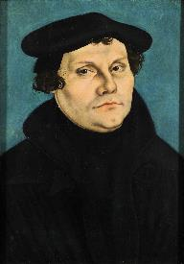
Martin Luther
(1483 – 1546 a.d.)
Roy B. Zuck, Basic Bible Interpretation: A Practical Guide to Discovering Biblical Truth (Colorado Springs, CO: Victor, 1991), 45.
“Though Luther vehemently opposed the allegorizing of Scripture, he too occasionally allegorized. For instance, he stated that Noah’s Ark is an allegory of the Church. For Luther, Bible interpretation is to be centered in Christ. Rather than allegorizing the Old Testament, he saw Christ frequently in the Old Testament, often beyond what is legitimately provided for in proper interpretation.”

Slide 33
V. The Reformers’ Incomplete Reforms
Selective literalism
“Irresponsibly” dealt with eschatology
Retained and Perpetuated Augustinian Amillennialism
Perpetuated Roman Catholicism’s Errors
Wanted to ‘reform’ not leave the Church
Infant baptism
Consubstantiation
Church = the earthly kingdom
Anti-Semitism
Notes:
Outline

Slide 34
Allegorization
Allegorizing is searching for a hidden or a secret meaning underlying but remote from and unrelated in reality to the more obvious meaning of a text. In other words the literal reading is a sort of code, which needs to be deciphered to determine the more significant and hidden meaning. In this approach the literal is superficial; the allegorical is the true meaning.
Zuck, Roy B. Basic Bible Interpretation: A Practical Guide to Discovering Biblical Truth (p. 29). Edited by Craig Bubeck Sr. Colorado Springs, CO: David C. Cook, 1991.

Slide 35
V. The Reformers’ Incomplete Reforms
Selective literalism
“Irresponsibly” dealt with eschatology
Retained and Perpetuated Augustinian Amillennialism
Perpetuated Roman Catholicism’s Errors
Wanted to ‘reform’ not leave the Church
Infant baptism
Consubstantiation
Church = the earthly kingdom
Anti-Semitism
Notes:
Outline

Slide 36
“Now their fiction is too childish either to need or to be worth a refutation. And the Apocalypse, from which they undoubtedly drew a pretext for their error, does not support them. For the number ‘one thousand’ [Rev. 20:4] does not apply to the eternal blessedness of the church but only to the various disturbances that awaited the church, while still toiling on earth…Those who assign the children of God a thousand years in which to enjoy the inheritance of the life to come do not realize how much reproach they are casting upon Christ and his Kingdom.”
John Calvin
(1509- 1564 a.d.)
Institutes of the Christian Religion, III, xxv, 5.

Slide 37
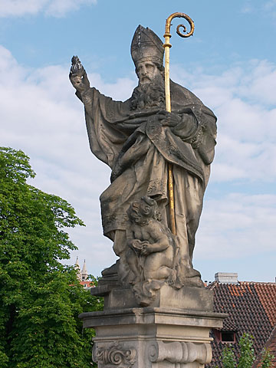
Renald Showers
John Ankerberg and Renald Showers, The Most Asked Prophecy Questions (Chattanooga, TN: ATRI, 2000), 328.
Showers explains, “The Lutheran, Reformed, and Anglican Reformers rejected Premillennialism as being ‘Jewish opinions.’ They maintained the Amillennial view which the Roman Catholic Church had adopted from Augustine.”

Slide 38
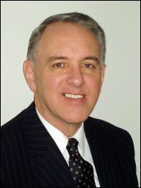
Barry Horner
Future Israel: Why Christian Anti-Judaism Must Be Challenged, ed. E. Ray Clendenen, NAC Stuides in Bible & Theology (Nashville, TN: Baker, 2007), 155-60.
“The inheritance from the Augustinian tradition that modern Europe received, . . .resulted in a continuance of an eschatology that upheld the essentially anti-Judiac thesis, namely, the transference of blessings, formerly promised to Israel, to the Christian church for it's fulfillment...On a much larger scale the reformed movement maintained its allegiance to Augustinian eschatology, which essentially found authoritative expression in the writings of Francis Turretin (1623–1687) who studied at Calvin's academy in Geneva and later taught there for 30 years. His monumental Institutes of Elenctic Theology became the epitome of reformed doctrine. Not surprisingly, his quotations of Augustine are copious, even far exceeding references to Calvin. Consequently, Turretin's eschatology is almost predictable. . .

Slide 39
Barry Horner
Future Israel: Why Christian Anti-Judaism Must Be Challenged, ed. E. Ray Clendenen, NAC Stuides in Bible & Theology (Nashville, TN: Baker, 2007), 155-60.
...Of course such a mass incorporation into the church is to the exclusion of any perpetuation of Jewish identity. In classic Augustinian fashion, there is token recognition of Jewish individuality for a time, though any form of Jewish restoration was considered to be a gross form of chiliasm. Turretin's Institutes became the central textbook for systematic theology in American Ivy League colleges during the later half of the 18th century. It is not surprising that the early theologians of Princeton Theological Seminary highly esteemed this most influential legacy, and of course it's eschatology.”

Slide 40
V. The Reformers’ Incomplete Reforms
Selective literalism
“Irresponsibly” dealt with eschatology
Retained and Perpetuated Augustinian Amillennialism
Perpetuated Roman Catholicism’s Errors
Wanted to ‘reform’ not leave the Church
Infant baptism
Consubstantiation
Church = the earthly kingdom
Anti-Semitism
Notes:
Outline

Slide 41
V. The Reformers’ Incomplete Reforms
Selective literalism
“Irresponsibly” dealt with eschatology
Retained and Perpetuated Augustinian Amillennialism
Perpetuated Roman Catholicism’s Errors
Wanted to ‘reform’ not leave the Church
Infant baptism
Consubstantiation
Church = the earthly kingdom
Anti-Semitism
Notes:
Outline

Slide 42
Augustine
The City of God, trans., Marcus Dods (NY: Random House, 1950), Book XX, chap. 9, p. 725-26.
Augustine wrote, “the saints reign with Christ during the same thousand years, understood in the same way, that is, of the time of His first coming” and “Therefore the Church even now is the kingdom of Christ, and the kingdom of heaven. Accordingly, even now His saints reign with Him.”

Slide 43
Augustine
“Advice to Marcellinus on the Punishment of Donatists,” AD 412; Tr. J. G. Cunningham, Letters of Augustine, II, 169ff. In Stevenson, Creeds, Councils, and Controversies, 213.
In matters of church discipline Calvin imitated Augustine’s totalitarian style of government. Augustine, it will be remembered, advised Marcellinus, an African governor, to punish the Donatists (a Christian sect who objected to certain Church practices), “not by stretching them on the rack, nor by furrowing their flesh with iron claws, nor by scorching them with flames, but by beating them with rods.”

Slide 44
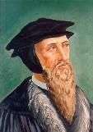
“Augustine is so wholly with me, that if I wished to write a confession of my faith, I could do so with all fullness and satisfaction to myself out of his writings.”
John Calvin
(1509- 1564 a.d.)
“A Treatise on the Eternal Predestination of God,” in John Calvin, Calvin’s Calvinism, trans. Henry Cole (Grandville, MI: Reformed Free Publishing Association, 1987), 38

Slide 45
Here, Calvin sought to reconstruct a society through the imposition of the Mosaic Law, “which he tried to imitate as much as possible in his new Christian republic in Geneva.”
John Calvin
(1509- 1564 a.d.)
Encyclopedia Judaica (Jerusalem: Keter Publishing, 1971), 66.

Slide 46
“A measure of legalism became apparent in Geneva, as the consistory put the lives of church members under continuous review and applied discipline to offenders. Church attendance was compulsory. Eating fish on Fridays was forbidden, as were attendance at theaters, dancing, cardplaying, and criticism of pastors. All heretical teaching was deemed subversive and subject to penalties under criminal law. Flagrant infractions could lead to banishment, imprisonment, and in extreme cases death. Judicial torture was common procedure.”
John Calvin
(1509- 1564 a.d.)
James Edward McGoldrick, "Introducing John Calvin: The Reformer's Preparation," Reformation and Revival 10, no. 4 (2001): 21.

Slide 47
The Encyclopaedia Judaica refers to Calvin’s “despotic theocratic regime in Geneva.”
John Calvin
(1509- 1564 a.d.)
“Calvin, John,” in Encyclopaedia Judaica, Vol. 5, 67.

Slide 48
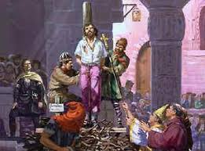
“The execution of Servetus is the greatest blot on Calvin’s life” and reveals “that vindictive streak which sometimes disgraced the character of the Reformer.”
John Calvin
(1509- 1564 a.d.)
Lewis Lupton, A History of the Geneva Bible, Vol. 2 (London: Olive Tree, 1969), 23–24.

Slide 49
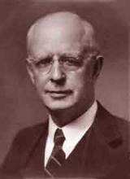
Lewis Sperry Chafer Satan: His Motives and Methods (Grand Rapids: Kregel, 1990), 29.
“Judging from the mass of Christian writings and from utterances in public address and prayer, this age is assumed by many, without question, to be the Kingdom of Christ; though no Scripture is found to warrant that conclusion.”

Slide 50
V. The Reformers’ Incomplete Reforms
Selective literalism
“Irresponsibly” dealt with eschatology
Retained and Perpetuated Augustinian Amillennialism
Perpetuated Roman Catholicism’s Errors
Wanted to ‘reform’ not leave the Church
Infant baptism
Consubstantiation
Church = the earthly kingdom
Anti-Semitism
Notes:
Outline

Slide 51
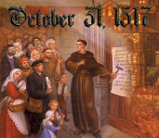
Luther and Antisemitism
95 Theses (1517)
Excommunication (1521)
“Jesus Was Born a Jew” (1523)
“Of the Jews and Their Lies” (1543)

Slide 52
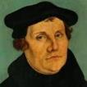
Martin Luther
Jesus Was Born a Jew (1523).
“If I had been a Jew and had seen such dolts and blockheads govern and teach the Christian faith, I would sooner have become a hog than a Christian. They have dealt with the Jews as if they were dogs rather than human beings; they have done little else than deride them and seize their property. When they baptize them they show them nothing of Christian doctrine or life, but only subject them to popishness and monkery…If the apostles, who also were Jews, had dealt with us Gentiles as we Gentiles deal with the Jews, there would never have been a Christian among the Gentiles…."
Notes:
Outline

Slide 53
Martin Luther
Jesus Was Born a Jew (1523).
“When we are inclined to boast of our position we should remember that we are but Gentiles, while the Jews are of the lineage of Christ. We are aliens and in-laws; they are blood relatives, cousins, and brothers of our Lord. Therefore, if one is to boast of flesh and blood, the Jews are actually nearer to Christ than we are…If we really want to help them, we must be guided in our dealings with them not by papal law but by the law of Christian love. We must receive them cordially, and permit them to trade and work with us, that they may have occasion and opportunity to associate with us, hear our Christian teaching, and witness our Christian life. If some of them should prove stiff-necked, what of it? After all, we ourselves are not all good Christians either."
Notes:
Outline

Slide 54
Luther and Antisemitism
95 Theses (1517)
Excommunication (1521)
“Jesus Was Born a Jew” (1523)
“Of the Jews and Their Lies” (1543)

Slide 55
Christian Anti-Semitism Concerning the Jews and Their Lies, cited in Michael Brown’s Our Hands Are Stained with Blood, pp. 14-15.
“First, their synagogues should be set on fire…Secondly, their homes should likewise be broken down and destroyed… Thirdly, they should be deprived of their prayer books and Talmuds…Fourthly, their rabbis must be forbidden under threat of death to teach any more… Fifthly, passport and traveling privileges should be absolutely forbidden to the Jews… Sixthly, they ought to be stopped from usury (charging interest on loans…Seventhly, let the young and strong Jews and Jewesses be given the flail, the ax, the hoe, the spade, the distaff, and spindle, and let the earn their bread by the sweat of their noses. We ought to drive the rascally lazy …

Slide 56
Christian Anti-Semitism Concerning the Jews and Their Lies, cited in Michael Brown’s Our Hands Are Stained with Blood, pp. 14-15.
bones out of our system…Therefore away with them… To sum up, dear princes and nobles who have Jews in your domains, if this advice of mine does not suit you, then find a better one so that you and we may all be free of this insufferable devilish burden–the Jews.”

Slide 57
Lutheran Statement https://www.ccjr.us/dialogika-resources/documents-and-statements/interreligious/759-lwfijcic1983
“We Lutherans take our name and much of our understanding of Christianity from Martin Luther. But we cannot accept or condone the violent verbal attacks that the Reformer made against the Jews…The sins of Luther’s anti-Jewish remarks, the violence of his attacks on the Jews, must be acknowledged with deep distress. And all occasions for similar sin in the present or the future must be removed from our churches…Lutherans of today refuse to be bound by all of Luther’s utterances on the Jews.”

Slide 58
John Calvin
Commentary on the Prophet Daniel (Vol 1, p. 185). Bellingham, WA: Logos Bible Software. Commentary on Daniel 2:44-45. (2010).
“But here he [the rabbi] not only betrays his ignorance, but his utter stupidity, since God so blinded the whole people that they were like restive dogs. I have had much conversation with many Jews: I have never seen either a drop of piety or a grain of truth or ingenuousness—nay, I have never found common sense in any Jew. But this fellow, who seems so sharp and ingenious, displays his own impudence to his great disgrace.”

Slide 59
The Reformers’ Report Card
‘A+’ – because they laid the groundwork for future generations by providing the right method whereby future generations could continue to reform the church through a consistent application of the Reformers’ interpretive approach.
‘F’ – because they did not make a clean break with the Roman Catholic Church and forced a ‘selective’ literal approach to Scripture upon the Protestant Church.

Slide 60
Overview
The Early Church
The Alexandrian Abdication
The Dark Ages
Positive Contributions Of The Reformers
The Reformers’ Incomplete Reforms
CONTEMPORARY REFORMATION THEOLOGY
Dispensationalism's Contribution
Notes:
Outline

Slide 61
VI. Contemporary Reformation Theology
Erroneously assumes no further theological progress to be made.
Has Frozen theological progress into creeds and confessions: Creeds and confessions = authority rather than Scripture.
Augustinian Amillennialism fossilized into RT.
Allegorizing of biblical Eschatological texts is common.
Zech. 14:4; Rev. 21-22; Ezek. 40-48
Inconsistent literal hermeneutic.
Notes:
Outline

Slide 62
VI. Contemporary Reformation Theology
Erroneously assumes no further theological progress to be made.
Has Frozen theological progress into creeds and confessions: Creeds and confessions = authority rather than Scripture.
Augustinian Amillennialism fossilized into RT.
Allegorizing of biblical Eschatological texts is common.
Zech. 14:4; Rev. 21-22; Ezek. 40-48
Inconsistent literal hermeneutic.
Notes:
Outline

Slide 63
VI. Contemporary Reformation Theology
Erroneously assumes no further theological progress to be made.
Has Frozen theological progress into creeds and confessions: Creeds and confessions = authority rather than Scripture.
Augustinian Amillennialism fossilized into RT.
Allegorizing of biblical Eschatological texts is common.
Zech. 14:4; Rev. 21-22; Ezek. 40-48
Inconsistent literal hermeneutic.
Notes:
Outline

Slide 64
Jeremy Edmondson
"Returning to Scripture as Our Sole Authority," in Free Grace Theology: 5 Ways It Magnifies the Gospel, ed. et al. Charlie C. Bing (Allen, TX: Bold Grace, 2016), 3.
“The goal of the Reformation was to point Christianity back to the Scriptures. The noble intentions of the Reformers called for the Bible as the supreme authority for believers everywhere. For this we rejoice! But if the Reformation and its resulting creeds are exalted to the standard of measuring orthodoxy, does it not defeat the very purpose for which it was intended?”

Slide 65
VI. Contemporary Reformation Theology
Erroneously assumes no further theological progress to be made.
Has Frozen theological progress into creeds and confessions: Creeds and confessions = authority rather than Scripture.
Augustinian Amillennialism fossilized into RT.
Allegorizing of biblical Eschatological texts is common.
Zech. 14:4; Rev. 21-22; Ezek. 40-48
Inconsistent literal hermeneutic.
Notes:
Outline

Slide 66
VI. Contemporary Reformation Theology
Erroneously assumes no further theological progress to be made.
Has Frozen theological progress into creeds and confessions: Creeds and confessions = authority rather than Scripture.
Augustinian Amillennialism fossilized into RT.
Allegorizing of biblical Eschatological texts is common.
Zech. 14:4; Rev. 21-22; Ezek. 40-48
Inconsistent literal hermeneutic.
Notes:
Outline

Slide 67
Zechariah 14:4
“In that day His feet will stand on the Mount of Olives, which is in front of Jerusalem on the east; and the Mount of Olives will be split in its middle from east to west by a very large valley, so that half of the mountain will move toward the north and the other half toward the south.”

Slide 68
David Reagan
“The Beginning and the Ending,” online: http://christinprophecy.org/ articles/the-beginning-and-the-ending/, accessed 19 April 2017, 1.
“In his *commentary on this passage, Boettner completely spiritualized it. He argued that the Mount of Olives stands…...for the human heart. The enemy forces symbolize the evil in this world that surrounds and attacks the heart. The Lord’s return represents what happens when a person accepts Jesus as Lord and Savior. Thus, when Jesus comes into a person’s heart, their heart (the Mount of Olives) splits in contrition, and all the evil influences in the person’s life are defeated, and Jesus becomes king of that person’s heart. That’s what I call an exercise in imagination!”
*Loraine Boettner, The Millennium (Phillipsburg, NJ: P&R Publishing Co., 1957).

Slide 69
VI. Contemporary Reformation Theology
Erroneously assumes no further theological progress to be made.
Has Frozen theological progress into creeds and confessions: Creeds and confessions = authority rather than Scripture.
Augustinian Amillennialism fossilized into RT.
Allegorizing of biblical Eschatological texts is common.
Zech. 14:4; Rev. 21-22; Ezek. 40-48
Inconsistent literal hermeneutic.
Notes:
Outline

Slide 70
Revelation 21
¹⁶ The city was laid out like a square, as long as it was wide. He measured the city with the rod and found it to be [1500 miles] in length, and as wide and high as it is long. ¹⁷ He measured its wall and it was 144 cubits thick, by man's measurement, which the angel was using.
Notes:
READ…

Slide 71
Paul Lee Tan
The Interpretation of Prophecy (Winona Lake, IN: BMH, 1974), 285-86.
Swete: “Such dimensions defy imagination and are permissible only in the language of symbolism.”
Barnes: “Of course, this must preclude all idea of there being such a city literally in Palestine…this cannot be understood literally; and the very idea of a literal fulfillment of this shows the absurdity of that method of interpretation…this cannot be taken literally; and an attempt to explain all of this literally would show that that method of interpreting the Apocalypse is impracticable.”
Grant: “no clearer proof…that all is figurative. Such a height is simply out of harmony with the constitution of our world.”
Boettner: “Neither the shape nor the dimensions of the city can be taken with mathematical exactness, as if it were a gigantic apartment house.”

Slide 72
VI. Contemporary Reformation Theology
Erroneously assumes no further theological progress to be made.
Has Frozen theological progress into creeds and confessions: Creeds and confessions = authority rather than Scripture.
Augustinian Amillennialism fossilized into RT.
Allegorizing of biblical Eschatological texts is common.
Zech. 14:4; Rev. 21-22; Ezek. 40-48
Inconsistent literal hermeneutic.
Notes:
Outline

Slide 73
Gary DeMar
Last Days Madness, 4th rev. ed. (Powder Springs, GA: American, 1999), 97-98.
“The Book of Hebrews was written to show beyond a shadow of a doubt that the entire Old Covenant system–with its priest, sacrifices, ceremonies, and temple–has been done away with in Christ…The prophecy of Ezekiel’s temple is a picture of the restored covenant community that returned to the land after the exile. The vision should not be projected 2500 years into the future into some earthly millennial kingdom where sacrifices will be offered for atonement in the presence of the crucified Christ.”

Slide 74
Ezekiel’s Two Temples
Solomon’s Chap. 8-11 & Millennial Chap. 40-48
Notes:
The Two Temples in Ezekiel Chap. 8-11 and Chap. 40-48.

Slide 75
VI. Contemporary Reformation Theology
Erroneously assumes no further theological progress to be made.
Has Frozen theological progress into creeds and confessions: Creeds and confessions = authority rather than Scripture.
Augustinian Amillennialism fossilized into RT.
Allegorizing of biblical Eschatological texts is common.
Zech. 14:4; Rev. 21-22; Ezek. 40-48
Inconsistent literal hermeneutic.
Notes:
Outline

Slide 76
Albertus Pieters
“The leader,” September 5, 1831; as cited in John F. Walvoord, The Millennial Kingdom: A Basic Text in Premillennial Theology (Findlay, OH: Dunham, 1959), 128.
“The question whether the Old Testament prophecies concerning the people of God must be interpreted in their ordinary sense, as other Scriptures are interpreted, or can properly be applied to the Christian church, is called the question of spiritualization of prophecy. This is one of the major problems in biblical interpretation, and confronts everyone who makes a serious study of the Word of God. It is one of the chief keys to the difference of opinion between Premillenarians and the mass of Christian scholars. The former reject spiritualization, the latter employ it; and as long as there is no agreement on this point the debate is interminable and fruitless.”

Slide 77
The Contemporary Reformation’s Report Card
‘F’ – because they, like the early reformers, have not made a clean break with the Roman Catholic Church and they continue to force a ‘selective’ literal approach to Scripture upon the Protestant Church.

Slide 78
Review
The Early Church
The Alexandrian Abdication
The Dark Ages
Positive Contributions of The Reformers
The Reformers’ Incomplete Reforms
Contemporary Reformation Theology
Dispensationalism's Contribution
Notes:
Outline

Slide 79
Resources
Alva J. McClain, Law & Grace, Moody, 1967 978-088469-001-6
Arnold H. Ehlert, “A Bibliography of Dispensationalism,” Bibliotheca Sacra (January 1944–January 1946): 101:95–101, 199–209, 319–28, 447–60; 102:84–92, 207–19, 322–34, 455–67; 103:57–67.
Charles C. Ryrie, Dispensationalism, Moody, 2007, 080242189X
Christopher Cone, gen. ed., Dispensationalism Tomorrow & Beyond, Tyndale Seminary Press, 2008 9780981479101
Christopher Cone, gen. ed., An Introduction To The New Covenant, Tyndale Seminary Press, 2013, 9781938484100
Walvoord, J. F., The Prophecy Knowledge Handbook. Wheaton, IL: Victor Books. 1990.
Lewis S. Chafer, Major Bible Themes, Zondervan, 1974, 0-310-22390-3
Mike Stallard, gen .ed., Dispensational Understanding of the New Covenant, Regular Baptist Books, 2012, 9781607764946
Paul Enns, The Moody Handbook of Theology, Moody 1989,
Renald E. Showers, There Really Is A Difference, Friend of Israel Gospel Ministry, 1990, 0915540509
Rene Pache, The Inspiration and Authority of Scripture, Sheffield Pub Co, 1992
Roy B. Zuck, Basic Bible Interpretation, SP Publications, 1991
Charting the End Times CD-Rom: A Visual Guide to Understanding Bible Prophecy, ISBN-10: 0736917624
Materials from:
Dr. Andy Woods, Sugar Land Bible Church, www.slbc.org
Dr. Vern Peterman, Holly Hills Bible Church, www.hollyhillsbiblechurch.org
George Zeller, Middletown Bible Church, www.middletownbiblechurch.org
Ed Allsteadt, Sugar Land Bible Church, www.slbc.org

