Slide 1
ISRAEL 2019
ANDY WOODS
Part 1

Slide 2
Ezekiel 36:24-28
²⁴ “For I will take you from the nations, gather you from all the lands and bring you into your own land. ²⁵ Then I will sprinkle clean water on you, and you will be clean; I will cleanse you from all your filthiness and from all your idols. ²⁶ Moreover, I will give you a new heart and put a new spirit within you; and I will remove the heart of stone from your flesh and give you a heart of flesh. ²⁷ I will put My Spirit within you and cause you to walk in My statutes, and you will be careful to observe My ordinances. ²⁸ You will live in the land that I gave to your forefathers; so you will be My people, and I will be your God.”

Slide 3
Ezekiel 37:7-11
So I prophesied as I was commanded; and as I prophesied, there was a noise, and behold, a rattling; and the bones came together, bone to its bone. ⁸ And I looked, and behold, sinews were on them, and flesh grew and skin covered them; but there was no breath in them. ⁹ Then He said to me, “Prophesy to the breath, prophesy, son of man, and say to the breath, ‘Thus says the Lord God, “Come from the four winds, O breath, and breathe on these slain, that they come to life.”’” ¹⁰ So I prophesied as He commanded me, and the breath came into them, and they came to life and stood on their feet, an exceedingly great army. ¹¹ Then He said to me, “Son of man, these bones are the whole house of Israel; behold, they say, ‘Our bones are dried up and our hope has perished. We are completely cut off’.”

Slide 4
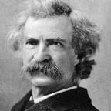
Mark Twain
The Innocents Abroad, Complete, 1st ed. (A Public Domain Book, 1869), 267, 285, 302. These quotes can be found in chapters 47, 49, 52.
“... A desolate country whose soil is rich enough, but is given over wholly to weeds… a silent mournful expanse…. a desolation is here that not even imagination can grace with the pomp of life and action…. we never saw a human being on the whole route…. there was hardly a tree or shrub anywhere. Even the olive tree and the cactus, those fast friends of a worthless soil, had almost deserted the country.”

Slide 5
Why?
COUNTRY | GROSS DOMESTIC PRODUCT
Israel | $123 billion
Egypt | $81 billion
Syria | $26 billion
Lebanon | $21 billion
Jordan | $12 billion
Source: CIA World Fact Book, 2005

Slide 6
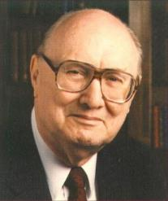
John Walvoord Israel in Prophecy, Page 26
“Of the many peculiar phenomena which characterize the present generation, few events can claim equal significance as far as Biblical prophecy is concerned with that of the return of Israel to their land. It constitutes a preparation for the end of the age, the setting for the coming of the Lord for His church, and the fulfillment of Israel’s prophetic destiny.”

Slide 7
Tel Aviv, Joppa, Caesarea Maritma,
Mt. Carmel, Sepphoris, Megiddo, Upper Galilee

Slide 8
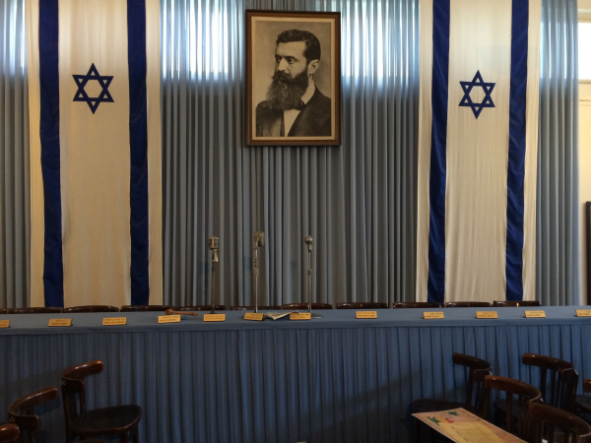
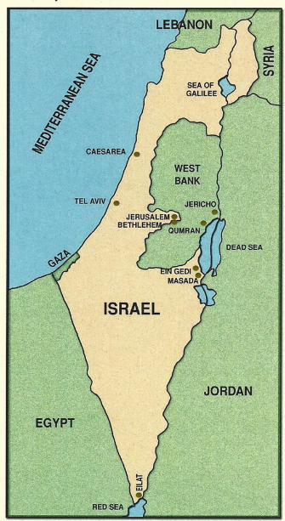
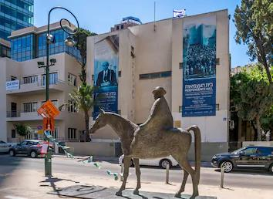
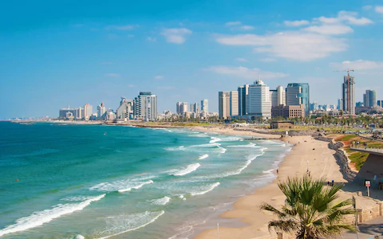
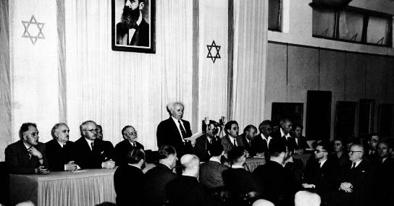
Tel Aviv
Independence Hall

Slide 9
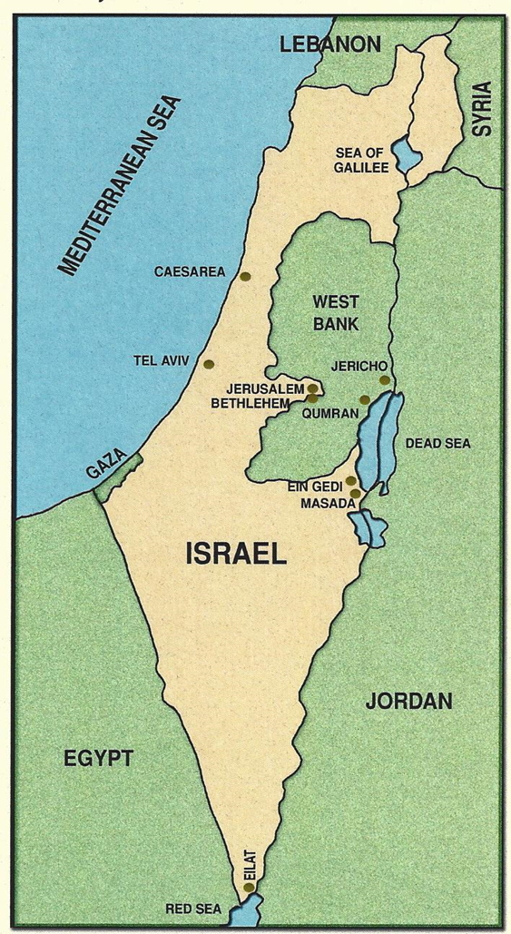
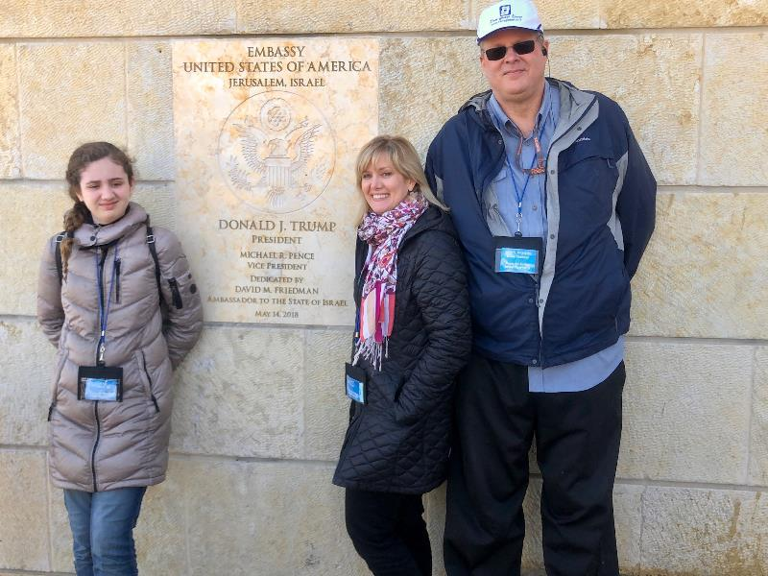

Slide 10
Tel Aviv
Independence Hall

Slide 11
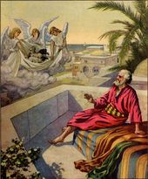
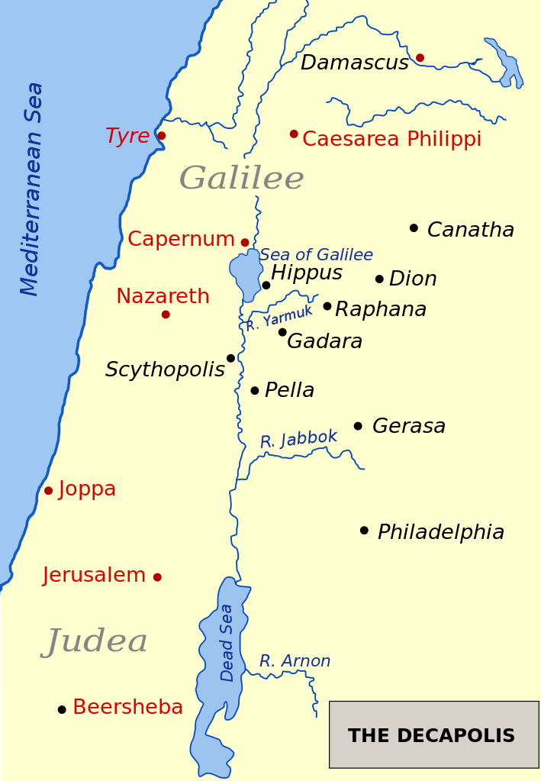
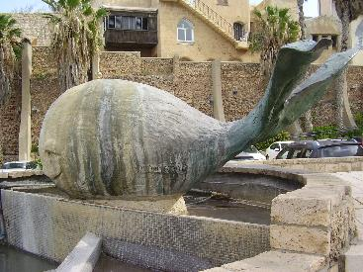
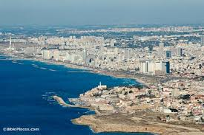
Ancient Joppa
Port used by Solomon
Peter
Simon the Tanner’s House
Jonah

Slide 13
Ancient Joppa
Port used by Solomon
Peter
Simon the Tanner’s House
Jonah

Slide 14
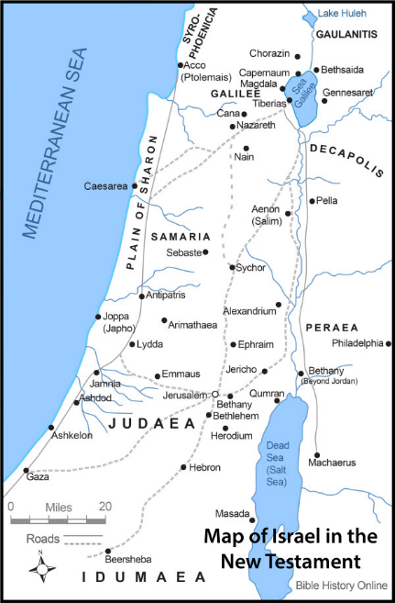
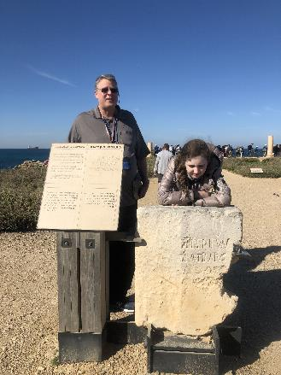
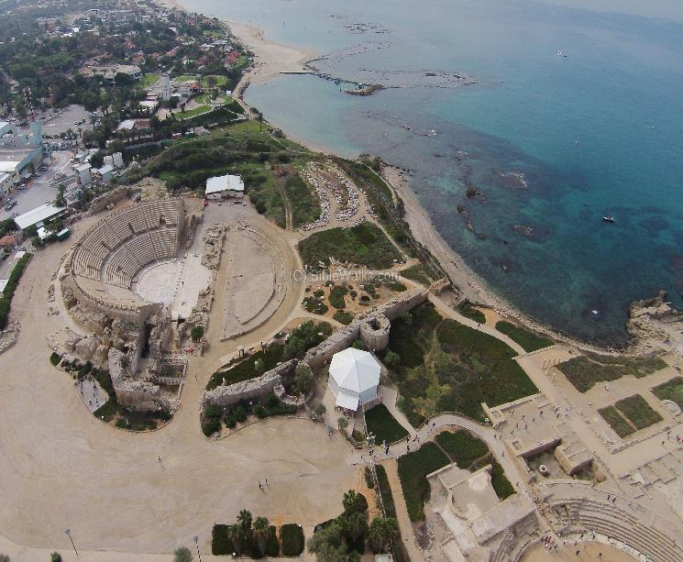
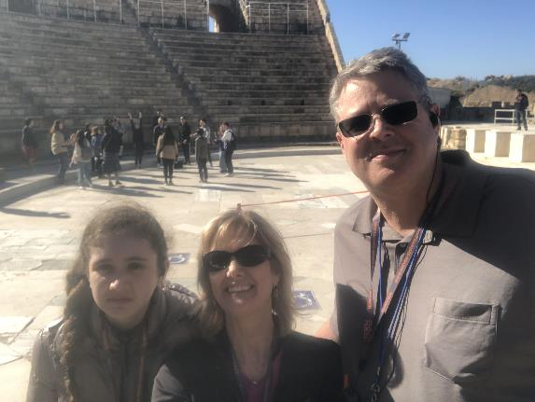
Caesarea Maritima
Peter meets Cornelius
Herod the Great
Pilate Stone

Slide 15
Message of the Book of Acts
Birth and growth of the church is depicted numerically, geographically, ethnically
Components
Numerically (progress reports)
Geographically (From Jerusalem to Rome)
Ethnically (From Judaism to Gentile domination)

Slide 17
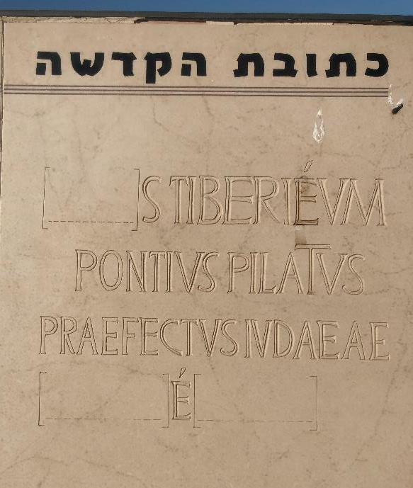

Slide 18
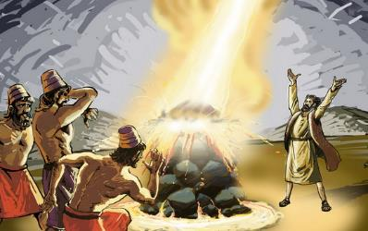
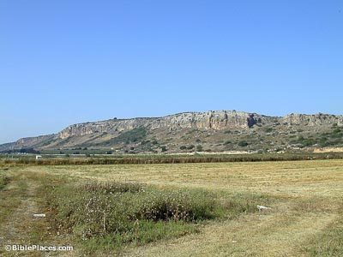
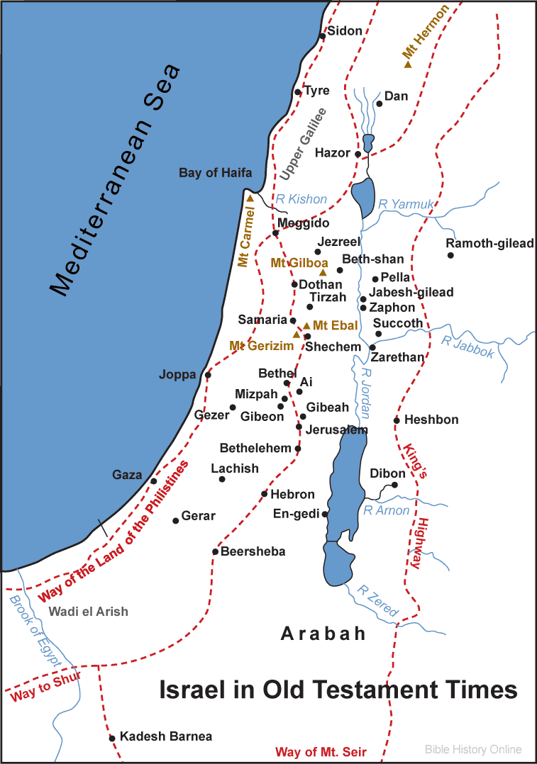
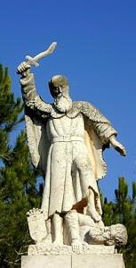
MT. Carmel
Accounts: Elijah faces the prophets of Baal

Slide 19
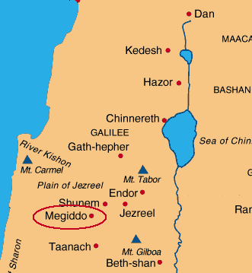
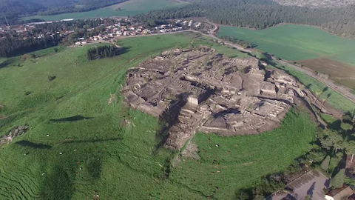
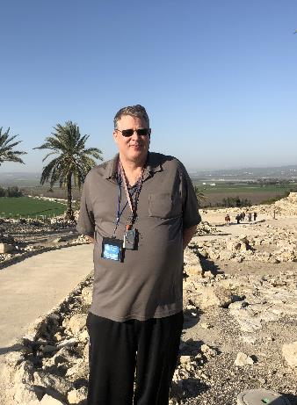
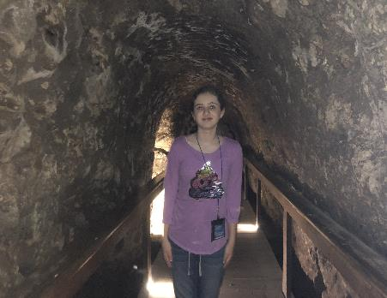
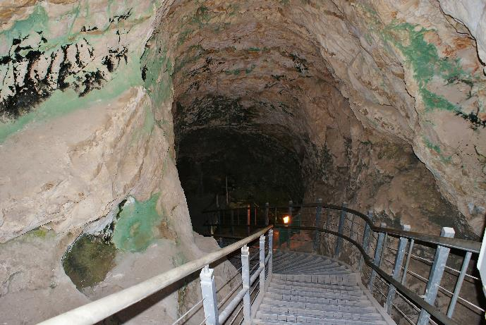
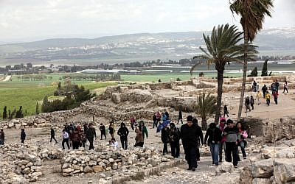
megiddo
Valley of Jezreel
Battle of Armageddon

Slide 20
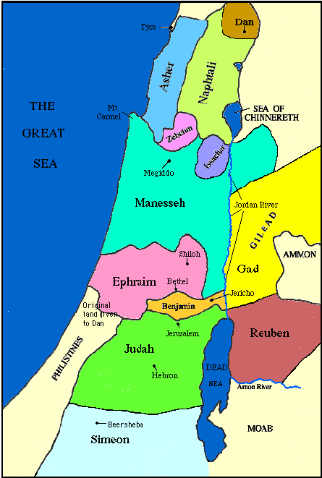

Slide 21
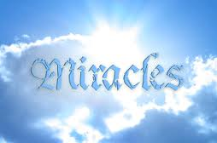
Satanic/Demonic Miracles
Exod. 7–8
Deut. 13:1-3
Matt. 7:21-23; 24:24
Acts 8:9; 16:16
Gal. 1:6-9
2 Thess. 2:9
Rev. 13:3, 13; 16:13-14

Slide 22
Literal Geography in Revelation
Asia | 1:4 | Philadelphia | 3:7
Ephesus | 2:1 | Laodicea | 3:14
Smyrna | 2:8 | Euphrates | 9:14;16:12
Pergamum | 2:12 | Jerusalem | 11:8
Thyatira | 2:18 | Armageddon | 16:16
Sardis | 3:1 | Jerusalem | 20:9

Slide 23
STOPPED HERE

Slide 24
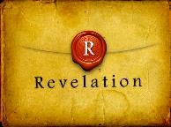
Revelation 11:15
“Then the seventh angel sounded; and there were loud voices in heaven, saying, ‘The kingdom of the world has become the kingdom of our Lord and of His Christ; and He will reign forever and ever.’”

Slide 25
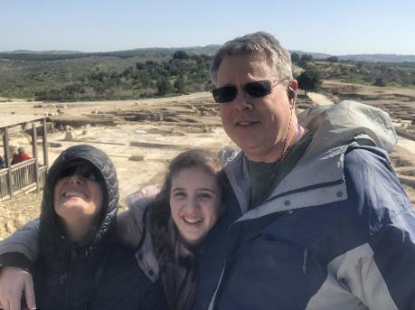
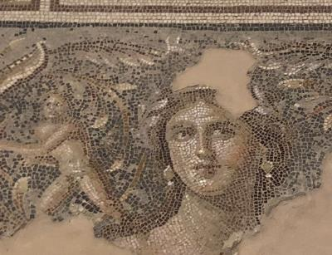
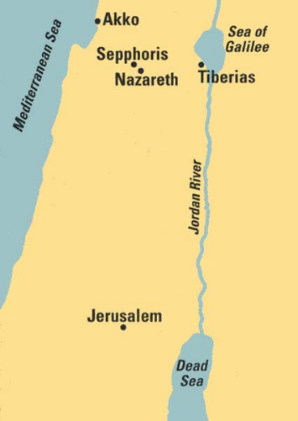
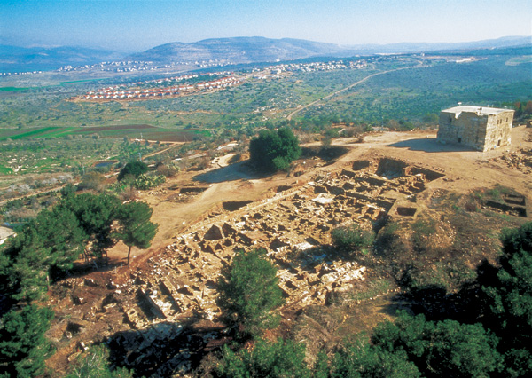
Sepphoris
Traditional birthplace of Mary, Mother of Jesus
“Mona Lisa of Galilee”

Slide 26
Galatians 4:4
“But when the fullness of the time came, God sent forth His Son, born of a woman, born under the Law.”

Slide 27
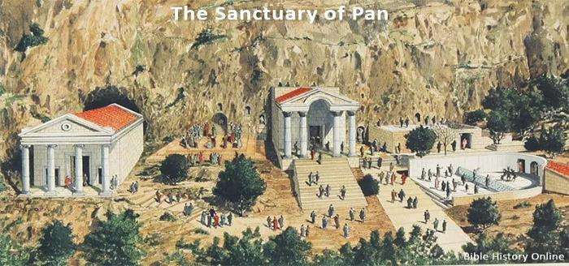
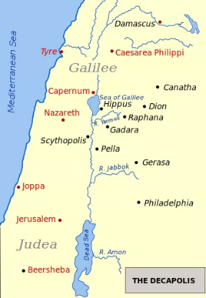
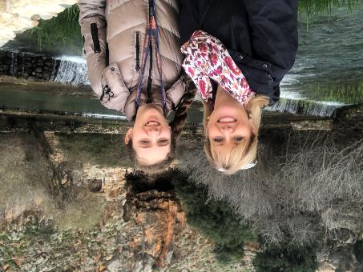
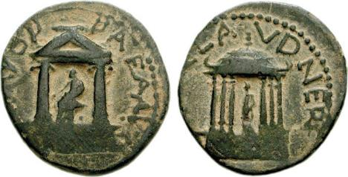
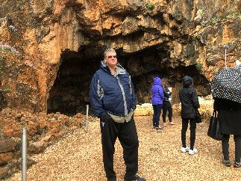
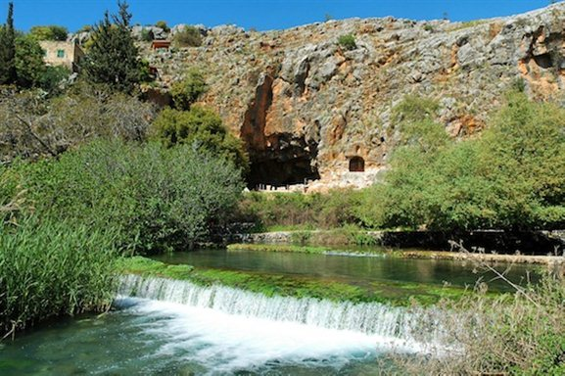
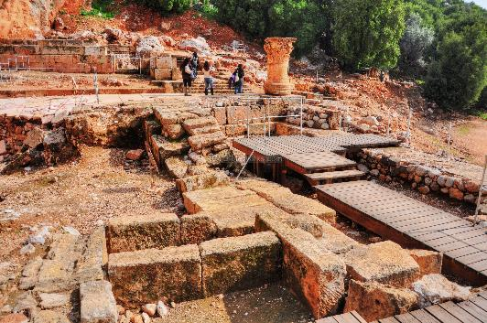
Upper Galilee
Caesarea-Philippi
Temple of Pan

Slide 28
Matthew 16:18
“I also say to you that you are Peter, and upon this rock I will build My church; and the gates of Hades will not overpower it.”

Slide 29
Matthew 16:18
I also say to you that you are Peter, and upon this rock I will build [oikodomeō] My church; and the gates of Hades will not overpower it.

Slide 30
Matthew 16:18
“I also say to you that you are Peter (petros, masculine, little stone), and upon this rock (petra, feminine, large stone) I will build My church; and the gates of Hades will not overpower it.”

Slide 31
Christ’s Two Great Purposes in Coming Into the World
“From that time on”
Matt 4:17 – offer kingdom to Israel; fulfilled at Second Advent
Matt 16:21 – Crucifixion and resurrection; fulfilled at First Advent

Slide 32
Messengers of the Kingdom In Matthew
John the Baptist – 3:2
Jesus Christ – 4:17
12 Apostles – 10:5-7
Seventy – Luke 10:1, 9
Toussaint, Behold the King, 18-20

