Slide 1
ISRAEL 2019
ANDY WOODS
Part 2

Slide 2
Tel Aviv, Joppa, Caesarea Maritma,
Mt. Carmel, Megiddo

Slide 3
Sepphoris, Upper Galilee/Caesarea-Philippi andTel Dan, Sea of Galilee, Mt. of Beatitudes, Capernaum, Tabgha

Slide 4
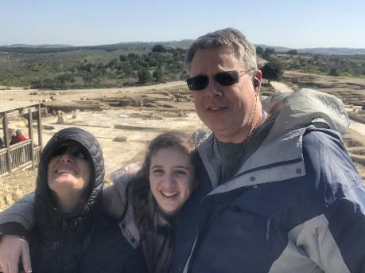
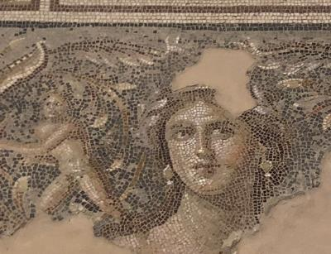
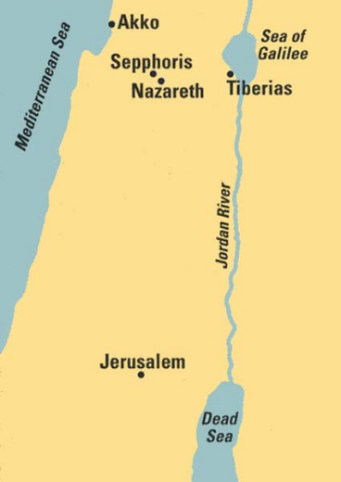
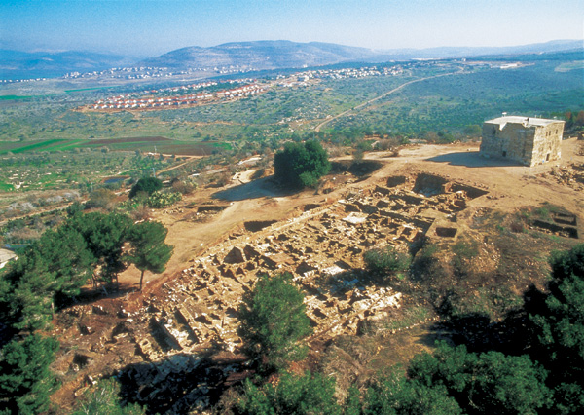
Sepphoris
Traditional birthplace of Mary, Mother of Jesus
“Mona Lisa of Galilee”

Slide 5
Galatians 4:4
“But when the fullness of the time came, God sent forth His Son, born of a woman, born under the Law.”

Slide 6
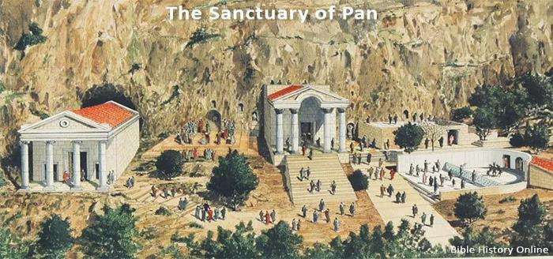
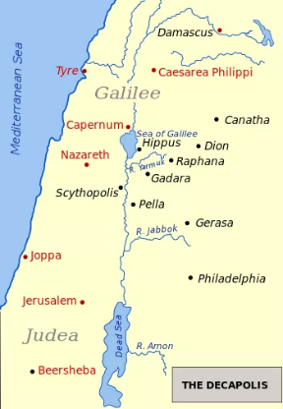
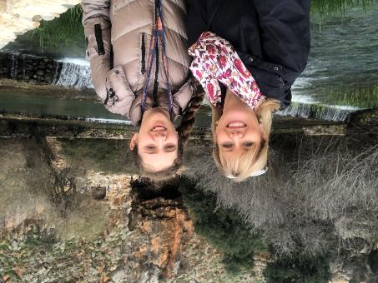
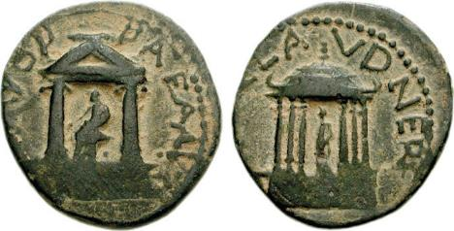
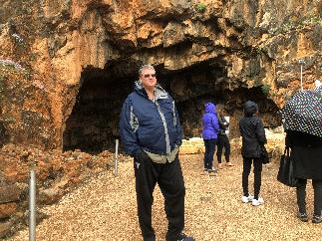
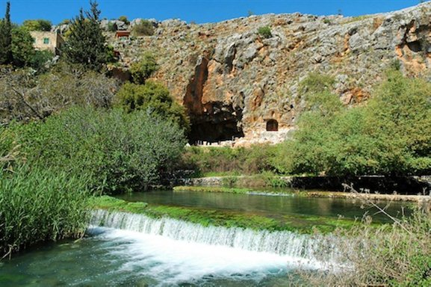
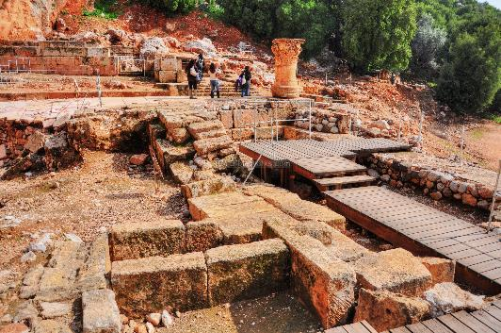
Upper Galilee
Caesarea Philippi
Temple of Pan

Slide 7
Matthew 16:18
“I also say to you that you are Peter, and upon this rock I will build My church; and the gates of Hades will not overpower it.”

Slide 8
Matthew 16:18
I also say to you that you are Peter, and upon this rock I will build [oikodomeō] My church; and the gates of Hades will not overpower it.

Slide 9
Matthew 16:18
“I also say to you that you are Peter (petros, masculine, little stone), and upon this rock (petra, feminine, large stone) I will build My church; and the gates of Hades will not overpower it.”

Slide 10
Upper Galilee
Caesarea Philippi
Temple of Pan

Slide 11
Christ’s Two Great Purposes in Coming Into the World
“From that time on”
Matt 4:17 – offer kingdom to Israel; fulfilled at Second Advent
Matt 16:21 – Crucifixion and resurrection; fulfilled at First Advent

Slide 12
Messengers of the Kingdom In Matthew
John the Baptist – 3:2
Jesus Christ – 4:17
12 Apostles – 10:5-7
Seventy – Luke 10:1, 9
Toussaint, Behold the King, 18-20

Slide 14
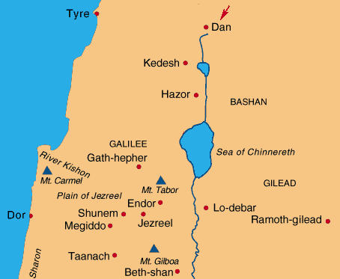
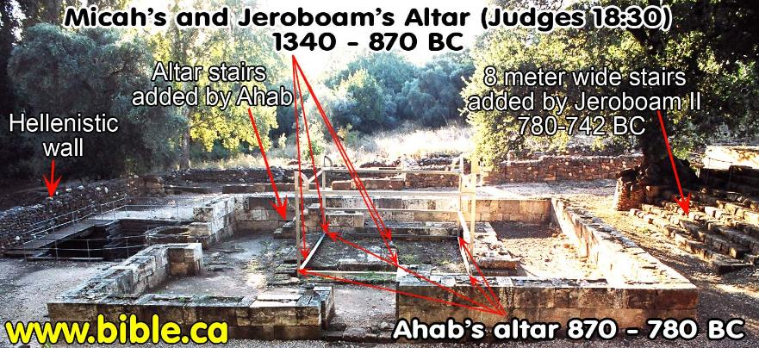
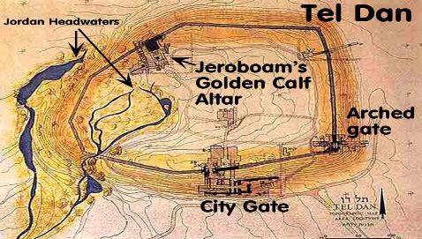
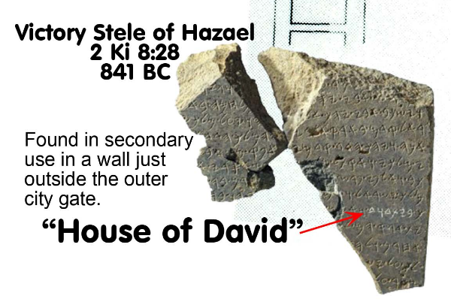
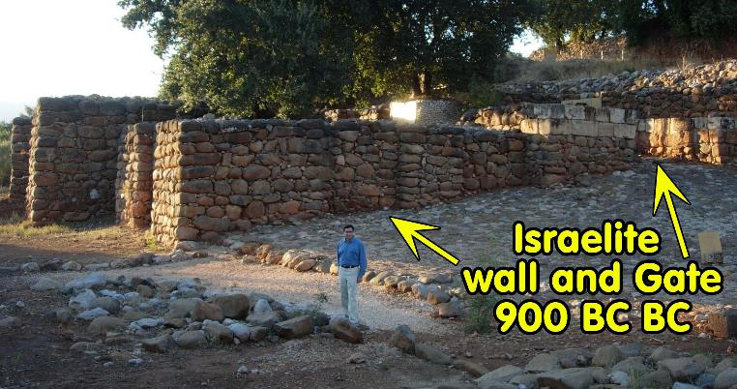
Upper Galilee
Tel Dan

Slide 16
Upper Galilee
Tel Dan

Slide 17
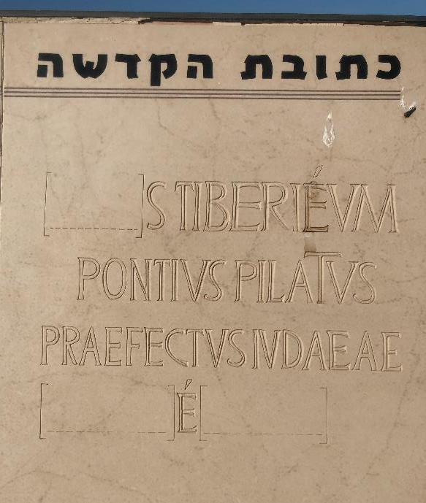

Slide 18
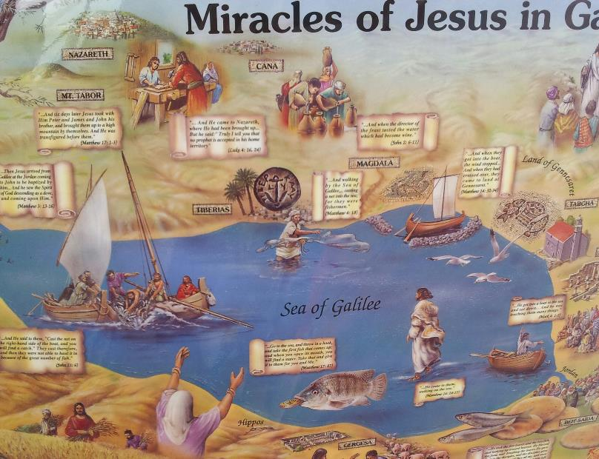
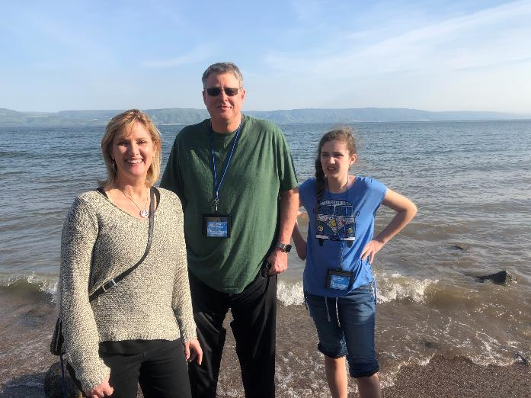
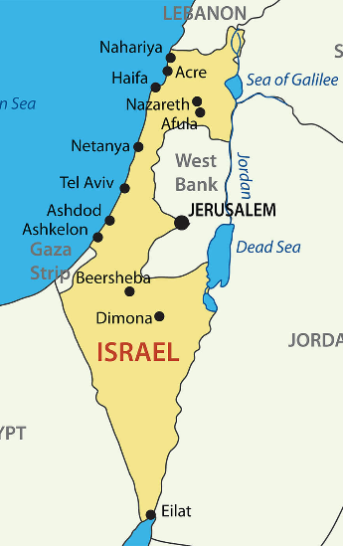
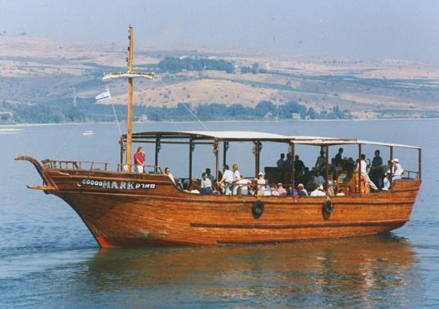
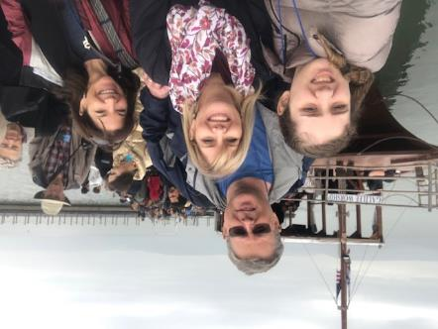
Sea of Galilee

Slide 19
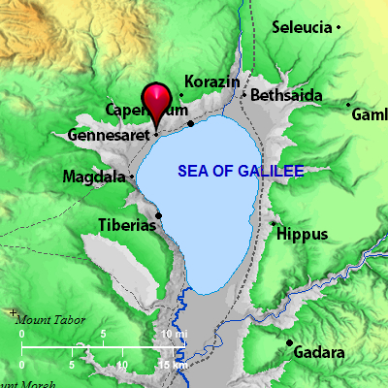
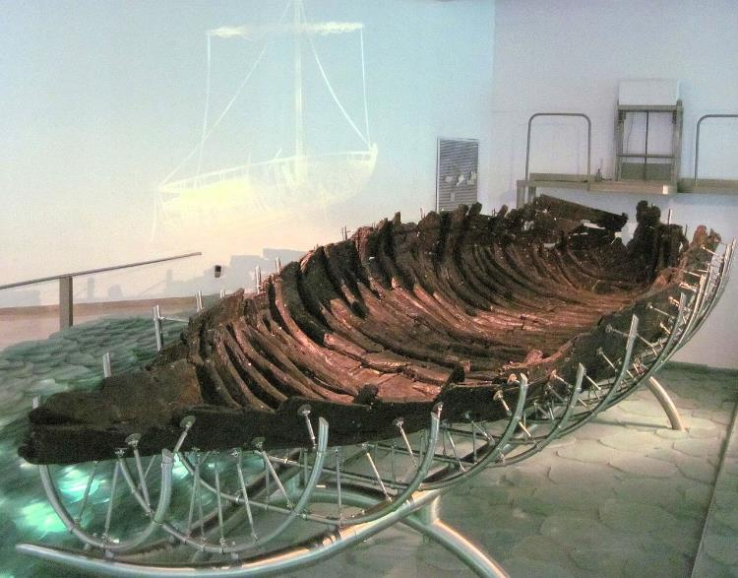
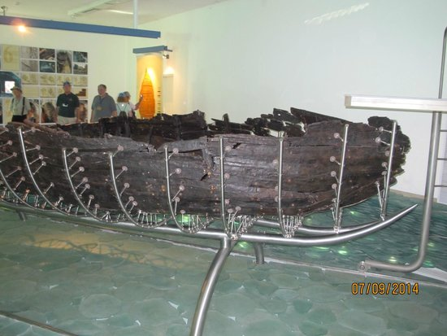
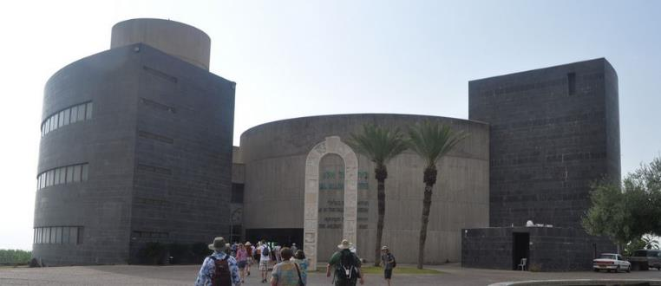

Slide 20
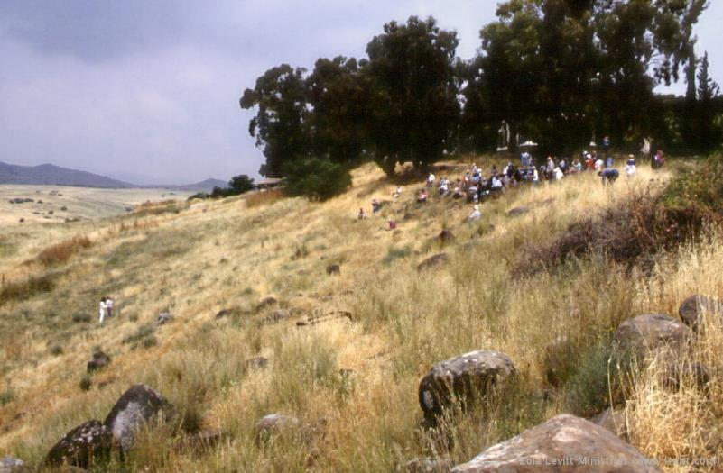
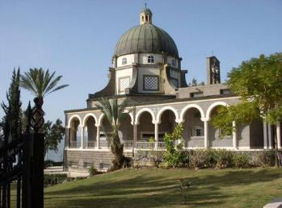
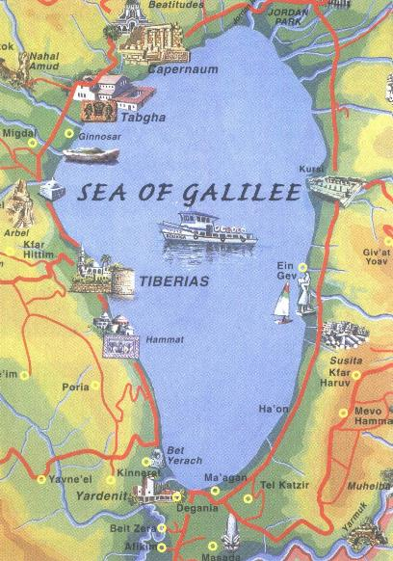
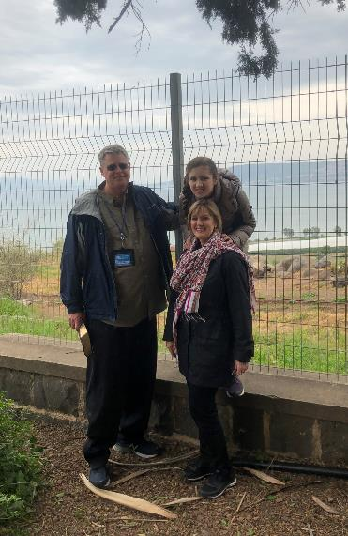
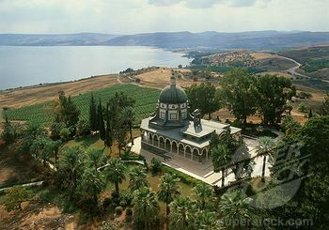
Mt of Beatitudes
Sermon on the Mount

Slide 22
Messengers of the Kingdom In Matthew
John the Baptist – 3:2
Jesus Christ – 4:17
12 Apostles – 10:5-7
Seventy – Luke 10:1, 9
Toussaint, Behold the King, 18-20

Slide 23
Mt of Beatitudes
Sermon on the Mount

Slide 24
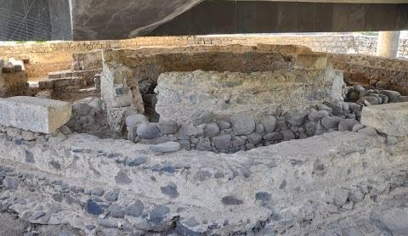
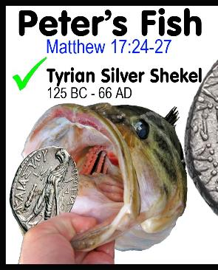
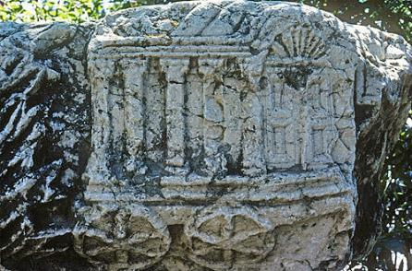
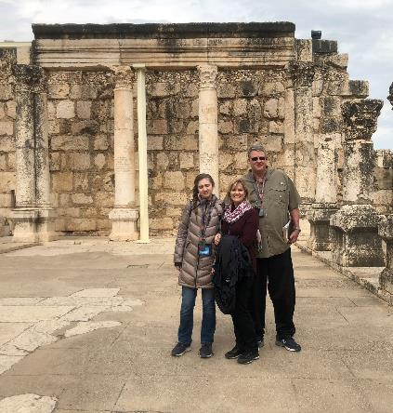
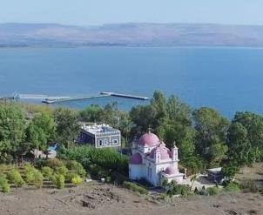
Capernaum
Peter’s family home
Synagogue

Slide 25
7 “I AM” statements in John
I am the Bread of Life | 6:35
I am the Light of the world | 8:12
I am the Gate for the sheep | 10:7; cf. v.9
I am the Good Shepherd | 10:11,14
I am the Resurrection and the Life | 11:25
I am the Way and the Truth and the Life | 14:6
I am the true Vine | 15:1; cf. v.5

Slide 26
Capernaum
Peter’s family home
Synagogue

Slide 27
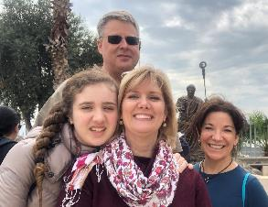
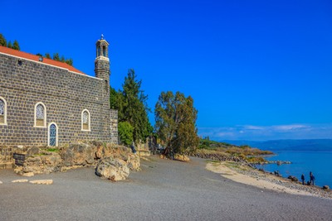
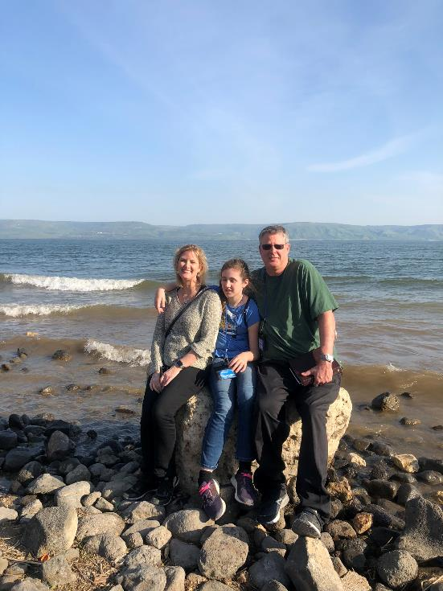
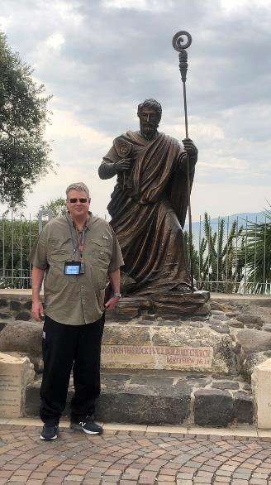
Tabgha
Peter’s Primacy
Feeding of 5000

