Slide 1
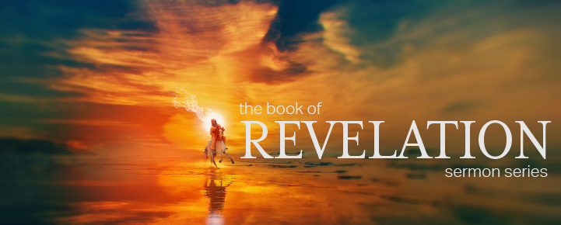
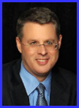
Dr. Andy Woods
Senior Pastor – Sugar Land Bible Church
President – Chafer Theological Seminary

Slide 3
7th Seal & 1st Six Trumpets (Revelation 8‒9)
7th Seal (8:1-6) – Trumpet preparation
1st Trumpet (8:7) – 1/3 vegetation destroyed
2nd Trumpet (8:8-9) – 1/3 ocean destroyed
3rd Trumpet (8:10-11) – 1/3 water destroyed
4th Trumpet (8:12-13) – 1/3 luminaries darkened
5th Trumpet (9:1-12) – Demons released
6th Trumpet (9:13-21) – 1/3 humanity destroyed

Slide 5
5 Non-Chronological Parenthetical Insertions
Rev 7 – 144,000 Jews
Rev 10:1-11:13 – Announcement of no more delay and the two witnesses
Rev 12-14 – Israel’s flight, two beasts, six scenes of hope
Rev 16:13-16 – Gathering of the nations to Armageddon
Rev 17:1-19:6 – Babylon’s fall

Slide 6
5 Non-Chronological Parenthetical Insertions
Rev 7 – 144,000 Jews
Rev 10:1-11:13 – Announcement of no more delay and the two witnesses
Rev 12-14 – Israel’s flight, two beasts, six scenes of hope
Rev 16:13-16 – Gathering of the nations to Armageddon
Rev 17:1-19:6 – Babylon’s fall

Slide 7
2. Revelation 10:1‒11:13
Rev 10 – Announcement of no more delay
Rev 11:1-2 – End of the Times of the Gentiles
Rev 11:3-13 – Ministry of the Two Witnesses

Slide 8
2. Revelation 10:1‒11:13
Rev 10 – Announcement of no more delay
Rev 11:1-2 – End of the Times of the Gentiles
Rev 11:3-13 – Ministry of the Two Witnesses

Slide 9
2. Revelation 10:1‒11:13
Rev 10 – Announcement of no more delay
Rev 11:1-2 – End of the Times of the Gentiles
Rev 11:3-13 – Ministry of the Two Witnesses

Slide 10
2. Revelation 10:1‒11:13
Rev 10 – Announcement of no more delay
Rev 11:1-2 – End of the Times of the Gentiles
Rev 11:3-13 – Ministry of the Two Witnesses

Slide 11
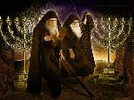
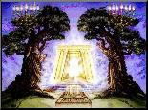
The Two Witnesses
(Revelation 11:3-13)
Their Ministry (11:3-6)
Their Martyrdom (11:7-10)
Their Revival (11:11-13)

Slide 12
The Two Witnesses
(Revelation 11:3-13)
Their Ministry (11:3-6)
Their Martyrdom (11:7-10)
Their Revival (11:11-13)

Slide 13
I. Their Ministry (Revelation 11:3-6)
Its Duration (11:3)
Its Empowerment (11:4)
Its Activity (11:5-6)
Fire (11:5)
Drought (11:6a)
Waters (11:6b)
Plagues (11:6c)

Slide 14
I. Their Ministry (Revelation 11:3-6)
Its Duration (11:3)
Its Empowerment (11:4)
Its Activity (11:5-6)
Fire (11:5)
Drought (11:6a)
Waters (11:6b)
Plagues (11:6c)

Slide 17
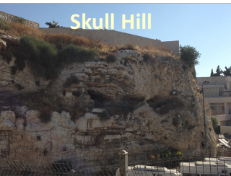
Revelation 11:8
“And their dead bodies will lie in the street of the great city which mystically is called Sodom and Egypt, where also their Lord was crucified.”

Slide 18
I. Their Ministry (Revelation 11:3-6)
Its Duration (11:3)
Its Empowerment (11:4)
Its Activity (11:5-6)
Fire (11:5)
Drought (11:6a)
Waters (11:6b)
Plagues (11:6c)

Slide 19
ISRAEL’S FOUR TEMPLES
Solomon’s pre exilic temple (Kings and Chronicles)
Zerubbabel’s post exilic temple (Ezra 1-6; John 2:20)
Antichrist's temple (Dan 9:27; Matt 24:15; 2 Thess 2:4; Rev 11:1-2)
Millennial temple (Ezek 40-48)

Slide 20
ISRAEL’S FOUR TEMPLES
Solomon’s pre exilic temple (Kings and Chronicles)
Zerubbabel’s post exilic temple (Ezra 1-6; John 2:20)
Antichrist's temple (Dan 9:27; Matt 24:15; 2 Thess 2:4; Rev 11:1-2)
Millennial temple (Ezek 40-48)

Slide 21
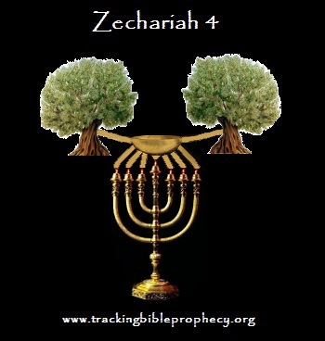

Slide 22
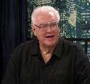
David Hocking
David Hocking, The Book of Revelation: Understanding the Future (Tustin, CA: Hope For Today Publications, 2014), 379.
“In Zechariah’s vision and prophecy there was only one lampstand, whereas there are two lampstands in Revelation 11:14. This distinction reveals that we are not to make the two passages identical, but rather to see that the one illustrates the other.”

Slide 23
I. Their Ministry (Revelation 11:3-6)
Its Duration (11:3)
Its Empowerment (11:4)
Its Activity (11:5-6)
Fire (11:5)
Drought (11:6a)
Waters (11:6b)
Plagues (11:6c)

Slide 24
I. Their Ministry (Revelation 11:3-6)
Its Duration (11:3)
Its Empowerment (11:4)
Its Activity (11:5-6)
Fire (11:5)
Drought (11:6a)
Waters (11:6b)
Plagues (11:6c)

Slide 25
I. Their Ministry (Revelation 11:3-6)
Its Duration (11:3)
Its Empowerment (11:4)
Its Activity (11:5-6)
Fire (11:5)
Drought (11:6a)
Waters (11:6b)
Plagues (11:6c)

Slide 26
I. Their Ministry (Revelation 11:3-6)
Its Duration (11:3)
Its Empowerment (11:4)
Its Activity (11:5-6)
Fire (11:5)
Drought (11:6a)
Waters (11:6b)
Plagues (11:6c)

Slide 27
I. Their Ministry (Revelation 11:3-6)
Its Duration (11:3)
Its Empowerment (11:4)
Its Activity (11:5-6)
Fire (11:5)
Drought (11:6a)
Waters (11:6b)
Plagues (11:6c)

Slide 28
The Two Witnesses
(Revelation 11:3-13)
Their Ministry (11:3-6)
Their Martyrdom (11:7-10)
Their Revival (11:11-13)

Slide 29
II. Their Martyrdom (Revelation 11:7-10)
Its Cause (11:7)
Its Place (11:8)
Its Contempt (11:9)
Its Celebration (11:10)

Slide 30
II. Their Martyrdom (Revelation 11:7-10)
Its Cause (11:7)
Its Place (11:8)
Its Contempt (11:9)
Its Celebration (11:10)

Slide 31
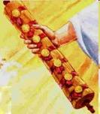
1st Six Seals (Revelation 6)
6:1-2 – Advent of antichrist
6:3-4 – War
6:5-6 – Famine
6:7-8 – Death
6:9-11 – Martyrdoms
6:12-17 – Cosmic disturbances

Slide 33
II. Their Martyrdom (Revelation 11:7-10)
Its Cause (11:7)
Its Place (11:8)
Its Contempt (11:9)
Its Celebration (11:10)

Slide 34
Revelation 11:8
“And their dead bodies will lie in the street of the great city which mystically is called Sodom and Egypt, where also their Lord was crucified.”

Slide 35
Literal Geography in Revelation
Asia | 1:4 | Philadelphia | 3:7
Ephesus | 2:1 | Laodicea | 3:14
Smyrna | 2:8 | Euphrates | 9:14;16:12
Pergamum | 2:12 | Jerusalem | 11:8
Thyatira | 2:18 | Armageddon | 16:16
Sardis | 3:1 | Jerusalem | 20:9

Slide 36
Revelation 11:8
“And their dead bodies will lie in the street of the great city which mystically is called Sodom and Egypt, where also their Lord was crucified.”

Slide 38
Israel’s Two Regatherings
THE PRESENT (FIRST) REGATHERING | THE PERMANENT (SECOND) REGATHERING
Return to part of the land | Return to all the land
Return in unbelief | Return in faith
Restored to the land only | Restored to the land and the Lord
Sets the stage for Tribulation (discipline) | Sets the stage for Millennium (blessing)
Adapted from: Price, Jerusalem In Prophecy, 219

Slide 39
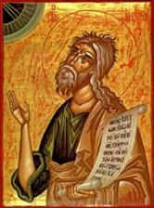
Jeremiah 30:7 (LXX)
“Alas! for that day is great, There is none like it; And it is the time of Jacob’s distress (Gen. 32:8; 35:10), But he will be saved [sōzō] from [apo] it.”

Slide 40
II. Their Martyrdom (Revelation 11:7-10)
Its Cause (11:7)
Its Place (11:8)
Its Contempt (11:9)
Its Celebration (11:10)

Slide 41
PROPHETIC CHESS BOARD IS BEING SET UP

Slide 42
II. Their Martyrdom (Revelation 11:7-10)
Its Cause (11:7)
Its Place (11:8)
Its Contempt (11:9)
Its Celebration (11:10)

Slide 43
Thomas Ice Thomas Ice, “Kept From the Hour,” online: www.pre-trib.org, accessed 4 September 2014, 2.
“This phrase ‘earth dwellers’ is used eleven times in nine verses in Revelation (3:10; 6:10; 8:13; 11:10 2xs; 13:8, 12, 14 2xs; 14:6; 17:8). As you examine each individual use, except 3:10, you will see that all refer to a special class of stubborn sinners who are set in their rebellion against the God of heaven. You will also find that the phrase is only used to refer to those during the tribulation period. Therefore, since the future hour spoken of in 3:10 is set in contrast with the present set of believers in the church age, and the future ‘earth dwellers’ will be active during the time period in which believers are said to be kept from, it is clear that John speaks of the time or hour of the tribulation. This is why 3:10 is a clear promise that Christ will keep believers from the time of the seven year tribulation.”

Slide 44
The Two Witnesses
(Revelation 11:3-13)
Their Ministry (11:3-6)
Their Martyrdom (11:7-10)
Their Revival (11:11-13)

Slide 45
III. Their Revival (Revelation 11:11-13)
Their Resuscitation (11:11)
Their Rapture (11:12)
Revival’s Result (11:13)
Earthquake (11:13a)
City’s One-Tenth (11:13b)
7000 Killed (11:13c)
Holy Fear (11:13d)

Slide 46
III. Their Revival (Revelation 11:11-13)
Their Resuscitation (11:11)
Their Rapture (11:12)
Revival’s Result (11:13)
Earthquake (11:13a)
City’s One-Tenth (11:13b)
7000 Killed (11:13c)
Holy Fear (11:13d)

Slide 47
III. Their Revival (Revelation 11:11-13)
Their Resuscitation (11:11)
Their Rapture (11:12)
Revival’s Result (11:13)
Earthquake (11:13a)
City’s One-Tenth (11:13b)
7000 Killed (11:13c)
Holy Fear (11:13d)

Slide 48
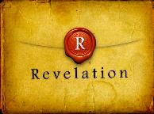
Revelation 4:1
“After these things I looked, and behold, a door standing open in heaven, and the first voice which I had heard, like the sound of a trumpet speaking with me, said, ‘Come up here, and I will show you what must take place after these things.’”

Slide 49
Exemption from Death (1 Cor 15:54-56)
Enoch (Gen 5)
Elijah (2 Kings 2)
Christ (Acts 1:11; Rev 12:5)
Philip (Acts 8:39)
Paul (2 Cor 12:2, 4)
John (Rev 4:1-2)
Two witnesses (Rev 11)

Slide 50
Jeremiah 30:7 (LXX)
“Alas! for that day is great, There is none like it; And it is the time of Jacob’s distress (Gen. 32:8; 35:10), But he will be saved [sōzō] from [apo] it.”

Slide 51
Daniel 9:24
Seventy weeks have been decreed for your people and your holy city, to finish the transgression, to make an end of sin, to make atonement for iniquity, to bring in everlasting righteousness, to seal up vision and prophecy and to anoint the most holy place.

Slide 53
III. Their Revival (Revelation 11:11-13)
Their Resuscitation (11:11)
Their Rapture (11:12)
Revival’s Result (11:13)
Earthquake (11:13a)
City’s One-Tenth (11:13b)
7000 Killed (11:13c)
Holy Fear (11:13d)

Slide 54
III. Their Revival (Revelation 11:11-13)
Their Resuscitation (11:11)
Their Rapture (11:12)
Revival’s Result (11:13)
Earthquake (11:13a)
City’s One-Tenth (11:13b)
7000 Killed (11:13c)
Holy Fear (11:13d)

Slide 55
Times of Israel 14 July 2018
After tremors, experts warn a huge quake is the greatest threat facing Israel
“Scientists say thousands could die because Israel, which sits on a major fault line, has ignored warnings to strengthen homes and schools. After a series of minor tremors rattled northern Israel over the last two weeks, experts warned that the country is negligently unprepared for a major earthquake that would likely kill thousands of people, including many children. ‘The threat of an earthquake, is in my eyes, the greatest threat facing the state of Israel,’ geologist Ariel Heimann told Hadashot news on Friday... ‘It is definitely a greater threat than the Qassam [rockets] fired … ”
https://www.timesofisrael.com/after-tremors-experts-warn-a-huge-quake-is-the-greatest-threat-facing-israel/14 July 2018.

Slide 56
Times of Israel 14 July 2018
After tremors, experts warn a huge quake is the greatest threat facing Israel
“… from Gaza, and it is a far greater danger than the Iranian threat.’ Israel sits on the Syrian-African rift, a tear in the earth’s crust running the length of the border separating Israel and Jordan, and is part of the Great Rift Valley, which extends from northern Syria to Mozambique. ‘If, God forbid, we have an earthquake like this, it will leave thousands dead and hundreds of thousands of people will have to leave their homes. Houses will be destroyed, there will be massive economic damage that will set the country back dozens of years,’ Heimann warned.”
https://www.timesofisrael.com/after-tremors-experts-warn-a-huge-quake-is-the-greatest-threat-facing-israel/14 July 2018.

Slide 57
III. Their Revival (Revelation 11:11-13)
Their Resuscitation (11:11)
Their Rapture (11:12)
Revival’s Result (11:13)
Earthquake (11:13a)
City’s One-Tenth (11:13b)
7000 Killed (11:13c)
Holy Fear (11:13d)

Slide 58
Revelation 11:8
“And their dead bodies will lie in the street of the great city which mystically is called Sodom and Egypt, where also their Lord was crucified.”

Slide 59
III. Their Revival (Revelation 11:11-13)
Their Resuscitation (11:11)
Their Rapture (11:12)
Revival’s Result (11:13)
Earthquake (11:13a)
City’s One-Tenth (11:13b)
7000 Killed (11:13c)
Holy Fear (11:13d)

Slide 60
III. Their Revival (Revelation 11:11-13)
Their Resuscitation (11:11)
Their Rapture (11:12)
Revival’s Result (11:13)
Earthquake (11:13a)
City’s One-Tenth (11:13b)
7000 Killed (11:13c)
Holy Fear (11:13d)

Slide 61
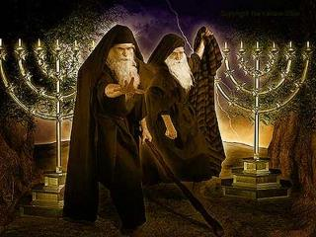
Identity of the Two Witnesses?
Symbolic view
Moses and Enoch
Moses and Elijah like
Moses and Elijah literal

Slide 62
Identity of the Two Witnesses?
Symbolic view
Moses and Enoch
Moses and Elijah like
Moses and Elijah literal

Slide 63
Identity of the Two Witnesses?
Symbolic view
Moses and Enoch
Moses and Elijah like
Moses and Elijah literal

Slide 64
Jeremiah 30:7 (LXX)
“Alas! for that day is great, There is none like it; And it is the time of Jacob’s distress (Gen. 32:8; 35:10), But he will be saved [sōzō] from [apo] it.”

Slide 65
Daniel 9:24
Seventy weeks have been decreed for your people and your holy city, to finish the transgression, to make an end of sin, to make atonement for iniquity, to bring in everlasting righteousness, to seal up vision and prophecy and to anoint the most holy place.

Slide 66
Identity of the Two Witnesses?
Symbolic view
Moses and Enoch
Moses and Elijah like
Moses and Elijah literal

Slide 67
Identity of the Two Witnesses?
Symbolic view
Moses and Enoch
Moses and Elijah like
Moses and Elijah literal

Slide 68
Identity of the Two Witnesses
Category | Revelation 11 | Moses & Elijah
Protection | Rev. 11:5 | Num. 16:35; 2 Kgs. 1:10-14
Activities | Rev. 11:6 | Exod. 7:12-21; 1 Kgs. 17:1
Duration | Rev. 11:3 | Luke 4:25; Jas. 5:17
Rapture | Rev. 11:12 | 2 Kgs. 2:11

Slide 69
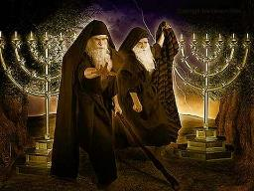
Identity of the 2 Witnesses: Moses and Elijah
Transfiguration (Matt 17:3)
Ministries cut short in the OT (2 Kgs 2:11-12; Num 20:12)
Future appearance predicted in the OT (Mal 4:5-6; Jude 9)
Never fulfilled in the NT (Luke 1:17; John 1:21)

Slide 70
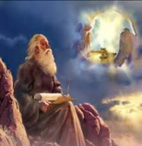
God’s Work Through Israel
Revelation 7 – 144,000 Jews
Revelation 11 – Two Jewish witnesses
Revelation 12 – Israel flees
Revelation 20:9 – Jerusalem in the kingdom
Revelation 21:12 – 13-Gates of the eternal city

Slide 71
God’s Work Through Israel
Revelation 7 – 144,000 Jews
Revelation 11 – Two Jewish witnesses
Revelation 12 – Israel flees
Revelation 20:9 – Jerusalem in the kingdom
Revelation 21:12 – 13-Gates of the eternal city

Slide 73
Conclusion

Slide 74
The Two Witnesses
(Revelation 11:3-13)
Their Ministry (11:3-6)
Their Martyrdom (11:7-10)
Their Revival (11:11-13)

Slide 75
“The Lord bless you and keep you; the Lord make his face shine on you and be gracious to you; the Lord turn his face toward you and give you peace.” (NIV)

