Slide 1
Dr. Andy Woods
Senior Pastor – Sugar Land Bible Church
President – Chafer Theological Seminary

Slide 3
7th Seal & 1st Six Trumpets (Revelation 8‒9)
7th Seal (8:1-6) – Trumpet preparation
1st Trumpet (8:7) – 1/3 vegetation destroyed
2nd Trumpet (8:8-9) – 1/3 ocean destroyed
3rd Trumpet (8:10-11) – 1/3 water destroyed
4th Trumpet (8:12-13) – 1/3 luminaries darkened
5th Trumpet (9:1-12) – Demons released
6th Trumpet (9:13-21) – 1/3 humanity destroyed

Slide 5
5 Non-Chronological Parenthetical Insertions
Rev 7 – 144,000 Jews
Rev 10:1-11:13 – Announcement of no more delay and the two witnesses
Rev 12-14 – Israel’s flight, two beasts, six scenes of hope
Rev 16:13-16 – Gathering of the nations to Armageddon
Rev 17:1-19:6 – Babylon’s fall

Slide 6
5 Non-Chronological Parenthetical Insertions
Rev 7 – 144,000 Jews
Rev 10:1-11:13 – Announcement of no more delay and the two witnesses
Rev 12-14 – Israel’s flight, two beasts, six scenes of hope
Rev 16:13-16 – Gathering of the nations to Armageddon
Rev 17:1-19:6 – Babylon’s fall

Slide 7
2. Revelation 10:1‒11:13
Rev 10 – Announcement of no more delay
Rev 11:1-2 – End of the Times of the Gentiles
Rev 11:3-13 – Ministry of the Two Witnesses

Slide 8
2. Revelation 10:1‒11:13
Rev 10 – Announcement of no more delay
Rev 11:1-2 – End of the Times of the Gentiles
Rev 11:3-13 – Ministry of the Two Witnesses

Slide 9
No Further Delay (Revelation 10)
The Angel’s Appearance (10:1)
The Angel’s Actions (10:2-7)
The Angel’s Commission (10:8-11)

Slide 10
2. Revelation 10:1‒11:13
Rev 10 – Announcement of no more delay
Rev 11:1-2 – End of the Times of the Gentiles
Rev 11:3-13 – Ministry of the Two Witnesses

Slide 11
End of the Times of the Gentiles (Revelation 11:1-2)
The Command (11:1)
The Court (11:2a)
The Contempt (11:2b)
Willmington, The outline Bible, p. 765.

Slide 12
End of the Times of the Gentiles (Revelation 11:1-2)
The Command (11:1)
The Court (11:2a)
The Contempt (11:2b)
Willmington, The outline Bible, p. 765.

Slide 13
Revelation 11:1-2
¹ “Then there was given me a measuring rod like a staff; and someone said, ‘Get up and measure the temple of God and the altar, and those who worship in it. ² Leave out the court which is outside the temple and do not measure it, for it has been given to the nations; and they will tread under foot the holy city for forty-two months.’”

Slide 14
Revelation 11:1-2
¹ “Then there was given me a measuring rod like a staff; and someone said, ‘Get up and measure the temple (naos) of God and the altar, and those who worship in it. ² Leave out the court which is outside the temple and do not measure it, for it has been given to the nations; and they will tread under foot the holy city for forty-two months.’”

Slide 15
ISRAEL’S FOUR TEMPLES
Solomon’s pre exilic temple (Kings and Chronicles)
Zerubbabel’s post exilic temple (Ezra 1-6; John 2:20)
Antichrist's temple (Dan 9:27; Matt 24:15; 2 Thess 2:4; Rev 11:1-2)
Millennial temple (Ezek 40-48)

Slide 16
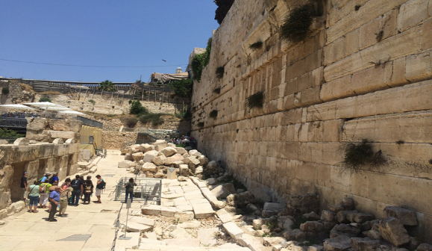

Slide 17
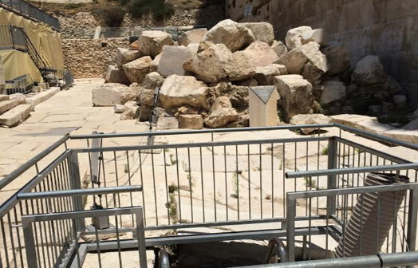

Slide 18
ISRAEL’S FOUR TEMPLES
Solomon’s pre exilic temple (Kings and Chronicles)
Zerubbabel’s post exilic temple (Ezra 1-6; John 2:20)
Antichrist's temple (Dan 9:27; Matt 24:15; 2 Thess 2:4; Rev 11:1-2)
Millennial temple (Ezek 40-48)

Slide 19
Daniel 9:27
“And he will make a firm covenant with the many for one week, but in the middle of the week he will put a stop to sacrifice and grain offering; and on the wing of abominations will come one who makes desolate, even until a complete destruction, one that is decreed, is poured out on the one who makes desolate.”

Slide 20
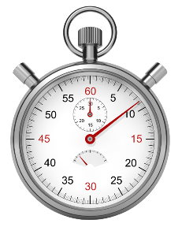
Daniel 12:11
“From the time that the regular sacrifice is abolished and the abomination of desolation is set up, there will be 1,290 days.”

Slide 21
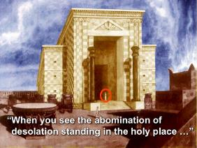
Matthew 24:15
“Therefore when you see the abomination of desolation which was spoken of through Daniel the prophet, standing in the holy place (let the reader understand).”

Slide 22
2 Thessalonians 2:4
“who opposes and exalts himself above every so-called god or object of worship, so that he takes his seat in the temple of God, displaying himself as being God.”

Slide 23
ISRAEL’S FOUR TEMPLES
Solomon’s pre exilic temple (Kings and Chronicles)
Zerubbabel’s post exilic temple (Ezra 1-6; John 2:20)
Antichrist's temple (Dan 9:27; Matt 24:15; 2 Thess 2:4; Rev 11:1-2)
Millennial temple (Ezek 40-48)

Slide 25
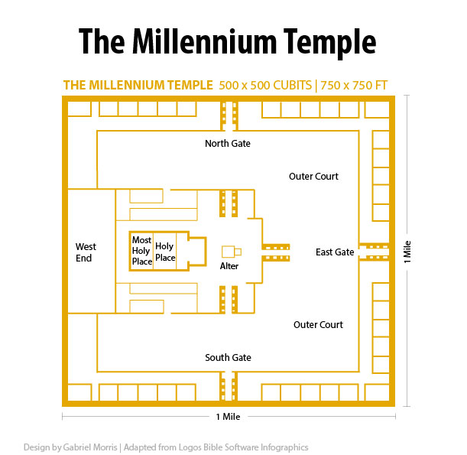

Slide 26
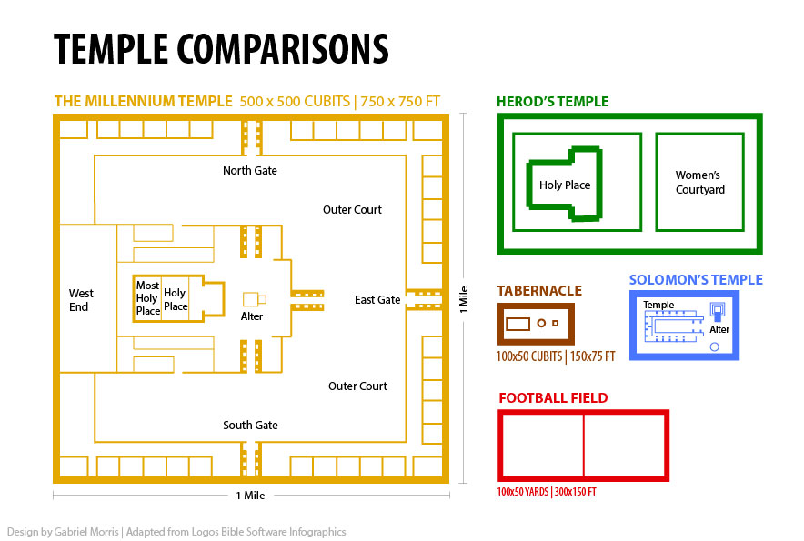

Slide 27
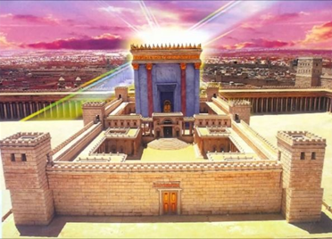
THREE MORE INTERIM TEMPLES
The Lord’s Body (John 2:20)
The Believer’s Body (1 Cor. 6:19)
The Church (1 Cor. 3:16)

Slide 28
THREE MORE INTERIM TEMPLES
The Lord’s Body (John 2:20)
The Believer’s Body (1 Cor. 6:19)
The Church (1 Cor. 3:16)

Slide 29
John 2:19-22
“¹⁹ Jesus answered them, “Destroy this temple, and in three days I will raise it up.” ²⁰ The Jews then said, “It took forty-six years to build this temple, and will You raise it up in three days?” ²¹ But He was speaking of the temple of His body. ²² So when He was raised from the dead, His disciples remembered that He said this; and they believed the Scripture and the word which Jesus had spoken.”

Slide 30
THREE MORE INTERIM TEMPLES
The Lord’s Body (John 2:20)
The Believer’s Body (1 Cor. 6:19)
The Church (1 Cor. 3:16)

Slide 31
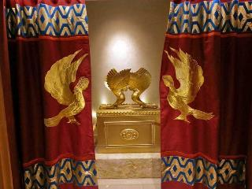
1 Corinthians 6:19
“Or do you not know that your body is a temple of the Holy Spirit who is in you, whom you have from God, and that you are not your own?”

Slide 32
THREE MORE INTERIM TEMPLES
The Lord’s Body (John 2:20)
The Believer’s Body (1 Cor. 6:19)
The Church (1 Cor. 3:16)

Slide 33
1 Corinthians 3:16
“Do you not know that you are a temple of God and that the Spirit of God dwells in you?”

Slide 35
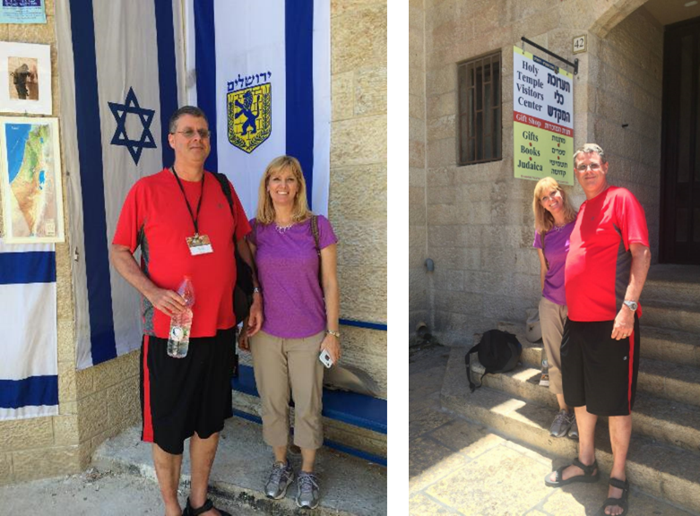

Slide 36
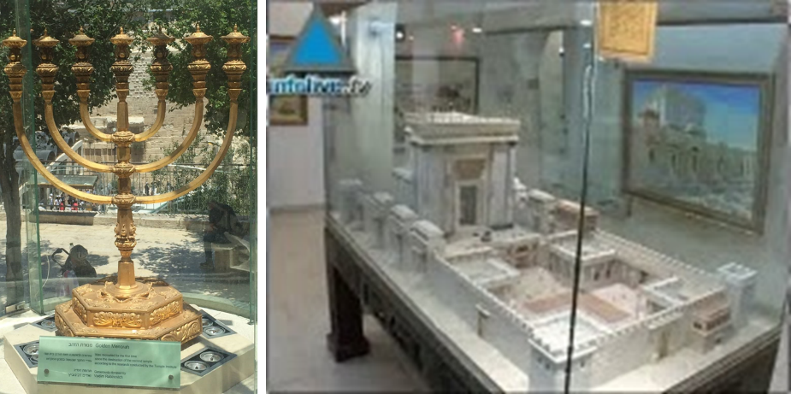

Slide 38
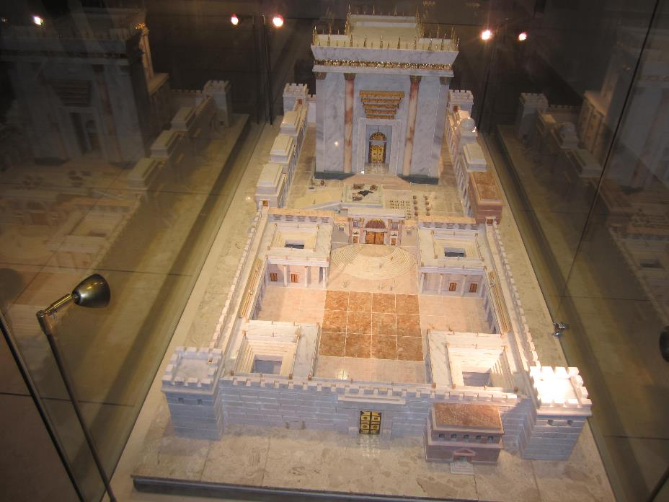

Slide 39
The Times of Israel April 6, 2017 In first, sheep slaughtered in Jerusalem Old City in reenactment of Passover sacrifice
“With priests blowing silver trumpets, a group of religious Jews slaughtered a sheep on Thursday in Jerusalem’s Old City to demonstrate the traditional paschal sacrifice, the first time such a reenactment has been held inside the city walls in 2,000 years.”
http://www.timesofisrael.com/in-a-first-sheep-slaughtered-in-jerusalem-old-city-in-reenactment-of-passover-sacrifice/#comments

Slide 42
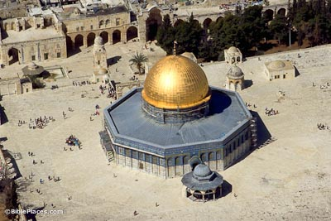

Slide 43
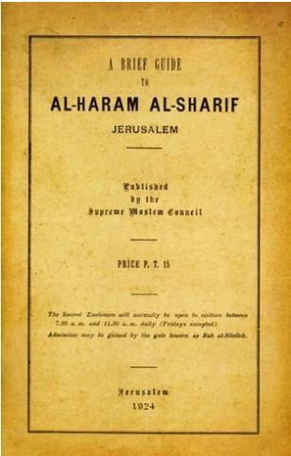
A Brief Guide to Al-Haram Al-Sharif Jerusalem
published in 1924 (and unchanged in all later editions through the 1950s), p. 4.
“The site is one of the oldest in the world. Its sanctity dates from the earliest (perhaps from pre-historic) times. Its identity with the site of Solomon’s Temple is beyond dispute. This, too, is the spot, according to the universal belief, on which ‘David built there an altar unto the Lord, and offered burnt offerings and peace offerings.’”

Slide 44
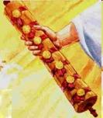
1st Six Seals (Revelation 6)
6:1-2 – Advent of antichrist
6:3-4 – War
6:5-6 – Famine
6:7-8 – Death
6:9-11 – Martyrdoms
6:12-17 – Cosmic disturbances

Slide 45
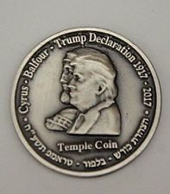
Half Shekel King Cyrus Donald Trump Jewish Temple Mount Israel Coin

Slide 46
Matthew 16:1-3
The Pharisees and Sadducees came up, and testing Jesus, they asked Him to show them a sign from heaven. ² But He replied to them, “When it is evening, you say, ‘It will be fair weather, for the sky is red.’ ³ And in the morning, ‘There will be a storm today, for the sky is red and threatening.’ Do you know how to discern the appearance of the sky, but cannot discern the signs of the times?”

Slide 47
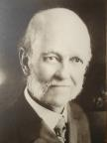
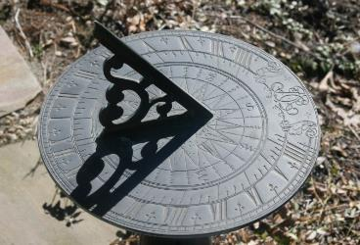
William E. Blackstone
Jesus Is Coming: God's Hope for a Restless World (New York: F.H. Revell, 1908; reprint, Grand Rapids: Kregel, 1989), 238.
“Israel is God's sun dial. If anyone desires to know our place in God’s chronology, our position in the great march of events, look at Israel.”

Slide 49
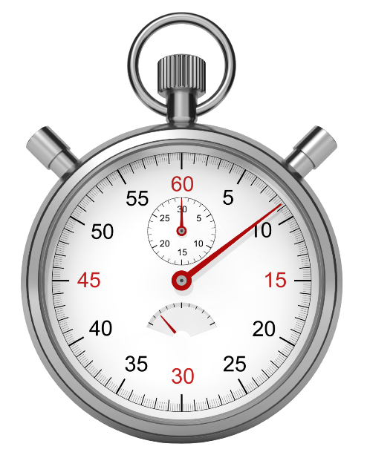

Slide 50
Revelation 11:1-2
¹ “Then there was given me a measuring rod like a staff; and someone said, ‘Get up and measure the temple of God and the altar, and those who worship in it. ² Leave out the court which is outside the temple and do not measure it, for it has been given to the nations; and they will tread under foot the holy city for forty-two months.’”

Slide 51
Revelation 11:1-2
¹ “Then there was given me a measuring rod like a staff; and someone said, ‘Get up and measure the temple of God and the altar, and those who worship in it. ² Leave out the court which is outside the temple and do not measure it, for it has been given to the nations; and they will tread under foot the holy city for forty-two months.’”

Slide 52
Revelation 11:1-2
¹ “Then there was given me a measuring rod like a staff; and someone said, ‘Get up and measure the temple of God and the altar, and those who worship in it. ² Leave out the court which is outside the temple and do not measure it, for it has been given to the nations; and they will tread under foot the holy city for forty-two months.’”

Slide 53
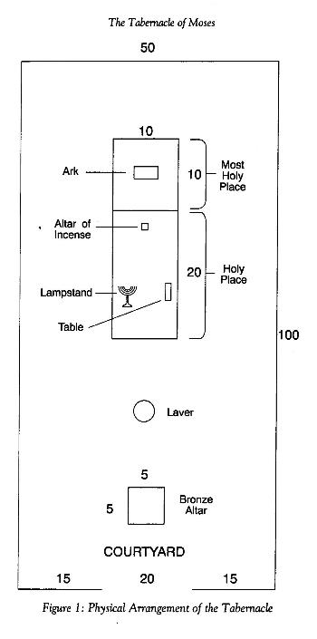

Slide 54
Revelation 11:1-2
¹ “Then there was given me a measuring rod like a staff; and someone said, ‘Get up and measure the temple of God and the altar, and those who worship in it. ² Leave out the court which is outside the temple and do not measure it, for it has been given to the nations; and they will tread under foot the holy city for forty-two months.’”

Slide 55
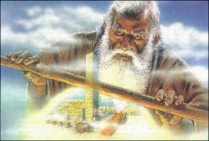
Zechariah 2:1-2
“Then I lifted up my eyes and looked, and behold, there was a man with a measuring line in his hand. So I said, ‘Where are you going?’ And he said to me, ‘To measure Jerusalem, to see how wide it is and how long it is.’”

Slide 56
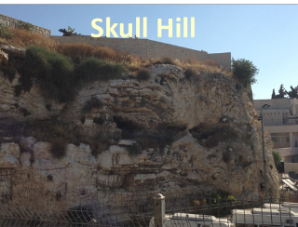
Revelation 11:8
“And their dead bodies will lie in the street of the great city which mystically is called Sodom and Egypt, where also their Lord was crucified.”

Slide 57
Revelation 11:1-2
¹ “Then there was given me a measuring rod like a staff; and someone said, ‘Get up and measure the temple of God and the altar, and those who worship in it. ² Leave out the court which is outside the temple and do not measure it, for it has been given to the nations; and they will tread under foot the holy city for forty-two months.’”

Slide 58
2 Thessalonians 2:4
“who opposes and exalts himself above every so-called god or object of worship, so that he takes his seat in the temple of God, displaying himself as being God.”

Slide 59
Revelation 11:1-2
¹ “Then there was given me a measuring rod like a staff; and someone said, ‘Get up and measure the temple of God and the altar, and those who worship in it. ² Leave out the court which is outside the temple and do not measure it, for it has been given to the nations; and they will tread under foot the holy city for forty-two months.’”

Slide 60
Revelation 11:8
“And their dead bodies will lie in the street of the great city which mystically is called Sodom and Egypt, where also their Lord was crucified.”

Slide 62
Romans 11:28
“From the standpoint of the gospel they are enemies for your sake, but from the standpoint of God’s choice they are beloved for the sake of the fathers.”

Slide 63
End of the Times of the Gentiles (Revelation 11:1-2)
The Command (11:1)
The Court (11:2a)
The Contempt (11:2b)
Willmington, The outline Bible, p. 765.

Slide 64
Revelation 11:1-2
¹ “Then there was given me a measuring rod like a staff; and someone said, ‘Get up and measure the temple of God and the altar, and those who worship in it. ² Leave out the court which is outside the temple and do not measure it, for it has been given to the nations; and they will tread under foot the holy city for forty-two months.’”

Slide 65
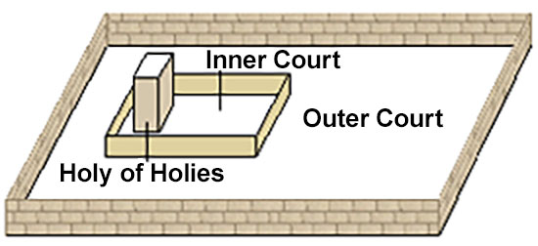

Slide 66
Psalm 147:19-20
“He declares His words to Jacob, His statutes and His ordinances to Israel. He has not dealt thus with any nation; And as for His ordinances, they have not known them. Praise the Lord!”
Notes:
The Mosaic Law required the children of Israel to pay three different tithes (23 1/3%): levitical tithe (Lev 27:30-32; Num 18:21,24), annual festival tithe (Dt 14:22-27), and tri-annual poor tithe (Dt 14:28-29). The levitical tithe was the standard tithe.

Slide 67
End of the Times of the Gentiles (Revelation 11:1-2)
The Command (11:1)
The Court (11:2a)
The Contempt (11:2b)
Willmington, The outline Bible, p. 765.

Slide 68
Revelation 11:1-2
¹ “Then there was given me a measuring rod like a staff; and someone said, ‘Get up and measure the temple of God and the altar, and those who worship in it. ² Leave out the court which is outside the temple and do not measure it, for it has been given to the nations (ethnos); and they will tread under foot the holy city for forty-two months.’”

Slide 69
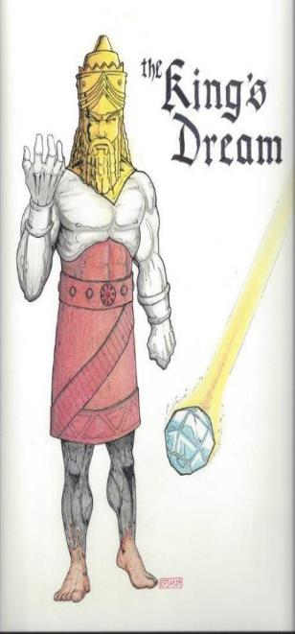
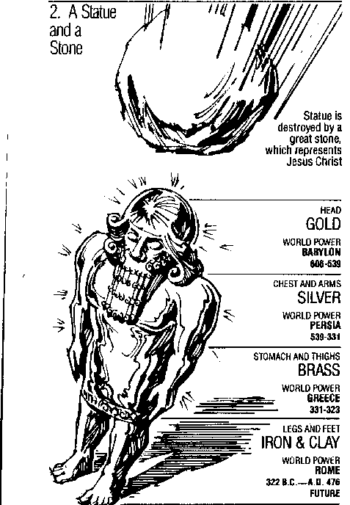
Statue
&
Stone

Slide 70
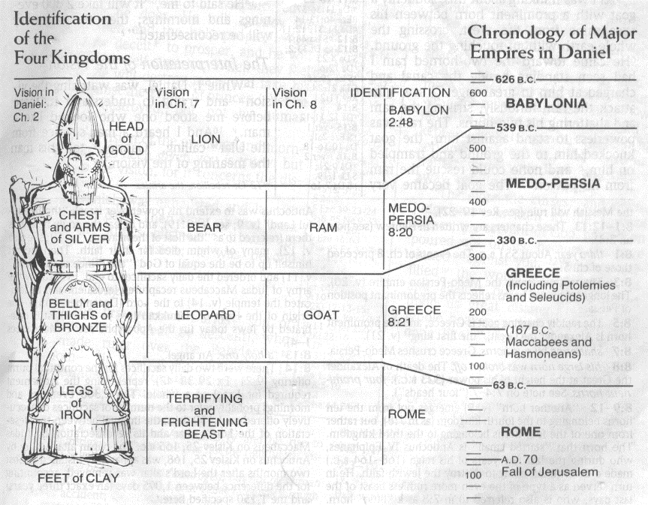

Slide 71
Revelation 11:1-2
¹ “Then there was given me a measuring rod like a staff; and someone said, ‘Get up and measure the temple of God and the altar, and those who worship in it. ² Leave out the court which is outside the temple and do not measure it, for it has been given to the nations (ethnos); and they will tread under foot the holy city for forty-two months.’”

Slide 72
Revelation 11:1-2
¹ “Then there was given me a measuring rod like a staff; and someone said, ‘Get up and measure the temple of God and the altar, and those who worship in it. ² Leave out the court which is outside the temple and do not measure it, for it has been given to the nations; and they will tread under foot the holy city for forty-two months.’”

Slide 73
Revelation 11:1-2
¹ “Then there was given me a measuring rod like a staff; and someone said, ‘Get up and measure the temple of God and the altar, and those who worship in it. ² Leave out the court which is outside the temple and do not measure it, for it has been given to the nations; and they will tread under foot (pateō) the holy city for forty-two months.’”

Slide 74
Revelation 11:1-2
¹ “Then there was given me a measuring rod like a staff; and someone said, ‘Get up and measure the temple of God and the altar, and those who worship in it. ² Leave out the court which is outside the temple and do not measure it, for it has been given to the nations; and they will tread under foot (pateō) the holy city for forty-two months.’”

Slide 75
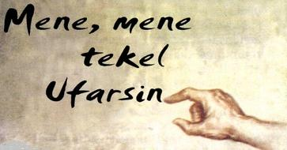
Daniel Interprets the Writing (5:24-28)

Slide 76
Belshazzar’s kingdom was to be taken away from him because he had been weighed in the balance of God’s justice and found wanting.

Slide 77
Revelation 11:1-2
¹ “Then there was given me a measuring rod like a staff; and someone said, ‘Get up and measure the temple of God and the altar, and those who worship in it. ² Leave out the court which is outside the temple and do not measure it, for it has been given to the nations; and they will tread under foot (pateō) the holy city for forty-two months.’”

Slide 79
Luke 21:24
“and they will fall by the edge of the sword, and will be led captive into all the nations; and Jerusalem will be trampled under foot by the Gentiles until the times of the Gentiles are fulfilled.”

Slide 80
Conclusion

Slide 81
End of the Times of the Gentiles (Revelation 11:1-2)
The Command (11:1)
The Court (11:2a)
The Contempt (11:2b)
Willmington, The outline Bible, p. 765.

Slide 82
“The Lord bless you and keep you; the Lord make his face shine on you and be gracious to you; the Lord turn his face toward you and give you peace.” (NIV)

