Slide 1


Slide 2

The Coming Kingdom
Chapter 18
Dr. Andy Woods
Senior Pastor – Sugar Land Bible Church
President – Chafer Theological Seminary

Slide 3

Kingdom Study Outline
What does the Bible Say About the Kingdom?
The Main Problem with Kingdom Now NT interpretations
Why do some believe that we are in the kingdom now?
Why does it matter?

Slide 4
Response to Kingdom Now Problem Passages
Passages from Christ’s ministry
Passages from Acts
Passages from Paul
Passages from the General letters
Passages from Revelation
Miscellaneous Arguments

Slide 5
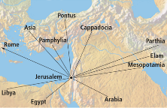
Acts 2
The Beginning of the Church Age
2:1-4 – The falling of the Holy Spirit
2:5-8 – The manifestation of the gift of tongues
2:9-12 – Those present from the known world
2:13-15 – Too early for drinking
2:16-21 – Manifestations taught in the OT (Joel 2)

Slide 6
Acts 2
The Beginning of the Church Age
2:1-4 – The falling of the Holy Spirit
2:5-8 – The manifestation of the gift of tongues
2:9-12 – Those present from the known world
2:13-15 – Too early for drinking
2:16-21 – Manifestations taught in the OT (Joel 2)

Slide 7
Acts 2
The Beginning of the Church Age
2:22-35 – Christ as the source of the manifestations
  2:22 – Miracle worker
  2:23 – Rejected by Israel
  2:24-29 – Resurrected (Ps 16:8-11)
  2:30-32 – Davidic descendant (Ps 132:11)
  2:33-35 – At God’s right hand (Ps 110:1)

Slide 8
Acts 2
The Beginning of the Church Age
2:36 – Conclusion
2:37 – Conviction
2:38-41 – Exhortation
2:42-47 – The first church meeting

Slide 9

Acts 2:16-21
¹⁶ “but this is what was spoken of through the prophet Joel: ¹⁷ ‘And it shall be in the last days,’ God says, ‘That I will pour forth of My Spirit on all mankind; And your sons and your daughters shall prophesy, And your young men shall see visions, And your old men shall dream dreams; ¹⁸ Even on My bond slaves, both men and women, I will in those days pour forth of My Spirit And they shall prophesy, ¹⁹ ‘And I will grant wonders in …

Slide 10
Acts 2:16-21
…the sky above And signs on the earth below, Blood, and fire, and vapor of smoke. ²⁰ ‘The sun will be turned into darkness And the moon into blood, Before the great and glorious day of the Lord shall come.²¹ ‘And it shall be that everyone who calls on the name of the Lord will be saved.’”

Slide 11


Darrell Bock
Darrell Bock, “The Reign of the Lord Christ,” in Dispensationalism, Israel and the Church, ed. Craig A. Blaising and Darrell L. Bock (Grand Rapids: Zondervan, 1992), 49.
“In other words, Jesus’ resurrection-ascension to God’s right hand is put forward by Peter as a fulfillment of the Davidic covenant, just as the allusion to Joel fulfills the new covenant.”

Slide 12

How Was Joel 2 Fulfilled in Acts 2?
(Joel 2:28-32; Acts 2:16-21)
Complete Fulfillment View
Partially Fulfilled View
Continuous Fulfillment View
Analogical Fulfillment View

Slide 13
How Was Joel 2 Fulfilled in Acts 2?
(Joel 2:28-32; Acts 2:16-21)
Complete Fulfillment View
Partially Fulfilled View
Continuous Fulfillment View
Analogical Fulfillment View

Slide 14
Acts 2:19-21
¹⁹ “ ‘And I will grant wonders in the sky above And signs on the earth below, Blood, and fire, and vapor of smoke. ²⁰ ‘The sun will be turned into darkness And the moon into blood, Before the great and glorious day of the Lord shall come.²¹ ‘And it shall be that everyone who calls on the name of the Lord will be saved.’”

Slide 15
How Was Joel 2 Fulfilled in Acts 2?
(Joel 2:28-32; Acts 2:16-21)
Complete Fulfillment View
Partially Fulfilled View
Continuous Fulfillment View
Analogical Fulfillment View

Slide 16
Acts 2:16-21
¹⁶ “but this is what was spoken of through the prophet Joel: ¹⁷ ‘And it shall be in the last days,’ God says, ‘That I will pour forth of My Spirit on all mankind; And your sons and your daughters shall prophesy, And your young men shall see visions, And your old men shall dream dreams; ¹⁸ Even on My bond slaves, both men and women, I will in those days pour forth of My Spirit And they shall prophesy, ¹⁹ ‘And I will grant wonders in …

Slide 17
Acts 2:16-21
…the sky above And signs on the earth below, Blood, and fire, and vapor of smoke. ²⁰ ‘The sun will be turned into darkness And the moon into blood, Before the great and glorious day of the Lord shall come.²¹ ‘And it shall be that everyone who calls on the name of the Lord will be saved.’”

Slide 18
How Was Joel 2 Fulfilled in Acts 2?
(Joel 2:28-32; Acts 2:16-21)
Complete Fulfillment View
Partially Fulfilled View
Continuous Fulfillment View
Analogical Fulfillment View

Slide 19
Acts 2:19-21
¹⁹ “ ‘And I will grant wonders in the sky above And signs on the earth below, Blood, and fire, and vapor of smoke. ²⁰ ‘The sun will be turned into darkness And the moon into blood, Before the great and glorious day of the Lord shall come.²¹ ‘And it shall be that everyone who calls on the name of the Lord will be saved.’”

Slide 20

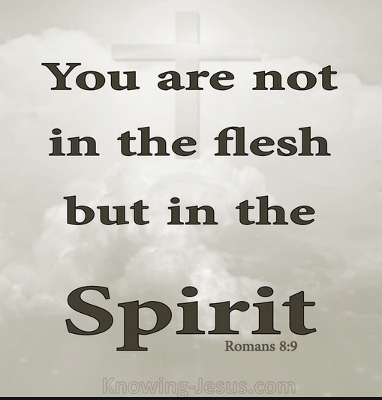
Romans 8:9
“However, you are not in the flesh but in the Spirit, if indeed the Spirit of God dwells in you. But if anyone does not have the Spirit of Christ, he does not belong to Him.”

Slide 21
How Was Joel 2 Fulfilled in Acts 2?
(Joel 2:28-32; Acts 2:16-21)
Complete Fulfillment View
Partially Fulfilled View
Continuous Fulfillment View
Analogical Fulfillment View

Slide 22
Acts 2
The Beginning of the Church Age
2:1-4 – The falling of the Holy Spirit
2:5-8 – The manifestation of the gift of tongues
2:9-12 – Those present from the known world
2:13-15 – Too early for drinking
2:16-21 – Manifestations taught in the OT (Joel 2)

Slide 23

Acts 2:13, 15
¹³ “But others were mocking and saying, ‘They are full of sweet wine.’… ¹⁵ ‘For these men are not drunk, as you suppose, for it is only the third hour of the day.’”

Slide 24
4. Analogical Fulfillment View
(Joel 2:28-32; Acts 2:16-21)
Spirit Poured Out On All Flesh?
Joel 2 Predictions Not In Acts 2
Acts 2 Realities Not Found In Joel 2
Different Wording in Acts 2
Absence of “Fulfilled”
Mystery Nature of the Church
“This is That”?
Arnold G. Fruchtenbaum, “Rabbinic Quotations of the Old Testament and How It relates to Joel 2 and Acts 2,” 5–7, accessed April 1, 2016, http://www.pre-trib.org; Thomas L. Constable, “Notes on Acts,” 42–49, accessed April 1, 2016, http://www.soniclight.com.

Slide 25
4. Analogical Fulfillment View
(Joel 2:28-32; Acts 2:16-21)
Spirit Poured Out On All Flesh?
Joel 2 Predictions Not In Acts 2
Acts 2 Realities Not Found In Joel 2
Different Wording in Acts 2
Absence of “Fulfilled”
Mystery Nature of the Church
“This is That”?
Arnold G. Fruchtenbaum, “Rabbinic Quotations of the Old Testament and How It relates to Joel 2 and Acts 2,” 5–7, accessed April 1, 2016, http://www.pre-trib.org; Thomas L. Constable, “Notes on Acts,” 42–49, accessed April 1, 2016, http://www.soniclight.com.

Slide 26
Acts 2:16-18
¹⁶ “but this is what was spoken of through the prophet Joel: ¹⁷ ‘And it shall be in the last days,’ God says, ‘That I will pour forth of My Spirit on all mankind; And your sons and your daughters shall prophesy, And your young men shall see visions, And your old men shall dream dreams; ¹⁸ Even on My bond slaves, both men and women, I will in those days pour forth of My Spirit And they shall prophesy….”

Slide 27
Acts 2:41
“So then, those who had received his word were baptized; and that day there were added about three thousand souls.”

Slide 28


Slide 29
Acts 2:19-21
¹⁹ “ ‘And I will grant wonders in the sky above And signs on the earth below, Blood, and fire, and vapor of smoke. ²⁰ ‘The sun will be turned into darkness And the moon into blood, Before the great and glorious day of the Lord shall come.²¹ ‘And it shall be that everyone who calls on the name of the Lord will be saved.’”

Slide 30

Matthew 23:37-39
³⁷ “Jerusalem, Jerusalem, who kills the prophets and stones those who are sent to her! How often I wanted to gather your children together, the way a hen gathers her chicks under her wings, and you were unwilling. ³⁸ Behold, your house is being left to you desolate! ³⁹ For I say to you, from now on you will not see Me until you say, ‘Blessed is He who comes in the name of the Lord!’”

Slide 31
Romans 10:9-10
“That if you confess with your mouth Jesus as Lord, and believe in your heart that God raised Him from the dead, you will be saved; for with the heart a person believes, resulting in righteousness, and with the mouth he confesses, resulting in salvation.”

Slide 32
Romans Outline
Salutation (1:1-17)
Sin (1:18–3:20)
Salvation (3:21–5:21)
Sanctification (6–8)
Sovereignty (9–11)
Service (12:1–15:13)
Summation (15:14–16:27)

Slide 33
Sovereignty (Rom 9–11)
Israel in the past: elected (Rom 9)
Israel in the present: rejected (Rom 10)
Israel in the future: accepted (Rom 11)

Slide 34

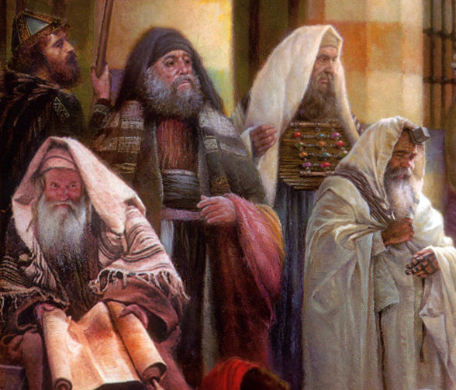
John 12:42
“Nevertheless many even of the rulers believed in Him, but because of the Pharisees they were not confessing Him, for fear that they would be put out of the synagogue.”

Slide 35

John 20:30-31
³⁰ “Therefore many other signs Jesus also performed in the presence of the disciples, which are not written in this book; ³¹ but these have been written so that you may believe that Jesus is the Christ, the Son of God; and that believing you may have life in His name.”

Slide 36
Acts 2:16-18
¹⁶ “but this is what was spoken of through the prophet Joel: ¹⁷ ‘And it shall be in the last days,’ God says, ‘That I will pour forth of My Spirit on all mankind; And your sons and your daughters shall prophesy, And your young men shall see visions, And your old men shall dream dreams; ¹⁸ Even on My bond slaves, both men and women, I will in those days pour forth of My Spirit And they shall prophesy….”

Slide 37
4. Analogical Fulfillment View
(Joel 2:28-32; Acts 2:16-21)
Spirit Poured Out On All Flesh?
Joel 2 Predictions Not In Acts 2
Acts 2 Realities Not Found In Joel 2
Different Wording in Acts 2
Absence of “Fulfilled”
Mystery Nature of the Church
“This is That”?
Arnold G. Fruchtenbaum, “Rabbinic Quotations of the Old Testament and How It relates to Joel 2 and Acts 2,” 5–7, accessed April 1, 2016, http://www.pre-trib.org; Thomas L. Constable, “Notes on Acts,” 42–49, accessed April 1, 2016, http://www.soniclight.com.

Slide 38
Acts 2:19-21
¹⁹ “ ‘And I will grant wonders in the sky above And signs on the earth below, Blood, and fire, and vapor of smoke. ²⁰ ‘The sun will be turned into darkness And the moon into blood, Before the great and glorious day of the Lord shall come.²¹ ‘And it shall be that everyone who calls on the name of the Lord will be saved.’”

Slide 39

Joel 2:32
“And it will come about that whoever calls on the name of the Lord Will be delivered; For on Mount Zion and in Jerusalem There will be those who escape, As the Lord has said, Even among the survivors whom the Lord calls.”

Slide 40
Acts 2:19-21
¹⁹ “ ‘And I will grant wonders in the sky above And signs on the earth below, Blood, and fire, and vapor of smoke. ²⁰ ‘The sun will be turned into darkness And the moon into blood, Before the great and glorious day of the Lord shall come.²¹ ‘And it shall be that everyone who calls on the name of the Lord will be saved.’”

Slide 41
Acts 2:16-18
¹⁶ “but this is what was spoken of through the prophet Joel: ¹⁷ ‘And it shall be in the last days,’ God says, ‘That I will pour forth of My Spirit on all mankind; And your sons and your daughters shall prophesy, And your young men shall see visions, And your old men shall dream dreams; ¹⁸ Even on My bond slaves, both men and women, I will in those days pour forth of My Spirit And they shall prophesy….”

Slide 42
4. Analogical Fulfillment View
(Joel 2:28-32; Acts 2:16-21)
Spirit Poured Out On All Flesh?
Joel 2 Predictions Not In Acts 2
Acts 2 Realities Not Found In Joel 2
Different Wording in Acts 2
Absence of “Fulfilled”
Mystery Nature of the Church
“This is That”?
Arnold G. Fruchtenbaum, “Rabbinic Quotations of the Old Testament and How It relates to Joel 2 and Acts 2,” 5–7, accessed April 1, 2016, http://www.pre-trib.org; Thomas L. Constable, “Notes on Acts,” 42–49, accessed April 1, 2016, http://www.soniclight.com.

Slide 43
Acts 2
The Beginning of the Church Age
2:1-4 – The falling of the Holy Spirit
2:5-8 – The manifestation of the gift of tongues
2:9-12 – Those present from the known world
2:13-15 – Too early for drinking
2:16-21 – Manifestations taught in the OT (Joel 2)

Slide 44
4. Analogical Fulfillment View
(Joel 2:28-32; Acts 2:16-21)
Spirit Poured Out On All Flesh?
Joel 2 Predictions Not In Acts 2
Acts 2 Realities Not Found In Joel 2
Different Wording in Acts 2
Absence of “Fulfilled”
Mystery Nature of the Church
“This is That”?
Arnold G. Fruchtenbaum, “Rabbinic Quotations of the Old Testament and How It relates to Joel 2 and Acts 2,” 5–7, accessed April 1, 2016, http://www.pre-trib.org; Thomas L. Constable, “Notes on Acts,” 42–49, accessed April 1, 2016, http://www.soniclight.com.

Slide 45
Acts 2:16-18
¹⁶ “but this is what was spoken of through the prophet Joel: ¹⁷ ‘And it shall be in the last days,’ God says, ‘That I will pour forth of My Spirit on all mankind; And your sons and your daughters shall prophesy, And your young men shall see visions, And your old men shall dream dreams; ¹⁸ Even on My bond slaves, both men and women, I will in those days pour forth of My Spirit And they shall prophesy….”

Slide 46
Acts 2:16-18
¹⁶ “but this is what was spoken of through the prophet Joel: ¹⁷ ‘And it shall be in the last days,’ God says, ‘That I will pour forth of My Spirit on all mankind; And your sons and your daughters shall prophesy, And your young men shall see visions, And your old men shall dream dreams; ¹⁸ Even on My bond slaves, both men and women, I will in those days pour forth of My Spirit And they shall prophesy….”

Slide 47
4. Analogical Fulfillment View
(Joel 2:28-32; Acts 2:16-21)
Spirit Poured Out On All Flesh?
Joel 2 Predictions Not In Acts 2
Acts 2 Realities Not Found In Joel 2
Different Wording in Acts 2
Absence of “Fulfilled”
Mystery Nature of the Church
“This is That”?
Arnold G. Fruchtenbaum, “Rabbinic Quotations of the Old Testament and How It relates to Joel 2 and Acts 2,” 5–7, accessed April 1, 2016, http://www.pre-trib.org; Thomas L. Constable, “Notes on Acts,” 42–49, accessed April 1, 2016, http://www.soniclight.com.

Slide 48
Acts 1:16
“Brethren, the Scripture had to be fulfilled (plēroō), which the Holy Spirit foretold by the mouth of David concerning Judas, who became a guide to those who arrested Jesus.”

Slide 49
4. Analogical Fulfillment View
(Joel 2:28-32; Acts 2:16-21)
Spirit Poured Out On All Flesh?
Joel 2 Predictions Not In Acts 2
Acts 2 Realities Not Found In Joel 2
Different Wording in Acts 2
Absence of “Fulfilled”
Mystery Nature of the Church
“This is That”?
Arnold G. Fruchtenbaum, “Rabbinic Quotations of the Old Testament and How It relates to Joel 2 and Acts 2,” 5–7, accessed April 1, 2016, http://www.pre-trib.org; Thomas L. Constable, “Notes on Acts,” 42–49, accessed April 1, 2016, http://www.soniclight.com.

Slide 50

Ephesians 2:14-16
¹⁴ “For He Himself is our peace, who made both groups into one and broke down the barrier of the dividing wall, ¹⁵ by abolishing in His flesh the enmity, which is the Law of commandments contained in ordinances, so that in Himself He might make the two into one new man, thus establishing peace, ¹⁶ and might reconcile them both in one body to God through the cross, by it having put to death the enmity.”

Slide 51
Ephesians 3:3-6
³ “that by revelation there was made known to me the mystery, as I wrote before in brief. ⁴ By referring to this, when you read you can understand my insight into the mystery of Christ, ⁵ which in other generations was not made known to the sons of men, as it has now been revealed to His holy apostles and prophets in the Spirit; ⁶ to be specific, that the Gentiles are fellow heirs and fellow members of the body, and fellow partakers of the promise in Christ Jesus through the gospel”.

Slide 52

Ephesians 3:9
“and to bring to light what is the administration of the mystery which for ages has been hidden in God who created all things.”

Slide 53
“Mystery” Defined
“In the N.T, it [mustērion] denotes, not the mysterious (as with the Eng. word), but that which, being outside the range of unassisted natural apprehension, can be made known only by Divine revelation, and is made known in a manner and at a time appointed by God, and to those who are illumined by His Spirit.”
W. E. Vine, Merrill F. Unger, and William White, Vine's Complete Expository Dictionary of the Old and New Testament Words (Nashville: Nelson, 1996), 424.

Slide 54
Romans 16:25-26
^{25 “}Now to Him who is able to establish you according to my gospel and the preaching of Jesus Christ, according to the revelation of the mystery which has been kept secret for long ages past, ²⁶ but now is manifested, and by the Scriptures of the prophets, according to the commandment of the eternal God, has been made known to all the nations, leading to obedience of faith

Slide 55
Colossians 1:26
“that is, the mystery which has been hidden from the past ages and generations, but has now been manifested to His.”

Slide 56
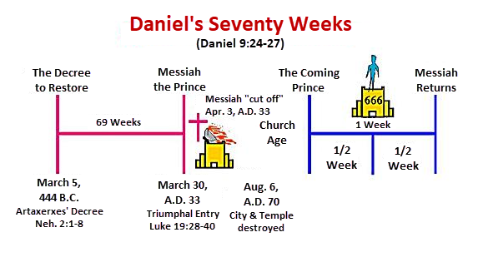

Slide 57
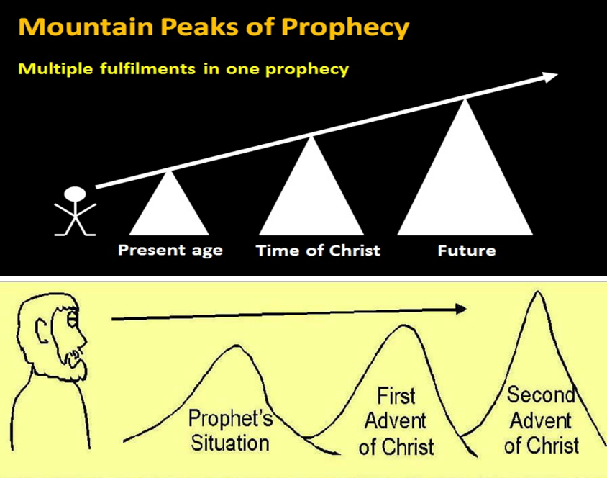

Slide 58


Statue
&
Stone

Slide 59
1 Peter 1:10-11
¹⁰ As to this salvation, the prophets who prophesied of the grace that would come to you made careful searches and inquiries, ¹¹ seeking to know what person or time the Spirit of Christ within them was indicating as He predicted the sufferings of Christ and the glories to follow.

Slide 60
4. Analogical Fulfillment View
(Joel 2:28-32; Acts 2:16-21)
Spirit Poured Out On All Flesh?
Joel 2 Predictions Not In Acts 2
Acts 2 Realities Not Found In Joel 2
Different Wording in Acts 2
Absence of “Fulfilled”
Mystery Nature of the Church
“This is That”?
Arnold G. Fruchtenbaum, “Rabbinic Quotations of the Old Testament and How It relates to Joel 2 and Acts 2,” 5–7, accessed April 1, 2016, http://www.pre-trib.org; Thomas L. Constable, “Notes on Acts,” 42–49, accessed April 1, 2016, http://www.soniclight.com.

Slide 61
Acts 2:16-18
¹⁶ “but this is what/that (touto estin to) was spoken of through the prophet Joel: ¹⁷ ‘And it shall be in the last days,’ God says, ‘That I will pour forth of My Spirit on all mankind; And your sons and your daughters shall prophesy, And your young men shall see visions, And your old men shall dream dreams; ¹⁸ Even on My bond slaves, both men and women, I will in those days pour forth of My Spirit And they shall prophesy….”

Slide 62
1 Corinthians 11:24-26
²⁴ “and when He had given thanks, He broke it and said, “This is (touto estin to) My body, which is for you; do this in remembrance of Me.” ²⁵ In the same way He took the cup also after supper, saying, “This cup is the new covenant in My blood; do this, as often as you drink it, in remembrance of Me.” ²⁶ For as often as you eat this bread and drink the cup, you proclaim the Lord’s death until He comes.”

Slide 63
Darrell Bock
Darrell Bock, “The Reign of the Lord Christ,” in Dispensationalism, Israel and the Church, ed. Craig A. Blaising and Darrell L. Bock (Grand Rapids: Zondervan, 1992), 49.
“In other words, Jesus’ resurrection-ascension to God’s right hand is put forward by Peter as a fulfillment of the Davidic covenant, just as the allusion to Joel fulfills the new covenant.”

Slide 64
4. Analogical Fulfillment View
(Joel 2:28-32; Acts 2:16-21)
Spirit Poured Out On All Flesh?
Joel 2 Predictions Not In Acts 2
Acts 2 Realities Not Found In Joel 2
Different Wording in Acts 2
Absence of “Fulfilled”
Mystery Nature of the Church
“This is That”?
Arnold G. Fruchtenbaum, “Rabbinic Quotations of the Old Testament and How It relates to Joel 2 and Acts 2,” 5–7, accessed April 1, 2016, http://www.pre-trib.org; Thomas L. Constable, “Notes on Acts,” 42–49, accessed April 1, 2016, http://www.soniclight.com.

Slide 65
CONCLUSION

Slide 66
Response to Kingdom Now Problem Passages
Passages from Christ’s ministry
Passages from Acts
Passages from Paul
Passages from the General letters
Passages from Revelation
Miscellaneous Arguments

