Slide 1
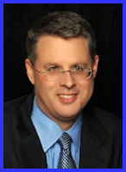
Ecclesiology Session 52
Dr. Andy Woods
Senior Pastor – Sugar Land Bible Church
President – Chafer Theological Seminary

Slide 2
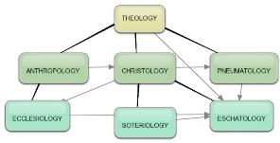
Areas of Systematic Theology
Prolegomena – Introduction
Theology – Study of God
Christology – Study of Christ
Pneumatology – Study of the Holy Spirit
Anthropology – Study of Man
Hamartiology – Study of sin
Soteriology – Study of salvation
Angelology – Study of angels
Ecclesiology – Study of the Church
Eschatology – Study of the end

Slide 3
Ecclesiology Overview
Definition
Universal vs. local
Word pictures
Origin
Israel – Church differences
Intercalation
Purposes
Activities
Government
Officers
Ordinances
Purity

