Slide 1


Dr. Andy Woods
Senior Pastor – Sugar Land Bible Church
President – Chafer Theological Seminary

Slide 2


Slide 3


7th Seal & 1st Six Trumpets (Revelation 8‒9)
7th Seal (8:1-6) – Trumpet preparation
1st Trumpet (8:7) – 1/3 vegetation destroyed
2nd Trumpet (8:8-9) – 1/3 ocean destroyed
3rd Trumpet (8:10-11) – 1/3 water destroyed
4th Trumpet (8:12-13) – 1/3 luminaries darkened
5th Trumpet (9:1-12) – Demons released
6th Trumpet (9:13-21) – 1/3 humanity destroyed

Slide 4
7th Seal & 1st Six Trumpets (Revelation 8‒9)
7th Seal (8:1-6) – Trumpet preparation
1st Trumpet (8:7) – 1/3 vegetation destroyed
2nd Trumpet (8:8-9) – 1/3 ocean destroyed
3rd Trumpet (8:10-11) – 1/3 water destroyed
4th Trumpet (8:12-13) – 1/3 luminaries darkened
5th Trumpet (9:1-12) – Demons released
6th Trumpet (9:13-21) – 1/3 humanity destroyed

Slide 5
7th Seal & 1st Six Trumpets (Revelation 8‒9)
7th Seal (8:1-6) – Trumpet preparation
1st Trumpet (8:7) – 1/3 vegetation destroyed
2nd Trumpet (8:8-9) – 1/3 ocean destroyed
3rd Trumpet (8:10-11) – 1/3 water destroyed
4th Trumpet (8:12-13) – 1/3 luminaries darkened
5th Trumpet (9:1-12) – Demons released
6th Trumpet (9:13-21) – 1/3 humanity destroyed

Slide 6
7th Seal & 1st Six Trumpets (Revelation 8‒9)
7th Seal (8:1-6) – Trumpet preparation
1st Trumpet (8:7) – 1/3 vegetation destroyed
2nd Trumpet (8:8-9) – 1/3 ocean destroyed
3rd Trumpet (8:10-11) – 1/3 water destroyed
4th Trumpet (8:12-13) – 1/3 luminaries darkened
5th Trumpet (9:1-12) – Demons released
6th Trumpet (9:13-21) – 1/3 humanity destroyed

Slide 7
7th Seal & 1st Six Trumpets (Revelation 8‒9)
7th Seal (8:1-6) – Trumpet preparation
1st Trumpet (8:7) – 1/3 vegetation destroyed
2nd Trumpet (8:8-9) – 1/3 ocean destroyed
3rd Trumpet (8:10-11) – 1/3 water destroyed
4th Trumpet (8:12-13) – 1/3 luminaries darkened
5th Trumpet (9:1-12) – Demons released
6th Trumpet (9:13-21) – 1/3 humanity destroyed

Slide 8
7th Seal & 1st Six Trumpets (Revelation 8‒9)
7th Seal (8:1-6) – Trumpet preparation
1st Trumpet (8:7) – 1/3 vegetation destroyed
2nd Trumpet (8:8-9) – 1/3 ocean destroyed
3rd Trumpet (8:10-11) – 1/3 water destroyed
4th Trumpet (8:12-13) – 1/3 luminaries darkened
5th Trumpet (9:1-12) – Demons released
6th Trumpet (9:13-21) – 1/3 humanity destroyed

Slide 9
7th Seal & 1st Six Trumpets (Revelation 8‒9)
7th Seal (8:1-6) – Trumpet preparation
1st Trumpet (8:7) – 1/3 vegetation destroyed
2nd Trumpet (8:8-9) – 1/3 ocean destroyed
3rd Trumpet (8:10-11) – 1/3 water destroyed
4th Trumpet (8:12-13) – 1/3 luminaries darkened
5th Trumpet (9:1-12) – Demons released
6th Trumpet (9:13-21) – 1/3 humanity destroyed

Slide 10
6. 5th Trumpet (Rev. 9:1-12)
Discharging angel (9:1)
Angel opens the abyss (9:2)
Demons emerge from the abyss (9:3)
Demonic activity (9:4-6)
Demonic description (9:7-10)
Demonic leader (9:11)
Remaining trumpets (9:12)

Slide 11
7th Seal & 1st Six Trumpets (Revelation 8‒9)
7th Seal (8:1-6) – Trumpet preparation
1st Trumpet (8:7) – 1/3 vegetation destroyed
2nd Trumpet (8:8-9) – 1/3 ocean destroyed
3rd Trumpet (8:10-11) – 1/3 water destroyed
4th Trumpet (8:12-13) – 1/3 luminaries darkened
5th Trumpet (9:1-12) – Demons released
6th Trumpet (9:13-21) – 1/3 humanity destroyed

Slide 12
Transitions | Fifth Trumpet | Sixth Trumpet
Scripture: | Rev. 9:1-12 | Rev. 9:13-21
Source: | Abyss | East
Kind of army: | Demonic | Human

Slide 13
7. 6th Trumpet
(Rev. 9:13-21)
Army released (9:13-15)
Army’s number (9:16)
Army’s description (9:17)
Army’s destruction (9:18-19)
Humanity’s non-repentance (9:20-21)

Slide 14
7. 6th Trumpet
(Rev. 9:13-21)
Army released (9:13-15)
Army’s number (9:16)
Army’s description (9:17)
Army’s destruction (9:18-19)
Humanity’s non-repentance (9:20-21)

Slide 16
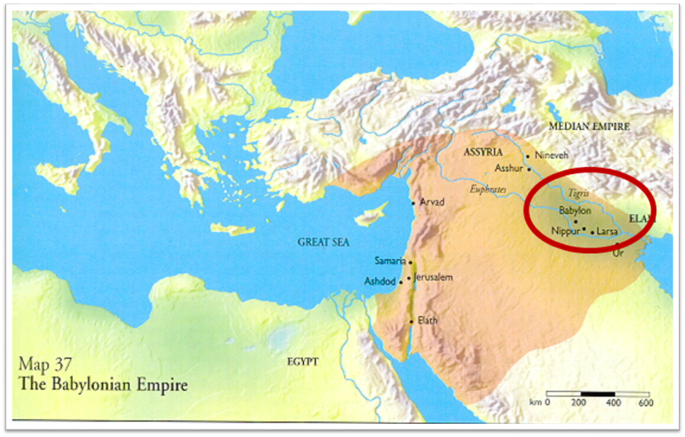

Slide 17
Literal Geography in Revelation Thomas, Revelation 8 to 22: An Exegetical Commentary, 206-207.
Asia | 1:4 | Sardis | 3:1
Ephesus | 2:1 | Philadelphia | 3:7
Smyrna | 2:8 | Laodicea | 3:14
Pergamum | 2:12 | Euphrates | 9:14;16:12
Thyatira | 2:18 | Armageddon | 16:16

Slide 19
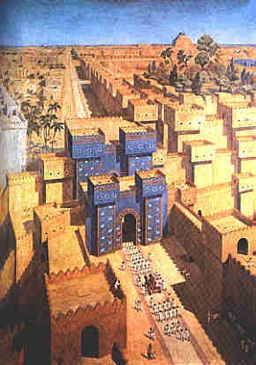
East = Babylon
Genesis 2:8
Genesis 11:2
Matthew 2:2

Slide 20


John 2:4
“And Jesus said to her, ‘Woman, what does that have to do with us? My hour hour [hōra] has not yet come.’”

Slide 21
John 12:27
“Now My soul has become troubled; and what shall I say, ‘Father, save Me from this hour [hōra]’? But for this purpose I came to this hour [hōra]’.”

Slide 22

Luke 19:42, 44
⁴² saying, “If you had known in this day, even you, the things which make for peace! But now they have been hidden from your eyes… ⁴⁴ and they will level you to the ground and your children within you, and they will not leave in you one stone upon another, because you did not recognize the time of your visitation.”

Slide 23
Galatians 4:4
“But when the fullness of the time came, God sent forth His Son, born of a woman, born under the Law.”

Slide 24


Jeremiah 30:7 (LXX)
“Alas! for that day is great, There is none like it; And it is the time of Jacob’s distress (Gen. 32:8; 35:10), But he will be saved [sōzō] from [apo] it.”

Slide 25
7. 6th Trumpet
(Rev. 9:13-21)
Army released (9:13-15)
Army’s number (9:16)
Army’s description (9:17)
Army’s destruction (9:18-19)
Humanity’s non-repentance (9:20-21)

Slide 26

Robert Thomas
Revelation 8 to 22: An Exegetical Commentary (Chicago: Moody Press, 1992), 408.
Robert Thomas observes that, "no number in Revelation is verifiably a symbolic number.”

Slide 27
7. 6th Trumpet
(Rev. 9:13-21)
Army released (9:13-15)
Army’s number (9:16)
Army’s description (9:17)
Army’s destruction (9:18-19)
Humanity’s non-repentance (9:20-21)

Slide 28
7. 6th Trumpet
(Rev. 9:13-21)
Army released (9:13-15)
Army’s number (9:16)
Army’s description (9:17)
Army’s destruction (9:18-19)
Humanity’s non-repentance (9:20-21)

Slide 29
7. 6th Trumpet
(Rev. 9:13-21)
Army released (9:13-15)
Army’s number (9:16)
Army’s description (9:17)
Army’s destruction (9:18-19)
Humanity’s non-repentance (9:20-21)

Slide 30

Revelation 9:20-21
²⁰ “The rest of mankind, who were not killed by these plagues, did not repent of the works of their hands, so as not to worship demons, and the idols of gold and of silver and of brass and of stone and of wood, which can neither see nor hear nor walk; ²¹ and they did not repent of their murders nor of their sorceries nor of their immorality nor of their thefts.”

Slide 31
Revelation 9:20-21
²⁰ “The rest of mankind, who were not killed by these plagues, did not repent of the works of their hands, so as not to worship demons, and the idols of gold and of silver and of brass and of stone and of wood, which can neither see nor hear nor walk; ²¹ and they did not repent of their murders nor of their sorceries nor of their immorality nor of their thefts.”

Slide 32

Revelation 9:20-21
“The rest of mankind, who were not killed by these plagues, did not repent of the works of their hands, so as not to worship demons, and the idols of gold and of silver and of brass and of stone and of wood, which can neither see nor hear nor walk; ²¹ and they did not repent of their murders nor of their sorceries (pharmakeia) nor of their immorality nor of their thefts.”

Slide 33
Luke 19:42, 44
⁴² saying, “If you had known in this day, even you, the things which make for peace! But now they have been hidden from your eyes… ⁴⁴ and they will level you to the ground and your children within you, and they will not leave in you one stone upon another, because you did not recognize the time of your visitation.”

Slide 34
Revelation 9:20-21
“The rest of mankind, who were not killed by these plagues, did not repent of the works of their hands, so as not to worship demons, and the idols of gold and of silver and of brass and of stone and of wood, which can neither see nor hear nor walk; ²¹ and they did not repent of their murders nor of their sorceries (pharmakeia) nor of their immorality nor of their thefts.”

Slide 35
Conclusion

Slide 36
7th Seal & 1st Six Trumpets (Revelation 8‒9)
7th Seal (8:1-6) – Trumpet preparation
1st Trumpet (8:7) – 1/3 vegetation destroyed
2nd Trumpet (8:8-9) – 1/3 ocean destroyed
3rd Trumpet (8:10-11) – 1/3 water destroyed
4th Trumpet (8:12-13) – 1/3 luminaries darkened
5th Trumpet (9:1-12) – Demons released
6th Trumpet (9:13-21) – 1/3 humanity destroyed

Slide 37
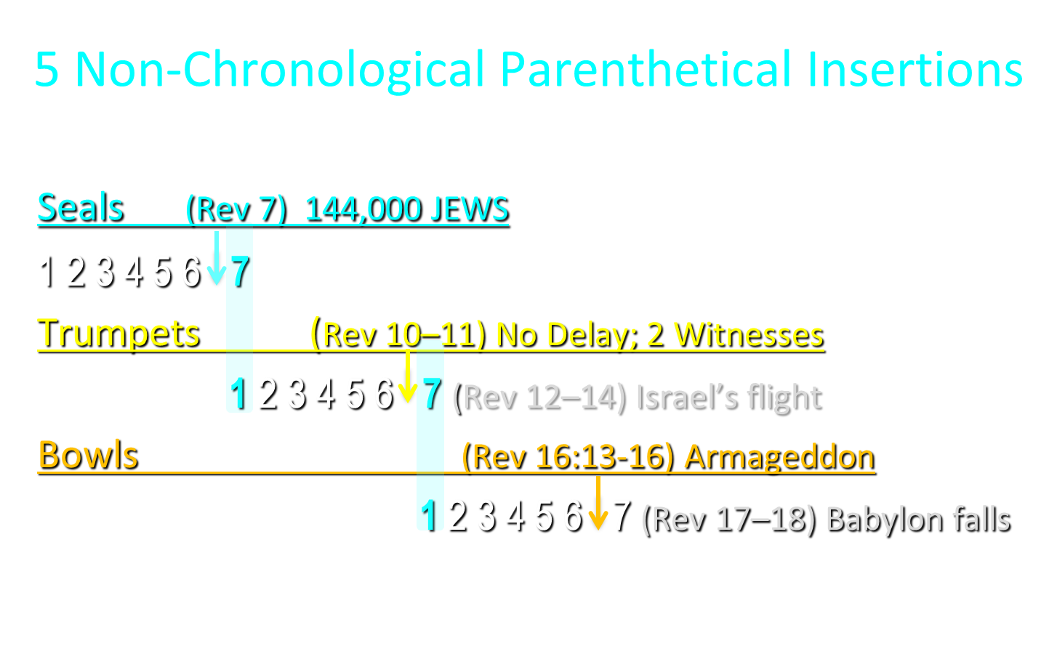

Slide 38

“The Lord bless you and keep you; the Lord make his face shine on you and be gracious to you; the Lord turn his face toward you and give you peace.” (NIV)

