Slide 1
Law and Grace: An Overview Jim McGowan, Th.D. Sugar Land Bible Church 02-10-2019
…but grace and truth were realized through Jesus Christ - John 1:17
For the Law was given through Moses…
Special thanks to Dr. Vern Peterman for access to his insights and resources.

Slide 2
Session 17 Outline
Purpose, Aim, and Objective
Introduction to the Gospel of Matthew
General Information
Concluding Observations

Slide 3
OUR PURPOSE, AIM AND OBJECTIVE
Law and Grace
…is to Compare and Contrast Law and Grace so as to properly understand these two important themes and how they are related to the life of the New Testament Believer.

Slide 4
C. I. SCOFIELD, D. D.
The Grace of God, The Fundamentals Vol. 3, Chapter VII, p. 98
We have, most of us, been reared and now live under the influence of Galatianism. Protestant theology, alas, is for the most part, thoroughly Galatianized, in that neither law nor grace are given their distinct and separated places, as in the counsels of God, but are mingled together in one incoherent system.
The law is no longer, as in the Divine intent, a ministration of death (2 Cor. 3:7), of cursing (Gal. 3:10), of conviction (Rom. 3:19), because we are taught that we must try to keep it, and that by Divine help we may.
Nor, on the other hand, does grace bring us blessed deliverance from the dominion of sin, for we are kept under the law as a rule of life despite the plain declaration, “Sin shall not have dominion over you: for ye are not under the law, but under grace” (Rom. 6:14). (emphasis mine)

Slide 5
William R. Newell
Romans Verse-by-Verse (p. 274).
Grand Rapids, MI: Christian Classics Ethereal Library.
It is because Reformed theology has kept us Gentiles under the Law,—if not as a means of righteousness, then as “a rule of life,” that all the trouble has arisen. The Law is no more a rule of life than it is a means of righteousness. Walking in the Spirit has now taken the place of walking by ordinances. God has another principle under which He has put his saints: “Ye are not under law, but, under grace!” (italics mine)

Slide 6
Session 17 Outline
Purpose, Aim, and Objective
Introduction to the Gospel of Matthew
General Information
Concluding Observations

Slide 7
Matthew 10:1, 5-6
¹ Jesus summoned His twelve disciples and gave them authority over unclean spirits, to cast them out, and to heal every kind of disease and every kind of sickness… ⁵ These twelve Jesus sent out after instructing them: "Do not go in the way of the Gentiles, and do not enter any city of the Samaritans; ⁶ but rather go to the lost sheep of the house of Israel."

Slide 8
Matthew 15:21-24
²¹ Jesus went away from there, and withdrew into the district of Tyre and Sidon. ²² And a Canaanite woman from that region came out and began to cry out, saying, "Have mercy on me, Lord, Son of David; my daughter is cruelly demon-possessed." ²³ But He did not answer her a word. And His disciples came and implored Him, saying, "Send her away, because she keeps shouting at us." ²⁴ But He answered and said, "I was sent only to the lost sheep of the house of Israel."

Slide 9
Law and Grace: Session 17

Slide 10
Welcome to the gospel of Matthew
Law and Grace: Session 17
As we now begin to explore the Gospel of Matthew, we will be at the greatest spiritual advantage if we realize that we are at a momentous and pivotal point in all of the inspired word of God.

Slide 11
Welcome to the gospel of Matthew
Law and Grace: Session 17
This gospel that was written by the apostle Matthew is strategically placed at the head of all of the New Testament books, yet we could say the gospels are the last of the Old Testament books.

Slide 12
Matthew’s Purposes
Law and Grace: Session 17
To explain that Jesus in whom they had believed was the long-awaited Jewish Messiah.
To explain why the kingdom had been postponed despite the fact that the king had arrived.
To explain the interim program of God during the kingdom’s absence.

Slide 13
Matthew & the Kingdom
Law and Grace: Session 17
Kingdom offered
Kingdom rejected
Kingdom postponed
Kingdom ultimately accepted
Interim program

Slide 14
Matthew’s Message
Law and Grace: Session 17
Jesus is the predicted Jewish king who ushered in an interim program by building the sons of the kingdom into the church in between Israel’s past rejection and future acceptance of her king.

Slide 15
Session 17 Outline
Purpose, Aim, and Objective
Introduction to the Gospel of Matthew
General Information
Concluding Observations

Slide 16
Comparison of the Living Beings of Revelation 4 to similar beings from Ezekiel & Isaiah
Living Beings (Rev. 4) | Living Beings (Eze. 1) | Cherubim (Eze. 10) | Seraphim (Isa. 6)
v. 6 midst of & around throne | v. 26 under throne | v. 1 under throne | v. 2 above throne
v. 6 full of eyes before & behind | v. 18 rings full of eyes | v. 12 full of eyes
v. 7 one face each: | v. 6 four faces each: | v. 14 four faces each:
like a lion like an ox (or calf) like a man like an eagle | like a lion like an ox like a man like an eagle | like a lion like a cherub* like a man like an eagle
v. 8 six wings full of eyes within | v. 6 four wings | v. 21 four wings | v. 2 six wings
v. 8 "Holy, holy, holy, Lord God Almighty" |  |  | v. 3 "Holy, holy, holy, Lord of hosts"
v. 8 "which was & is & is to come" |  |  | v. 3 "The whole earth is full of His glory"
 | v. 7 feet straight
 | v. 8 hands under wings
 | v.13 likeness of fire
 | v.16 wheels
* Not as in “baby-like”, but like one of the heavenly creatures called “cherubim”, mentioned in the Bible 27 times in the singular & 67 times in the plural. Adapted from chart by John Fok, Moody Bible Institute student, formerly at http://home.hkstar.com/~johnfok1/

Slide 17
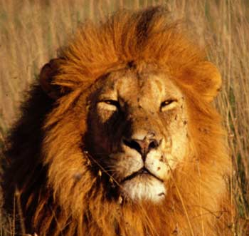
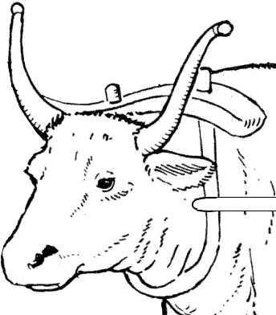
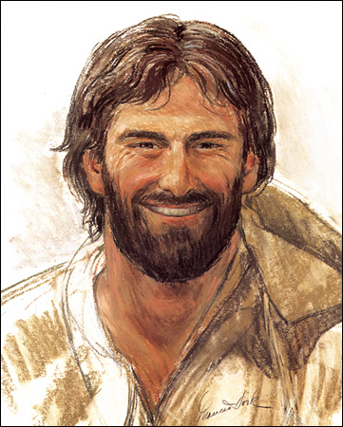
Law and Grace: Session 17
Comparison & Contrast in the Gospels
Book / Gospel | Matthew | Mark | Luke | John
Readers / Audience | Jews | Romans | Greeks | All
Creature Symbol: (Eze. 1 / Rev. 4) | Lion, as the Lion of Judah | Ox or Calf, as working | Man, Jesus as man | Eagle, Jesus’ deity

Slide 18
Law and Grace: Session 17
Comparison & Contrast in the Gospels
Book / Gospel | Matthew | Mark | Luke | John
Readers / Audience | Jews | Romans | Greeks | All
Creature Symbol: (Eze. 1 / Rev. 4) | Lion, as the Lion of Judah | Ox or Calf, as working | Man, Jesus as man | Eagle, Jesus’ deity

Slide 19
Law and Grace: Session 17
Comparison & Contrast in the Gospels
Book / Gospel | Matthew | Mark | Luke | John
Readers / Audience | Jews | Romans | Greeks | All
Creature Symbol: (Eze. 1 / Rev. 4) | Lion, as the Lion of Judah | Ox or Calf, as working | Man, Jesus as man | Eagle, Jesus’ deity

Slide 20
Law and Grace: Session 17
Comparison & Contrast in the Gospels
Book / Gospel | Matthew | Mark | Luke | John
Readers / Audience | Jews | Romans | Greeks | All
Creature Symbol: (Eze. 1 / Rev. 4) | Lion, as the Lion of Judah | Ox or Calf, as working | Man, Jesus as man | Eagle, Jesus’ deity

Slide 21
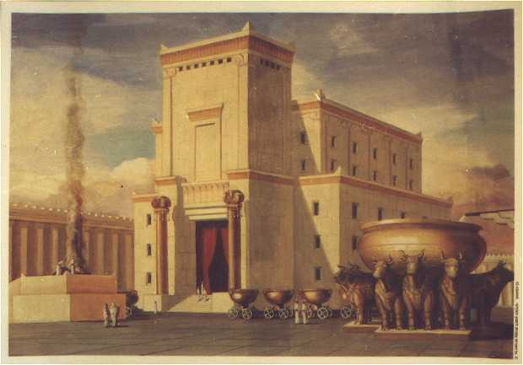
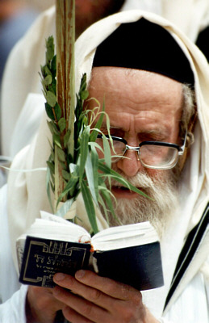
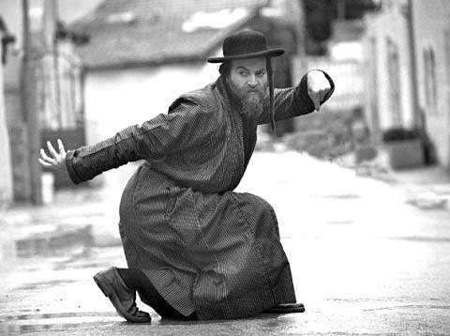
What? – Written to the Jews?
Law and Grace: Session 17
The Gospel written by Matthew shows evidence of being written to the people of Israel (the Jews).

Slide 22
What? – Written to the Jews?
Law and Grace: Session 17
It begins with a very Jewish genealogy, and no other gospel begins with such a Jewish genealogy.
Jesus [Yeshua: God saves]
Messiah [Christ: the Anointed One],
son of David, [his promised descendent]
son of Abraham: [of the lineage of Abraham, Isaac and Jacob]

Slide 23
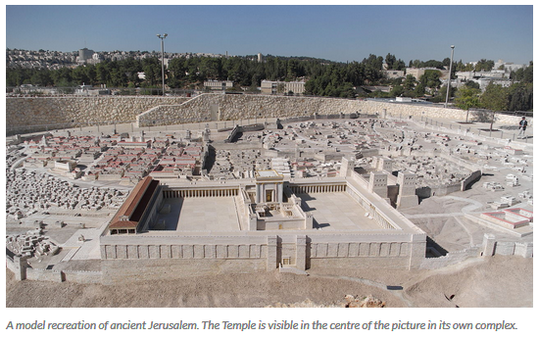
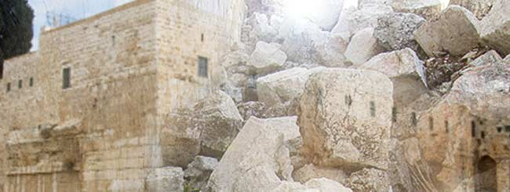
What? – Written to the Jews?
Law and Grace: Session 17
Until the destruction of the temple in Jerusalem by the Romans, in 70 AD, the Jews could assemble and check genealogies from the detailed records kept and made available at the temple.

Slide 24
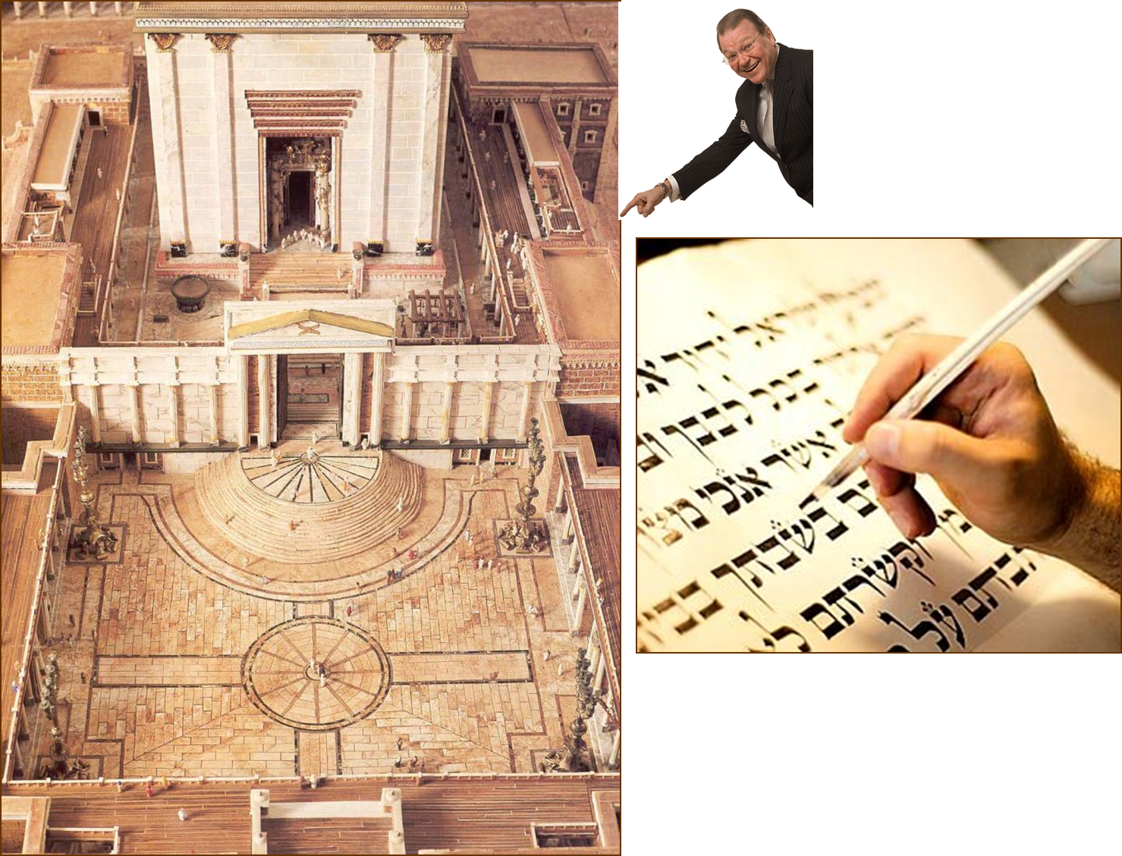
Law and Grace: Session 17
What? – Written to the Jews?

Slide 25
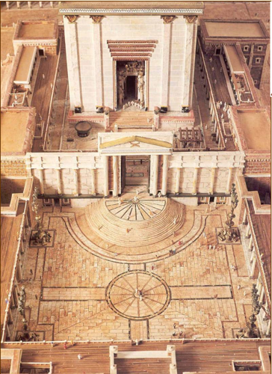
Hebrews 7:14
For it is evident that our Lord was descended from Judah, a tribe with reference to which Moses spoke nothing concerning priests.

Slide 26
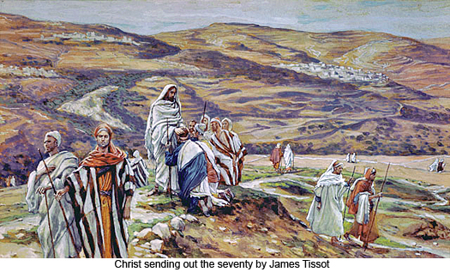
What? Written to the Jews?
Law and Grace: Session 17
Jesus tells the 12 disciples to go only to “the lost sheep of the house of Israel” (Matt. 10:1,5-6).
Jesus says that He was “sent only to the lost sheep of the house of Israel” (Matt. 15:21-24).

Slide 27
Matthew 10:1, 5-6
¹ Jesus summoned His twelve disciples and gave them authority over unclean spirits, to cast them out, and to heal every kind of disease and every kind of sickness… ⁵ These twelve Jesus sent out after instructing them: “Do not go in the way of the Gentiles, and do not enter any city of the Samaritans; ⁶ but rather go to the lost sheep of the house of Israel.

Slide 28
Matthew 15:21-24
²¹ Jesus went away from there, and withdrew into the district of Tyre and Sidon. ²² And a Canaanite woman from that region came out and began to cry out, saying, “Have mercy on me, Lord, Son of David; my daughter is cruelly demon-possessed.” ²³ But He did not answer her a word. And His disciples came and implored Him, saying, “Send her away, because she keeps shouting at us.” ²⁴ But He answered and said, “I was sent only to the lost sheep of the house of Israel.”

Slide 29
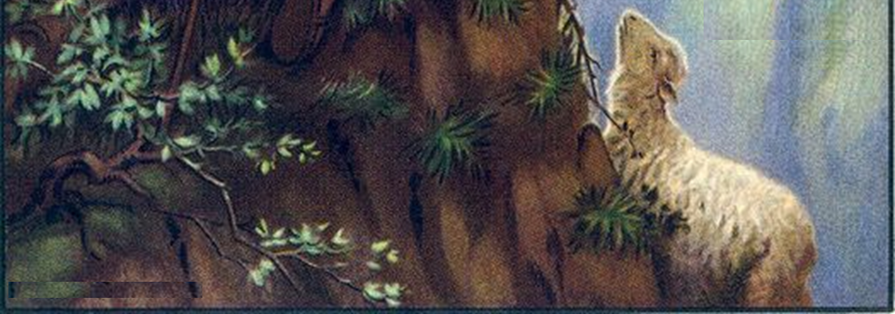
Jeremiah 50:6
“My people [Israel] have become lost sheep; their shepherds have led them astray. They have made them turn aside on the mountains; they have gone along from mountain to hill and have forgotten their resting place.” (cf. Eze. 34)

Slide 30
Ezekiel 34:11, 16
'For thus says the Lord God, "Behold, I Myself will search for My sheep and seek them out… I will seek the lost, bring back the scattered…"'

Slide 31
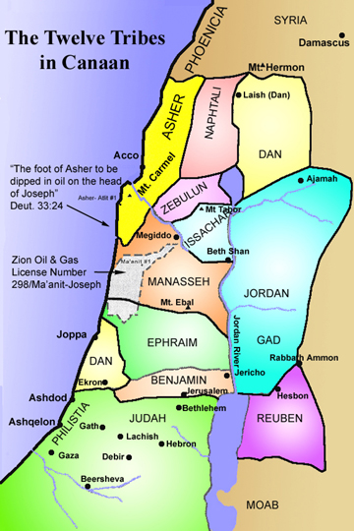
Only In the land of Israel and to people of Israel
Law and Grace: Session 17
Apart from His brief stay in Egypt as an infant (see Matthew 2:13-21), Christ is only said to be in the land designated for Israel from the beginning, and only for ministry to the people of Israel.

Slide 32
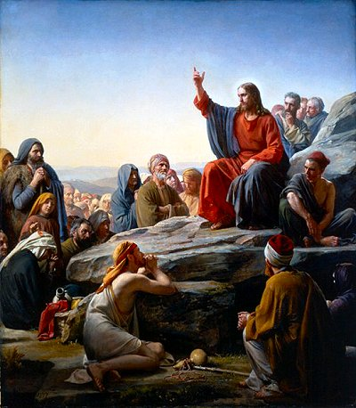
Only In the land of Israel and to people of Israel
Law and Grace: Session 17
In Matthew, we will see that Christ will direct the people of Israel back to the original intent of the Law of Moses, and away from those traditions that added to or distorted the original Law as given by Moses (cf. Matt. 5:21, 27, 33, 38, and 43).

Slide 33
Kingdom of God vs. Kingdom of Heaven
Law and Grace: Session 17
Only the Gospel of Matthew uses the term, ‘kingdom of heaven’, which it does 32 times.
We will take a closer look at the two terms for the kingdom later on in our study.

Slide 34
Kingdom of God vs. Kingdom of Heaven
Law and Grace: Session 17
The main reason Matthew replaced the usual expression ‘Kingdom of God’, with the *euphemism ‘Kingdom of heaven’, is due to the fact that the Jews didn’t want to risk saying the name of God [Yahweh] in vain.
* Definition of euphemism – the substitution of an agreeable or inoffensive expression for one that may offend… Merriam-Webster Online Dictionary.

Slide 35
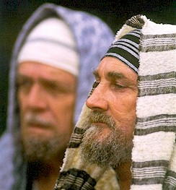
‘Heaven’ was and is a euphemism for ‘God’
Law and Grace: Session 17
Matthew alone used the euphemism ‘heaven’ to replace the name of God, which was a point of habit and concern among the Jews, further indicating that Matthew was written to the Jews.

Slide 36
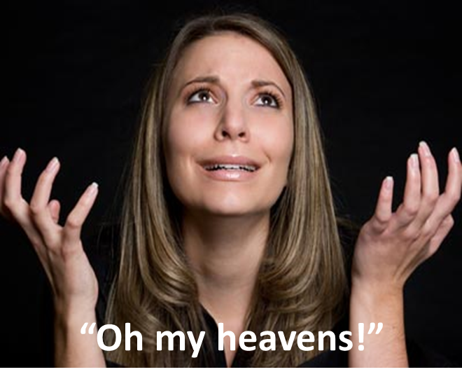
‘Heaven’ was and is a euphemism for ‘God’
Law and Grace: Session 17
We still carry on the same euphemism in our own language and culture today:
“Heaven knows…”
“For heaven’s sake”
“Oh, heavens!”, or “My heavens”, or “Oh my heavens!”

Slide 37
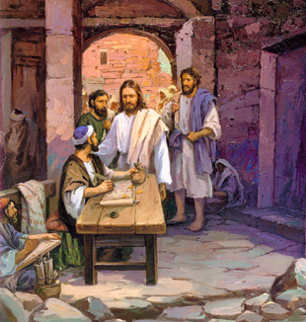
So who was Matthew?
Law and Grace: Session 17
Matthew was one of Christ’s 12 disciples whom He chose at the beginning of His 3 years of ministry.
The name ‘Matthew’ is a contraction of ‘Mattathias’, which means "gift of God”.

Slide 38
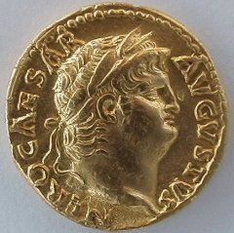
So who was Matthew?
Law and Grace: Session 17
Matthew, who was also called ‘Levi’, was a son of a man named Alphaeus (Mark 2:14).
Matthew had been a tax collector for the hated Romans (Matthew 9:9).

Slide 39
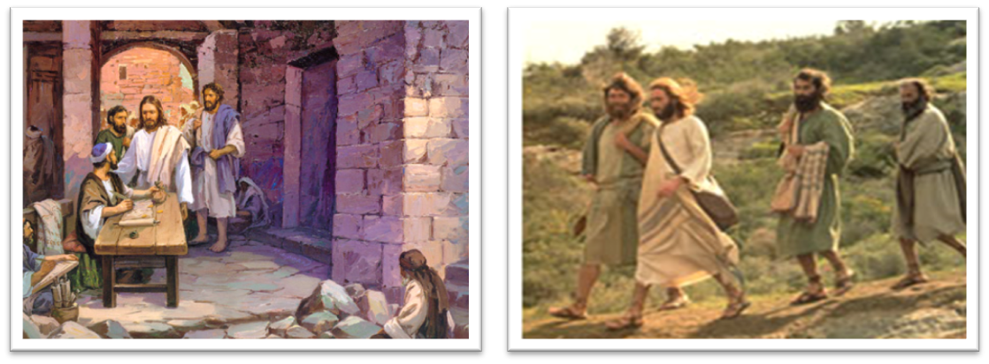
Luke 5:27-32
²⁷ After that He [Jesus] went out and noticed a tax collector named Levi [Matthew] sitting in the tax booth, and He said to him, "Follow Me." ²⁸ And he left everything behind, and got up and began to follow Him…

Slide 40
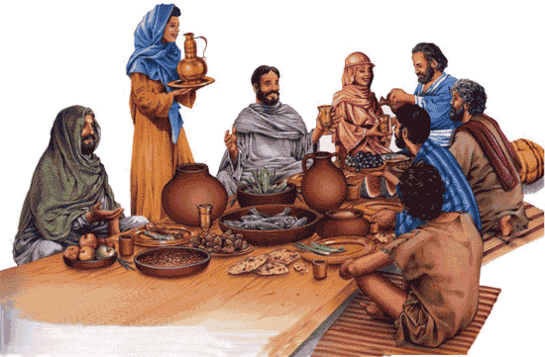
Luke 5:27-32
²⁹ And Levi gave a big reception for Him in his house; and there was a great crowd of tax collectors and other people who were reclining at the table with them… (cf. tax collectors and sinners - Matt. 9:10-11; 11:19; Mark 2:15-16; Luke 5:30; 7:34; 15:1).

Slide 41
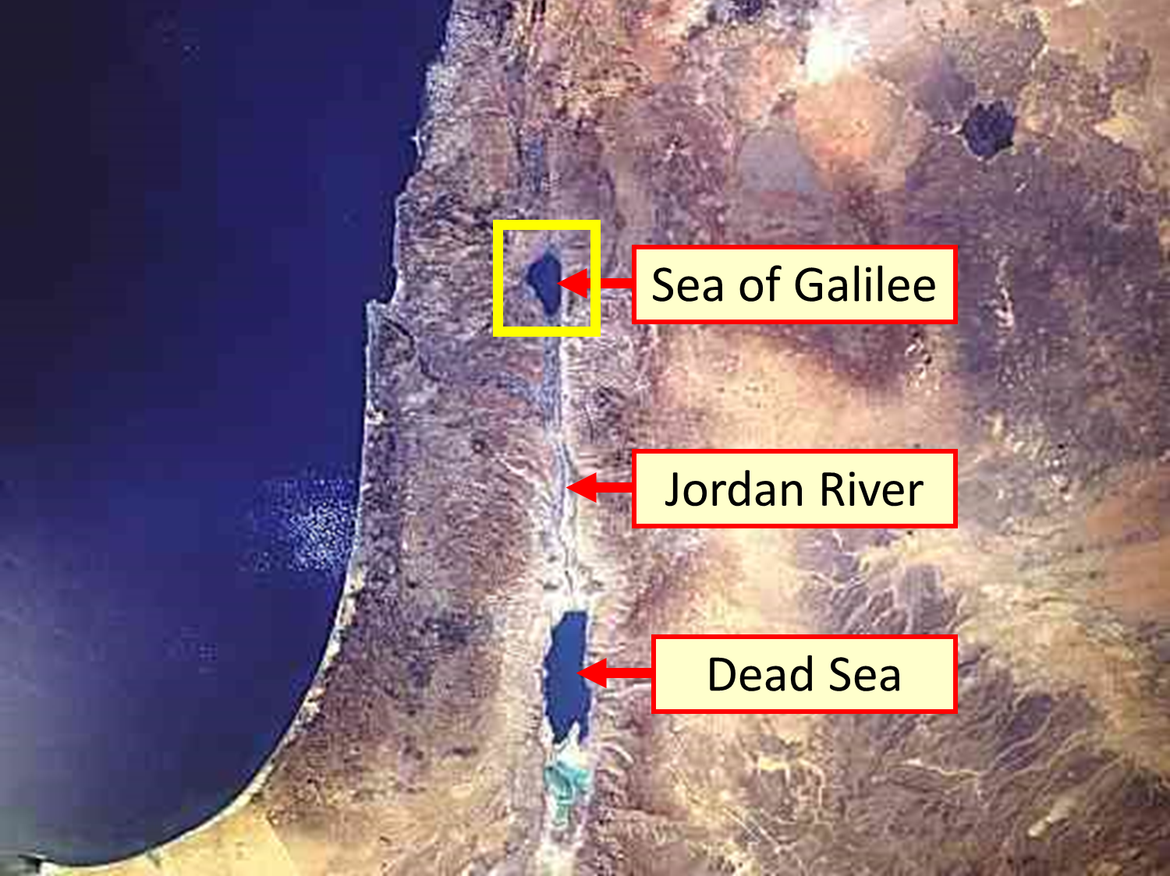
Law and Grace: Session 17
Matthew was from where?

Slide 42
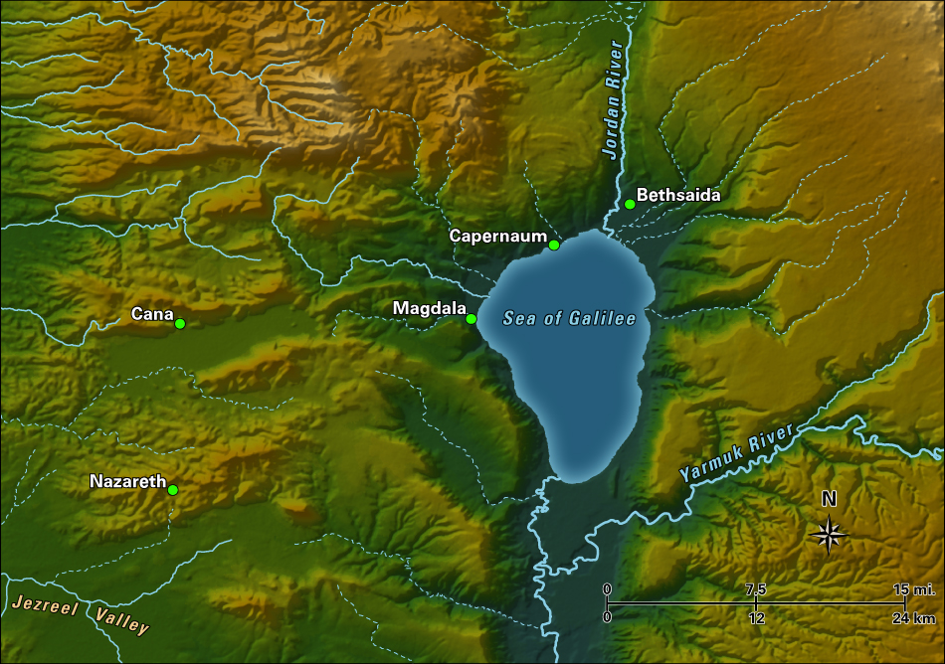
Law and Grace: Session 17
Matthew was from where?

Slide 43
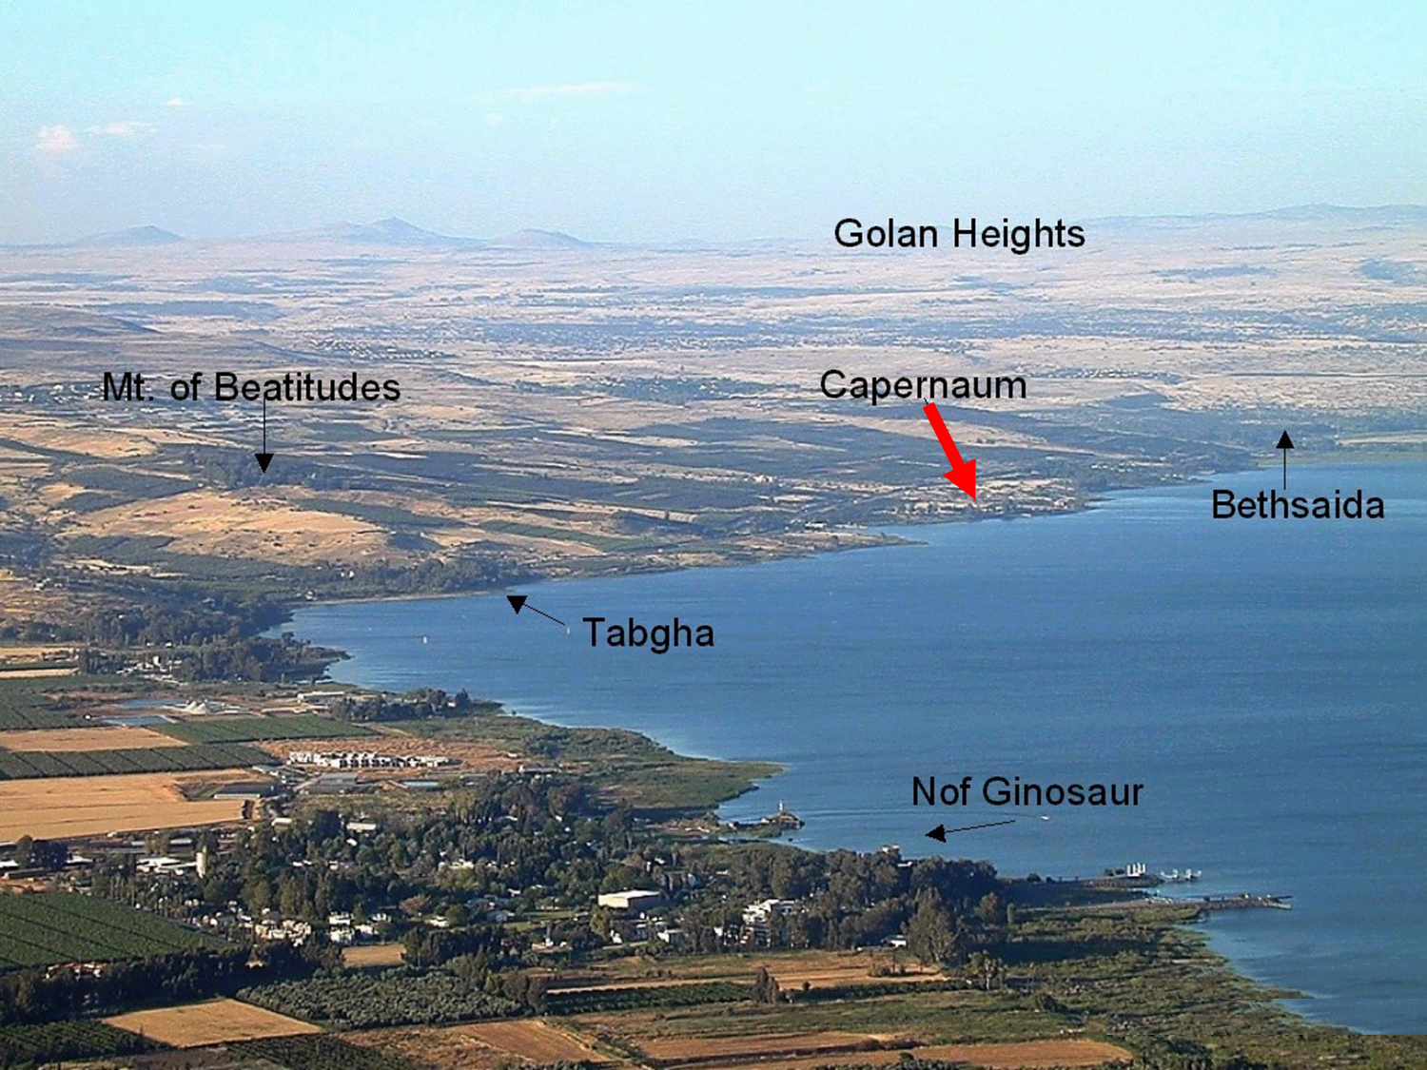
Law and Grace: Session 17
Matthew was from where?

Slide 44
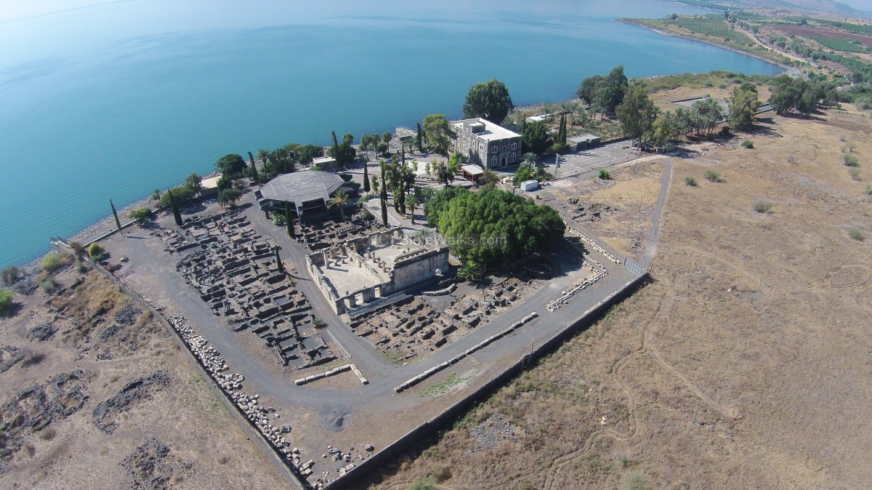
Law and Grace: Session 17
Matthew was from where?
Capernaum Archaeological Park

Slide 45
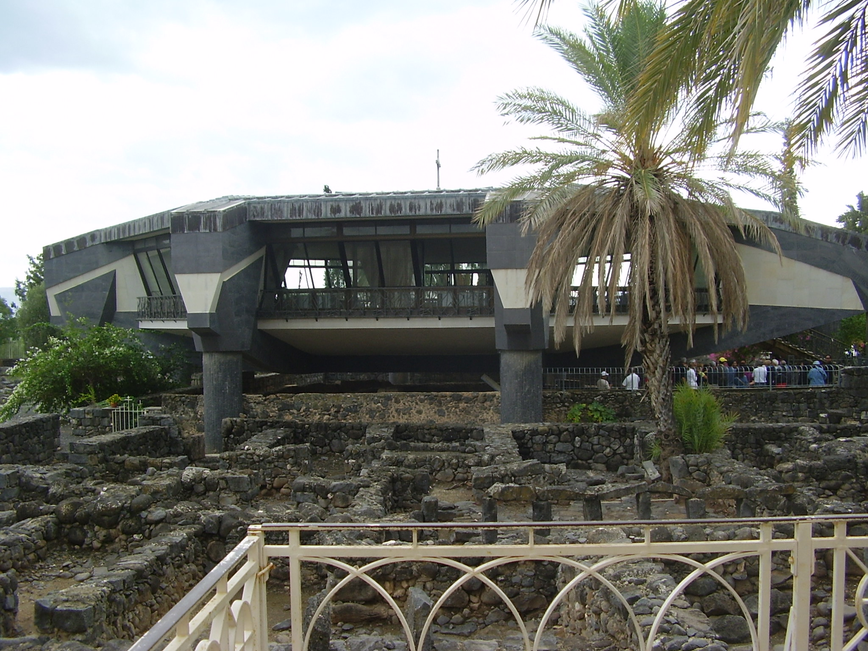
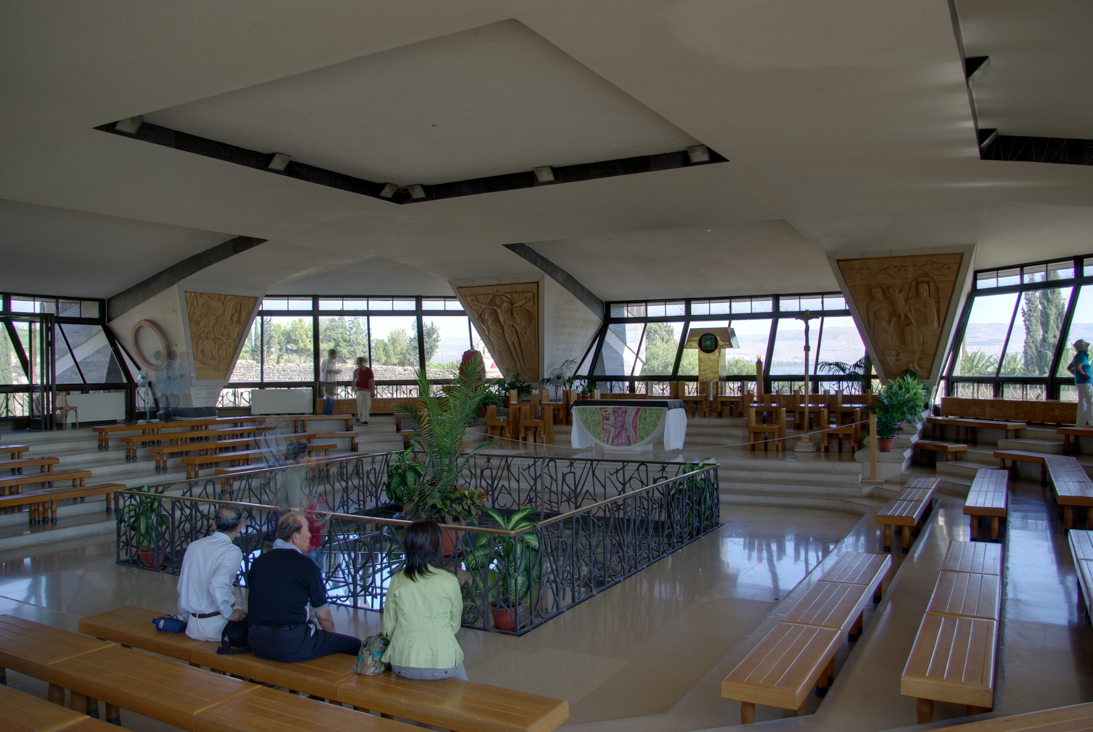
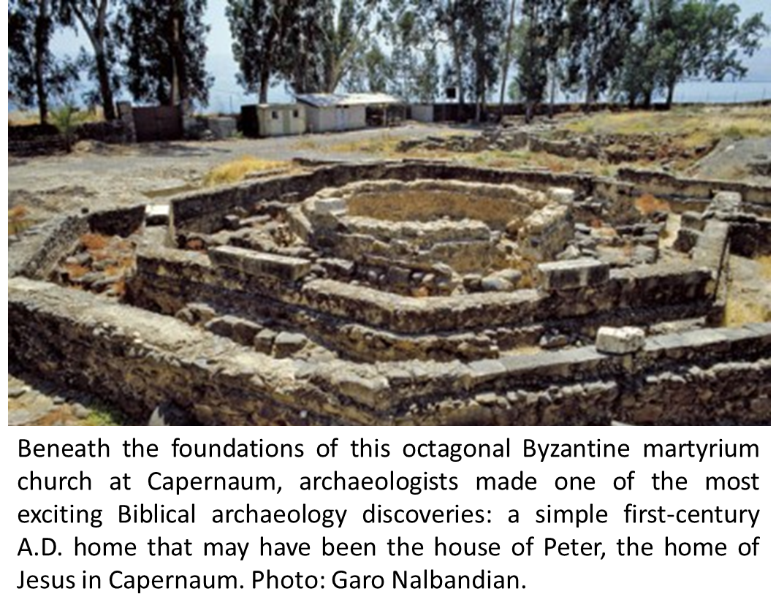
Law and Grace: Session 17
Matthew was from where?

Slide 46
Law and Grace: Session 17
Matthew was from where?
Since Capernaum was a trade center for Galilee’s fishing industry, Matthew collected taxes there.

Slide 47
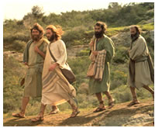
Law and Grace: Session 17
Matthew was from where?
When Matthew was called by Christ to follow Him as His disciple, Matthew seems to have left his place as a tax collector, and followed Christ as His disciple and then as an apostle in the church.

Slide 48
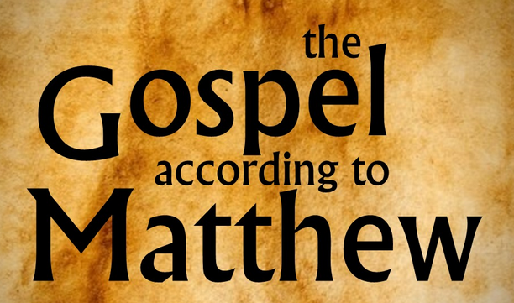
Law and Grace: Session 17
When and how did he write the book?
Matthew’s references to Jerusalem and the Sadducees point to a date of composition before 70 A.D. when the Romans destroyed Jerusalem. His references to Jerusalem assume its existence (e.g., 4:5; 27:53). Matthew recorded more warnings about the Sadducees than all the other New Testament writers combined, but after 70 A.D. they no longer existed as a significant authority in Israel. Consequently, Matthew probably wrote before 70 A.D.
References in the text to the customs of the Jews continuing “to this day” (27:8; 28:15) imply that some time had elapsed between the crucifixion of Jesus Christ and the composition of the Gospel. Since Jesus died in 33 A.D. Matthew may have composed his Gospel perhaps a decade or more later. A date between 40 and 70 A.D. is very probable.
Constable, T. (2003). Tom Constable’s Expository Notes on the Bible (Mal 4:6). Galaxie Software.

Slide 49
Law and Grace: Session 17
When and how did he write the book?
Matthew appears to have written in Greek from some written records and some memorized sayings and histories from others.
Translation from Hebrew and Aramaic is also apparent in some portions of the Gospel of Matthew, and very occasionally Latin as well.
A portion of Papyrus 37 of the Gospel of Matthew, 3rd or 4th century AD.

Slide 50
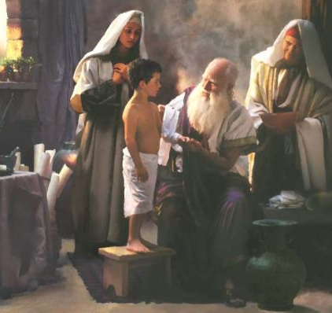
Law and Grace: Session 17
What happened to Matthew later?
Matthew was last named in the New Testament in Acts 1:13, by Luke, the physician.
After that he is only referred to as one of the apostles, last mentioned in the book of Revelation (Rev. 21:14).

Slide 51
Law and Grace: Session 17
What happened to Matthew later?
Outside of the Bible, Matthew was said to have gone to Parthia, where a number of Jews remained from the exile to Babylon, and died in Ethiopia by wooden stakes driven through him.

Slide 52
Session 17 Outline
Purpose, Aim, and Objective
Introduction to the Gospel of Matthew
General Information
Concluding Observations

Slide 53
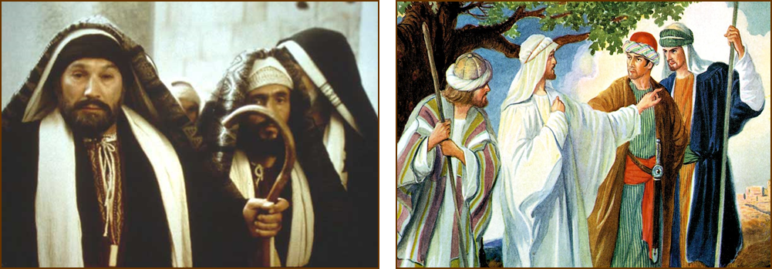
So what does the Gospel of Matthew have to do with us?
Law and Grace: Session 17
The Gospel of Matthew was written to the Jews, about Jesus, who was sent to the Jews.
Only in the last part of the book does Jesus speak to, or about, the church, as He speaks to His soon-to-be apostles.

Slide 54
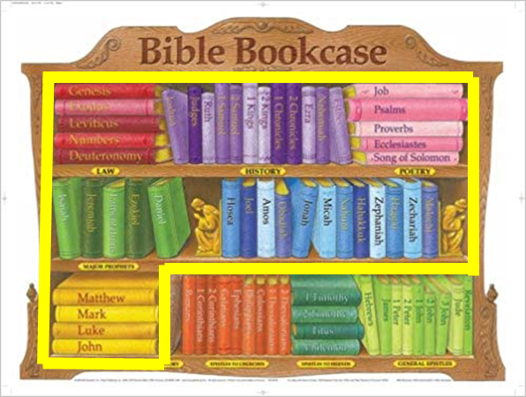
So what does the Gospel of Matthew have to do with us?
Law and Grace: Session 17
This gospel that was written by the apostle Matthew is strategically placed at the head of all of the New Testament books, yet we could say the gospels are the last of the Old Testament books.

Slide 55
So what does the Gospel of Matthew have to do with us?
Law and Grace: Session 17
In our next session we will explore our approach to the Gospel of Matthew so that we know what and how to apply what is written there.

Slide 56
Matthew’s Purposes
Law and Grace: Session 17
To explain that Jesus in whom they had believed was the long-awaited Jewish Messiah
To explain why the kingdom had been postponed despite the fact that the king had arrived
To explain the interim program of God during the kingdom’s absence

Slide 57
Law and Grace: An Overview Jim McGowan, Th.D. Sugar Land Bible Church 02-10-2019
…but grace and truth were realized through Jesus Christ - John 1:17
For the Law was given through Moses…
Special thanks to Dr. Vern Peterman for access to his insights and resources.

