Slide 1
Biblical Dispensationalism
Jim McGowan, MTS, Th.D.

Slide 2
Sessions 1-3:
Introduction to Biblical Dispensationalism

Slide 3
Introduction to Biblical Dispensationalism Sessions 1-3 Outline
Important Assumptions and Prerequisites
Definition of Biblical Dispensationalism
Origins of Biblical Dispensationalism
Evidence for Dispensationalism
What is a Dispensation?

Slide 5
Session 1-2 Outline
Important Assumptions and Prerequisites
The Inspiration & Authority of Scripture
Revelation
Inspiration
Inerrancy
Canon
Hermeneutics

Slide 7
Session 3 Outline
Definition of Biblical Dispensationalism
A Common Misconception
Some Anti-Dispensationalists
Definition
Literal Interpretation
Biblical Distinctions
Dispensations

Slide 8
Session 3 Outline
Origins of Biblical Dispensationalism
According to the writing of the church fathers, Dispensational concepts were held early and throughout the history of the church.
Chaldeans (1000 B.C.), Etruscan Religion (800 B.C.); The Persians (500 B.C.), Israel (200 B.C.)

Slide 9
Session 3 Outline
Evidence for Dispensationalism
Law vs. Grace
The Coming Kingdom
Logic and Additional Dispensations

Slide 10
Session 3 Outline
What is a Dispensation?
“As far as the use of the word in Scripture is concerned, a dispensation may be defined as a stewardship, administration, oversight, or management of others’ property.…this involves responsibility, accountability, and faithfulness on the part of the steward…A concise definition of a dispensation is this: A dispensation is a distinguishable economy in the outworking of God’s purpose….The differentiation of viewpoints in this definition is a helpful distinction. A dispensation is from God’s viewpoint an economy; from man’s, a responsibility; and in relation to progressive revelation, a stage in it.
Ryrie, C. C. (1995). Dispensationalism (Rev. and expanded., p. 33, 36). Chicago: Moody Publishers.
Notes:
Economy - the management of household or private affairs

Slide 11
Biblical Dispensationalism
Session 4
History of Biblical Dispensationalism

Slide 12
Overview
The Early Church
The Alexandrian Abdication
The Dark Ages
Positive Contributions of the Reformers
The Reformers’ Incomplete Reforms
Contemporary Reformation Theology
Dispensationalism's Contribution
Notes:
Outline

Slide 13
Overview
THE EARLY CHURCH
The Alexandrian Abdication
The Dark Ages
Positive Contributions of the Reformers
The Reformers’ Incomplete Reforms
Contemporary Reformation Theology
Dispensationalism's Contribution
Notes:
Outline

Slide 14
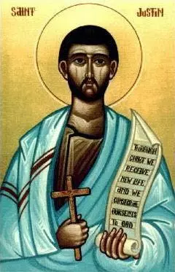
Justin Martyr
(100-165 a.d. Dialogue with Trypho, 80.
“But I and every other completely orthodox Christian feel certain that there will be a resurrection of the flesh, followed by a thousand years in the rebuilt, embellished, and enlarged city of Jerusalem as was announced by the prophets Ezekiel, Isaiah, and the others.”

Slide 15
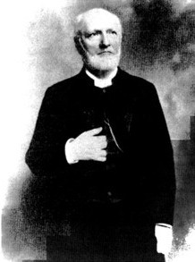
Rev. Philip Schaff
History of the Christian Church, vol. 2 , p. 614.
“The most striking point in the eschatology of the ante-Nicene age (A.D. 100–325) is the prominent chiliasm, or millenarianism, that is the belief of a visible reign of Christ in glory on earth with the risen saints for a thousand years, before the general resurrection and judgment. It was indeed not the doctrine of the church embodied in any creed or form of devotion, but a widely current opinion of distinguished teachers, such as Barnabas, Papias, Justin Martyr, Irenaeus, Tertullian, Methodius, and Lactantius.”

Slide 16
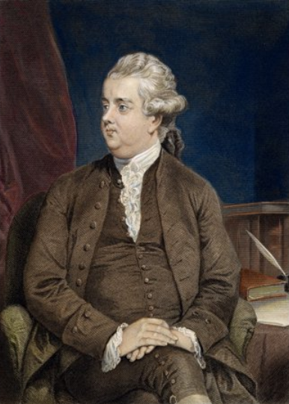
Edward Gibbon
History of Christianity (NY: Eckler, 1916), 141-44.
“The ancient and popular doctrine of the Millennium was intimately connected with the second coming of Christ. As the works of the creation had been finished in six days, their duration in their present state, according to a tradition which was attributed to the prophet Elijah, was fixed to six thousand years. By the same analogy it was inferred, that this long period of labor and contention, which was now almost elapsed, would be succeeded by a joyful Sabbath of a thousand years; and that Christ, with the triumphant band of the saints and the elect who had escaped death, or who had been miraculously revived, would reign upon earth till the time appointed for the last and general resurrection…The assurance of such a Millennium was carefully inculcated ...

Slide 17
Edward Gibbon
History of Christianity (NY: Eckler, 1916), 141-44.
…by a succession of fathers from Justin Martyr, and Irenaeus, who conversed with the immediate disciples of the apostles, down to Lactantius, who was preceptor to the son of Constantine. Though it might not be universally received, it appears to have been the reigning sentiment of the orthodox believers; and it seems so well adapted to the desires and apprehensions of mankind, that it must have contributed in a very considerable degree to the progress of the Christian faith.”
Gibbon also authored the, Decline and Fall of the Roman Empire

Slide 18
Jesse Forest Silver
The Lord’s Return: Seen in History and in Scripture as Premillennial and Imminent (NY: Revell, 1914), 62-64.
Silver says of the apostolic fathers that "they expected the return of the Lord in their day…They believed the time was imminent because the Lord had taught them to live in a watchful attitude." Concerning the ante Nicene fathers, he says: "by tradition they knew the faith of the apostles. They taught the doctrine of the imminent and pre-millennial return of the Lord.”

Slide 19
Overview
The Early Church
THE ALEXANDRIAN ABDICATION
The Dark Ages
Positive Contributions of the Reformers
The Reformers’ Incomplete Reforms
Contemporary Reformation Theology
Dispensationalism's Contribution
Notes:
Outline

Slide 20
Allegorization
Allegorizing is searching for a hidden or a secret meaning underlying but remote from and unrelated in reality to the more obvious meaning of a text. In other words the literal reading is a sort of code, which needs to be deciphered to determine the more significant and hidden meaning. In this approach the literal is superficial; the allegorical is the true meaning.
Zuck, Roy B. Basic Bible Interpretation: A Practical Guide to Discovering Biblical Truth (p. 29). Edited by Craig Bubeck Sr. Colorado Springs, CO: David C. Cook, 1991.

Slide 21
Alexander’s Four Generals Daniel 7:6; 8:8,22
Cassander Macedonia | Ptolemy Egypt
Lysimachus Thrace & Asia Minor | Seleucus Syria (including Israel)

Slide 22
The Hellenistic Age 336-30 BC
The Hellenistic Age was a time when Greek culture including Greek philosophers and philosophies were introduced to the cultures of Alexander's Empire.
After Alexander’s death, the Ptolemies (who ruled from Alexandria), introduced government practices designed to turn Jewish culture toward a more Hellenistic culture.
Many Greek-speaking Jews did not understand Hebrew and were embarrassed by Judaism’s religious practices as compared with the ‘sophisticated culture’ of the Greeks and consequently, enthusiastically embraced Greek culture including its philosophers and philosophies, and Greek allegorization was also enthusiastically embraced.

Slide 23
Jewish Allegorization
Jews in Alexandria, Egypt were influenced by Greek philosophy. But they too faced a problem: How could they accept the Old Testament and also Greek philosophy, particularly that of Plato? Their solution was to do the same as the Greek philosophers themselves, namely, to allegorize the Old Testament.…Because of the many Greeks living in Alexandria, the Jews were readily influenced by them, and easily took up allegorizing the Old Testament as a way of accepting it along with Greek philosophy.
Zuck, Roy B. Basic Bible Interpretation: A Practical Guide to Discovering Biblical Truth (p. 30). Edited by Craig Bubeck Sr. Colorado Springs, CO: David C. Cook, 1991.

Slide 24
Acts 20:29-30
“I know that after my departure savage wolves will come in among you, not sparing the flock; and from among your own selves men will arise, speaking perverse things, to draw away the disciples after them.”

Slide 25
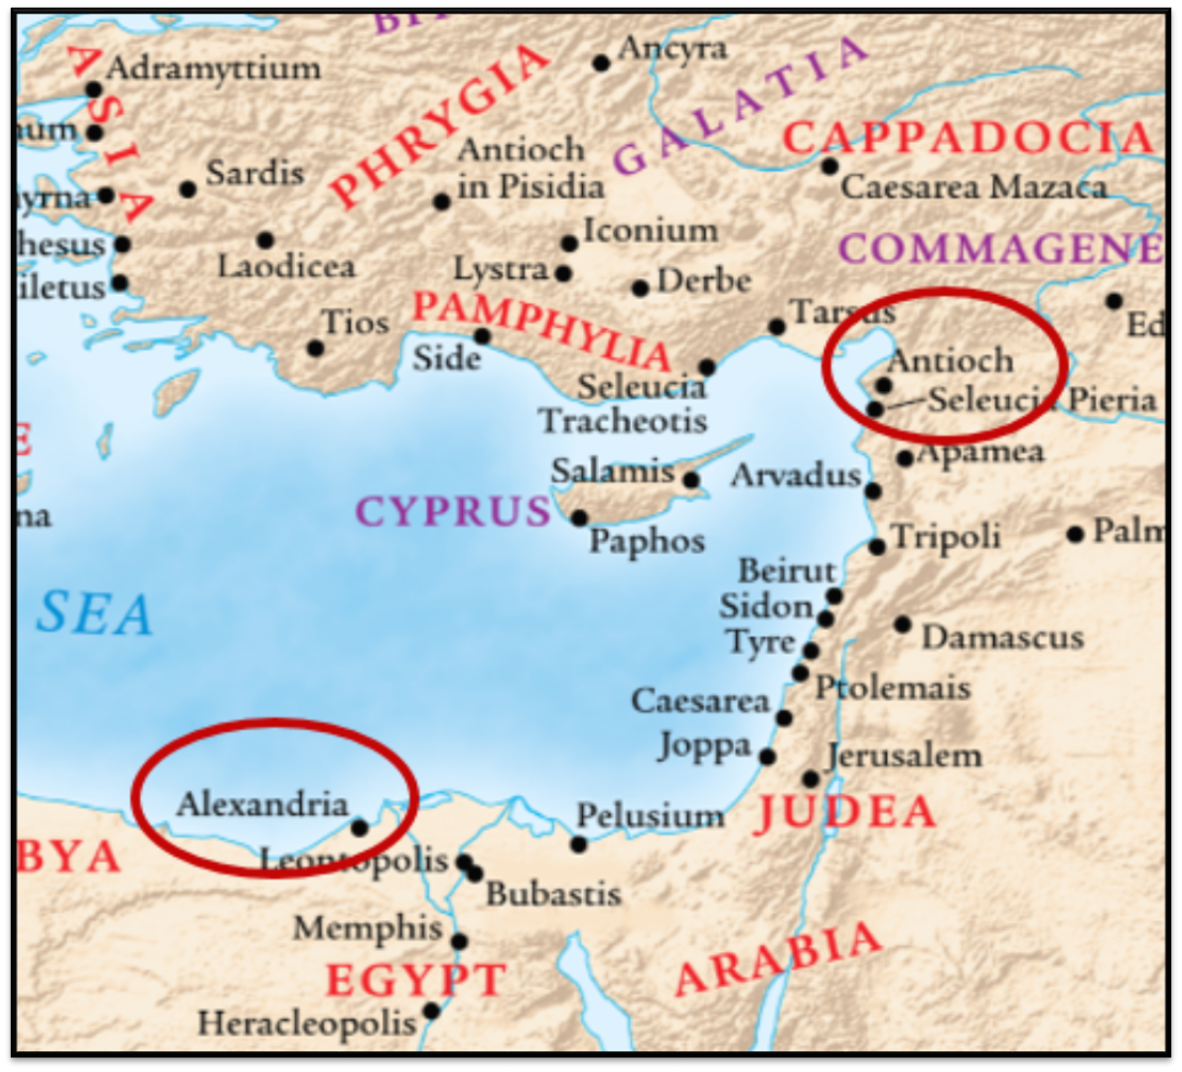
Alexandrian and Antiochene Fathers
Two schools of thought developed about 200 years or so after Christ, schools of hermeneutical views that had a strong impact on the church for centuries to come.
Zuck, Roy B. Basic Bible Interpretation: A Practical Guide to Discovering Biblical Truth (p. 35). Edited by Craig Bubeck Sr. Colorado Springs, CO: David C. Cook, 1991.

Slide 26
Alexandrian Fathers
Clement of Alexandria (155–216 A.D.), was influenced by the Jewish allegorist Philo. Clement taught that all Scripture speaks in a mysterious language of symbols. One reason is so that readers may become inquisitive and another is that it is not suitable for everyone to understand the Scriptures.
Five Meanings of Scripture: (a) historical (the stories of the Bible), (b) doctrinal, with moral and theological teachings, (c) prophetic, which includes types and prophecies, (d) philosophical (allegories in historical persons such as Sarah representing true wisdom and Hagar representing pagan philosophy), and (e) mystical (moral and spiritual truths).
Zuck, Roy B. Basic Bible Interpretation: A Practical Guide to Discovering Biblical Truth (pp. 35–36). Edited by Craig Bubeck Sr. Colorado Springs, CO: David C. Cook, 1991.

Slide 27
Antiochene Fathers
Sensing the rampant disregard for the literal meaning of the Scriptures in the Alexandrian Fathers, several church leaders in Antioch of Syria (Lucian, ca. 240–312 founder of the Antiochene school) emphasized historical, literal interpretation. They stressed the study of the Bible’s original languages (Hebrew and Greek) and they wrote commentaries on the Scriptures. The basis for uniting the Old and New Testaments was typology and predictive prophecy rather than allegorizing. For them, literal interpretation included figurative language.
Zuck, Roy B. Basic Bible Interpretation: A Practical Guide to Discovering Biblical Truth (p. 37). Edited by Craig Bubeck Sr. Colorado Springs, CO: David C. Cook, 1991.

Slide 28
“Proper” Hermeneutics
– a consistently literal, or normal, interpretive grid which attaches to every word the same meaning that it would have in normal usage, whether in speaking, writing, or thinking. Often referred to as the “Literal, Historical, Grammatical,” method of interpretation.

Slide 29
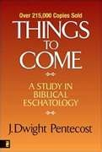
Dangers of Allegorization
Text is not being interpreted
Authority is transferred from text to interpreter
There is no way to test the interpreter
No mechanism for controlling the interpreter’s imagination
Pentecost, Things to Come, pps. 4-5

Slide 30
Dangers of Allegorization
Text is not being interpreted
Authority is transferred from text to interpreter
There is no way to test the interpreter
No mechanism for controlling the interpreter’s imagination
Pentecost, Things to Come, pps. 4-5

Slide 31
“…it will be noticed at once that its habit is to disregard the common signification of words and give wing to all manner of fanciful speculation. It does not draw out the legitimate meaning of an author’s language, but foists into it whatever the whim or fancy of an interpreter may desire.”
Milton S. Terry
Biblical Hermeneutics (NY: Philips and Hunt, 1883), 224.

Slide 32
“The one who spiritualizes tells spiritual lies.”

Slide 33
Dangers of Allegorization
Text is not being interpreted
Authority is transferred from text to interpreter
There is no way to test the interpreter
No mechanism for controlling the interpreter’s imagination
Pentecost, Things to Come, pps. 4-5

Slide 34
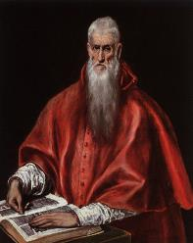
“…once we start with the rule that whole passages and books of scripture say one thing when they mean another, the reader is delivered bound hand and foot to the caprice of the interpreter.”
Jerome
347–420 a.d.
Quoted by F.W. Farrar, History of interpretation (NY: E.P. Dutton and Company, 1886), 238-39.

Slide 35
Dangers of Allegorization
Text is not being interpreted
Authority is transferred from text to interpreter
There is no way to test the interpreter
No mechanism for controlling the interpreter’s imagination
Pentecost, Things to Come, pps. 4-5

Slide 36
“Do not touch My anointed ones,
And do My prophets no harm.”
Psalm 105:15

Slide 37
Dangers of Allegorization
Text is not being interpreted
Authority is transferred from text to interpreter
There is no way to test the interpreter
No mechanism for controlling the interpreter’s imagination
Pentecost, Things to Come, pps. 4-5

Slide 38
Dangers of Allegorization

Slide 39
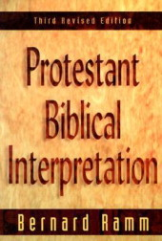
“…to state that the principal meaning of the Bible is a second-sense meaning, and that the principle method of interpretation is ‘spiritualizing,’ is to open the door to almost uncontrolled speculation and imagination. For this reason we have insisted that the control in interpretation is the literal method.”
Bernard Ramm
Protestant Biblical Interpretation, 3d ed. (Grand Rapids: Baker, 1979), 65.

Slide 40
5 Causes for the Shift to Allegorism
Need for immediate relevance
Incorporation of human philosophy into interpretation
Gnostic dualism (Gen. 1:31; 1 John 2:22; 4:2-3; Acts 17:32; 1 Cor. 15:12)
Decline of the church's Jewish population
Constantine’s Edict of Milan (A.D. 313)

Slide 41
5 Causes for the Shift to Allegorism
Need for immediate relevance
Incorporation of human philosophy into interpretation
Gnostic dualism (Gen. 1:31; 1 John 2:22; 4:2-3; Acts 17:32; 1 Cor. 15:12)
Decline of the church's Jewish population
Constantine’s Edict of Milan (A.D. 313)
Notes:
The sin nature rebels against the discipline and correction and boundaries contained in God’s Word. – The Burger King Mentality… I want my fancy tickled. This is what the Jews in Alexandria faced…they wanted to be relevant and accepted by the majority. Relevance rules over meaning! Application trumps interpretation! Authorial intent is discarded.
Howard Hendricks – “Anyone can be relevant if they don’t care about being Biblical.

Slide 42
Bernard Ramm
Protestant Biblical Interpretation, 3rd rev. ed. (Grand Rapids: Baker, 1970), 30.
“But citing verses in the Old Testament, in themselves frequently very obscure, as if superior to verses in the New, revealed no understanding of the significance of historical and progressive revelation for hermeneutics…They considered the Old (especially) and the New Testaments filled with parables, enigmas, and riddles. The allegorical method alone sufficed to bring out the meaning of these parables, enigmas, and riddles.”

Slide 43
5 Causes for the Shift to Allegorism
Need for immediate relevance
Incorporation of human philosophy into interpretation
Gnostic dualism (Gen. 1:31; 1 John 2:22; 4:2-3; Acts 17:32; 1 Cor. 15:12)
Decline of the church's Jewish population
Constantine’s Edict of Milan (A.D. 313)
Notes:
2. Pragmaticism – what’s the easiest way to get what I want without Biblical restrictions? Self-help. Submitting the Scriptures to the scrutiny of the World rather than Submitting the World to the scrutiny of the Scriptures!

Slide 44
Colossians 2:8
See to it that no one takes you captive through philosophy and empty deception, according to the tradition of men, according to the elementary principles of the world, rather than according to Christ.

Slide 45
Bernard Ramm
Protestant Biblical Interpretation, 3rd rev. ed. (Grand Rapids: Baker, 1970), 27.
“The outstanding Jewish allegorist was Philo (25-50 a.d.)…was a thoroughly convinced Jew. To him the Scriptures (primarily in the Septuagint version) were superior to Plato and Greek philosophy…Yet, he had a great fondness for Greek philosophy, especially Plato and Pythagoras. By a most elaborate system of allegorizing he was able to reconcile for himself his loyalty to his Hebrew faith and his love for Greek philosophy.”

Slide 46
Ronald E. Diprose
Israel in the Development of Christian Thought (Rome: IBEI, 2000), 157-58.
“Clement of Alexandria (c. 155‒c. 220) was unashamedly a Christian Platonist and as such he quoted from Plato, and indeed from other philosophers, with the same ease that He quoted from the Hebrew Scriptures and the New Testament. Moreover, he interpreted the Bible in light of Platonic concepts…His dependence upon Plato is further evident in a speculative passage in which the Jews feature as ‘helpers’ while the Christians are considered ‘fit to rule.’ Origen continued the Alexandrian tradition of interpreting the Bible in a way which harmonized with Greek philosophy.”

Slide 47
5 Causes for the Shift to Allegorism
Need for immediate relevance
Incorporation of human philosophy into interpretation
Gnostic dualism (Gen. 1:31; 1 John 2:22; 4:2-3; Acts 17:32; 1 Cor. 15:12)
Decline of the church's Jewish population
Constantine’s Edict of Milan (A.D. 313)

Slide 48
This philosophical doctrine taught that the flesh was evil and the spirit was good. Man therefore would not be judged for what he did in his body, but only for his spiritual deeds. This was the prominent philosophical doctrine of the Nicolaitans which Jesus condemned in the churches at Ephesus and Pergamos (Rev. 2:6, 15)

Slide 49
Renald Showers
John Ankerberg and Renald Showers, The Most Asked Prophecy Questions (Chattanooga, TN: ATRI, 2000), 326.
“The…factor in his [Augustine] change of view was the influence of Greek philosophy upon his thinking. Before his conversion Augustine was deeply immersed in the study of this philosophy, much of which asserted the inherent evil of the physical or material and the inherent goodness of the totally spiritual. This philosophy continued to leave it's mark up on him even after his conversion. It prompted him to reject as carnal the pre-millennial idea of an earthly, political Kingdom of God with great material blessings. He believed that, in order for the Kingdom of God to be good, it must be spiritual in nature.”
Notes:
Augustine of Hippo was once a Manichaean. Manichaeism thrived between the third and seventh centuries. It was briefly the main rival to Christianity before the spread of Islam.

Slide 50
Augustine
354-430 a.d.
The City of God, trans., Marcus Dods (NY: Random House, 1950), Book XX, chap. 7, p. 719.
“And this opinion would not be objectionable, if it were believed that the joys of the saints in that Sabbath shall be spiritual, and consequent on the presence of God; for I myself, too, once held this opinion. But, as they assert that those who then rise again shall enjoy the leisure of immoderate carnal banquets, furnished with an amount of meat and drink such as not only to shock the feeling of the temperate, but even to surpass the measure of credulity itself, such assertions can be believed only by the carnal. They who do believe them are called by the spiritual Chiliasts, which we may literally reproduce by the name Millenarians.”
Notes:
Augustine of Hippo was once a Manichaean. Manichaeism thrived between the third and seventh centuries. It was briefly the main rival to Christianity before the spread of Islam.

Slide 51
5 Causes for the Shift to Allegorism
Need for immediate relevance
Incorporation of human philosophy into interpretation
Gnostic dualism (Gen. 1:31; 1 John 2:22; 4:2-3; Acts 17:32; 1 Cor. 15:12)
Decline of the church's Jewish population
Constantine’s Edict of Milan (A.D. 313)

Slide 52
Notes:
Gentiles had no understanding of the O.T. nor of Hebrew so Roman Christians arrogantly begin to diminish the importance of God’s plan for Israel!

Slide 53
5 Causes for the Shift to Allegorism
Need for immediate relevance
Incorporation of human philosophy into interpretation
Gnostic dualism (Gen. 1:31; 1 John 2:22; 4:2-3; Acts 17:32; 1 Cor. 15:12)
Decline of the church's Jewish population
Constantine’s Edict of Milan (A.D. 313)

Slide 54
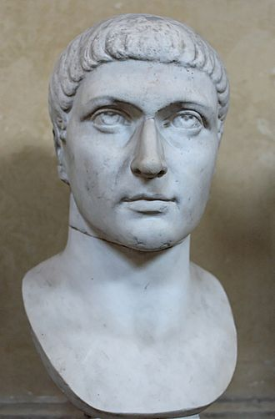
Constantine’s Edict of Milan (A.D. 313)
This agreement to treat Christians benevolently, was made in February 313 a.d. and it gave Christianity legal status within the Roman Empire. It did not however, make Christianity the official religion of the Roman empire, as some have mistakenly concluded. This took place under Emperor Theodosius I in 380 a.d.

Slide 55
Renald Showers
John Ankerberg and Renald Showers, The Most Asked Prophecy Questions (Chattanooga, TN: ATRI, 2000), 325.
“That new view became known as Amillennialism. Several things prompted this change in Augustine. First, the political situation of the Church in the Roman empire had changed radically around the period of his life. By his time the Roman persecution of the Church had stopped, and the state had made itself the servant of the Church. As the Roman empire crumbled, the Church stood fast, ready to rule in the place of the empire. It looked as if Gentile world dominion was being crushed and that the Church was becoming victorious over it. Under these circumstances Augustine concluded that Premillennialism was obsolete, and that it did not fit the current situation. In the place of it he developed the...

Slide 56
Renald Showers
John Ankerberg and Renald Showers, The Most Asked Prophecy Questions (Chattanooga, TN: ATRI, 2000), 325.
…the idea that the Church is the Kingdom of the Messiah foretold in such Scriptures as Daniel 2 and 7 and Revelation 20. In his book, The City of God, he became the first person to teach the idea that the organized Catholic (Universal) Church is the promised Messianic Kingdom and that the Millennium began with the first coming of Christ.”

Slide 57
Ronald E. Diprose
Israel in the Development of Christian Thought (Rome: IBEI, 2000), 86-87.
“Origen (185-254 a.d.) was also influenced by the example of Philo, a first-century Alexandrian Jew who had interpreted the Old Testament Scriptures allegorically in order to make them harmonize with his Platonism. Allegorism played an important part in Origen's theory of interpretation and, as he was the first biblical scholar to work out ‘a complete hermeneutical theory’, his work was destined to exert great influence on the Christian approach to the Hebrew Scriptures, for centuries to come…Origen is remembered for his philosophical speculation as the allegorist par excellence among Biblical interpreters.”

Slide 58
Augustine
354-430 a.d.
The City of God, trans., Marcus Dods (NY: Random House, 1950), Book XX, chap. 9, p. 725-26.
Augustine wrote, “the saints reign with Christ during the same thousand years, understood in the same way, that is, of the time of His first coming” and “Therefore the Church even now is the kingdom of Christ, and the kingdom of heaven. Accordingly, even now His saints reign with Him.”

Slide 59
Eusebius
263-339 a.d.
Ecclesiastical History, 3.39.12-13
“Papias . . . says that there will be a millennium after the resurrections of the dead, when the kingdom of Christ will be set up in material form on this earth. I suppose that he got these notions by a perverse reading of the apostolic accounts, not realizing that they had spoken mystically and symbolically. For he was a man of very little intelligence, as is clear from his books. But he is responsible for the fact that so many Christian writers after him held the same opinion, relying on his antiquity, for instance Irenaeus and whoever else appears to have held the same views.”

Slide 60
“How must we understand what the Saviour says in Matthew: ‘But I say to you, I will not drink again of this fruit of the vine until that day when I drink it new with you in the Kingdom of my Father’? (Matt. 26. 29). This passage is the origin of a certain fable of a thousand years, in which they say that Christ will reign in the flesh and will drink that wine which He has not drunk since that time until the end of the world…For the kingdom of God isn’t food and drink, but justice, joy and peace in the Holy Spirit (Rom. 14. 17).”
Jerome
347–420 a.d.
http://www.tertullian.org/fathers/jerome_letter_120.htm

Slide 61
Review
The Early Church
The Alexandrian Abdication
The Dark Ages
Positive Contributions Of The Reformers
The Reformers’ Incomplete Reforms
Contemporary Reformation Theology
Dispensationalism's Contribution
Notes:
Outline

Slide 62
Resources
Alva J. McClain, Law & Grace, Moody, 1967 978-088469-001-6
Arnold H. Ehlert, “A Bibliography of Dispensationalism,” Bibliotheca Sacra (January 1944–January 1946): 101:95–101, 199–209, 319–28, 447–60; 102:84–92, 207–19, 322–34, 455–67; 103:57–67.
Charles C. Ryrie, Dispensationalism, Moody, 2007, 080242189X
Christopher Cone, gen. ed., Dispensationalism Tomorrow & Beyond, Tyndale Seminary Press, 2008 9780981479101
Christopher Cone, gen. ed., An Introduction To The New Covenant, Tyndale Seminary Press, 2013, 9781938484100
Walvoord, J. F., The Prophecy Knowledge Handbook. Wheaton, IL: Victor Books. 1990.
Lewis S. Chafer, Major Bible Themes, Zondervan, 1974, 0-310-22390-3
Mike Stallard, gen .ed., Dispensational Understanding of the New Covenant, Regular Baptist Books, 2012, 9781607764946
Paul Enns, The Moody Handbook of Theology, Moody 1989,
Renald E. Showers, There Really Is A Difference, Friend of Israel Gospel Ministry, 1990, 0915540509
Rene Pache, The Inspiration and Authority of Scripture, Sheffield Pub Co, 1992
Roy B. Zuck, Basic Bible Interpretation, SP Publications, 1991
Charting the End Times CD-Rom: A Visual Guide to Understanding Bible Prophecy, ISBN-10: 0736917624
Materials from:
Dr. Andy Woods, Sugar Land Bible Church, www.slbc.org
Dr. Vern Peterman, Holly Hills Bible Church, www.hollyhillsbiblechurch.org
George Zeller, Middletown Bible Church, www.middletownbiblechurch.org
Ed Allsteadt, Sugar Land Bible Church, www.slbc.org

