Slide 1
Dr. Andy Woods
Senior Pastor – Sugar Land Bible Church
President – Chafer Theological Seminary

Slide 3
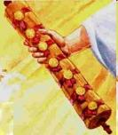
1st Six Seals (Revelation 6)
6:1-2 – Advent of antichrist
6:3-4 – War
6:5-6 – Famine
6:7-8 – Death
6:9-11 – Martyrdoms
6:12-17 – Cosmic disturbances

Slide 5
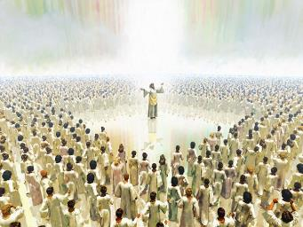
The Coming Spiritual Awakening (Rev. 7:1-17)
The Instruments (7:1-8)
Their sealing (7:1-3)
Their number (7:4)
Their lineage (7:5-8)
The Awakening (7:9-17)
Salvation’s quantity (7:9)
Salvation’s praises (7:10-12)
Salvation’s timing (7:13-14)
Salvation’s provisions (7:15-17)

Slide 6
7th Seal & 1st Six Trumpets (Revelation 8‒9)
7th Seal (8:1-6) – Trumpet preparation
1st Trumpet (8:7) – 1/3 vegetation destroyed
2nd Trumpet (8:8-9) – 1/3 ocean destroyed
3rd Trumpet (8:10-11) – 1/3 water destroyed
4th Trumpet (8:12-13) – 1/3 luminaries darkened
5th Trumpet (9:1-12) – Demons released
6th Trumpet (9:13-21) – 1/3 humanity destroyed

Slide 7
7th Seal & 1st Six Trumpets (Revelation 8‒9)
7th Seal (8:1-6) – Trumpet preparation
1st Trumpet (8:7) – 1/3 vegetation destroyed
2nd Trumpet (8:8-9) – 1/3 ocean destroyed
3rd Trumpet (8:10-11) – 1/3 water destroyed
4th Trumpet (8:12-13) – 1/3 luminaries darkened
5th Trumpet (9:1-12) – Demons released
6th Trumpet (9:13-21) – 1/3 humanity destroyed

Slide 9
Recapitulation
View that judgments overlap
Seals: 1 2 3 4 5 6 7
Trumpets: 1 2 3 4 5 6 7
Bowls: 1 2 3 4 5 6 7

Slide 10
Telescoping
7th judgment releases 1st in next series
Seals: 1 2 3 4 5 6 7
Trumpets: 1 2 3 4 5 6 7
Bowls: 1 2 3 4 5 6 7

Slide 11
1st Six Seals (Revelation 6)
6:1-2 – Advent of antichrist
6:3-4 – War
6:5-6 – Famine
6:7-8 – Death
6:9-11 – Martyrdoms
6:12-17 – Cosmic disturbances

Slide 13
Revelation 11:15
¹⁵ “Then the seventh angel sounded; and there were loud voices in heaven, saying, ‘The kingdom of the world has become the kingdom of our Lord and of His Christ; and He will reign forever and ever.’”

Slide 14
7th Seal & 1st Six Trumpets (Revelation 8‒9)
7th Seal (8:1-6) – Trumpet preparation
1st Trumpet (8:7) – 1/3 vegetation destroyed
2nd Trumpet (8:8-9) – 1/3 ocean destroyed
3rd Trumpet (8:10-11) – 1/3 water destroyed
4th Trumpet (8:12-13) – 1/3 luminaries darkened
5th Trumpet (9:1-12) – Demons released
6th Trumpet (9:13-21) – 1/3 humanity destroyed

Slide 15
Comparing Revelation 4 & 5
Chapter | Revelation 4 | Revelation 5
God-head Member | Father | Son
Role | Creator | Redeemer
Reason for Worship | Role in Creation (4:11) | Role in Redemption (5:9, 12)

Slide 16
7th Seal & 1st Six Trumpets (Revelation 8‒9)
7th Seal (8:1-6) – Trumpet preparation
1st Trumpet (8:7) – 1/3 vegetation destroyed
2nd Trumpet (8:8-9) – 1/3 ocean destroyed
3rd Trumpet (8:10-11) – 1/3 water destroyed
4th Trumpet (8:12-13) – 1/3 luminaries darkened
5th Trumpet (9:1-12) – Demons released
6th Trumpet (9:13-21) – 1/3 humanity destroyed

Slide 17
7th Seal & 1st Six Trumpets (Revelation 8‒9)
7th Seal (8:1-6) – Trumpet preparation
1st Trumpet (8:7) – 1/3 vegetation destroyed
2nd Trumpet (8:8-9) – 1/3 ocean destroyed
3rd Trumpet (8:10-11) – 1/3 water destroyed
4th Trumpet (8:12-13) – 1/3 luminaries darkened
5th Trumpet (9:1-12) – Demons released
6th Trumpet (9:13-21) – 1/3 humanity destroyed

Slide 18
7th Seal & 1st Six Trumpets (Revelation 8‒9)
7th Seal (8:1-6) – Trumpet preparation
1st Trumpet (8:7) – 1/3 vegetation destroyed
2nd Trumpet (8:8-9) – 1/3 ocean destroyed
3rd Trumpet (8:10-11) – 1/3 water destroyed
4th Trumpet (8:12-13) – 1/3 luminaries darkened
5th Trumpet (9:1-12) – Demons released
6th Trumpet (9:13-21) – 1/3 humanity destroyed

Slide 19
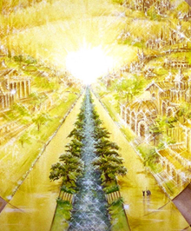
Eternal State is Future
No Satan (Rev 20:10)
No sea (Rev 21:1)
No death, crying, or pain (Rev 21:4)
No Sun (Rev 22:5)
No Moon (Rev 21:23)
No night (Rev 21:25)
No evil (Rev 21:27)
No curse (Rev 22:23)

Slide 20
Recapitulation
View that judgments overlap
Seals: 1 2 3 4 5 6 7
Trumpets: 1 2 3 4 5 6 7
Bowls: 1 2 3 4 5 6 7

Slide 21
Telescoping
7th judgment releases 1st in next series
Seals: 1 2 3 4 5 6 7
Trumpets: 1 2 3 4 5 6 7
Bowls: 1 2 3 4 5 6 7

Slide 22
7th Seal & 1st Six Trumpets (Revelation 8‒9)
7th Seal (8:1-6) – Trumpet preparation
1st Trumpet (8:7) – 1/3 vegetation destroyed
2nd Trumpet (8:8-9) – 1/3 ocean destroyed
3rd Trumpet (8:10-11) – 1/3 water destroyed
4th Trumpet (8:12-13) – 1/3 luminaries darkened
5th Trumpet (9:1-12) – Demons released
6th Trumpet (9:13-21) – 1/3 humanity destroyed

Slide 23
6. 5th Trumpet (Rev. 9:1-12)
Discharging angel (9:1)
Angel opens the abyss (9:2)
Demons emerge from the abyss (9:3)
Demonic activity (9:4-6)
Demonic description (9:7-10)
Demonic leader (9:11)
Remaining trumpets (9:12)

Slide 24
6. 5th Trumpet (Rev. 9:1-12)
Discharging angel (9:1)
Angel opens the abyss (9:2)
Demons emerge from the abyss (9:3)
Demonic activity (9:4-6)
Demonic description (9:7-10)
Demonic leader (9:11)
Remaining trumpets (9:12)

Slide 25
6. 5th Trumpet (Rev. 9:1-12)
Discharging angel (9:1)
Angel opens the abyss (9:2)
Demons emerge from the abyss (9:3)
Demonic activity (9:4-6)
Demonic description (9:7-10)
Demonic leader (9:11)
Remaining trumpets (9:12)

Slide 26
6. 5th Trumpet (Rev. 9:1-12)
Discharging angel (9:1)
Angel opens the abyss (9:2)
Demons emerge from the abyss (9:3)
Demonic activity (9:4-6)
Demonic description (9:7-10)
Demonic leader (9:11)
Remaining trumpets (9:12)

Slide 27
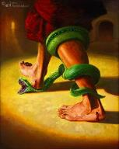
Genesis 3:15
“And I will put enmity Between you and the woman, And between your seed and her seed; He shall bruise you on the head, And you shall bruise him on the heel.”

Slide 29
6. 5th Trumpet (Rev. 9:1-12)
Discharging angel (9:1)
Angel opens the abyss (9:2)
Demons emerge from the abyss (9:3)
Demonic activity (9:4-6)
Demonic description (9:7-10)
Demonic leader (9:11)
Remaining trumpets (9:12)

Slide 30
6. 5th Trumpet (Rev. 9:1-12)
Discharging angel (9:1)
Angel opens the abyss (9:2)
Demons emerge from the abyss (9:3)
Demonic activity (9:4-6)
Demonic description (9:7-10)
Demonic leader (9:11)
Remaining trumpets (9:12)

Slide 31
6. 5th Trumpet (Rev. 9:1-12)
Discharging angel (9:1)
Angel opens the abyss (9:2)
Demons emerge from the abyss (9:3)
Demonic activity (9:4-6)
Demonic description (9:7-10)
Demonic leader (9:11)
Remaining trumpets (9:12)

Slide 32
6. 5th Trumpet (Rev. 9:1-12)
Discharging angel (9:1)
Angel opens the abyss (9:2)
Demons emerge from the abyss (9:3)
Demonic activity (9:4-6)
Demonic description (9:7-10)
Demonic leader (9:11)
Remaining trumpets (9:12)

Slide 33
Recapitulation
View that judgments overlap
Seals: 1 2 3 4 5 6 7
Trumpets: 1 2 3 4 5 6 7
Bowls: 1 2 3 4 5 6 7

Slide 34
Telescoping
7th judgment releases 1st in next series
Seals: 1 2 3 4 5 6 7
Trumpets: 1 2 3 4 5 6 7
Bowls: 1 2 3 4 5 6 7

Slide 35
7th Seal & 1st Six Trumpets (Revelation 8‒9)
7th Seal (8:1-6) – Trumpet preparation
1st Trumpet (8:7) – 1/3 vegetation destroyed
2nd Trumpet (8:8-9) – 1/3 ocean destroyed
3rd Trumpet (8:10-11) – 1/3 water destroyed
4th Trumpet (8:12-13) – 1/3 luminaries darkened
5th Trumpet (9:1-12) – Demons released
6th Trumpet (9:13-21) – 1/3 humanity destroyed

Slide 36
Transitions | Fifth Trumpet | Sixth Trumpet
Scripture: | Rev. 9:1-12 | Rev. 9:13-21
Source: | Abyss | East
Kind of army: | Demonic | Human

Slide 37
7. 6th Trumpet (Rev. 9:13-21)
Army released (9:13-15)
Army’s number (9:16)
Army’s description (9:17)
Army’s destruction (9:18-19)
Humanity’s non-repentance (9:20-21)

Slide 38
7. 6th Trumpet (Rev. 9:13-21)
Army released (9:13-15)
Army’s number (9:16)
Army’s description (9:17)
Army’s destruction (9:18-19)
Humanity’s non-repentance (9:20-21)

Slide 39
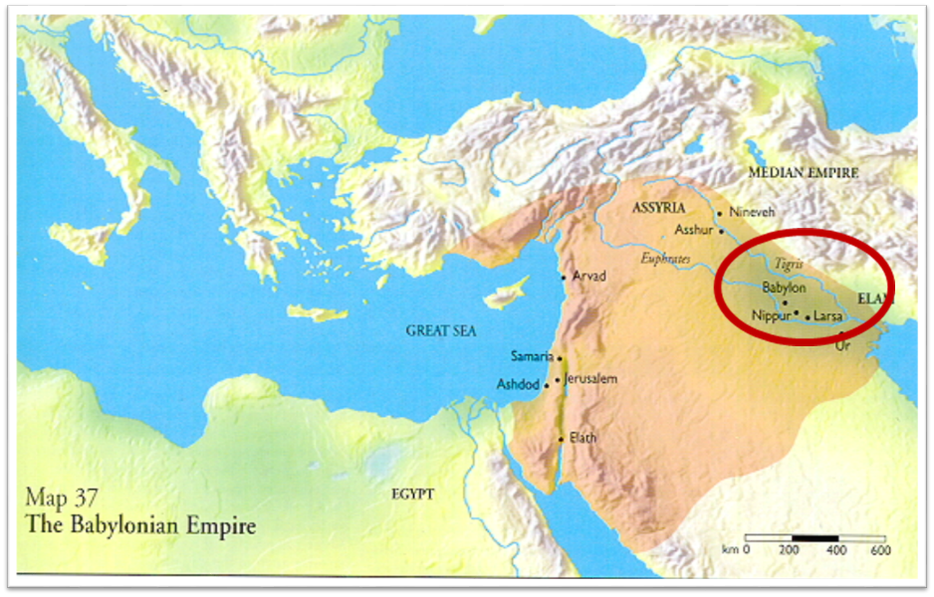

Slide 40
Literal Geography in Revelation Thomas, Revelation 8 to 22: An Exegetical Commentary, 206-207.
Asia | 1:4 | Sardis | 3:1
Ephesus | 2:1 | Philadelphia | 3:7
Smyrna | 2:8 | Laodicea | 3:14
Pergamum | 2:12 | Euphrates | 9:14;16:12
Thyatira | 2:18 | Armageddon | 16:16

Slide 41
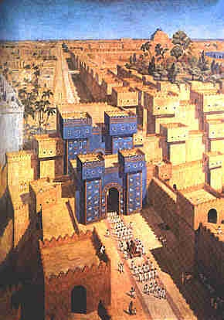
East = Babylon
Genesis 2:8
Genesis 11:2
Matthew 2:2

Slide 42
John 2:4
“And Jesus said to her, ‘Woman, what does that have to do with us? My hour hour [hōra] has not yet come.’”

Slide 43
John 12:27
“Now My soul has become troubled; and what shall I say, ‘Father, save Me from this hour [hōra]’? But for this purpose I came to this hour [hōra]’.”

Slide 44
7. 6th Trumpet (Rev. 9:13-21)
Army released (9:13-15)
Army’s number (9:16)
Army’s description (9:17)
Army’s destruction (9:18-19)
Humanity’s non-repentance (9:20-21)

Slide 45
Robert Thomas
Revelation 8 to 22: An Exegetical Commentary (Chicago: Moody Press, 1992), 408.
Robert Thomas observes that, "no number in Revelation is verifiably a symbolic number.”

Slide 46
7. 6th Trumpet (Rev. 9:13-21)
Army released (9:13-15)
Army’s number (9:16)
Army’s description (9:17)
Army’s destruction (9:18-19)
Humanity’s non-repentance (9:20-21)

Slide 47
7. 6th Trumpet (Rev. 9:13-21)
Army released (9:13-15)
Army’s number (9:16)
Army’s description (9:17)
Army’s destruction (9:18-19)
Humanity’s non-repentance (9:20-21)

Slide 48
7. 6th Trumpet (Rev. 9:13-21)
Army released (9:13-15)
Army’s number (9:16)
Army’s description (9:17)
Army’s destruction (9:18-19)
Humanity’s non-repentance (9:20-21)

Slide 49
Revelation 9:20-21
²⁰ “The rest of mankind, who were not killed by these plagues, did not repent of the works of their hands, so as not to worship demons, and the idols of gold and of silver and of brass and of stone and of wood, which can neither see nor hear nor walk; ²¹ and they did not repent of their murders nor of their sorceries nor of their immorality nor of their thefts.”

Slide 50
Revelation 9:20-21
“The rest of mankind, who were not killed by these plagues, did not repent of the works of their hands, so as not to worship demons, and the idols of gold and of silver and of brass and of stone and of wood, which can neither see nor hear nor walk; ²¹ and they did not repent of their murders nor of their sorceries (pharmakeia) nor of their immorality nor of their thefts.”

Slide 51
Conclusion

Slide 52
7th Seal & 1st Six Trumpets (Revelation 8‒9)
7th Seal (8:1-6) – Trumpet preparation
1st Trumpet (8:7) – 1/3 vegetation destroyed
2nd Trumpet (8:8-9) – 1/3 ocean destroyed
3rd Trumpet (8:10-11) – 1/3 water destroyed
4th Trumpet (8:12-13) – 1/3 luminaries darkened
5th Trumpet (9:1-12) – Demons released
6th Trumpet (9:13-21) – 1/3 humanity destroyed

Slide 53
“The Lord bless you and keep you; the Lord make his face shine on you and be gracious to you; the Lord turn his face toward you and give you peace.” (NIV)

