Slide 1

Ecclesiology
Session 49
Dr. Andy Woods
Senior Pastor – Sugar Land Bible Church
President – Chafer Theological Seminary

Slide 2


Areas of Systematic Theology
Prolegomena – Introduction
Theology – Study of God
Christology – Study of Christ
Pneumatology – Study of the Holy Spirit
Anthropology – Study of Man
Hamartiology – Study of sin
Soteriology – Study of salvation
Angelology – Study of angels
Ecclesiology – Study of the Church
Eschatology – Study of the end

Slide 3

Ecclesiology Overview
Definition
Universal vs. local
Word pictures
Origin
Israel – Church differences
Intercalation
Purposes
Activities
Government
Officers
Ordinances
Purity

Slide 4

Purity of the Church
Ecclesiastical separation
Church discipline

Slide 5
Purity of the Church
Ecclesiastical separation
Church discipline

Slide 6
Ecclesiastical Separation
Why separate?
Biblical basis for separation
What to separate from?

Slide 7
Ecclesiastical Separation
Why separate?
Biblical basis for separation
What to separate from?

Slide 8
A. Why Separate?
Not hatred
Gives world a false sense of security
Loss of distinctiveness and power

Slide 9
Ecclesiastical Separation
Why separate?
Biblical basis for separation
What to separate from?

Slide 10

B. Biblical Basis for Separation?
2 Thess. 3:6, 14
1 Cor. 5:11
2 Cor. 6:14-18
Rom. 16:17
Eph. 5:11
Titus 3:9-11
2 John 9-11

Slide 11

2 John 7-11
“⁷ For many deceivers have gone out into the world, those who do not acknowledge Jesus Christ as coming in the flesh. This is the deceiver and the antichrist. ⁸ Watch yourselves, that you do not lose what we have accomplished, but that you may receive a full reward. ⁹ Anyone who goes too far and does not abide in the teaching of Christ, does not have God; the one who abides in the teaching, he has both the Father and the Son. ¹⁰ If anyone comes to you and does not bring this teaching, do not receive him into your house, and do not give him a greeting; ¹¹ for the one who gives him a greeting participates in his evil deeds.”

Slide 12
Ecclesiastical Separation
Why separate?
Biblical basis for separation
What to separate from?

Slide 13

C. What to Separate From?
False doctrine – 1 Tim. 4:16; Titus 1:9
Divisive persons – Rom. 16:17; Titus 3:9-11
Immorality – 1 Cor. 5:9-11; Eph. 5:11
General disobedience to Scripture –2 Thess. 3:6, 14

Slide 14
C. What to Separate From?
False doctrine – 1 Tim. 4:16; Titus 1:9
Divisive persons – Rom. 16:17; Titus 3:9-11
Immorality – 1 Cor. 5:9-11; Eph. 5:11
General disobedience to Scripture –2 Thess. 3:6, 14

Slide 15

Fundamentals of the Faith
Creation/Fall – Rom. 5:14
Inspiration/inerrancy of the Scripture – Matt. 5:18; John 17:17; 2 Tim. 3:16; 2 Pet. 1:20-21
Salvation by faith alone
Eternal existence of heaven/hell – Dan. 12:2; Matt. 25:46
Trinity
Virgin birth of Christ
Deity of Christ
Atoning death of Christ – Isa. 53:3-6; 1 Pet. 2:24
Bodily Resurrection of Christ – John 20:27-28; 1 Cor. 15:14
Bodily Second Advent of Christ – Job 19:25; Zech. 14:4; Acts 1:9-11

Slide 16
Fundamentals of the Faith
Creation/Fall – Rom. 5:14
Inspiration/inerrancy of the Scripture – Matt. 5:18; John 17:17; 2 Tim. 3:16; 2 Pet. 1:20-21
Salvation by faith alone
Eternal existence of heaven/hell – Dan. 12:2; Matt. 25:46
Trinity
Virgin birth of Christ
Deity of Christ
Atoning death of Christ – Isa. 53:3-6; 1 Pet. 2:24
Bodily Resurrection of Christ – John 20:27-28; 1 Cor. 15:14
Bodily Second Advent of Christ – Job 19:25; Zech. 14:4; Acts 1:9-11

Slide 17
Fundamentals of the Faith
Creation/Fall – Rom. 5:14
Inspiration/inerrancy of the Scripture – Matt. 5:18; John 17:17; 2 Tim. 3:16; 2 Pet. 1:20-21
Salvation by faith alone
Eternal existence of heaven/hell – Dan. 12:2; Matt. 25:46
Trinity
Virgin birth of Christ
Deity of Christ
Atoning death of Christ – Isa. 53:3-6; 1 Pet. 2:24
Bodily Resurrection of Christ – John 20:27-28; 1 Cor. 15:14
Bodily Second Advent of Christ – Job 19:25; Zech. 14:4; Acts 1:9-11

Slide 18

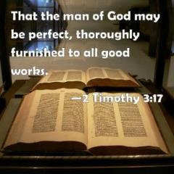
2 Timothy 3:16-17
“All Scripture is inspired by God [theopneustos] and profitable for teaching, for reproof, for correction, for training in righteousness; so that the man of God may be adequate, equipped for every good work.”

Slide 19
INSPIRATION OF SCRIPTURE
2 Peter 1:20-21
Men Wrote as they were inspired by Holy Spirit
  “phero” = to carry
    Acts 27:15,17
Opposite of Knowledge of False Teachers
  Which is their own imagination
    Jer. 23:16

Slide 20

John 17:17, 20-23
“¹⁷ Sanctify them in the truth; Your word is truth…²⁰ I do not ask on behalf of these alone, but for those also who believe in Me through their word; ²¹ that they may all be one; even as You, Father, are in Me and I in You, that they also may be in Us, so that the world may believe that You sent Me. ²² The glory which You have given Me I have given to them, that they may be one, just as We are one; ²³ I in them and You in Me, that they may be perfected in unity, so that the world may know that You sent Me, and loved them, even as You have loved Me.”

Slide 21

Matthew 4:4
“But He answered and said, “It is written, ‘Man shall not live on bread alone, but on every word that proceeds out of the mouth of God.’”

Slide 22
Matthew 5:18
“For truly I say to you, until heaven and earth pass away, not the smallest letter or stroke shall pass from the Law until all is accomplished.”

Slide 23
Fundamentals of the Faith
Creation/Fall – Rom. 5:14
Inspiration/inerrancy of the Scripture – Matt. 5:18; John 17:17; 2 Tim. 3:16; 2 Pet. 1:20-21
Salvation by faith alone
Eternal existence of heaven/hell – Dan. 12:2; Matt. 25:46
Trinity
Virgin birth of Christ
Deity of Christ
Atoning death of Christ – Isa. 53:3-6; 1 Pet. 2:24
Bodily Resurrection of Christ – John 20:27-28; 1 Cor. 15:14
Bodily Second Advent of Christ – Job 19:25; Zech. 14:4; Acts 1:9-11

Slide 24
Chart courtesy of Thomas Stegall

Slide 25
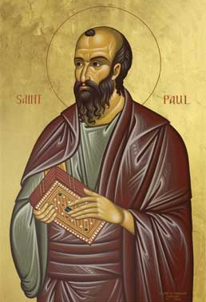
Romans 4:4-5
“ Now to the one who works, his wage is not credited as a favor, but as what is due. But to the one who does not work, but believes in Him who justifies the ungodly, his faith is credited as righteousness.”

Slide 26

John MacArthur
The Gospel According to Jesus, p. 140
"Eternal life is indeed a free gift (Rom. 6:23). Salvation cannot be earned with good deeds or purchased with money. It has already been bought by Christ, who paid the ransom with His blood. But that does not mean there is no cost in terms of salvation's impact on the sinner's life. This paradox may be difficult but it is nevertheless true: SALVATION IS BOTH FREE AND COSTLY. Eternal life brings immediate death to self. 'Knowing this, that our old self was crucified with Him, that our body of sin might be done away with, that we should no longer be slaves to sin' (Rom 6:6). Thus in a sense we pay the ultimate price for salvation when our sinful self is nailed to a cross. It is a total abandonment of self-will, like the grain of wheat that falls to the ground and dies so that it can bear much fruit (cf. John 12:24). It is an exchange of all that we are for all that Christ is. And it denotes implicit obedience, full surrender to the lordship of Christ. Nothing less can qualify as saving faith.”

Slide 27
John MacArthur
Faith Works, p. 25
“Jesus is Lord of all, and the faith He demands involves unconditional surrender . . . He does not bestow eternal life on those whose hearts remain set against Him.”

Slide 28

John MacArthur
Transcription of The Art of Self-Discipline, part 2, www.gty.org.
“Self discipline comes when you look back to the covenant of your salvation…that is to say when you remember that at the point of your salvation YOU MADE A PROMISE TO SUBMIT TO THE LORD. YOU MADE A PLEDGE AT THAT TIME TO BE OBEDIENT TO CHRIST. You confessed Him as Lord…And Lord means that He is above all. It’s essential then as believers to remember that WE MADE A COVENANT OF OBEDIENCE when we confessed Jesus as Lord. We were saved unto obedience which God had before ordained that we should walk…and obedience characterized by good works…and obedience to God's Word. That pledge was inherent in salvation. God at the time you came to Him for salvation promised you forgiveness and eternal life and all the grace necessary to fulfill His will, and the Holy Spirit, and YOU PLEDGED OBEDIENCE. And you need to go back and remember that and have the integrity to be faithful to YOUR ORIGINAL PROMISE…”

Slide 29

Lordship Salvation 7 Problems
Changes the gospel
Places an impossible burden upon the unsaved
Confuses justification with sanctification
Confuses the result of with requirement for salvation
Fails to make basic dispensational distinctions
Ignores the reality of a carnal Christian
Destroys the assurance of salvation

Slide 30
Galatians 1:6-9
“⁶ I am amazed that you are so quickly deserting Him who called you by the grace of Christ, for a different gospel; ⁷ which is really not another; only there are some who are disturbing you and want to distort the gospel of Christ. ⁸ But even if we, or an angel from heaven, should preach to you a gospel contrary to what we have preached to you, he is to be accursed (anathema)! ⁹ As we have said before, so I say again now, if any man is preaching to you a gospel contrary to what you received, he is to be accursed(anathema)!”

Slide 31
Fundamentals of the Faith
Creation/Fall – Rom. 5:14
Inspiration/inerrancy of the Scripture – Matt. 5:18; John 17:17; 2 Tim. 3:16; 2 Pet. 1:20-21
Salvation by faith alone
Eternal existence of heaven/hell – Dan. 12:2; Matt. 25:46
Trinity
Virgin birth of Christ
Deity of Christ
Atoning death of Christ – Isa. 53:3-6; 1 Pet. 2:24
Bodily Resurrection of Christ – John 20:27-28; 1 Cor. 15:14
Bodily Second Advent of Christ – Job 19:25; Zech. 14:4; Acts 1:9-11

Slide 32

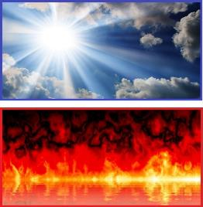
Daniel 12:2
“Many of those who sleep in the dust of the ground will awake, these to everlasting (olam) life, but the others to disgrace and everlasting (olam) contempt.”

Slide 33

Psalm 90:2
“Before the mountains were born Or You gave birth to the earth and the world, Even from everlasting (olam) to everlasting (olam), You are God.”

Slide 34
Matthew 25:46
“These will go away into eternal (aiōnios) punishment (kolasis), but the righteous into eternal life.

Slide 35
Matthew 25:46
“These will go away into eternal (aiōnios) punishment, but the righteous into eternal (aiōnios) life.

Slide 36
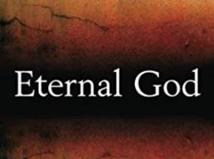
Romans 16:26
“but now is manifested, and by the Scriptures of the prophets, according to the commandment of the eternal (aiōnios) God, has been made known to all the nations, leading to obedience of faith

Slide 37
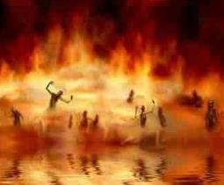
Revelation 14:11
“And the smoke of their torment goes up forever (aiōn) and ever (aiōn); they have no rest day and night, those who worship the beast and his image, and whoever receives the mark of his name.”

Slide 38
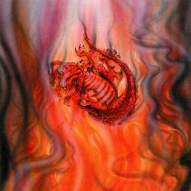
Revelation 19:20
“And the beast was seized, and with him the false prophet who performed the signs in his presence, by which he deceived those who had received the mark of the beast and those who worshiped his image; these two were thrown alive into the lake of fire which burns with brimstone.”

Slide 39


Slide 40
Revelation 20:10
“And the devil who deceived them was thrown into the lake of fire and brimstone, where the beast and the false prophet are also; and they will be tormented day and night forever (aiōn) and ever (aiōn).”

Slide 41
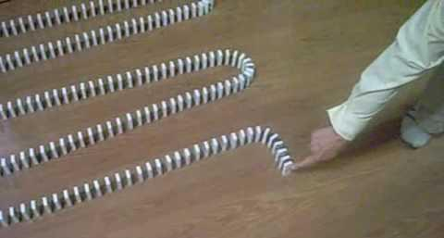
Dominoes in a Row

Slide 42

Dr. Alan W. Gomes
(Summer 1991). “Evangelicals and the Annihilation of Hell” (Part 2).
In the Christian Research Journal. Page 11.
“A punishment [such as torment] that is not felt is not a punishment. It is an odd use of language to speak of an insensate state (i.e., unfeeling), an inanimate object receiving punishment. To say, ‘I punished my car for not starting by slowly plucking out it’s spark plug wires, one by one,’ would invoke laughter, not serious consideration.”

Slide 43
Fundamentals of the Faith
Creation/Fall – Rom. 5:14
Inspiration/inerrancy of the Scripture – Matt. 5:18; John 17:17; 2 Tim. 3:16; 2 Pet. 1:20-21
Salvation by faith alone
Eternal existence of heaven/hell – Dan. 12:2; Matt. 25:46
Trinity
Virgin birth of Christ
Deity of Christ
Atoning death of Christ – Isa. 53:3-6; 1 Pet. 2:24
Bodily Resurrection of Christ – John 20:27-28; 1 Cor. 15:14
Bodily Second Advent of Christ – Job 19:25; Zech. 14:4; Acts 1:9-11

Slide 44
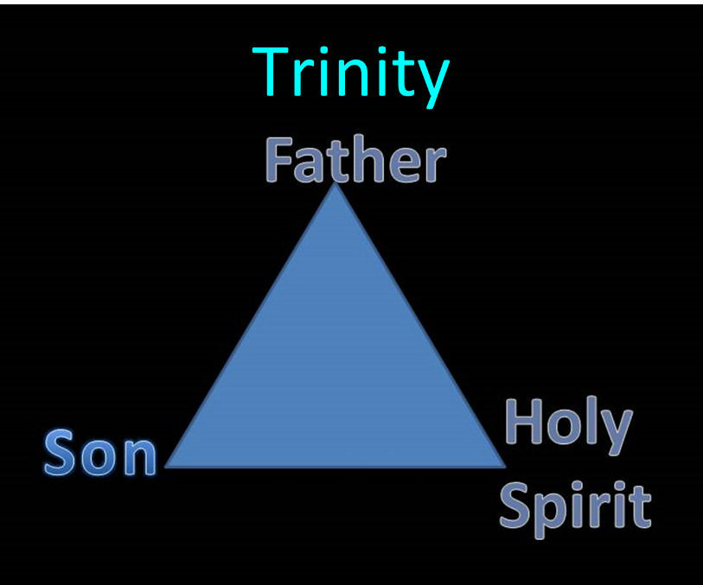

Slide 45
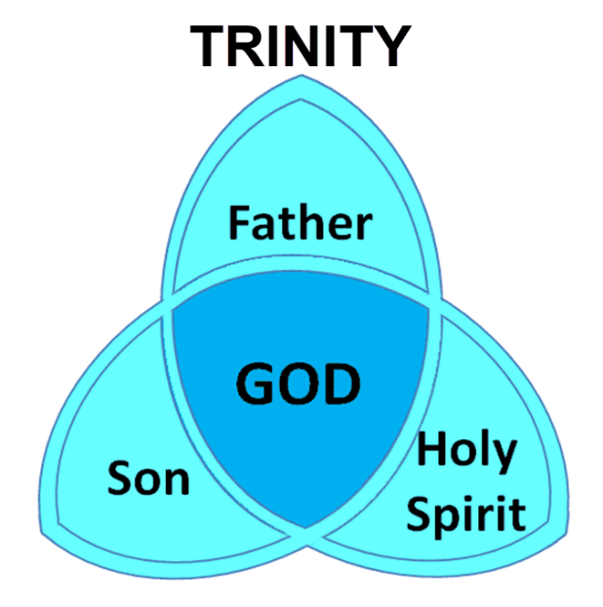

Slide 46
Fundamentals of the Faith
Creation/Fall – Rom. 5:14
Inspiration/inerrancy of the Scripture – Matt. 5:18; John 17:17; 2 Tim. 3:16; 2 Pet. 1:20-21
Salvation by faith alone
Eternal existence of heaven/hell – Dan. 12:2; Matt. 25:46
Trinity
Virgin birth of Christ
Deity of Christ
Atoning death of Christ – Isa. 53:3-6; 1 Pet. 2:24
Bodily Resurrection of Christ – John 20:27-28; 1 Cor. 15:14
Bodily Second Advent of Christ – Job 19:25; Zech. 14:4; Acts 1:9-11

Slide 47

Andy Stanley
https://christianindex.org/andy-stanleys-approach-to-the-virgin-birth/
“One of the challenging things about the Christmas season and one of the challenging things about the Christmas story is, in fact, the Christmas story – the Christmas story as it relates to the birth of Jesus. Because there is so much miraculous, there is so much amazing, there is so much that’s really unbelievable about it and a whole lot of people just don’t believe; and I understand that. Maybe the thought is that they had to come up with some myth about the birth of Jesus to give him street cred later on. It is interesting because Matthew gives us a version of the birth of Jesus. Luke does, but Mark and John don’t even mention it; and a lot has been made of that. And you have heard me say some version of this a million times, but if somebody can predict their own death and resurrection, I’m not all that concerned about how they got into the world, because the whole resurrection thing is so amazing and, in fact, you should know this. Christianity does not hinge on the truth or even the stories about the birth of Jesus, it really hinges on the resurrection of Jesus.”

Slide 48

Brian McLaren
https://juicyecumenism.com/2018/12/11/virgin-birth-not-literal-symbol-vs-patriarchy-brian-mclaren/
“Pastor Brian McLaren meditates on the virgin birth in the “Be Still and Go” podcast of The Riverside Church in New York City. In a segment titled “A Post-Patriarchal Christmas,” McLaren took issue with the virgin birth as a “science-defying miracle that proved something about Jesus.” He protested, “This approach never really worked for me. How can you use something you can’t prove—a virgin birth long ago—to prove something else—the unique identity of Jesus?” McLaren draws a different conclusion. He says the virgin birth’s “greatest value isn’t in proving something, but in meaning something.” McLaren said God got so tired of men “messing things up” that he said, “I’m going to work directly with women for a change. I’m taking a step to overthrow the patriarchy.” Whether you believe the “virgin birth story” or not, McLaren said, its “literal factuality” is “not the point.” McLaren concluded the virgin birth is “about a profound rejection of violence,” the notion that peace can never come through the old, blood-stained path of patriarchy.”

Slide 49


Slide 50
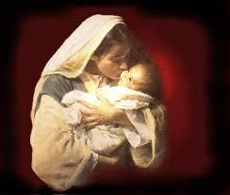

Why the Virgin Birth?
To fulfill OT prophecy
To emphasize Christ’s humanity and deity
To emphasize Christ’s eternality
To maintain Christ’s sinlessness
To protect the bodily atonement
To circumvent the curse of Jeconiah
To vindicate the NT

Slide 51
Fundamentals of the Faith
Creation/Fall – Rom. 5:14
Inspiration/inerrancy of the Scripture – Matt. 5:18; John 17:17; 2 Tim. 3:16; 2 Pet. 1:20-21
Salvation by faith alone
Eternal existence of heaven/hell – Dan. 12:2; Matt. 25:46
Trinity
Virgin birth of Christ
Deity of Christ
Atoning death of Christ – Isa. 53:3-6; 1 Pet. 2:24
Bodily Resurrection of Christ – John 20:27-28; 1 Cor. 15:14
Bodily Second Advent of Christ – Job 19:25; Zech. 14:4; Acts 1:9-11

Slide 52
Fundamentals of the Faith
Creation/Fall – Rom. 5:14
Inspiration/inerrancy of the Scripture – Matt. 5:18; John 17:17; 2 Tim. 3:16; 2 Pet. 1:20-21
Salvation by faith alone
Eternal existence of heaven/hell – Dan. 12:2; Matt. 25:46
Trinity
Virgin birth of Christ
Deity of Christ
Atoning death of Christ – Isa. 53:3-6; 1 Pet. 2:24
Bodily Resurrection of Christ – John 20:27-28; 1 Cor. 15:14
Bodily Second Advent of Christ – Job 19:25; Zech. 14:4; Acts 1:9-11

Slide 53
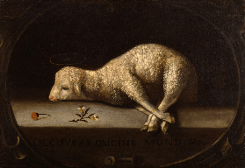
Christ’s Atoning Death
Substitution – Isa 53:3-6
Illustrations
  Secret serviceman
  Bee sting

Slide 54
Christ’s Atoning Death
Substitution – Isa 53:3-6
Illustrations
  Secret serviceman
  Bee sting

Slide 55

Isaiah 53:3–6
³ He was despised and forsaken of men, A man of sorrows and acquainted with grief; And like one from whom men hide their face He was despised, and we did not esteem Him. ⁴ Surely our griefs He Himself bore, And our sorrows He carried; Yet we ourselves esteemed Him stricken, Smitten of God, and afflicted. ⁵ But He was pierced through for our transgressions, He was crushed for our iniquities; The chastening for our well-being fell upon Him, And by His scourging we are healed. ⁶ All of us like sheep have gone astray, Each of us has turned to his own way; But the Lord has caused the iniquity of us all To fall on Him.

Slide 56
Christ’s Atoning Death
Substitution – Isa 53:3-6
Illustrations
  Secret serviceman
  Bee sting

Slide 57

Christ’s Atoning Death
Substitution – Isa 53:3-6
Illustrations
  Secret serviceman
  Bee sting

Slide 58

Christ’s Atoning Death
Substitution – Isa 53:3-6
Illustrations
  Secret serviceman
  Bee sting

Slide 59
Fundamentals of the Faith
Creation/Fall – Rom. 5:14
Inspiration/inerrancy of the Scripture – Matt. 5:18; John 17:17; 2 Tim. 3:16; 2 Pet. 1:20-21
Salvation by faith alone
Eternal existence of heaven/hell – Dan. 12:2; Matt. 25:46
Trinity
Virgin birth of Christ
Deity of Christ
Atoning death of Christ – Isa. 53:3-6; 1 Pet. 2:24
Bodily Resurrection of Christ – John 20:27-28; 1 Cor. 15:14
Bodily Second Advent of Christ – Job 19:25; Zech. 14:4; Acts 1:9-11

Slide 60
Fundamentals of the Faith
Creation/Fall – Rom. 5:14
Inspiration/inerrancy of the Scripture – Matt. 5:18; John 17:17; 2 Tim. 3:16; 2 Pet. 1:20-21
Salvation by faith alone
Eternal existence of heaven/hell – Dan. 12:2; Matt. 25:46
Trinity
Virgin birth of Christ
Deity of Christ
Atoning death of Christ – Isa. 53:3-6; 1 Pet. 2:24
Bodily Resurrection of Christ – John 20:27-28; 1 Cor. 15:14
Bodily Second Advent of Christ – Job 19:25; Zech. 14:4; Acts 1:9-11

Slide 61
David Reagan
“The Beginning and the Ending,” online: http://christinprophecy.org/articles/the-beginning-and-the-ending/, accessed 19 April 2017, 1.
“Let me give you a classic example of spiritualization taken from the writings of a theologian by the name of Loraine Boettner. It has to do with his interpretation of Zechariah 14:1-9. That passage says that in the end times Jerusalem will be surrounded by enemy forces and will be ready to fall to them when the Lord will suddenly return to the Mount of Olives. When His feet touch the Mount, it will split down the middle. The Lord will then speak a supernatural word that will instantly destroy all the enemy forces. And on that day, the Lord will become King over all the earth. In his commentary on this passage, Boettner completely spiritualized it. He argued that the Mount of Olives stands for the human . . .

Slide 62
David Reagan
“The Beginning and the Ending,” online: http://christinprophecy.org/articles/the-beginning-and-the-ending/, accessed 19 April 2017, 1.
. . . heart. The enemy forces symbolize the evil in this world that surrounds and attacks the heart. The Lord’s return represents what happens when a person accepts Jesus as Lord and Savior. Thus, when Jesus comes into a person’s heart, their heart (the Mount of Olives) splits in contrition, and all the evil influences in the person’s life are defeated, and Jesus becomes king of that person’s heart. That’s what I call an exercise in imagination!”

Slide 63
C. What to Separate From?
False doctrine – 1 Tim. 4:16; Titus 1:9
Divisive persons – Rom. 16:17; Titus 3:9-11
Immorality – 1 Cor. 5:9-11; Eph. 5:11
General disobedience to Scripture –2 Thess. 3:6, 14

Slide 64

Romans 16:17
“Now I urge you, brethren, keep your eye on those who cause dissensions and hindrances contrary to the teaching which you learned, and turn away from them.”

Slide 65

Titus 3:9-11
^{“9} But avoid foolish controversies and genealogies and strife and disputes about the Law, for they are unprofitable and worthless. ¹⁰ Reject a factious (hairetikos) man after a first and second warning,¹¹ knowing that such a man is perverted and is sinning, being self-condemned.”

Slide 66
C. What to Separate From?
False doctrine – 1 Tim. 4:16; Titus 1:9
Divisive persons – Rom. 16:17; Titus 3:9-11
Immorality – 1 Cor. 5:9-11; Eph. 5:11
General disobedience to Scripture –2 Thess. 3:6, 14

Slide 67
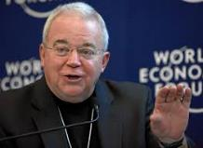
Jim Wallis
Mary Danielson, The Dangerous Truth About the Social-Justice “Gospel,” n. 21
“Abomination is a pretty strong word . . . there is a debate and questions over the meaning of the word ‘abomination.’” (Referring to Leviticus 18:22; as heard on Moody Christian Radio Network, in Chicago, Feb.19, 2008, when asked about government sanctions on civil unions for gays.)

Slide 68
C. What to Separate From?
False doctrine – 1 Tim. 4:16; Titus 1:9
Divisive persons – Rom. 16:17; Titus 3:9-11
Immorality – 1 Cor. 5:9-11; Eph. 5:11
General disobedience to Scripture –2 Thess. 3:6, 14

Slide 69
Conclusion

Slide 70
Ecclesiology Overview
Definition
Universal vs. local
Word pictures
Origin
Israel – Church differences
Intercalation
Purposes
Activities
Government
Officers
Ordinances
Purity

Slide 71
Purity of the Church
Ecclesiastical separation
Church discipline

Slide 72
Ecclesiastical Separation
Why separate?
Biblical basis for separation
What to separate from?

Slide 73
Purity of the Church
Ecclesiastical separation
Church discipline

