Slide 1


Slide 2

The Coming Kingdom
Chapter 17
Dr. Andy Woods
Senior Pastor – Sugar Land Bible Church
President – Chafer Theological Seminary

Slide 3

Kingdom Study Outline
What does the Bible Say About the Kingdom?
The Main Problem with Kingdom Now NT interpretations
Why do some believe that we are in the kingdom now?
Why does it matter?

Slide 4
Response to Kingdom Now Problem Passages
Passages from Christ’s ministry
Passages from Acts
Passages from Paul
Passages from the General letters
Passages from Revelation
Miscellaneous Arguments

Slide 5

2. Is Jesus Now Reigning from David’s Throne?
(Acts 2)
David’s Throne is Earthly
A Davidic heavenly Throne changes its original meaning
No NT verse places Jesus currently of David’s Throne
The Davidic Throne comes into existence only after the Times of the Gentiles have run their course
A present Davidic Throne misunderstands the mystery nature of the Church
A present Davidic Throne misunderstands the parenthetical nature of the Church

Slide 6
2. Is Jesus Now Reigning from David’s Throne?
(Acts 2)
David’s Throne is Earthly
A Davidic heavenly Throne changes its original meaning
No NT verse places Jesus currently of David’s Throne
The Davidic Throne comes into existence only after the Times of the Gentiles have run their course
A present Davidic Throne misunderstands the mystery nature of the Church
A present Davidic Throne misunderstands the parenthetical nature of the Church

Slide 7


1 Kings 2:11-12
“The days that David reigned over Israel were forty years: seven years he reigned in Hebron and thirty-three years he reigned in Jerusalem. And Solomon sat on the throne of David his father, and his kingdom was firmly established.”

Slide 8
2. Is Jesus Now Reigning from David’s Throne?
(Acts 2)
David’s Throne is Earthly
A Davidic heavenly Throne changes its original meaning
No NT verse places Jesus currently of David’s Throne
The Davidic Throne comes into existence only after the Times of the Gentiles have run their course
A present Davidic Throne misunderstands the mystery nature of the Church
A present Davidic Throne misunderstands the parenthetical nature of the Church

Slide 9
Changes | Biblical Davidic Throne | Davidic Throne Now?
Place: | Earth | Heaven
People: | Israel | Gentile Church
Israel: | Converted | Unconverted

Slide 10
2. Is Jesus Now Reigning from David’s Throne?
(Acts 2)
David’s Throne is Earthly
A Davidic heavenly Throne changes its original meaning
No NT verse places Jesus currently of David’s Throne
The Davidic Throne comes into existence only after the Times of the Gentiles have run their course
A present Davidic Throne misunderstands the mystery nature of the Church
A present Davidic Throne misunderstands the parenthetical nature of the Church

Slide 11
2. Is Jesus Now Reigning from David’s Throne?
(Acts 2)
David’s Throne is Earthly
A Davidic heavenly Throne changes its original meaning
No NT verse places Jesus currently of David’s Throne
The Davidic Throne comes into existence only after the Times of the Gentiles have run their course
A present Davidic Throne misunderstands the mystery nature of the Church
A present Davidic Throne misunderstands the parenthetical nature of the Church

Slide 12


Statue
&
Stone

Slide 13

CHART1

Slide 14
Synthetic Outline
  Chiasm “Aramaic” ( 2-7)
1. Gentile History (2)
  2. Protection (3)
    3. Revelation to a gentile king (4)
    3. Revelation to a gentile king (5)
  2. Protection (6)
1. Gentile history (7)

Slide 15
Statue
&
Stone

Slide 16

J. Dwight Pentecost
"Daniel,” in Bible Knowledge Commentary, Old Testament, ed. John F. Walvoord and Roy B. Zuck (Colorado Springs, CO: Chariot Victor, 1985), 1336.
“Amillennialists hold that this kingdom was established by Christ at His First Advent and that now the church is that kingdom. They argue that: (a) Christianity, like the growing mountain, began to grow and spread geographically and is still doing so; (b) Christ came in the days of the Roman Empire; (c) the Roman Empire fell into the hands of 10 kingdoms (10 toes); (d) Christ is the chief Cornerstone (Eph. 2:20). Premillenarians, however, hold that the kingdom to be established by Christ on earth is yet future. At least six points favor that view: (1) The stone will become a mountain suddenly, not gradually. Christianity did not suddenly fill “the whole earth” (Dan. 2:35) at Christ’s First Advent. (2) Though Christ came in the days of the Roman Empire, He did not destroy it. (3) During Christ’s time on earth the Roman Empire did not have 10 kings at once.”

Slide 17
J. Dwight Pentecost
"Daniel,” in Bible Knowledge Commentary, Old Testament, ed. John F. Walvoord and Roy B. Zuck (Colorado Springs, CO: Chariot Victor, 1985), 1336.
“Yet Nebuchadnezzar’s statue suggests that when Christ comes to establish His kingdom, 10 rulers will be in existence and will be destroyed by Him. (4) Though Christ is now the chief Cornerstone to the church (Eph. 2:20) and “a stone that causes [unbelievers] to stumble” (1 Peter 2:8), He is not yet a smiting Stone as He will be when He comes again. (5) The Stone (Messiah) will crush and end all the kingdoms of the world. But the church has not and will not conquer the world’s kingdoms. (6) The church is not a kingdom with a political realm, but the future Millennium will be. Thus Nebuchadnezzar’s dream clearly teaches premillennialism, that Christ will return to earth to establish His rule on the earth, thereby subduing all nations. The church is not that kingdom.”

Slide 18
2. Is Jesus Now Reigning from David’s Throne?
(Acts 2)
David’s Throne is Earthly
A Davidic heavenly Throne changes its original meaning
No NT verse places Jesus currently of David’s Throne
The Davidic Throne comes into existence only after the Times of the Gentiles have run their course
A present Davidic Throne misunderstands the mystery nature of the Church
A present Davidic Throne misunderstands the parenthetical nature of the Church

Slide 19

Ephesians 2:14-16
“¹⁴ For He Himself is our peace, who made both groups into one and broke down the barrier of the dividing wall, ¹⁵ by abolishing in His flesh the enmity, which is the Law of commandments contained in ordinances, so that in Himself He might make the two into one new man, thus establishing peace, ¹⁶ and might reconcile them both in one body to God through the cross, by it having put to death the enmity.”

Slide 20
Ephesians 3:3-6
“that by revelation there was made known to me the mystery, as I wrote before in brief. ⁴ By referring to this, when you read you can understand my insight into the mystery of Christ, ⁵ which in other generations was not made known to the sons of men, as it has now been revealed to His holy apostles and prophets in the Spirit; ⁶ to be specific, that the Gentiles are fellow heirs and fellow members of the body, and fellow partakers of the promise in Christ Jesus through the gospel”.

Slide 21

Ephesians 3:9
“and to bring to light what is the administration of the mystery which for ages has been hidden in God who created all things.”

Slide 22

Colossians 1:26
“that is, the mystery which has been hidden from the past ages and generations, but has now been manifested to His.”

Slide 23
“Mystery” Defined
“In the N.T, it [mystērion] denotes, not the mysterious (as with the Eng. word), but that which, being outside the range of unassisted natural apprehension, can be made known only by Divine revelation, and is made known in a manner and at a time appointed by God, and to those who are illumined by His Spirit.”
W. E. Vine, Merrill F. Unger, and William White, Vine's Complete Expository Dictionary of the Old and New Testament Words (Nashville: Nelson, 1996), 424.

Slide 24

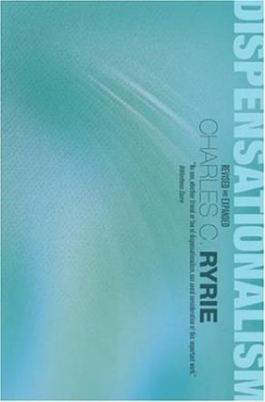
Charles Ryrie
Ryrie, Dispensationalism, 134
Ryrie presents a word study from both the biblical and extra-biblical material and concludes “that the mystery of the equality of Jews and Gentiles in the one body of Christ was unknown and unrevealed in the Old Testament.”

Slide 25
2 Samuel 7:12-16
¹² “When your days are complete and you lie down with your fathers, I will raise up your descendant after you, who will come forth from you, and I will establish his kingdom. ¹³ He shall build a house for My name, and I will establish the throne of his kingdom forever. ¹⁴ I will be a father to him and he will be a son to Me; when he commits iniquity, I will correct him with the rod of men and the strokes of the . . .

Slide 26
2 Samuel 7:12-16
. . . sons of men, ¹⁵ but My lovingkindness shall not depart from him, as I took it away from Saul, whom I removed from before you. ¹⁶ Your house and your kingdom shall endure before Me forever; your throne shall be established forever.” ¹⁷ In accordance with all these words and all this vision, so Nathan spoke to David.”

Slide 27
2. Is Jesus Now Reigning from David’s Throne?
(Acts 2)
David’s Throne is Earthly
A Davidic heavenly Throne changes its original meaning
No NT verse places Jesus currently of David’s Throne
The Davidic Throne comes into existence only after the Times of the Gentiles have run their course
A present Davidic Throne misunderstands the mystery nature of the Church
A present Davidic Throne misunderstands the parenthetical nature of the Church

Slide 28

Lewis Sperry Chafer
vol. 4, Systematic Theology (Grand Rapids, MI: Kregel Publications, 1993), 41.
“In fact, the new, hitherto unrevealed purpose of God in the out calling of a heavenly people from Jews and Gentiles is so divergent with respect to the divine purpose toward Israel, which purpose preceded it and will yet follow it, that the term parenthetical, commonly employed to describe the new age purpose, is inaccurate. A parenthetical portion sustains some direct and indirect relation to that which goes before or that which follows; but the present age-purpose is not thus related and therefore is more properly termed an intercalation. The appropriateness of this word will . . .

Slide 29
Lewis Sperry Chafer
vol. 4, Systematic Theology (Grand Rapids, MI: Kregel Publications, 1993), 41.
. . . be seen in the fact that, as an interpolation is formed by inserting a word or phrase into a context, so when intercalation is formed by introducing a day or a period of time into the calendar. The present age of the church is an intercalation into the revealed calendar or program of God as that program was foreseen by the prophets of old. Such, indeed, is the precise character of the present age.”

Slide 30
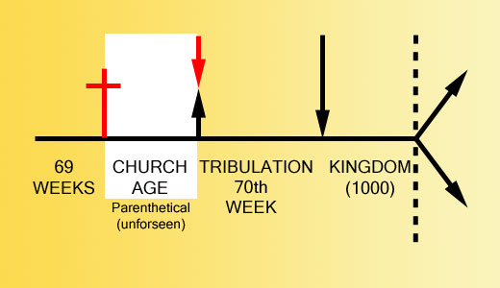

Slide 31
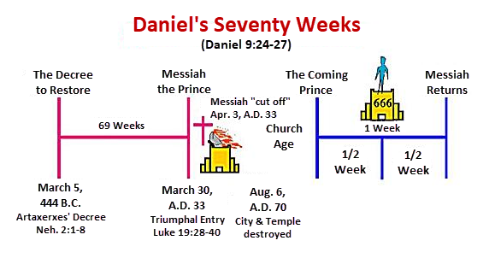

Slide 32
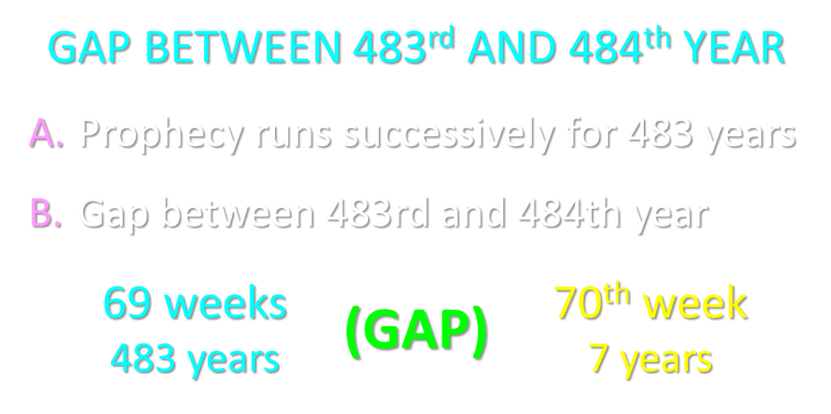

Slide 33
Ephesians 2:14-16
“¹⁴ For He Himself is our peace, who made both groups into one and broke down the barrier of the dividing wall, ¹⁵ by abolishing in His flesh the enmity, which is the Law of commandments contained in ordinances, so that in Himself He might make the two into one new man, thus establishing peace, ¹⁶ and might reconcile them both in one body to God through the cross, by it having put to death the enmity.”

Slide 34
2. Is Jesus Now Reigning from David’s Throne?
(Acts 2)
David’s Throne is Earthly
A Davidic heavenly Throne changes its original meaning
No NT verse places Jesus currently of David’s Throne
The Davidic Throne comes into existence only after the Times of the Gentiles have run their course
A present Davidic Throne misunderstands the mystery nature of the Church
A present Davidic Throne misunderstands the parenthetical nature of the Church

Slide 35

Stephen Nichols
“The Dispensational View of the Davidic Kingdom: A Response to Progressive Dispensationalism,” in The Master’s Perspective on Biblical Prophecy, ed. Richard L. Mayue and Robert L. Thomas, Master’s Perspective Series (Grand Rapids: Kregel, 2002), 54.
“Although the progressive dispensationalists are careful to express their commitment to a future for ethnic Israel and a future, literal fulfillment of Israel’s covenant promise, these views concerning the inaugural fulfillment of Old Testament promise, especially that of the Davidic covenant, and the redefining of the present form of the church mark an aberration from normative dispensationalism. The consistently held offer, rejection, postponement, and fully future fulfillment of the Davidic kingdom is absent from their teaching.”

Slide 36
Stephen Nichols
“The Dispensational View of the Kingdom: A Response to Progressive Dispensationalism,” The Master’s Seminary Journal 7 (Fall 1996): 238.
“From the perspective of dispensational tradition, the current landscape of progressive dispensationalists appears to be a different terrain. The view of the offer, rejection, postponement, and fully future fulfillment of the Davidic kingdom and the corollary view of the church as something different and distinct is and has been the consistent view of normative dispensationalism. By viewing the present form of the church as an inaugural stage of the Davidic kingdom with Christ seated on the Davidic throne in heaven, the progressive dispensational position has distanced itself from this distinguishing feature of dispensationalism. The distinguishing feature of dispensationalism, i.e., the consistent distinction between Israel and the church, is all but absent. Consequently, the legitimacy of calling PD part of the dispensational tradition is questionable.”

Slide 37
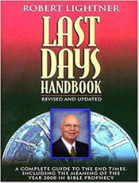
Is Jesus Now Reigning on David’s Throne?
“Many who are classic dispensationalists—and even those who are not dispensationalists at all—question why those who no longer believe in the foundational essentials of dispensationalism still want to be part of the dispensationalism family. This is truly something not yet revealed.”
Robert Lightner, Last Days Handbook (Nashville: Thomas Nelson, 1997), 211.

Slide 38
Is Jesus Now Reigning on David’s Throne?
“The term used by those who still wish to be called dispensationalists but who do not believe some of the basic essentials of dispensationalism. They do not believe God has a program for Israel and one for the church. They believe that Christ is presently on the throne of David in heaven and the Davidic kingdom is being fulfilled now in part.”
Robert Lightner, Last Days Handbook (Nashville: Thomas Nelson, 1997), 233.

Slide 39

Robert Lightner
“Progressive Dispensationalism,” Conservative Theological Journal 4, no. 11 (March 2000): 47–49, 54.
“Progressives are very set on finding various periods within the history of dispensationalism where there have been changes made or developments. They like to talk about the initial period. They like to talk about the classical period and the essentialist or revised period. I personally do not wish to get involved in that kind of breakdown of category. I do not think that is genuine at all. I think that this is an attempt to pave the way for their defense of their own system. What they’re really wanting to say is that since dispensationalism has changed from year to year or decade to decade, why get so excited about this new change that we are introducing?”

Slide 40
Robert Lightner
“Progressive Dispensationalism,” Conservative Theological Journal 4, no. 11 (March 2000): 47–49, 54.
“Our change is just like the other changes. Dispensationalism has always had various people believing certain things about it within dispensationalism. There has been change; therefore, this is just another one of those changes. However, I do not believe the changes are the same at all. To be sure, dispensationalists have always differed, Dr. Walvoord differs at points with Dr. Chafer, Dr. Chafer differs at points with Dr. Ryrie, Dr. Ryrie with Dr. Pentecost, but the core beliefs of dispensationalism have not changed since Darby.”

Slide 41
Robert Lightner
“Progressive Dispensationalism,” Conservative Theological Journal 4, no. 11 (March 2000): 47–49, 54.
“The core beliefs involved are what Ryrie calls the “sine qua non,” which simply means the most essential, bedrock, bases for dispensationalism. First, Ryrie proposed that the sine qua non, the least common denominator, the most basic beliefs, involve distinction between God’s program with Israel and His program with the Church. The first distinction is one part of the sine qua non. A second would be that the view of the distinction between those two programs is based on a literal hermeneutic consistently applied to Scripture.”

Slide 42
Robert Lightner
“Progressive Dispensationalism,” Conservative Theological Journal 4, no. 11 (March 2000): 47–49, 54.
“The third sine qua non is that God has introduced these various economies—dispensations—in the history of time so as to bring the most glory to Himself. God’s major purpose in the world as He implements His sovereign plan is to bring glory to Himself. Certainly, there are other purposes but dispensationalists have always believed the overriding one is for God to bring glory to Himself. In progressive dispensationalism all three of these basic essentials, which Ryrie pointed out and that have been believed from the beginning of the dispensational emphasis, have been rejected.”

Slide 43
Robert Lightner
“Progressive Dispensationalism,” Conservative Theological Journal 4, no. 11 (March 2000): 47–49, 54.
“At least two of them, have been categorically rejected. Namely, a distinction between God’s program for Israel and the Church has been blurred, and the concept of a literal, consistent, interpretation has been replaced by a complementary hermeneutic. The third has been rejected, the glory of God as the primary purpose of God. It has been replaced by a Christological salvific purpose. The salvation of sinners has been the primary purpose of God, progressives say. So it is a salvific purpose rather than a doxological, glory to God purpose that includes salvation.”

Slide 44
Robert Lightner
“Progressive Dispensationalism,” Conservative Theological Journal 4, no. 11 (March 2000): 47–49, 54.
“I think that progressive dispensationalists have made this classification of initial, classical, and essential in order to simply argue that there have been these spurts of growth, development, and change; therefore, their view is just another one. I want to categorically reject that thesis because I think there is a world of difference between various differences within the system and altering the foundation of the system. I liken the three essentials, or sine qua non, as the foundation upon which dispensationalism rests. You can’t be a dispensationalist without these essentials, in my opinion.”

Slide 45
Robert Lightner
“Progressive Dispensationalism,” Conservative Theological Journal 4, no. 11 (March 2000): 47–49, 54.
“The other changes, the differences between how to interpret the New Covenant, for example, and whether or not the Tribulation is another dispensation or a thousand other things such as that, I liken to moving furniture around a room. It doesn’t affect the system. In fact, it’s healthy to have differences as to where this piece of furniture belongs and that one, and you may get tired of it being this way, so you shift it. That doesn’t affect the structure of the house. But the dispensational house is built upon the foundation of the three essentials I just named, and progressive dispensationalism is attacking these essentials.”

Slide 46
Robert Lightner
“Progressive Dispensationalism,” Conservative Theological Journal 4, no. 11 (March 2000): 47–49, 54.
“That is a world of difference between any change, any development that has ever taken place since Darby. So, it’s not fair, it’s a misrepresentation to say that here’s another development just like all the other ones. No, it is not like all the other ones. It is drastically different from all the other ones because it attacks the foundation upon which the system has been built. That is different from moving the furniture around to different places in the dispensational house, or to carry it through more literally the household, the economy, the stewardship. . . . I am not manufacturing these doctrines. These are the core beliefs of progressive dispensationalism and are at great variance with normative dispensationalism.”

Slide 47
2. Is Jesus Now Reigning from David’s Throne?
(Acts 2)
David’s Throne is Earthly
A Davidic heavenly Throne changes its original meaning
No NT verse places Jesus currently of David’s Throne
The Davidic Throne comes into existence only after the Times of the Gentiles have run their course
A present Davidic Throne misunderstands the mystery nature of the Church
A present Davidic Throne misunderstands the parenthetical nature of the Church

Slide 48
CONCLUSION

Slide 49
Response to Kingdom Now Problem Passages
Passages from Christ’s ministry
Passages from Acts
Passages from Paul
Passages from the General letters
Passages from Revelation
Miscellaneous Arguments

