Slide 1
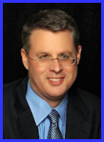
Ecclesiology Session 46
Dr. Andy Woods
Senior Pastor – Sugar Land Bible Church
President – Chafer Theological Seminary

Slide 2
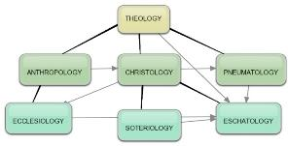
Areas of Systematic Theology
Prolegomena – Introduction
Theology – Study of God
Christology – Study of Christ
Pneumatology – Study of the Holy Spirit
Anthropology – Study of Man
Hamartiology – Study of sin
Soteriology – Study of salvation
Angelology – Study of angels
Ecclesiology – Study of the Church
Eschatology – Study of the end

Slide 3
Ecclesiology Overview
Definition
Universal vs. local
Word pictures
Origin
Israel – Church differences
Intercalation
Purposes
Activities
Government
Officers
Ordinances
Purity

Slide 4
XI. Ordinances
Foot washing?
Communion
Baptism

Slide 5
XI. Ordinances
Foot washing?
Communion
Baptism

Slide 6
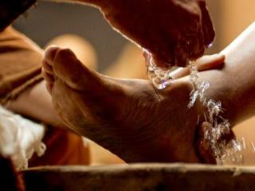
A. Foot Washing?
Scriptural support: John 13:5-7, 12-15
Not mandatory:
Epistles?
Example: John 13:15
Take some time to grasp: John 13:6-7

Slide 7
XI. Ordinances
Foot washing?
Communion
Baptism

Slide 8
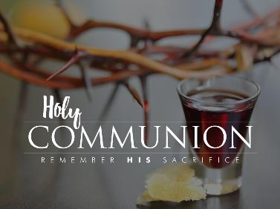
B. Communion
Frequency? Acts 2:42, 46; 20:7
Self-examination? 1 Cor.11:27-31
Meaning?

Slide 9
Communion Views
Transubstantiation
Consubstantiation
Memorial

Slide 10
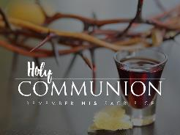
Memorial
Genesis 9:8-17
Zwingli View
Reformed, Presbyterian, Baptist
Scriptural support – Luke 22:19; 1 Cor. 11:24, 26
What are we remembering?

Slide 11
What are We Remembering?
Christ’s past sacrifice (John 19:30)
Present union with Christ (Rom. 6:3)
Present union with all believers (1 Cor. 12:13)
Christ’s promise to return (1 Cor. 11:26)
The basic facts of the Gospel (1 Cor. 11:24-25)

Slide 12
XI. Ordinances
Foot washing?
Communion
Baptism

Slide 13
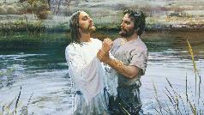
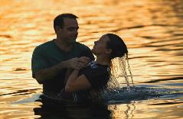
C. Baptism
False views
Baptismal regeneration?
Infant baptism?
Correct view: outward symbol of an inward reality
Mode of baptism
Sprinkling?
Immersion?

Slide 14
C. Baptism
False views
Baptismal regeneration?
Infant baptism?
Correct view: outward symbol of an inward reality
Mode of baptism
Sprinkling?
Immersion?

Slide 15
C. Baptism
False views
Baptismal regeneration?
Infant baptism?
Correct view: outward symbol of an inward reality
Mode of baptism
Sprinkling?
Immersion?

Slide 16
Baptismal Regeneration?
Salvation is not by works (Eph. 2:8-9)
Thief on the cross (Luke 23:39-43)
Paul’s personal de-emphasis on baptism (1 Cor. 1:13-17)

Slide 17
C. Baptism
False views
Baptismal regeneration?
Infant baptism?
Correct view: outward symbol of an inward reality
Mode of baptism
Sprinkling?
Immersion?

Slide 18
Infant Baptism?
Lutheran View
Like circumcision (Gen. 17)
Problems
Dispensationalism
Pattern of Acts – Matt. 28:19; Acts 8:12, 35-39; 10:43-48; 16:14-15, 30-34; 18:8
No biblical examples of infant baptism

Slide 19
Infant Baptism?
Lutheran View
Like circumcision (Gen. 17)
Problems
Dispensationalism
Pattern of Acts – Matt. 28:19; Acts 8:12, 35-39; 10:43-48; 16:14-15, 30-34; 18:8
No biblical examples of infant baptism

Slide 20
Infant Baptism?
Lutheran View
Like circumcision (Gen. 17)
Problems
Dispensationalism
Pattern of Acts – Matt. 28:19; Acts 8:12, 35-39; 10:43-48; 16:14-15, 30-34; 18:1
No biblical examples of infant baptism

Slide 21
C. Baptism
False views
Baptismal regeneration?
Infant baptism?
Correct view: outward symbol of an inward reality
Mode of baptism
Sprinkling?
Immersion?

Slide 22
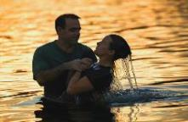
What Baptism Symbolizes
Obedience to Christ’s command (Matt. 28:19)
Sharing in Christ’s death, burial, resurrection, and ascension (Rom. 6:3)
Holy Spirit’s baptism (1 Cor. 12:13)
Public identification with Christ’s church and message
Personal forgiveness of sins

Slide 23
Miscellaneous Truths About Baptism
For believers only
Contributes nothing to justification
Performed in public
Contributes to sanctification (1 Pet. 3:20-21)

Slide 24
1 Peter 3:20-21
²⁰ “who once were disobedient, when the patience of God kept waiting in the days of Noah, during the construction of the ark, in which a few, that is, eight persons, were brought safely through the water. ²¹ Corresponding to that, baptism now saves you—not the removal of dirt from the flesh, but an appeal to God for a good conscience—through the resurrection of Jesus Christ.”

Slide 25
1 Peter 3:20-21
²⁰ “who once were disobedient, when the patience of God kept waiting in the days of Noah, during the construction of the ark, in which a few, that is, eight persons, were brought safely through the water. ²¹ Corresponding to that, baptism now saves you—not the removal of dirt from the flesh, but an appeal to God for a good conscience—through the resurrection of Jesus Christ.”

Slide 26
Three Tenses of Salvation
Phase | Justification | Sanctification | Glorification
Tense | Past | Present | Future
Saved from sin’s: | Penalty | Power | Presence
Scripture | Eph 2:8-9; Titus 3:5 | Philip 2:12 | Rom 5:10

Slide 27
Three Tenses of Salvation
Phase | JUSTIFICATION | Sanctification | Glorification
Tense | Past | Present | Future
Saved from sin’s: | Penalty | Power | Presence
Scripture | Eph 2:8-9; Titus 3:5 | Philip 2:12 | Rom 5:10

Slide 28
Three Tenses of Salvation
Phase | Justification | SANCTIFICATION | Glorification
Tense | Past | Present | Future
Saved from sin’s: | Penalty | Power | Presence
Scripture | Eph 2:8-9; Titus 3:5 | Philip 2:12 | Rom 5:10

Slide 29
Three Tenses of Salvation
Phase | Justification | Sanctification | GLORIFICATION
Tense | Past | Present | Future
Saved from sin’s: | Penalty | Power | Presence
Scripture | Eph 2:8-9; Titus 3:5 | Philip 2:12 | Rom 5:10

Slide 30
C. Baptism
False views
Baptismal regeneration?
Infant baptism?
Correct view: outward symbol of an inward reality
Mode of baptism
Sprinkling?
Immersion?

Slide 31
C. Baptism
False views
Baptismal regeneration?
Infant baptism?
Correct view: outward symbol of an inward reality
Mode of baptism
Sprinkling?
Immersion?

Slide 32
C. Baptism
False views
Baptismal regeneration?
Infant baptism?
Correct view: outward symbol of an inward reality
Mode of baptism
Sprinkling?
Immersion?

Slide 33
Sprinkling or Immersion?
Sprinkling? Other words (1 Pet. 1:12; 2 Tim. 4:6)
Immersion?
Christ’s baptism (Matt. 3:16; Mark 1:10)
Ethiopian eunuch's baptism (Acts 8:38-39)
Best symbolizes our union with Christ (Rom. 6:3)

Slide 34
Conclusion

Slide 35
XI. Ordinances
Foot washing?
Communion
Baptism

Slide 36
Ecclesiology Overview
Definition
Universal vs. local
Word pictures
Origin
Israel – Church differences
Intercalation
Purposes
Activities
Government
Officers
Ordinances
Purity

