Slide 1
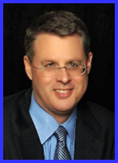
Ecclesiology Session 45
Dr. Andy Woods
Senior Pastor – Sugar Land Bible Church
President – Chafer Theological Seminary

Slide 2
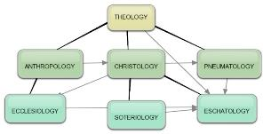
Areas of Systematic Theology
Prolegomena – Introduction
Theology – Study of God
Christology – Study of Christ
Pneumatology – Study of the Holy Spirit
Anthropology – Study of Man
Hamartiology – Study of sin
Soteriology – Study of salvation
Angelology – Study of angels
Ecclesiology – Study of the Church
Eschatology – Study of the end

Slide 3
Ecclesiology Overview
Definition
Universal vs. local
Word pictures
Origin
Israel – Church differences
Intercalation
Purposes
Activities
Government
Officers
Ordinances
Purity

Slide 4
XI. Ordinances
Foot washing?
Communion
Baptism

Slide 5
XI. Ordinances
Foot washing?
Communion
Baptism

Slide 6
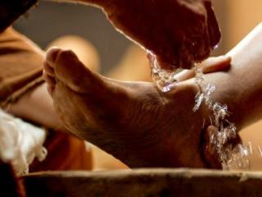
A. Foot Washing?
Scriptural support: John 13:5-7, 12-15
Not mandatory:
Epistles?
Example: John 13:15
Take some time to grasp: John 13:6-7

Slide 7
XI. Ordinances
Foot washing?
Communion
Baptism

Slide 8
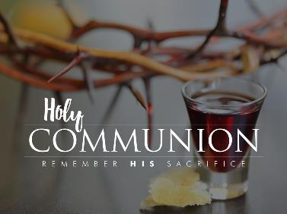
B. Communion
Frequency? Acts 2:42, 46; 20:7
Self-examination? 1 Cor.11:27-31
Meaning?

Slide 9
B. Communion
Frequency? Acts 2:42, 46; 20:7
Self-examination? 1 Cor.11:27-31
Meaning?

Slide 10
B. Communion
Frequency? Acts 2:42, 46; 20:7
Self-examination? 1 Cor.11:27-31
Meaning?

Slide 11
B. Communion
Frequency? Acts 2:42, 46; 20:7
Self-examination? 1 Cor.11:27-31
Meaning?

Slide 12
Communion Views
Transubstantiation
Consubstantiation
Memorial

Slide 13
Communion Views
Transubstantiation
Consubstantiation
Memorial

Slide 14
Transubstantiation
Roman Catholic View
Problems
Christ’s 1x sacrifice – Heb. 10:10, 14
Christ’s metaphorical language – Luke 22:19
Lack of scriptural support – John 6:53-58

Slide 15
Communion Views
Transubstantiation
Consubstantiation
Memorial

Slide 16
Consubstantiation
Real Presence View
Lutheran View
Emergent Church mysticism
Lack of Scriptural support – Rom. 8:9; Matt. 18:20

Slide 17
Consubstantiation
Real Presence View
Lutheran View
Emergent Church mysticism
Lack of Scriptural support – Rom. 8:9; Matt. 18:20

Slide 18
Consubstantiation
Real Presence View
Lutheran View
Emergent Church mysticism
Lack of Scriptural support – Rom. 8:9; Matt. 18:20

Slide 19
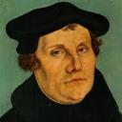
Martin Luther
Emir Caner, "Balthsar Hubmaier and His Theological Participation in the Reformation: Ecclesiology and Soteriology," Faith and Mission 21, no. 1 (2003): 42.
Caner explains, “Luther denied the doctrine of Transubstantiation, rejecting any molecular change of the elements. Consubstantiation, a term never employed by Luther, is used to explain his view that the body and blood are present ‘in, with, and under’ the bread and wine.” (the real presence view).
Notes:
Outline

Slide 20
Consubstantiation
Real Presence View
Lutheran View
Emergent Church mysticism
Lack of Scriptural support – Rom. 8:9; Matt. 18:20

Slide 21
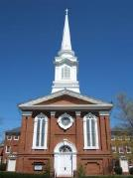
Emergent Church Worship
“Post-moderns prefer to encounter Christ by using all their senses. That’s part of the appeal of classical liturgical or contemplative worship: the incense and candles, making the sign of the cross, the taste and smell of the bread and wine, touching icons and being anointed with oil.”
Julie B. Sevig, The Lutheran, 9/2001.

Slide 22
Dan Kimball The Emerging Church, 121
“Modern thinkers want things very orderly and systematic because they learn in a logical and progressive manner. They prefer, generally, to sit and listen. Emerging post-Christian generations, on the other hand, long to experience a transcendent God during a worship gathering rather than simply learn about him.” (Italics added)

Slide 23
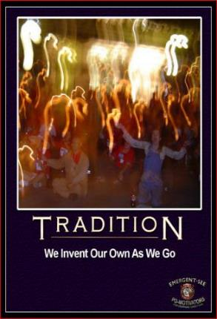
Dan Kimball The Emerging Church, 121
“They want fluidity and freedom rather than a neatly flowing set program. They want to see the arts and a sense of mystery brought into the worship service, rather than focusing on professionalism and excellence. This will shape how a worship gathering is designed” (Italics added).

Slide 24
Consubstantiation
Real Presence View
Lutheran View
Emergent Church mysticism
Lack of Scriptural support – Rom. 8:9; Matt. 18:20

Slide 25
Romans 8:9
“However, you are not in the flesh but in the Spirit, if indeed the Spirit of God dwells in you. But if anyone does not have the Spirit of Christ, he does not belong to Him.”

Slide 26
Matthew 18:20
“¹⁵ If your brother sins, go and show him his fault in private; if he listens to you, you have won your brother. ¹⁶ But if he does not listen to you, take one or two more with you, so that by the mouth of two or three witnesses every fact may be confirmed. ¹⁷ If he refuses to listen to them, tell it to the church; and if he refuses to listen even to the church, let him be to you as a Gentile and a tax collector. ¹⁸ Truly I say to you, whatever you bind on earth shall have been bound in heaven; and whatever you loose on earth shall have been loosed in heaven. ¹⁹ Again I say to you, that if two of you agree on earth about anything that they may ask, it shall be done for them by My Father who is in heaven. ²⁰ For where two or three have gathered together in My name, I am there in their midst.”

Slide 27
Communion Views
Transubstantiation
Consubstantiation
Memorial

Slide 28
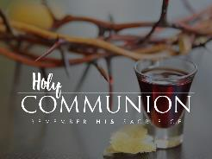
Memorial
Genesis 9:8-17
Zwingli View
Reformed, Presbyterian, Baptist
Scriptural support – Luke 22:19; 1 Cor. 11:24, 26
What are we remembering?

Slide 29
Memorial
Genesis 9:8-17
Zwingli View
Reformed, Presbyterian, Baptist
Scriptural support – Luke 22:19; 1 Cor. 11:24, 26
What are we remembering?

Slide 30
Memorial
Genesis 9:8-17
Zwingli View
Reformed, Presbyterian, Baptist
Scriptural support – Luke 22:19; 1 Cor. 11:24, 26
What are we remembering?

Slide 31
Memorial
Genesis 9:8-17
Zwingli View
Reformed, Presbyterian, Baptist
Scriptural support – Luke 22:19; 1 Cor. 11:24, 26
What are we remembering?

Slide 32
Memorial
Genesis 9:8-17
Zwingli View
Reformed, Presbyterian, Baptist
Scriptural support – Luke 22:19; 1 Cor. 11:24, 26
What are we remembering?

Slide 33
Luke 22:19-20
“And when He had taken some bread and given thanks, He broke it and gave it to them, saying, ‘This is My body which is given for you; do this in remembrance of Me.’ ²⁰And in the same way He took the cup after they had eaten, saying, ‘This cup which is poured out for you is the new covenant in My blood.’”

Slide 34
Memorial
Genesis 9:8-17
Zwingli View
Reformed, Presbyterian, Baptist
Scriptural support – Luke 22:19; 1 Cor. 11:24, 26
What are we remembering?

Slide 35
What are We Remembering?
Christ’s past sacrifice (John 19:30)
Present union with Christ (Rom. 6:3)
Present union with all believers (1 Cor. 12:13)
Christ’s promise to return (1 Cor. 11:26)
The basic facts of the Gospel (1 Cor. 11:24-25)

Slide 36
XI. Ordinances
Foot washing?
Communion
Baptism

Slide 37
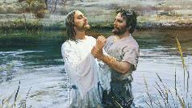
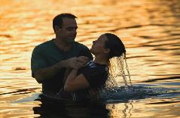
C. Baptism
False views
Baptismal regeneration?
Infant baptism?
Correct view: outward symbol of an inward reality
Mode of baptism
Sprinkling?
Immersion?

Slide 38
C. Baptism
False views
Baptismal regeneration?
Infant baptism?
Correct view: outward symbol of an inward reality
Mode of baptism
Sprinkling?
Immersion?

Slide 39
C. Baptism
False views
Baptismal regeneration?
Infant baptism?
Correct view: outward symbol of an inward reality
Mode of baptism
Sprinkling?
Immersion?

Slide 40
Baptismal Regeneration?
Salvation is not by works (Eph. 2:8-9)
Thief on the cross (Luke 23:39-43)
Paul’s personal de-emphasis on baptism (1 Cor. 1:13-17)

Slide 41
C. Baptism
False views
Baptismal regeneration?
Infant baptism?
Correct view: outward symbol of an inward reality
Mode of baptism
Sprinkling?
Immersion?

Slide 42
Infant Baptism?
Lutheran View
Like circumcision (Gen. 17)
Problems
Dispensationalism
Pattern of Acts – Matt. 28:19; Acts 8:12, 35-39; 10:43-48; 16:14-15, 30-34; 18:1
No biblical examples of infant baptism

Slide 43
Infant Baptism?
Lutheran View
Like circumcision (Gen. 17)
Problems
Dispensationalism
Pattern of Acts – Matt. 28:19; Acts 8:12, 35-39; 10:43-48; 16:14-15, 30-34; 18:1
No biblical examples of infant baptism

Slide 44
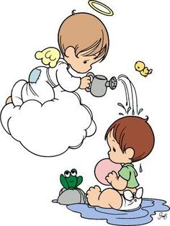
Martin Luther
Alister E. McGrath, Reformation Thought: An Introduction (Grand Rapids: Baker, 1995), 179.
He believed that “such sacraments could generate faith; and hence baptism could generate faith of an infant.”
Notes:
Outline

Slide 45
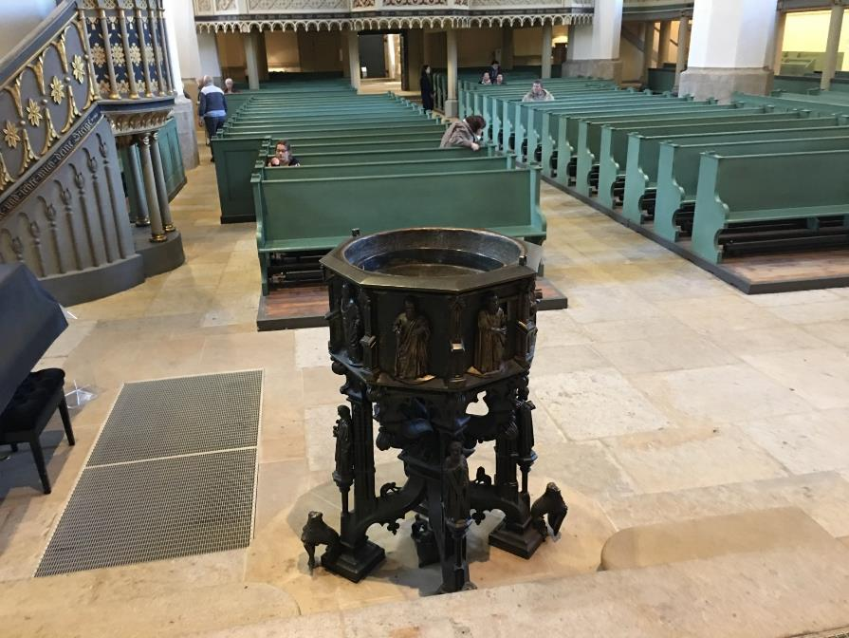

Slide 46
Infant Baptism?
Lutheran View
Like circumcision (Gen. 17)
Problems
Dispensationalism
Pattern of Acts – Matt. 28:19; Acts 8:12, 35-39; 10:43-48; 16:14-15, 30-34; 18:1
No biblical examples of infant baptism

Slide 47
Infant Baptism?
Lutheran View
Like circumcision (Gen. 17)
Problems
Dispensationalism
Pattern of Acts – Matt. 28:19; Acts 8:12, 35-39; 10:43-48; 16:14-15, 30-34; 18:1
No biblical examples of infant baptism

Slide 48
Infant Baptism?
Lutheran View
Like circumcision (Gen. 17)
Problems
Dispensationalism
Pattern of Acts – Matt. 28:19; Acts 8:12, 35-39; 10:43-48; 16:14-15, 30-34; 18:1
No biblical examples of infant baptism

Slide 49
Infant Baptism?
Lutheran View
Like circumcision (Gen. 17)
Problems
Dispensationalism
Pattern of Acts – Matt. 28:19; Acts 8:12, 35-39; 10:43-48; 16:14-15, 30-34; 18:1
No biblical examples of infant baptism

Slide 50
Infant Baptism?
Lutheran View
Like circumcision (Gen. 17)
Problems
Dispensationalism
Pattern of Acts – Matt. 28:19; Acts 8:12, 35-39; 10:43-48; 16:14-15, 30-34; 18:1
No biblical examples of infant baptism

Slide 51
C. Baptism
False views
Baptismal regeneration?
Infant baptism?
Correct view: outward symbol of an inward reality
Mode of baptism
Sprinkling?
Immersion?

Slide 52
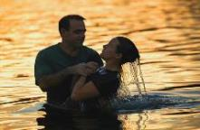
What Baptism Symbolizes
Obedience to Christ’s command (Matt. 28:19)
Sharing in Christ’s death, burial, resurrection, and ascension (Rom. 6:3)
Holy Spirit’s baptism (1 Cor. 12:13)
Public identification with Christ’s church and message
Personal forgiveness of sins

Slide 53
Miscellaneous Truths About Baptism
For believers only
Contributes nothing to justification
Performed in public
Contributes to sanctification (1 Pet. 3:20-21)

Slide 54
1 Peter 3:20-21
²⁰ “who once were disobedient, when the patience of God kept waiting in the days of Noah, during the construction of the ark, in which a few, that is, eight persons, were brought safely through the water. ²¹ Corresponding to that, baptism now saves you—not the removal of dirt from the flesh, but an appeal to God for a good conscience—through the resurrection of Jesus Christ.”

Slide 55
1 Peter 3:20-21
²⁰ “who once were disobedient, when the patience of God kept waiting in the days of Noah, during the construction of the ark, in which a few, that is, eight persons, were brought safely through the water. ²¹ Corresponding to that, baptism now saves you—not the removal of dirt from the flesh, but an appeal to God for a good conscience—through the resurrection of Jesus Christ.”

Slide 56
Three Tenses of Salvation
Phase | Justification | Sanctification | Glorification
Tense | Past | Present | Future
Saved from sin’s: | Penalty | Power | Presence
Scripture | Eph 2:8-9; Titus 3:5 | Philip 2:12 | Rom 5:10

Slide 57
Three Tenses of Salvation
Phase | JUSTIFICATION | Sanctification | Glorification
Tense | Past | Present | Future
Saved from sin’s: | Penalty | Power | Presence
Scripture | Eph 2:8-9; Titus 3:5 | Philip 2:12 | Rom 5:10

Slide 58
Three Tenses of Salvation
Phase | Justification | SANCTIFICATION | Glorification
Tense | Past | Present | Future
Saved from sin’s: | Penalty | Power | Presence
Scripture | Eph 2:8-9; Titus 3:5 | Philip 2:12 | Rom 5:10

Slide 59
Three Tenses of Salvation
Phase | Justification | Sanctification | GLORIFICATION
Tense | Past | Present | Future
Saved from sin’s: | Penalty | Power | Presence
Scripture | Eph 2:8-9; Titus 3:5 | Philip 2:12 | Rom 5:10

Slide 60
C. Baptism
False views
Baptismal regeneration?
Infant baptism?
Correct view: outward symbol of an inward reality
Mode of baptism
Sprinkling?
Immersion?

Slide 61
C. Baptism
False views
Baptismal regeneration?
Infant baptism?
Correct view: outward symbol of an inward reality
Mode of baptism
Sprinkling?
Immersion?

Slide 62
C. Baptism
False views
Baptismal regeneration?
Infant baptism?
Correct view: outward symbol of an inward reality
Mode of baptism
Sprinkling?
Immersion?

Slide 63
Sprinkling or Immersion?
Sprinkling? Other words (1 Pet. 1:12; 2 Tim. 4:6)
Immersion?
Christ’s baptism (Matt. 3:16; Mark 1:10)
Ethiopian eunuch's baptism (Acts 8:38-39)
Best symbolizes our union with Christ (Rom. 6:3)

Slide 64
Conclusion

Slide 65
XI. Ordinances
Foot washing?
Communion
Baptism

Slide 66
Ecclesiology Overview
Definition
Universal vs. local
Word pictures
Origin
Israel – Church differences
Intercalation
Purposes
Activities
Government
Officers
Ordinances
Purity

