Slide 1
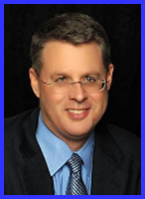
Ecclesiology Session 44
Dr. Andy Woods
Senior Pastor – Sugar Land Bible Church
President – Chafer Theological Seminary

Slide 2
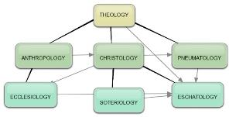
Areas of Systematic Theology
Prolegomena – Introduction
Theology – Study of God
Christology – Study of Christ
Pneumatology – Study of the Holy Spirit
Anthropology – Study of Man
Hamartiology – Study of sin
Soteriology – Study of salvation
Angelology – Study of angels
Ecclesiology – Study of the Church
Eschatology – Study of the end

Slide 3
Ecclesiology Overview
Definition
Universal vs. local
Word pictures
Origin
Israel – Church differences
Intercalation
Purposes
Activities
Government
Officers
Ordinances
Purity

Slide 4
XI. Ordinances
Foot washing?
Communion
Baptism

Slide 5
XI. Ordinances
Foot washing?
Communion
Baptism

Slide 6
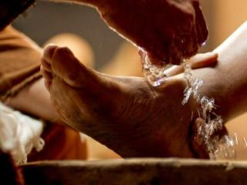
A. Foot Washing?
Scriptural support: John 13:5-7, 12-15
Not mandatory:
Epistles?
Example: John 13:15
Take some time to grasp: John 13:6-7

Slide 7
XI. Ordinances
Foot washing?
Communion
Baptism

Slide 8
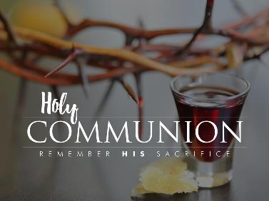
B. Communion
Frequency? Acts 2:42, 46; 20:7
Self-examination? 1 Cor.11:27-31
Meaning?

Slide 9
B. Communion
Frequency? Acts 2:42, 46; 20:7
Self-examination? 1 Cor.11:27-31
Meaning?

Slide 10
B. Communion
Frequency? Acts 2:42, 46; 20:7
Self-examination? 1 Cor.11:27-31
Meaning?

Slide 11
B. Communion
Frequency? Acts 2:42, 46; 20:7
Self-examination? 1 Cor.11:27-31
Meaning?

Slide 12
Communion Views
Transubstantiation
Consubstantiation
Memorial

Slide 13
Communion Views
Transubstantiation
Consubstantiation
Memorial

Slide 14
Transubstantiation
Roman Catholic View
Problems
Christ’s 1x sacrifice-Heb. 10:10, 14
Christ’s metaphorical language-Luke 22:19
Lack of scriptural support-John 6:53-58

Slide 15
7 “I AM” statements in John
I am the Bread of Life | 6:35
I am the Light of the world | 8:12
I am the Gate for the sheep | 10:7; cf. v.9
I am the Good Shepherd | 10:11,14
I am the Resurrection and the Life | 11:25
I am the Way and the Truth and the Life | 14:6
I am the true Vine | 15:1; cf. v.5

Slide 16
OUTLINE OF JOHN
1:1-18 | HEAVENLY GENEALOGY (Explains who Jesus is)
1:19-11:57 | PUBLIC MINISTRY ( 7 signs & discourses)
12:1-50 | TRIUMPHAL ENTRY (public national rejection of Christ-12:37)
13-17 | UPPER ROOM DISCOURSE (new dispensation)
18-21 | PASSION NARRATIVES (crucifixion to resurrection)

Slide 17
Communion Views
Transubstantiation
Consubstantiation
Memorial

Slide 18
Consubstantiation
Lutheran View
Real Presence View
Emergent Church mysticism
Lack of Scriptural support-Rom. 8:9; Matt. 18:20

Slide 19
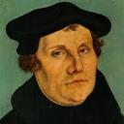
Martin Luther
Emir Caner, "Balthsar Hubmaier and His Theological Participation in the Reformation: Ecclesiology and Soteriology," Faith and Mission 21, no. 1 (2003): 42.
Caner explains, “Luther denied the doctrine of Transubstantiation, rejecting any molecular change of the elements. Consubstantiation, a term never employed by Luther, is used to explain his view that the body and blood are present ‘in, with, and under’ the bread and wine.” (the real presence view).
Notes:
Outline

Slide 20
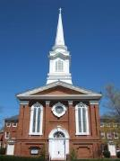
Emergent Church Worship
“Post-moderns prefer to encounter Christ by using all their senses. That’s part of the appeal of classical liturgical or contemplative worship: the incense and candles, making the sign of the cross, the taste and smell of the bread and wine, touching icons and being anointed with oil.”
Julie B. Sevig, The Lutheran, 9/2001.

Slide 21
Dan Kimball The Emerging Church, 121
“Modern thinkers want things very orderly and systematic because they learn in a logical and progressive manner. They prefer, generally, to sit and listen. Emerging post-Christian generations, on the other hand, long to experience a transcendent God during a worship gathering rather than simply learn about him.” (Italics added)

Slide 22
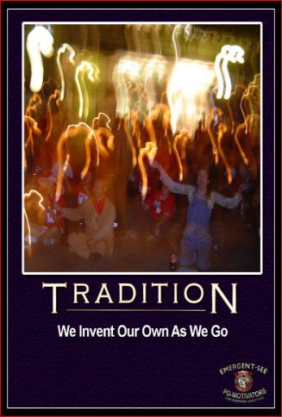
Dan Kimball The Emerging Church, 121
“They want fluidity and freedom rather than a neatly flowing set program. They want to see the arts and a sense of mystery brought into the worship service, rather than focusing on professionalism and excellence. This will shape how a worship gathering is designed” (Italics added).

Slide 23
Communion Views
Transubstantiation
Consubstantiation
Memorial

Slide 24
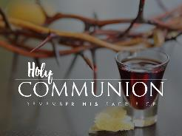
Memorial
Zwingli View
Reformed, Presbyterian, Baptist
Scriptural support-Luke 22:19; 1 Cor. 11:24, 26
What are we remembering?

Slide 25
Luke 22:19-20
“And when He had taken some bread and given thanks, He broke it and gave it to them, saying, ‘This is My body which is given for you; do this in remembrance of Me.’ ²⁰And in the same way He took the cup after they had eaten, saying, ‘This cup which is poured out for you is the new covenant in My blood.’”

Slide 26
XI. Ordinances
Foot washing?
Communion
Baptism

Slide 27
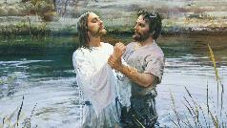
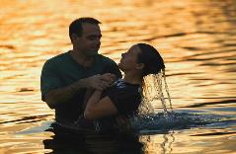
C. Baptism
False views
Baptismal regeneration?
Infant baptism?
Correct view: outward symbol of an inward reality
Mode of baptism
Sprinkling?
Immersion?

Slide 28
C. Baptism
False views
Baptismal regeneration?
Infant baptism?
Correct view: outward symbol of an inward reality
Mode of baptism
Sprinkling?
Immersion?

Slide 29
C. Baptism
False views
Baptismal regeneration?
Infant baptism?
Correct view: outward symbol of an inward reality
Mode of baptism
Sprinkling?
Immersion?

Slide 30
C. Baptism
False views
Baptismal regeneration?
Infant baptism?
Correct view: outward symbol of an inward reality
Mode of baptism
Sprinkling?
Immersion?

Slide 31
Martin Luther
Alister E. McGrath, Reformation Thought: An Introduction (Grand Rapids: Baker, 1995), 179.
He believed that “such sacraments could generate faith; and hence baptism could generate faith of an infant.”
Notes:
Outline

Slide 32
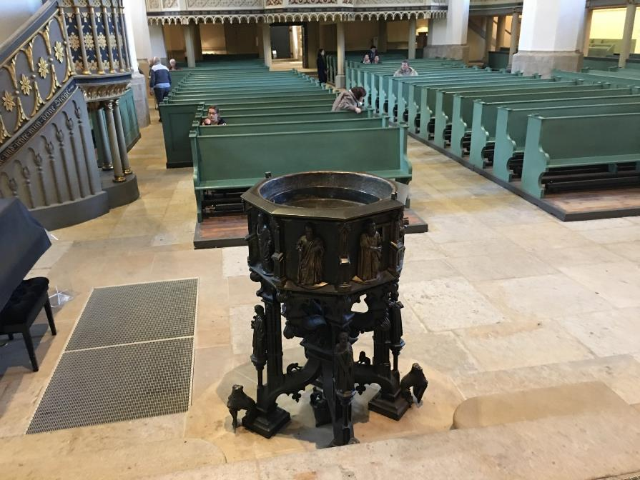

Slide 33
C. Baptism
False views
Baptismal regeneration?
Infant baptism?
Correct view: outward symbol of an inward reality
Mode of baptism
Sprinkling?
Immersion?

Slide 34
Three Tenses of Salvation
Phase | Justification | Sanctification | Glorification
Tense | Past | Present | Future
Saved from sin’s: | Penalty | Power | Presence
Scripture | Eph 2:8-9; Titus 3:5 | Philip 2:12 | Rom 5:10

Slide 35
Three Tenses of Salvation
Phase | JUSTIFICATION | Sanctification | Glorification
Tense | Past | Present | Future
Saved from sin’s: | Penalty | Power | Presence
Scripture | Eph 2:8-9; Titus 3:5 | Philip 2:12 | Rom 5:10

Slide 36
Three Tenses of Salvation
Phase | Justification | SANCTIFICATION | Glorification
Tense | Past | Present | Future
Saved from sin’s: | Penalty | Power | Presence
Scripture | Eph 2:8-9; Titus 3:5 | Philip 2:12 | Rom 5:10

Slide 37
Three Tenses of Salvation
Phase | Justification | Sanctification | GLORIFICATION
Tense | Past | Present | Future
Saved from sin’s: | Penalty | Power | Presence
Scripture | Eph 2:8-9; Titus 3:5 | Philip 2:12 | Rom 5:10

Slide 38
C. Baptism
False views
Baptismal regeneration?
Infant baptism?
Correct view: outward symbol of an inward reality
Mode of baptism
Sprinkling?
Immersion?

Slide 39
C. Baptism
False views
Baptismal regeneration?
Infant baptism?
Correct view: outward symbol of an inward reality
Mode of baptism
Sprinkling?
Immersion?

Slide 40
C. Baptism
False views
Baptismal regeneration?
Infant baptism?
Correct view: outward symbol of an inward reality
Mode of baptism
Sprinkling?
Immersion?

Slide 41
Conclusion

Slide 42
XI. Ordinances
Foot washing?
Communion
Baptism

Slide 43
Ecclesiology Overview
Definition
Universal vs. local
Word pictures
Origin
Israel – Church differences
Intercalation
Purposes
Activities
Government
Officers
Ordinances
Purity

