Slide 1
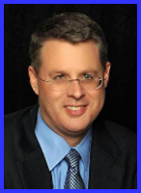
Ecclesiology Session 43
Dr. Andy Woods
Senior Pastor – Sugar Land Bible Church
President – Chafer Theological Seminary

Slide 2
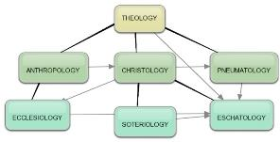
Areas of Systematic Theology
Prolegomena – Introduction
Theology – Study of God
Christology – Study of Christ
Pneumatology – Study of the Holy Spirit
Anthropology – Study of Man
Hamartiology – Study of sin
Soteriology – Study of salvation
Angelology – Study of angels
Ecclesiology – Study of the Church
Eschatology – Study of the end

Slide 3
Ecclesiology Overview
Definition
Universal vs. local
Word pictures
Origin
Israel – Church differences
Intercalation
Purposes
Activities
Government
Officers
Ordinances
Purity

Slide 4
Activities of the Local Church (Acts 2:41-47)
Doctrine (Acts 2:42)
Ordinances (Acts 2:41-42, 46)
Prayer (Acts 2:42)
Evangelism (Acts 2:47)
Worship (Acts 2:47)
Benevolence (Acts 2:44-45)
Fellowship (Acts 2:42, 46-47)

Slide 5
Ecclesiology Overview
Definition
Universal vs. local
Word pictures
Origin
Israel – Church differences
Intercalation
Purposes
Activities
Government
Officers
Ordinances
Purity

Slide 6
Local Church Government
Episcopalian/bishop rule – Acts 15:2, 6
Congregational rule – Acts 6:1-7
Presbyterian/elder rule – Acts 20:28; 1 Tim 5:17; 4:14

Slide 7
Local Church Government
Episcopalian/bishop rule – Acts 15:2, 6
Congregational rule – Acts 6:1-7
Presbyterian/elder rule – Acts 20:28; 1 Tim 5:17; 4:14

Slide 8
Ecclesiology Overview
Definition
Universal vs. local
Word pictures
Origin
Israel – Church differences
Intercalation
Purposes
Activities
Government
Officers
Ordinances
Purity

Slide 9
Local Church Officers
Elder
Qualifications (1 Tim 3:1-7; Titus 1:5-9)
Number (Jas 5:14)
Distinction among elders (1 Tim 5:17)
Duties
Removal (1 Tim 5:19)
Deacon
Definition (Acts 6:1-7)
Qualifications (1 Tim 3:8-13)

Slide 10
Deacon Qualifications 1 Tim. 3:8-13
Men of dignity
Not double-tongued
Not addicted to much wine
Not fond of sordid gain
Holding to the mystery of the faith with a clear conscience
First tested
Beyond reproach
Husband of one wife
Good managers of their children & household

Slide 11
Gender Restrictions
Women are the backbone of the church
Trinitarian example
Gender restrictions
Elder: 1 Tim 3:1-2; Titus 1:6 (2x); 1 Tim 2:11-14
Deacon
Yes: Acts 6:3; 1 Tim. 3:8, 10, 12
No: Rom. 16:1; 1 Tim. 3:11

Slide 12
Gender Restrictions
Women are the backbone of the church
Trinitarian example
Gender restrictions
Elder: 1 Tim 3:1-2; Titus 1:6 (2x); 1 Tim 2:11-14
Deacon
Yes: Acts 6:3; 1 Tim. 3:8, 10, 12
No: Rom. 16:1; 1 Tim. 3:11

Slide 13
Gender Restrictions
Women are the backbone of the church
Trinitarian example
Gender restrictions
Elder: 1 Tim 3:1-2; Titus 1:6 (2x); 1 Tim 2:11-14
Deacon
Yes: Acts 6:3; 1 Tim. 3:8, 10, 12
No: Rom. 16:1; 1 Tim. 3:11

Slide 14
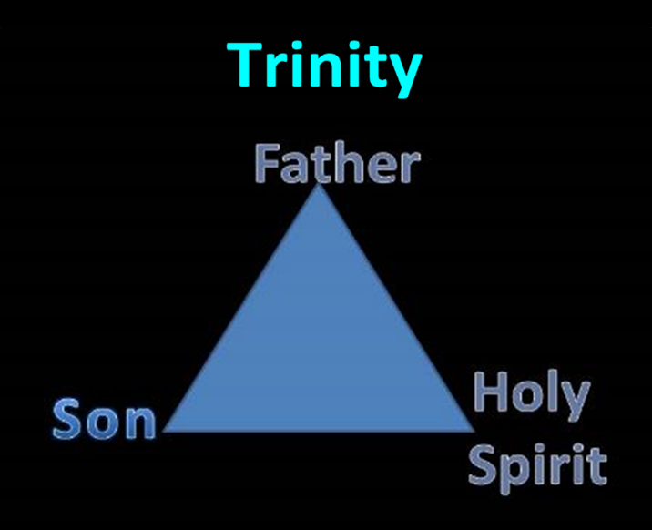

Slide 15
Genesis 1:26-28
²⁶ Then God said, “Let Us make man in Our image, according to Our likeness; and let them rule over the fish of the sea and over the birds of the sky and over the cattle and over all the earth, and over every creeping thing that creeps on the earth.” ²⁷ God created man in His own image, in the image of God He created him; male and female He created them. ²⁸ God blessed them; and God said to them, “Be fruitful and multiply, and fill the earth, and subdue it; and rule over the fish of the sea and over the birds of the sky and over every living thing that moves on the earth.”

Slide 16
1 Peter 3:7
“You husbands in the same way, live with your wives in an understanding way, as with someone weaker, since she is a woman; and show her honor as a fellow heir of the grace of life, so that your prayers will not be hindered.”

Slide 17
Gender Restrictions
Women are the backbone of the church
Trinitarian example
Gender restrictions
Elder: 1 Tim 3:1-2; Titus 1:6 (2x); 1 Tim 2:11-14
Deacon
Yes: Acts 6:3; 1 Tim. 3:8, 10, 12
No: Rom. 16:1; 1 Tim. 3:11

Slide 18
Gender Restrictions
Women are the backbone of the church
Trinitarian example
Gender restrictions
Elder: 1 Tim 3:1-2; Titus 1:6 (2x); 1 Tim 2:11-14
Deacon
Yes: Acts 6:3; 1 Tim. 3:8, 10, 12
No: Rom. 16:1; 1 Tim. 3:11

Slide 19
Gender Restrictions
Women are the backbone of the church
Trinitarian example
Gender restrictions
Elder: 1 Tim 3:1-2; Titus 1:6 (2x); 1 Tim 2:11-14
Deacon
Yes: Acts 6:3; 1 Tim. 3:8, 10, 12
No: Rom. 16:1; 1 Tim. 3:11

Slide 20
Gender Restrictions
Women are the backbone of the church
Trinitarian example
Gender restrictions
Elder: 1 Tim 3:1-2; Titus 1:6 (2x); 1 Tim 2:11-14
Deacon
Yes: Acts 6:3; 1 Tim. 3:8, 10, 12
No: Rom. 16:1; 1 Tim. 3:11

Slide 21
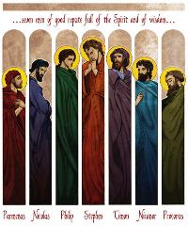
Acts 6:3
“Therefore, brethren, select from among you seven men of good reputation, full of the Spirit and of wisdom, whom we may put in charge of this task.”

Slide 22
Gender Restrictions
Women are the backbone of the church
Trinitarian example
Gender restrictions
Elder: 1 Tim 3:1-2; Titus 1:6 (2x); 1 Tim 2:11-14
Deacon
Yes: Acts 6:3; 1 Tim. 3:8, 10, 12
No: Rom. 16:1; 1 Tim. 3:11

Slide 23
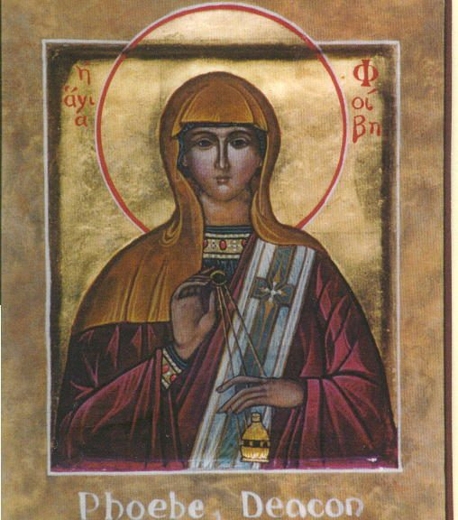
Romans 16:1
“I commend to you our sister Phoebe, who is a servant [διάκονος (diakonos)] of the church which is at Cenchrea.”

Slide 24
The New English Translation (NET) Bible
Romans 16:1
“Or ‘deaconess.’ It is debated whether διάκονος (diakonos) here refers to a specific office within the church. One contextual argument used to support this view is that Phoebe is associated with a particular church, Cenchrea, and as such would therefore be a deacon of that church. In the NT some who are called διάκονος are related to a particular church, yet the scholarly consensus is that such individuals are not deacons, but ‘servants’ or ‘ministers’ (other viable translations for διάκονος).”

Slide 25
The New English Translation (NET) Bible
Romans 16:1
“For example, Epaphras is associated with the church in Colossians and is called a διάκονος in Col 1:7, but no contemporary translation regards him as a deacon. In 1 Tim 4:6 Paul calls Timothy a διάκονος; Timothy was associated with the church in Ephesus, but he obviously was not a deacon. In addition, the lexical evidence leans away from this view: Within the NT, the διακον- word group rarely functions with a technical nuance. In any case, the evidence is not compelling either way. The view accepted in the translation above is that Phoebe was a servant of the church, not a deaconess, although this conclusion should be regarded as tentative.”

Slide 26
1 Timothy 3:11
“Women [gynē] must likewise be dignified, not malicious gossips, but temperate, faithful in all things.”

Slide 27
Meaning of gynē in 1 Tim. 3:11
1 TIM. 3:11 | WIFE OF DEACON | DEACONESS
Example | “Wife”: Eph. 5:22 | “Woman”: Matt. 9:20
Advocate | Charles C. Ryrie | Thomas L. Constable
Problem | No corresponding requirement for elder’s wife (1 Tim. 3:1-7) | Disruption of the train of thought

Slide 28
Charles Ryrie
The Ryrie Study Bible
“3:11 Women. Most likely a reference to the wives of the deacons, rather than to a separate office of deaconess, since the qualifications for deacons are continued in verse 12. If he had a different group in mind, it would seem more natural for Paul to have finished the qualifications for deacons before introducing the office of deaconess.”

Slide 29
Conclusion

Slide 30
Local Church Officers
Elder
Qualifications (1 Tim 3:1-7; Titus 1:5-9)
Number (Jas 5:14)
Distinction among elders (1 Tim 5:17)
Duties
Removal (1 Tim 5:19)
Deacon
Definition (Acts 6:1-7)
Qualifications (1 Tim 3:8-13)

Slide 31
Ecclesiology Overview
Definition
Universal vs. local
Word pictures
Origin
Israel – Church differences
Intercalation
Purposes
Activities
Government
Officers
Ordinances
Purity

